Slide 1


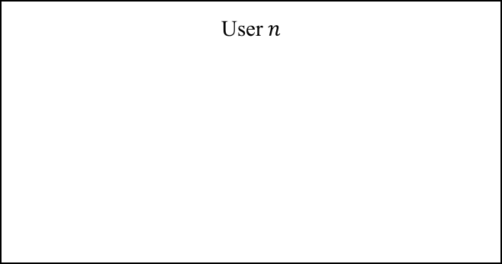
Environment
User $n$
Slower strategy adaptation Eqs.(10) (11) (12)
Faster utility learning Eq.(9)
User $1$
User $N$
…
…

