Slide 1
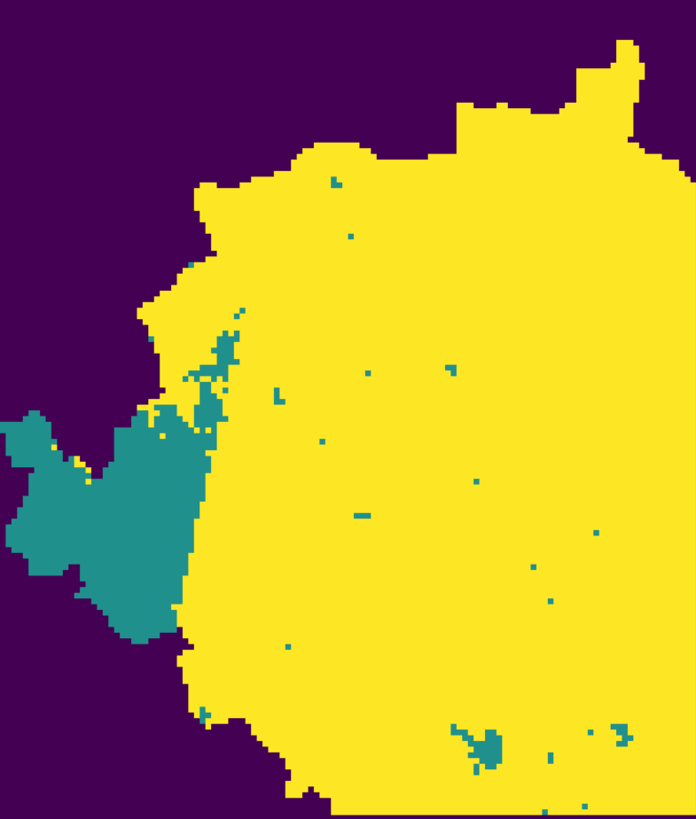
Deep Learning for Groundwater Potential - Dharwad

