Slide 1
End-to-End ML Deployment: Titanic Survival Prediction with Kubernetes & Docker
EGT309 AI Solution Development Project
Team MAL Members:
Angel Zhang XinYu [221993P]
Mock Ying Jing [224416M]
Lim En Huai [221714Y]

Slide 2
Table of Contents
1
Project Introduction
5
Model Optimization
2
System Architecture
6
Model Inference (App)
3
Data Preprocessing
7
Challenges & Solutions
4
Model Training
8
Demo

Slide 3
01 Project Introduction
Overview of the project goals and significance

Slide 4

Project Introduction
Background:
On April 15, 1912, during Titanic maiden voyage, the widely considered “unsinkable” RMS Titanic sank after colliding with an iceberg. Unfortunately, there weren't enough lifeboats for everyone onboard, resulting in the deaths of many passengers and crew.
Objective
To build a scalable, automated, and containerized ML pipeline that streamlines data processing, model deployment, and real-time predictions in a Kubernetes environment.
Overview
This project aims to develop a containerized ML pipeline for predicting Titanic passenger survival using a deployed web application.
The pipeline consists of data preprocessing, model training, optimization, and deployment using Docker and Kubernetes.
Data Preprocessing Cleans and transforms raw passenger data for model training.
Model Training & Optimization Builds and optimizes an ML model for survival prediction.
Web-Based UI (Streamlit) Provides Single & Batch Prediction via a user-friendly interface.
Containerization & Orchestration Deployed in Docker containers and managed via Kubernetes (Minikube).

Slide 5










Technologies used
Development environment (software)
Containerization & Orchestration
(Platforms)
Web & UI Framework
Programming Language
Libraries & Framework

Slide 6
02 System Architecture
Preparing the necessary tools and environment for development

Slide 7
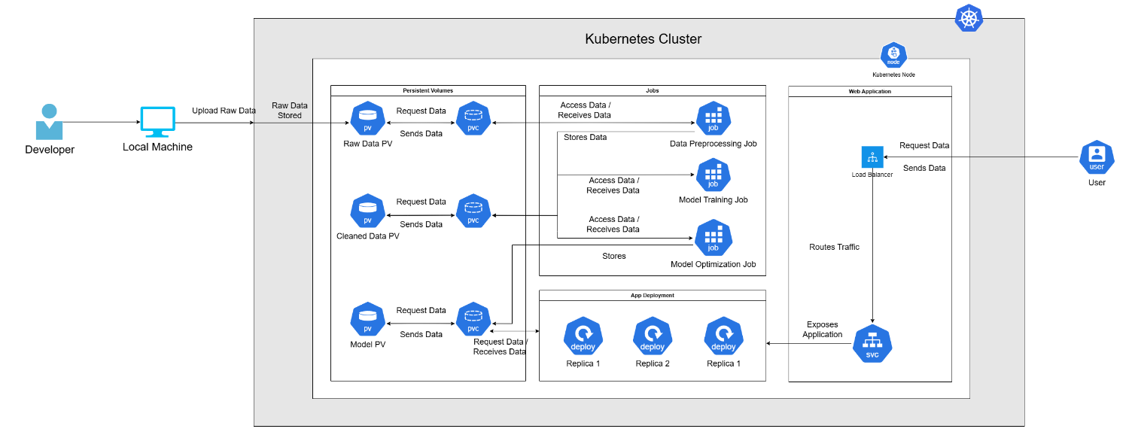
System Architecture

Slide 8
03 Data Preprocessing
Packaging the entire pipeline into containers for easy deployment

Slide 9
Data Preprocessing: ML Pipeline
Preparing raw data for model training by cleaning, transforming, and structuring it to improve performance and accuracy
Feature Engineering
Execute pipeline
Handling Outliers
Uses IQR (Interquartile Range) method to detect and clip extreme values for Age and Fare.
Removes passengers with unrealistically high fares (>500).
Extracts Title (e.g., Mr, Mrs) from the Name column.
Creates Family Size (SibSp + Parch).
Categorizes Age and Fare into meaningful bins.
Runs all preprocessing steps sequentially.
Saves the cleaned dataset for model training.
Data Encoding
Handle missing values
Remove unnecessary features
KNN Imputer for Age, median imputation for Fare.
Fills missing Embarked values with the most common category.
Drops Cabin due to excessive missing values.
Converts categorical values to numerical form:
Sex (male → 1, female → 0)
Embarked (S → 0, C → 1, Q → 2)
Keeps only useful features for model training：
Drops irrelevant columns: PassengerId, Ticket, Name.

Slide 10
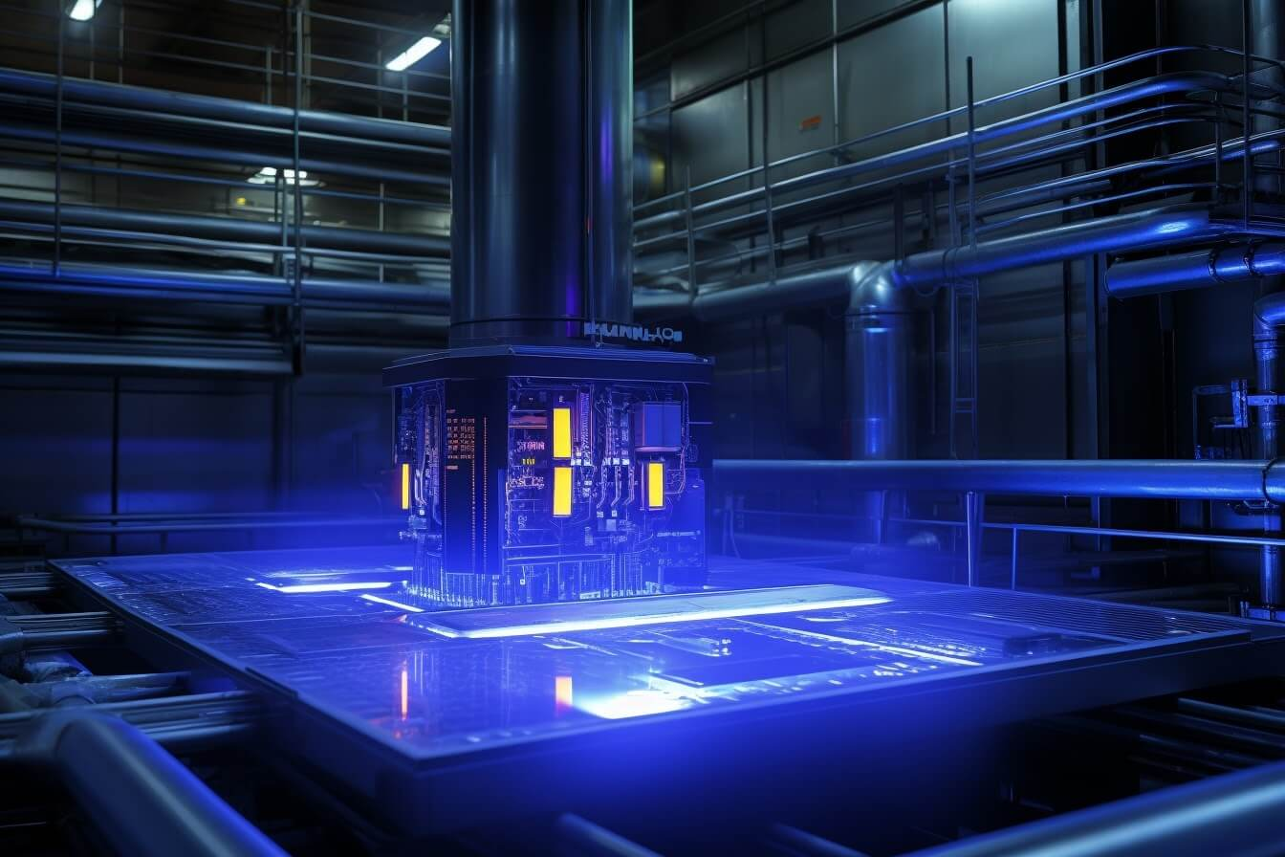



Data Preprocessing: Docker & K8s
Data preprocessing in this project is containerized using Docker and orchestrated with Kubernetes Jobs.
1
2
3
4
Raw Data
(train.csv)
Stored in PVC
Docker Container
Cleaned data saved to PVC
The dataset is initially stored in Persistent Volume (PV).
Ensures data availability for preprocessing tasks.
A Persistent Volume Claim (PVC) is created.
Provides storage abstraction for Kubernetes Jobs.
Runs the preprocessing script
Reads data from PVC → Applies transformations → Output cleaned data.
The cleaned dataset is stored in a new PVC.
Ensures it is available for model training in the next pipeline step.

Slide 11
04 Model Training
Deploying the containerized pipeline on a Kubernetes cluster

Slide 12
Machine Learning Model Used
Why use these models?
1
2
3
Logistic Regression
Random Forest
Gradient Boosting
Simple and effective approach.
Served as the baseline model.
Identifying linear relationships between features and target variable.
Able to capture non-linear relationships and reduce overfitting.
Improves generalization and handles missing data well.
More sophisticated and iterative approach.
Gradually minimize errors and improve accuracy from previous iterations.
Effective for complex data structures.

Slide 13
Model Performance (Trained)
Model | Precision | Recall | F1 Score | Accuracy
Logistic Regression | 0.76 | 0.74 | 0.75 | 0.80
Random Forest | 0.80 | 0.77 | 0.79 | 0.83
Gradient Boosting | 0.81 | 0.78 | 0.79 | 0.83

Slide 14
Model Training: Docker & K8s
Model Training in this project is containerized using Docker and orchestrated with Kubernetes Jobs.
1
2
3
Stored in PVC
Docker Container
Clean Data
(cleaned_train_data.csv)
A Persistent Volume Claim (PVC) is created.
Provides storage abstraction for Kubernetes Jobs.
Runs the model training python script.
Reads data from PVC → Trained the model → Output the evaluation of the trained models.
The dataset is stored in the Persistent Volume (PV).
Ensures data availability for model training tasks.

Slide 15
05 Model Optimization

Slide 16
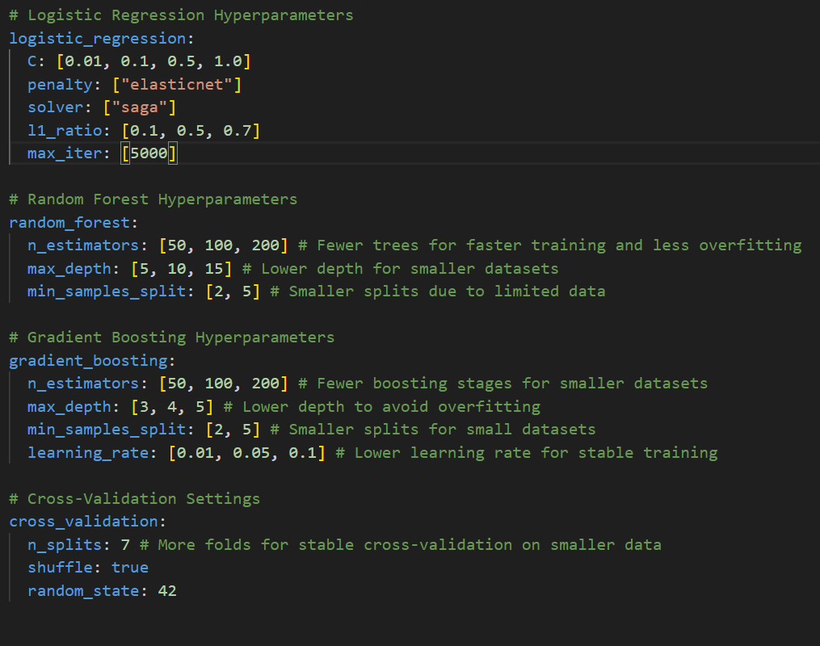
Hyperparameter tuning

Slide 17
Voting Ensembler
Voting Ensemble Overview:
Combines predictions from multiple models to improve accuracy and robustness.
A final prediction is made based on the majority vote of the base models.
Hard Voting:
In Hard Voting, each model in the ensemble predicts a class label.
The class label with the most votes across all models is selected as the final prediction.
Why Hard Voting:
Simple and Effective: Easy to implement and works well when base models are diverse.
Reduces Overfitting: Combines strengths of various models, leading to better generalization.
Benefits:
Improved Prediction Accuracy: Voting ensemble leverages the strengths of each model.
Robustness: More reliable and stable predictions by reducing the effect of individual model errors.

Slide 18
Model Performance (Optimized)
Model | Precision | Recall | F1 Score | Accuracy
Logistic Regression | 0.76 | 0.70 | 0.73 | 0.80
Random Forest | 0.84 | 0.76 | 0.79 | 0.86
Gradient Boosting | 0.80 | 0.79 | 0.83 | 0.82
Voting Ensemble | 0.82 | 0.78 | 0.82 | 0.84

Slide 19
06 Model Inference (App)
-

Slide 20
Web-based UI Prediction
Provides a web-based UI to predict Titanic passenger survival using the trained optimized ML model
Supports single prediction (manual input) and batch prediction (CSV upload).
Single Prediction
Batch Prediction
Enter passenger details (features) manually
Preprocesses it (feature engineering, data encoding)
Output whether passenger survived or not
Upload of CSV (dataset）
Preprocesses it (Handling missing values, feature encoding & transformation)
Batch inference -> Output of results in tabular format

Slide 21
Deployment with Docker and Kubernetes
Ensure consistent deployment across environments.
Enables auto-scaling, fault tolerance, and easy management.
How does they work?
1. Docker packages the Streamlit app, ML model, and dependencies into a container.
2. Kubernetes deploys multiple instances of the container for scalability and reliability.
3. Load Balancer Service exposes the app to users.

Slide 22
Kubernetes Service Integration
1
Exposes Streamlit app to external users
2
Uses a Load Balancer for public access
3
Ensures traffic reaches the right pod
4
Supports scaling and high availability

Slide 23
07 Challenges & Solutions
-

Slide 24
Challenges & Solutions
Here are some challenges we faced and how we overcame them:
1
File Path Issues
Challenges: Docker fails to locate files or mount volumes correctly.
Solution: Use proper Windows path format for WSL, resolve permission errors, and fix volume mount syntax.
2
Docker
Challenges: Docker fails to start or crashes.
Solution: Restart the Docker service, check for port conflicts, and increase system resources.
3
Kubernetes
Challenges: Pods keep restarting due to application failures, leading to a CrashLoopBackOff state.
Solution: If the workload is a one-time or batch process, use a Kubernetes Job instead of a Deployment.

Slide 25
08 Demo
-

Slide 26
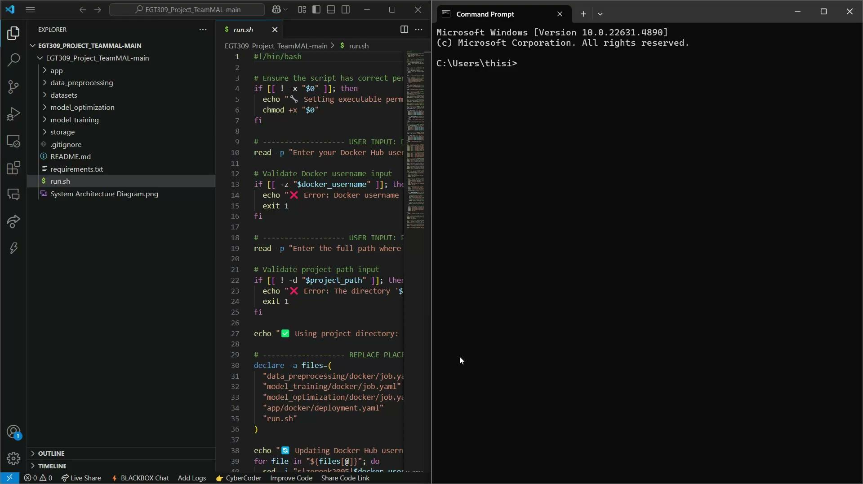
Demo video

Slide 27
Thank You

Slide 28
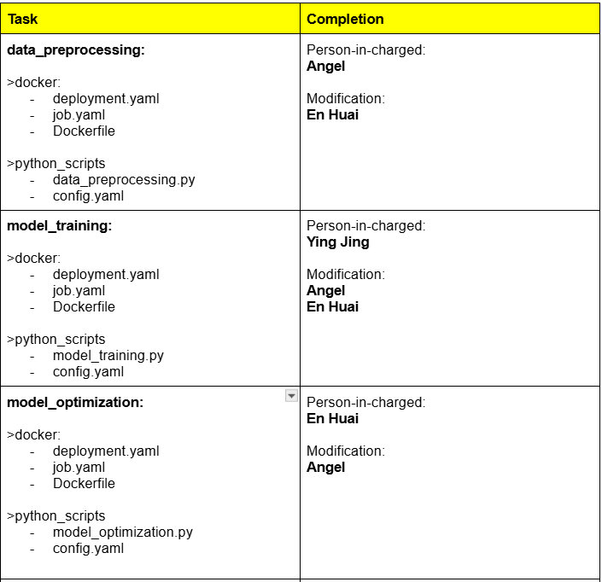
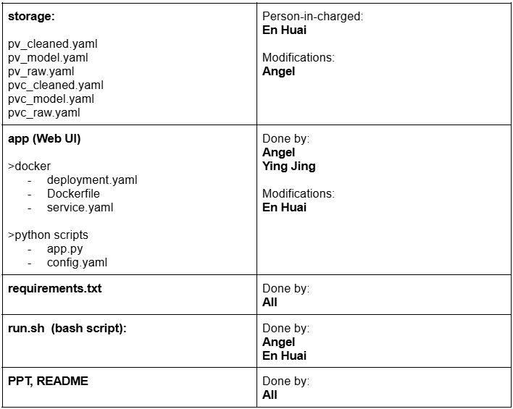
Project Contribution

