Slide 1
POLOCENTRO · EXPLORATORY EVIDENCE
Treatment and control
comparisons
AMC migration and socioeconomic outcomes · Municipal GDP · MapBiomas land cover · FAO/GAEZ crop suitability · Propensity-score diagnostics
Notes:
[Sources]
- C:\Users\josez\OneDrive\Desktop\EPGE\climate_migration\code\polocentro_es\amcs_munis_summary_mean_comparisons.py
- C:\Users\josez\OneDrive\Desktop\EPGE\climate_migration\figs\treatment_control_comparisons\analysis_manifest.json
- C:\Users\josez\OneDrive\Desktop\EPGE\climate_migration\reports\polocentro_environment_crop_suitability_report.md

Slide 2
The comparisons preserve each dataset’s analytical grain
Every chart is descriptive and unadjusted. Propensity scores use matched specifications with and without static GAEZ controls.
AMC outcomes
Municipal GDP
MapBiomas
GAEZ and PSW
One AMC × census-year row
One municipality × GDP-year row
One AMC × year, 1985–2025
Static crop endowments
Resident traits, migration totals, and real GDP or value added per resident in census years.
Real levels, logs, annualized log growth, and sector shares at the municipality-year grain.
Mapped-area shares and cumulative native-cover net loss, observed only after treatment.
Eight high-input rainfed crop-suitability controls augment the 1970 selection model.
Methods and scope
2
Notes:
These comparisons are exploratory summaries, not causal estimates.
[Sources]
- C:\Users\josez\OneDrive\Desktop\EPGE\climate_migration\code\polocentro_es\amcs_munis_summary_mean_comparisons.py
- C:\Users\josez\OneDrive\Desktop\EPGE\climate_migration\figs\treatment_control_comparisons\analysis_manifest.json
- C:\Users\josez\OneDrive\Desktop\EPGE\climate_migration\reports\polocentro_environment_crop_suitability_report.md

Slide 3
TREATMENT DEFINITION 1 OF 4
Any operational-area overlap
Treated when any non-trivial part of the unit overlaps an operational POLOCENTRO area.
110
125
69
treated AMCs
treated municipalities
time-varying outcomes
Any operational-area overlap
3
Notes:
[Sources]
- C:\Users\josez\OneDrive\Desktop\EPGE\climate_migration\figs\treatment_control_comparisons\polocentro_operational_any_overlap\propensity\diagnostics_without_gaez.json
- C:\Users\josez\OneDrive\Desktop\EPGE\climate_migration\figs\treatment_control_comparisons\polocentro_operational_any_overlap\propensity\diagnostics_with_gaez.json
- C:\Users\josez\OneDrive\Desktop\EPGE\climate_migration\figs\treatment_control_comparisons\polocentro_operational_any_overlap\amc\tables\weighted_interstate_migrants.csv

Slide 4
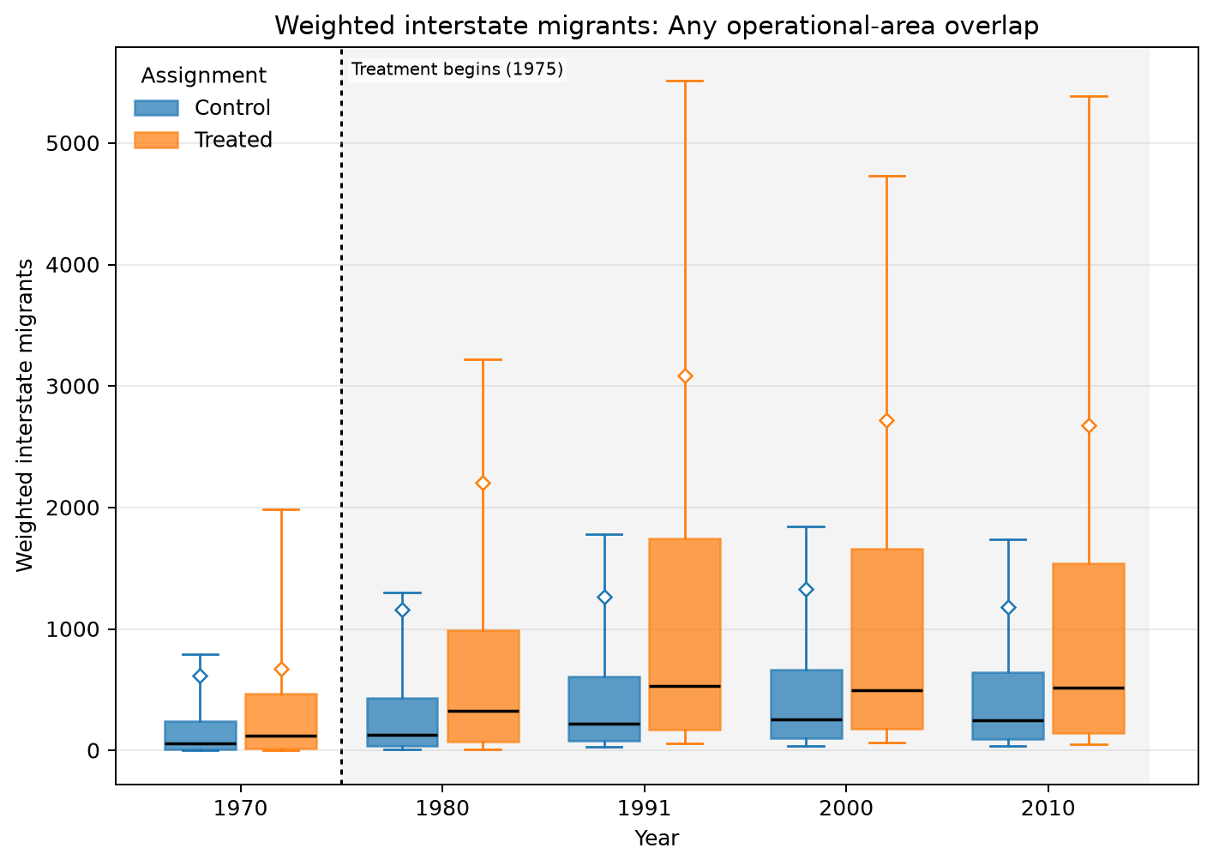
ANY OPERATIONAL-AREA OVERLAP · AMC · MIGRATION · WEIGHTED INTERSTATE MIGRANTS
Treated means are higher in all 5 observed years
UNADJUSTED MEANS (SD)
Year | Control | Treated
1970 | 616 (7.28k) | 676 (1.47k)
1980 | 1.16k (12.8k) | 2.20k (8.67k)
1991 | 1.27k (9.63k) | 3.09k (10.9k)
2000 | 1.33k (9.19k) | 2.72k (8.25k)
2010 | 1.18k (7.26k) | 2.68k (7.53k)
Box: Q1–Q3 · whiskers: P10–P90 · diamond: mean. Full median/IQR/N and mean-difference table is saved as LaTeX.
Any operational-area overlap · Migration
4
Notes:
The title summarizes unadjusted group means and should not be interpreted causally.
[Sources]
- C:\Users\josez\OneDrive\Desktop\EPGE\climate_migration\figs\treatment_control_comparisons\polocentro_operational_any_overlap\amc\plots\weighted_interstate_migrants.png
- C:\Users\josez\OneDrive\Desktop\EPGE\climate_migration\figs\treatment_control_comparisons\polocentro_operational_any_overlap\amc\tables\weighted_interstate_migrants.csv
- C:\Users\josez\OneDrive\Desktop\EPGE\climate_migration\figs\treatment_control_comparisons\polocentro_operational_any_overlap\amc\tables\weighted_interstate_migrants.tex

Slide 5
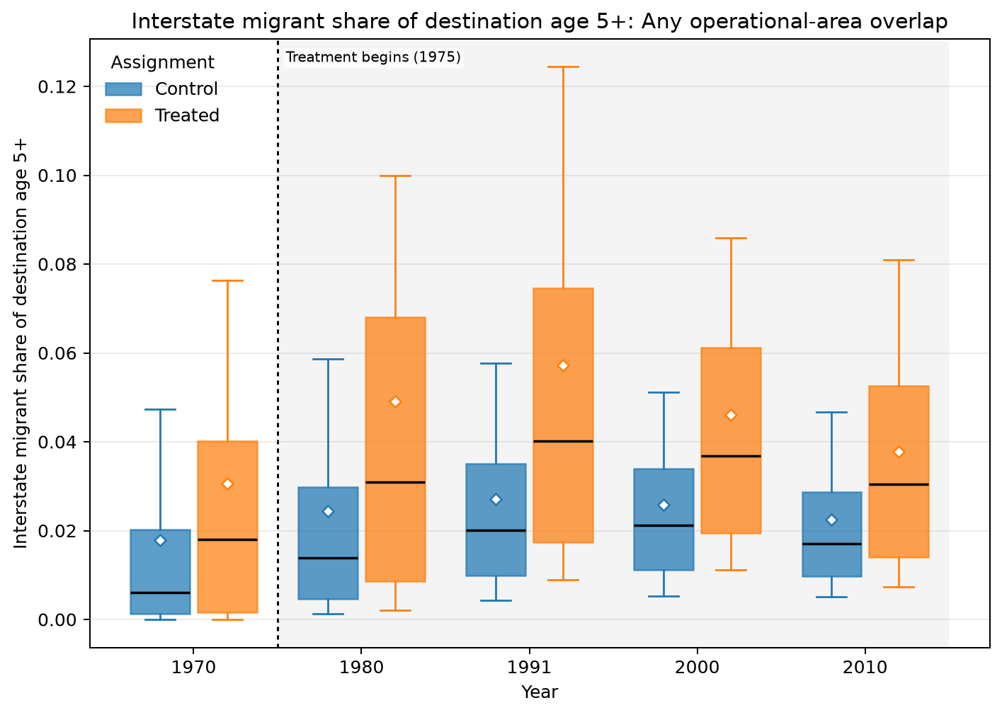
ANY OPERATIONAL-AREA OVERLAP · AMC · MIGRATION · INTERSTATE MIGRANT SHARE OF DESTINATION AGE 5+
Treated means are higher in all 5 observed years
UNADJUSTED MEANS (SD)
Year | Control | Treated
1970 | 0.0179 (0.035) | 0.0306 (0.0426)
1980 | 0.0245 (0.0345) | 0.0491 (0.0711)
1991 | 0.0271 (0.0263) | 0.0573 (0.0562)
2000 | 0.0259 (0.0219) | 0.0461 (0.0391)
2010 | 0.0226 (0.0203) | 0.0378 (0.0291)
Box: Q1–Q3 · whiskers: P10–P90 · diamond: mean. Full median/IQR/N and mean-difference table is saved as LaTeX.
Any operational-area overlap · Migration
5
Notes:
The title summarizes unadjusted group means and should not be interpreted causally.
[Sources]
- C:\Users\josez\OneDrive\Desktop\EPGE\climate_migration\figs\treatment_control_comparisons\polocentro_operational_any_overlap\amc\plots\interstate_migrant_share_of_destination_age5plus.png
- C:\Users\josez\OneDrive\Desktop\EPGE\climate_migration\figs\treatment_control_comparisons\polocentro_operational_any_overlap\amc\tables\interstate_migrant_share_of_destination_age5plus.csv
- C:\Users\josez\OneDrive\Desktop\EPGE\climate_migration\figs\treatment_control_comparisons\polocentro_operational_any_overlap\amc\tables\interstate_migrant_share_of_destination_age5plus.tex

Slide 6
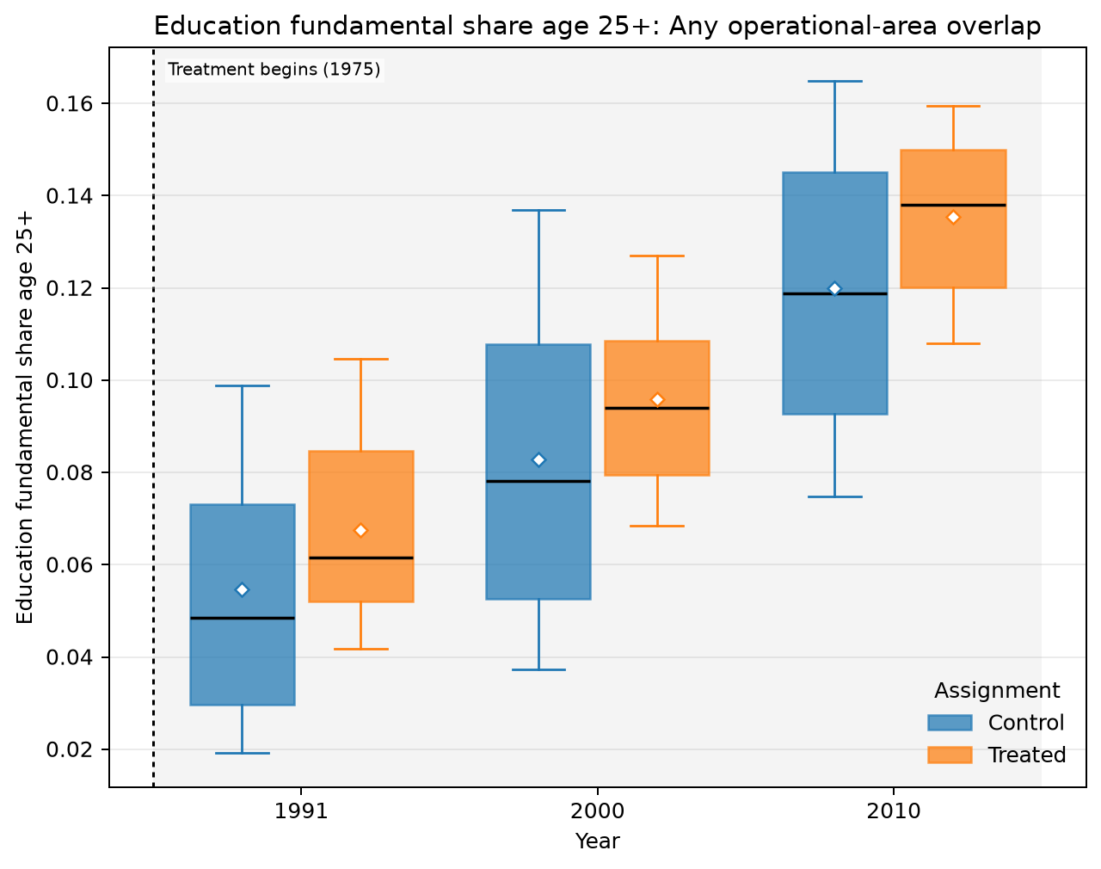
ANY OPERATIONAL-AREA OVERLAP · AMC · EDUCATION · EDUCATION FUNDAMENTAL SHARE AGE 25+
Treated means are higher in all 3 observed years
UNADJUSTED MEANS (SD)
Year | Control | Treated
1991 | 0.0546 (0.0321) | 0.0675 (0.0245)
2000 | 0.0828 (0.038) | 0.0959 (0.0249)
2010 | 0.12 (0.0347) | 0.135 (0.0209)
Box: Q1–Q3 · whiskers: P10–P90 · diamond: mean. Full median/IQR/N and mean-difference table is saved as LaTeX.
Any operational-area overlap · Education
6
Notes:
The title summarizes unadjusted group means and should not be interpreted causally.
[Sources]
- C:\Users\josez\OneDrive\Desktop\EPGE\climate_migration\figs\treatment_control_comparisons\polocentro_operational_any_overlap\amc\plots\education_fundamental_share_age25plus.png
- C:\Users\josez\OneDrive\Desktop\EPGE\climate_migration\figs\treatment_control_comparisons\polocentro_operational_any_overlap\amc\tables\education_fundamental_share_age25plus.csv
- C:\Users\josez\OneDrive\Desktop\EPGE\climate_migration\figs\treatment_control_comparisons\polocentro_operational_any_overlap\amc\tables\education_fundamental_share_age25plus.tex

Slide 7
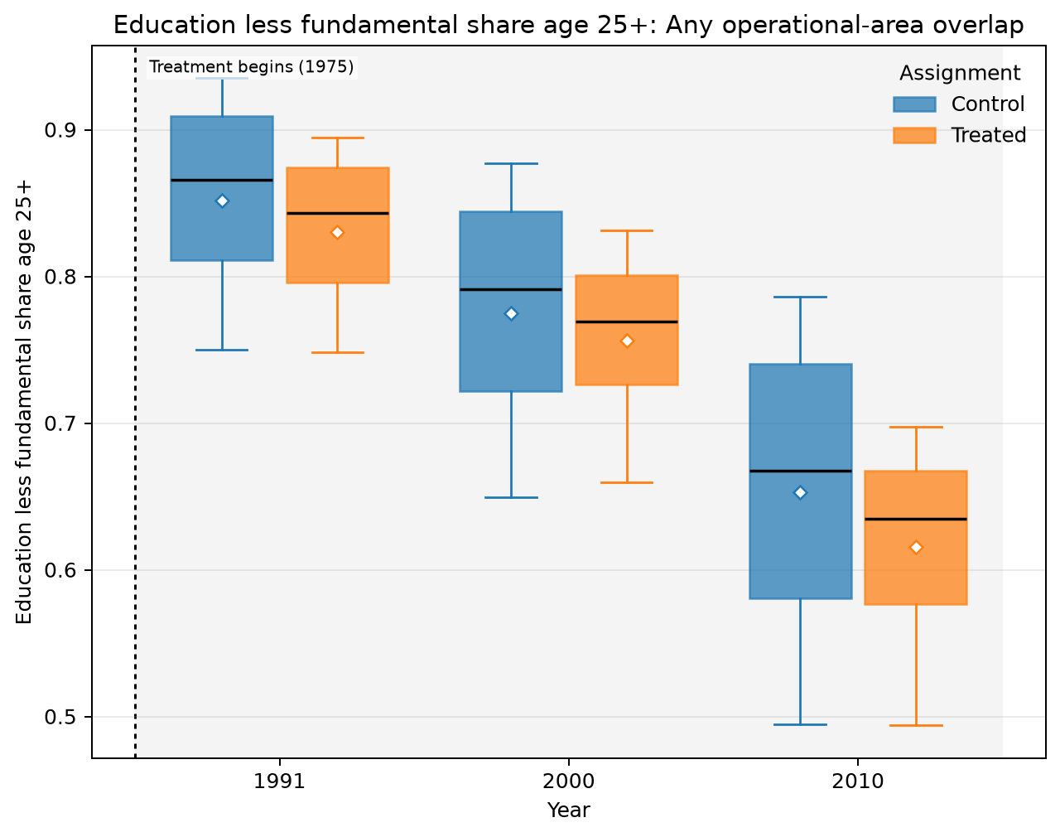
ANY OPERATIONAL-AREA OVERLAP · AMC · EDUCATION · EDUCATION LESS FUNDAMENTAL SHARE AGE 25+
Treated means are lower in all 3 observed years
UNADJUSTED MEANS (SD)
Year | Control | Treated
1991 | 0.852 (0.0778) | 0.83 (0.0626)
2000 | 0.775 (0.0919) | 0.756 (0.0701)
2010 | 0.653 (0.113) | 0.615 (0.0784)
Box: Q1–Q3 · whiskers: P10–P90 · diamond: mean. Full median/IQR/N and mean-difference table is saved as LaTeX.
Any operational-area overlap · Education
7
Notes:
The title summarizes unadjusted group means and should not be interpreted causally.
[Sources]
- C:\Users\josez\OneDrive\Desktop\EPGE\climate_migration\figs\treatment_control_comparisons\polocentro_operational_any_overlap\amc\plots\education_less_fundamental_share_age25plus.png
- C:\Users\josez\OneDrive\Desktop\EPGE\climate_migration\figs\treatment_control_comparisons\polocentro_operational_any_overlap\amc\tables\education_less_fundamental_share_age25plus.csv
- C:\Users\josez\OneDrive\Desktop\EPGE\climate_migration\figs\treatment_control_comparisons\polocentro_operational_any_overlap\amc\tables\education_less_fundamental_share_age25plus.tex

Slide 8
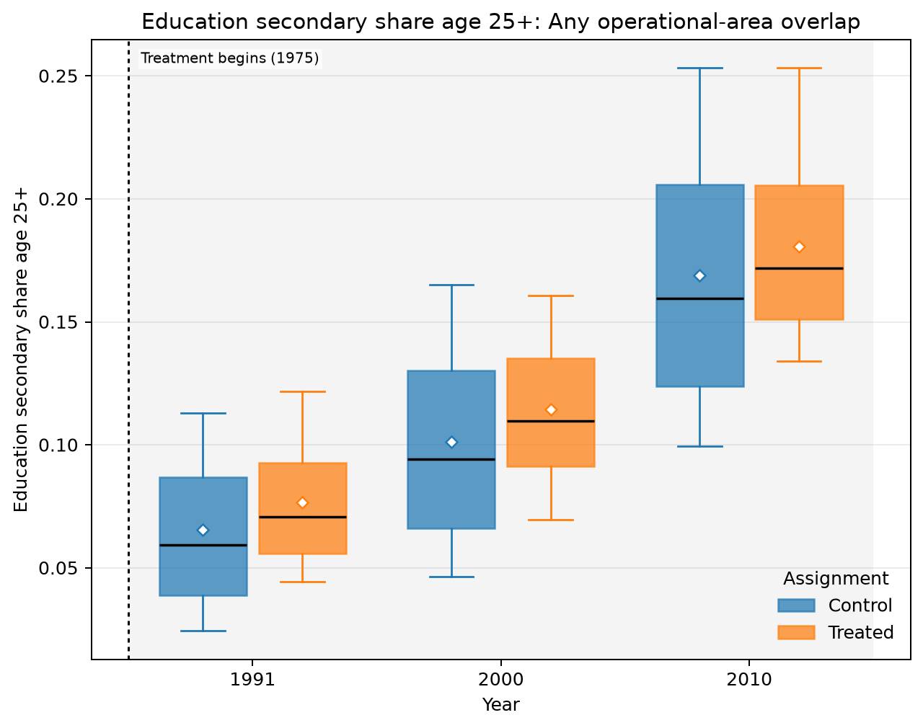
ANY OPERATIONAL-AREA OVERLAP · AMC · EDUCATION · EDUCATION SECONDARY SHARE AGE 25+
Treated means are higher in all 3 observed years
UNADJUSTED MEANS (SD)
Year | Control | Treated
1991 | 0.0656 (0.0365) | 0.0766 (0.0307)
2000 | 0.101 (0.0468) | 0.115 (0.0364)
2010 | 0.169 (0.0602) | 0.181 (0.0449)
Box: Q1–Q3 · whiskers: P10–P90 · diamond: mean. Full median/IQR/N and mean-difference table is saved as LaTeX.
Any operational-area overlap · Education
8
Notes:
The title summarizes unadjusted group means and should not be interpreted causally.
[Sources]
- C:\Users\josez\OneDrive\Desktop\EPGE\climate_migration\figs\treatment_control_comparisons\polocentro_operational_any_overlap\amc\plots\education_secondary_share_age25plus.png
- C:\Users\josez\OneDrive\Desktop\EPGE\climate_migration\figs\treatment_control_comparisons\polocentro_operational_any_overlap\amc\tables\education_secondary_share_age25plus.csv
- C:\Users\josez\OneDrive\Desktop\EPGE\climate_migration\figs\treatment_control_comparisons\polocentro_operational_any_overlap\amc\tables\education_secondary_share_age25plus.tex

Slide 9
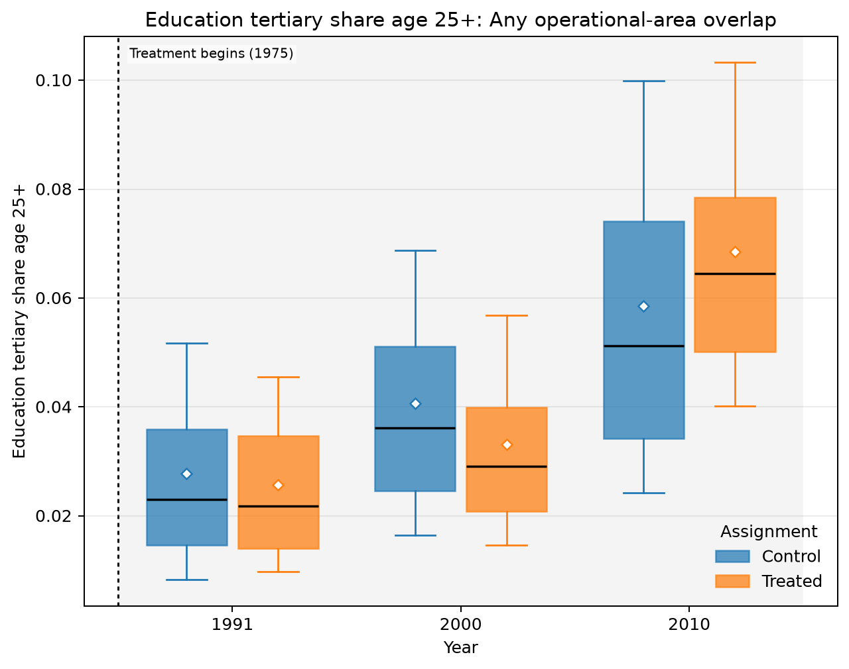
ANY OPERATIONAL-AREA OVERLAP · AMC · EDUCATION · EDUCATION TERTIARY SHARE AGE 25+
Treated means are lower in 2 of 3 observed years
UNADJUSTED MEANS (SD)
Year | Control | Treated
1991 | 0.0277 (0.02) | 0.0257 (0.0165)
2000 | 0.0406 (0.024) | 0.0331 (0.0192)
2010 | 0.0585 (0.0347) | 0.0685 (0.0277)
Box: Q1–Q3 · whiskers: P10–P90 · diamond: mean. Full median/IQR/N and mean-difference table is saved as LaTeX.
Any operational-area overlap · Education
9
Notes:
The title summarizes unadjusted group means and should not be interpreted causally.
[Sources]
- C:\Users\josez\OneDrive\Desktop\EPGE\climate_migration\figs\treatment_control_comparisons\polocentro_operational_any_overlap\amc\plots\education_tertiary_share_age25plus.png
- C:\Users\josez\OneDrive\Desktop\EPGE\climate_migration\figs\treatment_control_comparisons\polocentro_operational_any_overlap\amc\tables\education_tertiary_share_age25plus.csv
- C:\Users\josez\OneDrive\Desktop\EPGE\climate_migration\figs\treatment_control_comparisons\polocentro_operational_any_overlap\amc\tables\education_tertiary_share_age25plus.tex

Slide 10
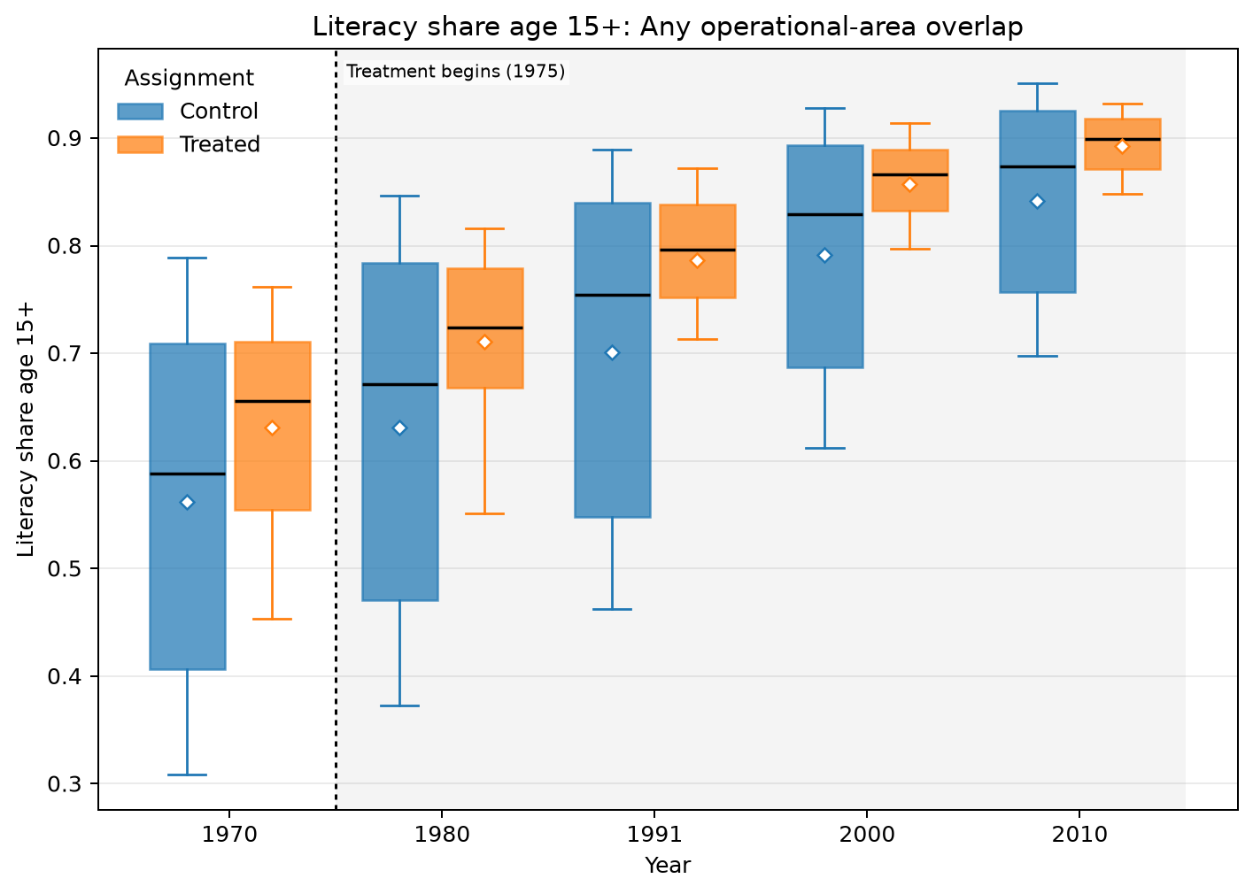
ANY OPERATIONAL-AREA OVERLAP · AMC · EDUCATION · LITERACY SHARE AGE 15+
Treated means are higher in all 5 observed years
UNADJUSTED MEANS (SD)
Year | Control | Treated
1970 | 0.562 (0.182) | 0.631 (0.123)
1980 | 0.631 (0.181) | 0.711 (0.103)
1991 | 0.701 (0.166) | 0.787 (0.0812)
2000 | 0.792 (0.121) | 0.857 (0.051)
2010 | 0.842 (0.0982) | 0.893 (0.0382)
Box: Q1–Q3 · whiskers: P10–P90 · diamond: mean. Full median/IQR/N and mean-difference table is saved as LaTeX.
Any operational-area overlap · Education
10
Notes:
The title summarizes unadjusted group means and should not be interpreted causally.
[Sources]
- C:\Users\josez\OneDrive\Desktop\EPGE\climate_migration\figs\treatment_control_comparisons\polocentro_operational_any_overlap\amc\plots\literacy_share_age15plus.png
- C:\Users\josez\OneDrive\Desktop\EPGE\climate_migration\figs\treatment_control_comparisons\polocentro_operational_any_overlap\amc\tables\literacy_share_age15plus.csv
- C:\Users\josez\OneDrive\Desktop\EPGE\climate_migration\figs\treatment_control_comparisons\polocentro_operational_any_overlap\amc\tables\literacy_share_age15plus.tex

Slide 11
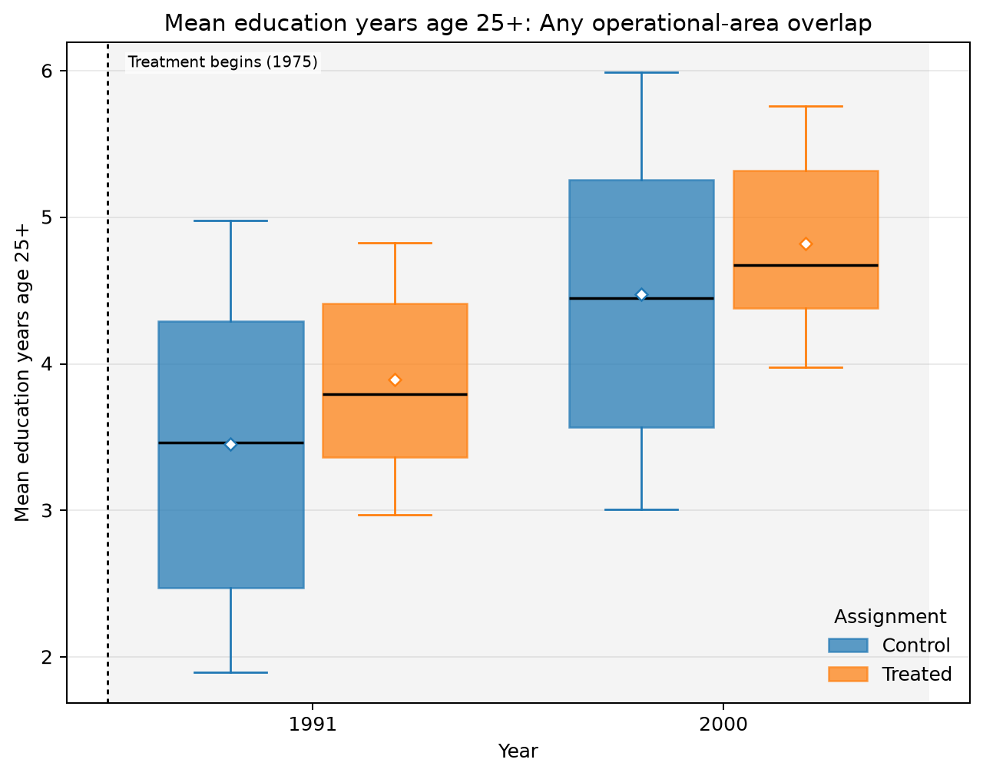
ANY OPERATIONAL-AREA OVERLAP · AMC · EDUCATION · MEAN EDUCATION YEARS AGE 25+
Treated means are higher in all 2 observed years
UNADJUSTED MEANS (SD)
Year | Control | Treated
1991 | 3.45 (1.2) | 3.9 (0.832)
2000 | 4.48 (1.16) | 4.82 (0.816)
Box: Q1–Q3 · whiskers: P10–P90 · diamond: mean. Full median/IQR/N and mean-difference table is saved as LaTeX.
Any operational-area overlap · Education
11
Notes:
The title summarizes unadjusted group means and should not be interpreted causally.
[Sources]
- C:\Users\josez\OneDrive\Desktop\EPGE\climate_migration\figs\treatment_control_comparisons\polocentro_operational_any_overlap\amc\plots\mean_education_years_age25plus.png
- C:\Users\josez\OneDrive\Desktop\EPGE\climate_migration\figs\treatment_control_comparisons\polocentro_operational_any_overlap\amc\tables\mean_education_years_age25plus.csv
- C:\Users\josez\OneDrive\Desktop\EPGE\climate_migration\figs\treatment_control_comparisons\polocentro_operational_any_overlap\amc\tables\mean_education_years_age25plus.tex

Slide 12
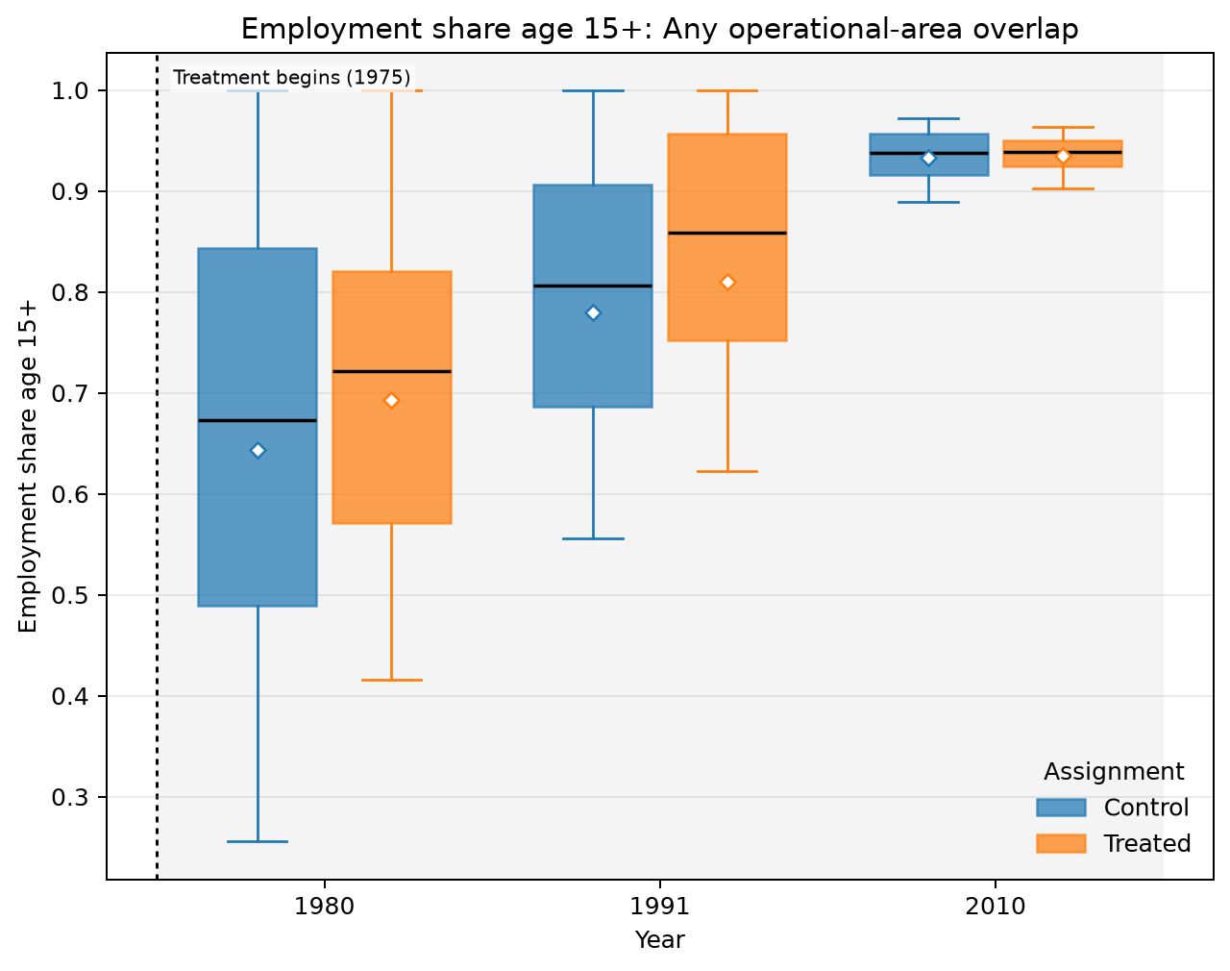
ANY OPERATIONAL-AREA OVERLAP · AMC · LABOR MARKET · EMPLOYMENT SHARE AGE 15+
Treated means are higher in all 3 observed years
UNADJUSTED MEANS (SD)
Year | Control | Treated
1980 | 0.643 (0.274) | 0.693 (0.21)
1991 | 0.78 (0.18) | 0.811 (0.206)
2010 | 0.933 (0.0349) | 0.936 (0.025)
Box: Q1–Q3 · whiskers: P10–P90 · diamond: mean. Full median/IQR/N and mean-difference table is saved as LaTeX.
Any operational-area overlap · Labor market
12
Notes:
The title summarizes unadjusted group means and should not be interpreted causally.
[Sources]
- C:\Users\josez\OneDrive\Desktop\EPGE\climate_migration\figs\treatment_control_comparisons\polocentro_operational_any_overlap\amc\plots\employment_share_age15plus.png
- C:\Users\josez\OneDrive\Desktop\EPGE\climate_migration\figs\treatment_control_comparisons\polocentro_operational_any_overlap\amc\tables\employment_share_age15plus.csv
- C:\Users\josez\OneDrive\Desktop\EPGE\climate_migration\figs\treatment_control_comparisons\polocentro_operational_any_overlap\amc\tables\employment_share_age15plus.tex

Slide 13
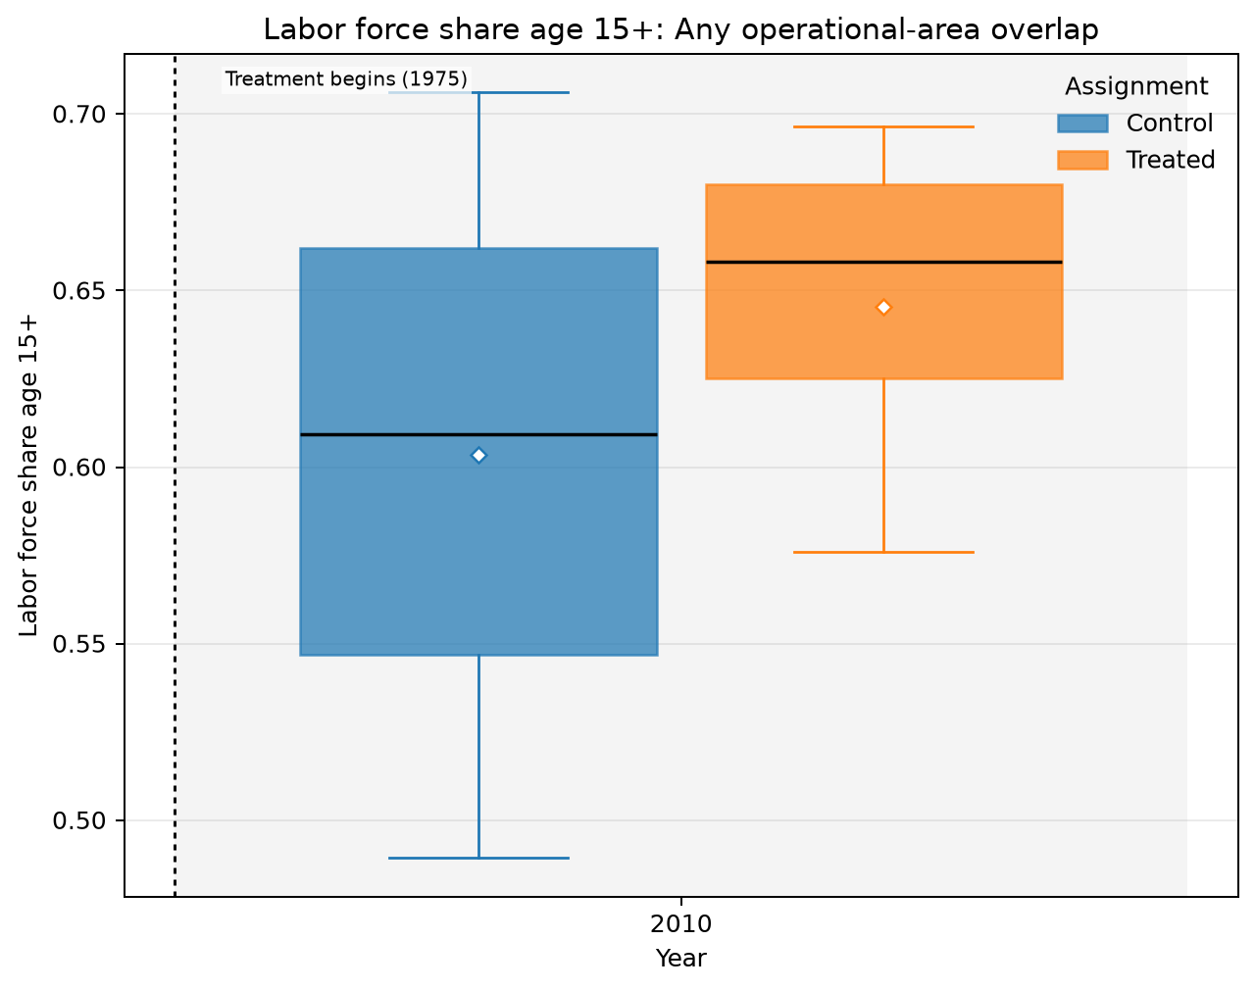
ANY OPERATIONAL-AREA OVERLAP · AMC · LABOR MARKET · LABOR FORCE SHARE AGE 15+
Treated means are higher in all 1 observed years
UNADJUSTED MEANS (SD)
Year | Control | Treated
2010 | 0.604 (0.0861) | 0.645 (0.0492)
Box: Q1–Q3 · whiskers: P10–P90 · diamond: mean. Full median/IQR/N and mean-difference table is saved as LaTeX.
Any operational-area overlap · Labor market
13
Notes:
The title summarizes unadjusted group means and should not be interpreted causally.
[Sources]
- C:\Users\josez\OneDrive\Desktop\EPGE\climate_migration\figs\treatment_control_comparisons\polocentro_operational_any_overlap\amc\plots\labor_force_share_age15plus.png
- C:\Users\josez\OneDrive\Desktop\EPGE\climate_migration\figs\treatment_control_comparisons\polocentro_operational_any_overlap\amc\tables\labor_force_share_age15plus.csv
- C:\Users\josez\OneDrive\Desktop\EPGE\climate_migration\figs\treatment_control_comparisons\polocentro_operational_any_overlap\amc\tables\labor_force_share_age15plus.tex

Slide 14
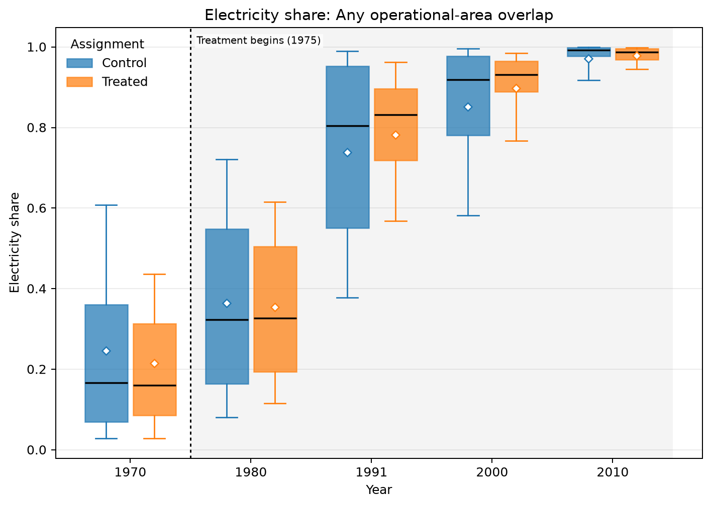
ANY OPERATIONAL-AREA OVERLAP · AMC · HOUSING AND AMENITIES · ELECTRICITY SHARE
Treated means are higher in 3 of 5 observed years
UNADJUSTED MEANS (SD)
Year | Control | Treated
1970 | 0.246 (0.227) | 0.215 (0.178)
1980 | 0.364 (0.238) | 0.354 (0.203)
1991 | 0.738 (0.234) | 0.783 (0.169)
2000 | 0.852 (0.163) | 0.897 (0.106)
2010 | 0.971 (0.0571) | 0.979 (0.0218)
Box: Q1–Q3 · whiskers: P10–P90 · diamond: mean. Full median/IQR/N and mean-difference table is saved as LaTeX.
Any operational-area overlap · Housing and amenities
14
Notes:
The title summarizes unadjusted group means and should not be interpreted causally.
[Sources]
- C:\Users\josez\OneDrive\Desktop\EPGE\climate_migration\figs\treatment_control_comparisons\polocentro_operational_any_overlap\amc\plots\electricity_share.png
- C:\Users\josez\OneDrive\Desktop\EPGE\climate_migration\figs\treatment_control_comparisons\polocentro_operational_any_overlap\amc\tables\electricity_share.csv
- C:\Users\josez\OneDrive\Desktop\EPGE\climate_migration\figs\treatment_control_comparisons\polocentro_operational_any_overlap\amc\tables\electricity_share.tex

Slide 15
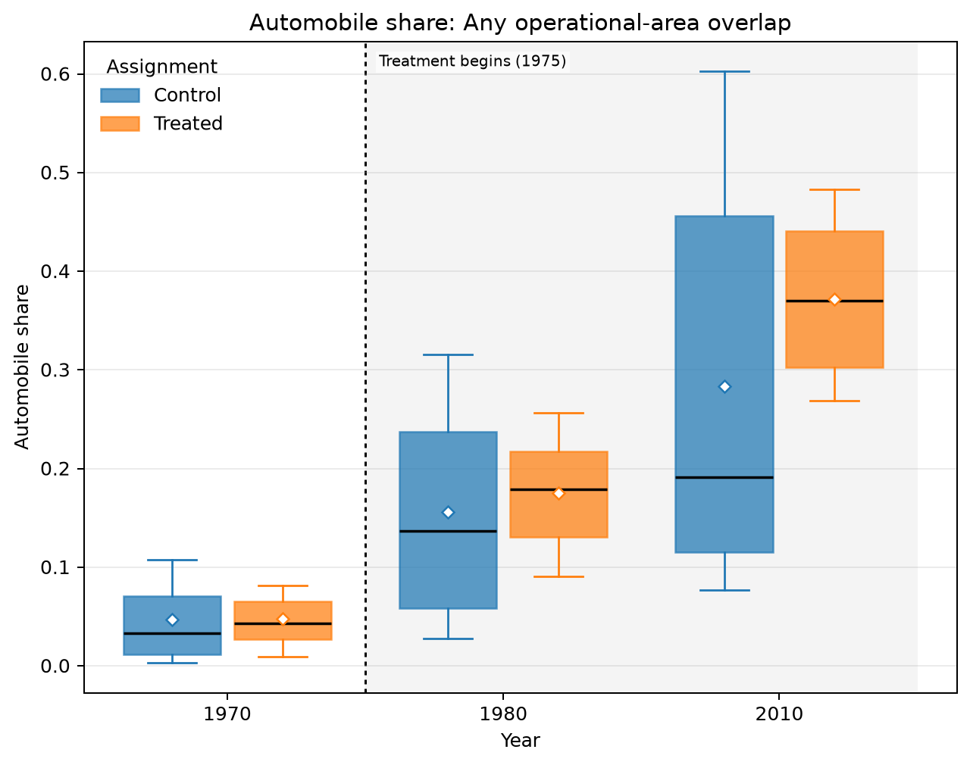
ANY OPERATIONAL-AREA OVERLAP · AMC · HOUSING AND AMENITIES · AUTOMOBILE SHARE
Treated means are higher in all 3 observed years
UNADJUSTED MEANS (SD)
Year | Control | Treated
1970 | 0.0466 (0.0441) | 0.048 (0.032)
1980 | 0.156 (0.114) | 0.175 (0.0622)
2010 | 0.283 (0.206) | 0.372 (0.0866)
Box: Q1–Q3 · whiskers: P10–P90 · diamond: mean. Full median/IQR/N and mean-difference table is saved as LaTeX.
Any operational-area overlap · Housing and amenities
15
Notes:
The title summarizes unadjusted group means and should not be interpreted causally.
[Sources]
- C:\Users\josez\OneDrive\Desktop\EPGE\climate_migration\figs\treatment_control_comparisons\polocentro_operational_any_overlap\amc\plots\automobile_share.png
- C:\Users\josez\OneDrive\Desktop\EPGE\climate_migration\figs\treatment_control_comparisons\polocentro_operational_any_overlap\amc\tables\automobile_share.csv
- C:\Users\josez\OneDrive\Desktop\EPGE\climate_migration\figs\treatment_control_comparisons\polocentro_operational_any_overlap\amc\tables\automobile_share.tex

Slide 16
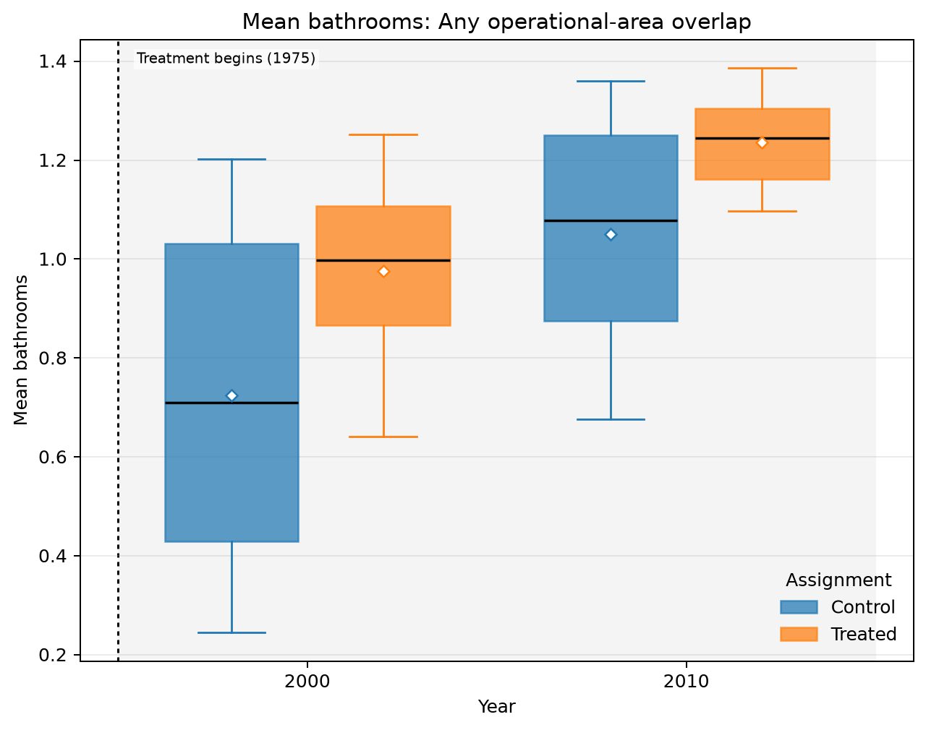
ANY OPERATIONAL-AREA OVERLAP · AMC · HOUSING AND AMENITIES · MEAN BATHROOMS
Treated means are higher in all 2 observed years
UNADJUSTED MEANS (SD)
Year | Control | Treated
2000 | 0.725 (0.36) | 0.976 (0.217)
2010 | 1.05 (0.271) | 1.24 (0.123)
Box: Q1–Q3 · whiskers: P10–P90 · diamond: mean. Full median/IQR/N and mean-difference table is saved as LaTeX.
Any operational-area overlap · Housing and amenities
16
Notes:
The title summarizes unadjusted group means and should not be interpreted causally.
[Sources]
- C:\Users\josez\OneDrive\Desktop\EPGE\climate_migration\figs\treatment_control_comparisons\polocentro_operational_any_overlap\amc\plots\mean_bathrooms.png
- C:\Users\josez\OneDrive\Desktop\EPGE\climate_migration\figs\treatment_control_comparisons\polocentro_operational_any_overlap\amc\tables\mean_bathrooms.csv
- C:\Users\josez\OneDrive\Desktop\EPGE\climate_migration\figs\treatment_control_comparisons\polocentro_operational_any_overlap\amc\tables\mean_bathrooms.tex

Slide 17
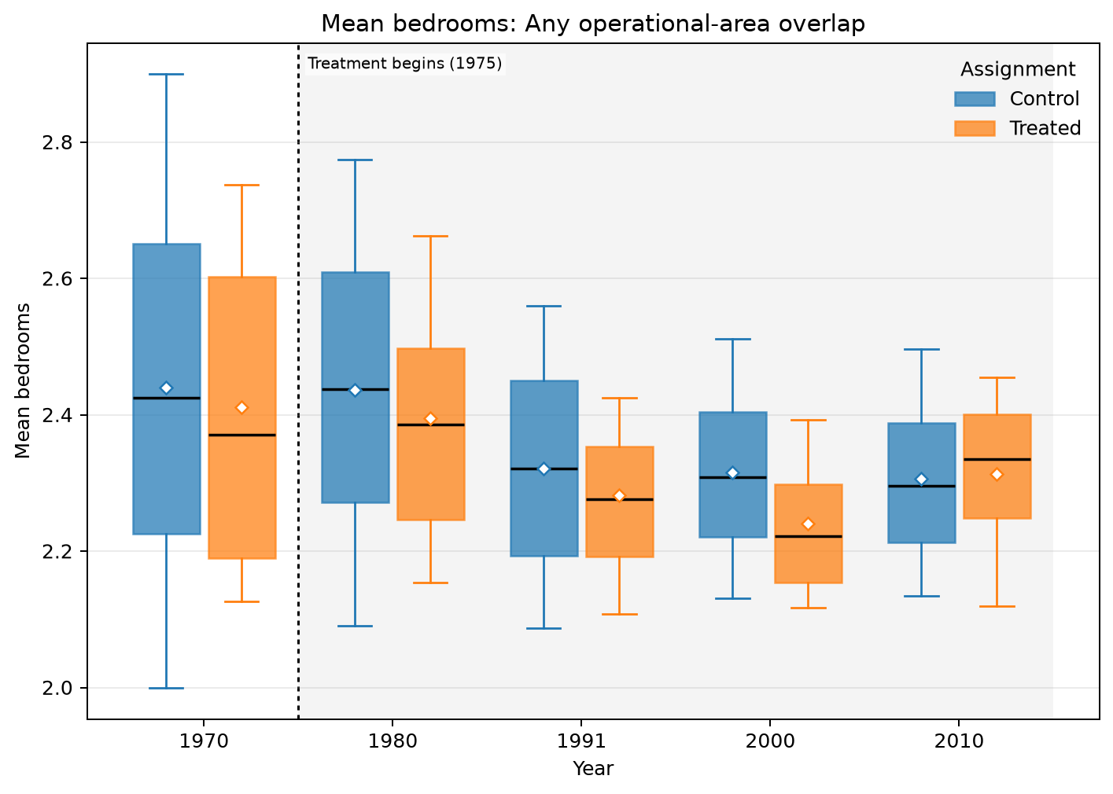
ANY OPERATIONAL-AREA OVERLAP · AMC · HOUSING AND AMENITIES · MEAN BEDROOMS
Treated means are lower in 4 of 5 observed years
UNADJUSTED MEANS (SD)
Year | Control | Treated
1970 | 2.44 (0.362) | 2.41 (0.259)
1980 | 2.44 (0.287) | 2.4 (0.203)
1991 | 2.32 (0.198) | 2.28 (0.132)
2000 | 2.32 (0.161) | 2.24 (0.132)
2010 | 2.31 (0.155) | 2.31 (0.131)
Box: Q1–Q3 · whiskers: P10–P90 · diamond: mean. Full median/IQR/N and mean-difference table is saved as LaTeX.
Any operational-area overlap · Housing and amenities
17
Notes:
The title summarizes unadjusted group means and should not be interpreted causally.
[Sources]
- C:\Users\josez\OneDrive\Desktop\EPGE\climate_migration\figs\treatment_control_comparisons\polocentro_operational_any_overlap\amc\plots\mean_bedrooms.png
- C:\Users\josez\OneDrive\Desktop\EPGE\climate_migration\figs\treatment_control_comparisons\polocentro_operational_any_overlap\amc\tables\mean_bedrooms.csv
- C:\Users\josez\OneDrive\Desktop\EPGE\climate_migration\figs\treatment_control_comparisons\polocentro_operational_any_overlap\amc\tables\mean_bedrooms.tex

Slide 18
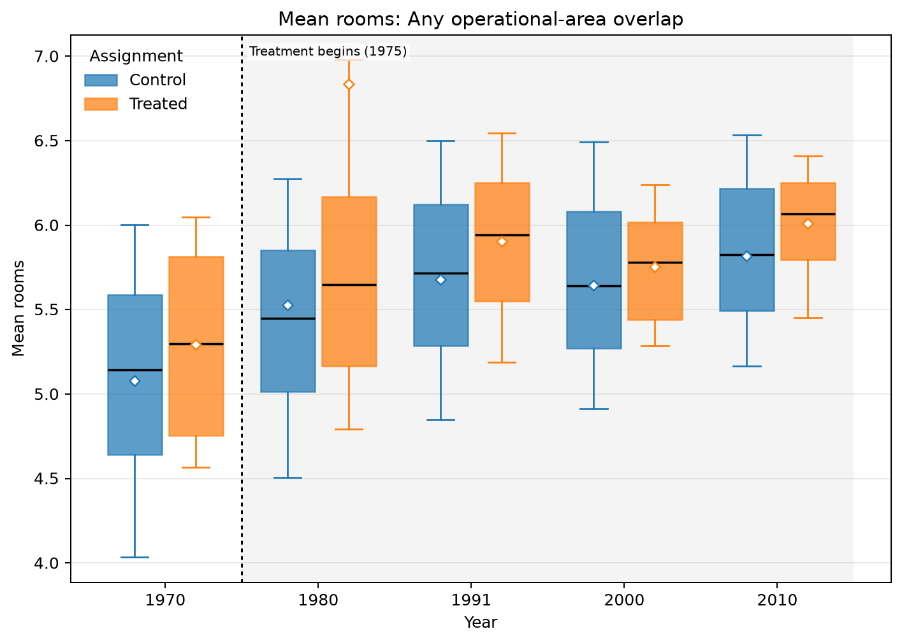
ANY OPERATIONAL-AREA OVERLAP · AMC · HOUSING AND AMENITIES · MEAN ROOMS
Treated means are higher in all 5 observed years
UNADJUSTED MEANS (SD)
Year | Control | Treated
1970 | 5.08 (0.782) | 5.29 (0.62)
1980 | 5.53 (1.62) | 6.84 (4.28)
1991 | 5.68 (0.685) | 5.9 (0.507)
2000 | 5.65 (0.724) | 5.75 (0.382)
2010 | 5.82 (0.625) | 6.01 (0.393)
Box: Q1–Q3 · whiskers: P10–P90 · diamond: mean. Full median/IQR/N and mean-difference table is saved as LaTeX.
Any operational-area overlap · Housing and amenities
18
Notes:
The title summarizes unadjusted group means and should not be interpreted causally.
[Sources]
- C:\Users\josez\OneDrive\Desktop\EPGE\climate_migration\figs\treatment_control_comparisons\polocentro_operational_any_overlap\amc\plots\mean_rooms.png
- C:\Users\josez\OneDrive\Desktop\EPGE\climate_migration\figs\treatment_control_comparisons\polocentro_operational_any_overlap\amc\tables\mean_rooms.csv
- C:\Users\josez\OneDrive\Desktop\EPGE\climate_migration\figs\treatment_control_comparisons\polocentro_operational_any_overlap\amc\tables\mean_rooms.tex

Slide 19
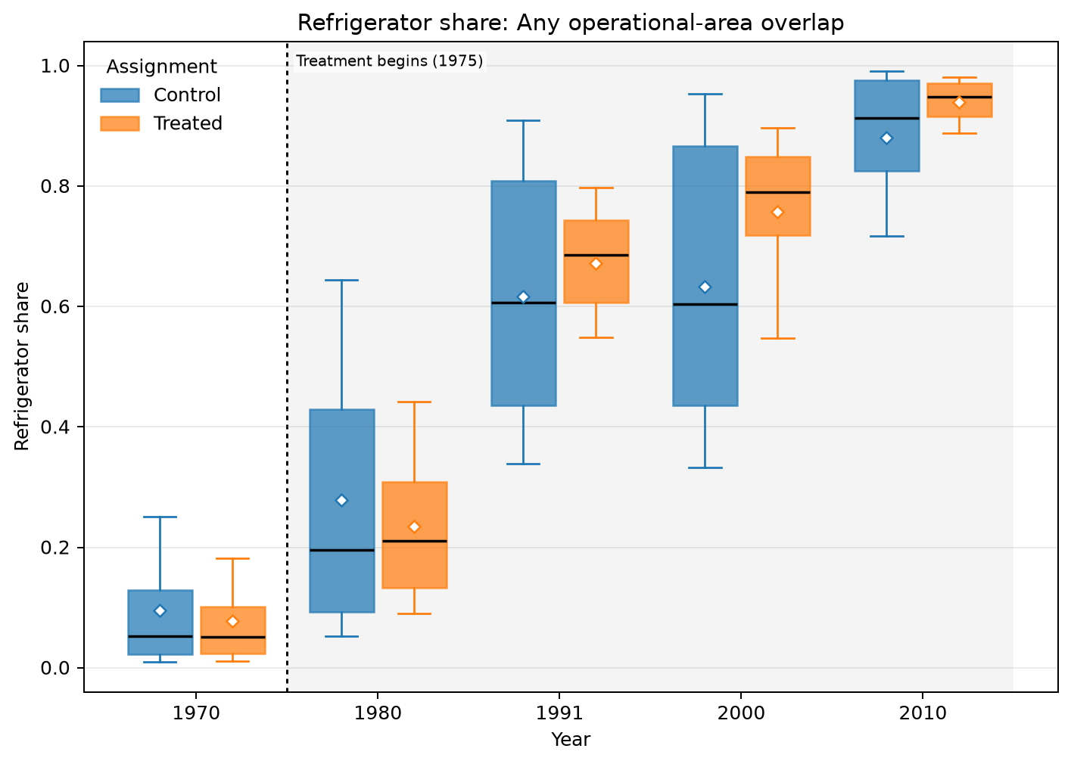
ANY OPERATIONAL-AREA OVERLAP · AMC · HOUSING AND AMENITIES · REFRIGERATOR SHARE
Treated means are higher in 3 of 5 observed years
UNADJUSTED MEANS (SD)
Year | Control | Treated
1970 | 0.0956 (0.11) | 0.0774 (0.0765)
1980 | 0.278 (0.226) | 0.235 (0.139)
1991 | 0.616 (0.212) | 0.672 (0.111)
2000 | 0.633 (0.234) | 0.758 (0.141)
2010 | 0.88 (0.118) | 0.939 (0.0389)
Box: Q1–Q3 · whiskers: P10–P90 · diamond: mean. Full median/IQR/N and mean-difference table is saved as LaTeX.
Any operational-area overlap · Housing and amenities
19
Notes:
The title summarizes unadjusted group means and should not be interpreted causally.
[Sources]
- C:\Users\josez\OneDrive\Desktop\EPGE\climate_migration\figs\treatment_control_comparisons\polocentro_operational_any_overlap\amc\plots\refrigerator_share.png
- C:\Users\josez\OneDrive\Desktop\EPGE\climate_migration\figs\treatment_control_comparisons\polocentro_operational_any_overlap\amc\tables\refrigerator_share.csv
- C:\Users\josez\OneDrive\Desktop\EPGE\climate_migration\figs\treatment_control_comparisons\polocentro_operational_any_overlap\amc\tables\refrigerator_share.tex

Slide 20
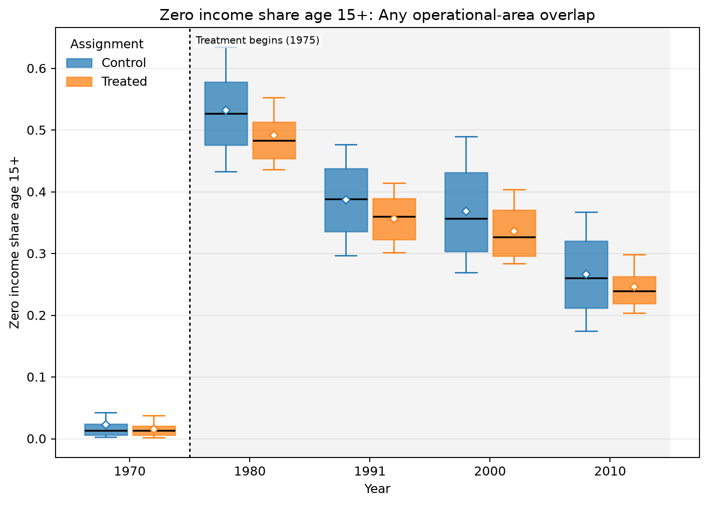
ANY OPERATIONAL-AREA OVERLAP · AMC · INCOME DISTRIBUTION · ZERO INCOME SHARE AGE 15+
Treated means are lower in all 5 observed years
UNADJUSTED MEANS (SD)
Year | Control | Treated
1970 | 0.0229 (0.0473) | 0.0158 (0.0136)
1980 | 0.533 (0.0856) | 0.492 (0.0615)
1991 | 0.387 (0.0697) | 0.357 (0.0447)
2000 | 0.369 (0.0877) | 0.337 (0.051)
2010 | 0.267 (0.0771) | 0.247 (0.045)
Box: Q1–Q3 · whiskers: P10–P90 · diamond: mean. Full median/IQR/N and mean-difference table is saved as LaTeX.
Any operational-area overlap · Income distribution
20
Notes:
The title summarizes unadjusted group means and should not be interpreted causally.
[Sources]
- C:\Users\josez\OneDrive\Desktop\EPGE\climate_migration\figs\treatment_control_comparisons\polocentro_operational_any_overlap\amc\plots\zero_income_share_age15plus.png
- C:\Users\josez\OneDrive\Desktop\EPGE\climate_migration\figs\treatment_control_comparisons\polocentro_operational_any_overlap\amc\tables\zero_income_share_age15plus.csv
- C:\Users\josez\OneDrive\Desktop\EPGE\climate_migration\figs\treatment_control_comparisons\polocentro_operational_any_overlap\amc\tables\zero_income_share_age15plus.tex

Slide 21
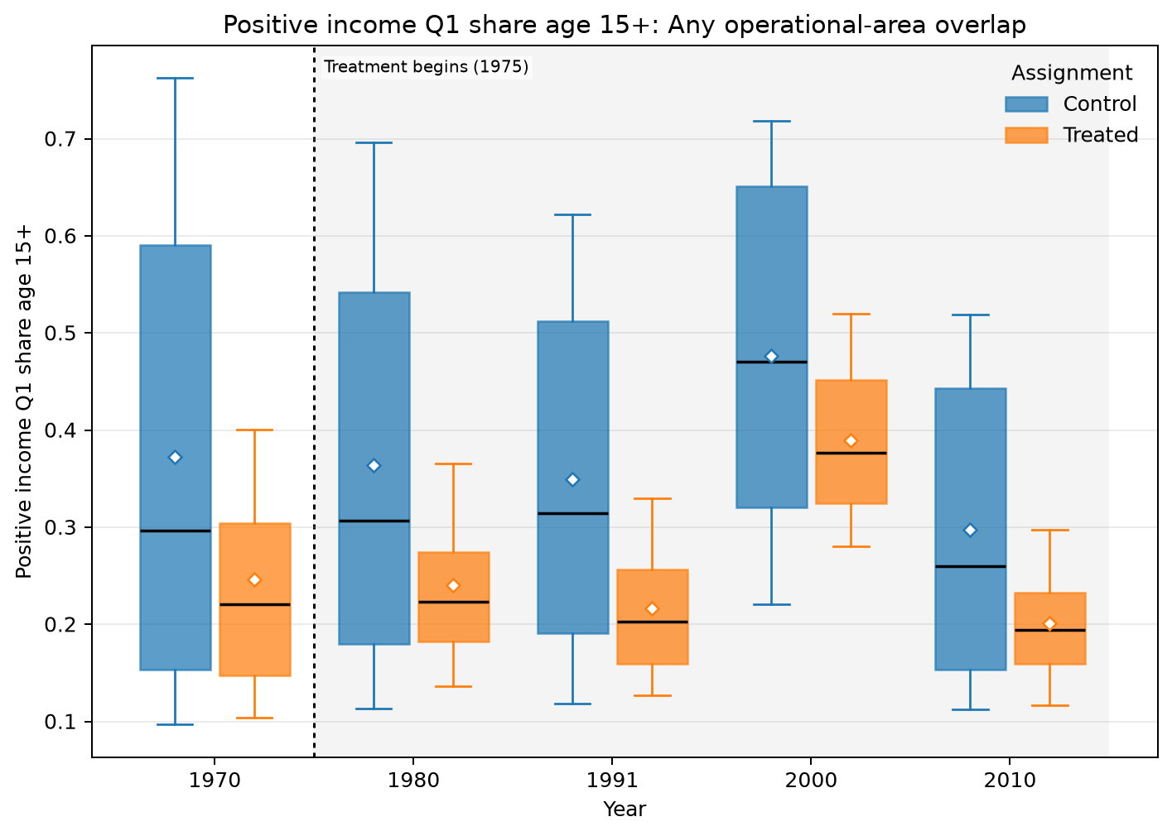
ANY OPERATIONAL-AREA OVERLAP · AMC · INCOME DISTRIBUTION · POSITIVE INCOME Q1 SHARE AGE 15+
Treated means are lower in all 5 observed years
UNADJUSTED MEANS (SD)
Year | Control | Treated
1970 | 0.372 (0.254) | 0.246 (0.137)
1980 | 0.364 (0.219) | 0.241 (0.0993)
1991 | 0.349 (0.189) | 0.216 (0.0872)
2000 | 0.477 (0.188) | 0.389 (0.0981)
2010 | 0.297 (0.157) | 0.201 (0.0699)
Box: Q1–Q3 · whiskers: P10–P90 · diamond: mean. Full median/IQR/N and mean-difference table is saved as LaTeX.
Any operational-area overlap · Income distribution
21
Notes:
The title summarizes unadjusted group means and should not be interpreted causally.
[Sources]
- C:\Users\josez\OneDrive\Desktop\EPGE\climate_migration\figs\treatment_control_comparisons\polocentro_operational_any_overlap\amc\plots\positive_income_q1_share_age15plus.png
- C:\Users\josez\OneDrive\Desktop\EPGE\climate_migration\figs\treatment_control_comparisons\polocentro_operational_any_overlap\amc\tables\positive_income_q1_share_age15plus.csv
- C:\Users\josez\OneDrive\Desktop\EPGE\climate_migration\figs\treatment_control_comparisons\polocentro_operational_any_overlap\amc\tables\positive_income_q1_share_age15plus.tex

Slide 22
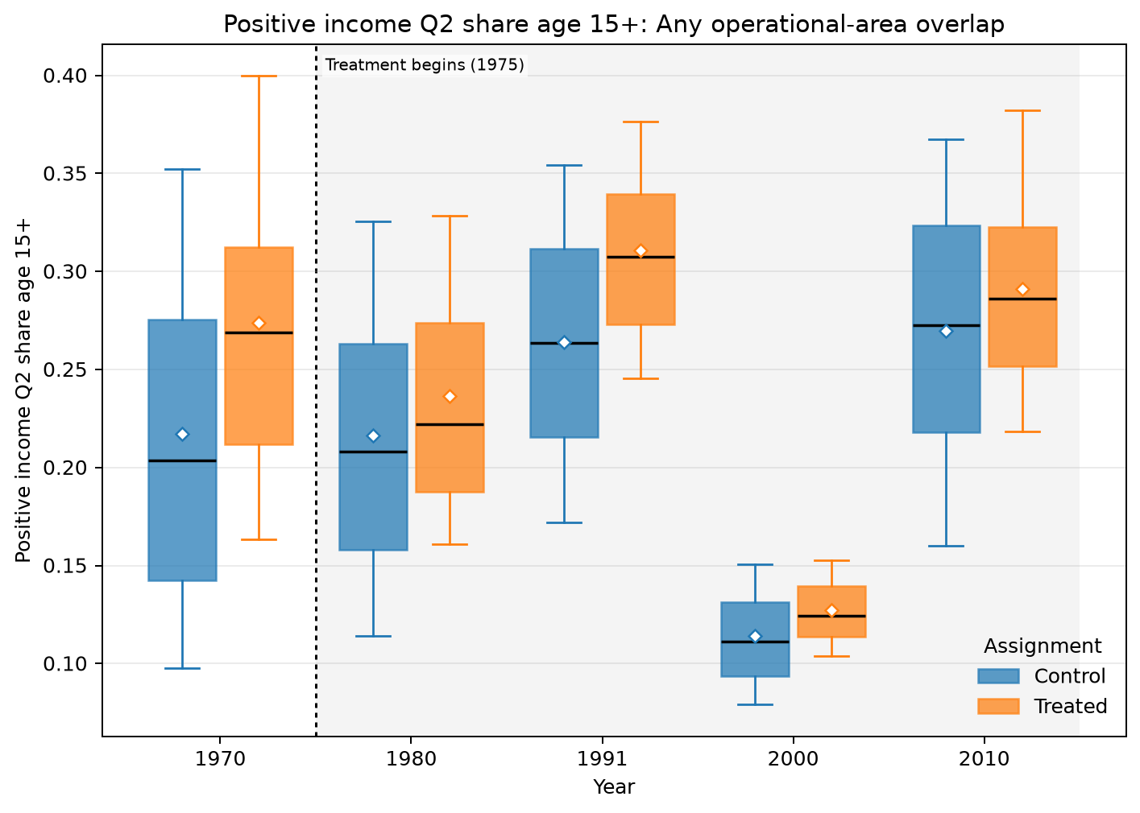
ANY OPERATIONAL-AREA OVERLAP · AMC · INCOME DISTRIBUTION · POSITIVE INCOME Q2 SHARE AGE 15+
Treated means are higher in all 5 observed years
UNADJUSTED MEANS (SD)
Year | Control | Treated
1970 | 0.217 (0.103) | 0.274 (0.0929)
1980 | 0.216 (0.0859) | 0.236 (0.0762)
1991 | 0.264 (0.0731) | 0.311 (0.0587)
2000 | 0.114 (0.0297) | 0.127 (0.0209)
2010 | 0.27 (0.0786) | 0.291 (0.0632)
Box: Q1–Q3 · whiskers: P10–P90 · diamond: mean. Full median/IQR/N and mean-difference table is saved as LaTeX.
Any operational-area overlap · Income distribution
22
Notes:
The title summarizes unadjusted group means and should not be interpreted causally.
[Sources]
- C:\Users\josez\OneDrive\Desktop\EPGE\climate_migration\figs\treatment_control_comparisons\polocentro_operational_any_overlap\amc\plots\positive_income_q2_share_age15plus.png
- C:\Users\josez\OneDrive\Desktop\EPGE\climate_migration\figs\treatment_control_comparisons\polocentro_operational_any_overlap\amc\tables\positive_income_q2_share_age15plus.csv
- C:\Users\josez\OneDrive\Desktop\EPGE\climate_migration\figs\treatment_control_comparisons\polocentro_operational_any_overlap\amc\tables\positive_income_q2_share_age15plus.tex

Slide 23
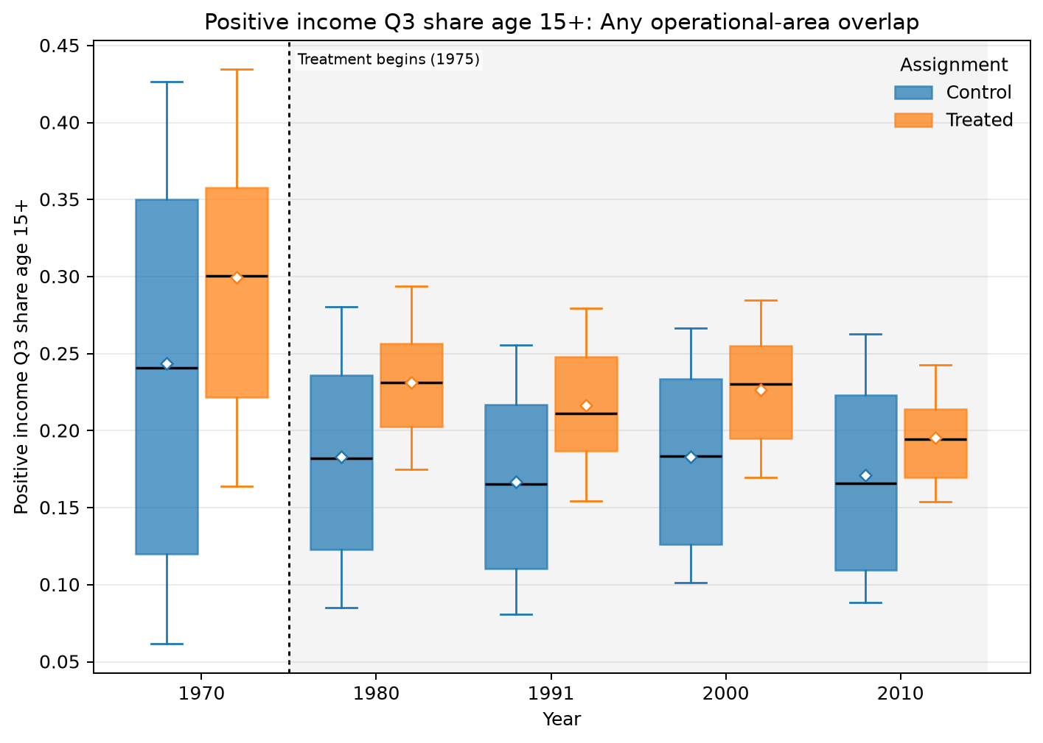
ANY OPERATIONAL-AREA OVERLAP · AMC · INCOME DISTRIBUTION · POSITIVE INCOME Q3 SHARE AGE 15+
Treated means are higher in all 5 observed years
UNADJUSTED MEANS (SD)
Year | Control | Treated
1970 | 0.244 (0.142) | 0.299 (0.112)
1980 | 0.183 (0.0768) | 0.231 (0.0477)
1991 | 0.167 (0.0676) | 0.216 (0.0515)
2000 | 0.183 (0.0648) | 0.226 (0.0455)
2010 | 0.171 (0.0675) | 0.195 (0.0338)
Box: Q1–Q3 · whiskers: P10–P90 · diamond: mean. Full median/IQR/N and mean-difference table is saved as LaTeX.
Any operational-area overlap · Income distribution
23
Notes:
The title summarizes unadjusted group means and should not be interpreted causally.
[Sources]
- C:\Users\josez\OneDrive\Desktop\EPGE\climate_migration\figs\treatment_control_comparisons\polocentro_operational_any_overlap\amc\plots\positive_income_q3_share_age15plus.png
- C:\Users\josez\OneDrive\Desktop\EPGE\climate_migration\figs\treatment_control_comparisons\polocentro_operational_any_overlap\amc\tables\positive_income_q3_share_age15plus.csv
- C:\Users\josez\OneDrive\Desktop\EPGE\climate_migration\figs\treatment_control_comparisons\polocentro_operational_any_overlap\amc\tables\positive_income_q3_share_age15plus.tex

Slide 24
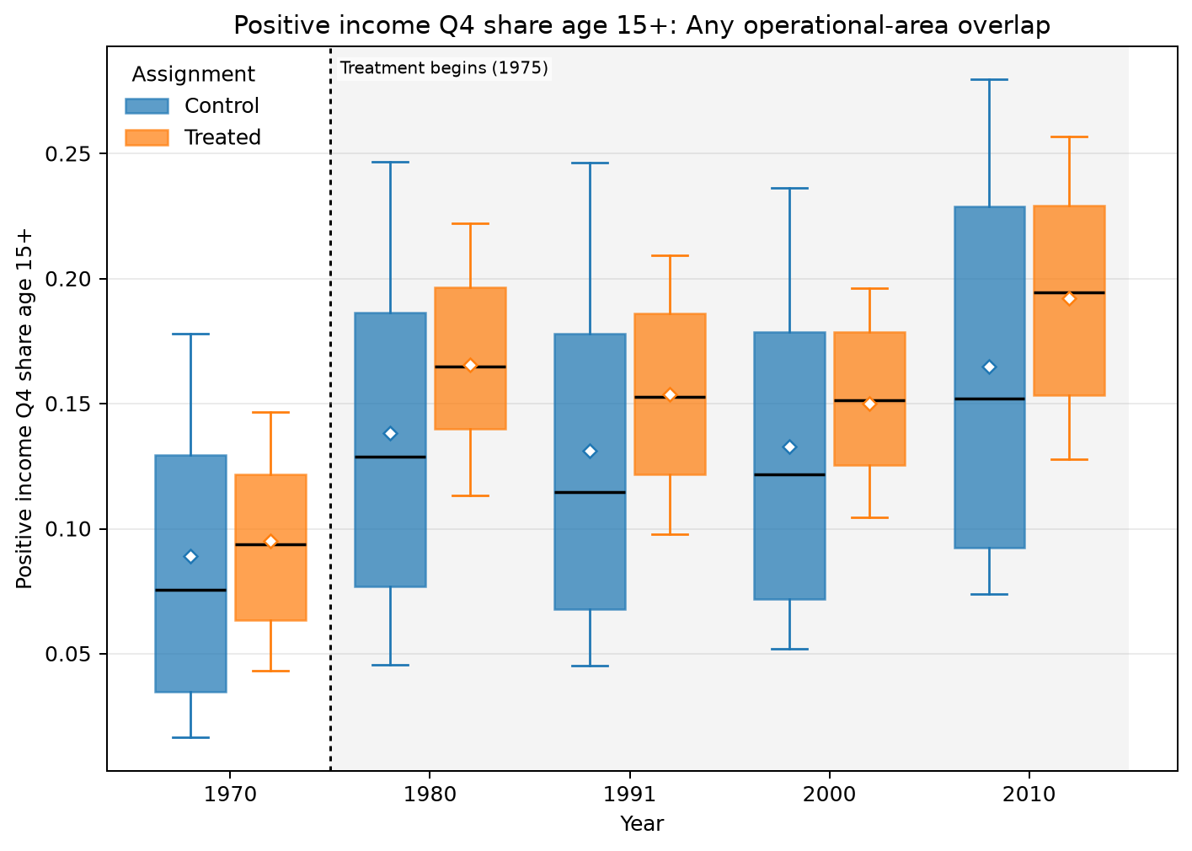
ANY OPERATIONAL-AREA OVERLAP · AMC · INCOME DISTRIBUTION · POSITIVE INCOME Q4 SHARE AGE 15+
Treated means are higher in all 5 observed years
UNADJUSTED MEANS (SD)
Year | Control | Treated
1970 | 0.0891 (0.0657) | 0.095 (0.0413)
1980 | 0.138 (0.0777) | 0.166 (0.0457)
1991 | 0.131 (0.0787) | 0.154 (0.0461)
2000 | 0.133 (0.0715) | 0.15 (0.0378)
2010 | 0.165 (0.0798) | 0.192 (0.0478)
Box: Q1–Q3 · whiskers: P10–P90 · diamond: mean. Full median/IQR/N and mean-difference table is saved as LaTeX.
Any operational-area overlap · Income distribution
24
Notes:
The title summarizes unadjusted group means and should not be interpreted causally.
[Sources]
- C:\Users\josez\OneDrive\Desktop\EPGE\climate_migration\figs\treatment_control_comparisons\polocentro_operational_any_overlap\amc\plots\positive_income_q4_share_age15plus.png
- C:\Users\josez\OneDrive\Desktop\EPGE\climate_migration\figs\treatment_control_comparisons\polocentro_operational_any_overlap\amc\tables\positive_income_q4_share_age15plus.csv
- C:\Users\josez\OneDrive\Desktop\EPGE\climate_migration\figs\treatment_control_comparisons\polocentro_operational_any_overlap\amc\tables\positive_income_q4_share_age15plus.tex

Slide 25
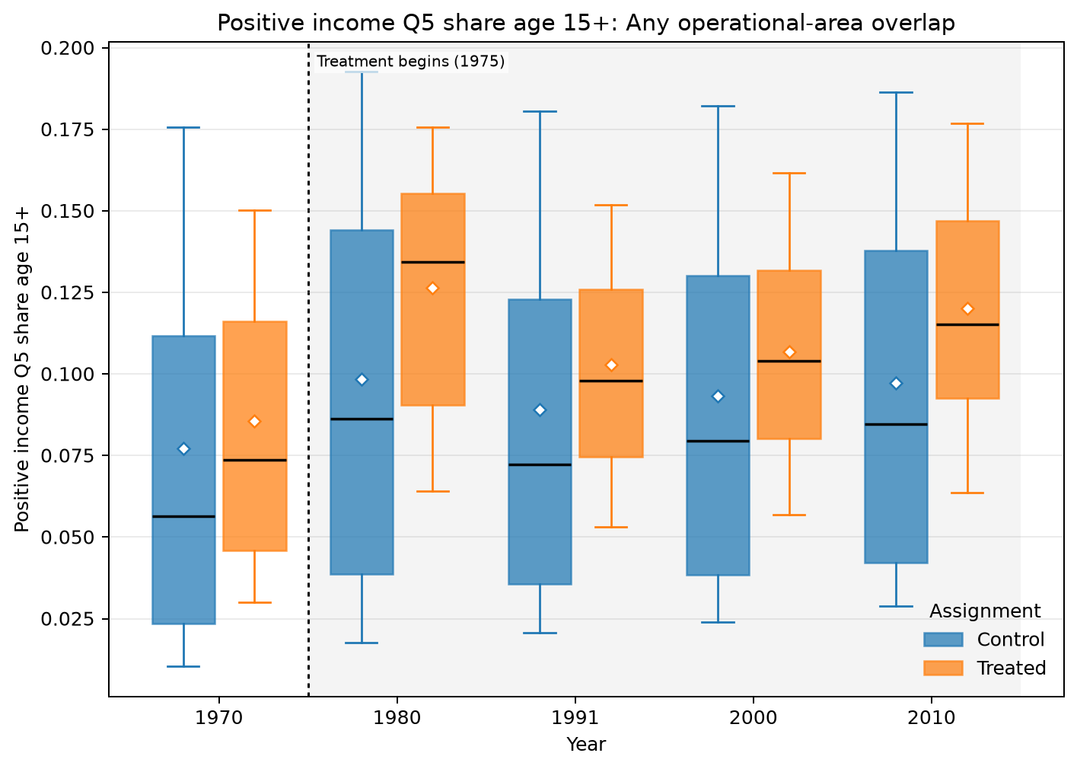
ANY OPERATIONAL-AREA OVERLAP · AMC · INCOME DISTRIBUTION · POSITIVE INCOME Q5 SHARE AGE 15+
Treated means are higher in all 5 observed years
UNADJUSTED MEANS (SD)
Year | Control | Treated
1970 | 0.0772 (0.0704) | 0.0856 (0.0514)
1980 | 0.0983 (0.0713) | 0.126 (0.0455)
1991 | 0.089 (0.0686) | 0.103 (0.0428)
2000 | 0.0933 (0.0665) | 0.107 (0.0408)
2010 | 0.0972 (0.0644) | 0.12 (0.044)
Box: Q1–Q3 · whiskers: P10–P90 · diamond: mean. Full median/IQR/N and mean-difference table is saved as LaTeX.
Any operational-area overlap · Income distribution
25
Notes:
The title summarizes unadjusted group means and should not be interpreted causally.
[Sources]
- C:\Users\josez\OneDrive\Desktop\EPGE\climate_migration\figs\treatment_control_comparisons\polocentro_operational_any_overlap\amc\plots\positive_income_q5_share_age15plus.png
- C:\Users\josez\OneDrive\Desktop\EPGE\climate_migration\figs\treatment_control_comparisons\polocentro_operational_any_overlap\amc\tables\positive_income_q5_share_age15plus.csv
- C:\Users\josez\OneDrive\Desktop\EPGE\climate_migration\figs\treatment_control_comparisons\polocentro_operational_any_overlap\amc\tables\positive_income_q5_share_age15plus.tex

Slide 26
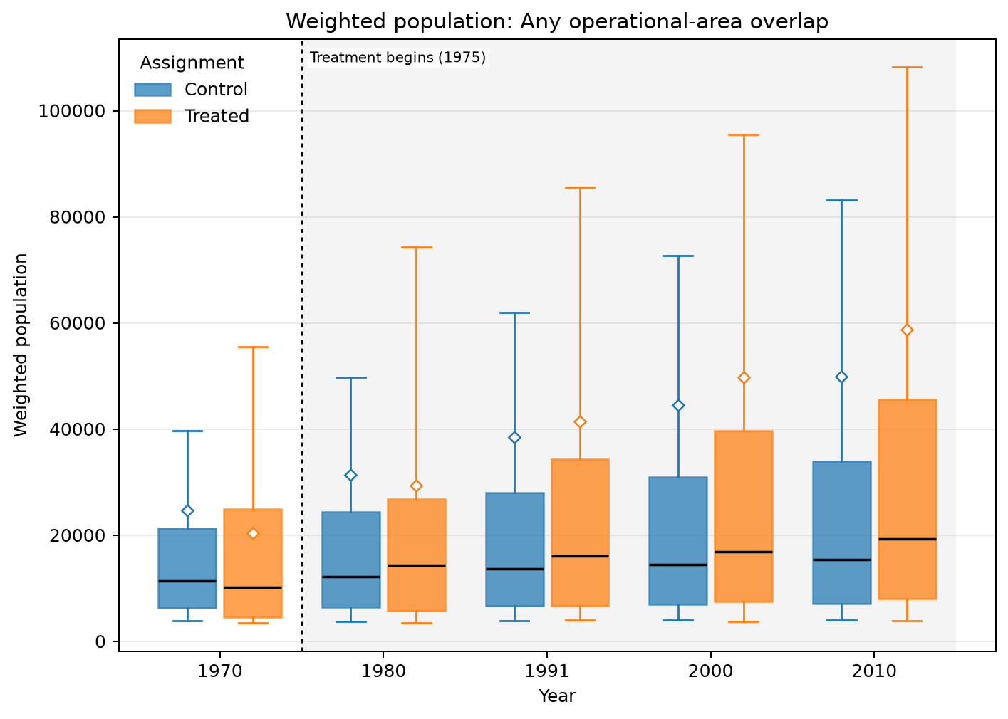
ANY OPERATIONAL-AREA OVERLAP · AMC · POPULATION · WEIGHTED POPULATION
Treated means are higher in 3 of 5 observed years
UNADJUSTED MEANS (SD)
Year | Control | Treated
1970 | 24.7k (131k) | 20.4k (25.6k)
1980 | 31.4k (180k) | 29.3k (47.1k)
1991 | 38.6k (208k) | 41.4k (85.1k)
2000 | 44.6k (230k) | 49.7k (110k)
2010 | 49.9k (252k) | 58.8k (137k)
Box: Q1–Q3 · whiskers: P10–P90 · diamond: mean. Full median/IQR/N and mean-difference table is saved as LaTeX.
Any operational-area overlap · Population
26
Notes:
The title summarizes unadjusted group means and should not be interpreted causally.
[Sources]
- C:\Users\josez\OneDrive\Desktop\EPGE\climate_migration\figs\treatment_control_comparisons\polocentro_operational_any_overlap\amc\plots\weighted_population.png
- C:\Users\josez\OneDrive\Desktop\EPGE\climate_migration\figs\treatment_control_comparisons\polocentro_operational_any_overlap\amc\tables\weighted_population.csv
- C:\Users\josez\OneDrive\Desktop\EPGE\climate_migration\figs\treatment_control_comparisons\polocentro_operational_any_overlap\amc\tables\weighted_population.tex

Slide 27
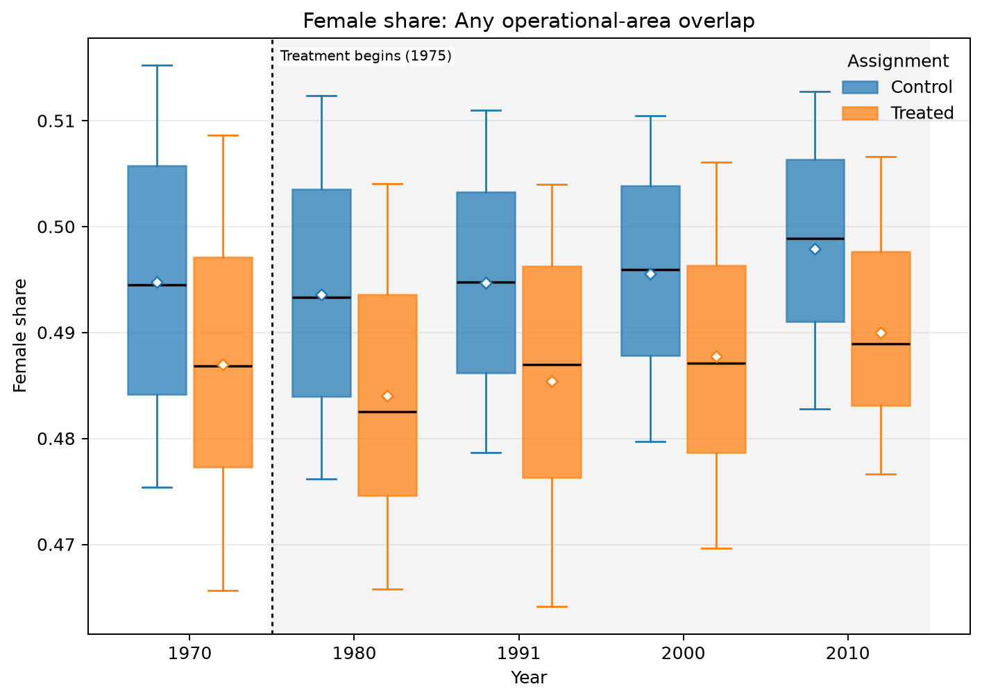
ANY OPERATIONAL-AREA OVERLAP · AMC · DEMOGRAPHICS · FEMALE SHARE
Treated means are lower in all 5 observed years
UNADJUSTED MEANS (SD)
Year | Control | Treated
1970 | 0.495 (0.0164) | 0.487 (0.0163)
1980 | 0.494 (0.0148) | 0.484 (0.0144)
1991 | 0.495 (0.0132) | 0.485 (0.016)
2000 | 0.496 (0.0124) | 0.488 (0.0137)
2010 | 0.498 (0.0146) | 0.49 (0.0122)
Box: Q1–Q3 · whiskers: P10–P90 · diamond: mean. Full median/IQR/N and mean-difference table is saved as LaTeX.
Any operational-area overlap · Demographics
27
Notes:
The title summarizes unadjusted group means and should not be interpreted causally.
[Sources]
- C:\Users\josez\OneDrive\Desktop\EPGE\climate_migration\figs\treatment_control_comparisons\polocentro_operational_any_overlap\amc\plots\female_share.png
- C:\Users\josez\OneDrive\Desktop\EPGE\climate_migration\figs\treatment_control_comparisons\polocentro_operational_any_overlap\amc\tables\female_share.csv
- C:\Users\josez\OneDrive\Desktop\EPGE\climate_migration\figs\treatment_control_comparisons\polocentro_operational_any_overlap\amc\tables\female_share.tex

Slide 28
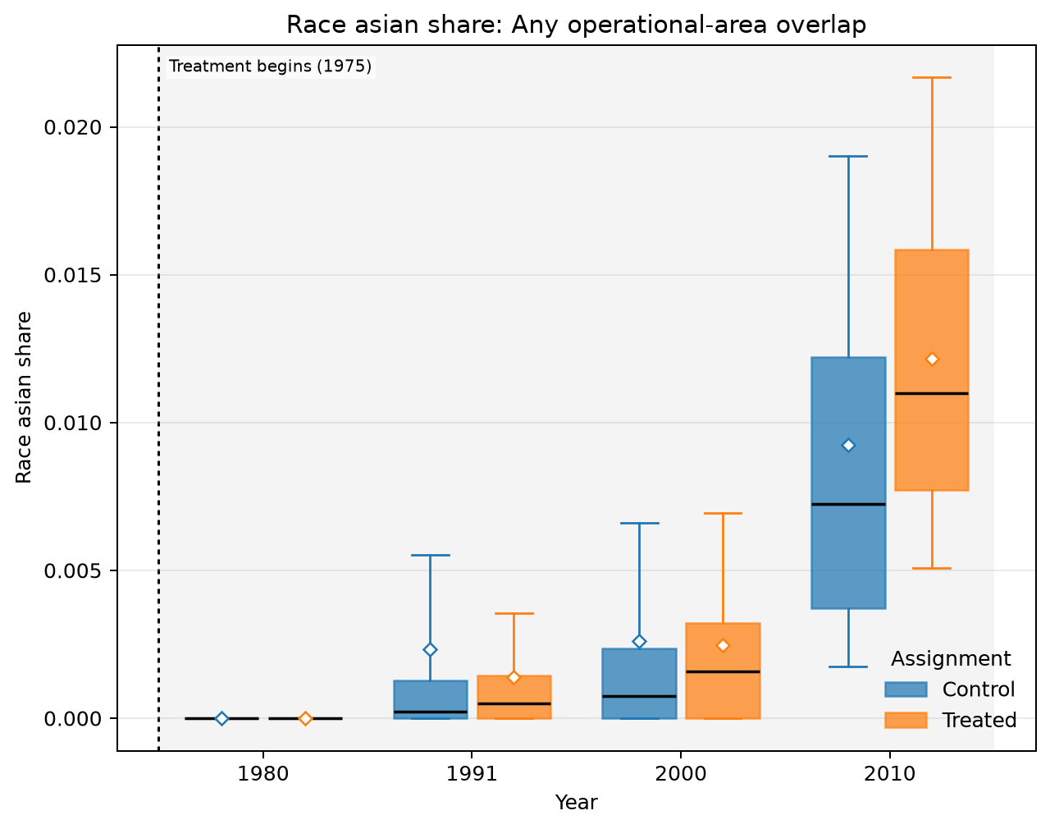
ANY OPERATIONAL-AREA OVERLAP · AMC · DEMOGRAPHICS · RACE ASIAN SHARE
Treated means are lower in 2 of 4 observed years
UNADJUSTED MEANS (SD)
Year | Control | Treated
1980 | 0 (0) | 0 (0)
1991 | 0.00234 (0.0074) | 0.0014 (0.00258)
2000 | 0.00262 (0.00624) | 0.00248 (0.00296)
2010 | 0.00926 (0.00838) | 0.0122 (0.00669)
Box: Q1–Q3 · whiskers: P10–P90 · diamond: mean. Full median/IQR/N and mean-difference table is saved as LaTeX.
Any operational-area overlap · Demographics
28
Notes:
The title summarizes unadjusted group means and should not be interpreted causally.
[Sources]
- C:\Users\josez\OneDrive\Desktop\EPGE\climate_migration\figs\treatment_control_comparisons\polocentro_operational_any_overlap\amc\plots\race_asian_share.png
- C:\Users\josez\OneDrive\Desktop\EPGE\climate_migration\figs\treatment_control_comparisons\polocentro_operational_any_overlap\amc\tables\race_asian_share.csv
- C:\Users\josez\OneDrive\Desktop\EPGE\climate_migration\figs\treatment_control_comparisons\polocentro_operational_any_overlap\amc\tables\race_asian_share.tex

Slide 29
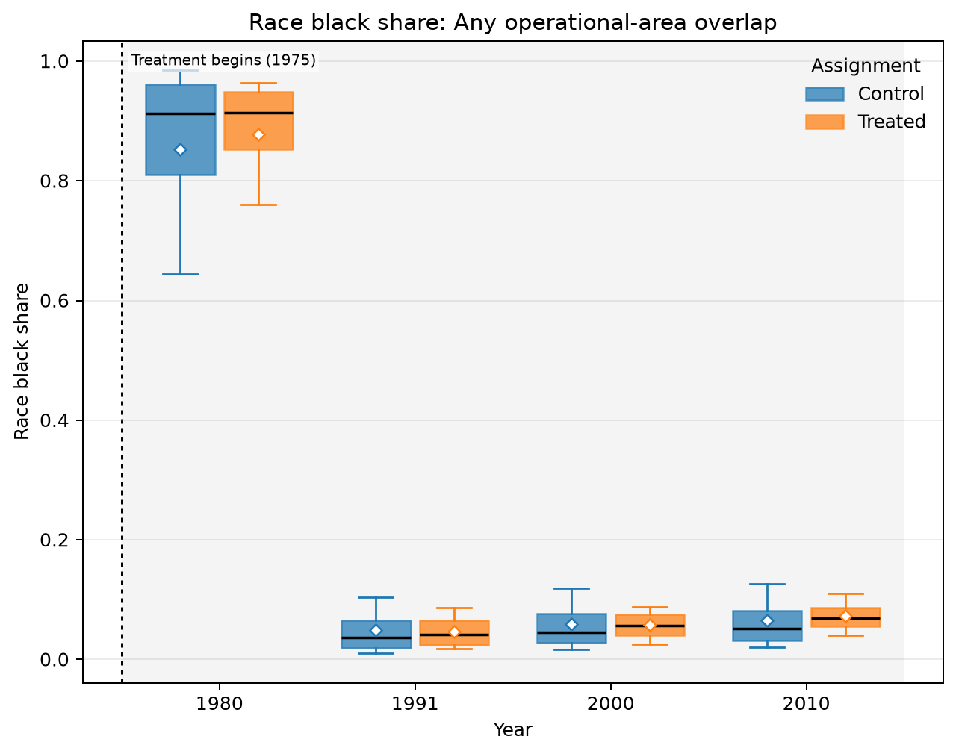
ANY OPERATIONAL-AREA OVERLAP · AMC · DEMOGRAPHICS · RACE BLACK SHARE
Treated means are higher in 2 of 4 observed years
UNADJUSTED MEANS (SD)
Year | Control | Treated
1980 | 0.853 (0.169) | 0.878 (0.123)
1991 | 0.0494 (0.0452) | 0.047 (0.0284)
2000 | 0.0592 (0.0467) | 0.058 (0.0246)
2010 | 0.0653 (0.0509) | 0.0732 (0.0269)
Box: Q1–Q3 · whiskers: P10–P90 · diamond: mean. Full median/IQR/N and mean-difference table is saved as LaTeX.
Any operational-area overlap · Demographics
29
Notes:
The title summarizes unadjusted group means and should not be interpreted causally.
[Sources]
- C:\Users\josez\OneDrive\Desktop\EPGE\climate_migration\figs\treatment_control_comparisons\polocentro_operational_any_overlap\amc\plots\race_black_share.png
- C:\Users\josez\OneDrive\Desktop\EPGE\climate_migration\figs\treatment_control_comparisons\polocentro_operational_any_overlap\amc\tables\race_black_share.csv
- C:\Users\josez\OneDrive\Desktop\EPGE\climate_migration\figs\treatment_control_comparisons\polocentro_operational_any_overlap\amc\tables\race_black_share.tex

Slide 30
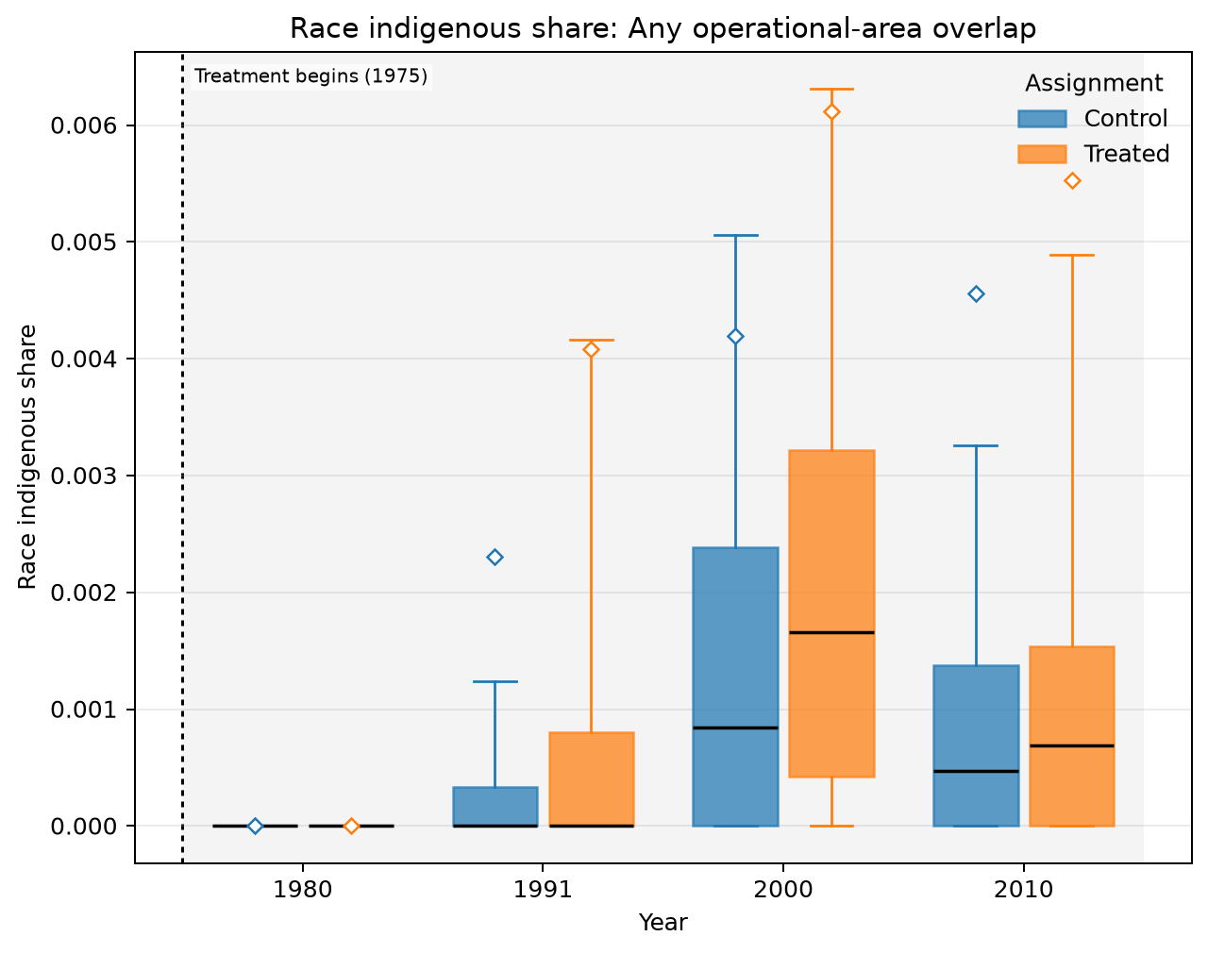
ANY OPERATIONAL-AREA OVERLAP · AMC · DEMOGRAPHICS · RACE INDIGENOUS SHARE
Treated means are higher in 3 of 4 observed years
UNADJUSTED MEANS (SD)
Year | Control | Treated
1980 | 0 (0) | 0 (0)
1991 | 0.0023 (0.0212) | 0.00408 (0.0193)
2000 | 0.0042 (0.0233) | 0.00612 (0.0234)
2010 | 0.00456 (0.0297) | 0.00553 (0.0236)
Box: Q1–Q3 · whiskers: P10–P90 · diamond: mean. Full median/IQR/N and mean-difference table is saved as LaTeX.
Any operational-area overlap · Demographics
30
Notes:
The title summarizes unadjusted group means and should not be interpreted causally.
[Sources]
- C:\Users\josez\OneDrive\Desktop\EPGE\climate_migration\figs\treatment_control_comparisons\polocentro_operational_any_overlap\amc\plots\race_indigenous_share.png
- C:\Users\josez\OneDrive\Desktop\EPGE\climate_migration\figs\treatment_control_comparisons\polocentro_operational_any_overlap\amc\tables\race_indigenous_share.csv
- C:\Users\josez\OneDrive\Desktop\EPGE\climate_migration\figs\treatment_control_comparisons\polocentro_operational_any_overlap\amc\tables\race_indigenous_share.tex

Slide 31
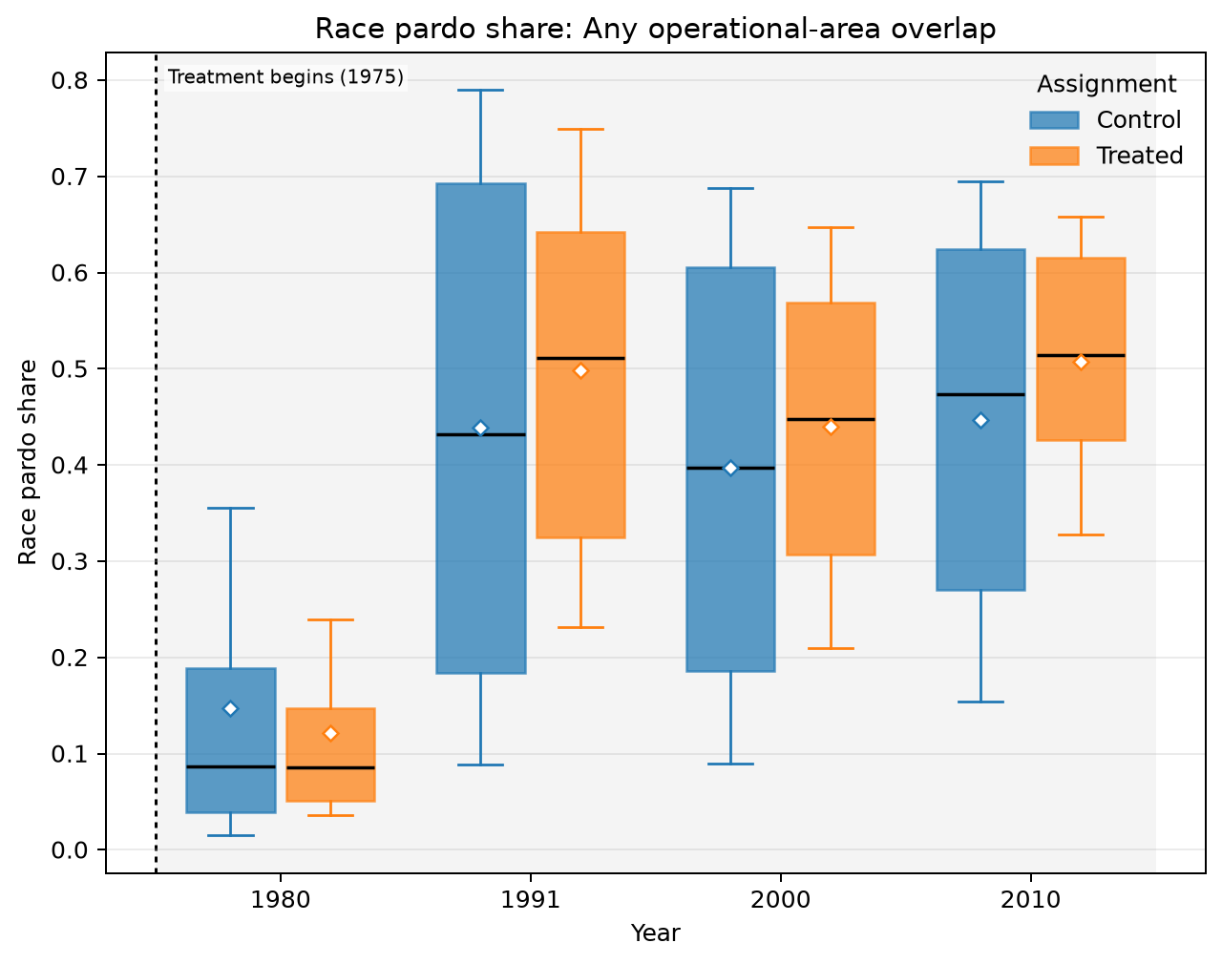
ANY OPERATIONAL-AREA OVERLAP · AMC · DEMOGRAPHICS · RACE PARDO SHARE
Treated means are higher in 3 of 4 observed years
UNADJUSTED MEANS (SD)
Year | Control | Treated
1980 | 0.147 (0.169) | 0.122 (0.123)
1991 | 0.439 (0.271) | 0.499 (0.203)
2000 | 0.397 (0.231) | 0.44 (0.163)
2010 | 0.447 (0.206) | 0.507 (0.125)
Box: Q1–Q3 · whiskers: P10–P90 · diamond: mean. Full median/IQR/N and mean-difference table is saved as LaTeX.
Any operational-area overlap · Demographics
31
Notes:
The title summarizes unadjusted group means and should not be interpreted causally.
[Sources]
- C:\Users\josez\OneDrive\Desktop\EPGE\climate_migration\figs\treatment_control_comparisons\polocentro_operational_any_overlap\amc\plots\race_pardo_share.png
- C:\Users\josez\OneDrive\Desktop\EPGE\climate_migration\figs\treatment_control_comparisons\polocentro_operational_any_overlap\amc\tables\race_pardo_share.csv
- C:\Users\josez\OneDrive\Desktop\EPGE\climate_migration\figs\treatment_control_comparisons\polocentro_operational_any_overlap\amc\tables\race_pardo_share.tex

Slide 32
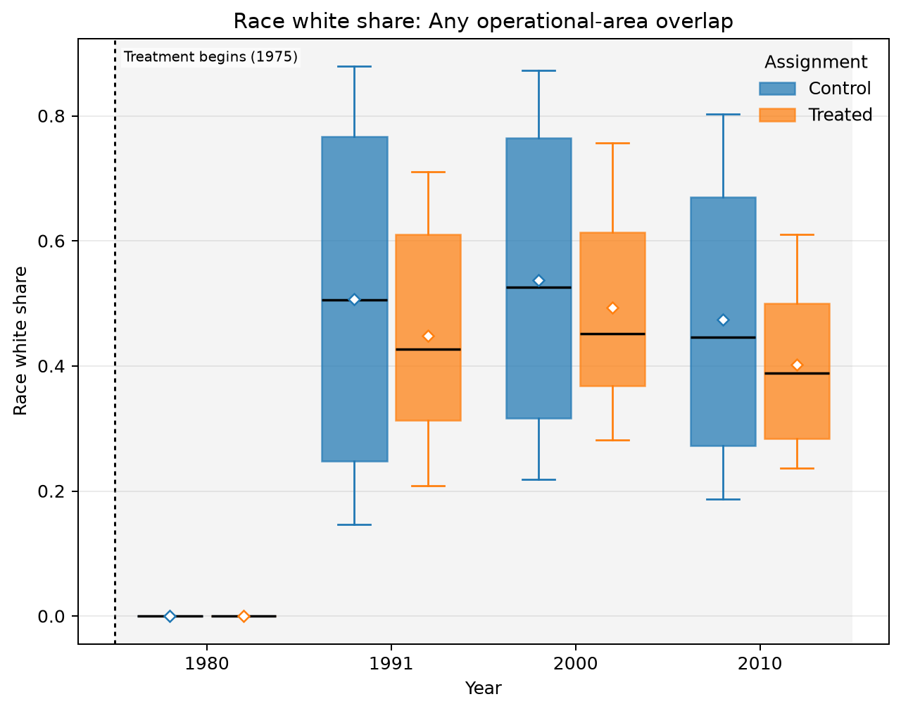
ANY OPERATIONAL-AREA OVERLAP · AMC · DEMOGRAPHICS · RACE WHITE SHARE
Treated means are lower in 3 of 4 observed years
UNADJUSTED MEANS (SD)
Year | Control | Treated
1980 | 0 (0) | 0 (0)
1991 | 0.507 (0.279) | 0.449 (0.198)
2000 | 0.537 (0.248) | 0.494 (0.169)
2010 | 0.474 (0.231) | 0.402 (0.138)
Box: Q1–Q3 · whiskers: P10–P90 · diamond: mean. Full median/IQR/N and mean-difference table is saved as LaTeX.
Any operational-area overlap · Demographics
32
Notes:
The title summarizes unadjusted group means and should not be interpreted causally.
[Sources]
- C:\Users\josez\OneDrive\Desktop\EPGE\climate_migration\figs\treatment_control_comparisons\polocentro_operational_any_overlap\amc\plots\race_white_share.png
- C:\Users\josez\OneDrive\Desktop\EPGE\climate_migration\figs\treatment_control_comparisons\polocentro_operational_any_overlap\amc\tables\race_white_share.csv
- C:\Users\josez\OneDrive\Desktop\EPGE\climate_migration\figs\treatment_control_comparisons\polocentro_operational_any_overlap\amc\tables\race_white_share.tex

Slide 33
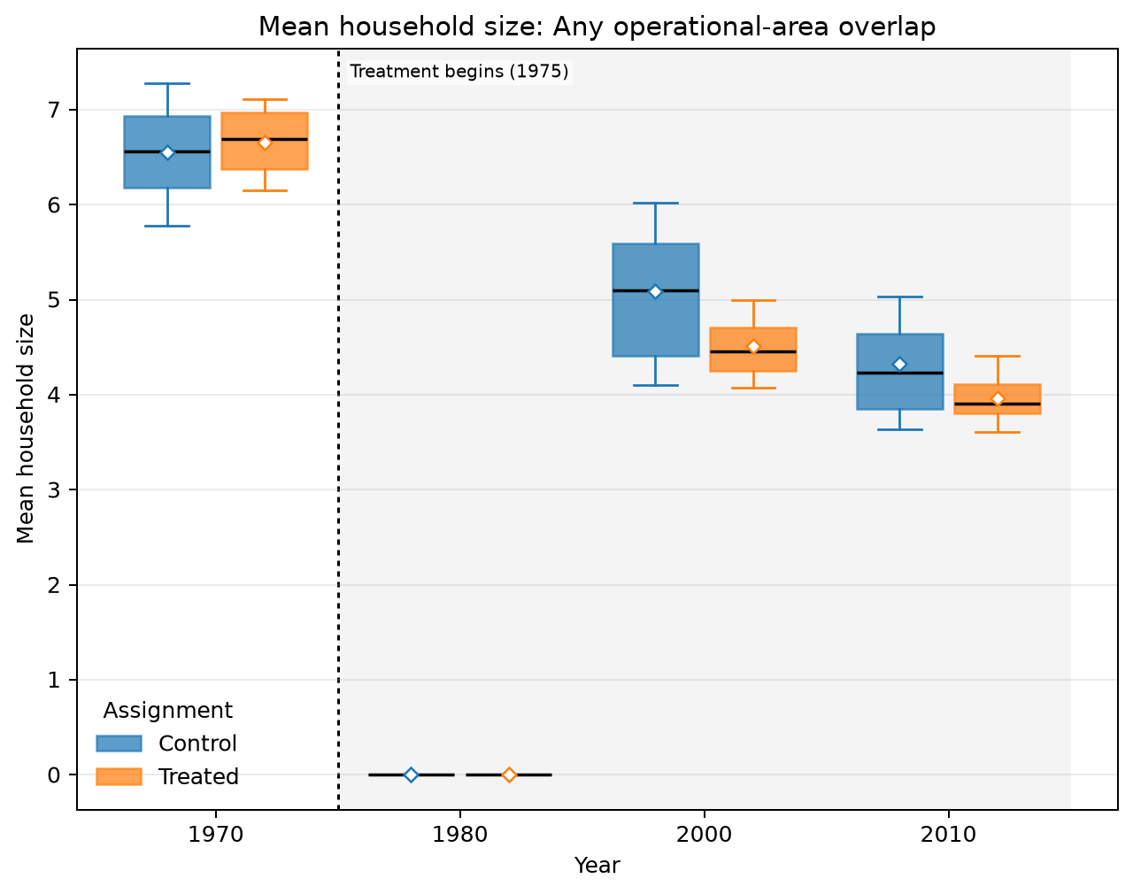
ANY OPERATIONAL-AREA OVERLAP · AMC · DEMOGRAPHICS · MEAN HOUSEHOLD SIZE
Treated means are lower in 3 of 4 observed years
UNADJUSTED MEANS (SD)
Year | Control | Treated
1970 | 6.55 (0.583) | 6.66 (0.405)
1980 | 0.00211 (0.12) | 0 (0)
2000 | 5.09 (0.792) | 4.51 (0.355)
2010 | 4.32 (0.657) | 3.96 (0.287)
Box: Q1–Q3 · whiskers: P10–P90 · diamond: mean. Full median/IQR/N and mean-difference table is saved as LaTeX.
Any operational-area overlap · Demographics
33
Notes:
The title summarizes unadjusted group means and should not be interpreted causally.
[Sources]
- C:\Users\josez\OneDrive\Desktop\EPGE\climate_migration\figs\treatment_control_comparisons\polocentro_operational_any_overlap\amc\plots\mean_household_size.png
- C:\Users\josez\OneDrive\Desktop\EPGE\climate_migration\figs\treatment_control_comparisons\polocentro_operational_any_overlap\amc\tables\mean_household_size.csv
- C:\Users\josez\OneDrive\Desktop\EPGE\climate_migration\figs\treatment_control_comparisons\polocentro_operational_any_overlap\amc\tables\mean_household_size.tex

Slide 34
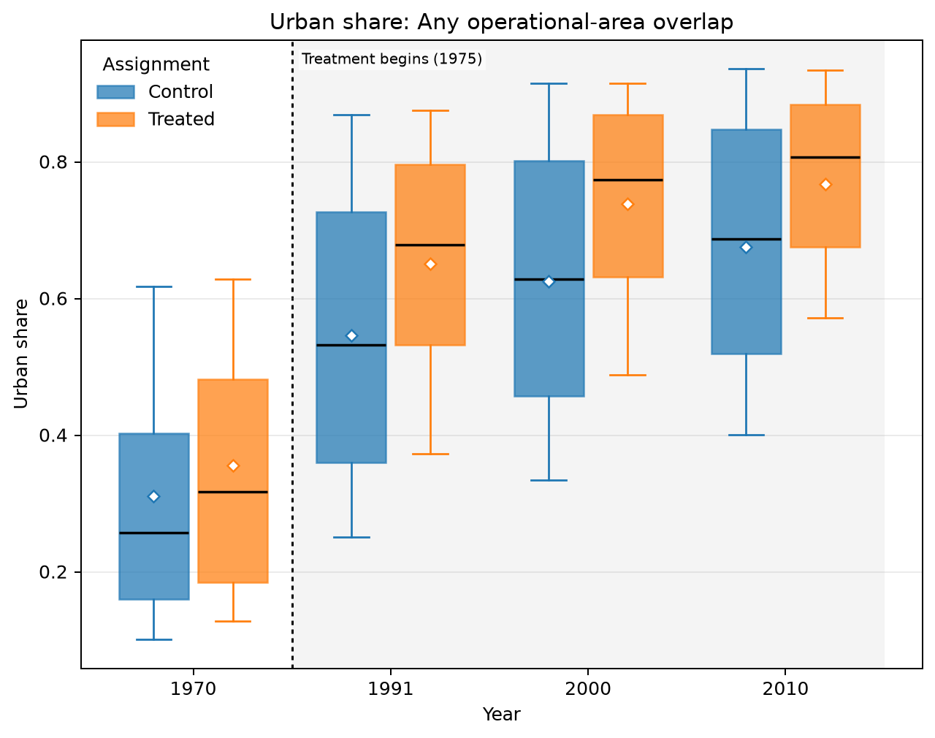
ANY OPERATIONAL-AREA OVERLAP · AMC · DEMOGRAPHICS · URBAN SHARE
Treated means are higher in all 4 observed years
UNADJUSTED MEANS (SD)
Year | Control | Treated
1970 | 0.311 (0.206) | 0.356 (0.206)
1991 | 0.546 (0.228) | 0.65 (0.194)
2000 | 0.625 (0.214) | 0.738 (0.17)
2010 | 0.676 (0.201) | 0.767 (0.159)
Box: Q1–Q3 · whiskers: P10–P90 · diamond: mean. Full median/IQR/N and mean-difference table is saved as LaTeX.
Any operational-area overlap · Demographics
34
Notes:
The title summarizes unadjusted group means and should not be interpreted causally.
[Sources]
- C:\Users\josez\OneDrive\Desktop\EPGE\climate_migration\figs\treatment_control_comparisons\polocentro_operational_any_overlap\amc\plots\urban_share.png
- C:\Users\josez\OneDrive\Desktop\EPGE\climate_migration\figs\treatment_control_comparisons\polocentro_operational_any_overlap\amc\tables\urban_share.csv
- C:\Users\josez\OneDrive\Desktop\EPGE\climate_migration\figs\treatment_control_comparisons\polocentro_operational_any_overlap\amc\tables\urban_share.tex

Slide 35
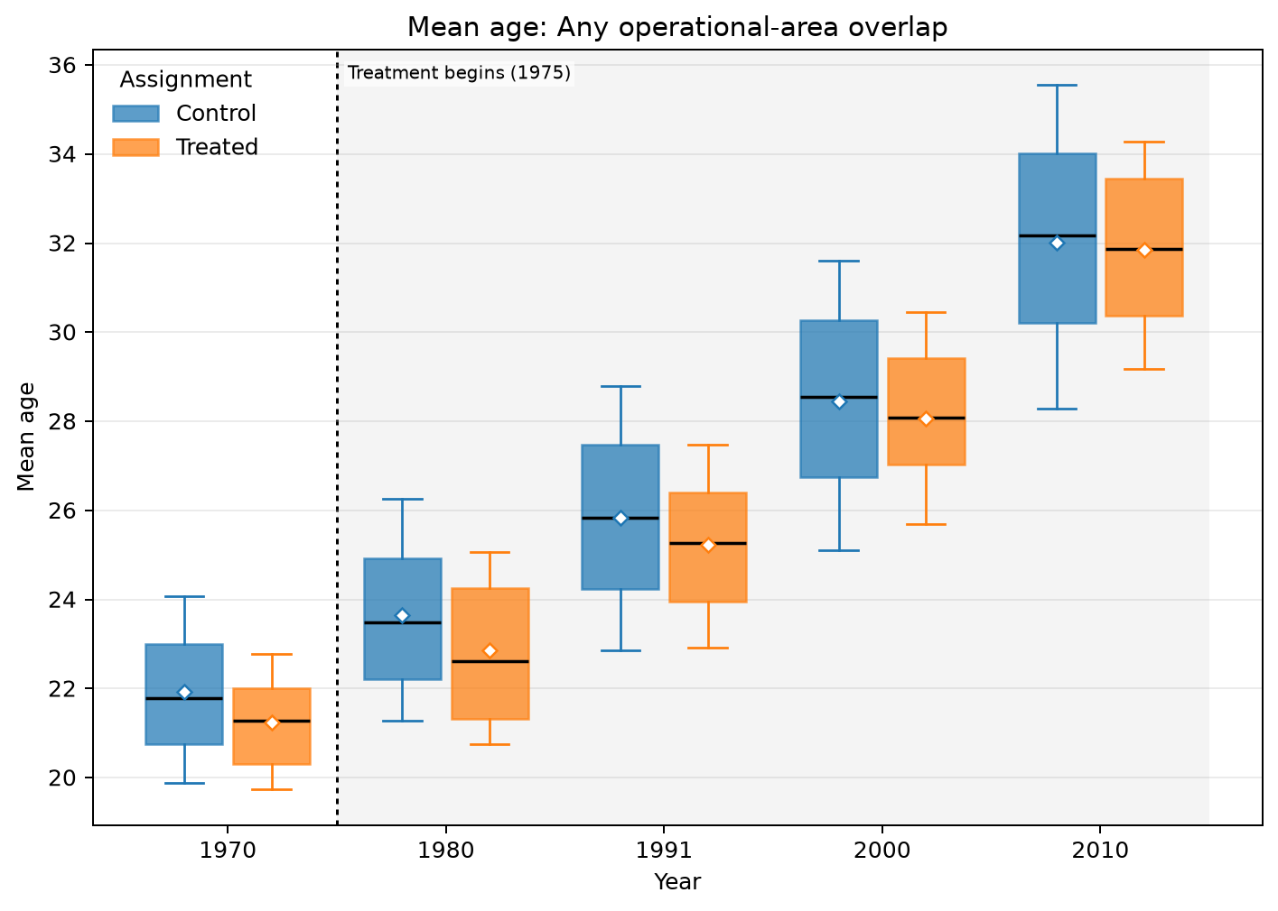
ANY OPERATIONAL-AREA OVERLAP · AMC · AGE COMPOSITION · MEAN AGE
Treated means are lower in all 5 observed years
UNADJUSTED MEANS (SD)
Year | Control | Treated
1970 | 21.9 (1.67) | 21.2 (1.22)
1980 | 23.6 (1.95) | 22.9 (1.66)
1991 | 25.8 (2.3) | 25.2 (1.72)
2000 | 28.4 (2.59) | 28.1 (1.79)
2010 | 32 (2.9) | 31.8 (2.02)
Box: Q1–Q3 · whiskers: P10–P90 · diamond: mean. Full median/IQR/N and mean-difference table is saved as LaTeX.
Any operational-area overlap · Age composition
35
Notes:
The title summarizes unadjusted group means and should not be interpreted causally.
[Sources]
- C:\Users\josez\OneDrive\Desktop\EPGE\climate_migration\figs\treatment_control_comparisons\polocentro_operational_any_overlap\amc\plots\mean_age.png
- C:\Users\josez\OneDrive\Desktop\EPGE\climate_migration\figs\treatment_control_comparisons\polocentro_operational_any_overlap\amc\tables\mean_age.csv
- C:\Users\josez\OneDrive\Desktop\EPGE\climate_migration\figs\treatment_control_comparisons\polocentro_operational_any_overlap\amc\tables\mean_age.tex

Slide 36
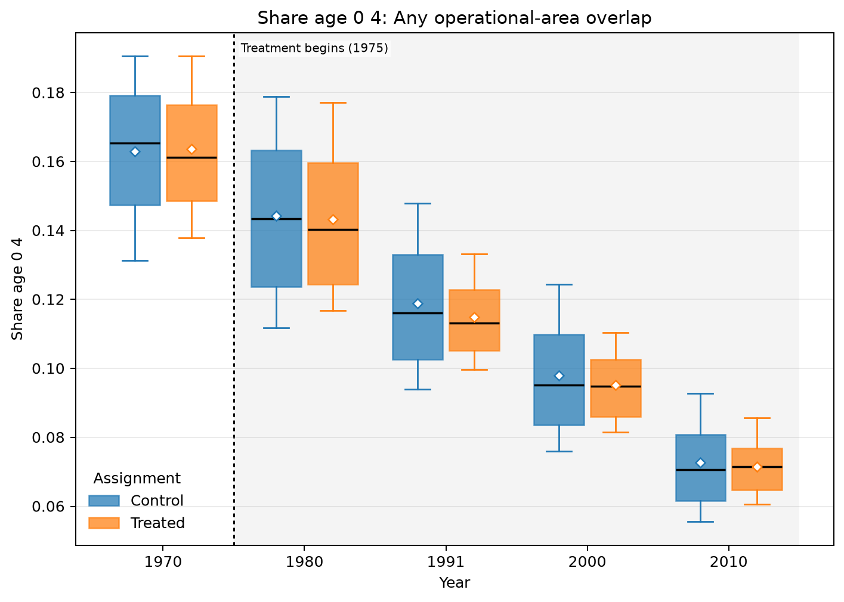
ANY OPERATIONAL-AREA OVERLAP · AMC · AGE COMPOSITION · SHARE AGE 0 4
Treated means are lower in 4 of 5 observed years
UNADJUSTED MEANS (SD)
Year | Control | Treated
1970 | 0.163 (0.023) | 0.164 (0.0199)
1980 | 0.144 (0.026) | 0.143 (0.0234)
1991 | 0.119 (0.0215) | 0.115 (0.0149)
2000 | 0.098 (0.0199) | 0.0952 (0.0123)
2010 | 0.0727 (0.0159) | 0.0715 (0.00928)
Box: Q1–Q3 · whiskers: P10–P90 · diamond: mean. Full median/IQR/N and mean-difference table is saved as LaTeX.
Any operational-area overlap · Age composition
36
Notes:
The title summarizes unadjusted group means and should not be interpreted causally.
[Sources]
- C:\Users\josez\OneDrive\Desktop\EPGE\climate_migration\figs\treatment_control_comparisons\polocentro_operational_any_overlap\amc\plots\share_age_0_4.png
- C:\Users\josez\OneDrive\Desktop\EPGE\climate_migration\figs\treatment_control_comparisons\polocentro_operational_any_overlap\amc\tables\share_age_0_4.csv
- C:\Users\josez\OneDrive\Desktop\EPGE\climate_migration\figs\treatment_control_comparisons\polocentro_operational_any_overlap\amc\tables\share_age_0_4.tex

Slide 37
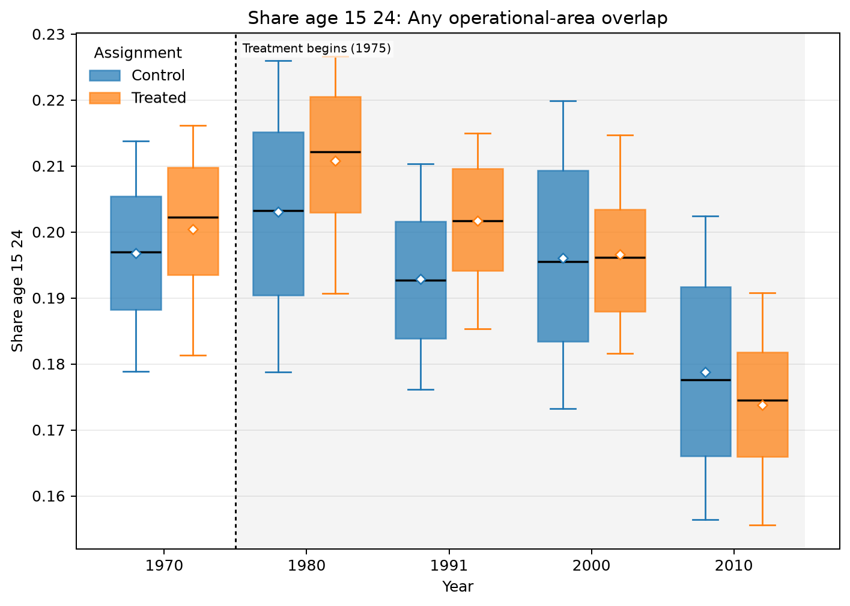
ANY OPERATIONAL-AREA OVERLAP · AMC · AGE COMPOSITION · SHARE AGE 15 24
Treated means are higher in 4 of 5 observed years
UNADJUSTED MEANS (SD)
Year | Control | Treated
1970 | 0.197 (0.0144) | 0.2 (0.0131)
1980 | 0.203 (0.0183) | 0.211 (0.0147)
1991 | 0.193 (0.0137) | 0.202 (0.0117)
2000 | 0.196 (0.018) | 0.197 (0.0135)
2010 | 0.179 (0.0178) | 0.174 (0.0137)
Box: Q1–Q3 · whiskers: P10–P90 · diamond: mean. Full median/IQR/N and mean-difference table is saved as LaTeX.
Any operational-area overlap · Age composition
37
Notes:
The title summarizes unadjusted group means and should not be interpreted causally.
[Sources]
- C:\Users\josez\OneDrive\Desktop\EPGE\climate_migration\figs\treatment_control_comparisons\polocentro_operational_any_overlap\amc\plots\share_age_15_24.png
- C:\Users\josez\OneDrive\Desktop\EPGE\climate_migration\figs\treatment_control_comparisons\polocentro_operational_any_overlap\amc\tables\share_age_15_24.csv
- C:\Users\josez\OneDrive\Desktop\EPGE\climate_migration\figs\treatment_control_comparisons\polocentro_operational_any_overlap\amc\tables\share_age_15_24.tex

Slide 38
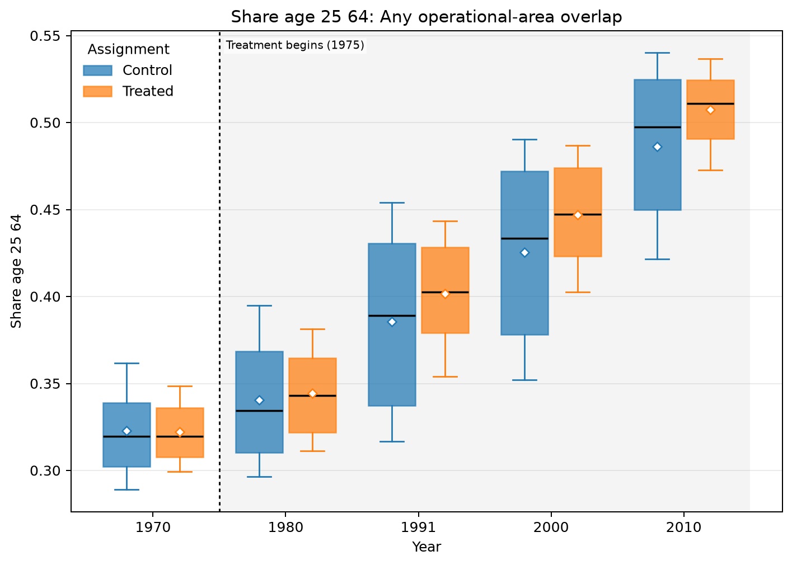
ANY OPERATIONAL-AREA OVERLAP · AMC · AGE COMPOSITION · SHARE AGE 25 64
Treated means are higher in 4 of 5 observed years
UNADJUSTED MEANS (SD)
Year | Control | Treated
1970 | 0.323 (0.0292) | 0.322 (0.0214)
1980 | 0.341 (0.0383) | 0.344 (0.0268)
1991 | 0.386 (0.0536) | 0.402 (0.0348)
2000 | 0.426 (0.0549) | 0.447 (0.0328)
2010 | 0.486 (0.048) | 0.508 (0.0235)
Box: Q1–Q3 · whiskers: P10–P90 · diamond: mean. Full median/IQR/N and mean-difference table is saved as LaTeX.
Any operational-area overlap · Age composition
38
Notes:
The title summarizes unadjusted group means and should not be interpreted causally.
[Sources]
- C:\Users\josez\OneDrive\Desktop\EPGE\climate_migration\figs\treatment_control_comparisons\polocentro_operational_any_overlap\amc\plots\share_age_25_64.png
- C:\Users\josez\OneDrive\Desktop\EPGE\climate_migration\figs\treatment_control_comparisons\polocentro_operational_any_overlap\amc\tables\share_age_25_64.csv
- C:\Users\josez\OneDrive\Desktop\EPGE\climate_migration\figs\treatment_control_comparisons\polocentro_operational_any_overlap\amc\tables\share_age_25_64.tex

Slide 39
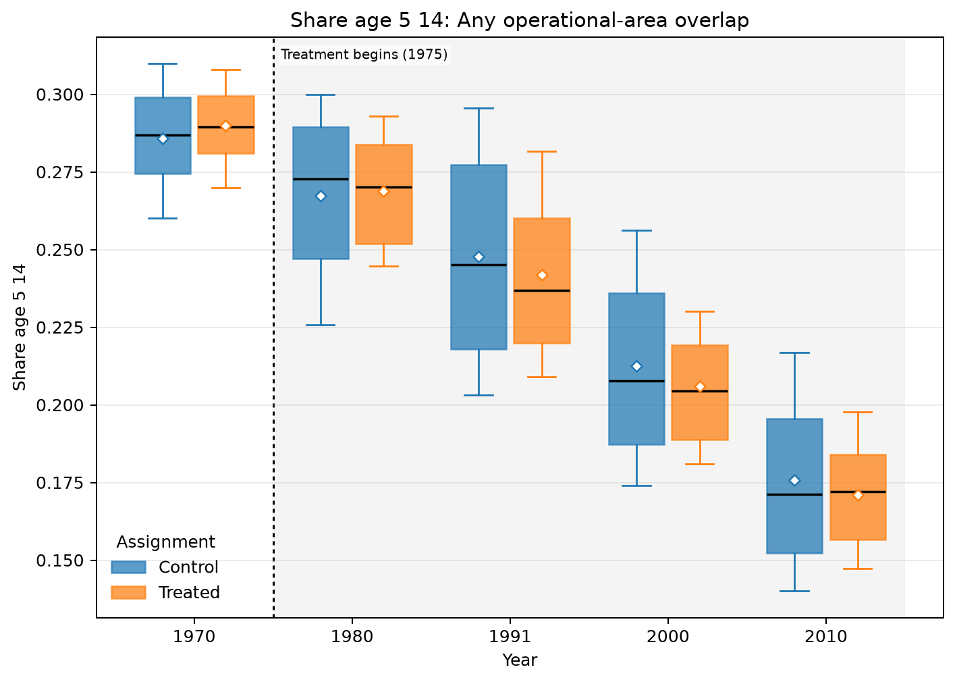
ANY OPERATIONAL-AREA OVERLAP · AMC · AGE COMPOSITION · SHARE AGE 5 14
Treated means are lower in 3 of 5 observed years
UNADJUSTED MEANS (SD)
Year | Control | Treated
1970 | 0.286 (0.0199) | 0.29 (0.0161)
1980 | 0.267 (0.029) | 0.269 (0.0198)
1991 | 0.248 (0.0358) | 0.242 (0.03)
2000 | 0.213 (0.0323) | 0.206 (0.0209)
2010 | 0.176 (0.0309) | 0.171 (0.0186)
Box: Q1–Q3 · whiskers: P10–P90 · diamond: mean. Full median/IQR/N and mean-difference table is saved as LaTeX.
Any operational-area overlap · Age composition
39
Notes:
The title summarizes unadjusted group means and should not be interpreted causally.
[Sources]
- C:\Users\josez\OneDrive\Desktop\EPGE\climate_migration\figs\treatment_control_comparisons\polocentro_operational_any_overlap\amc\plots\share_age_5_14.png
- C:\Users\josez\OneDrive\Desktop\EPGE\climate_migration\figs\treatment_control_comparisons\polocentro_operational_any_overlap\amc\tables\share_age_5_14.csv
- C:\Users\josez\OneDrive\Desktop\EPGE\climate_migration\figs\treatment_control_comparisons\polocentro_operational_any_overlap\amc\tables\share_age_5_14.tex

Slide 40
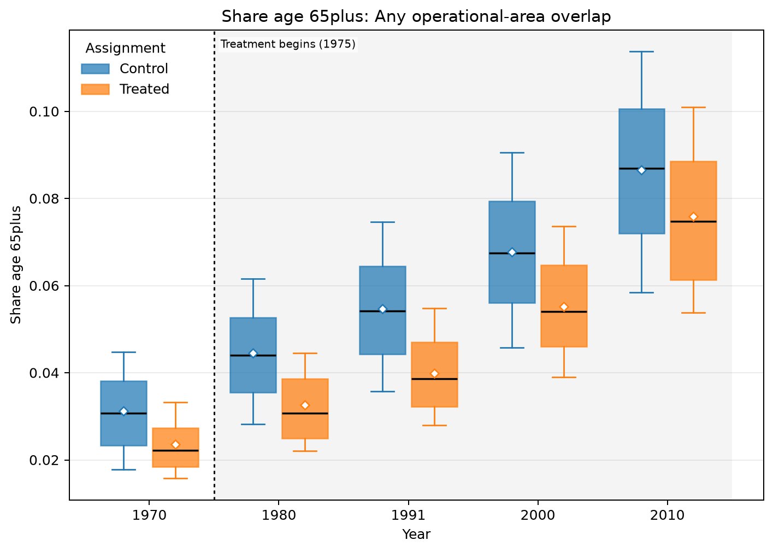
ANY OPERATIONAL-AREA OVERLAP · AMC · AGE COMPOSITION · SHARE AGE 65PLUS
Treated means are lower in all 5 observed years
UNADJUSTED MEANS (SD)
Year | Control | Treated
1970 | 0.0313 (0.0105) | 0.0236 (0.00748)
1980 | 0.0446 (0.0131) | 0.0326 (0.00987)
1991 | 0.0547 (0.0152) | 0.04 (0.0104)
2000 | 0.0678 (0.0174) | 0.0552 (0.0136)
2010 | 0.0865 (0.0219) | 0.0759 (0.0186)
Box: Q1–Q3 · whiskers: P10–P90 · diamond: mean. Full median/IQR/N and mean-difference table is saved as LaTeX.
Any operational-area overlap · Age composition
40
Notes:
The title summarizes unadjusted group means and should not be interpreted causally.
[Sources]
- C:\Users\josez\OneDrive\Desktop\EPGE\climate_migration\figs\treatment_control_comparisons\polocentro_operational_any_overlap\amc\plots\share_age_65plus.png
- C:\Users\josez\OneDrive\Desktop\EPGE\climate_migration\figs\treatment_control_comparisons\polocentro_operational_any_overlap\amc\tables\share_age_65plus.csv
- C:\Users\josez\OneDrive\Desktop\EPGE\climate_migration\figs\treatment_control_comparisons\polocentro_operational_any_overlap\amc\tables\share_age_65plus.tex

Slide 41
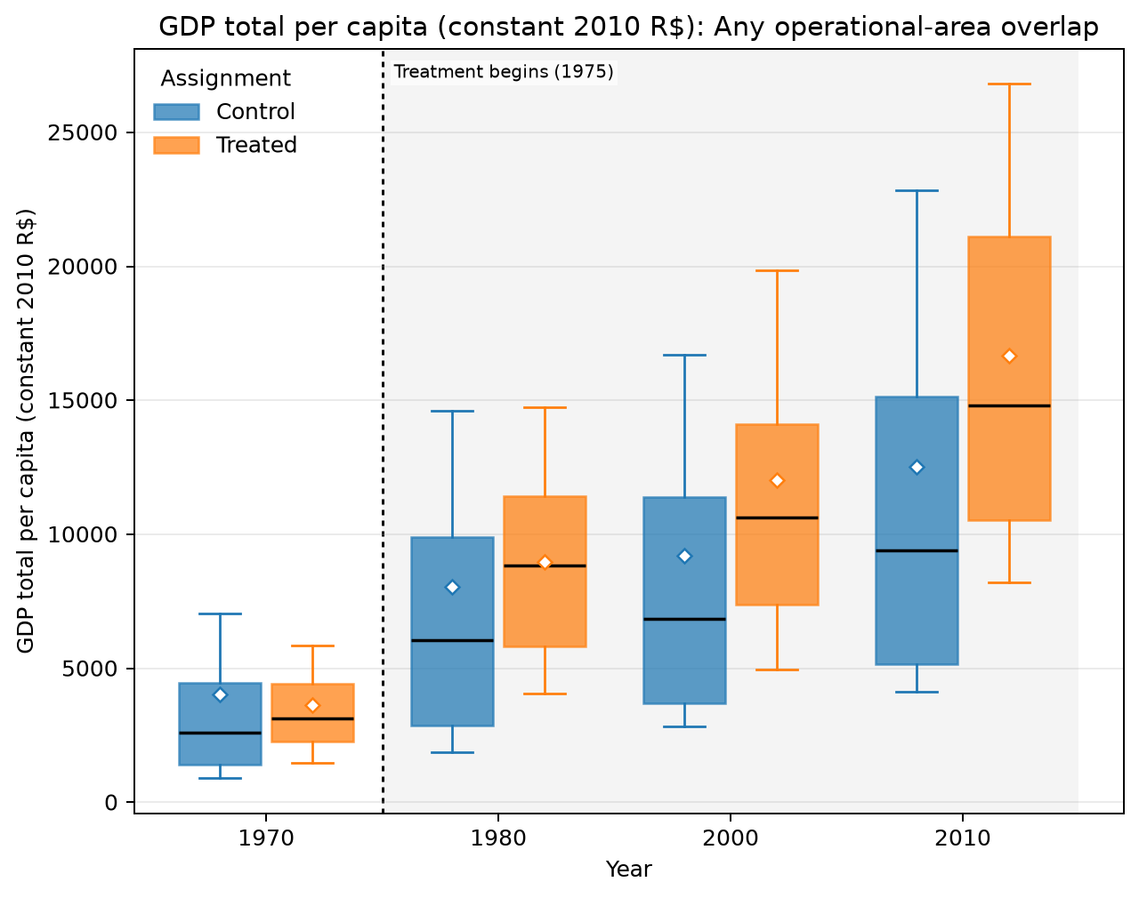
ANY OPERATIONAL-AREA OVERLAP · AMC · AMC GDP PER CAPITA · GDP TOTAL PER CAPITA (CONSTANT 2010 R$)
Treated means are higher in 3 of 4 observed years
UNADJUSTED MEANS (SD)
Year | Control | Treated
1970 | 4.02k (22.5k) | 3.62k (2.08k)
1980 | 8.06k (19.1k) | 8.98k (4.02k)
2000 | 9.20k (11.0k) | 12.0k (7.84k)
2010 | 12.5k (13.8k) | 16.7k (8.05k)
Box: Q1–Q3 · whiskers: P10–P90 · diamond: mean. Full median/IQR/N and mean-difference table is saved as LaTeX.
Any operational-area overlap · AMC GDP per capita
41
Notes:
The title summarizes unadjusted group means and should not be interpreted causally.
[Sources]
- C:\Users\josez\OneDrive\Desktop\EPGE\climate_migration\figs\treatment_control_comparisons\polocentro_operational_any_overlap\amc\plots\gdp_total_per_capita_2010_brl.png
- C:\Users\josez\OneDrive\Desktop\EPGE\climate_migration\figs\treatment_control_comparisons\polocentro_operational_any_overlap\amc\tables\gdp_total_per_capita_2010_brl.csv
- C:\Users\josez\OneDrive\Desktop\EPGE\climate_migration\figs\treatment_control_comparisons\polocentro_operational_any_overlap\amc\tables\gdp_total_per_capita_2010_brl.tex

Slide 42
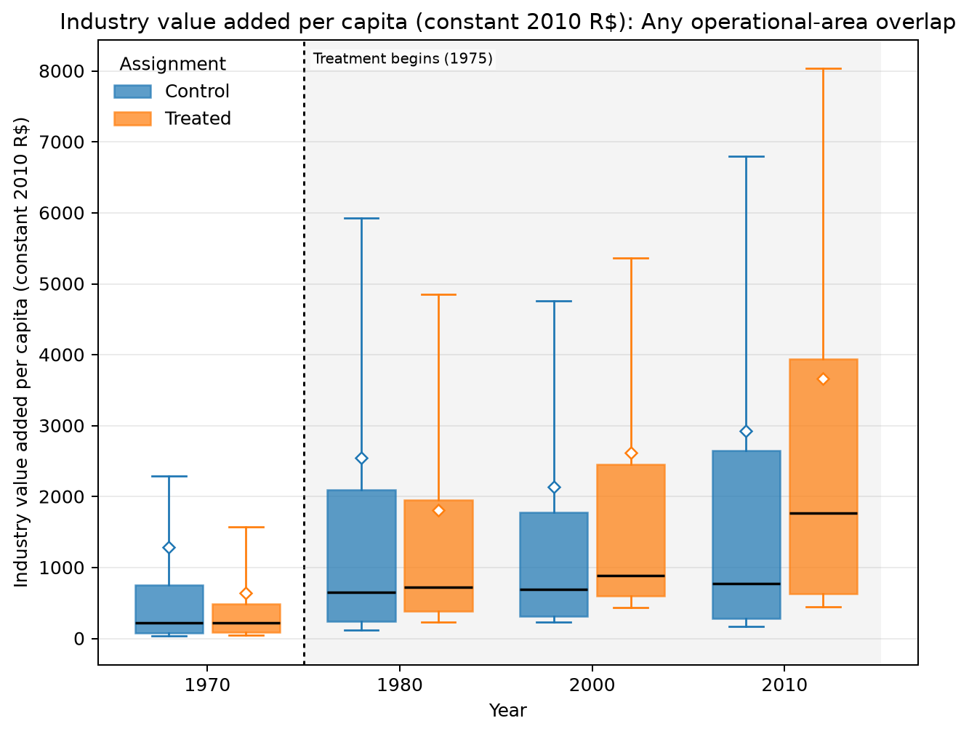
ANY OPERATIONAL-AREA OVERLAP · AMC · AMC GDP PER CAPITA · INDUSTRY VALUE ADDED PER CAPITA (CONSTANT 2010 R$)
Treated means are higher in 2 of 4 observed years
UNADJUSTED MEANS (SD)
Year | Control | Treated
1970 | 1.28k (21.0k) | 639 (1.22k)
1980 | 2.55k (9.84k) | 1.81k (2.48k)
2000 | 2.14k (5.72k) | 2.62k (5.06k)
2010 | 2.93k (8.26k) | 3.66k (5.62k)
Box: Q1–Q3 · whiskers: P10–P90 · diamond: mean. Full median/IQR/N and mean-difference table is saved as LaTeX.
Any operational-area overlap · AMC GDP per capita
42
Notes:
The title summarizes unadjusted group means and should not be interpreted causally.
[Sources]
- C:\Users\josez\OneDrive\Desktop\EPGE\climate_migration\figs\treatment_control_comparisons\polocentro_operational_any_overlap\amc\plots\va_industry_per_capita_2010_brl.png
- C:\Users\josez\OneDrive\Desktop\EPGE\climate_migration\figs\treatment_control_comparisons\polocentro_operational_any_overlap\amc\tables\va_industry_per_capita_2010_brl.csv
- C:\Users\josez\OneDrive\Desktop\EPGE\climate_migration\figs\treatment_control_comparisons\polocentro_operational_any_overlap\amc\tables\va_industry_per_capita_2010_brl.tex

Slide 43
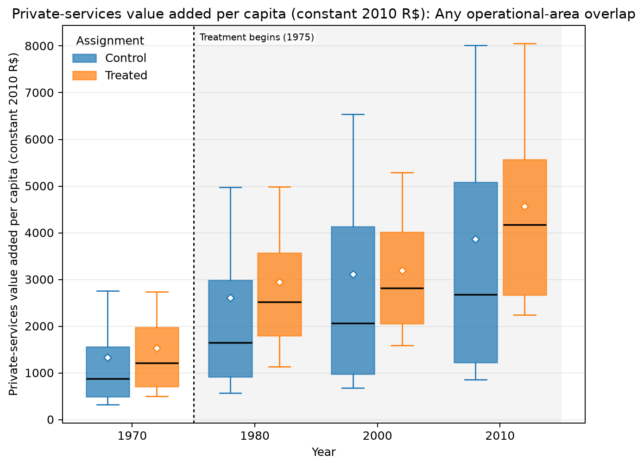
ANY OPERATIONAL-AREA OVERLAP · AMC · AMC GDP PER CAPITA · PRIVATE-SERVICES VALUE ADDED PER CAPITA (CONSTANT 2010 R$)
Treated means are higher in all 4 observed years
UNADJUSTED MEANS (SD)
Year | Control | Treated
1970 | 1.33k (1.91k) | 1.53k (1.16k)
1980 | 2.61k (9.77k) | 2.94k (1.81k)
2000 | 3.12k (4.29k) | 3.19k (1.66k)
2010 | 3.87k (4.34k) | 4.57k (2.38k)
Box: Q1–Q3 · whiskers: P10–P90 · diamond: mean. Full median/IQR/N and mean-difference table is saved as LaTeX.
Any operational-area overlap · AMC GDP per capita
43
Notes:
The title summarizes unadjusted group means and should not be interpreted causally.
[Sources]
- C:\Users\josez\OneDrive\Desktop\EPGE\climate_migration\figs\treatment_control_comparisons\polocentro_operational_any_overlap\amc\plots\va_services_private_per_capita_2010_brl.png
- C:\Users\josez\OneDrive\Desktop\EPGE\climate_migration\figs\treatment_control_comparisons\polocentro_operational_any_overlap\amc\tables\va_services_private_per_capita_2010_brl.csv
- C:\Users\josez\OneDrive\Desktop\EPGE\climate_migration\figs\treatment_control_comparisons\polocentro_operational_any_overlap\amc\tables\va_services_private_per_capita_2010_brl.tex

Slide 44
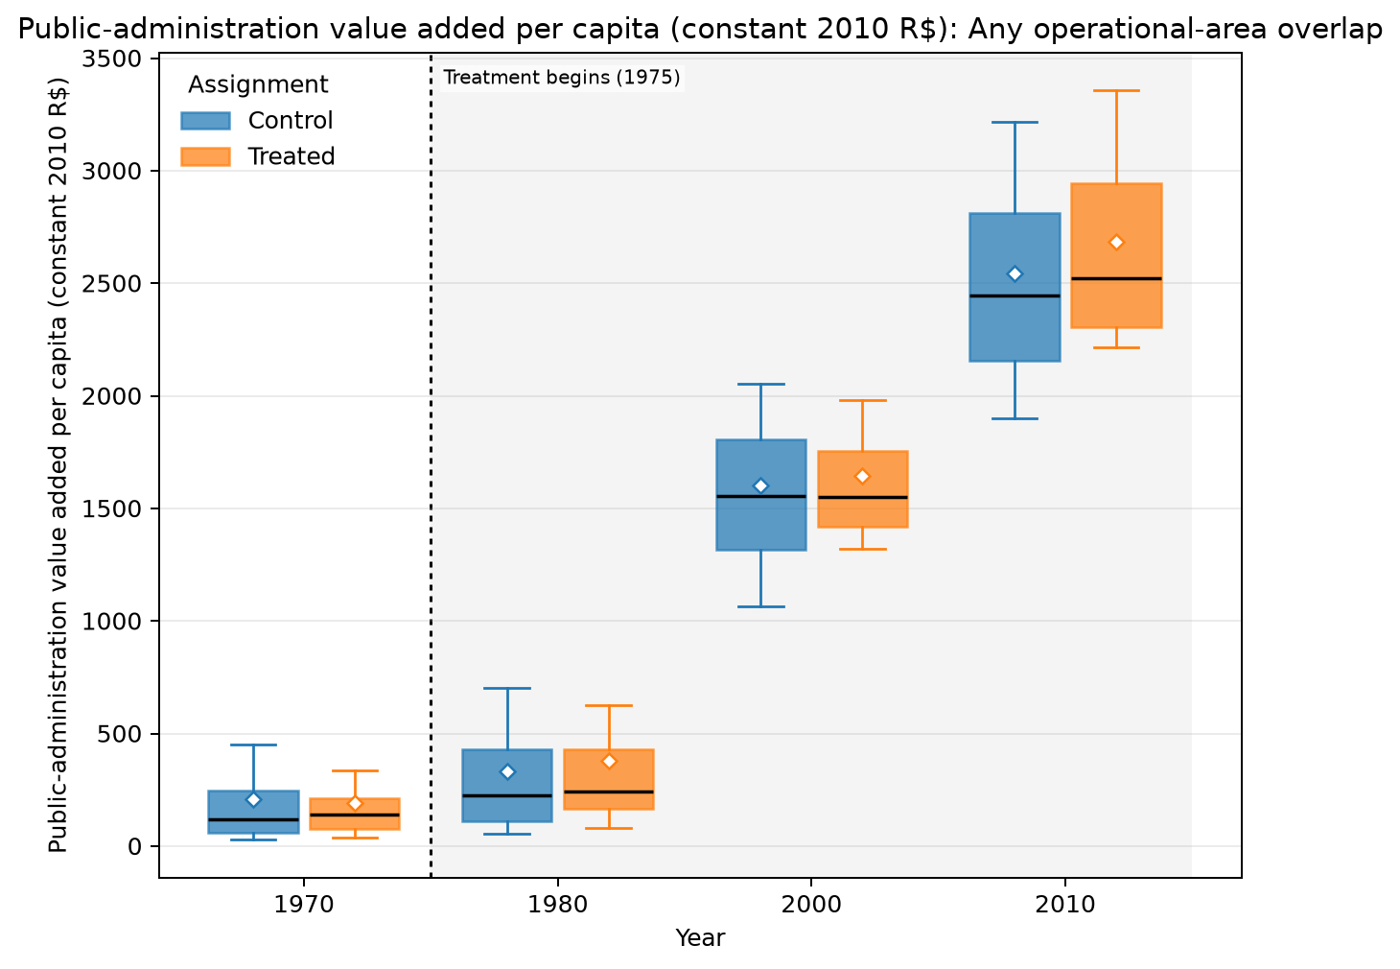
ANY OPERATIONAL-AREA OVERLAP · AMC · AMC GDP PER CAPITA · PUBLIC-ADMINISTRATION VALUE ADDED PER CAPITA (CONSTANT 2010 R$)
Treated means are higher in 3 of 4 observed years
UNADJUSTED MEANS (SD)
Year | Control | Treated
1970 | 211 (340) | 192 (207)
1980 | 334 (387) | 379 (608)
2000 | 1.60k (624) | 1.64k (387)
2010 | 2.54k (687) | 2.69k (583)
Box: Q1–Q3 · whiskers: P10–P90 · diamond: mean. Full median/IQR/N and mean-difference table is saved as LaTeX.
Any operational-area overlap · AMC GDP per capita
44
Notes:
The title summarizes unadjusted group means and should not be interpreted causally.
[Sources]
- C:\Users\josez\OneDrive\Desktop\EPGE\climate_migration\figs\treatment_control_comparisons\polocentro_operational_any_overlap\amc\plots\va_public_administration_per_capita_2010_brl.png
- C:\Users\josez\OneDrive\Desktop\EPGE\climate_migration\figs\treatment_control_comparisons\polocentro_operational_any_overlap\amc\tables\va_public_administration_per_capita_2010_brl.csv
- C:\Users\josez\OneDrive\Desktop\EPGE\climate_migration\figs\treatment_control_comparisons\polocentro_operational_any_overlap\amc\tables\va_public_administration_per_capita_2010_brl.tex

Slide 45
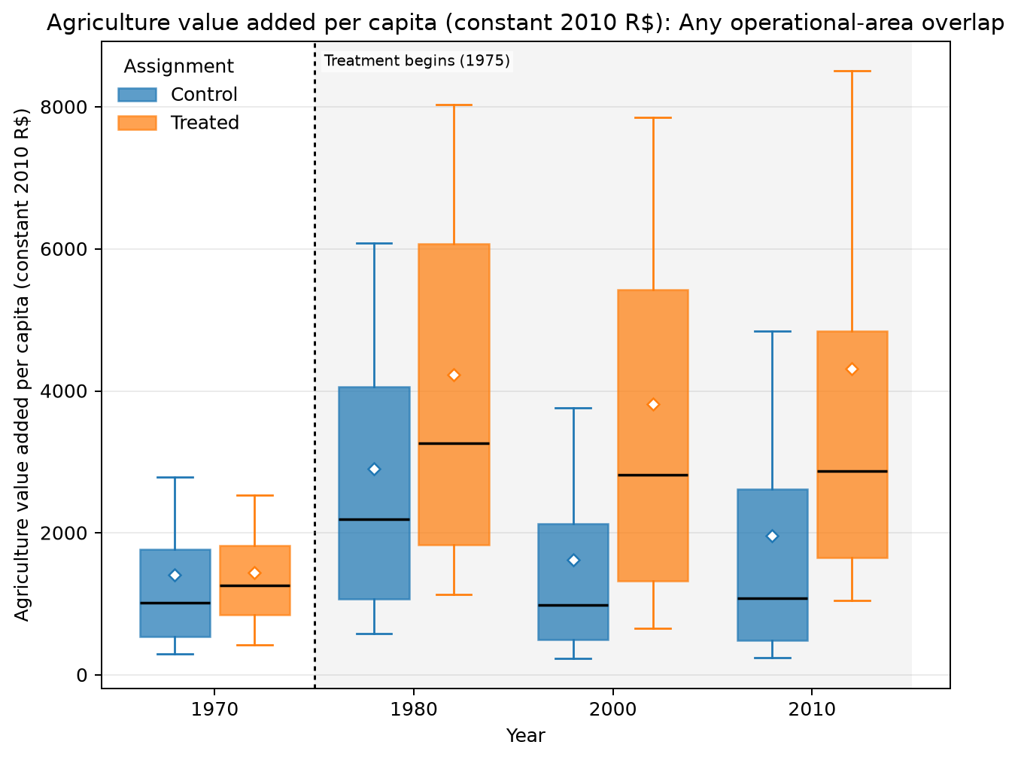
ANY OPERATIONAL-AREA OVERLAP · AMC · AMC GDP PER CAPITA · AGRICULTURE VALUE ADDED PER CAPITA (CONSTANT 2010 R$)
Treated means are higher in all 4 observed years
UNADJUSTED MEANS (SD)
Year | Control | Treated
1970 | 1.41k (2.85k) | 1.45k (965)
1980 | 2.90k (2.59k) | 4.23k (3.15k)
2000 | 1.62k (1.94k) | 3.82k (3.40k)
2010 | 1.96k (2.38k) | 4.31k (5.72k)
Box: Q1–Q3 · whiskers: P10–P90 · diamond: mean. Full median/IQR/N and mean-difference table is saved as LaTeX.
Any operational-area overlap · AMC GDP per capita
45
Notes:
The title summarizes unadjusted group means and should not be interpreted causally.
[Sources]
- C:\Users\josez\OneDrive\Desktop\EPGE\climate_migration\figs\treatment_control_comparisons\polocentro_operational_any_overlap\amc\plots\va_agriculture_per_capita_2010_brl.png
- C:\Users\josez\OneDrive\Desktop\EPGE\climate_migration\figs\treatment_control_comparisons\polocentro_operational_any_overlap\amc\tables\va_agriculture_per_capita_2010_brl.csv
- C:\Users\josez\OneDrive\Desktop\EPGE\climate_migration\figs\treatment_control_comparisons\polocentro_operational_any_overlap\amc\tables\va_agriculture_per_capita_2010_brl.tex

Slide 46
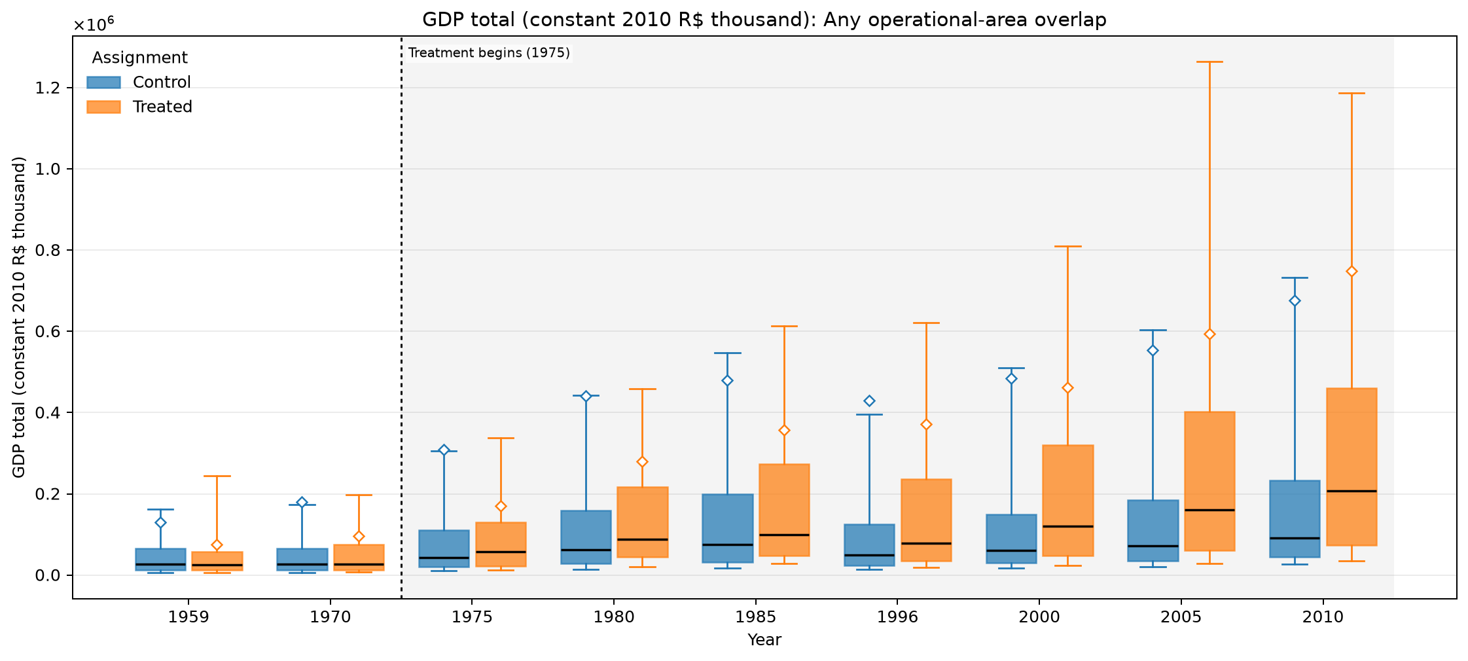
ANY OPERATIONAL-AREA OVERLAP · MUNICIPALITY · MUNICIPAL GDP LEVELS · GDP TOTAL (CONSTANT 2010 R$ THOUSAND)
Treated means are lower in 7 of 9 observed years
UNADJUSTED MEANS (SD)
Year | Control | Treated
1959 | 131k (1.60m) | 75.1k (139k)
1970 | 180k (2.66m) | 96.8k (210k)
1975 | 308k (4.25m) | 170k (402k)
1980 | 441k (5.37m) | 280k (702k)
1985 | 480k (5.01m) | 357k (919k)
1996 | 430k (5.58m) | 371k (1.20m)
2000 | 484k (5.92m) | 462k (1.36m)
2005 | 554k (6.16m) | 593k (1.62m)
2010 | 676k (7.28m) | 748k (2.21m)
Box: Q1–Q3 · whiskers: P10–P90 · diamond: mean. Full median/IQR/N and mean-difference table is saved as LaTeX.
Any operational-area overlap · Municipal GDP levels
46
Notes:
The title summarizes unadjusted group means and should not be interpreted causally.
[Sources]
- C:\Users\josez\OneDrive\Desktop\EPGE\climate_migration\figs\treatment_control_comparisons\polocentro_operational_any_overlap\municipality\plots\gdp_total_2010_brl_thousand.png
- C:\Users\josez\OneDrive\Desktop\EPGE\climate_migration\figs\treatment_control_comparisons\polocentro_operational_any_overlap\municipality\tables\gdp_total_2010_brl_thousand.csv
- C:\Users\josez\OneDrive\Desktop\EPGE\climate_migration\figs\treatment_control_comparisons\polocentro_operational_any_overlap\municipality\tables\gdp_total_2010_brl_thousand.tex

Slide 47
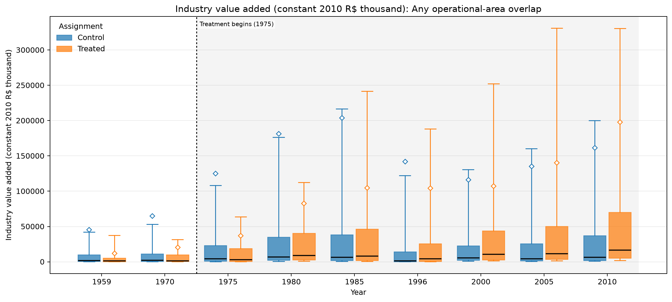
ANY OPERATIONAL-AREA OVERLAP · MUNICIPALITY · MUNICIPAL GDP LEVELS · INDUSTRY VALUE ADDED (CONSTANT 2010 R$ THOUSAND)
Treated means are lower in 7 of 9 observed years
UNADJUSTED MEANS (SD)
Year | Control | Treated
1959 | 45.7k (728k) | 12.3k (28.4k)
1970 | 64.9k (1.14m) | 20.5k (58.3k)
1975 | 125k (2.02m) | 37.0k (111k)
1980 | 181k (2.24m) | 83.0k (282k)
1985 | 204k (2.20m) | 105k (305k)
1996 | 142k (1.88m) | 104k (480k)
2000 | 116k (1.24m) | 107k (331k)
2005 | 136k (1.05m) | 141k (375k)
2010 | 162k (1.17m) | 198k (652k)
Box: Q1–Q3 · whiskers: P10–P90 · diamond: mean. Full median/IQR/N and mean-difference table is saved as LaTeX.
Any operational-area overlap · Municipal GDP levels
47
Notes:
The title summarizes unadjusted group means and should not be interpreted causally.
[Sources]
- C:\Users\josez\OneDrive\Desktop\EPGE\climate_migration\figs\treatment_control_comparisons\polocentro_operational_any_overlap\municipality\plots\va_industry_2010_brl_thousand.png
- C:\Users\josez\OneDrive\Desktop\EPGE\climate_migration\figs\treatment_control_comparisons\polocentro_operational_any_overlap\municipality\tables\va_industry_2010_brl_thousand.csv
- C:\Users\josez\OneDrive\Desktop\EPGE\climate_migration\figs\treatment_control_comparisons\polocentro_operational_any_overlap\municipality\tables\va_industry_2010_brl_thousand.tex

Slide 48
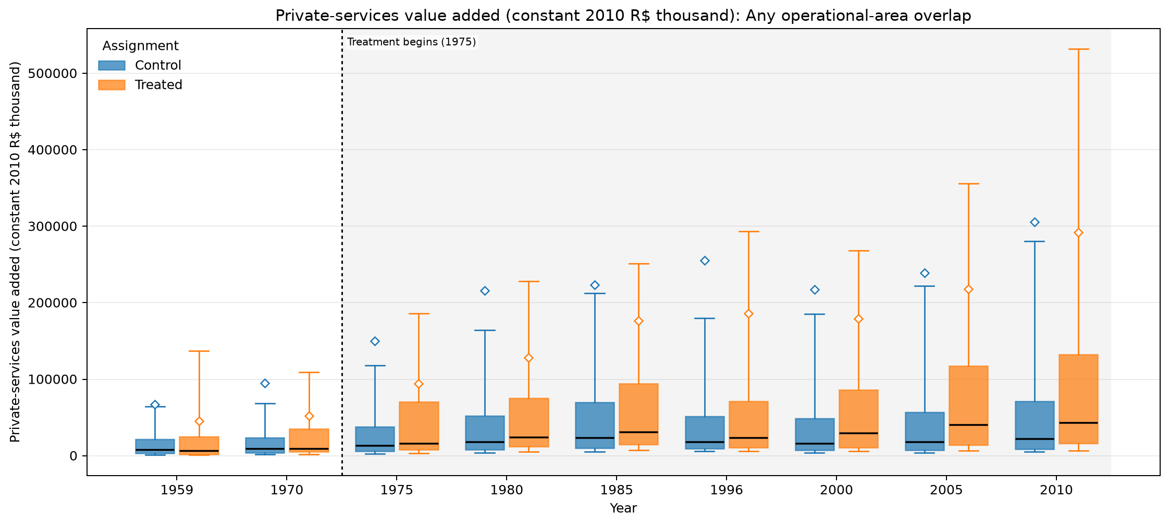
ANY OPERATIONAL-AREA OVERLAP · MUNICIPALITY · MUNICIPAL GDP LEVELS · PRIVATE-SERVICES VALUE ADDED (CONSTANT 2010 R$ THOUSAND)
Treated means are lower in all 9 observed years
UNADJUSTED MEANS (SD)
Year | Control | Treated
1959 | 67.1k (965k) | 45.5k (105k)
1970 | 94.7k (1.57m) | 52.5k (141k)
1975 | 150k (2.31m) | 94.5k (277k)
1980 | 216k (3.20m) | 128k (423k)
1985 | 223k (2.90m) | 177k (600k)
1996 | 255k (3.77m) | 186k (751k)
2000 | 218k (3.22m) | 179k (655k)
2005 | 239k (3.47m) | 218k (740k)
2010 | 306k (4.34m) | 292k (1.01m)
Box: Q1–Q3 · whiskers: P10–P90 · diamond: mean. Full median/IQR/N and mean-difference table is saved as LaTeX.
Any operational-area overlap · Municipal GDP levels
48
Notes:
The title summarizes unadjusted group means and should not be interpreted causally.
[Sources]
- C:\Users\josez\OneDrive\Desktop\EPGE\climate_migration\figs\treatment_control_comparisons\polocentro_operational_any_overlap\municipality\plots\va_services_private_2010_brl_thousand.png
- C:\Users\josez\OneDrive\Desktop\EPGE\climate_migration\figs\treatment_control_comparisons\polocentro_operational_any_overlap\municipality\tables\va_services_private_2010_brl_thousand.csv
- C:\Users\josez\OneDrive\Desktop\EPGE\climate_migration\figs\treatment_control_comparisons\polocentro_operational_any_overlap\municipality\tables\va_services_private_2010_brl_thousand.tex

Slide 49
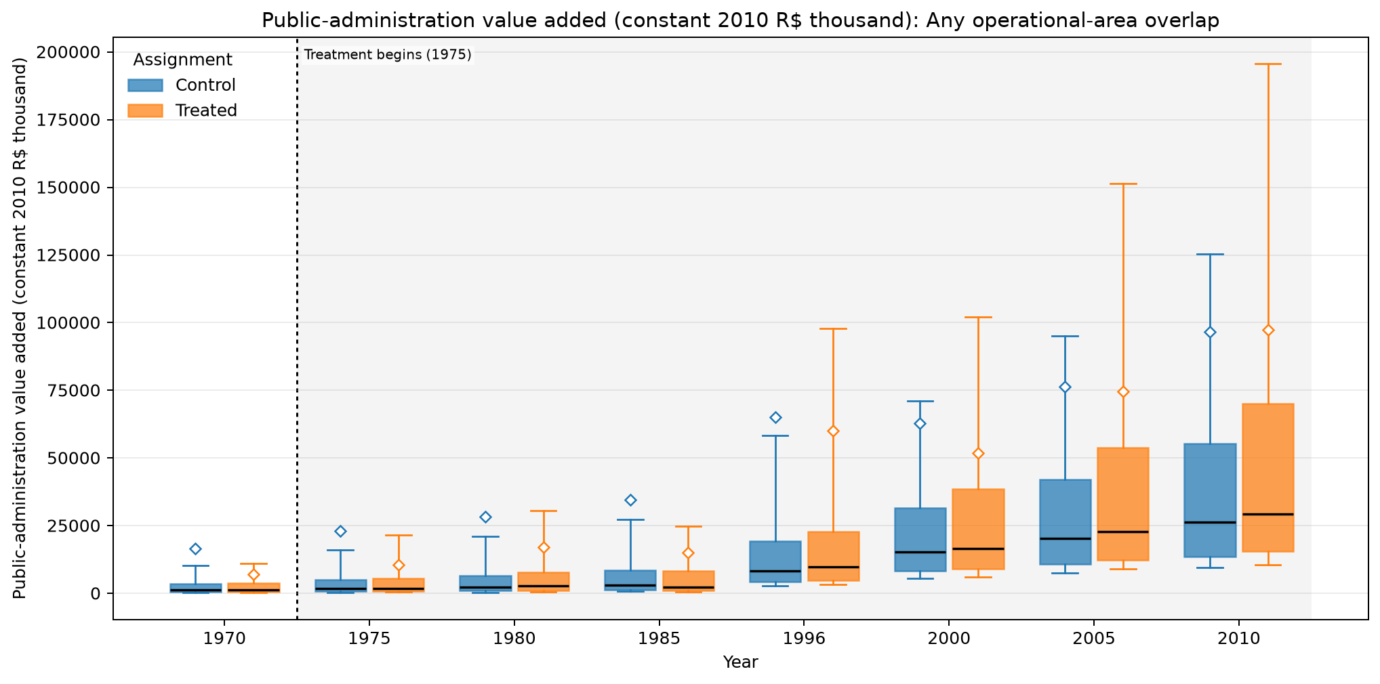
ANY OPERATIONAL-AREA OVERLAP · MUNICIPALITY · MUNICIPAL GDP LEVELS · PUBLIC-ADMINISTRATION VALUE ADDED (CONSTANT 2010 R$ THOUSAND)
Treated means are lower in 7 of 8 observed years
UNADJUSTED MEANS (SD)
Year | Control | Treated
1970 | 16.7k (265k) | 7.04k (23.8k)
1975 | 23.2k (340k) | 10.6k (37.8k)
1980 | 28.3k (379k) | 17.0k (73.8k)
1985 | 34.6k (436k) | 15.0k (44.6k)
1996 | 65.0k (722k) | 60.1k (276k)
2000 | 62.8k (829k) | 51.7k (138k)
2005 | 76.3k (757k) | 74.5k (202k)
2010 | 96.6k (929k) | 97.4k (273k)
Box: Q1–Q3 · whiskers: P10–P90 · diamond: mean. Full median/IQR/N and mean-difference table is saved as LaTeX.
Any operational-area overlap · Municipal GDP levels
49
Notes:
The title summarizes unadjusted group means and should not be interpreted causally.
[Sources]
- C:\Users\josez\OneDrive\Desktop\EPGE\climate_migration\figs\treatment_control_comparisons\polocentro_operational_any_overlap\municipality\plots\va_public_administration_2010_brl_thousand.png
- C:\Users\josez\OneDrive\Desktop\EPGE\climate_migration\figs\treatment_control_comparisons\polocentro_operational_any_overlap\municipality\tables\va_public_administration_2010_brl_thousand.csv
- C:\Users\josez\OneDrive\Desktop\EPGE\climate_migration\figs\treatment_control_comparisons\polocentro_operational_any_overlap\municipality\tables\va_public_administration_2010_brl_thousand.tex

Slide 50
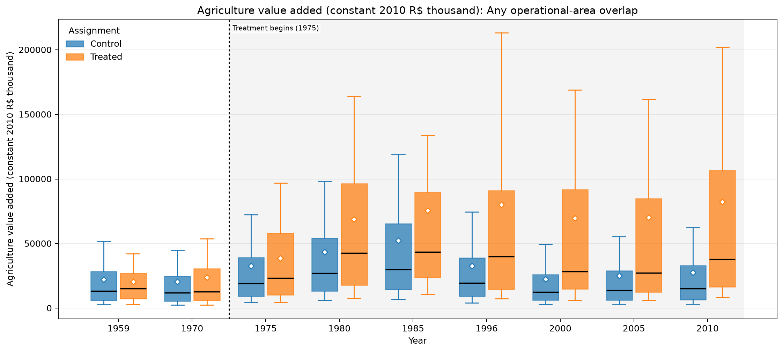
ANY OPERATIONAL-AREA OVERLAP · MUNICIPALITY · MUNICIPAL GDP LEVELS · AGRICULTURE VALUE ADDED (CONSTANT 2010 R$ THOUSAND)
Treated means are higher in 8 of 9 observed years
UNADJUSTED MEANS (SD)
Year | Control | Treated
1959 | 22.2k (28.2k) | 20.6k (22.0k)
1970 | 20.5k (32.1k) | 23.8k (30.5k)
1975 | 32.6k (51.4k) | 38.5k (40.8k)
1980 | 43.5k (52.4k) | 68.8k (69.0k)
1985 | 52.4k (67.5k) | 75.7k (103k)
1996 | 32.7k (44.5k) | 80.1k (104k)
2000 | 22.4k (33.2k) | 69.6k (94.1k)
2005 | 25.1k (42.9k) | 70.2k (106k)
2010 | 27.5k (39.3k) | 82.4k (110k)
Box: Q1–Q3 · whiskers: P10–P90 · diamond: mean. Full median/IQR/N and mean-difference table is saved as LaTeX.
Any operational-area overlap · Municipal GDP levels
50
Notes:
The title summarizes unadjusted group means and should not be interpreted causally.
[Sources]
- C:\Users\josez\OneDrive\Desktop\EPGE\climate_migration\figs\treatment_control_comparisons\polocentro_operational_any_overlap\municipality\plots\va_agriculture_2010_brl_thousand.png
- C:\Users\josez\OneDrive\Desktop\EPGE\climate_migration\figs\treatment_control_comparisons\polocentro_operational_any_overlap\municipality\tables\va_agriculture_2010_brl_thousand.csv
- C:\Users\josez\OneDrive\Desktop\EPGE\climate_migration\figs\treatment_control_comparisons\polocentro_operational_any_overlap\municipality\tables\va_agriculture_2010_brl_thousand.tex

Slide 51
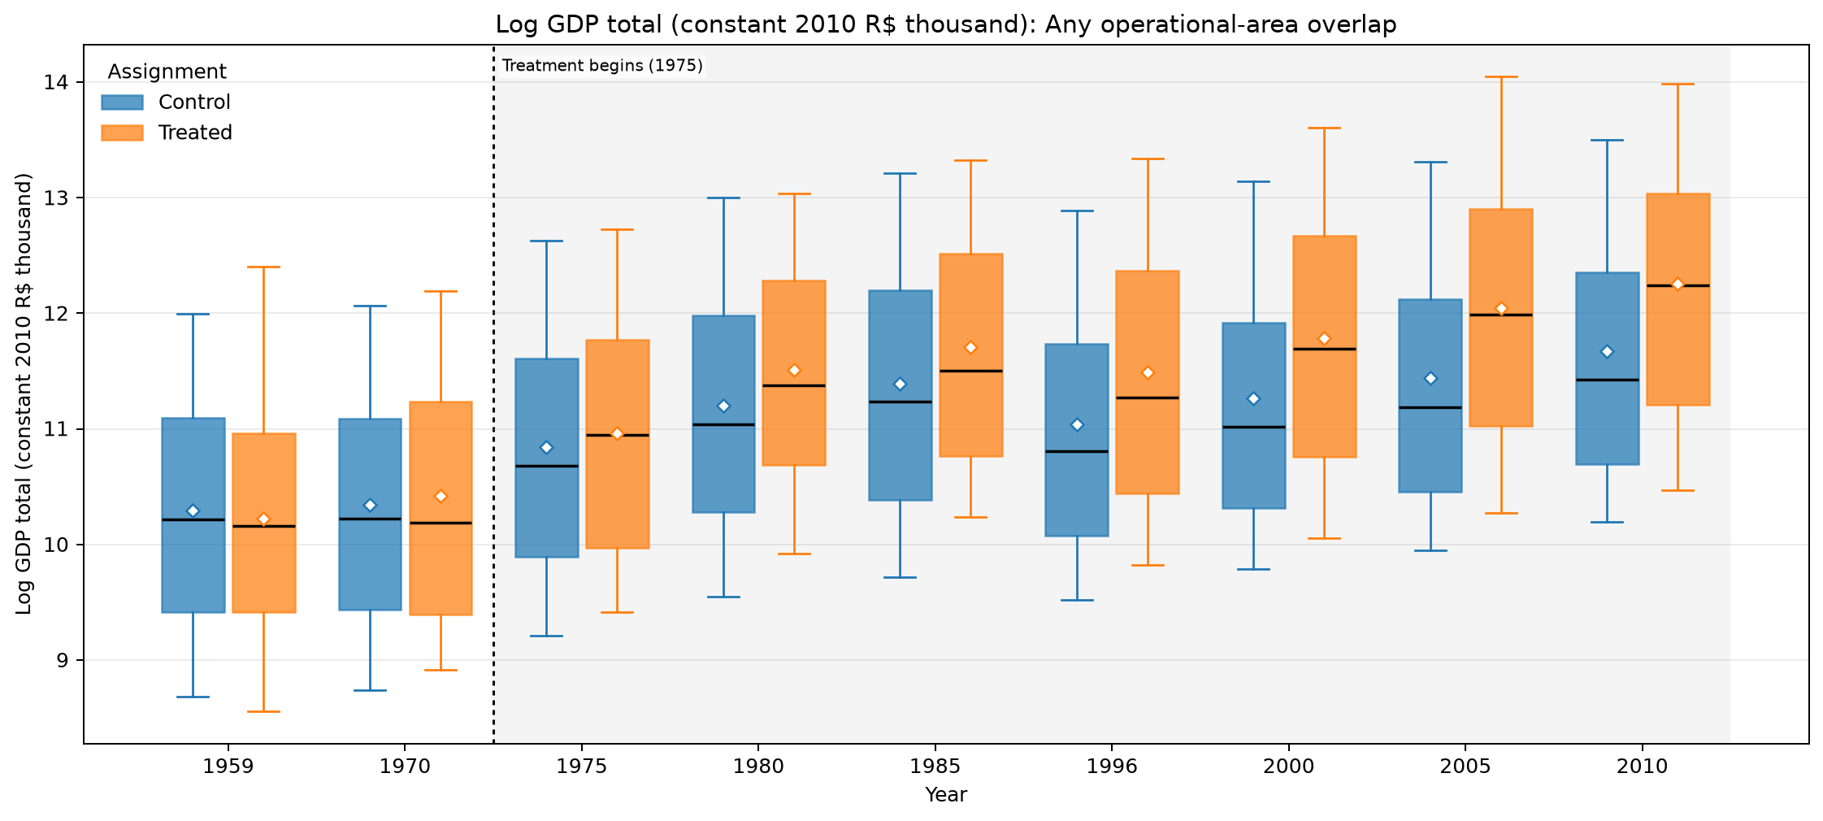
ANY OPERATIONAL-AREA OVERLAP · MUNICIPALITY · MUNICIPAL GDP LOGS · LOG GDP TOTAL (CONSTANT 2010 R$ THOUSAND)
Treated means are higher in 8 of 9 observed years
UNADJUSTED MEANS (SD)
Year | Control | Treated
1959 | 10.3 (1.34) | 10.2 (1.38)
1970 | 10.3 (1.38) | 10.4 (1.36)
1975 | 10.8 (1.4) | 11 (1.4)
1980 | 11.2 (1.43) | 11.5 (1.3)
1985 | 11.4 (1.44) | 11.7 (1.31)
1996 | 11 (1.41) | 11.5 (1.44)
2000 | 11.3 (1.39) | 11.8 (1.43)
2005 | 11.4 (1.39) | 12 (1.44)
2010 | 11.7 (1.38) | 12.3 (1.42)
Box: Q1–Q3 · whiskers: P10–P90 · diamond: mean. Full median/IQR/N and mean-difference table is saved as LaTeX.
Any operational-area overlap · Municipal GDP logs
51
Notes:
The title summarizes unadjusted group means and should not be interpreted causally.
[Sources]
- C:\Users\josez\OneDrive\Desktop\EPGE\climate_migration\figs\treatment_control_comparisons\polocentro_operational_any_overlap\municipality\plots\log_gdp_total_2010_brl_thousand.png
- C:\Users\josez\OneDrive\Desktop\EPGE\climate_migration\figs\treatment_control_comparisons\polocentro_operational_any_overlap\municipality\tables\log_gdp_total_2010_brl_thousand.csv
- C:\Users\josez\OneDrive\Desktop\EPGE\climate_migration\figs\treatment_control_comparisons\polocentro_operational_any_overlap\municipality\tables\log_gdp_total_2010_brl_thousand.tex

Slide 52
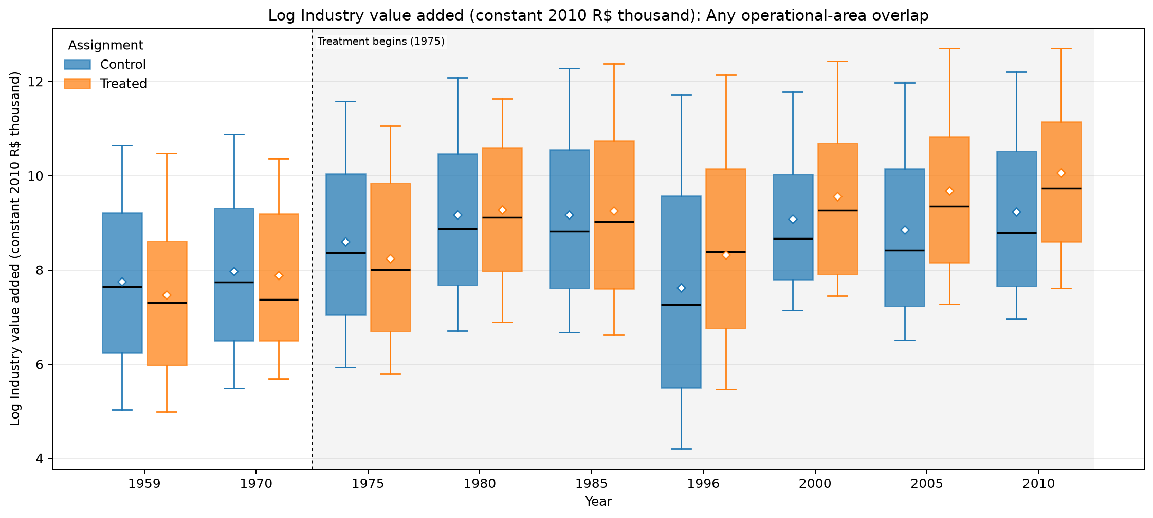
ANY OPERATIONAL-AREA OVERLAP · MUNICIPALITY · MUNICIPAL GDP LOGS · LOG INDUSTRY VALUE ADDED (CONSTANT 2010 R$ THOUSAND)
Treated means are higher in 6 of 9 observed years
UNADJUSTED MEANS (SD)
Year | Control | Treated
1959 | 7.76 (2.2) | 7.48 (2.05)
1970 | 7.98 (2.13) | 7.89 (1.96)
1975 | 8.6 (2.22) | 8.25 (2.22)
1980 | 9.17 (2.13) | 9.28 (1.93)
1985 | 9.17 (2.23) | 9.25 (2.24)
1996 | 7.63 (2.91) | 8.32 (2.97)
2000 | 9.09 (1.83) | 9.57 (1.92)
2005 | 8.85 (2.15) | 9.68 (2.06)
2010 | 9.24 (2.06) | 10.1 (1.97)
Box: Q1–Q3 · whiskers: P10–P90 · diamond: mean. Full median/IQR/N and mean-difference table is saved as LaTeX.
Any operational-area overlap · Municipal GDP logs
52
Notes:
The title summarizes unadjusted group means and should not be interpreted causally.
[Sources]
- C:\Users\josez\OneDrive\Desktop\EPGE\climate_migration\figs\treatment_control_comparisons\polocentro_operational_any_overlap\municipality\plots\log_va_industry_2010_brl_thousand.png
- C:\Users\josez\OneDrive\Desktop\EPGE\climate_migration\figs\treatment_control_comparisons\polocentro_operational_any_overlap\municipality\tables\log_va_industry_2010_brl_thousand.csv
- C:\Users\josez\OneDrive\Desktop\EPGE\climate_migration\figs\treatment_control_comparisons\polocentro_operational_any_overlap\municipality\tables\log_va_industry_2010_brl_thousand.tex

Slide 53
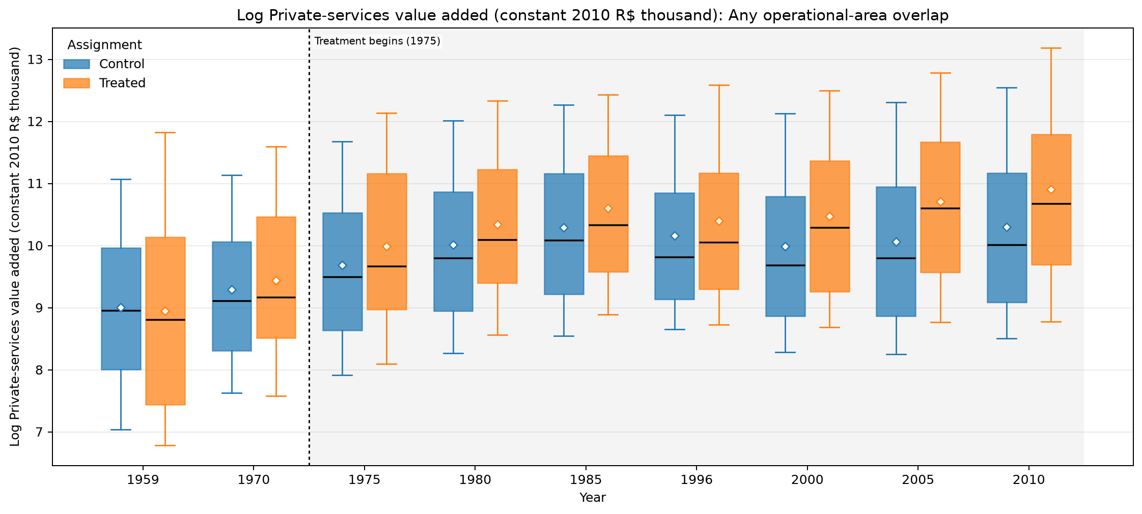
ANY OPERATIONAL-AREA OVERLAP · MUNICIPALITY · MUNICIPAL GDP LOGS · LOG PRIVATE-SERVICES VALUE ADDED (CONSTANT 2010 R$ THOUSAND)
Treated means are higher in 8 of 9 observed years
UNADJUSTED MEANS (SD)
Year | Control | Treated
1959 | 9.01 (1.66) | 8.95 (1.96)
1970 | 9.29 (1.46) | 9.44 (1.55)
1975 | 9.68 (1.54) | 9.99 (1.56)
1980 | 10 (1.54) | 10.3 (1.49)
1985 | 10.3 (1.52) | 10.6 (1.52)
1996 | 10.2 (1.46) | 10.4 (1.54)
2000 | 9.99 (1.59) | 10.5 (1.56)
2005 | 10.1 (1.64) | 10.7 (1.59)
2010 | 10.3 (1.64) | 10.9 (1.63)
Box: Q1–Q3 · whiskers: P10–P90 · diamond: mean. Full median/IQR/N and mean-difference table is saved as LaTeX.
Any operational-area overlap · Municipal GDP logs
53
Notes:
The title summarizes unadjusted group means and should not be interpreted causally.
[Sources]
- C:\Users\josez\OneDrive\Desktop\EPGE\climate_migration\figs\treatment_control_comparisons\polocentro_operational_any_overlap\municipality\plots\log_va_services_private_2010_brl_thousand.png
- C:\Users\josez\OneDrive\Desktop\EPGE\climate_migration\figs\treatment_control_comparisons\polocentro_operational_any_overlap\municipality\tables\log_va_services_private_2010_brl_thousand.csv
- C:\Users\josez\OneDrive\Desktop\EPGE\climate_migration\figs\treatment_control_comparisons\polocentro_operational_any_overlap\municipality\tables\log_va_services_private_2010_brl_thousand.tex

Slide 54

ANY OPERATIONAL-AREA OVERLAP · MUNICIPALITY · MUNICIPAL GDP LOGS · LOG PUBLIC-ADMINISTRATION VALUE ADDED (CONSTANT 2010 R$ THOUSAND)
Treated means are higher in 6 of 8 observed years
UNADJUSTED MEANS (SD)
Year | Control | Treated
1970 | 7.28 (1.62) | 7.26 (1.63)
1975 | 7.69 (1.57) | 7.78 (1.49)
1980 | 7.93 (1.6) | 8.04 (1.62)
1985 | 8.2 (1.7) | 8.02 (1.65)
1996 | 9.27 (1.3) | 9.5 (1.38)
2000 | 9.81 (1.09) | 9.93 (1.15)
2005 | 10.1 (1.09) | 10.3 (1.14)
2010 | 10.3 (1.09) | 10.5 (1.16)
Box: Q1–Q3 · whiskers: P10–P90 · diamond: mean. Full median/IQR/N and mean-difference table is saved as LaTeX.
Any operational-area overlap · Municipal GDP logs
54
Notes:
The title summarizes unadjusted group means and should not be interpreted causally.
[Sources]
- C:\Users\josez\OneDrive\Desktop\EPGE\climate_migration\figs\treatment_control_comparisons\polocentro_operational_any_overlap\municipality\plots\log_va_public_administration_2010_brl_thousand.png
- C:\Users\josez\OneDrive\Desktop\EPGE\climate_migration\figs\treatment_control_comparisons\polocentro_operational_any_overlap\municipality\tables\log_va_public_administration_2010_brl_thousand.csv
- C:\Users\josez\OneDrive\Desktop\EPGE\climate_migration\figs\treatment_control_comparisons\polocentro_operational_any_overlap\municipality\tables\log_va_public_administration_2010_brl_thousand.tex

Slide 55

ANY OPERATIONAL-AREA OVERLAP · MUNICIPALITY · MUNICIPAL GDP LOGS · LOG AGRICULTURE VALUE ADDED (CONSTANT 2010 R$ THOUSAND)
Treated means are higher in all 9 observed years
UNADJUSTED MEANS (SD)
Year | Control | Treated
1959 | 9.41 (1.2) | 9.45 (1.08)
1970 | 9.33 (1.15) | 9.43 (1.27)
1975 | 9.85 (1.07) | 10.1 (1.11)
1980 | 10.2 (1.11) | 10.6 (1.15)
1985 | 10.3 (1.14) | 10.7 (1.06)
1996 | 9.82 (1.18) | 10.6 (1.27)
2000 | 9.41 (1.13) | 10.4 (1.3)
2005 | 9.47 (1.19) | 10.4 (1.3)
2010 | 9.55 (1.23) | 10.6 (1.27)
Box: Q1–Q3 · whiskers: P10–P90 · diamond: mean. Full median/IQR/N and mean-difference table is saved as LaTeX.
Any operational-area overlap · Municipal GDP logs
55
Notes:
The title summarizes unadjusted group means and should not be interpreted causally.
[Sources]
- C:\Users\josez\OneDrive\Desktop\EPGE\climate_migration\figs\treatment_control_comparisons\polocentro_operational_any_overlap\municipality\plots\log_va_agriculture_2010_brl_thousand.png
- C:\Users\josez\OneDrive\Desktop\EPGE\climate_migration\figs\treatment_control_comparisons\polocentro_operational_any_overlap\municipality\tables\log_va_agriculture_2010_brl_thousand.csv
- C:\Users\josez\OneDrive\Desktop\EPGE\climate_migration\figs\treatment_control_comparisons\polocentro_operational_any_overlap\municipality\tables\log_va_agriculture_2010_brl_thousand.tex

Slide 56

ANY OPERATIONAL-AREA OVERLAP · MUNICIPALITY · MUNICIPAL GDP GROWTH · ANNUALIZED GDP TOTAL LOG GROWTH (%)
Treated means are higher in 6 of 8 observed years
UNADJUSTED MEANS (SD)
Year | Control | Treated
1970 | 3.53 (6.49) | 4.83 (5.71)
1975 | 10.1 (8.77) | 10.8 (11.8)
1980 | 7.03 (8.81) | 11 (8.24)
1985 | 3.75 (10.3) | 4.15 (12.3)
1996 | -1.93 (5.22) | -0.571 (5.53)
2000 | 8.6 (10.3) | 7.94 (10.9)
2005 | 3.66 (4.63) | 5.23 (5.06)
2010 | 4.64 (4.38) | 4.25 (4.72)
Box: Q1–Q3 · whiskers: P10–P90 · diamond: mean. Full median/IQR/N and mean-difference table is saved as LaTeX.
Any operational-area overlap · Municipal GDP growth
56
Notes:
The title summarizes unadjusted group means and should not be interpreted causally.
[Sources]
- C:\Users\josez\OneDrive\Desktop\EPGE\climate_migration\figs\treatment_control_comparisons\polocentro_operational_any_overlap\municipality\plots\gdp_total_annualized_log_growth_pct.png
- C:\Users\josez\OneDrive\Desktop\EPGE\climate_migration\figs\treatment_control_comparisons\polocentro_operational_any_overlap\municipality\tables\gdp_total_annualized_log_growth_pct.csv
- C:\Users\josez\OneDrive\Desktop\EPGE\climate_migration\figs\treatment_control_comparisons\polocentro_operational_any_overlap\municipality\tables\gdp_total_annualized_log_growth_pct.tex

Slide 57

ANY OPERATIONAL-AREA OVERLAP · MUNICIPALITY · MUNICIPAL GDP GROWTH · ANNUALIZED INDUSTRY VALUE ADDED LOG GROWTH (%)
Treated means are higher in 4 of 8 observed years
UNADJUSTED MEANS (SD)
Year | Control | Treated
1970 | 7.87 (10.9) | 9.39 (11.3)
1975 | 12.7 (15.6) | 7.23 (20.5)
1980 | 11.3 (15.8) | 20.5 (19.5)
1985 | 0.349 (15.2) | -0.0544 (21.4)
1996 | -11.7 (13.7) | -6.47 (14.9)
2000 | 40.6 (38.5) | 32.5 (43.7)
2005 | -4.47 (15.1) | 2.25 (14.2)
2010 | 7.73 (12.2) | 7.57 (11.3)
Box: Q1–Q3 · whiskers: P10–P90 · diamond: mean. Full median/IQR/N and mean-difference table is saved as LaTeX.
Any operational-area overlap · Municipal GDP growth
57
Notes:
The title summarizes unadjusted group means and should not be interpreted causally.
[Sources]
- C:\Users\josez\OneDrive\Desktop\EPGE\climate_migration\figs\treatment_control_comparisons\polocentro_operational_any_overlap\municipality\plots\va_industry_annualized_log_growth_pct.png
- C:\Users\josez\OneDrive\Desktop\EPGE\climate_migration\figs\treatment_control_comparisons\polocentro_operational_any_overlap\municipality\tables\va_industry_annualized_log_growth_pct.csv
- C:\Users\josez\OneDrive\Desktop\EPGE\climate_migration\figs\treatment_control_comparisons\polocentro_operational_any_overlap\municipality\tables\va_industry_annualized_log_growth_pct.tex

Slide 58

ANY OPERATIONAL-AREA OVERLAP · MUNICIPALITY · MUNICIPAL GDP GROWTH · ANNUALIZED PRIVATE-SERVICES VALUE ADDED LOG GROWTH (%)
Treated means are higher in 5 of 8 observed years
UNADJUSTED MEANS (SD)
Year | Control | Treated
1970 | 6.61 (8.27) | 8.89 (8.48)
1975 | 7.79 (8.18) | 11 (9.46)
1980 | 6.46 (7.95) | 7.01 (8.31)
1985 | 5.76 (10.9) | 5.74 (12.1)
1996 | 0.358 (5.61) | -0.266 (4.85)
2000 | -0.443 (11.3) | 2.65 (9.59)
2005 | 1.76 (6.69) | 4.78 (4.9)
2010 | 4.69 (4.75) | 3.9 (4.02)
Box: Q1–Q3 · whiskers: P10–P90 · diamond: mean. Full median/IQR/N and mean-difference table is saved as LaTeX.
Any operational-area overlap · Municipal GDP growth
58
Notes:
The title summarizes unadjusted group means and should not be interpreted causally.
[Sources]
- C:\Users\josez\OneDrive\Desktop\EPGE\climate_migration\figs\treatment_control_comparisons\polocentro_operational_any_overlap\municipality\plots\va_services_private_annualized_log_growth_pct.png
- C:\Users\josez\OneDrive\Desktop\EPGE\climate_migration\figs\treatment_control_comparisons\polocentro_operational_any_overlap\municipality\tables\va_services_private_annualized_log_growth_pct.csv
- C:\Users\josez\OneDrive\Desktop\EPGE\climate_migration\figs\treatment_control_comparisons\polocentro_operational_any_overlap\municipality\tables\va_services_private_annualized_log_growth_pct.tex

Slide 59

ANY OPERATIONAL-AREA OVERLAP · MUNICIPALITY · MUNICIPAL GDP GROWTH · ANNUALIZED PUBLIC-ADMINISTRATION VALUE ADDED LOG GROWTH (%)
Treated means are higher in 4 of 7 observed years
UNADJUSTED MEANS (SD)
Year | Control | Treated
1975 | 8.73 (10.3) | 10.8 (12.8)
1980 | 4.71 (9.33) | 5.12 (10.4)
1985 | 6.84 (13.9) | 0.165 (14.2)
1996 | 11 (8.95) | 14.8 (8.38)
2000 | 15.6 (13.9) | 11.6 (11.2)
2005 | 5.96 (3.06) | 7.31 (2.2)
2010 | 5.11 (2.5) | 4.78 (2.31)
Box: Q1–Q3 · whiskers: P10–P90 · diamond: mean. Full median/IQR/N and mean-difference table is saved as LaTeX.
Any operational-area overlap · Municipal GDP growth
59
Notes:
The title summarizes unadjusted group means and should not be interpreted causally.
[Sources]
- C:\Users\josez\OneDrive\Desktop\EPGE\climate_migration\figs\treatment_control_comparisons\polocentro_operational_any_overlap\municipality\plots\va_public_administration_annualized_log_growth_pct.png
- C:\Users\josez\OneDrive\Desktop\EPGE\climate_migration\figs\treatment_control_comparisons\polocentro_operational_any_overlap\municipality\tables\va_public_administration_annualized_log_growth_pct.csv
- C:\Users\josez\OneDrive\Desktop\EPGE\climate_migration\figs\treatment_control_comparisons\polocentro_operational_any_overlap\municipality\tables\va_public_administration_annualized_log_growth_pct.tex

Slide 60

ANY OPERATIONAL-AREA OVERLAP · MUNICIPALITY · MUNICIPAL GDP GROWTH · ANNUALIZED AGRICULTURE VALUE ADDED LOG GROWTH (%)
Treated means are higher in 6 of 8 observed years
UNADJUSTED MEANS (SD)
Year | Control | Treated
1970 | 1.25 (8.35) | 2.55 (6.19)
1975 | 10.4 (13.5) | 11.9 (13.3)
1980 | 5.85 (11.4) | 11.3 (11.2)
1985 | 2.75 (11.8) | 1.96 (16.2)
1996 | -3.79 (6.7) | 0.19 (6.5)
2000 | -8.43 (17.5) | -4.6 (15.2)
2005 | 1.18 (12.4) | -0.52 (8.69)
2010 | 1.69 (7.76) | 4.31 (8.03)
Box: Q1–Q3 · whiskers: P10–P90 · diamond: mean. Full median/IQR/N and mean-difference table is saved as LaTeX.
Any operational-area overlap · Municipal GDP growth
60
Notes:
The title summarizes unadjusted group means and should not be interpreted causally.
[Sources]
- C:\Users\josez\OneDrive\Desktop\EPGE\climate_migration\figs\treatment_control_comparisons\polocentro_operational_any_overlap\municipality\plots\va_agriculture_annualized_log_growth_pct.png
- C:\Users\josez\OneDrive\Desktop\EPGE\climate_migration\figs\treatment_control_comparisons\polocentro_operational_any_overlap\municipality\tables\va_agriculture_annualized_log_growth_pct.csv
- C:\Users\josez\OneDrive\Desktop\EPGE\climate_migration\figs\treatment_control_comparisons\polocentro_operational_any_overlap\municipality\tables\va_agriculture_annualized_log_growth_pct.tex

Slide 61

ANY OPERATIONAL-AREA OVERLAP · MUNICIPALITY · MUNICIPAL GDP COMPOSITION · VALUE ADDED INDUSTRY SHARE OF GDP
Treated means are lower in 5 of 9 observed years
UNADJUSTED MEANS (SD)
Year | Control | Treated
1959 | 0.149 (0.174) | 0.095 (0.124)
1970 | 0.159 (0.166) | 0.134 (0.159)
1975 | 0.181 (0.182) | 0.148 (0.239)
1980 | 0.202 (0.185) | 0.169 (0.172)
1985 | 0.189 (0.22) | 0.169 (0.201)
1996 | 0.118 (0.183) | 0.125 (0.171)
2000 | 0.145 (0.122) | 0.151 (0.14)
2005 | 0.138 (0.335) | 0.147 (0.174)
2010 | 0.148 (0.246) | 0.165 (0.176)
Box: Q1–Q3 · whiskers: P10–P90 · diamond: mean. Full median/IQR/N and mean-difference table is saved as LaTeX.
Any operational-area overlap · Municipal GDP composition
61
Notes:
The title summarizes unadjusted group means and should not be interpreted causally.
[Sources]
- C:\Users\josez\OneDrive\Desktop\EPGE\climate_migration\figs\treatment_control_comparisons\polocentro_operational_any_overlap\municipality\plots\va_industry_share_of_gdp.png
- C:\Users\josez\OneDrive\Desktop\EPGE\climate_migration\figs\treatment_control_comparisons\polocentro_operational_any_overlap\municipality\tables\va_industry_share_of_gdp.csv
- C:\Users\josez\OneDrive\Desktop\EPGE\climate_migration\figs\treatment_control_comparisons\polocentro_operational_any_overlap\municipality\tables\va_industry_share_of_gdp.tex

Slide 62

ANY OPERATIONAL-AREA OVERLAP · MUNICIPALITY · MUNICIPAL GDP COMPOSITION · VALUE ADDED SERVICES PRIVATE SHARE OF GDP
Treated means are higher in 7 of 9 observed years
UNADJUSTED MEANS (SD)
Year | Control | Treated
1959 | 0.325 (0.193) | 0.349 (0.238)
1970 | 0.381 (0.161) | 0.404 (0.158)
1975 | 0.339 (0.139) | 0.431 (0.332)
1980 | 0.33 (0.148) | 0.343 (0.156)
1985 | 0.354 (0.166) | 0.372 (0.178)
1996 | 0.456 (0.198) | 0.384 (0.186)
2000 | 0.298 (0.11) | 0.287 (0.099)
2005 | 0.278 (0.141) | 0.285 (0.112)
2010 | 0.279 (0.13) | 0.283 (0.12)
Box: Q1–Q3 · whiskers: P10–P90 · diamond: mean. Full median/IQR/N and mean-difference table is saved as LaTeX.
Any operational-area overlap · Municipal GDP composition
62
Notes:
The title summarizes unadjusted group means and should not be interpreted causally.
[Sources]
- C:\Users\josez\OneDrive\Desktop\EPGE\climate_migration\figs\treatment_control_comparisons\polocentro_operational_any_overlap\municipality\plots\va_services_private_share_of_gdp.png
- C:\Users\josez\OneDrive\Desktop\EPGE\climate_migration\figs\treatment_control_comparisons\polocentro_operational_any_overlap\municipality\tables\va_services_private_share_of_gdp.csv
- C:\Users\josez\OneDrive\Desktop\EPGE\climate_migration\figs\treatment_control_comparisons\polocentro_operational_any_overlap\municipality\tables\va_services_private_share_of_gdp.tex

Slide 63

ANY OPERATIONAL-AREA OVERLAP · MUNICIPALITY · MUNICIPAL GDP COMPOSITION · VALUE ADDED PUBLIC ADMINISTRATION SHARE OF GDP
Treated means are lower in 7 of 8 observed years
UNADJUSTED MEANS (SD)
Year | Control | Treated
1970 | 0.0622 (0.0562) | 0.0527 (0.044)
1975 | 0.0543 (0.045) | 0.0572 (0.0811)
1980 | 0.0493 (0.0415) | 0.0453 (0.0669)
1985 | 0.0614 (0.0565) | 0.0359 (0.0307)
1996 | 0.202 (0.119) | 0.164 (0.103)
2000 | 0.269 (0.137) | 0.178 (0.087)
2005 | 0.307 (0.166) | 0.202 (0.106)
2010 | 0.313 (0.168) | 0.202 (0.101)
Box: Q1–Q3 · whiskers: P10–P90 · diamond: mean. Full median/IQR/N and mean-difference table is saved as LaTeX.
Any operational-area overlap · Municipal GDP composition
63
Notes:
The title summarizes unadjusted group means and should not be interpreted causally.
[Sources]
- C:\Users\josez\OneDrive\Desktop\EPGE\climate_migration\figs\treatment_control_comparisons\polocentro_operational_any_overlap\municipality\plots\va_public_administration_share_of_gdp.png
- C:\Users\josez\OneDrive\Desktop\EPGE\climate_migration\figs\treatment_control_comparisons\polocentro_operational_any_overlap\municipality\tables\va_public_administration_share_of_gdp.csv
- C:\Users\josez\OneDrive\Desktop\EPGE\climate_migration\figs\treatment_control_comparisons\polocentro_operational_any_overlap\municipality\tables\va_public_administration_share_of_gdp.tex

Slide 64

ANY OPERATIONAL-AREA OVERLAP · MUNICIPALITY · MUNICIPAL GDP COMPOSITION · VALUE ADDED AGRICULTURE SHARE OF GDP
Treated means are higher in 8 of 9 observed years
UNADJUSTED MEANS (SD)
Year | Control | Treated
1959 | 0.544 (0.262) | 0.581 (0.29)
1970 | 0.46 (0.227) | 0.462 (0.22)
1975 | 0.48 (0.232) | 0.421 (0.512)
1980 | 0.468 (0.246) | 0.488 (0.236)
1985 | 0.457 (0.244) | 0.459 (0.238)
1996 | 0.426 (0.249) | 0.492 (0.245)
2000 | 0.238 (0.156) | 0.324 (0.184)
2005 | 0.214 (0.168) | 0.248 (0.165)
2010 | 0.196 (0.172) | 0.254 (0.225)
Box: Q1–Q3 · whiskers: P10–P90 · diamond: mean. Full median/IQR/N and mean-difference table is saved as LaTeX.
Any operational-area overlap · Municipal GDP composition
64
Notes:
The title summarizes unadjusted group means and should not be interpreted causally.
[Sources]
- C:\Users\josez\OneDrive\Desktop\EPGE\climate_migration\figs\treatment_control_comparisons\polocentro_operational_any_overlap\municipality\plots\va_agriculture_share_of_gdp.png
- C:\Users\josez\OneDrive\Desktop\EPGE\climate_migration\figs\treatment_control_comparisons\polocentro_operational_any_overlap\municipality\tables\va_agriculture_share_of_gdp.csv
- C:\Users\josez\OneDrive\Desktop\EPGE\climate_migration\figs\treatment_control_comparisons\polocentro_operational_any_overlap\municipality\tables\va_agriculture_share_of_gdp.tex

Slide 65

ANY OPERATIONAL-AREA OVERLAP · MAPBIOMAS AMC · MAPBIOMAS LAND-COVER SHARES · NATIVE VEGETATION SHARE OF MAPPED AREA
Treated means are lower in 7 of 9 observed years
UNADJUSTED MEANS (SD)
Year | Control | Treated
1985 | 0.462 (0.298) | 0.543 (0.231)
1990 | 0.438 (0.298) | 0.46 (0.223)
1995 | 0.422 (0.293) | 0.417 (0.21)
2000 | 0.414 (0.287) | 0.396 (0.198)
2005 | 0.409 (0.282) | 0.375 (0.184)
2010 | 0.406 (0.277) | 0.363 (0.177)
2015 | 0.401 (0.27) | 0.355 (0.169)
2020 | 0.395 (0.265) | 0.348 (0.166)
2025 | 0.378 (0.253) | 0.331 (0.157)
Box: Q1–Q3 · whiskers: P10–P90 · diamond: mean. Full median/IQR/N and mean-difference table is saved as LaTeX.
Any operational-area overlap · MapBiomas land-cover shares
65
Notes:
The title summarizes unadjusted group means and should not be interpreted causally.
[Sources]
- C:\Users\josez\OneDrive\Desktop\EPGE\climate_migration\figs\treatment_control_comparisons\polocentro_operational_any_overlap\environment\plots\native_vegetation_share_of_mapped.png
- C:\Users\josez\OneDrive\Desktop\EPGE\climate_migration\figs\treatment_control_comparisons\polocentro_operational_any_overlap\environment\tables\native_vegetation_share_of_mapped.csv
- C:\Users\josez\OneDrive\Desktop\EPGE\climate_migration\figs\treatment_control_comparisons\polocentro_operational_any_overlap\environment\tables\native_vegetation_share_of_mapped.tex
- C:\Users\josez\OneDrive\Desktop\EPGE\climate_migration\data\processed\polocentro_environment\mapbiomas_collection11_metadata.json
- C:\Users\josez\OneDrive\Desktop\EPGE\climate_migration\reports\polocentro_environment_crop_suitability_report.md

Slide 66

ANY OPERATIONAL-AREA OVERLAP · MAPBIOMAS AMC · MAPBIOMAS LAND-COVER SHARES · ANTHROPIC-USE SHARE OF MAPPED AREA
Treated means are higher in 7 of 9 observed years
UNADJUSTED MEANS (SD)
Year | Control | Treated
1985 | 0.517 (0.3) | 0.434 (0.223)
1990 | 0.542 (0.301) | 0.519 (0.216)
1995 | 0.558 (0.295) | 0.558 (0.203)
2000 | 0.567 (0.29) | 0.582 (0.192)
2005 | 0.571 (0.285) | 0.601 (0.179)
2010 | 0.575 (0.28) | 0.613 (0.173)
2015 | 0.581 (0.272) | 0.625 (0.165)
2020 | 0.587 (0.268) | 0.631 (0.161)
2025 | 0.602 (0.257) | 0.645 (0.154)
Box: Q1–Q3 · whiskers: P10–P90 · diamond: mean. Full median/IQR/N and mean-difference table is saved as LaTeX.
Any operational-area overlap · MapBiomas land-cover shares
66
Notes:
The title summarizes unadjusted group means and should not be interpreted causally.
[Sources]
- C:\Users\josez\OneDrive\Desktop\EPGE\climate_migration\figs\treatment_control_comparisons\polocentro_operational_any_overlap\environment\plots\anthropic_use_share_of_mapped.png
- C:\Users\josez\OneDrive\Desktop\EPGE\climate_migration\figs\treatment_control_comparisons\polocentro_operational_any_overlap\environment\tables\anthropic_use_share_of_mapped.csv
- C:\Users\josez\OneDrive\Desktop\EPGE\climate_migration\figs\treatment_control_comparisons\polocentro_operational_any_overlap\environment\tables\anthropic_use_share_of_mapped.tex
- C:\Users\josez\OneDrive\Desktop\EPGE\climate_migration\data\processed\polocentro_environment\mapbiomas_collection11_metadata.json
- C:\Users\josez\OneDrive\Desktop\EPGE\climate_migration\reports\polocentro_environment_crop_suitability_report.md

Slide 67

ANY OPERATIONAL-AREA OVERLAP · MAPBIOMAS AMC · MAPBIOMAS LAND-COVER SHARES · FARMING SHARE OF MAPPED AREA
Treated means are higher in 7 of 9 observed years
UNADJUSTED MEANS (SD)
Year | Control | Treated
1985 | 0.506 (0.3) | 0.431 (0.222)
1990 | 0.528 (0.301) | 0.515 (0.214)
1995 | 0.542 (0.296) | 0.554 (0.201)
2000 | 0.549 (0.291) | 0.577 (0.191)
2005 | 0.551 (0.286) | 0.595 (0.178)
2010 | 0.553 (0.281) | 0.607 (0.172)
2015 | 0.558 (0.275) | 0.618 (0.163)
2020 | 0.562 (0.271) | 0.624 (0.16)
2025 | 0.575 (0.261) | 0.637 (0.153)
Box: Q1–Q3 · whiskers: P10–P90 · diamond: mean. Full median/IQR/N and mean-difference table is saved as LaTeX.
Any operational-area overlap · MapBiomas land-cover shares
67
Notes:
The title summarizes unadjusted group means and should not be interpreted causally.
[Sources]
- C:\Users\josez\OneDrive\Desktop\EPGE\climate_migration\figs\treatment_control_comparisons\polocentro_operational_any_overlap\environment\plots\farming_share_of_mapped.png
- C:\Users\josez\OneDrive\Desktop\EPGE\climate_migration\figs\treatment_control_comparisons\polocentro_operational_any_overlap\environment\tables\farming_share_of_mapped.csv
- C:\Users\josez\OneDrive\Desktop\EPGE\climate_migration\figs\treatment_control_comparisons\polocentro_operational_any_overlap\environment\tables\farming_share_of_mapped.tex
- C:\Users\josez\OneDrive\Desktop\EPGE\climate_migration\data\processed\polocentro_environment\mapbiomas_collection11_metadata.json
- C:\Users\josez\OneDrive\Desktop\EPGE\climate_migration\reports\polocentro_environment_crop_suitability_report.md

Slide 68

ANY OPERATIONAL-AREA OVERLAP · MAPBIOMAS AMC · MAPBIOMAS LAND-COVER SHARES · PASTURE SHARE OF MAPPED AREA
Treated means are higher in all 9 observed years
UNADJUSTED MEANS (SD)
Year | Control | Treated
1985 | 0.349 (0.275) | 0.358 (0.182)
1990 | 0.381 (0.28) | 0.422 (0.183)
1995 | 0.382 (0.277) | 0.441 (0.177)
2000 | 0.382 (0.275) | 0.445 (0.168)
2005 | 0.369 (0.265) | 0.433 (0.167)
2010 | 0.345 (0.255) | 0.423 (0.162)
2015 | 0.333 (0.248) | 0.406 (0.157)
2020 | 0.326 (0.245) | 0.381 (0.151)
2025 | 0.325 (0.242) | 0.358 (0.152)
Box: Q1–Q3 · whiskers: P10–P90 · diamond: mean. Full median/IQR/N and mean-difference table is saved as LaTeX.
Any operational-area overlap · MapBiomas land-cover shares
68
Notes:
The title summarizes unadjusted group means and should not be interpreted causally.
[Sources]
- C:\Users\josez\OneDrive\Desktop\EPGE\climate_migration\figs\treatment_control_comparisons\polocentro_operational_any_overlap\environment\plots\pasture_share_of_mapped.png
- C:\Users\josez\OneDrive\Desktop\EPGE\climate_migration\figs\treatment_control_comparisons\polocentro_operational_any_overlap\environment\tables\pasture_share_of_mapped.csv
- C:\Users\josez\OneDrive\Desktop\EPGE\climate_migration\figs\treatment_control_comparisons\polocentro_operational_any_overlap\environment\tables\pasture_share_of_mapped.tex
- C:\Users\josez\OneDrive\Desktop\EPGE\climate_migration\data\processed\polocentro_environment\mapbiomas_collection11_metadata.json
- C:\Users\josez\OneDrive\Desktop\EPGE\climate_migration\reports\polocentro_environment_crop_suitability_report.md

Slide 69

ANY OPERATIONAL-AREA OVERLAP · MAPBIOMAS AMC · MAPBIOMAS LAND-COVER SHARES · AGRICULTURE SHARE OF MAPPED AREA
Treated means are lower in 5 of 9 observed years
UNADJUSTED MEANS (SD)
Year | Control | Treated
1985 | 0.0655 (0.145) | 0.0348 (0.0661)
1990 | 0.0855 (0.166) | 0.0567 (0.101)
1995 | 0.0982 (0.18) | 0.0746 (0.122)
2000 | 0.105 (0.186) | 0.0877 (0.13)
2005 | 0.111 (0.189) | 0.114 (0.153)
2010 | 0.129 (0.202) | 0.126 (0.159)
2015 | 0.141 (0.209) | 0.143 (0.163)
2020 | 0.146 (0.211) | 0.161 (0.169)
2025 | 0.15 (0.213) | 0.169 (0.172)
Box: Q1–Q3 · whiskers: P10–P90 · diamond: mean. Full median/IQR/N and mean-difference table is saved as LaTeX.
Any operational-area overlap · MapBiomas land-cover shares
69
Notes:
The title summarizes unadjusted group means and should not be interpreted causally.
[Sources]
- C:\Users\josez\OneDrive\Desktop\EPGE\climate_migration\figs\treatment_control_comparisons\polocentro_operational_any_overlap\environment\plots\agriculture_share_of_mapped.png
- C:\Users\josez\OneDrive\Desktop\EPGE\climate_migration\figs\treatment_control_comparisons\polocentro_operational_any_overlap\environment\tables\agriculture_share_of_mapped.csv
- C:\Users\josez\OneDrive\Desktop\EPGE\climate_migration\figs\treatment_control_comparisons\polocentro_operational_any_overlap\environment\tables\agriculture_share_of_mapped.tex
- C:\Users\josez\OneDrive\Desktop\EPGE\climate_migration\data\processed\polocentro_environment\mapbiomas_collection11_metadata.json
- C:\Users\josez\OneDrive\Desktop\EPGE\climate_migration\reports\polocentro_environment_crop_suitability_report.md

Slide 70

ANY OPERATIONAL-AREA OVERLAP · MAPBIOMAS AMC · MAPBIOMAS LAND-COVER SHARES · SOYBEAN SHARE OF MAPPED AREA
Treated means are higher in 5 of 9 observed years
UNADJUSTED MEANS (SD)
Year | Control | Treated
1985 | 0.0108 (0.0442) | 0.00369 (0.0122)
1990 | 0.023 (0.0784) | 0.0179 (0.0541)
1995 | 0.025 (0.0862) | 0.019 (0.0487)
2000 | 0.0298 (0.0998) | 0.0278 (0.0617)
2005 | 0.0373 (0.114) | 0.0483 (0.0796)
2010 | 0.0377 (0.115) | 0.0556 (0.0795)
2015 | 0.0419 (0.116) | 0.0728 (0.0921)
2020 | 0.0533 (0.136) | 0.0915 (0.102)
2025 | 0.0589 (0.145) | 0.11 (0.125)
Box: Q1–Q3 · whiskers: P10–P90 · diamond: mean. Full median/IQR/N and mean-difference table is saved as LaTeX.
Any operational-area overlap · MapBiomas land-cover shares
70
Notes:
The title summarizes unadjusted group means and should not be interpreted causally.
[Sources]
- C:\Users\josez\OneDrive\Desktop\EPGE\climate_migration\figs\treatment_control_comparisons\polocentro_operational_any_overlap\environment\plots\soybean_share_of_mapped.png
- C:\Users\josez\OneDrive\Desktop\EPGE\climate_migration\figs\treatment_control_comparisons\polocentro_operational_any_overlap\environment\tables\soybean_share_of_mapped.csv
- C:\Users\josez\OneDrive\Desktop\EPGE\climate_migration\figs\treatment_control_comparisons\polocentro_operational_any_overlap\environment\tables\soybean_share_of_mapped.tex
- C:\Users\josez\OneDrive\Desktop\EPGE\climate_migration\data\processed\polocentro_environment\mapbiomas_collection11_metadata.json
- C:\Users\josez\OneDrive\Desktop\EPGE\climate_migration\reports\polocentro_environment_crop_suitability_report.md

Slide 71

ANY OPERATIONAL-AREA OVERLAP · MAPBIOMAS AMC · MAPBIOMAS LAND-COVER SHARES · URBAN-AREA SHARE OF MAPPED AREA
Treated means are lower in all 9 observed years
UNADJUSTED MEANS (SD)
Year | Control | Treated
1985 | 0.0113 (0.052) | 0.00292 (0.0063)
1990 | 0.0131 (0.0559) | 0.00353 (0.00767)
1995 | 0.0153 (0.0607) | 0.00417 (0.00879)
2000 | 0.0174 (0.0653) | 0.00468 (0.01)
2005 | 0.0192 (0.0689) | 0.00509 (0.0109)
2010 | 0.0207 (0.0713) | 0.00554 (0.0119)
2015 | 0.0225 (0.0741) | 0.00603 (0.0127)
2020 | 0.0239 (0.0758) | 0.00646 (0.0135)
2025 | 0.0255 (0.0782) | 0.00688 (0.0143)
Box: Q1–Q3 · whiskers: P10–P90 · diamond: mean. Full median/IQR/N and mean-difference table is saved as LaTeX.
Any operational-area overlap · MapBiomas land-cover shares
71
Notes:
The title summarizes unadjusted group means and should not be interpreted causally.
[Sources]
- C:\Users\josez\OneDrive\Desktop\EPGE\climate_migration\figs\treatment_control_comparisons\polocentro_operational_any_overlap\environment\plots\urban_area_share_of_mapped.png
- C:\Users\josez\OneDrive\Desktop\EPGE\climate_migration\figs\treatment_control_comparisons\polocentro_operational_any_overlap\environment\tables\urban_area_share_of_mapped.csv
- C:\Users\josez\OneDrive\Desktop\EPGE\climate_migration\figs\treatment_control_comparisons\polocentro_operational_any_overlap\environment\tables\urban_area_share_of_mapped.tex
- C:\Users\josez\OneDrive\Desktop\EPGE\climate_migration\data\processed\polocentro_environment\mapbiomas_collection11_metadata.json
- C:\Users\josez\OneDrive\Desktop\EPGE\climate_migration\reports\polocentro_environment_crop_suitability_report.md

Slide 72

ANY OPERATIONAL-AREA OVERLAP · MAPBIOMAS AMC · MAPBIOMAS CUMULATIVE LAND-COVER CHANGE · NATIVE-VEGETATION NET LOSS RELATIVE TO 1985
Treated means are higher in 8 of 9 observed years
UNADJUSTED MEANS (SD)
Year | Control | Treated
1985 | 0 (0) | 0 (0)
1990 | 0.0704 (0.115) | 0.164 (0.0898)
1995 | 0.101 (0.154) | 0.242 (0.111)
2000 | 0.106 (0.175) | 0.276 (0.12)
2005 | 0.0977 (0.213) | 0.306 (0.135)
2010 | 0.0919 (0.238) | 0.323 (0.143)
2015 | 0.082 (0.275) | 0.33 (0.15)
2020 | 0.0832 (0.31) | 0.342 (0.157)
2025 | 0.102 (0.339) | 0.372 (0.157)
Box: Q1–Q3 · whiskers: P10–P90 · diamond: mean. Full median/IQR/N and mean-difference table is saved as LaTeX.
Any operational-area overlap · MapBiomas cumulative land-cover change
72
Notes:
The title summarizes unadjusted group means and should not be interpreted causally.
[Sources]
- C:\Users\josez\OneDrive\Desktop\EPGE\climate_migration\figs\treatment_control_comparisons\polocentro_operational_any_overlap\environment\plots\native_vegetation_net_loss_share_of_1985.png
- C:\Users\josez\OneDrive\Desktop\EPGE\climate_migration\figs\treatment_control_comparisons\polocentro_operational_any_overlap\environment\tables\native_vegetation_net_loss_share_of_1985.csv
- C:\Users\josez\OneDrive\Desktop\EPGE\climate_migration\figs\treatment_control_comparisons\polocentro_operational_any_overlap\environment\tables\native_vegetation_net_loss_share_of_1985.tex
- C:\Users\josez\OneDrive\Desktop\EPGE\climate_migration\data\processed\polocentro_environment\mapbiomas_collection11_metadata.json
- C:\Users\josez\OneDrive\Desktop\EPGE\climate_migration\reports\polocentro_environment_crop_suitability_report.md

Slide 73

ANY OPERATIONAL-AREA OVERLAP · STATIC FAO/GAEZ SELECTION CONTROLS
Treated suitability is higher for 8 of 8 crops
HIGH-INPUT SUITABILITY: MEAN (SD)
Crop | Control | Treated
Soybean | 50.2 (17.6) | 61.2 (10.3)
Maize | 38.4 (17.6) | 41.2 (11.8)
Dryland rice | 51.1 (26.6) | 72.2 (13.3)
Phaseolus bean | 49.5 (17.6) | 62.7 (8.94)
Wheat | 21.3 (19.9) | 35.1 (12.4)
Cotton | 31 (17) | 34.5 (8.56)
Coffee | 34 (24.8) | 50.4 (11.2)
Sugarcane | 37.2 (23) | 41.8 (12)
Static 1961–1990 climate normal · rainfed · all land · commercial/modern-input management · index 0–100.
Any operational-area overlap · FAO/GAEZ controls
73
Notes:
GAEZ suitability is a modeled static endowment, not observed annual production or actual input use.
[Sources]
- C:\Users\josez\OneDrive\Desktop\EPGE\climate_migration\figs\treatment_control_comparisons\polocentro_operational_any_overlap\gaez\high_input_crop_suitability.png
- C:\Users\josez\OneDrive\Desktop\EPGE\climate_migration\figs\treatment_control_comparisons\polocentro_operational_any_overlap\gaez\high_input_crop_suitability.csv
- C:\Users\josez\OneDrive\Desktop\EPGE\climate_migration\figs\treatment_control_comparisons\polocentro_operational_any_overlap\gaez\high_input_crop_suitability.tex
- C:\Users\josez\OneDrive\Desktop\EPGE\climate_migration\data\processed\polocentro_environment\gaez_v4_6190_metadata.json
- C:\Users\josez\OneDrive\Desktop\EPGE\climate_migration\reports\polocentro_environment_crop_suitability_report.md

Slide 74

ANY OPERATIONAL-AREA OVERLAP · PROPENSITY-SCORE WEIGHTING
GAEZ raises max |SMD| after weighting: 0.114 → 0.132
Diagnostic | Without GAEZ | With GAEZ
Treated retained | 101/110 | 104/110
Controls retained | 2,506 | 1,364
Effective N | 381 | 330
Support | 0.01–0.476 | 0.01–0.573
Max |SMD| after | 0.114 | 0.132
Both panels show only the zoomed common-support comparison. The GAEZ model adds eight high-input rainfed crop-suitability measures to the same 1970 census and GDP covariates.
Any operational-area overlap · PSW diagnostic
74
Notes:
[Sources]
- C:\Users\josez\OneDrive\Desktop\EPGE\climate_migration\figs\treatment_control_comparisons\polocentro_operational_any_overlap\propensity\propensity_score_overlap_gaez_comparison.png
- C:\Users\josez\OneDrive\Desktop\EPGE\climate_migration\figs\treatment_control_comparisons\polocentro_operational_any_overlap\propensity\diagnostics_without_gaez.json
- C:\Users\josez\OneDrive\Desktop\EPGE\climate_migration\figs\treatment_control_comparisons\polocentro_operational_any_overlap\propensity\covariate_balance_without_gaez.csv
- C:\Users\josez\OneDrive\Desktop\EPGE\climate_migration\figs\treatment_control_comparisons\polocentro_operational_any_overlap\propensity\amc_1970_psw_weights_without_gaez.parquet
- C:\Users\josez\OneDrive\Desktop\EPGE\climate_migration\figs\treatment_control_comparisons\polocentro_operational_any_overlap\propensity\diagnostics_with_gaez.json
- C:\Users\josez\OneDrive\Desktop\EPGE\climate_migration\figs\treatment_control_comparisons\polocentro_operational_any_overlap\propensity\covariate_balance_with_gaez.csv
- C:\Users\josez\OneDrive\Desktop\EPGE\climate_migration\figs\treatment_control_comparisons\polocentro_operational_any_overlap\propensity\amc_1970_psw_weights_with_gaez.parquet
- C:\Users\josez\OneDrive\Desktop\EPGE\climate_migration\data\processed\polocentro_environment\gaez_v4_6190_metadata.json
- C:\Users\josez\OneDrive\Desktop\EPGE\climate_migration\reports\polocentro_environment_crop_suitability_report.md

Slide 75
TREATMENT DEFINITION 2 OF 4
Majority operational-area overlap
Treated when at least 50% of unit land area overlaps an operational POLOCENTRO area.
38
49
69
treated AMCs
treated municipalities
time-varying outcomes
Majority operational-area overlap
75
Notes:
[Sources]
- C:\Users\josez\OneDrive\Desktop\EPGE\climate_migration\figs\treatment_control_comparisons\polocentro_operational_majority_area\propensity\diagnostics_without_gaez.json
- C:\Users\josez\OneDrive\Desktop\EPGE\climate_migration\figs\treatment_control_comparisons\polocentro_operational_majority_area\propensity\diagnostics_with_gaez.json
- C:\Users\josez\OneDrive\Desktop\EPGE\climate_migration\figs\treatment_control_comparisons\polocentro_operational_majority_area\amc\tables\weighted_interstate_migrants.csv

Slide 76

MAJORITY OPERATIONAL-AREA OVERLAP · AMC · MIGRATION · WEIGHTED INTERSTATE MIGRANTS
Treated means are higher in 3 of 5 observed years
UNADJUSTED MEANS (SD)
Year | Control | Treated
1970 | 620 (7.22k) | 409 (866)
1980 | 1.19k (12.8k) | 1.01k (2.78k)
1991 | 1.32k (9.71k) | 1.54k (4.06k)
2000 | 1.36k (9.20k) | 1.75k (5.10k)
2010 | 1.21k (7.29k) | 1.93k (5.02k)
Box: Q1–Q3 · whiskers: P10–P90 · diamond: mean. Full median/IQR/N and mean-difference table is saved as LaTeX.
Majority operational-area overlap · Migration
76
Notes:
The title summarizes unadjusted group means and should not be interpreted causally.
[Sources]
- C:\Users\josez\OneDrive\Desktop\EPGE\climate_migration\figs\treatment_control_comparisons\polocentro_operational_majority_area\amc\plots\weighted_interstate_migrants.png
- C:\Users\josez\OneDrive\Desktop\EPGE\climate_migration\figs\treatment_control_comparisons\polocentro_operational_majority_area\amc\tables\weighted_interstate_migrants.csv
- C:\Users\josez\OneDrive\Desktop\EPGE\climate_migration\figs\treatment_control_comparisons\polocentro_operational_majority_area\amc\tables\weighted_interstate_migrants.tex

Slide 77

MAJORITY OPERATIONAL-AREA OVERLAP · AMC · MIGRATION · INTERSTATE MIGRANT SHARE OF DESTINATION AGE 5+
Treated means are higher in all 5 observed years
UNADJUSTED MEANS (SD)
Year | Control | Treated
1970 | 0.0182 (0.0353) | 0.023 (0.0346)
1980 | 0.0251 (0.0364) | 0.0335 (0.0328)
1991 | 0.0278 (0.0277) | 0.0488 (0.05)
2000 | 0.0263 (0.0226) | 0.0449 (0.0317)
2010 | 0.0229 (0.0206) | 0.0377 (0.0325)
Box: Q1–Q3 · whiskers: P10–P90 · diamond: mean. Full median/IQR/N and mean-difference table is saved as LaTeX.
Majority operational-area overlap · Migration
77
Notes:
The title summarizes unadjusted group means and should not be interpreted causally.
[Sources]
- C:\Users\josez\OneDrive\Desktop\EPGE\climate_migration\figs\treatment_control_comparisons\polocentro_operational_majority_area\amc\plots\interstate_migrant_share_of_destination_age5plus.png
- C:\Users\josez\OneDrive\Desktop\EPGE\climate_migration\figs\treatment_control_comparisons\polocentro_operational_majority_area\amc\tables\interstate_migrant_share_of_destination_age5plus.csv
- C:\Users\josez\OneDrive\Desktop\EPGE\climate_migration\figs\treatment_control_comparisons\polocentro_operational_majority_area\amc\tables\interstate_migrant_share_of_destination_age5plus.tex

Slide 78

MAJORITY OPERATIONAL-AREA OVERLAP · AMC · EDUCATION · EDUCATION FUNDAMENTAL SHARE AGE 25+
Treated means are higher in all 3 observed years
UNADJUSTED MEANS (SD)
Year | Control | Treated
1991 | 0.0548 (0.032) | 0.0708 (0.0224)
2000 | 0.083 (0.0378) | 0.101 (0.0264)
2010 | 0.12 (0.0346) | 0.138 (0.0207)
Box: Q1–Q3 · whiskers: P10–P90 · diamond: mean. Full median/IQR/N and mean-difference table is saved as LaTeX.
Majority operational-area overlap · Education
78
Notes:
The title summarizes unadjusted group means and should not be interpreted causally.
[Sources]
- C:\Users\josez\OneDrive\Desktop\EPGE\climate_migration\figs\treatment_control_comparisons\polocentro_operational_majority_area\amc\plots\education_fundamental_share_age25plus.png
- C:\Users\josez\OneDrive\Desktop\EPGE\climate_migration\figs\treatment_control_comparisons\polocentro_operational_majority_area\amc\tables\education_fundamental_share_age25plus.csv
- C:\Users\josez\OneDrive\Desktop\EPGE\climate_migration\figs\treatment_control_comparisons\polocentro_operational_majority_area\amc\tables\education_fundamental_share_age25plus.tex

Slide 79

MAJORITY OPERATIONAL-AREA OVERLAP · AMC · EDUCATION · EDUCATION LESS FUNDAMENTAL SHARE AGE 25+
Treated means are lower in all 3 observed years
UNADJUSTED MEANS (SD)
Year | Control | Treated
1991 | 0.852 (0.0776) | 0.821 (0.0561)
2000 | 0.775 (0.0916) | 0.748 (0.063)
2010 | 0.652 (0.113) | 0.618 (0.072)
Box: Q1–Q3 · whiskers: P10–P90 · diamond: mean. Full median/IQR/N and mean-difference table is saved as LaTeX.
Majority operational-area overlap · Education
79
Notes:
The title summarizes unadjusted group means and should not be interpreted causally.
[Sources]
- C:\Users\josez\OneDrive\Desktop\EPGE\climate_migration\figs\treatment_control_comparisons\polocentro_operational_majority_area\amc\plots\education_less_fundamental_share_age25plus.png
- C:\Users\josez\OneDrive\Desktop\EPGE\climate_migration\figs\treatment_control_comparisons\polocentro_operational_majority_area\amc\tables\education_less_fundamental_share_age25plus.csv
- C:\Users\josez\OneDrive\Desktop\EPGE\climate_migration\figs\treatment_control_comparisons\polocentro_operational_majority_area\amc\tables\education_less_fundamental_share_age25plus.tex

Slide 80

MAJORITY OPERATIONAL-AREA OVERLAP · AMC · EDUCATION · EDUCATION SECONDARY SHARE AGE 25+
Treated means are higher in all 3 observed years
UNADJUSTED MEANS (SD)
Year | Control | Treated
1991 | 0.0658 (0.0365) | 0.0821 (0.0303)
2000 | 0.102 (0.0467) | 0.117 (0.0311)
2010 | 0.169 (0.06) | 0.175 (0.0406)
Box: Q1–Q3 · whiskers: P10–P90 · diamond: mean. Full median/IQR/N and mean-difference table is saved as LaTeX.
Majority operational-area overlap · Education
80
Notes:
The title summarizes unadjusted group means and should not be interpreted causally.
[Sources]
- C:\Users\josez\OneDrive\Desktop\EPGE\climate_migration\figs\treatment_control_comparisons\polocentro_operational_majority_area\amc\plots\education_secondary_share_age25plus.png
- C:\Users\josez\OneDrive\Desktop\EPGE\climate_migration\figs\treatment_control_comparisons\polocentro_operational_majority_area\amc\tables\education_secondary_share_age25plus.csv
- C:\Users\josez\OneDrive\Desktop\EPGE\climate_migration\figs\treatment_control_comparisons\polocentro_operational_majority_area\amc\tables\education_secondary_share_age25plus.tex

Slide 81

MAJORITY OPERATIONAL-AREA OVERLAP · AMC · EDUCATION · EDUCATION TERTIARY SHARE AGE 25+
Treated means are lower in 2 of 3 observed years
UNADJUSTED MEANS (SD)
Year | Control | Treated
1991 | 0.0277 (0.0199) | 0.0261 (0.0154)
2000 | 0.0405 (0.0239) | 0.0335 (0.0181)
2010 | 0.0587 (0.0346) | 0.0688 (0.0249)
Box: Q1–Q3 · whiskers: P10–P90 · diamond: mean. Full median/IQR/N and mean-difference table is saved as LaTeX.
Majority operational-area overlap · Education
81
Notes:
The title summarizes unadjusted group means and should not be interpreted causally.
[Sources]
- C:\Users\josez\OneDrive\Desktop\EPGE\climate_migration\figs\treatment_control_comparisons\polocentro_operational_majority_area\amc\plots\education_tertiary_share_age25plus.png
- C:\Users\josez\OneDrive\Desktop\EPGE\climate_migration\figs\treatment_control_comparisons\polocentro_operational_majority_area\amc\tables\education_tertiary_share_age25plus.csv
- C:\Users\josez\OneDrive\Desktop\EPGE\climate_migration\figs\treatment_control_comparisons\polocentro_operational_majority_area\amc\tables\education_tertiary_share_age25plus.tex

Slide 82

MAJORITY OPERATIONAL-AREA OVERLAP · AMC · EDUCATION · LITERACY SHARE AGE 15+
Treated means are higher in all 5 observed years
UNADJUSTED MEANS (SD)
Year | Control | Treated
1970 | 0.563 (0.181) | 0.685 (0.0978)
1980 | 0.632 (0.18) | 0.746 (0.101)
1991 | 0.702 (0.165) | 0.808 (0.0662)
2000 | 0.793 (0.121) | 0.872 (0.0461)
2010 | 0.843 (0.0976) | 0.901 (0.0303)
Box: Q1–Q3 · whiskers: P10–P90 · diamond: mean. Full median/IQR/N and mean-difference table is saved as LaTeX.
Majority operational-area overlap · Education
82
Notes:
The title summarizes unadjusted group means and should not be interpreted causally.
[Sources]
- C:\Users\josez\OneDrive\Desktop\EPGE\climate_migration\figs\treatment_control_comparisons\polocentro_operational_majority_area\amc\plots\literacy_share_age15plus.png
- C:\Users\josez\OneDrive\Desktop\EPGE\climate_migration\figs\treatment_control_comparisons\polocentro_operational_majority_area\amc\tables\literacy_share_age15plus.csv
- C:\Users\josez\OneDrive\Desktop\EPGE\climate_migration\figs\treatment_control_comparisons\polocentro_operational_majority_area\amc\tables\literacy_share_age15plus.tex

Slide 83

MAJORITY OPERATIONAL-AREA OVERLAP · AMC · EDUCATION · MEAN EDUCATION YEARS AGE 25+
Treated means are higher in all 2 observed years
UNADJUSTED MEANS (SD)
Year | Control | Treated
1991 | 3.46 (1.2) | 4.1 (0.729)
2000 | 4.48 (1.15) | 4.98 (0.692)
Box: Q1–Q3 · whiskers: P10–P90 · diamond: mean. Full median/IQR/N and mean-difference table is saved as LaTeX.
Majority operational-area overlap · Education
83
Notes:
The title summarizes unadjusted group means and should not be interpreted causally.
[Sources]
- C:\Users\josez\OneDrive\Desktop\EPGE\climate_migration\figs\treatment_control_comparisons\polocentro_operational_majority_area\amc\plots\mean_education_years_age25plus.png
- C:\Users\josez\OneDrive\Desktop\EPGE\climate_migration\figs\treatment_control_comparisons\polocentro_operational_majority_area\amc\tables\mean_education_years_age25plus.csv
- C:\Users\josez\OneDrive\Desktop\EPGE\climate_migration\figs\treatment_control_comparisons\polocentro_operational_majority_area\amc\tables\mean_education_years_age25plus.tex

Slide 84

MAJORITY OPERATIONAL-AREA OVERLAP · AMC · LABOR MARKET · EMPLOYMENT SHARE AGE 15+
Treated means are higher in 2 of 3 observed years
UNADJUSTED MEANS (SD)
Year | Control | Treated
1980 | 0.645 (0.273) | 0.679 (0.25)
1991 | 0.781 (0.18) | 0.772 (0.23)
2010 | 0.933 (0.0347) | 0.939 (0.0215)
Box: Q1–Q3 · whiskers: P10–P90 · diamond: mean. Full median/IQR/N and mean-difference table is saved as LaTeX.
Majority operational-area overlap · Labor market
84
Notes:
The title summarizes unadjusted group means and should not be interpreted causally.
[Sources]
- C:\Users\josez\OneDrive\Desktop\EPGE\climate_migration\figs\treatment_control_comparisons\polocentro_operational_majority_area\amc\plots\employment_share_age15plus.png
- C:\Users\josez\OneDrive\Desktop\EPGE\climate_migration\figs\treatment_control_comparisons\polocentro_operational_majority_area\amc\tables\employment_share_age15plus.csv
- C:\Users\josez\OneDrive\Desktop\EPGE\climate_migration\figs\treatment_control_comparisons\polocentro_operational_majority_area\amc\tables\employment_share_age15plus.tex

Slide 85

MAJORITY OPERATIONAL-AREA OVERLAP · AMC · LABOR MARKET · LABOR FORCE SHARE AGE 15+
Treated means are higher in all 1 observed years
UNADJUSTED MEANS (SD)
Year | Control | Treated
2010 | 0.604 (0.0857) | 0.643 (0.0508)
Box: Q1–Q3 · whiskers: P10–P90 · diamond: mean. Full median/IQR/N and mean-difference table is saved as LaTeX.
Majority operational-area overlap · Labor market
85
Notes:
The title summarizes unadjusted group means and should not be interpreted causally.
[Sources]
- C:\Users\josez\OneDrive\Desktop\EPGE\climate_migration\figs\treatment_control_comparisons\polocentro_operational_majority_area\amc\plots\labor_force_share_age15plus.png
- C:\Users\josez\OneDrive\Desktop\EPGE\climate_migration\figs\treatment_control_comparisons\polocentro_operational_majority_area\amc\tables\labor_force_share_age15plus.csv
- C:\Users\josez\OneDrive\Desktop\EPGE\climate_migration\figs\treatment_control_comparisons\polocentro_operational_majority_area\amc\tables\labor_force_share_age15plus.tex

Slide 86

MAJORITY OPERATIONAL-AREA OVERLAP · AMC · HOUSING AND AMENITIES · ELECTRICITY SHARE
Treated means are higher in all 5 observed years
UNADJUSTED MEANS (SD)
Year | Control | Treated
1970 | 0.245 (0.226) | 0.29 (0.187)
1980 | 0.363 (0.237) | 0.445 (0.194)
1991 | 0.739 (0.233) | 0.862 (0.106)
2000 | 0.853 (0.162) | 0.947 (0.0426)
2010 | 0.971 (0.0565) | 0.992 (0.0114)
Box: Q1–Q3 · whiskers: P10–P90 · diamond: mean. Full median/IQR/N and mean-difference table is saved as LaTeX.
Majority operational-area overlap · Housing and amenities
86
Notes:
The title summarizes unadjusted group means and should not be interpreted causally.
[Sources]
- C:\Users\josez\OneDrive\Desktop\EPGE\climate_migration\figs\treatment_control_comparisons\polocentro_operational_majority_area\amc\plots\electricity_share.png
- C:\Users\josez\OneDrive\Desktop\EPGE\climate_migration\figs\treatment_control_comparisons\polocentro_operational_majority_area\amc\tables\electricity_share.csv
- C:\Users\josez\OneDrive\Desktop\EPGE\climate_migration\figs\treatment_control_comparisons\polocentro_operational_majority_area\amc\tables\electricity_share.tex

Slide 87

MAJORITY OPERATIONAL-AREA OVERLAP · AMC · HOUSING AND AMENITIES · AUTOMOBILE SHARE
Treated means are higher in all 3 observed years
UNADJUSTED MEANS (SD)
Year | Control | Treated
1970 | 0.0466 (0.0439) | 0.0503 (0.0269)
1980 | 0.156 (0.113) | 0.195 (0.0536)
2010 | 0.285 (0.205) | 0.397 (0.0759)
Box: Q1–Q3 · whiskers: P10–P90 · diamond: mean. Full median/IQR/N and mean-difference table is saved as LaTeX.
Majority operational-area overlap · Housing and amenities
87
Notes:
The title summarizes unadjusted group means and should not be interpreted causally.
[Sources]
- C:\Users\josez\OneDrive\Desktop\EPGE\climate_migration\figs\treatment_control_comparisons\polocentro_operational_majority_area\amc\plots\automobile_share.png
- C:\Users\josez\OneDrive\Desktop\EPGE\climate_migration\figs\treatment_control_comparisons\polocentro_operational_majority_area\amc\tables\automobile_share.csv
- C:\Users\josez\OneDrive\Desktop\EPGE\climate_migration\figs\treatment_control_comparisons\polocentro_operational_majority_area\amc\tables\automobile_share.tex

Slide 88

MAJORITY OPERATIONAL-AREA OVERLAP · AMC · HOUSING AND AMENITIES · MEAN BATHROOMS
Treated means are higher in all 2 observed years
UNADJUSTED MEANS (SD)
Year | Control | Treated
2000 | 0.73 (0.359) | 1.06 (0.134)
2010 | 1.05 (0.269) | 1.29 (0.0756)
Box: Q1–Q3 · whiskers: P10–P90 · diamond: mean. Full median/IQR/N and mean-difference table is saved as LaTeX.
Majority operational-area overlap · Housing and amenities
88
Notes:
The title summarizes unadjusted group means and should not be interpreted causally.
[Sources]
- C:\Users\josez\OneDrive\Desktop\EPGE\climate_migration\figs\treatment_control_comparisons\polocentro_operational_majority_area\amc\plots\mean_bathrooms.png
- C:\Users\josez\OneDrive\Desktop\EPGE\climate_migration\figs\treatment_control_comparisons\polocentro_operational_majority_area\amc\tables\mean_bathrooms.csv
- C:\Users\josez\OneDrive\Desktop\EPGE\climate_migration\figs\treatment_control_comparisons\polocentro_operational_majority_area\amc\tables\mean_bathrooms.tex

Slide 89

MAJORITY OPERATIONAL-AREA OVERLAP · AMC · HOUSING AND AMENITIES · MEAN BEDROOMS
Treated means are higher in 3 of 5 observed years
UNADJUSTED MEANS (SD)
Year | Control | Treated
1970 | 2.44 (0.36) | 2.47 (0.269)
1980 | 2.43 (0.285) | 2.44 (0.235)
1991 | 2.32 (0.197) | 2.28 (0.101)
2000 | 2.31 (0.161) | 2.26 (0.103)
2010 | 2.31 (0.155) | 2.35 (0.0929)
Box: Q1–Q3 · whiskers: P10–P90 · diamond: mean. Full median/IQR/N and mean-difference table is saved as LaTeX.
Majority operational-area overlap · Housing and amenities
89
Notes:
The title summarizes unadjusted group means and should not be interpreted causally.
[Sources]
- C:\Users\josez\OneDrive\Desktop\EPGE\climate_migration\figs\treatment_control_comparisons\polocentro_operational_majority_area\amc\plots\mean_bedrooms.png
- C:\Users\josez\OneDrive\Desktop\EPGE\climate_migration\figs\treatment_control_comparisons\polocentro_operational_majority_area\amc\tables\mean_bedrooms.csv
- C:\Users\josez\OneDrive\Desktop\EPGE\climate_migration\figs\treatment_control_comparisons\polocentro_operational_majority_area\amc\tables\mean_bedrooms.tex

Slide 90

MAJORITY OPERATIONAL-AREA OVERLAP · AMC · HOUSING AND AMENITIES · MEAN ROOMS
Treated means are higher in all 5 observed years
UNADJUSTED MEANS (SD)
Year | Control | Treated
1970 | 5.08 (0.779) | 5.52 (0.563)
1980 | 5.56 (1.76) | 6.18 (2.45)
1991 | 5.68 (0.683) | 6.09 (0.416)
2000 | 5.65 (0.719) | 5.76 (0.407)
2010 | 5.82 (0.621) | 6.18 (0.28)
Box: Q1–Q3 · whiskers: P10–P90 · diamond: mean. Full median/IQR/N and mean-difference table is saved as LaTeX.
Majority operational-area overlap · Housing and amenities
90
Notes:
The title summarizes unadjusted group means and should not be interpreted causally.
[Sources]
- C:\Users\josez\OneDrive\Desktop\EPGE\climate_migration\figs\treatment_control_comparisons\polocentro_operational_majority_area\amc\plots\mean_rooms.png
- C:\Users\josez\OneDrive\Desktop\EPGE\climate_migration\figs\treatment_control_comparisons\polocentro_operational_majority_area\amc\tables\mean_rooms.csv
- C:\Users\josez\OneDrive\Desktop\EPGE\climate_migration\figs\treatment_control_comparisons\polocentro_operational_majority_area\amc\tables\mean_rooms.tex

Slide 91

MAJORITY OPERATIONAL-AREA OVERLAP · AMC · HOUSING AND AMENITIES · REFRIGERATOR SHARE
Treated means are higher in 3 of 5 observed years
UNADJUSTED MEANS (SD)
Year | Control | Treated
1970 | 0.0951 (0.109) | 0.0858 (0.0719)
1980 | 0.277 (0.224) | 0.272 (0.135)
1991 | 0.617 (0.211) | 0.7 (0.0864)
2000 | 0.636 (0.233) | 0.813 (0.0841)
2010 | 0.881 (0.117) | 0.966 (0.0274)
Box: Q1–Q3 · whiskers: P10–P90 · diamond: mean. Full median/IQR/N and mean-difference table is saved as LaTeX.
Majority operational-area overlap · Housing and amenities
91
Notes:
The title summarizes unadjusted group means and should not be interpreted causally.
[Sources]
- C:\Users\josez\OneDrive\Desktop\EPGE\climate_migration\figs\treatment_control_comparisons\polocentro_operational_majority_area\amc\plots\refrigerator_share.png
- C:\Users\josez\OneDrive\Desktop\EPGE\climate_migration\figs\treatment_control_comparisons\polocentro_operational_majority_area\amc\tables\refrigerator_share.csv
- C:\Users\josez\OneDrive\Desktop\EPGE\climate_migration\figs\treatment_control_comparisons\polocentro_operational_majority_area\amc\tables\refrigerator_share.tex

Slide 92

MAJORITY OPERATIONAL-AREA OVERLAP · AMC · INCOME DISTRIBUTION · ZERO INCOME SHARE AGE 15+
Treated means are lower in all 5 observed years
UNADJUSTED MEANS (SD)
Year | Control | Treated
1970 | 0.0228 (0.0469) | 0.0137 (0.0135)
1980 | 0.532 (0.0854) | 0.485 (0.0545)
1991 | 0.387 (0.0694) | 0.342 (0.0456)
2000 | 0.369 (0.0872) | 0.316 (0.0392)
2010 | 0.267 (0.0767) | 0.23 (0.0354)
Box: Q1–Q3 · whiskers: P10–P90 · diamond: mean. Full median/IQR/N and mean-difference table is saved as LaTeX.
Majority operational-area overlap · Income distribution
92
Notes:
The title summarizes unadjusted group means and should not be interpreted causally.
[Sources]
- C:\Users\josez\OneDrive\Desktop\EPGE\climate_migration\figs\treatment_control_comparisons\polocentro_operational_majority_area\amc\plots\zero_income_share_age15plus.png
- C:\Users\josez\OneDrive\Desktop\EPGE\climate_migration\figs\treatment_control_comparisons\polocentro_operational_majority_area\amc\tables\zero_income_share_age15plus.csv
- C:\Users\josez\OneDrive\Desktop\EPGE\climate_migration\figs\treatment_control_comparisons\polocentro_operational_majority_area\amc\tables\zero_income_share_age15plus.tex

Slide 93

MAJORITY OPERATIONAL-AREA OVERLAP · AMC · INCOME DISTRIBUTION · POSITIVE INCOME Q1 SHARE AGE 15+
Treated means are lower in all 5 observed years
UNADJUSTED MEANS (SD)
Year | Control | Treated
1970 | 0.37 (0.253) | 0.268 (0.174)
1980 | 0.362 (0.218) | 0.223 (0.0846)
1991 | 0.347 (0.188) | 0.199 (0.0636)
2000 | 0.475 (0.187) | 0.388 (0.0963)
2010 | 0.296 (0.157) | 0.184 (0.0588)
Box: Q1–Q3 · whiskers: P10–P90 · diamond: mean. Full median/IQR/N and mean-difference table is saved as LaTeX.
Majority operational-area overlap · Income distribution
93
Notes:
The title summarizes unadjusted group means and should not be interpreted causally.
[Sources]
- C:\Users\josez\OneDrive\Desktop\EPGE\climate_migration\figs\treatment_control_comparisons\polocentro_operational_majority_area\amc\plots\positive_income_q1_share_age15plus.png
- C:\Users\josez\OneDrive\Desktop\EPGE\climate_migration\figs\treatment_control_comparisons\polocentro_operational_majority_area\amc\tables\positive_income_q1_share_age15plus.csv
- C:\Users\josez\OneDrive\Desktop\EPGE\climate_migration\figs\treatment_control_comparisons\polocentro_operational_majority_area\amc\tables\positive_income_q1_share_age15plus.tex

Slide 94

MAJORITY OPERATIONAL-AREA OVERLAP · AMC · INCOME DISTRIBUTION · POSITIVE INCOME Q2 SHARE AGE 15+
Treated means are higher in all 5 observed years
UNADJUSTED MEANS (SD)
Year | Control | Treated
1970 | 0.219 (0.103) | 0.251 (0.0831)
1980 | 0.217 (0.0858) | 0.248 (0.0641)
1991 | 0.265 (0.073) | 0.317 (0.0659)
2000 | 0.114 (0.0296) | 0.129 (0.0205)
2010 | 0.27 (0.0782) | 0.313 (0.0697)
Box: Q1–Q3 · whiskers: P10–P90 · diamond: mean. Full median/IQR/N and mean-difference table is saved as LaTeX.
Majority operational-area overlap · Income distribution
94
Notes:
The title summarizes unadjusted group means and should not be interpreted causally.
[Sources]
- C:\Users\josez\OneDrive\Desktop\EPGE\climate_migration\figs\treatment_control_comparisons\polocentro_operational_majority_area\amc\plots\positive_income_q2_share_age15plus.png
- C:\Users\josez\OneDrive\Desktop\EPGE\climate_migration\figs\treatment_control_comparisons\polocentro_operational_majority_area\amc\tables\positive_income_q2_share_age15plus.csv
- C:\Users\josez\OneDrive\Desktop\EPGE\climate_migration\figs\treatment_control_comparisons\polocentro_operational_majority_area\amc\tables\positive_income_q2_share_age15plus.tex

Slide 95

MAJORITY OPERATIONAL-AREA OVERLAP · AMC · INCOME DISTRIBUTION · POSITIVE INCOME Q3 SHARE AGE 15+
Treated means are higher in all 5 observed years
UNADJUSTED MEANS (SD)
Year | Control | Treated
1970 | 0.245 (0.141) | 0.297 (0.13)
1980 | 0.184 (0.0766) | 0.236 (0.0489)
1991 | 0.167 (0.0676) | 0.224 (0.0438)
2000 | 0.184 (0.0648) | 0.228 (0.0424)
2010 | 0.171 (0.0671) | 0.195 (0.0347)
Box: Q1–Q3 · whiskers: P10–P90 · diamond: mean. Full median/IQR/N and mean-difference table is saved as LaTeX.
Majority operational-area overlap · Income distribution
95
Notes:
The title summarizes unadjusted group means and should not be interpreted causally.
[Sources]
- C:\Users\josez\OneDrive\Desktop\EPGE\climate_migration\figs\treatment_control_comparisons\polocentro_operational_majority_area\amc\plots\positive_income_q3_share_age15plus.png
- C:\Users\josez\OneDrive\Desktop\EPGE\climate_migration\figs\treatment_control_comparisons\polocentro_operational_majority_area\amc\tables\positive_income_q3_share_age15plus.csv
- C:\Users\josez\OneDrive\Desktop\EPGE\climate_migration\figs\treatment_control_comparisons\polocentro_operational_majority_area\amc\tables\positive_income_q3_share_age15plus.tex

Slide 96

MAJORITY OPERATIONAL-AREA OVERLAP · AMC · INCOME DISTRIBUTION · POSITIVE INCOME Q4 SHARE AGE 15+
Treated means are higher in all 5 observed years
UNADJUSTED MEANS (SD)
Year | Control | Treated
1970 | 0.0892 (0.0654) | 0.0954 (0.0385)
1980 | 0.139 (0.0774) | 0.165 (0.0384)
1991 | 0.132 (0.0782) | 0.158 (0.044)
2000 | 0.133 (0.0711) | 0.149 (0.0367)
2010 | 0.165 (0.0795) | 0.19 (0.0446)
Box: Q1–Q3 · whiskers: P10–P90 · diamond: mean. Full median/IQR/N and mean-difference table is saved as LaTeX.
Majority operational-area overlap · Income distribution
96
Notes:
The title summarizes unadjusted group means and should not be interpreted causally.
[Sources]
- C:\Users\josez\OneDrive\Desktop\EPGE\climate_migration\figs\treatment_control_comparisons\polocentro_operational_majority_area\amc\plots\positive_income_q4_share_age15plus.png
- C:\Users\josez\OneDrive\Desktop\EPGE\climate_migration\figs\treatment_control_comparisons\polocentro_operational_majority_area\amc\tables\positive_income_q4_share_age15plus.csv
- C:\Users\josez\OneDrive\Desktop\EPGE\climate_migration\figs\treatment_control_comparisons\polocentro_operational_majority_area\amc\tables\positive_income_q4_share_age15plus.tex

Slide 97

MAJORITY OPERATIONAL-AREA OVERLAP · AMC · INCOME DISTRIBUTION · POSITIVE INCOME Q5 SHARE AGE 15+
Treated means are higher in all 5 observed years
UNADJUSTED MEANS (SD)
Year | Control | Treated
1970 | 0.0774 (0.0701) | 0.0884 (0.0485)
1980 | 0.0989 (0.071) | 0.128 (0.0442)
1991 | 0.0893 (0.0682) | 0.103 (0.0428)
2000 | 0.0935 (0.0662) | 0.106 (0.0404)
2010 | 0.0977 (0.0642) | 0.118 (0.0415)
Box: Q1–Q3 · whiskers: P10–P90 · diamond: mean. Full median/IQR/N and mean-difference table is saved as LaTeX.
Majority operational-area overlap · Income distribution
97
Notes:
The title summarizes unadjusted group means and should not be interpreted causally.
[Sources]
- C:\Users\josez\OneDrive\Desktop\EPGE\climate_migration\figs\treatment_control_comparisons\polocentro_operational_majority_area\amc\plots\positive_income_q5_share_age15plus.png
- C:\Users\josez\OneDrive\Desktop\EPGE\climate_migration\figs\treatment_control_comparisons\polocentro_operational_majority_area\amc\tables\positive_income_q5_share_age15plus.csv
- C:\Users\josez\OneDrive\Desktop\EPGE\climate_migration\figs\treatment_control_comparisons\polocentro_operational_majority_area\amc\tables\positive_income_q5_share_age15plus.tex

Slide 98

MAJORITY OPERATIONAL-AREA OVERLAP · AMC · POPULATION · WEIGHTED POPULATION
Treated means are lower in all 5 observed years
UNADJUSTED MEANS (SD)
Year | Control | Treated
1970 | 24.6k (129k) | 17.3k (24.6k)
1980 | 31.4k (178k) | 23.0k (42.0k)
1991 | 38.7k (207k) | 30.0k (61.7k)
2000 | 44.8k (229k) | 35.9k (83.3k)
2010 | 50.3k (251k) | 42.0k (101k)
Box: Q1–Q3 · whiskers: P10–P90 · diamond: mean. Full median/IQR/N and mean-difference table is saved as LaTeX.
Majority operational-area overlap · Population
98
Notes:
The title summarizes unadjusted group means and should not be interpreted causally.
[Sources]
- C:\Users\josez\OneDrive\Desktop\EPGE\climate_migration\figs\treatment_control_comparisons\polocentro_operational_majority_area\amc\plots\weighted_population.png
- C:\Users\josez\OneDrive\Desktop\EPGE\climate_migration\figs\treatment_control_comparisons\polocentro_operational_majority_area\amc\tables\weighted_population.csv
- C:\Users\josez\OneDrive\Desktop\EPGE\climate_migration\figs\treatment_control_comparisons\polocentro_operational_majority_area\amc\tables\weighted_population.tex

Slide 99

MAJORITY OPERATIONAL-AREA OVERLAP · AMC · DEMOGRAPHICS · FEMALE SHARE
Treated means are lower in all 5 observed years
UNADJUSTED MEANS (SD)
Year | Control | Treated
1970 | 0.495 (0.0164) | 0.49 (0.0157)
1980 | 0.493 (0.0149) | 0.489 (0.0145)
1991 | 0.494 (0.0133) | 0.49 (0.0154)
2000 | 0.495 (0.0125) | 0.491 (0.0137)
2010 | 0.498 (0.0146) | 0.493 (0.012)
Box: Q1–Q3 · whiskers: P10–P90 · diamond: mean. Full median/IQR/N and mean-difference table is saved as LaTeX.
Majority operational-area overlap · Demographics
99
Notes:
The title summarizes unadjusted group means and should not be interpreted causally.
[Sources]
- C:\Users\josez\OneDrive\Desktop\EPGE\climate_migration\figs\treatment_control_comparisons\polocentro_operational_majority_area\amc\plots\female_share.png
- C:\Users\josez\OneDrive\Desktop\EPGE\climate_migration\figs\treatment_control_comparisons\polocentro_operational_majority_area\amc\tables\female_share.csv
- C:\Users\josez\OneDrive\Desktop\EPGE\climate_migration\figs\treatment_control_comparisons\polocentro_operational_majority_area\amc\tables\female_share.tex

Slide 100

MAJORITY OPERATIONAL-AREA OVERLAP · AMC · DEMOGRAPHICS · RACE ASIAN SHARE
Treated means are lower in 2 of 4 observed years
UNADJUSTED MEANS (SD)
Year | Control | Treated
1980 | 0 (0) | 0 (0)
1991 | 0.00232 (0.00734) | 0.00134 (0.00208)
2000 | 0.00263 (0.0062) | 0.00157 (0.00233)
2010 | 0.00933 (0.00836) | 0.0105 (0.00692)
Box: Q1–Q3 · whiskers: P10–P90 · diamond: mean. Full median/IQR/N and mean-difference table is saved as LaTeX.
Majority operational-area overlap · Demographics
100
Notes:
The title summarizes unadjusted group means and should not be interpreted causally.
[Sources]
- C:\Users\josez\OneDrive\Desktop\EPGE\climate_migration\figs\treatment_control_comparisons\polocentro_operational_majority_area\amc\plots\race_asian_share.png
- C:\Users\josez\OneDrive\Desktop\EPGE\climate_migration\figs\treatment_control_comparisons\polocentro_operational_majority_area\amc\tables\race_asian_share.csv
- C:\Users\josez\OneDrive\Desktop\EPGE\climate_migration\figs\treatment_control_comparisons\polocentro_operational_majority_area\amc\tables\race_asian_share.tex

Slide 101

MAJORITY OPERATIONAL-AREA OVERLAP · AMC · DEMOGRAPHICS · RACE BLACK SHARE
Treated means are higher in 2 of 4 observed years
UNADJUSTED MEANS (SD)
Year | Control | Treated
1980 | 0.854 (0.169) | 0.875 (0.134)
1991 | 0.0494 (0.045) | 0.0464 (0.0253)
2000 | 0.0592 (0.0464) | 0.0539 (0.0233)
2010 | 0.0654 (0.0506) | 0.0752 (0.0238)
Box: Q1–Q3 · whiskers: P10–P90 · diamond: mean. Full median/IQR/N and mean-difference table is saved as LaTeX.
Majority operational-area overlap · Demographics
101
Notes:
The title summarizes unadjusted group means and should not be interpreted causally.
[Sources]
- C:\Users\josez\OneDrive\Desktop\EPGE\climate_migration\figs\treatment_control_comparisons\polocentro_operational_majority_area\amc\plots\race_black_share.png
- C:\Users\josez\OneDrive\Desktop\EPGE\climate_migration\figs\treatment_control_comparisons\polocentro_operational_majority_area\amc\tables\race_black_share.csv
- C:\Users\josez\OneDrive\Desktop\EPGE\climate_migration\figs\treatment_control_comparisons\polocentro_operational_majority_area\amc\tables\race_black_share.tex

Slide 102

MAJORITY OPERATIONAL-AREA OVERLAP · AMC · DEMOGRAPHICS · RACE INDIGENOUS SHARE
Treated means are lower in 3 of 4 observed years
UNADJUSTED MEANS (SD)
Year | Control | Treated
1980 | 0 (0) | 0 (0)
1991 | 0.00237 (0.0212) | 0.000432 (0.000856)
2000 | 0.00428 (0.0234) | 0.00144 (0.00164)
2010 | 0.00463 (0.0297) | 0.000851 (0.00134)
Box: Q1–Q3 · whiskers: P10–P90 · diamond: mean. Full median/IQR/N and mean-difference table is saved as LaTeX.
Majority operational-area overlap · Demographics
102
Notes:
The title summarizes unadjusted group means and should not be interpreted causally.
[Sources]
- C:\Users\josez\OneDrive\Desktop\EPGE\climate_migration\figs\treatment_control_comparisons\polocentro_operational_majority_area\amc\plots\race_indigenous_share.png
- C:\Users\josez\OneDrive\Desktop\EPGE\climate_migration\figs\treatment_control_comparisons\polocentro_operational_majority_area\amc\tables\race_indigenous_share.csv
- C:\Users\josez\OneDrive\Desktop\EPGE\climate_migration\figs\treatment_control_comparisons\polocentro_operational_majority_area\amc\tables\race_indigenous_share.tex

Slide 103

MAJORITY OPERATIONAL-AREA OVERLAP · AMC · DEMOGRAPHICS · RACE PARDO SHARE
Treated means are higher in 3 of 4 observed years
UNADJUSTED MEANS (SD)
Year | Control | Treated
1980 | 0.146 (0.169) | 0.125 (0.134)
1991 | 0.441 (0.27) | 0.471 (0.246)
2000 | 0.398 (0.23) | 0.411 (0.19)
2010 | 0.448 (0.204) | 0.491 (0.143)
Box: Q1–Q3 · whiskers: P10–P90 · diamond: mean. Full median/IQR/N and mean-difference table is saved as LaTeX.
Majority operational-area overlap · Demographics
103
Notes:
The title summarizes unadjusted group means and should not be interpreted causally.
[Sources]
- C:\Users\josez\OneDrive\Desktop\EPGE\climate_migration\figs\treatment_control_comparisons\polocentro_operational_majority_area\amc\plots\race_pardo_share.png
- C:\Users\josez\OneDrive\Desktop\EPGE\climate_migration\figs\treatment_control_comparisons\polocentro_operational_majority_area\amc\tables\race_pardo_share.csv
- C:\Users\josez\OneDrive\Desktop\EPGE\climate_migration\figs\treatment_control_comparisons\polocentro_operational_majority_area\amc\tables\race_pardo_share.tex

Slide 104

MAJORITY OPERATIONAL-AREA OVERLAP · AMC · DEMOGRAPHICS · RACE WHITE SHARE
Treated means are lower in 3 of 4 observed years
UNADJUSTED MEANS (SD)
Year | Control | Treated
1980 | 0 (0) | 0 (0)
1991 | 0.505 (0.277) | 0.481 (0.241)
2000 | 0.536 (0.247) | 0.532 (0.189)
2010 | 0.473 (0.23) | 0.422 (0.153)
Box: Q1–Q3 · whiskers: P10–P90 · diamond: mean. Full median/IQR/N and mean-difference table is saved as LaTeX.
Majority operational-area overlap · Demographics
104
Notes:
The title summarizes unadjusted group means and should not be interpreted causally.
[Sources]
- C:\Users\josez\OneDrive\Desktop\EPGE\climate_migration\figs\treatment_control_comparisons\polocentro_operational_majority_area\amc\plots\race_white_share.png
- C:\Users\josez\OneDrive\Desktop\EPGE\climate_migration\figs\treatment_control_comparisons\polocentro_operational_majority_area\amc\tables\race_white_share.csv
- C:\Users\josez\OneDrive\Desktop\EPGE\climate_migration\figs\treatment_control_comparisons\polocentro_operational_majority_area\amc\tables\race_white_share.tex

Slide 105

MAJORITY OPERATIONAL-AREA OVERLAP · AMC · DEMOGRAPHICS · MEAN HOUSEHOLD SIZE
Treated means are lower in 3 of 4 observed years
UNADJUSTED MEANS (SD)
Year | Control | Treated
1970 | 6.56 (0.58) | 6.59 (0.483)
1980 | 0.00206 (0.119) | 0 (0)
2000 | 5.08 (0.79) | 4.53 (0.313)
2010 | 4.32 (0.653) | 3.96 (0.153)
Box: Q1–Q3 · whiskers: P10–P90 · diamond: mean. Full median/IQR/N and mean-difference table is saved as LaTeX.
Majority operational-area overlap · Demographics
105
Notes:
The title summarizes unadjusted group means and should not be interpreted causally.
[Sources]
- C:\Users\josez\OneDrive\Desktop\EPGE\climate_migration\figs\treatment_control_comparisons\polocentro_operational_majority_area\amc\plots\mean_household_size.png
- C:\Users\josez\OneDrive\Desktop\EPGE\climate_migration\figs\treatment_control_comparisons\polocentro_operational_majority_area\amc\tables\mean_household_size.csv
- C:\Users\josez\OneDrive\Desktop\EPGE\climate_migration\figs\treatment_control_comparisons\polocentro_operational_majority_area\amc\tables\mean_household_size.tex

Slide 106

MAJORITY OPERATIONAL-AREA OVERLAP · AMC · DEMOGRAPHICS · URBAN SHARE
Treated means are higher in all 4 observed years
UNADJUSTED MEANS (SD)
Year | Control | Treated
1970 | 0.311 (0.207) | 0.403 (0.178)
1991 | 0.547 (0.228) | 0.699 (0.161)
2000 | 0.627 (0.214) | 0.791 (0.137)
2010 | 0.677 (0.2) | 0.815 (0.123)
Box: Q1–Q3 · whiskers: P10–P90 · diamond: mean. Full median/IQR/N and mean-difference table is saved as LaTeX.
Majority operational-area overlap · Demographics
106
Notes:
The title summarizes unadjusted group means and should not be interpreted causally.
[Sources]
- C:\Users\josez\OneDrive\Desktop\EPGE\climate_migration\figs\treatment_control_comparisons\polocentro_operational_majority_area\amc\plots\urban_share.png
- C:\Users\josez\OneDrive\Desktop\EPGE\climate_migration\figs\treatment_control_comparisons\polocentro_operational_majority_area\amc\tables\urban_share.csv
- C:\Users\josez\OneDrive\Desktop\EPGE\climate_migration\figs\treatment_control_comparisons\polocentro_operational_majority_area\amc\tables\urban_share.tex

Slide 107

MAJORITY OPERATIONAL-AREA OVERLAP · AMC · AGE COMPOSITION · MEAN AGE
Treated means are higher in 4 of 5 observed years
UNADJUSTED MEANS (SD)
Year | Control | Treated
1970 | 21.9 (1.66) | 21.9 (1.2)
1980 | 23.6 (1.95) | 23.8 (1.57)
1991 | 25.8 (2.29) | 26 (1.57)
2000 | 28.4 (2.58) | 28.8 (1.65)
2010 | 32 (2.89) | 32.5 (1.77)
Box: Q1–Q3 · whiskers: P10–P90 · diamond: mean. Full median/IQR/N and mean-difference table is saved as LaTeX.
Majority operational-area overlap · Age composition
107
Notes:
The title summarizes unadjusted group means and should not be interpreted causally.
[Sources]
- C:\Users\josez\OneDrive\Desktop\EPGE\climate_migration\figs\treatment_control_comparisons\polocentro_operational_majority_area\amc\plots\mean_age.png
- C:\Users\josez\OneDrive\Desktop\EPGE\climate_migration\figs\treatment_control_comparisons\polocentro_operational_majority_area\amc\tables\mean_age.csv
- C:\Users\josez\OneDrive\Desktop\EPGE\climate_migration\figs\treatment_control_comparisons\polocentro_operational_majority_area\amc\tables\mean_age.tex

Slide 108

MAJORITY OPERATIONAL-AREA OVERLAP · AMC · AGE COMPOSITION · SHARE AGE 0 4
Treated means are lower in all 5 observed years
UNADJUSTED MEANS (SD)
Year | Control | Treated
1970 | 0.163 (0.0229) | 0.155 (0.0185)
1980 | 0.144 (0.0259) | 0.133 (0.0203)
1991 | 0.119 (0.0214) | 0.11 (0.0118)
2000 | 0.098 (0.0198) | 0.0919 (0.0112)
2010 | 0.0727 (0.0158) | 0.0688 (0.00748)
Box: Q1–Q3 · whiskers: P10–P90 · diamond: mean. Full median/IQR/N and mean-difference table is saved as LaTeX.
Majority operational-area overlap · Age composition
108
Notes:
The title summarizes unadjusted group means and should not be interpreted causally.
[Sources]
- C:\Users\josez\OneDrive\Desktop\EPGE\climate_migration\figs\treatment_control_comparisons\polocentro_operational_majority_area\amc\plots\share_age_0_4.png
- C:\Users\josez\OneDrive\Desktop\EPGE\climate_migration\figs\treatment_control_comparisons\polocentro_operational_majority_area\amc\tables\share_age_0_4.csv
- C:\Users\josez\OneDrive\Desktop\EPGE\climate_migration\figs\treatment_control_comparisons\polocentro_operational_majority_area\amc\tables\share_age_0_4.tex

Slide 109

MAJORITY OPERATIONAL-AREA OVERLAP · AMC · AGE COMPOSITION · SHARE AGE 15 24
Treated means are higher in 3 of 5 observed years
UNADJUSTED MEANS (SD)
Year | Control | Treated
1970 | 0.197 (0.0143) | 0.199 (0.0147)
1980 | 0.203 (0.0182) | 0.213 (0.0148)
1991 | 0.193 (0.0137) | 0.2 (0.0127)
2000 | 0.196 (0.0179) | 0.194 (0.0137)
2010 | 0.179 (0.0178) | 0.172 (0.012)
Box: Q1–Q3 · whiskers: P10–P90 · diamond: mean. Full median/IQR/N and mean-difference table is saved as LaTeX.
Majority operational-area overlap · Age composition
109
Notes:
The title summarizes unadjusted group means and should not be interpreted causally.
[Sources]
- C:\Users\josez\OneDrive\Desktop\EPGE\climate_migration\figs\treatment_control_comparisons\polocentro_operational_majority_area\amc\plots\share_age_15_24.png
- C:\Users\josez\OneDrive\Desktop\EPGE\climate_migration\figs\treatment_control_comparisons\polocentro_operational_majority_area\amc\tables\share_age_15_24.csv
- C:\Users\josez\OneDrive\Desktop\EPGE\climate_migration\figs\treatment_control_comparisons\polocentro_operational_majority_area\amc\tables\share_age_15_24.tex

Slide 110

MAJORITY OPERATIONAL-AREA OVERLAP · AMC · AGE COMPOSITION · SHARE AGE 25 64
Treated means are higher in all 5 observed years
UNADJUSTED MEANS (SD)
Year | Control | Treated
1970 | 0.323 (0.029) | 0.333 (0.0203)
1980 | 0.341 (0.0381) | 0.358 (0.0251)
1991 | 0.386 (0.0533) | 0.416 (0.0344)
2000 | 0.426 (0.0546) | 0.455 (0.0297)
2010 | 0.487 (0.0477) | 0.51 (0.0204)
Box: Q1–Q3 · whiskers: P10–P90 · diamond: mean. Full median/IQR/N and mean-difference table is saved as LaTeX.
Majority operational-area overlap · Age composition
110
Notes:
The title summarizes unadjusted group means and should not be interpreted causally.
[Sources]
- C:\Users\josez\OneDrive\Desktop\EPGE\climate_migration\figs\treatment_control_comparisons\polocentro_operational_majority_area\amc\plots\share_age_25_64.png
- C:\Users\josez\OneDrive\Desktop\EPGE\climate_migration\figs\treatment_control_comparisons\polocentro_operational_majority_area\amc\tables\share_age_25_64.csv
- C:\Users\josez\OneDrive\Desktop\EPGE\climate_migration\figs\treatment_control_comparisons\polocentro_operational_majority_area\amc\tables\share_age_25_64.tex

Slide 111

MAJORITY OPERATIONAL-AREA OVERLAP · AMC · AGE COMPOSITION · SHARE AGE 5 14
Treated means are lower in 4 of 5 observed years
UNADJUSTED MEANS (SD)
Year | Control | Treated
1970 | 0.286 (0.0198) | 0.286 (0.0182)
1980 | 0.267 (0.0288) | 0.259 (0.0199)
1991 | 0.248 (0.0357) | 0.231 (0.029)
2000 | 0.213 (0.0321) | 0.198 (0.0182)
2010 | 0.176 (0.0307) | 0.166 (0.0185)
Box: Q1–Q3 · whiskers: P10–P90 · diamond: mean. Full median/IQR/N and mean-difference table is saved as LaTeX.
Majority operational-area overlap · Age composition
111
Notes:
The title summarizes unadjusted group means and should not be interpreted causally.
[Sources]
- C:\Users\josez\OneDrive\Desktop\EPGE\climate_migration\figs\treatment_control_comparisons\polocentro_operational_majority_area\amc\plots\share_age_5_14.png
- C:\Users\josez\OneDrive\Desktop\EPGE\climate_migration\figs\treatment_control_comparisons\polocentro_operational_majority_area\amc\tables\share_age_5_14.csv
- C:\Users\josez\OneDrive\Desktop\EPGE\climate_migration\figs\treatment_control_comparisons\polocentro_operational_majority_area\amc\tables\share_age_5_14.tex

Slide 112

MAJORITY OPERATIONAL-AREA OVERLAP · AMC · AGE COMPOSITION · SHARE AGE 65PLUS
Treated means are lower in all 5 observed years
UNADJUSTED MEANS (SD)
Year | Control | Treated
1970 | 0.0311 (0.0105) | 0.0264 (0.00762)
1980 | 0.0443 (0.0131) | 0.0374 (0.00917)
1991 | 0.0544 (0.0153) | 0.0427 (0.0103)
2000 | 0.0675 (0.0174) | 0.0611 (0.0149)
2010 | 0.0863 (0.0219) | 0.083 (0.0175)
Box: Q1–Q3 · whiskers: P10–P90 · diamond: mean. Full median/IQR/N and mean-difference table is saved as LaTeX.
Majority operational-area overlap · Age composition
112
Notes:
The title summarizes unadjusted group means and should not be interpreted causally.
[Sources]
- C:\Users\josez\OneDrive\Desktop\EPGE\climate_migration\figs\treatment_control_comparisons\polocentro_operational_majority_area\amc\plots\share_age_65plus.png
- C:\Users\josez\OneDrive\Desktop\EPGE\climate_migration\figs\treatment_control_comparisons\polocentro_operational_majority_area\amc\tables\share_age_65plus.csv
- C:\Users\josez\OneDrive\Desktop\EPGE\climate_migration\figs\treatment_control_comparisons\polocentro_operational_majority_area\amc\tables\share_age_65plus.tex

Slide 113

MAJORITY OPERATIONAL-AREA OVERLAP · AMC · AMC GDP PER CAPITA · GDP TOTAL PER CAPITA (CONSTANT 2010 R$)
Treated means are higher in all 4 observed years
UNADJUSTED MEANS (SD)
Year | Control | Treated
1970 | 4.01k (22.3k) | 4.24k (2.59k)
1980 | 8.07k (19.0k) | 9.33k (3.82k)
2000 | 9.23k (10.9k) | 13.8k (11.2k)
2010 | 12.6k (13.7k) | 17.8k (9.68k)
Box: Q1–Q3 · whiskers: P10–P90 · diamond: mean. Full median/IQR/N and mean-difference table is saved as LaTeX.
Majority operational-area overlap · AMC GDP per capita
113
Notes:
The title summarizes unadjusted group means and should not be interpreted causally.
[Sources]
- C:\Users\josez\OneDrive\Desktop\EPGE\climate_migration\figs\treatment_control_comparisons\polocentro_operational_majority_area\amc\plots\gdp_total_per_capita_2010_brl.png
- C:\Users\josez\OneDrive\Desktop\EPGE\climate_migration\figs\treatment_control_comparisons\polocentro_operational_majority_area\amc\tables\gdp_total_per_capita_2010_brl.csv
- C:\Users\josez\OneDrive\Desktop\EPGE\climate_migration\figs\treatment_control_comparisons\polocentro_operational_majority_area\amc\tables\gdp_total_per_capita_2010_brl.tex

Slide 114

MAJORITY OPERATIONAL-AREA OVERLAP · AMC · AMC GDP PER CAPITA · INDUSTRY VALUE ADDED PER CAPITA (CONSTANT 2010 R$)
Treated means are higher in 2 of 4 observed years
UNADJUSTED MEANS (SD)
Year | Control | Treated
1970 | 1.27k (20.8k) | 994 (1.79k)
1980 | 2.53k (9.75k) | 2.22k (2.87k)
2000 | 2.14k (5.67k) | 3.73k (7.77k)
2010 | 2.93k (8.20k) | 4.27k (7.40k)
Box: Q1–Q3 · whiskers: P10–P90 · diamond: mean. Full median/IQR/N and mean-difference table is saved as LaTeX.
Majority operational-area overlap · AMC GDP per capita
114
Notes:
The title summarizes unadjusted group means and should not be interpreted causally.
[Sources]
- C:\Users\josez\OneDrive\Desktop\EPGE\climate_migration\figs\treatment_control_comparisons\polocentro_operational_majority_area\amc\plots\va_industry_per_capita_2010_brl.png
- C:\Users\josez\OneDrive\Desktop\EPGE\climate_migration\figs\treatment_control_comparisons\polocentro_operational_majority_area\amc\tables\va_industry_per_capita_2010_brl.csv
- C:\Users\josez\OneDrive\Desktop\EPGE\climate_migration\figs\treatment_control_comparisons\polocentro_operational_majority_area\amc\tables\va_industry_per_capita_2010_brl.tex

Slide 115

MAJORITY OPERATIONAL-AREA OVERLAP · AMC · AMC GDP PER CAPITA · PRIVATE-SERVICES VALUE ADDED PER CAPITA (CONSTANT 2010 R$)
Treated means are higher in all 4 observed years
UNADJUSTED MEANS (SD)
Year | Control | Treated
1970 | 1.34k (1.90k) | 1.63k (1.20k)
1980 | 2.61k (9.68k) | 3.09k (1.65k)
2000 | 3.12k (4.25k) | 3.43k (1.89k)
2010 | 3.88k (4.31k) | 4.69k (2.40k)
Box: Q1–Q3 · whiskers: P10–P90 · diamond: mean. Full median/IQR/N and mean-difference table is saved as LaTeX.
Majority operational-area overlap · AMC GDP per capita
115
Notes:
The title summarizes unadjusted group means and should not be interpreted causally.
[Sources]
- C:\Users\josez\OneDrive\Desktop\EPGE\climate_migration\figs\treatment_control_comparisons\polocentro_operational_majority_area\amc\plots\va_services_private_per_capita_2010_brl.png
- C:\Users\josez\OneDrive\Desktop\EPGE\climate_migration\figs\treatment_control_comparisons\polocentro_operational_majority_area\amc\tables\va_services_private_per_capita_2010_brl.csv
- C:\Users\josez\OneDrive\Desktop\EPGE\climate_migration\figs\treatment_control_comparisons\polocentro_operational_majority_area\amc\tables\va_services_private_per_capita_2010_brl.tex

Slide 116

MAJORITY OPERATIONAL-AREA OVERLAP · AMC · AMC GDP PER CAPITA · PUBLIC-ADMINISTRATION VALUE ADDED PER CAPITA (CONSTANT 2010 R$)
Treated means are higher in all 4 observed years
UNADJUSTED MEANS (SD)
Year | Control | Treated
1970 | 211 (338) | 216 (194)
1980 | 334 (386) | 484 (921)
2000 | 1.60k (619) | 1.68k (490)
2010 | 2.55k (684) | 2.68k (727)
Box: Q1–Q3 · whiskers: P10–P90 · diamond: mean. Full median/IQR/N and mean-difference table is saved as LaTeX.
Majority operational-area overlap · AMC GDP per capita
116
Notes:
The title summarizes unadjusted group means and should not be interpreted causally.
[Sources]
- C:\Users\josez\OneDrive\Desktop\EPGE\climate_migration\figs\treatment_control_comparisons\polocentro_operational_majority_area\amc\plots\va_public_administration_per_capita_2010_brl.png
- C:\Users\josez\OneDrive\Desktop\EPGE\climate_migration\figs\treatment_control_comparisons\polocentro_operational_majority_area\amc\tables\va_public_administration_per_capita_2010_brl.csv
- C:\Users\josez\OneDrive\Desktop\EPGE\climate_migration\figs\treatment_control_comparisons\polocentro_operational_majority_area\amc\tables\va_public_administration_per_capita_2010_brl.tex

Slide 117

MAJORITY OPERATIONAL-AREA OVERLAP · AMC · AMC GDP PER CAPITA · AGRICULTURE VALUE ADDED PER CAPITA (CONSTANT 2010 R$)
Treated means are higher in all 4 observed years
UNADJUSTED MEANS (SD)
Year | Control | Treated
1970 | 1.40k (2.82k) | 1.62k (1.25k)
1980 | 2.93k (2.61k) | 4.01k (3.00k)
2000 | 1.65k (1.98k) | 4.32k (4.15k)
2010 | 2.00k (2.42k) | 4.85k (8.42k)
Box: Q1–Q3 · whiskers: P10–P90 · diamond: mean. Full median/IQR/N and mean-difference table is saved as LaTeX.
Majority operational-area overlap · AMC GDP per capita
117
Notes:
The title summarizes unadjusted group means and should not be interpreted causally.
[Sources]
- C:\Users\josez\OneDrive\Desktop\EPGE\climate_migration\figs\treatment_control_comparisons\polocentro_operational_majority_area\amc\plots\va_agriculture_per_capita_2010_brl.png
- C:\Users\josez\OneDrive\Desktop\EPGE\climate_migration\figs\treatment_control_comparisons\polocentro_operational_majority_area\amc\tables\va_agriculture_per_capita_2010_brl.csv
- C:\Users\josez\OneDrive\Desktop\EPGE\climate_migration\figs\treatment_control_comparisons\polocentro_operational_majority_area\amc\tables\va_agriculture_per_capita_2010_brl.tex

Slide 118

MAJORITY OPERATIONAL-AREA OVERLAP · MUNICIPALITY · MUNICIPAL GDP LEVELS · GDP TOTAL (CONSTANT 2010 R$ THOUSAND)
Treated means are lower in 6 of 9 observed years
UNADJUSTED MEANS (SD)
Year | Control | Treated
1959 | 129k (1.59m) | 102k (160k)
1970 | 179k (2.64m) | 100k (204k)
1975 | 306k (4.21m) | 181k (455k)
1980 | 439k (5.33m) | 264k (664k)
1985 | 478k (4.97m) | 350k (942k)
1996 | 429k (5.54m) | 370k (1.31m)
2000 | 483k (5.88m) | 509k (1.68m)
2005 | 555k (6.12m) | 609k (1.94m)
2010 | 677k (7.23m) | 786k (2.66m)
Box: Q1–Q3 · whiskers: P10–P90 · diamond: mean. Full median/IQR/N and mean-difference table is saved as LaTeX.
Majority operational-area overlap · Municipal GDP levels
118
Notes:
The title summarizes unadjusted group means and should not be interpreted causally.
[Sources]
- C:\Users\josez\OneDrive\Desktop\EPGE\climate_migration\figs\treatment_control_comparisons\polocentro_operational_majority_area\municipality\plots\gdp_total_2010_brl_thousand.png
- C:\Users\josez\OneDrive\Desktop\EPGE\climate_migration\figs\treatment_control_comparisons\polocentro_operational_majority_area\municipality\tables\gdp_total_2010_brl_thousand.csv
- C:\Users\josez\OneDrive\Desktop\EPGE\climate_migration\figs\treatment_control_comparisons\polocentro_operational_majority_area\municipality\tables\gdp_total_2010_brl_thousand.tex

Slide 119

MAJORITY OPERATIONAL-AREA OVERLAP · MUNICIPALITY · MUNICIPAL GDP LEVELS · INDUSTRY VALUE ADDED (CONSTANT 2010 R$ THOUSAND)
Treated means are lower in 8 of 9 observed years
UNADJUSTED MEANS (SD)
Year | Control | Treated
1959 | 45.1k (723k) | 17.1k (34.2k)
1970 | 64.2k (1.13m) | 19.5k (48.4k)
1975 | 124k (2.00m) | 35.4k (109k)
1980 | 180k (2.22m) | 82.2k (277k)
1985 | 203k (2.19m) | 95.0k (320k)
1996 | 141k (1.86m) | 122k (669k)
2000 | 116k (1.24m) | 115k (406k)
2005 | 136k (1.04m) | 132k (409k)
2010 | 162k (1.16m) | 205k (836k)
Box: Q1–Q3 · whiskers: P10–P90 · diamond: mean. Full median/IQR/N and mean-difference table is saved as LaTeX.
Majority operational-area overlap · Municipal GDP levels
119
Notes:
The title summarizes unadjusted group means and should not be interpreted causally.
[Sources]
- C:\Users\josez\OneDrive\Desktop\EPGE\climate_migration\figs\treatment_control_comparisons\polocentro_operational_majority_area\municipality\plots\va_industry_2010_brl_thousand.png
- C:\Users\josez\OneDrive\Desktop\EPGE\climate_migration\figs\treatment_control_comparisons\polocentro_operational_majority_area\municipality\tables\va_industry_2010_brl_thousand.csv
- C:\Users\josez\OneDrive\Desktop\EPGE\climate_migration\figs\treatment_control_comparisons\polocentro_operational_majority_area\municipality\tables\va_industry_2010_brl_thousand.tex

Slide 120

MAJORITY OPERATIONAL-AREA OVERLAP · MUNICIPALITY · MUNICIPAL GDP LEVELS · PRIVATE-SERVICES VALUE ADDED (CONSTANT 2010 R$ THOUSAND)
Treated means are lower in 8 of 9 observed years
UNADJUSTED MEANS (SD)
Year | Control | Treated
1959 | 66.6k (957k) | 59.4k (113k)
1970 | 94.0k (1.56m) | 52.8k (138k)
1975 | 149k (2.29m) | 104k (318k)
1980 | 215k (3.18m) | 119k (347k)
1985 | 223k (2.88m) | 172k (556k)
1996 | 254k (3.74m) | 164k (591k)
2000 | 217k (3.20m) | 207k (797k)
2005 | 238k (3.44m) | 233k (808k)
2010 | 306k (4.31m) | 310k (1.12m)
Box: Q1–Q3 · whiskers: P10–P90 · diamond: mean. Full median/IQR/N and mean-difference table is saved as LaTeX.
Majority operational-area overlap · Municipal GDP levels
120
Notes:
The title summarizes unadjusted group means and should not be interpreted causally.
[Sources]
- C:\Users\josez\OneDrive\Desktop\EPGE\climate_migration\figs\treatment_control_comparisons\polocentro_operational_majority_area\municipality\plots\va_services_private_2010_brl_thousand.png
- C:\Users\josez\OneDrive\Desktop\EPGE\climate_migration\figs\treatment_control_comparisons\polocentro_operational_majority_area\municipality\tables\va_services_private_2010_brl_thousand.csv
- C:\Users\josez\OneDrive\Desktop\EPGE\climate_migration\figs\treatment_control_comparisons\polocentro_operational_majority_area\municipality\tables\va_services_private_2010_brl_thousand.tex

Slide 121

MAJORITY OPERATIONAL-AREA OVERLAP · MUNICIPALITY · MUNICIPAL GDP LEVELS · PUBLIC-ADMINISTRATION VALUE ADDED (CONSTANT 2010 R$ THOUSAND)
Treated means are lower in all 8 observed years
UNADJUSTED MEANS (SD)
Year | Control | Treated
1970 | 16.5k (262k) | 5.59k (13.0k)
1975 | 23.0k (337k) | 7.99k (17.0k)
1980 | 28.2k (376k) | 10.9k (22.9k)
1985 | 34.3k (433k) | 13.5k (35.3k)
1996 | 65.2k (718k) | 37.7k (98.0k)
2000 | 62.7k (823k) | 46.8k (111k)
2005 | 76.4k (752k) | 68.2k (167k)
2010 | 96.7k (923k) | 86.2k (216k)
Box: Q1–Q3 · whiskers: P10–P90 · diamond: mean. Full median/IQR/N and mean-difference table is saved as LaTeX.
Majority operational-area overlap · Municipal GDP levels
121
Notes:
The title summarizes unadjusted group means and should not be interpreted causally.
[Sources]
- C:\Users\josez\OneDrive\Desktop\EPGE\climate_migration\figs\treatment_control_comparisons\polocentro_operational_majority_area\municipality\plots\va_public_administration_2010_brl_thousand.png
- C:\Users\josez\OneDrive\Desktop\EPGE\climate_migration\figs\treatment_control_comparisons\polocentro_operational_majority_area\municipality\tables\va_public_administration_2010_brl_thousand.csv
- C:\Users\josez\OneDrive\Desktop\EPGE\climate_migration\figs\treatment_control_comparisons\polocentro_operational_majority_area\municipality\tables\va_public_administration_2010_brl_thousand.tex

Slide 122

MAJORITY OPERATIONAL-AREA OVERLAP · MUNICIPALITY · MUNICIPAL GDP LEVELS · AGRICULTURE VALUE ADDED (CONSTANT 2010 R$ THOUSAND)
Treated means are higher in all 9 observed years
UNADJUSTED MEANS (SD)
Year | Control | Treated
1959 | 22.1k (28.1k) | 26.4k (24.1k)
1970 | 20.5k (31.9k) | 27.7k (42.0k)
1975 | 32.6k (51.1k) | 41.1k (51.1k)
1980 | 44.0k (52.7k) | 63.2k (71.6k)
1985 | 52.7k (68.1k) | 82.5k (112k)
1996 | 33.3k (45.7k) | 83.4k (127k)
2000 | 23.0k (34.7k) | 75.2k (111k)
2005 | 25.8k (45.1k) | 62.0k (86.9k)
2010 | 28.2k (41.1k) | 84.0k (129k)
Box: Q1–Q3 · whiskers: P10–P90 · diamond: mean. Full median/IQR/N and mean-difference table is saved as LaTeX.
Majority operational-area overlap · Municipal GDP levels
122
Notes:
The title summarizes unadjusted group means and should not be interpreted causally.
[Sources]
- C:\Users\josez\OneDrive\Desktop\EPGE\climate_migration\figs\treatment_control_comparisons\polocentro_operational_majority_area\municipality\plots\va_agriculture_2010_brl_thousand.png
- C:\Users\josez\OneDrive\Desktop\EPGE\climate_migration\figs\treatment_control_comparisons\polocentro_operational_majority_area\municipality\tables\va_agriculture_2010_brl_thousand.csv
- C:\Users\josez\OneDrive\Desktop\EPGE\climate_migration\figs\treatment_control_comparisons\polocentro_operational_majority_area\municipality\tables\va_agriculture_2010_brl_thousand.tex

Slide 123

MAJORITY OPERATIONAL-AREA OVERLAP · MUNICIPALITY · MUNICIPAL GDP LOGS · LOG GDP TOTAL (CONSTANT 2010 R$ THOUSAND)
Treated means are higher in all 9 observed years
UNADJUSTED MEANS (SD)
Year | Control | Treated
1959 | 10.3 (1.34) | 10.6 (1.35)
1970 | 10.3 (1.38) | 10.4 (1.39)
1975 | 10.8 (1.4) | 10.9 (1.5)
1980 | 11.2 (1.43) | 11.4 (1.3)
1985 | 11.4 (1.43) | 11.6 (1.34)
1996 | 11 (1.41) | 11.4 (1.44)
2000 | 11.3 (1.39) | 11.7 (1.45)
2005 | 11.4 (1.4) | 11.9 (1.44)
2010 | 11.7 (1.38) | 12.2 (1.4)
Box: Q1–Q3 · whiskers: P10–P90 · diamond: mean. Full median/IQR/N and mean-difference table is saved as LaTeX.
Majority operational-area overlap · Municipal GDP logs
123
Notes:
The title summarizes unadjusted group means and should not be interpreted causally.
[Sources]
- C:\Users\josez\OneDrive\Desktop\EPGE\climate_migration\figs\treatment_control_comparisons\polocentro_operational_majority_area\municipality\plots\log_gdp_total_2010_brl_thousand.png
- C:\Users\josez\OneDrive\Desktop\EPGE\climate_migration\figs\treatment_control_comparisons\polocentro_operational_majority_area\municipality\tables\log_gdp_total_2010_brl_thousand.csv
- C:\Users\josez\OneDrive\Desktop\EPGE\climate_migration\figs\treatment_control_comparisons\polocentro_operational_majority_area\municipality\tables\log_gdp_total_2010_brl_thousand.tex

Slide 124

MAJORITY OPERATIONAL-AREA OVERLAP · MUNICIPALITY · MUNICIPAL GDP LOGS · LOG INDUSTRY VALUE ADDED (CONSTANT 2010 R$ THOUSAND)
Treated means are higher in 8 of 9 observed years
UNADJUSTED MEANS (SD)
Year | Control | Treated
1959 | 7.75 (2.2) | 7.98 (2.11)
1970 | 7.98 (2.13) | 8.12 (1.99)
1975 | 8.6 (2.22) | 8.46 (2.01)
1980 | 9.17 (2.12) | 9.38 (1.91)
1985 | 9.17 (2.23) | 9.39 (2)
1996 | 7.64 (2.91) | 8.36 (2.65)
2000 | 9.1 (1.84) | 9.52 (1.95)
2005 | 8.87 (2.15) | 9.47 (2.03)
2010 | 9.25 (2.06) | 9.95 (1.87)
Box: Q1–Q3 · whiskers: P10–P90 · diamond: mean. Full median/IQR/N and mean-difference table is saved as LaTeX.
Majority operational-area overlap · Municipal GDP logs
124
Notes:
The title summarizes unadjusted group means and should not be interpreted causally.
[Sources]
- C:\Users\josez\OneDrive\Desktop\EPGE\climate_migration\figs\treatment_control_comparisons\polocentro_operational_majority_area\municipality\plots\log_va_industry_2010_brl_thousand.png
- C:\Users\josez\OneDrive\Desktop\EPGE\climate_migration\figs\treatment_control_comparisons\polocentro_operational_majority_area\municipality\tables\log_va_industry_2010_brl_thousand.csv
- C:\Users\josez\OneDrive\Desktop\EPGE\climate_migration\figs\treatment_control_comparisons\polocentro_operational_majority_area\municipality\tables\log_va_industry_2010_brl_thousand.tex

Slide 125

MAJORITY OPERATIONAL-AREA OVERLAP · MUNICIPALITY · MUNICIPAL GDP LOGS · LOG PRIVATE-SERVICES VALUE ADDED (CONSTANT 2010 R$ THOUSAND)
Treated means are higher in all 9 observed years
UNADJUSTED MEANS (SD)
Year | Control | Treated
1959 | 9 (1.67) | 9.5 (1.85)
1970 | 9.3 (1.46) | 9.46 (1.59)
1975 | 9.69 (1.54) | 9.97 (1.65)
1980 | 10 (1.54) | 10.3 (1.5)
1985 | 10.3 (1.52) | 10.5 (1.56)
1996 | 10.2 (1.46) | 10.4 (1.52)
2000 | 10 (1.59) | 10.5 (1.59)
2005 | 10.1 (1.64) | 10.7 (1.6)
2010 | 10.3 (1.64) | 10.9 (1.61)
Box: Q1–Q3 · whiskers: P10–P90 · diamond: mean. Full median/IQR/N and mean-difference table is saved as LaTeX.
Majority operational-area overlap · Municipal GDP logs
125
Notes:
The title summarizes unadjusted group means and should not be interpreted causally.
[Sources]
- C:\Users\josez\OneDrive\Desktop\EPGE\climate_migration\figs\treatment_control_comparisons\polocentro_operational_majority_area\municipality\plots\log_va_services_private_2010_brl_thousand.png
- C:\Users\josez\OneDrive\Desktop\EPGE\climate_migration\figs\treatment_control_comparisons\polocentro_operational_majority_area\municipality\tables\log_va_services_private_2010_brl_thousand.csv
- C:\Users\josez\OneDrive\Desktop\EPGE\climate_migration\figs\treatment_control_comparisons\polocentro_operational_majority_area\municipality\tables\log_va_services_private_2010_brl_thousand.tex

Slide 126

MAJORITY OPERATIONAL-AREA OVERLAP · MUNICIPALITY · MUNICIPAL GDP LOGS · LOG PUBLIC-ADMINISTRATION VALUE ADDED (CONSTANT 2010 R$ THOUSAND)
Treated means are higher in 7 of 8 observed years
UNADJUSTED MEANS (SD)
Year | Control | Treated
1970 | 7.27 (1.62) | 7.41 (1.52)
1975 | 7.69 (1.57) | 7.83 (1.43)
1980 | 7.93 (1.61) | 8.12 (1.5)
1985 | 8.19 (1.7) | 8.16 (1.5)
1996 | 9.28 (1.3) | 9.42 (1.31)
2000 | 9.81 (1.09) | 9.86 (1.15)
2005 | 10.1 (1.09) | 10.2 (1.14)
2010 | 10.4 (1.09) | 10.4 (1.15)
Box: Q1–Q3 · whiskers: P10–P90 · diamond: mean. Full median/IQR/N and mean-difference table is saved as LaTeX.
Majority operational-area overlap · Municipal GDP logs
126
Notes:
The title summarizes unadjusted group means and should not be interpreted causally.
[Sources]
- C:\Users\josez\OneDrive\Desktop\EPGE\climate_migration\figs\treatment_control_comparisons\polocentro_operational_majority_area\municipality\plots\log_va_public_administration_2010_brl_thousand.png
- C:\Users\josez\OneDrive\Desktop\EPGE\climate_migration\figs\treatment_control_comparisons\polocentro_operational_majority_area\municipality\tables\log_va_public_administration_2010_brl_thousand.csv
- C:\Users\josez\OneDrive\Desktop\EPGE\climate_migration\figs\treatment_control_comparisons\polocentro_operational_majority_area\municipality\tables\log_va_public_administration_2010_brl_thousand.tex

Slide 127

MAJORITY OPERATIONAL-AREA OVERLAP · MUNICIPALITY · MUNICIPAL GDP LOGS · LOG AGRICULTURE VALUE ADDED (CONSTANT 2010 R$ THOUSAND)
Treated means are higher in all 9 observed years
UNADJUSTED MEANS (SD)
Year | Control | Treated
1959 | 9.41 (1.2) | 9.68 (1.19)
1970 | 9.34 (1.15) | 9.38 (1.38)
1975 | 9.85 (1.07) | 10 (1.21)
1980 | 10.2 (1.11) | 10.4 (1.3)
1985 | 10.3 (1.14) | 10.7 (1.17)
1996 | 9.83 (1.18) | 10.5 (1.35)
2000 | 9.43 (1.14) | 10.3 (1.42)
2005 | 9.48 (1.2) | 10.2 (1.35)
2010 | 9.57 (1.24) | 10.5 (1.33)
Box: Q1–Q3 · whiskers: P10–P90 · diamond: mean. Full median/IQR/N and mean-difference table is saved as LaTeX.
Majority operational-area overlap · Municipal GDP logs
127
Notes:
The title summarizes unadjusted group means and should not be interpreted causally.
[Sources]
- C:\Users\josez\OneDrive\Desktop\EPGE\climate_migration\figs\treatment_control_comparisons\polocentro_operational_majority_area\municipality\plots\log_va_agriculture_2010_brl_thousand.png
- C:\Users\josez\OneDrive\Desktop\EPGE\climate_migration\figs\treatment_control_comparisons\polocentro_operational_majority_area\municipality\tables\log_va_agriculture_2010_brl_thousand.csv
- C:\Users\josez\OneDrive\Desktop\EPGE\climate_migration\figs\treatment_control_comparisons\polocentro_operational_majority_area\municipality\tables\log_va_agriculture_2010_brl_thousand.tex

Slide 128

MAJORITY OPERATIONAL-AREA OVERLAP · MUNICIPALITY · MUNICIPAL GDP GROWTH · ANNUALIZED GDP TOTAL LOG GROWTH (%)
Treated means are higher in 4 of 8 observed years
UNADJUSTED MEANS (SD)
Year | Control | Treated
1970 | 3.57 (6.49) | 3.17 (5.41)
1975 | 10.1 (8.79) | 9.17 (14.1)
1980 | 7.1 (8.8) | 10.7 (9.55)
1985 | 3.76 (10.3) | 3.53 (9.94)
1996 | -1.91 (5.24) | -0.415 (3.29)
2000 | 8.58 (10.3) | 9.35 (8.86)
2005 | 3.7 (4.65) | 3.64 (2.91)
2010 | 4.63 (4.38) | 5.09 (5.24)
Box: Q1–Q3 · whiskers: P10–P90 · diamond: mean. Full median/IQR/N and mean-difference table is saved as LaTeX.
Majority operational-area overlap · Municipal GDP growth
128
Notes:
The title summarizes unadjusted group means and should not be interpreted causally.
[Sources]
- C:\Users\josez\OneDrive\Desktop\EPGE\climate_migration\figs\treatment_control_comparisons\polocentro_operational_majority_area\municipality\plots\gdp_total_annualized_log_growth_pct.png
- C:\Users\josez\OneDrive\Desktop\EPGE\climate_migration\figs\treatment_control_comparisons\polocentro_operational_majority_area\municipality\tables\gdp_total_annualized_log_growth_pct.csv
- C:\Users\josez\OneDrive\Desktop\EPGE\climate_migration\figs\treatment_control_comparisons\polocentro_operational_majority_area\municipality\tables\gdp_total_annualized_log_growth_pct.tex

Slide 129

MAJORITY OPERATIONAL-AREA OVERLAP · MUNICIPALITY · MUNICIPAL GDP GROWTH · ANNUALIZED INDUSTRY VALUE ADDED LOG GROWTH (%)
Treated means are higher in 4 of 8 observed years
UNADJUSTED MEANS (SD)
Year | Control | Treated
1970 | 7.92 (10.9) | 6.89 (10.1)
1975 | 12.6 (15.7) | 6.8 (20)
1980 | 11.5 (15.9) | 18.4 (17.4)
1985 | 0.341 (15.4) | 0.0861 (13.7)
1996 | -11.6 (13.8) | -5.77 (8.54)
2000 | 40.5 (38.6) | 30.6 (39.1)
2005 | -4.35 (15.1) | -0.871 (10.1)
2010 | 7.71 (12.2) | 9.58 (10.2)
Box: Q1–Q3 · whiskers: P10–P90 · diamond: mean. Full median/IQR/N and mean-difference table is saved as LaTeX.
Majority operational-area overlap · Municipal GDP growth
129
Notes:
The title summarizes unadjusted group means and should not be interpreted causally.
[Sources]
- C:\Users\josez\OneDrive\Desktop\EPGE\climate_migration\figs\treatment_control_comparisons\polocentro_operational_majority_area\municipality\plots\va_industry_annualized_log_growth_pct.png
- C:\Users\josez\OneDrive\Desktop\EPGE\climate_migration\figs\treatment_control_comparisons\polocentro_operational_majority_area\municipality\tables\va_industry_annualized_log_growth_pct.csv
- C:\Users\josez\OneDrive\Desktop\EPGE\climate_migration\figs\treatment_control_comparisons\polocentro_operational_majority_area\municipality\tables\va_industry_annualized_log_growth_pct.tex

Slide 130

MAJORITY OPERATIONAL-AREA OVERLAP · MUNICIPALITY · MUNICIPAL GDP GROWTH · ANNUALIZED PRIVATE-SERVICES VALUE ADDED LOG GROWTH (%)
Treated means are higher in 5 of 8 observed years
UNADJUSTED MEANS (SD)
Year | Control | Treated
1970 | 6.69 (8.3) | 5.29 (7.18)
1975 | 7.85 (8.24) | 10.2 (6.9)
1980 | 6.47 (7.95) | 7.35 (8.44)
1985 | 5.77 (11) | 3.99 (6.38)
1996 | 0.34 (5.61) | 0.542 (2.57)
2000 | -0.397 (11.3) | 2.7 (7.37)
2005 | 1.8 (6.68) | 4.5 (4.61)
2010 | 4.68 (4.75) | 4.16 (4.16)
Box: Q1–Q3 · whiskers: P10–P90 · diamond: mean. Full median/IQR/N and mean-difference table is saved as LaTeX.
Majority operational-area overlap · Municipal GDP growth
130
Notes:
The title summarizes unadjusted group means and should not be interpreted causally.
[Sources]
- C:\Users\josez\OneDrive\Desktop\EPGE\climate_migration\figs\treatment_control_comparisons\polocentro_operational_majority_area\municipality\plots\va_services_private_annualized_log_growth_pct.png
- C:\Users\josez\OneDrive\Desktop\EPGE\climate_migration\figs\treatment_control_comparisons\polocentro_operational_majority_area\municipality\tables\va_services_private_annualized_log_growth_pct.csv
- C:\Users\josez\OneDrive\Desktop\EPGE\climate_migration\figs\treatment_control_comparisons\polocentro_operational_majority_area\municipality\tables\va_services_private_annualized_log_growth_pct.tex

Slide 131

MAJORITY OPERATIONAL-AREA OVERLAP · MUNICIPALITY · MUNICIPAL GDP GROWTH · ANNUALIZED PUBLIC-ADMINISTRATION VALUE ADDED LOG GROWTH (%)
Treated means are higher in 4 of 7 observed years
UNADJUSTED MEANS (SD)
Year | Control | Treated
1975 | 8.78 (10.3) | 8.87 (10.8)
1980 | 4.71 (9.35) | 5.78 (10.5)
1985 | 6.72 (14) | 1.92 (10.9)
1996 | 11.1 (8.97) | 12.6 (7.58)
2000 | 15.6 (13.9) | 11.8 (9.56)
2005 | 5.98 (3.05) | 7.13 (2.26)
2010 | 5.11 (2.5) | 4.39 (1.83)
Box: Q1–Q3 · whiskers: P10–P90 · diamond: mean. Full median/IQR/N and mean-difference table is saved as LaTeX.
Majority operational-area overlap · Municipal GDP growth
131
Notes:
The title summarizes unadjusted group means and should not be interpreted causally.
[Sources]
- C:\Users\josez\OneDrive\Desktop\EPGE\climate_migration\figs\treatment_control_comparisons\polocentro_operational_majority_area\municipality\plots\va_public_administration_annualized_log_growth_pct.png
- C:\Users\josez\OneDrive\Desktop\EPGE\climate_migration\figs\treatment_control_comparisons\polocentro_operational_majority_area\municipality\tables\va_public_administration_annualized_log_growth_pct.csv
- C:\Users\josez\OneDrive\Desktop\EPGE\climate_migration\figs\treatment_control_comparisons\polocentro_operational_majority_area\municipality\tables\va_public_administration_annualized_log_growth_pct.tex

Slide 132

MAJORITY OPERATIONAL-AREA OVERLAP · MUNICIPALITY · MUNICIPAL GDP GROWTH · ANNUALIZED AGRICULTURE VALUE ADDED LOG GROWTH (%)
Treated means are higher in 7 of 8 observed years
UNADJUSTED MEANS (SD)
Year | Control | Treated
1970 | 1.28 (8.32) | 1.4 (5.95)
1975 | 10.4 (13.5) | 11 (8.79)
1980 | 5.96 (11.5) | 9.13 (11.4)
1985 | 2.69 (11.8) | 5.97 (18.7)
1996 | -3.73 (6.73) | 0.0624 (5.23)
2000 | -8.37 (17.5) | -4.38 (10.7)
2005 | 1.18 (12.4) | -2.21 (8.5)
2010 | 1.72 (7.76) | 5.29 (8.43)
Box: Q1–Q3 · whiskers: P10–P90 · diamond: mean. Full median/IQR/N and mean-difference table is saved as LaTeX.
Majority operational-area overlap · Municipal GDP growth
132
Notes:
The title summarizes unadjusted group means and should not be interpreted causally.
[Sources]
- C:\Users\josez\OneDrive\Desktop\EPGE\climate_migration\figs\treatment_control_comparisons\polocentro_operational_majority_area\municipality\plots\va_agriculture_annualized_log_growth_pct.png
- C:\Users\josez\OneDrive\Desktop\EPGE\climate_migration\figs\treatment_control_comparisons\polocentro_operational_majority_area\municipality\tables\va_agriculture_annualized_log_growth_pct.csv
- C:\Users\josez\OneDrive\Desktop\EPGE\climate_migration\figs\treatment_control_comparisons\polocentro_operational_majority_area\municipality\tables\va_agriculture_annualized_log_growth_pct.tex

Slide 133

MAJORITY OPERATIONAL-AREA OVERLAP · MUNICIPALITY · MUNICIPAL GDP COMPOSITION · VALUE ADDED INDUSTRY SHARE OF GDP
Treated means are higher in 5 of 9 observed years
UNADJUSTED MEANS (SD)
Year | Control | Treated
1959 | 0.148 (0.173) | 0.119 (0.158)
1970 | 0.158 (0.165) | 0.166 (0.192)
1975 | 0.18 (0.182) | 0.19 (0.331)
1980 | 0.201 (0.185) | 0.201 (0.193)
1985 | 0.188 (0.22) | 0.17 (0.169)
1996 | 0.118 (0.183) | 0.122 (0.157)
2000 | 0.145 (0.122) | 0.151 (0.135)
2005 | 0.138 (0.334) | 0.13 (0.144)
2010 | 0.148 (0.245) | 0.157 (0.149)
Box: Q1–Q3 · whiskers: P10–P90 · diamond: mean. Full median/IQR/N and mean-difference table is saved as LaTeX.
Majority operational-area overlap · Municipal GDP composition
133
Notes:
The title summarizes unadjusted group means and should not be interpreted causally.
[Sources]
- C:\Users\josez\OneDrive\Desktop\EPGE\climate_migration\figs\treatment_control_comparisons\polocentro_operational_majority_area\municipality\plots\va_industry_share_of_gdp.png
- C:\Users\josez\OneDrive\Desktop\EPGE\climate_migration\figs\treatment_control_comparisons\polocentro_operational_majority_area\municipality\tables\va_industry_share_of_gdp.csv
- C:\Users\josez\OneDrive\Desktop\EPGE\climate_migration\figs\treatment_control_comparisons\polocentro_operational_majority_area\municipality\tables\va_industry_share_of_gdp.tex

Slide 134

MAJORITY OPERATIONAL-AREA OVERLAP · MUNICIPALITY · MUNICIPAL GDP COMPOSITION · VALUE ADDED SERVICES PRIVATE SHARE OF GDP
Treated means are higher in 8 of 9 observed years
UNADJUSTED MEANS (SD)
Year | Control | Treated
1959 | 0.325 (0.194) | 0.39 (0.226)
1970 | 0.382 (0.161) | 0.399 (0.157)
1975 | 0.34 (0.139) | 0.485 (0.492)
1980 | 0.33 (0.148) | 0.373 (0.176)
1985 | 0.355 (0.166) | 0.365 (0.157)
1996 | 0.455 (0.198) | 0.414 (0.177)
2000 | 0.298 (0.11) | 0.302 (0.105)
2005 | 0.278 (0.141) | 0.315 (0.11)
2010 | 0.279 (0.13) | 0.309 (0.128)
Box: Q1–Q3 · whiskers: P10–P90 · diamond: mean. Full median/IQR/N and mean-difference table is saved as LaTeX.
Majority operational-area overlap · Municipal GDP composition
134
Notes:
The title summarizes unadjusted group means and should not be interpreted causally.
[Sources]
- C:\Users\josez\OneDrive\Desktop\EPGE\climate_migration\figs\treatment_control_comparisons\polocentro_operational_majority_area\municipality\plots\va_services_private_share_of_gdp.png
- C:\Users\josez\OneDrive\Desktop\EPGE\climate_migration\figs\treatment_control_comparisons\polocentro_operational_majority_area\municipality\tables\va_services_private_share_of_gdp.csv
- C:\Users\josez\OneDrive\Desktop\EPGE\climate_migration\figs\treatment_control_comparisons\polocentro_operational_majority_area\municipality\tables\va_services_private_share_of_gdp.tex

Slide 135

MAJORITY OPERATIONAL-AREA OVERLAP · MUNICIPALITY · MUNICIPAL GDP COMPOSITION · VALUE ADDED PUBLIC ADMINISTRATION SHARE OF GDP
Treated means are lower in 6 of 8 observed years
UNADJUSTED MEANS (SD)
Year | Control | Treated
1970 | 0.0621 (0.056) | 0.0554 (0.0491)
1975 | 0.0542 (0.0448) | 0.0711 (0.122)
1980 | 0.0491 (0.0413) | 0.0575 (0.099)
1985 | 0.0609 (0.0563) | 0.0436 (0.0365)
1996 | 0.201 (0.119) | 0.167 (0.107)
2000 | 0.268 (0.137) | 0.177 (0.0849)
2005 | 0.305 (0.166) | 0.211 (0.108)
2010 | 0.312 (0.167) | 0.201 (0.1)
Box: Q1–Q3 · whiskers: P10–P90 · diamond: mean. Full median/IQR/N and mean-difference table is saved as LaTeX.
Majority operational-area overlap · Municipal GDP composition
135
Notes:
The title summarizes unadjusted group means and should not be interpreted causally.
[Sources]
- C:\Users\josez\OneDrive\Desktop\EPGE\climate_migration\figs\treatment_control_comparisons\polocentro_operational_majority_area\municipality\plots\va_public_administration_share_of_gdp.png
- C:\Users\josez\OneDrive\Desktop\EPGE\climate_migration\figs\treatment_control_comparisons\polocentro_operational_majority_area\municipality\tables\va_public_administration_share_of_gdp.csv
- C:\Users\josez\OneDrive\Desktop\EPGE\climate_migration\figs\treatment_control_comparisons\polocentro_operational_majority_area\municipality\tables\va_public_administration_share_of_gdp.tex

Slide 136

MAJORITY OPERATIONAL-AREA OVERLAP · MUNICIPALITY · MUNICIPAL GDP COMPOSITION · VALUE ADDED AGRICULTURE SHARE OF GDP
Treated means are higher in 5 of 9 observed years
UNADJUSTED MEANS (SD)
Year | Control | Treated
1959 | 0.546 (0.263) | 0.495 (0.279)
1970 | 0.46 (0.227) | 0.435 (0.225)
1975 | 0.48 (0.232) | 0.325 (0.759)
1980 | 0.469 (0.246) | 0.427 (0.243)
1985 | 0.457 (0.245) | 0.465 (0.22)
1996 | 0.427 (0.249) | 0.464 (0.232)
2000 | 0.239 (0.157) | 0.312 (0.183)
2005 | 0.215 (0.168) | 0.231 (0.178)
2010 | 0.197 (0.172) | 0.248 (0.283)
Box: Q1–Q3 · whiskers: P10–P90 · diamond: mean. Full median/IQR/N and mean-difference table is saved as LaTeX.
Majority operational-area overlap · Municipal GDP composition
136
Notes:
The title summarizes unadjusted group means and should not be interpreted causally.
[Sources]
- C:\Users\josez\OneDrive\Desktop\EPGE\climate_migration\figs\treatment_control_comparisons\polocentro_operational_majority_area\municipality\plots\va_agriculture_share_of_gdp.png
- C:\Users\josez\OneDrive\Desktop\EPGE\climate_migration\figs\treatment_control_comparisons\polocentro_operational_majority_area\municipality\tables\va_agriculture_share_of_gdp.csv
- C:\Users\josez\OneDrive\Desktop\EPGE\climate_migration\figs\treatment_control_comparisons\polocentro_operational_majority_area\municipality\tables\va_agriculture_share_of_gdp.tex

Slide 137

MAJORITY OPERATIONAL-AREA OVERLAP · MAPBIOMAS AMC · MAPBIOMAS LAND-COVER SHARES · NATIVE VEGETATION SHARE OF MAPPED AREA
Treated means are lower in all 9 observed years
UNADJUSTED MEANS (SD)
Year | Control | Treated
1985 | 0.465 (0.297) | 0.406 (0.196)
1990 | 0.44 (0.297) | 0.335 (0.177)
1995 | 0.423 (0.291) | 0.301 (0.157)
2000 | 0.415 (0.286) | 0.291 (0.145)
2005 | 0.409 (0.28) | 0.283 (0.134)
2010 | 0.406 (0.275) | 0.277 (0.127)
2015 | 0.401 (0.268) | 0.274 (0.121)
2020 | 0.394 (0.264) | 0.273 (0.121)
2025 | 0.378 (0.252) | 0.262 (0.115)
Box: Q1–Q3 · whiskers: P10–P90 · diamond: mean. Full median/IQR/N and mean-difference table is saved as LaTeX.
Majority operational-area overlap · MapBiomas land-cover shares
137
Notes:
The title summarizes unadjusted group means and should not be interpreted causally.
[Sources]
- C:\Users\josez\OneDrive\Desktop\EPGE\climate_migration\figs\treatment_control_comparisons\polocentro_operational_majority_area\environment\plots\native_vegetation_share_of_mapped.png
- C:\Users\josez\OneDrive\Desktop\EPGE\climate_migration\figs\treatment_control_comparisons\polocentro_operational_majority_area\environment\tables\native_vegetation_share_of_mapped.csv
- C:\Users\josez\OneDrive\Desktop\EPGE\climate_migration\figs\treatment_control_comparisons\polocentro_operational_majority_area\environment\tables\native_vegetation_share_of_mapped.tex
- C:\Users\josez\OneDrive\Desktop\EPGE\climate_migration\data\processed\polocentro_environment\mapbiomas_collection11_metadata.json
- C:\Users\josez\OneDrive\Desktop\EPGE\climate_migration\reports\polocentro_environment_crop_suitability_report.md

Slide 138

MAJORITY OPERATIONAL-AREA OVERLAP · MAPBIOMAS AMC · MAPBIOMAS LAND-COVER SHARES · ANTHROPIC-USE SHARE OF MAPPED AREA
Treated means are higher in all 9 observed years
UNADJUSTED MEANS (SD)
Year | Control | Treated
1985 | 0.514 (0.299) | 0.566 (0.189)
1990 | 0.54 (0.3) | 0.641 (0.171)
1995 | 0.557 (0.294) | 0.667 (0.152)
2000 | 0.566 (0.288) | 0.679 (0.14)
2005 | 0.571 (0.283) | 0.684 (0.129)
2010 | 0.574 (0.278) | 0.692 (0.123)
2015 | 0.581 (0.271) | 0.7 (0.115)
2020 | 0.587 (0.267) | 0.699 (0.116)
2025 | 0.602 (0.255) | 0.707 (0.11)
Box: Q1–Q3 · whiskers: P10–P90 · diamond: mean. Full median/IQR/N and mean-difference table is saved as LaTeX.
Majority operational-area overlap · MapBiomas land-cover shares
138
Notes:
The title summarizes unadjusted group means and should not be interpreted causally.
[Sources]
- C:\Users\josez\OneDrive\Desktop\EPGE\climate_migration\figs\treatment_control_comparisons\polocentro_operational_majority_area\environment\plots\anthropic_use_share_of_mapped.png
- C:\Users\josez\OneDrive\Desktop\EPGE\climate_migration\figs\treatment_control_comparisons\polocentro_operational_majority_area\environment\tables\anthropic_use_share_of_mapped.csv
- C:\Users\josez\OneDrive\Desktop\EPGE\climate_migration\figs\treatment_control_comparisons\polocentro_operational_majority_area\environment\tables\anthropic_use_share_of_mapped.tex
- C:\Users\josez\OneDrive\Desktop\EPGE\climate_migration\data\processed\polocentro_environment\mapbiomas_collection11_metadata.json
- C:\Users\josez\OneDrive\Desktop\EPGE\climate_migration\reports\polocentro_environment_crop_suitability_report.md

Slide 139

MAJORITY OPERATIONAL-AREA OVERLAP · MAPBIOMAS AMC · MAPBIOMAS LAND-COVER SHARES · FARMING SHARE OF MAPPED AREA
Treated means are higher in all 9 observed years
UNADJUSTED MEANS (SD)
Year | Control | Treated
1985 | 0.503 (0.299) | 0.563 (0.189)
1990 | 0.527 (0.3) | 0.636 (0.171)
1995 | 0.541 (0.294) | 0.662 (0.152)
2000 | 0.549 (0.29) | 0.674 (0.139)
2005 | 0.551 (0.285) | 0.678 (0.129)
2010 | 0.553 (0.28) | 0.685 (0.122)
2015 | 0.558 (0.273) | 0.693 (0.115)
2020 | 0.562 (0.269) | 0.691 (0.115)
2025 | 0.576 (0.259) | 0.699 (0.11)
Box: Q1–Q3 · whiskers: P10–P90 · diamond: mean. Full median/IQR/N and mean-difference table is saved as LaTeX.
Majority operational-area overlap · MapBiomas land-cover shares
139
Notes:
The title summarizes unadjusted group means and should not be interpreted causally.
[Sources]
- C:\Users\josez\OneDrive\Desktop\EPGE\climate_migration\figs\treatment_control_comparisons\polocentro_operational_majority_area\environment\plots\farming_share_of_mapped.png
- C:\Users\josez\OneDrive\Desktop\EPGE\climate_migration\figs\treatment_control_comparisons\polocentro_operational_majority_area\environment\tables\farming_share_of_mapped.csv
- C:\Users\josez\OneDrive\Desktop\EPGE\climate_migration\figs\treatment_control_comparisons\polocentro_operational_majority_area\environment\tables\farming_share_of_mapped.tex
- C:\Users\josez\OneDrive\Desktop\EPGE\climate_migration\data\processed\polocentro_environment\mapbiomas_collection11_metadata.json
- C:\Users\josez\OneDrive\Desktop\EPGE\climate_migration\reports\polocentro_environment_crop_suitability_report.md

Slide 140

MAJORITY OPERATIONAL-AREA OVERLAP · MAPBIOMAS AMC · MAPBIOMAS LAND-COVER SHARES · PASTURE SHARE OF MAPPED AREA
Treated means are higher in all 9 observed years
UNADJUSTED MEANS (SD)
Year | Control | Treated
1985 | 0.349 (0.273) | 0.448 (0.153)
1990 | 0.381 (0.279) | 0.495 (0.157)
1995 | 0.383 (0.276) | 0.488 (0.154)
2000 | 0.383 (0.273) | 0.473 (0.145)
2005 | 0.37 (0.263) | 0.437 (0.149)
2010 | 0.347 (0.254) | 0.421 (0.145)
2015 | 0.335 (0.247) | 0.4 (0.143)
2020 | 0.327 (0.243) | 0.367 (0.139)
2025 | 0.326 (0.24) | 0.337 (0.154)
Box: Q1–Q3 · whiskers: P10–P90 · diamond: mean. Full median/IQR/N and mean-difference table is saved as LaTeX.
Majority operational-area overlap · MapBiomas land-cover shares
140
Notes:
The title summarizes unadjusted group means and should not be interpreted causally.
[Sources]
- C:\Users\josez\OneDrive\Desktop\EPGE\climate_migration\figs\treatment_control_comparisons\polocentro_operational_majority_area\environment\plots\pasture_share_of_mapped.png
- C:\Users\josez\OneDrive\Desktop\EPGE\climate_migration\figs\treatment_control_comparisons\polocentro_operational_majority_area\environment\tables\pasture_share_of_mapped.csv
- C:\Users\josez\OneDrive\Desktop\EPGE\climate_migration\figs\treatment_control_comparisons\polocentro_operational_majority_area\environment\tables\pasture_share_of_mapped.tex
- C:\Users\josez\OneDrive\Desktop\EPGE\climate_migration\data\processed\polocentro_environment\mapbiomas_collection11_metadata.json
- C:\Users\josez\OneDrive\Desktop\EPGE\climate_migration\reports\polocentro_environment_crop_suitability_report.md

Slide 141

MAJORITY OPERATIONAL-AREA OVERLAP · MAPBIOMAS AMC · MAPBIOMAS LAND-COVER SHARES · AGRICULTURE SHARE OF MAPPED AREA
Treated means are higher in 8 of 9 observed years
UNADJUSTED MEANS (SD)
Year | Control | Treated
1985 | 0.0647 (0.144) | 0.0573 (0.0816)
1990 | 0.0846 (0.165) | 0.0874 (0.126)
1995 | 0.0973 (0.179) | 0.114 (0.153)
2000 | 0.104 (0.185) | 0.133 (0.16)
2005 | 0.11 (0.188) | 0.168 (0.184)
2010 | 0.129 (0.201) | 0.181 (0.189)
2015 | 0.14 (0.208) | 0.196 (0.191)
2020 | 0.146 (0.21) | 0.216 (0.198)
2025 | 0.149 (0.212) | 0.224 (0.201)
Box: Q1–Q3 · whiskers: P10–P90 · diamond: mean. Full median/IQR/N and mean-difference table is saved as LaTeX.
Majority operational-area overlap · MapBiomas land-cover shares
141
Notes:
The title summarizes unadjusted group means and should not be interpreted causally.
[Sources]
- C:\Users\josez\OneDrive\Desktop\EPGE\climate_migration\figs\treatment_control_comparisons\polocentro_operational_majority_area\environment\plots\agriculture_share_of_mapped.png
- C:\Users\josez\OneDrive\Desktop\EPGE\climate_migration\figs\treatment_control_comparisons\polocentro_operational_majority_area\environment\tables\agriculture_share_of_mapped.csv
- C:\Users\josez\OneDrive\Desktop\EPGE\climate_migration\figs\treatment_control_comparisons\polocentro_operational_majority_area\environment\tables\agriculture_share_of_mapped.tex
- C:\Users\josez\OneDrive\Desktop\EPGE\climate_migration\data\processed\polocentro_environment\mapbiomas_collection11_metadata.json
- C:\Users\josez\OneDrive\Desktop\EPGE\climate_migration\reports\polocentro_environment_crop_suitability_report.md

Slide 142

MAJORITY OPERATIONAL-AREA OVERLAP · MAPBIOMAS AMC · MAPBIOMAS LAND-COVER SHARES · SOYBEAN SHARE OF MAPPED AREA
Treated means are higher in 6 of 9 observed years
UNADJUSTED MEANS (SD)
Year | Control | Treated
1985 | 0.0106 (0.0438) | 0.00309 (0.0129)
1990 | 0.0229 (0.0778) | 0.0195 (0.075)
1995 | 0.0249 (0.0855) | 0.0177 (0.0586)
2000 | 0.0297 (0.0991) | 0.0312 (0.0755)
2005 | 0.0375 (0.113) | 0.0574 (0.0893)
2010 | 0.0379 (0.114) | 0.0702 (0.09)
2015 | 0.0423 (0.116) | 0.0923 (0.108)
2020 | 0.0538 (0.136) | 0.114 (0.114)
2025 | 0.0596 (0.144) | 0.141 (0.147)
Box: Q1–Q3 · whiskers: P10–P90 · diamond: mean. Full median/IQR/N and mean-difference table is saved as LaTeX.
Majority operational-area overlap · MapBiomas land-cover shares
142
Notes:
The title summarizes unadjusted group means and should not be interpreted causally.
[Sources]
- C:\Users\josez\OneDrive\Desktop\EPGE\climate_migration\figs\treatment_control_comparisons\polocentro_operational_majority_area\environment\plots\soybean_share_of_mapped.png
- C:\Users\josez\OneDrive\Desktop\EPGE\climate_migration\figs\treatment_control_comparisons\polocentro_operational_majority_area\environment\tables\soybean_share_of_mapped.csv
- C:\Users\josez\OneDrive\Desktop\EPGE\climate_migration\figs\treatment_control_comparisons\polocentro_operational_majority_area\environment\tables\soybean_share_of_mapped.tex
- C:\Users\josez\OneDrive\Desktop\EPGE\climate_migration\data\processed\polocentro_environment\mapbiomas_collection11_metadata.json
- C:\Users\josez\OneDrive\Desktop\EPGE\climate_migration\reports\polocentro_environment_crop_suitability_report.md

Slide 143

MAJORITY OPERATIONAL-AREA OVERLAP · MAPBIOMAS AMC · MAPBIOMAS LAND-COVER SHARES · URBAN-AREA SHARE OF MAPPED AREA
Treated means are lower in all 9 observed years
UNADJUSTED MEANS (SD)
Year | Control | Treated
1985 | 0.0112 (0.0515) | 0.0036 (0.00431)
1990 | 0.0129 (0.0553) | 0.00429 (0.00509)
1995 | 0.0151 (0.0601) | 0.00498 (0.00589)
2000 | 0.0172 (0.0647) | 0.00552 (0.00668)
2005 | 0.0189 (0.0683) | 0.00593 (0.00722)
2010 | 0.0204 (0.0707) | 0.00655 (0.0085)
2015 | 0.0222 (0.0734) | 0.00708 (0.00922)
2020 | 0.0235 (0.0752) | 0.00758 (0.00988)
2025 | 0.0251 (0.0776) | 0.00814 (0.0108)
Box: Q1–Q3 · whiskers: P10–P90 · diamond: mean. Full median/IQR/N and mean-difference table is saved as LaTeX.
Majority operational-area overlap · MapBiomas land-cover shares
143
Notes:
The title summarizes unadjusted group means and should not be interpreted causally.
[Sources]
- C:\Users\josez\OneDrive\Desktop\EPGE\climate_migration\figs\treatment_control_comparisons\polocentro_operational_majority_area\environment\plots\urban_area_share_of_mapped.png
- C:\Users\josez\OneDrive\Desktop\EPGE\climate_migration\figs\treatment_control_comparisons\polocentro_operational_majority_area\environment\tables\urban_area_share_of_mapped.csv
- C:\Users\josez\OneDrive\Desktop\EPGE\climate_migration\figs\treatment_control_comparisons\polocentro_operational_majority_area\environment\tables\urban_area_share_of_mapped.tex
- C:\Users\josez\OneDrive\Desktop\EPGE\climate_migration\data\processed\polocentro_environment\mapbiomas_collection11_metadata.json
- C:\Users\josez\OneDrive\Desktop\EPGE\climate_migration\reports\polocentro_environment_crop_suitability_report.md

Slide 144

MAJORITY OPERATIONAL-AREA OVERLAP · MAPBIOMAS AMC · MAPBIOMAS CUMULATIVE LAND-COVER CHANGE · NATIVE-VEGETATION NET LOSS RELATIVE TO 1985
Treated means are higher in 8 of 9 observed years
UNADJUSTED MEANS (SD)
Year | Control | Treated
1985 | 0 (0) | 0 (0)
1990 | 0.072 (0.115) | 0.179 (0.0946)
1995 | 0.103 (0.154) | 0.256 (0.102)
2000 | 0.109 (0.176) | 0.275 (0.104)
2005 | 0.102 (0.214) | 0.287 (0.121)
2010 | 0.0966 (0.238) | 0.295 (0.134)
2015 | 0.0872 (0.276) | 0.294 (0.145)
2020 | 0.0886 (0.31) | 0.296 (0.155)
2025 | 0.108 (0.339) | 0.321 (0.157)
Box: Q1–Q3 · whiskers: P10–P90 · diamond: mean. Full median/IQR/N and mean-difference table is saved as LaTeX.
Majority operational-area overlap · MapBiomas cumulative land-cover change
144
Notes:
The title summarizes unadjusted group means and should not be interpreted causally.
[Sources]
- C:\Users\josez\OneDrive\Desktop\EPGE\climate_migration\figs\treatment_control_comparisons\polocentro_operational_majority_area\environment\plots\native_vegetation_net_loss_share_of_1985.png
- C:\Users\josez\OneDrive\Desktop\EPGE\climate_migration\figs\treatment_control_comparisons\polocentro_operational_majority_area\environment\tables\native_vegetation_net_loss_share_of_1985.csv
- C:\Users\josez\OneDrive\Desktop\EPGE\climate_migration\figs\treatment_control_comparisons\polocentro_operational_majority_area\environment\tables\native_vegetation_net_loss_share_of_1985.tex
- C:\Users\josez\OneDrive\Desktop\EPGE\climate_migration\data\processed\polocentro_environment\mapbiomas_collection11_metadata.json
- C:\Users\josez\OneDrive\Desktop\EPGE\climate_migration\reports\polocentro_environment_crop_suitability_report.md

Slide 145

MAJORITY OPERATIONAL-AREA OVERLAP · STATIC FAO/GAEZ SELECTION CONTROLS
Treated suitability is higher for 8 of 8 crops
HIGH-INPUT SUITABILITY: MEAN (SD)
Crop | Control | Treated
Soybean | 50.4 (17.6) | 64.3 (8.82)
Maize | 38.4 (17.5) | 42.6 (12.7)
Dryland rice | 51.4 (26.5) | 76.5 (12.9)
Phaseolus bean | 49.7 (17.6) | 65.7 (7.1)
Wheat | 21.5 (19.8) | 38.9 (11.2)
Cotton | 31.1 (16.9) | 36.1 (8.06)
Coffee | 34.3 (24.7) | 51.6 (8.72)
Sugarcane | 37.3 (22.8) | 43 (9.78)
Static 1961–1990 climate normal · rainfed · all land · commercial/modern-input management · index 0–100.
Majority operational-area overlap · FAO/GAEZ controls
145
Notes:
GAEZ suitability is a modeled static endowment, not observed annual production or actual input use.
[Sources]
- C:\Users\josez\OneDrive\Desktop\EPGE\climate_migration\figs\treatment_control_comparisons\polocentro_operational_majority_area\gaez\high_input_crop_suitability.png
- C:\Users\josez\OneDrive\Desktop\EPGE\climate_migration\figs\treatment_control_comparisons\polocentro_operational_majority_area\gaez\high_input_crop_suitability.csv
- C:\Users\josez\OneDrive\Desktop\EPGE\climate_migration\figs\treatment_control_comparisons\polocentro_operational_majority_area\gaez\high_input_crop_suitability.tex
- C:\Users\josez\OneDrive\Desktop\EPGE\climate_migration\data\processed\polocentro_environment\gaez_v4_6190_metadata.json
- C:\Users\josez\OneDrive\Desktop\EPGE\climate_migration\reports\polocentro_environment_crop_suitability_report.md

Slide 146

MAJORITY OPERATIONAL-AREA OVERLAP · PROPENSITY-SCORE WEIGHTING
GAEZ lowers max |SMD| after weighting: 0.229 → 0.163
Diagnostic | Without GAEZ | With GAEZ
Treated retained | 32/38 | 34/38
Controls retained | 1,265 | 756
Effective N | 111 | 122
Support | 0.01–0.135 | 0.01–0.421
Max |SMD| after | 0.229 | 0.163
Both panels show only the zoomed common-support comparison. The GAEZ model adds eight high-input rainfed crop-suitability measures to the same 1970 census and GDP covariates.
Majority operational-area overlap · PSW diagnostic
146
Notes:
[Sources]
- C:\Users\josez\OneDrive\Desktop\EPGE\climate_migration\figs\treatment_control_comparisons\polocentro_operational_majority_area\propensity\propensity_score_overlap_gaez_comparison.png
- C:\Users\josez\OneDrive\Desktop\EPGE\climate_migration\figs\treatment_control_comparisons\polocentro_operational_majority_area\propensity\diagnostics_without_gaez.json
- C:\Users\josez\OneDrive\Desktop\EPGE\climate_migration\figs\treatment_control_comparisons\polocentro_operational_majority_area\propensity\covariate_balance_without_gaez.csv
- C:\Users\josez\OneDrive\Desktop\EPGE\climate_migration\figs\treatment_control_comparisons\polocentro_operational_majority_area\propensity\amc_1970_psw_weights_without_gaez.parquet
- C:\Users\josez\OneDrive\Desktop\EPGE\climate_migration\figs\treatment_control_comparisons\polocentro_operational_majority_area\propensity\diagnostics_with_gaez.json
- C:\Users\josez\OneDrive\Desktop\EPGE\climate_migration\figs\treatment_control_comparisons\polocentro_operational_majority_area\propensity\covariate_balance_with_gaez.csv
- C:\Users\josez\OneDrive\Desktop\EPGE\climate_migration\figs\treatment_control_comparisons\polocentro_operational_majority_area\propensity\amc_1970_psw_weights_with_gaez.parquet
- C:\Users\josez\OneDrive\Desktop\EPGE\climate_migration\data\processed\polocentro_environment\gaez_v4_6190_metadata.json
- C:\Users\josez\OneDrive\Desktop\EPGE\climate_migration\reports\polocentro_environment_crop_suitability_report.md

Slide 147
TREATMENT DEFINITION 3 OF 4
Municipal seat inside an operational area
AMC treated when any constituent municipal seat is inside; municipality treated when its own seat is inside.
57
62
69
treated AMCs
treated municipalities
time-varying outcomes
Municipal seat inside an operational area
147
Notes:
[Sources]
- C:\Users\josez\OneDrive\Desktop\EPGE\climate_migration\figs\treatment_control_comparisons\polocentro_operational_any_seat_inside\propensity\diagnostics_without_gaez.json
- C:\Users\josez\OneDrive\Desktop\EPGE\climate_migration\figs\treatment_control_comparisons\polocentro_operational_any_seat_inside\propensity\diagnostics_with_gaez.json
- C:\Users\josez\OneDrive\Desktop\EPGE\climate_migration\figs\treatment_control_comparisons\polocentro_operational_any_seat_inside\amc\tables\weighted_interstate_migrants.csv

Slide 148

MUNICIPAL SEAT INSIDE AN OPERATIONAL AREA · AMC · MIGRATION · WEIGHTED INTERSTATE MIGRANTS
Treated means are higher in all 5 observed years
UNADJUSTED MEANS (SD)
Year | Control | Treated
1970 | 617 (7.23k) | 659 (1.45k)
1980 | 1.18k (12.8k) | 1.55k (4.05k)
1991 | 1.30k (9.71k) | 2.48k (6.37k)
2000 | 1.35k (9.21k) | 2.36k (6.00k)
2010 | 1.20k (7.29k) | 2.44k (5.71k)
Box: Q1–Q3 · whiskers: P10–P90 · diamond: mean. Full median/IQR/N and mean-difference table is saved as LaTeX.
Municipal seat inside an operational area · Migration
148
Notes:
The title summarizes unadjusted group means and should not be interpreted causally.
[Sources]
- C:\Users\josez\OneDrive\Desktop\EPGE\climate_migration\figs\treatment_control_comparisons\polocentro_operational_any_seat_inside\amc\plots\weighted_interstate_migrants.png
- C:\Users\josez\OneDrive\Desktop\EPGE\climate_migration\figs\treatment_control_comparisons\polocentro_operational_any_seat_inside\amc\tables\weighted_interstate_migrants.csv
- C:\Users\josez\OneDrive\Desktop\EPGE\climate_migration\figs\treatment_control_comparisons\polocentro_operational_any_seat_inside\amc\tables\weighted_interstate_migrants.tex

Slide 149

MUNICIPAL SEAT INSIDE AN OPERATIONAL AREA · AMC · MIGRATION · INTERSTATE MIGRANT SHARE OF DESTINATION AGE 5+
Treated means are higher in all 5 observed years
UNADJUSTED MEANS (SD)
Year | Control | Treated
1970 | 0.0181 (0.0352) | 0.029 (0.0377)
1980 | 0.0249 (0.0362) | 0.0429 (0.0406)
1991 | 0.0276 (0.0271) | 0.0579 (0.0564)
2000 | 0.0262 (0.0225) | 0.0463 (0.0306)
2010 | 0.0228 (0.0205) | 0.0398 (0.0298)
Box: Q1–Q3 · whiskers: P10–P90 · diamond: mean. Full median/IQR/N and mean-difference table is saved as LaTeX.
Municipal seat inside an operational area · Migration
149
Notes:
The title summarizes unadjusted group means and should not be interpreted causally.
[Sources]
- C:\Users\josez\OneDrive\Desktop\EPGE\climate_migration\figs\treatment_control_comparisons\polocentro_operational_any_seat_inside\amc\plots\interstate_migrant_share_of_destination_age5plus.png
- C:\Users\josez\OneDrive\Desktop\EPGE\climate_migration\figs\treatment_control_comparisons\polocentro_operational_any_seat_inside\amc\tables\interstate_migrant_share_of_destination_age5plus.csv
- C:\Users\josez\OneDrive\Desktop\EPGE\climate_migration\figs\treatment_control_comparisons\polocentro_operational_any_seat_inside\amc\tables\interstate_migrant_share_of_destination_age5plus.tex

Slide 150

MUNICIPAL SEAT INSIDE AN OPERATIONAL AREA · AMC · EDUCATION · EDUCATION FUNDAMENTAL SHARE AGE 25+
Treated means are higher in all 3 observed years
UNADJUSTED MEANS (SD)
Year | Control | Treated
1991 | 0.0547 (0.032) | 0.0714 (0.0235)
2000 | 0.0829 (0.0379) | 0.101 (0.0256)
2010 | 0.12 (0.0346) | 0.137 (0.019)
Box: Q1–Q3 · whiskers: P10–P90 · diamond: mean. Full median/IQR/N and mean-difference table is saved as LaTeX.
Municipal seat inside an operational area · Education
150
Notes:
The title summarizes unadjusted group means and should not be interpreted causally.
[Sources]
- C:\Users\josez\OneDrive\Desktop\EPGE\climate_migration\figs\treatment_control_comparisons\polocentro_operational_any_seat_inside\amc\plots\education_fundamental_share_age25plus.png
- C:\Users\josez\OneDrive\Desktop\EPGE\climate_migration\figs\treatment_control_comparisons\polocentro_operational_any_seat_inside\amc\tables\education_fundamental_share_age25plus.csv
- C:\Users\josez\OneDrive\Desktop\EPGE\climate_migration\figs\treatment_control_comparisons\polocentro_operational_any_seat_inside\amc\tables\education_fundamental_share_age25plus.tex

Slide 151

MUNICIPAL SEAT INSIDE AN OPERATIONAL AREA · AMC · EDUCATION · EDUCATION LESS FUNDAMENTAL SHARE AGE 25+
Treated means are lower in all 3 observed years
UNADJUSTED MEANS (SD)
Year | Control | Treated
1991 | 0.852 (0.0776) | 0.82 (0.0649)
2000 | 0.775 (0.0916) | 0.744 (0.0695)
2010 | 0.652 (0.113) | 0.609 (0.0807)
Box: Q1–Q3 · whiskers: P10–P90 · diamond: mean. Full median/IQR/N and mean-difference table is saved as LaTeX.
Municipal seat inside an operational area · Education
151
Notes:
The title summarizes unadjusted group means and should not be interpreted causally.
[Sources]
- C:\Users\josez\OneDrive\Desktop\EPGE\climate_migration\figs\treatment_control_comparisons\polocentro_operational_any_seat_inside\amc\plots\education_less_fundamental_share_age25plus.png
- C:\Users\josez\OneDrive\Desktop\EPGE\climate_migration\figs\treatment_control_comparisons\polocentro_operational_any_seat_inside\amc\tables\education_less_fundamental_share_age25plus.csv
- C:\Users\josez\OneDrive\Desktop\EPGE\climate_migration\figs\treatment_control_comparisons\polocentro_operational_any_seat_inside\amc\tables\education_less_fundamental_share_age25plus.tex

Slide 152

MUNICIPAL SEAT INSIDE AN OPERATIONAL AREA · AMC · EDUCATION · EDUCATION SECONDARY SHARE AGE 25+
Treated means are higher in all 3 observed years
UNADJUSTED MEANS (SD)
Year | Control | Treated
1991 | 0.0657 (0.0364) | 0.0815 (0.0325)
2000 | 0.102 (0.0467) | 0.119 (0.0328)
2010 | 0.169 (0.06) | 0.181 (0.0455)
Box: Q1–Q3 · whiskers: P10–P90 · diamond: mean. Full median/IQR/N and mean-difference table is saved as LaTeX.
Municipal seat inside an operational area · Education
152
Notes:
The title summarizes unadjusted group means and should not be interpreted causally.
[Sources]
- C:\Users\josez\OneDrive\Desktop\EPGE\climate_migration\figs\treatment_control_comparisons\polocentro_operational_any_seat_inside\amc\plots\education_secondary_share_age25plus.png
- C:\Users\josez\OneDrive\Desktop\EPGE\climate_migration\figs\treatment_control_comparisons\polocentro_operational_any_seat_inside\amc\tables\education_secondary_share_age25plus.csv
- C:\Users\josez\OneDrive\Desktop\EPGE\climate_migration\figs\treatment_control_comparisons\polocentro_operational_any_seat_inside\amc\tables\education_secondary_share_age25plus.tex

Slide 153

MUNICIPAL SEAT INSIDE AN OPERATIONAL AREA · AMC · EDUCATION · EDUCATION TERTIARY SHARE AGE 25+
Treated means are lower in 2 of 3 observed years
UNADJUSTED MEANS (SD)
Year | Control | Treated
1991 | 0.0277 (0.0199) | 0.0275 (0.0177)
2000 | 0.0405 (0.0239) | 0.0359 (0.0213)
2010 | 0.0586 (0.0346) | 0.0729 (0.0288)
Box: Q1–Q3 · whiskers: P10–P90 · diamond: mean. Full median/IQR/N and mean-difference table is saved as LaTeX.
Municipal seat inside an operational area · Education
153
Notes:
The title summarizes unadjusted group means and should not be interpreted causally.
[Sources]
- C:\Users\josez\OneDrive\Desktop\EPGE\climate_migration\figs\treatment_control_comparisons\polocentro_operational_any_seat_inside\amc\plots\education_tertiary_share_age25plus.png
- C:\Users\josez\OneDrive\Desktop\EPGE\climate_migration\figs\treatment_control_comparisons\polocentro_operational_any_seat_inside\amc\tables\education_tertiary_share_age25plus.csv
- C:\Users\josez\OneDrive\Desktop\EPGE\climate_migration\figs\treatment_control_comparisons\polocentro_operational_any_seat_inside\amc\tables\education_tertiary_share_age25plus.tex

Slide 154

MUNICIPAL SEAT INSIDE AN OPERATIONAL AREA · AMC · EDUCATION · LITERACY SHARE AGE 15+
Treated means are higher in all 5 observed years
UNADJUSTED MEANS (SD)
Year | Control | Treated
1970 | 0.562 (0.181) | 0.661 (0.103)
1980 | 0.632 (0.181) | 0.729 (0.103)
1991 | 0.702 (0.165) | 0.802 (0.0665)
2000 | 0.793 (0.121) | 0.867 (0.0469)
2010 | 0.842 (0.0978) | 0.898 (0.0331)
Box: Q1–Q3 · whiskers: P10–P90 · diamond: mean. Full median/IQR/N and mean-difference table is saved as LaTeX.
Municipal seat inside an operational area · Education
154
Notes:
The title summarizes unadjusted group means and should not be interpreted causally.
[Sources]
- C:\Users\josez\OneDrive\Desktop\EPGE\climate_migration\figs\treatment_control_comparisons\polocentro_operational_any_seat_inside\amc\plots\literacy_share_age15plus.png
- C:\Users\josez\OneDrive\Desktop\EPGE\climate_migration\figs\treatment_control_comparisons\polocentro_operational_any_seat_inside\amc\tables\literacy_share_age15plus.csv
- C:\Users\josez\OneDrive\Desktop\EPGE\climate_migration\figs\treatment_control_comparisons\polocentro_operational_any_seat_inside\amc\tables\literacy_share_age15plus.tex

Slide 155

MUNICIPAL SEAT INSIDE AN OPERATIONAL AREA · AMC · EDUCATION · MEAN EDUCATION YEARS AGE 25+
Treated means are higher in all 2 observed years
UNADJUSTED MEANS (SD)
Year | Control | Treated
1991 | 3.46 (1.2) | 4.06 (0.818)
2000 | 4.48 (1.16) | 4.97 (0.78)
Box: Q1–Q3 · whiskers: P10–P90 · diamond: mean. Full median/IQR/N and mean-difference table is saved as LaTeX.
Municipal seat inside an operational area · Education
155
Notes:
The title summarizes unadjusted group means and should not be interpreted causally.
[Sources]
- C:\Users\josez\OneDrive\Desktop\EPGE\climate_migration\figs\treatment_control_comparisons\polocentro_operational_any_seat_inside\amc\plots\mean_education_years_age25plus.png
- C:\Users\josez\OneDrive\Desktop\EPGE\climate_migration\figs\treatment_control_comparisons\polocentro_operational_any_seat_inside\amc\tables\mean_education_years_age25plus.csv
- C:\Users\josez\OneDrive\Desktop\EPGE\climate_migration\figs\treatment_control_comparisons\polocentro_operational_any_seat_inside\amc\tables\mean_education_years_age25plus.tex

Slide 156

MUNICIPAL SEAT INSIDE AN OPERATIONAL AREA · AMC · LABOR MARKET · EMPLOYMENT SHARE AGE 15+
Treated means are higher in all 3 observed years
UNADJUSTED MEANS (SD)
Year | Control | Treated
1980 | 0.644 (0.273) | 0.691 (0.22)
1991 | 0.781 (0.18) | 0.798 (0.2)
2010 | 0.933 (0.0348) | 0.937 (0.0207)
Box: Q1–Q3 · whiskers: P10–P90 · diamond: mean. Full median/IQR/N and mean-difference table is saved as LaTeX.
Municipal seat inside an operational area · Labor market
156
Notes:
The title summarizes unadjusted group means and should not be interpreted causally.
[Sources]
- C:\Users\josez\OneDrive\Desktop\EPGE\climate_migration\figs\treatment_control_comparisons\polocentro_operational_any_seat_inside\amc\plots\employment_share_age15plus.png
- C:\Users\josez\OneDrive\Desktop\EPGE\climate_migration\figs\treatment_control_comparisons\polocentro_operational_any_seat_inside\amc\tables\employment_share_age15plus.csv
- C:\Users\josez\OneDrive\Desktop\EPGE\climate_migration\figs\treatment_control_comparisons\polocentro_operational_any_seat_inside\amc\tables\employment_share_age15plus.tex

Slide 157

MUNICIPAL SEAT INSIDE AN OPERATIONAL AREA · AMC · LABOR MARKET · LABOR FORCE SHARE AGE 15+
Treated means are higher in all 1 observed years
UNADJUSTED MEANS (SD)
Year | Control | Treated
2010 | 0.604 (0.0858) | 0.646 (0.0514)
Box: Q1–Q3 · whiskers: P10–P90 · diamond: mean. Full median/IQR/N and mean-difference table is saved as LaTeX.
Municipal seat inside an operational area · Labor market
157
Notes:
The title summarizes unadjusted group means and should not be interpreted causally.
[Sources]
- C:\Users\josez\OneDrive\Desktop\EPGE\climate_migration\figs\treatment_control_comparisons\polocentro_operational_any_seat_inside\amc\plots\labor_force_share_age15plus.png
- C:\Users\josez\OneDrive\Desktop\EPGE\climate_migration\figs\treatment_control_comparisons\polocentro_operational_any_seat_inside\amc\tables\labor_force_share_age15plus.csv
- C:\Users\josez\OneDrive\Desktop\EPGE\climate_migration\figs\treatment_control_comparisons\polocentro_operational_any_seat_inside\amc\tables\labor_force_share_age15plus.tex

Slide 158

MUNICIPAL SEAT INSIDE AN OPERATIONAL AREA · AMC · HOUSING AND AMENITIES · ELECTRICITY SHARE
Treated means are higher in all 5 observed years
UNADJUSTED MEANS (SD)
Year | Control | Treated
1970 | 0.245 (0.227) | 0.258 (0.177)
1980 | 0.363 (0.237) | 0.406 (0.204)
1991 | 0.738 (0.234) | 0.827 (0.132)
2000 | 0.853 (0.162) | 0.926 (0.0761)
2010 | 0.971 (0.0567) | 0.986 (0.0175)
Box: Q1–Q3 · whiskers: P10–P90 · diamond: mean. Full median/IQR/N and mean-difference table is saved as LaTeX.
Municipal seat inside an operational area · Housing and amenities
158
Notes:
The title summarizes unadjusted group means and should not be interpreted causally.
[Sources]
- C:\Users\josez\OneDrive\Desktop\EPGE\climate_migration\figs\treatment_control_comparisons\polocentro_operational_any_seat_inside\amc\plots\electricity_share.png
- C:\Users\josez\OneDrive\Desktop\EPGE\climate_migration\figs\treatment_control_comparisons\polocentro_operational_any_seat_inside\amc\tables\electricity_share.csv
- C:\Users\josez\OneDrive\Desktop\EPGE\climate_migration\figs\treatment_control_comparisons\polocentro_operational_any_seat_inside\amc\tables\electricity_share.tex

Slide 159

MUNICIPAL SEAT INSIDE AN OPERATIONAL AREA · AMC · HOUSING AND AMENITIES · AUTOMOBILE SHARE
Treated means are higher in all 3 observed years
UNADJUSTED MEANS (SD)
Year | Control | Treated
1970 | 0.0466 (0.0439) | 0.0508 (0.0317)
1980 | 0.156 (0.113) | 0.185 (0.0581)
2010 | 0.284 (0.205) | 0.377 (0.0845)
Box: Q1–Q3 · whiskers: P10–P90 · diamond: mean. Full median/IQR/N and mean-difference table is saved as LaTeX.
Municipal seat inside an operational area · Housing and amenities
159
Notes:
The title summarizes unadjusted group means and should not be interpreted causally.
[Sources]
- C:\Users\josez\OneDrive\Desktop\EPGE\climate_migration\figs\treatment_control_comparisons\polocentro_operational_any_seat_inside\amc\plots\automobile_share.png
- C:\Users\josez\OneDrive\Desktop\EPGE\climate_migration\figs\treatment_control_comparisons\polocentro_operational_any_seat_inside\amc\tables\automobile_share.csv
- C:\Users\josez\OneDrive\Desktop\EPGE\climate_migration\figs\treatment_control_comparisons\polocentro_operational_any_seat_inside\amc\tables\automobile_share.tex

Slide 160

MUNICIPAL SEAT INSIDE AN OPERATIONAL AREA · AMC · HOUSING AND AMENITIES · MEAN BATHROOMS
Treated means are higher in all 2 observed years
UNADJUSTED MEANS (SD)
Year | Control | Treated
2000 | 0.728 (0.359) | 1.02 (0.211)
2010 | 1.05 (0.27) | 1.27 (0.117)
Box: Q1–Q3 · whiskers: P10–P90 · diamond: mean. Full median/IQR/N and mean-difference table is saved as LaTeX.
Municipal seat inside an operational area · Housing and amenities
160
Notes:
The title summarizes unadjusted group means and should not be interpreted causally.
[Sources]
- C:\Users\josez\OneDrive\Desktop\EPGE\climate_migration\figs\treatment_control_comparisons\polocentro_operational_any_seat_inside\amc\plots\mean_bathrooms.png
- C:\Users\josez\OneDrive\Desktop\EPGE\climate_migration\figs\treatment_control_comparisons\polocentro_operational_any_seat_inside\amc\tables\mean_bathrooms.csv
- C:\Users\josez\OneDrive\Desktop\EPGE\climate_migration\figs\treatment_control_comparisons\polocentro_operational_any_seat_inside\amc\tables\mean_bathrooms.tex

Slide 161

MUNICIPAL SEAT INSIDE AN OPERATIONAL AREA · AMC · HOUSING AND AMENITIES · MEAN BEDROOMS
Treated means are lower in all 5 observed years
UNADJUSTED MEANS (SD)
Year | Control | Treated
1970 | 2.44 (0.36) | 2.41 (0.264)
1980 | 2.44 (0.286) | 2.39 (0.222)
1991 | 2.32 (0.198) | 2.26 (0.106)
2000 | 2.32 (0.161) | 2.23 (0.137)
2010 | 2.31 (0.155) | 2.3 (0.122)
Box: Q1–Q3 · whiskers: P10–P90 · diamond: mean. Full median/IQR/N and mean-difference table is saved as LaTeX.
Municipal seat inside an operational area · Housing and amenities
161
Notes:
The title summarizes unadjusted group means and should not be interpreted causally.
[Sources]
- C:\Users\josez\OneDrive\Desktop\EPGE\climate_migration\figs\treatment_control_comparisons\polocentro_operational_any_seat_inside\amc\plots\mean_bedrooms.png
- C:\Users\josez\OneDrive\Desktop\EPGE\climate_migration\figs\treatment_control_comparisons\polocentro_operational_any_seat_inside\amc\tables\mean_bedrooms.csv
- C:\Users\josez\OneDrive\Desktop\EPGE\climate_migration\figs\treatment_control_comparisons\polocentro_operational_any_seat_inside\amc\tables\mean_bedrooms.tex

Slide 162

MUNICIPAL SEAT INSIDE AN OPERATIONAL AREA · AMC · HOUSING AND AMENITIES · MEAN ROOMS
Treated means are higher in all 5 observed years
UNADJUSTED MEANS (SD)
Year | Control | Treated
1970 | 5.08 (0.78) | 5.33 (0.6)
1980 | 5.55 (1.7) | 6.76 (4.19)
1991 | 5.68 (0.684) | 5.92 (0.466)
2000 | 5.65 (0.721) | 5.7 (0.404)
2010 | 5.82 (0.623) | 5.99 (0.37)
Box: Q1–Q3 · whiskers: P10–P90 · diamond: mean. Full median/IQR/N and mean-difference table is saved as LaTeX.
Municipal seat inside an operational area · Housing and amenities
162
Notes:
The title summarizes unadjusted group means and should not be interpreted causally.
[Sources]
- C:\Users\josez\OneDrive\Desktop\EPGE\climate_migration\figs\treatment_control_comparisons\polocentro_operational_any_seat_inside\amc\plots\mean_rooms.png
- C:\Users\josez\OneDrive\Desktop\EPGE\climate_migration\figs\treatment_control_comparisons\polocentro_operational_any_seat_inside\amc\tables\mean_rooms.csv
- C:\Users\josez\OneDrive\Desktop\EPGE\climate_migration\figs\treatment_control_comparisons\polocentro_operational_any_seat_inside\amc\tables\mean_rooms.tex

Slide 163

MUNICIPAL SEAT INSIDE AN OPERATIONAL AREA · AMC · HOUSING AND AMENITIES · REFRIGERATOR SHARE
Treated means are higher in 3 of 5 observed years
UNADJUSTED MEANS (SD)
Year | Control | Treated
1970 | 0.0951 (0.11) | 0.0907 (0.0767)
1980 | 0.277 (0.225) | 0.266 (0.139)
1991 | 0.617 (0.211) | 0.692 (0.0985)
2000 | 0.634 (0.233) | 0.791 (0.122)
2010 | 0.881 (0.118) | 0.948 (0.032)
Box: Q1–Q3 · whiskers: P10–P90 · diamond: mean. Full median/IQR/N and mean-difference table is saved as LaTeX.
Municipal seat inside an operational area · Housing and amenities
163
Notes:
The title summarizes unadjusted group means and should not be interpreted causally.
[Sources]
- C:\Users\josez\OneDrive\Desktop\EPGE\climate_migration\figs\treatment_control_comparisons\polocentro_operational_any_seat_inside\amc\plots\refrigerator_share.png
- C:\Users\josez\OneDrive\Desktop\EPGE\climate_migration\figs\treatment_control_comparisons\polocentro_operational_any_seat_inside\amc\tables\refrigerator_share.csv
- C:\Users\josez\OneDrive\Desktop\EPGE\climate_migration\figs\treatment_control_comparisons\polocentro_operational_any_seat_inside\amc\tables\refrigerator_share.tex

Slide 164

MUNICIPAL SEAT INSIDE AN OPERATIONAL AREA · AMC · INCOME DISTRIBUTION · ZERO INCOME SHARE AGE 15+
Treated means are lower in all 5 observed years
UNADJUSTED MEANS (SD)
Year | Control | Treated
1970 | 0.0229 (0.0471) | 0.0134 (0.0111)
1980 | 0.532 (0.0854) | 0.482 (0.0607)
1991 | 0.387 (0.0695) | 0.348 (0.0437)
2000 | 0.369 (0.0873) | 0.33 (0.0475)
2010 | 0.267 (0.0768) | 0.24 (0.0378)
Box: Q1–Q3 · whiskers: P10–P90 · diamond: mean. Full median/IQR/N and mean-difference table is saved as LaTeX.
Municipal seat inside an operational area · Income distribution
164
Notes:
The title summarizes unadjusted group means and should not be interpreted causally.
[Sources]
- C:\Users\josez\OneDrive\Desktop\EPGE\climate_migration\figs\treatment_control_comparisons\polocentro_operational_any_seat_inside\amc\plots\zero_income_share_age15plus.png
- C:\Users\josez\OneDrive\Desktop\EPGE\climate_migration\figs\treatment_control_comparisons\polocentro_operational_any_seat_inside\amc\tables\zero_income_share_age15plus.csv
- C:\Users\josez\OneDrive\Desktop\EPGE\climate_migration\figs\treatment_control_comparisons\polocentro_operational_any_seat_inside\amc\tables\zero_income_share_age15plus.tex

Slide 165

MUNICIPAL SEAT INSIDE AN OPERATIONAL AREA · AMC · INCOME DISTRIBUTION · POSITIVE INCOME Q1 SHARE AGE 15+
Treated means are lower in all 5 observed years
UNADJUSTED MEANS (SD)
Year | Control | Treated
1970 | 0.371 (0.253) | 0.242 (0.155)
1980 | 0.363 (0.218) | 0.219 (0.0754)
1991 | 0.348 (0.188) | 0.197 (0.0795)
2000 | 0.476 (0.187) | 0.382 (0.0968)
2010 | 0.296 (0.157) | 0.19 (0.0573)
Box: Q1–Q3 · whiskers: P10–P90 · diamond: mean. Full median/IQR/N and mean-difference table is saved as LaTeX.
Municipal seat inside an operational area · Income distribution
165
Notes:
The title summarizes unadjusted group means and should not be interpreted causally.
[Sources]
- C:\Users\josez\OneDrive\Desktop\EPGE\climate_migration\figs\treatment_control_comparisons\polocentro_operational_any_seat_inside\amc\plots\positive_income_q1_share_age15plus.png
- C:\Users\josez\OneDrive\Desktop\EPGE\climate_migration\figs\treatment_control_comparisons\polocentro_operational_any_seat_inside\amc\tables\positive_income_q1_share_age15plus.csv
- C:\Users\josez\OneDrive\Desktop\EPGE\climate_migration\figs\treatment_control_comparisons\polocentro_operational_any_seat_inside\amc\tables\positive_income_q1_share_age15plus.tex

Slide 166

MUNICIPAL SEAT INSIDE AN OPERATIONAL AREA · AMC · INCOME DISTRIBUTION · POSITIVE INCOME Q2 SHARE AGE 15+
Treated means are higher in all 5 observed years
UNADJUSTED MEANS (SD)
Year | Control | Treated
1970 | 0.219 (0.103) | 0.251 (0.0801)
1980 | 0.217 (0.0859) | 0.242 (0.066)
1991 | 0.264 (0.0731) | 0.31 (0.059)
2000 | 0.114 (0.0296) | 0.13 (0.0206)
2010 | 0.27 (0.0783) | 0.297 (0.07)
Box: Q1–Q3 · whiskers: P10–P90 · diamond: mean. Full median/IQR/N and mean-difference table is saved as LaTeX.
Municipal seat inside an operational area · Income distribution
166
Notes:
The title summarizes unadjusted group means and should not be interpreted causally.
[Sources]
- C:\Users\josez\OneDrive\Desktop\EPGE\climate_migration\figs\treatment_control_comparisons\polocentro_operational_any_seat_inside\amc\plots\positive_income_q2_share_age15plus.png
- C:\Users\josez\OneDrive\Desktop\EPGE\climate_migration\figs\treatment_control_comparisons\polocentro_operational_any_seat_inside\amc\tables\positive_income_q2_share_age15plus.csv
- C:\Users\josez\OneDrive\Desktop\EPGE\climate_migration\figs\treatment_control_comparisons\polocentro_operational_any_seat_inside\amc\tables\positive_income_q2_share_age15plus.tex

Slide 167

MUNICIPAL SEAT INSIDE AN OPERATIONAL AREA · AMC · INCOME DISTRIBUTION · POSITIVE INCOME Q3 SHARE AGE 15+
Treated means are higher in all 5 observed years
UNADJUSTED MEANS (SD)
Year | Control | Treated
1970 | 0.245 (0.141) | 0.308 (0.116)
1980 | 0.184 (0.0767) | 0.235 (0.0456)
1991 | 0.167 (0.0675) | 0.224 (0.0504)
2000 | 0.184 (0.0648) | 0.227 (0.0445)
2010 | 0.171 (0.0671) | 0.198 (0.0354)
Box: Q1–Q3 · whiskers: P10–P90 · diamond: mean. Full median/IQR/N and mean-difference table is saved as LaTeX.
Municipal seat inside an operational area · Income distribution
167
Notes:
The title summarizes unadjusted group means and should not be interpreted causally.
[Sources]
- C:\Users\josez\OneDrive\Desktop\EPGE\climate_migration\figs\treatment_control_comparisons\polocentro_operational_any_seat_inside\amc\plots\positive_income_q3_share_age15plus.png
- C:\Users\josez\OneDrive\Desktop\EPGE\climate_migration\figs\treatment_control_comparisons\polocentro_operational_any_seat_inside\amc\tables\positive_income_q3_share_age15plus.csv
- C:\Users\josez\OneDrive\Desktop\EPGE\climate_migration\figs\treatment_control_comparisons\polocentro_operational_any_seat_inside\amc\tables\positive_income_q3_share_age15plus.tex

Slide 168

MUNICIPAL SEAT INSIDE AN OPERATIONAL AREA · AMC · INCOME DISTRIBUTION · POSITIVE INCOME Q4 SHARE AGE 15+
Treated means are higher in all 5 observed years
UNADJUSTED MEANS (SD)
Year | Control | Treated
1970 | 0.089 (0.0654) | 0.102 (0.0429)
1980 | 0.139 (0.0775) | 0.168 (0.0379)
1991 | 0.131 (0.0783) | 0.16 (0.0438)
2000 | 0.133 (0.0712) | 0.15 (0.0361)
2010 | 0.165 (0.0796) | 0.191 (0.0441)
Box: Q1–Q3 · whiskers: P10–P90 · diamond: mean. Full median/IQR/N and mean-difference table is saved as LaTeX.
Municipal seat inside an operational area · Income distribution
168
Notes:
The title summarizes unadjusted group means and should not be interpreted causally.
[Sources]
- C:\Users\josez\OneDrive\Desktop\EPGE\climate_migration\figs\treatment_control_comparisons\polocentro_operational_any_seat_inside\amc\plots\positive_income_q4_share_age15plus.png
- C:\Users\josez\OneDrive\Desktop\EPGE\climate_migration\figs\treatment_control_comparisons\polocentro_operational_any_seat_inside\amc\tables\positive_income_q4_share_age15plus.csv
- C:\Users\josez\OneDrive\Desktop\EPGE\climate_migration\figs\treatment_control_comparisons\polocentro_operational_any_seat_inside\amc\tables\positive_income_q4_share_age15plus.tex

Slide 169

MUNICIPAL SEAT INSIDE AN OPERATIONAL AREA · AMC · INCOME DISTRIBUTION · POSITIVE INCOME Q5 SHARE AGE 15+
Treated means are higher in all 5 observed years
UNADJUSTED MEANS (SD)
Year | Control | Treated
1970 | 0.0772 (0.0701) | 0.0955 (0.0559)
1980 | 0.0986 (0.071) | 0.136 (0.0457)
1991 | 0.0891 (0.0683) | 0.108 (0.0442)
2000 | 0.0934 (0.0663) | 0.111 (0.0414)
2010 | 0.0975 (0.0642) | 0.125 (0.0439)
Box: Q1–Q3 · whiskers: P10–P90 · diamond: mean. Full median/IQR/N and mean-difference table is saved as LaTeX.
Municipal seat inside an operational area · Income distribution
169
Notes:
The title summarizes unadjusted group means and should not be interpreted causally.
[Sources]
- C:\Users\josez\OneDrive\Desktop\EPGE\climate_migration\figs\treatment_control_comparisons\polocentro_operational_any_seat_inside\amc\plots\positive_income_q5_share_age15plus.png
- C:\Users\josez\OneDrive\Desktop\EPGE\climate_migration\figs\treatment_control_comparisons\polocentro_operational_any_seat_inside\amc\tables\positive_income_q5_share_age15plus.csv
- C:\Users\josez\OneDrive\Desktop\EPGE\climate_migration\figs\treatment_control_comparisons\polocentro_operational_any_seat_inside\amc\tables\positive_income_q5_share_age15plus.tex

Slide 170

MUNICIPAL SEAT INSIDE AN OPERATIONAL AREA · AMC · POPULATION · WEIGHTED POPULATION
Treated means are higher in 3 of 5 observed years
UNADJUSTED MEANS (SD)
Year | Control | Treated
1970 | 24.6k (130k) | 21.0k (27.2k)
1980 | 31.4k (179k) | 29.6k (50.2k)
1991 | 38.6k (207k) | 40.8k (83.6k)
2000 | 44.6k (229k) | 48.8k (108k)
2010 | 50.1k (251k) | 57.1k (130k)
Box: Q1–Q3 · whiskers: P10–P90 · diamond: mean. Full median/IQR/N and mean-difference table is saved as LaTeX.
Municipal seat inside an operational area · Population
170
Notes:
The title summarizes unadjusted group means and should not be interpreted causally.
[Sources]
- C:\Users\josez\OneDrive\Desktop\EPGE\climate_migration\figs\treatment_control_comparisons\polocentro_operational_any_seat_inside\amc\plots\weighted_population.png
- C:\Users\josez\OneDrive\Desktop\EPGE\climate_migration\figs\treatment_control_comparisons\polocentro_operational_any_seat_inside\amc\tables\weighted_population.csv
- C:\Users\josez\OneDrive\Desktop\EPGE\climate_migration\figs\treatment_control_comparisons\polocentro_operational_any_seat_inside\amc\tables\weighted_population.tex

Slide 171

MUNICIPAL SEAT INSIDE AN OPERATIONAL AREA · AMC · DEMOGRAPHICS · FEMALE SHARE
Treated means are lower in all 5 observed years
UNADJUSTED MEANS (SD)
Year | Control | Treated
1970 | 0.495 (0.0164) | 0.488 (0.016)
1980 | 0.493 (0.0149) | 0.487 (0.0136)
1991 | 0.495 (0.0133) | 0.489 (0.0159)
2000 | 0.495 (0.0125) | 0.491 (0.0137)
2010 | 0.498 (0.0147) | 0.493 (0.0111)
Box: Q1–Q3 · whiskers: P10–P90 · diamond: mean. Full median/IQR/N and mean-difference table is saved as LaTeX.
Municipal seat inside an operational area · Demographics
171
Notes:
The title summarizes unadjusted group means and should not be interpreted causally.
[Sources]
- C:\Users\josez\OneDrive\Desktop\EPGE\climate_migration\figs\treatment_control_comparisons\polocentro_operational_any_seat_inside\amc\plots\female_share.png
- C:\Users\josez\OneDrive\Desktop\EPGE\climate_migration\figs\treatment_control_comparisons\polocentro_operational_any_seat_inside\amc\tables\female_share.csv
- C:\Users\josez\OneDrive\Desktop\EPGE\climate_migration\figs\treatment_control_comparisons\polocentro_operational_any_seat_inside\amc\tables\female_share.tex

Slide 172

MUNICIPAL SEAT INSIDE AN OPERATIONAL AREA · AMC · DEMOGRAPHICS · RACE ASIAN SHARE
Treated means are lower in 2 of 4 observed years
UNADJUSTED MEANS (SD)
Year | Control | Treated
1980 | 0 (0) | 0 (0)
1991 | 0.00232 (0.00735) | 0.00179 (0.00288)
2000 | 0.00262 (0.00621) | 0.00226 (0.00282)
2010 | 0.00931 (0.00837) | 0.0115 (0.00649)
Box: Q1–Q3 · whiskers: P10–P90 · diamond: mean. Full median/IQR/N and mean-difference table is saved as LaTeX.
Municipal seat inside an operational area · Demographics
172
Notes:
The title summarizes unadjusted group means and should not be interpreted causally.
[Sources]
- C:\Users\josez\OneDrive\Desktop\EPGE\climate_migration\figs\treatment_control_comparisons\polocentro_operational_any_seat_inside\amc\plots\race_asian_share.png
- C:\Users\josez\OneDrive\Desktop\EPGE\climate_migration\figs\treatment_control_comparisons\polocentro_operational_any_seat_inside\amc\tables\race_asian_share.csv
- C:\Users\josez\OneDrive\Desktop\EPGE\climate_migration\figs\treatment_control_comparisons\polocentro_operational_any_seat_inside\amc\tables\race_asian_share.tex

Slide 173

MUNICIPAL SEAT INSIDE AN OPERATIONAL AREA · AMC · DEMOGRAPHICS · RACE BLACK SHARE
Treated means are higher in 2 of 4 observed years
UNADJUSTED MEANS (SD)
Year | Control | Treated
1980 | 0.853 (0.169) | 0.878 (0.122)
1991 | 0.0493 (0.045) | 0.0483 (0.0289)
2000 | 0.0592 (0.0465) | 0.0566 (0.0243)
2010 | 0.0654 (0.0507) | 0.075 (0.0273)
Box: Q1–Q3 · whiskers: P10–P90 · diamond: mean. Full median/IQR/N and mean-difference table is saved as LaTeX.
Municipal seat inside an operational area · Demographics
173
Notes:
The title summarizes unadjusted group means and should not be interpreted causally.
[Sources]
- C:\Users\josez\OneDrive\Desktop\EPGE\climate_migration\figs\treatment_control_comparisons\polocentro_operational_any_seat_inside\amc\plots\race_black_share.png
- C:\Users\josez\OneDrive\Desktop\EPGE\climate_migration\figs\treatment_control_comparisons\polocentro_operational_any_seat_inside\amc\tables\race_black_share.csv
- C:\Users\josez\OneDrive\Desktop\EPGE\climate_migration\figs\treatment_control_comparisons\polocentro_operational_any_seat_inside\amc\tables\race_black_share.tex

Slide 174

MUNICIPAL SEAT INSIDE AN OPERATIONAL AREA · AMC · DEMOGRAPHICS · RACE INDIGENOUS SHARE
Treated means are higher in 3 of 4 observed years
UNADJUSTED MEANS (SD)
Year | Control | Treated
1980 | 0 (0) | 0 (0)
1991 | 0.0023 (0.021) | 0.00621 (0.026)
2000 | 0.00419 (0.0232) | 0.00852 (0.0318)
2010 | 0.00454 (0.0295) | 0.00793 (0.031)
Box: Q1–Q3 · whiskers: P10–P90 · diamond: mean. Full median/IQR/N and mean-difference table is saved as LaTeX.
Municipal seat inside an operational area · Demographics
174
Notes:
The title summarizes unadjusted group means and should not be interpreted causally.
[Sources]
- C:\Users\josez\OneDrive\Desktop\EPGE\climate_migration\figs\treatment_control_comparisons\polocentro_operational_any_seat_inside\amc\plots\race_indigenous_share.png
- C:\Users\josez\OneDrive\Desktop\EPGE\climate_migration\figs\treatment_control_comparisons\polocentro_operational_any_seat_inside\amc\tables\race_indigenous_share.csv
- C:\Users\josez\OneDrive\Desktop\EPGE\climate_migration\figs\treatment_control_comparisons\polocentro_operational_any_seat_inside\amc\tables\race_indigenous_share.tex

Slide 175

MUNICIPAL SEAT INSIDE AN OPERATIONAL AREA · AMC · DEMOGRAPHICS · RACE PARDO SHARE
Treated means are higher in 3 of 4 observed years
UNADJUSTED MEANS (SD)
Year | Control | Treated
1980 | 0.147 (0.169) | 0.122 (0.122)
1991 | 0.44 (0.27) | 0.49 (0.215)
2000 | 0.398 (0.23) | 0.43 (0.172)
2010 | 0.448 (0.205) | 0.504 (0.127)
Box: Q1–Q3 · whiskers: P10–P90 · diamond: mean. Full median/IQR/N and mean-difference table is saved as LaTeX.
Municipal seat inside an operational area · Demographics
175
Notes:
The title summarizes unadjusted group means and should not be interpreted causally.
[Sources]
- C:\Users\josez\OneDrive\Desktop\EPGE\climate_migration\figs\treatment_control_comparisons\polocentro_operational_any_seat_inside\amc\plots\race_pardo_share.png
- C:\Users\josez\OneDrive\Desktop\EPGE\climate_migration\figs\treatment_control_comparisons\polocentro_operational_any_seat_inside\amc\tables\race_pardo_share.csv
- C:\Users\josez\OneDrive\Desktop\EPGE\climate_migration\figs\treatment_control_comparisons\polocentro_operational_any_seat_inside\amc\tables\race_pardo_share.tex

Slide 176

MUNICIPAL SEAT INSIDE AN OPERATIONAL AREA · AMC · DEMOGRAPHICS · RACE WHITE SHARE
Treated means are lower in 3 of 4 observed years
UNADJUSTED MEANS (SD)
Year | Control | Treated
1980 | 0 (0) | 0 (0)
1991 | 0.506 (0.278) | 0.453 (0.211)
2000 | 0.536 (0.247) | 0.502 (0.174)
2010 | 0.473 (0.23) | 0.402 (0.139)
Box: Q1–Q3 · whiskers: P10–P90 · diamond: mean. Full median/IQR/N and mean-difference table is saved as LaTeX.
Municipal seat inside an operational area · Demographics
176
Notes:
The title summarizes unadjusted group means and should not be interpreted causally.
[Sources]
- C:\Users\josez\OneDrive\Desktop\EPGE\climate_migration\figs\treatment_control_comparisons\polocentro_operational_any_seat_inside\amc\plots\race_white_share.png
- C:\Users\josez\OneDrive\Desktop\EPGE\climate_migration\figs\treatment_control_comparisons\polocentro_operational_any_seat_inside\amc\tables\race_white_share.csv
- C:\Users\josez\OneDrive\Desktop\EPGE\climate_migration\figs\treatment_control_comparisons\polocentro_operational_any_seat_inside\amc\tables\race_white_share.tex

Slide 177

MUNICIPAL SEAT INSIDE AN OPERATIONAL AREA · AMC · DEMOGRAPHICS · MEAN HOUSEHOLD SIZE
Treated means are lower in 3 of 4 observed years
UNADJUSTED MEANS (SD)
Year | Control | Treated
1970 | 6.56 (0.581) | 6.61 (0.444)
1980 | 0.00207 (0.12) | 0 (0)
2000 | 5.08 (0.791) | 4.54 (0.333)
2010 | 4.32 (0.654) | 3.98 (0.26)
Box: Q1–Q3 · whiskers: P10–P90 · diamond: mean. Full median/IQR/N and mean-difference table is saved as LaTeX.
Municipal seat inside an operational area · Demographics
177
Notes:
The title summarizes unadjusted group means and should not be interpreted causally.
[Sources]
- C:\Users\josez\OneDrive\Desktop\EPGE\climate_migration\figs\treatment_control_comparisons\polocentro_operational_any_seat_inside\amc\plots\mean_household_size.png
- C:\Users\josez\OneDrive\Desktop\EPGE\climate_migration\figs\treatment_control_comparisons\polocentro_operational_any_seat_inside\amc\tables\mean_household_size.csv
- C:\Users\josez\OneDrive\Desktop\EPGE\climate_migration\figs\treatment_control_comparisons\polocentro_operational_any_seat_inside\amc\tables\mean_household_size.tex

Slide 178

MUNICIPAL SEAT INSIDE AN OPERATIONAL AREA · AMC · DEMOGRAPHICS · URBAN SHARE
Treated means are higher in all 4 observed years
UNADJUSTED MEANS (SD)
Year | Control | Treated
1970 | 0.311 (0.206) | 0.4 (0.191)
1991 | 0.546 (0.228) | 0.69 (0.171)
2000 | 0.626 (0.214) | 0.781 (0.137)
2010 | 0.676 (0.201) | 0.806 (0.123)
Box: Q1–Q3 · whiskers: P10–P90 · diamond: mean. Full median/IQR/N and mean-difference table is saved as LaTeX.
Municipal seat inside an operational area · Demographics
178
Notes:
The title summarizes unadjusted group means and should not be interpreted causally.
[Sources]
- C:\Users\josez\OneDrive\Desktop\EPGE\climate_migration\figs\treatment_control_comparisons\polocentro_operational_any_seat_inside\amc\plots\urban_share.png
- C:\Users\josez\OneDrive\Desktop\EPGE\climate_migration\figs\treatment_control_comparisons\polocentro_operational_any_seat_inside\amc\tables\urban_share.csv
- C:\Users\josez\OneDrive\Desktop\EPGE\climate_migration\figs\treatment_control_comparisons\polocentro_operational_any_seat_inside\amc\tables\urban_share.tex

Slide 179

MUNICIPAL SEAT INSIDE AN OPERATIONAL AREA · AMC · AGE COMPOSITION · MEAN AGE
Treated means are lower in all 5 observed years
UNADJUSTED MEANS (SD)
Year | Control | Treated
1970 | 21.9 (1.66) | 21.5 (1.22)
1980 | 23.6 (1.95) | 23.2 (1.63)
1991 | 25.8 (2.29) | 25.5 (1.68)
2000 | 28.4 (2.58) | 28.2 (1.76)
2010 | 32 (2.89) | 31.9 (2)
Box: Q1–Q3 · whiskers: P10–P90 · diamond: mean. Full median/IQR/N and mean-difference table is saved as LaTeX.
Municipal seat inside an operational area · Age composition
179
Notes:
The title summarizes unadjusted group means and should not be interpreted causally.
[Sources]
- C:\Users\josez\OneDrive\Desktop\EPGE\climate_migration\figs\treatment_control_comparisons\polocentro_operational_any_seat_inside\amc\plots\mean_age.png
- C:\Users\josez\OneDrive\Desktop\EPGE\climate_migration\figs\treatment_control_comparisons\polocentro_operational_any_seat_inside\amc\tables\mean_age.csv
- C:\Users\josez\OneDrive\Desktop\EPGE\climate_migration\figs\treatment_control_comparisons\polocentro_operational_any_seat_inside\amc\tables\mean_age.tex

Slide 180

MUNICIPAL SEAT INSIDE AN OPERATIONAL AREA · AMC · AGE COMPOSITION · SHARE AGE 0 4
Treated means are lower in all 5 observed years
UNADJUSTED MEANS (SD)
Year | Control | Treated
1970 | 0.163 (0.023) | 0.161 (0.0201)
1980 | 0.144 (0.026) | 0.139 (0.0209)
1991 | 0.119 (0.0215) | 0.114 (0.0135)
2000 | 0.098 (0.0198) | 0.0952 (0.011)
2010 | 0.0727 (0.0158) | 0.0716 (0.00894)
Box: Q1–Q3 · whiskers: P10–P90 · diamond: mean. Full median/IQR/N and mean-difference table is saved as LaTeX.
Municipal seat inside an operational area · Age composition
180
Notes:
The title summarizes unadjusted group means and should not be interpreted causally.
[Sources]
- C:\Users\josez\OneDrive\Desktop\EPGE\climate_migration\figs\treatment_control_comparisons\polocentro_operational_any_seat_inside\amc\plots\share_age_0_4.png
- C:\Users\josez\OneDrive\Desktop\EPGE\climate_migration\figs\treatment_control_comparisons\polocentro_operational_any_seat_inside\amc\tables\share_age_0_4.csv
- C:\Users\josez\OneDrive\Desktop\EPGE\climate_migration\figs\treatment_control_comparisons\polocentro_operational_any_seat_inside\amc\tables\share_age_0_4.tex

Slide 181

MUNICIPAL SEAT INSIDE AN OPERATIONAL AREA · AMC · AGE COMPOSITION · SHARE AGE 15 24
Treated means are higher in 4 of 5 observed years
UNADJUSTED MEANS (SD)
Year | Control | Treated
1970 | 0.197 (0.0144) | 0.2 (0.0129)
1980 | 0.203 (0.0182) | 0.212 (0.0145)
1991 | 0.193 (0.0137) | 0.201 (0.011)
2000 | 0.196 (0.0179) | 0.196 (0.0132)
2010 | 0.179 (0.0178) | 0.175 (0.0132)
Box: Q1–Q3 · whiskers: P10–P90 · diamond: mean. Full median/IQR/N and mean-difference table is saved as LaTeX.
Municipal seat inside an operational area · Age composition
181
Notes:
The title summarizes unadjusted group means and should not be interpreted causally.
[Sources]
- C:\Users\josez\OneDrive\Desktop\EPGE\climate_migration\figs\treatment_control_comparisons\polocentro_operational_any_seat_inside\amc\plots\share_age_15_24.png
- C:\Users\josez\OneDrive\Desktop\EPGE\climate_migration\figs\treatment_control_comparisons\polocentro_operational_any_seat_inside\amc\tables\share_age_15_24.csv
- C:\Users\josez\OneDrive\Desktop\EPGE\climate_migration\figs\treatment_control_comparisons\polocentro_operational_any_seat_inside\amc\tables\share_age_15_24.tex

Slide 182

MUNICIPAL SEAT INSIDE AN OPERATIONAL AREA · AMC · AGE COMPOSITION · SHARE AGE 25 64
Treated means are higher in all 5 observed years
UNADJUSTED MEANS (SD)
Year | Control | Treated
1970 | 0.323 (0.0291) | 0.328 (0.0207)
1980 | 0.341 (0.0382) | 0.35 (0.0261)
1991 | 0.386 (0.0534) | 0.407 (0.0344)
2000 | 0.426 (0.0547) | 0.448 (0.0308)
2010 | 0.487 (0.0478) | 0.506 (0.0219)
Box: Q1–Q3 · whiskers: P10–P90 · diamond: mean. Full median/IQR/N and mean-difference table is saved as LaTeX.
Municipal seat inside an operational area · Age composition
182
Notes:
The title summarizes unadjusted group means and should not be interpreted causally.
[Sources]
- C:\Users\josez\OneDrive\Desktop\EPGE\climate_migration\figs\treatment_control_comparisons\polocentro_operational_any_seat_inside\amc\plots\share_age_25_64.png
- C:\Users\josez\OneDrive\Desktop\EPGE\climate_migration\figs\treatment_control_comparisons\polocentro_operational_any_seat_inside\amc\tables\share_age_25_64.csv
- C:\Users\josez\OneDrive\Desktop\EPGE\climate_migration\figs\treatment_control_comparisons\polocentro_operational_any_seat_inside\amc\tables\share_age_25_64.tex

Slide 183

MUNICIPAL SEAT INSIDE AN OPERATIONAL AREA · AMC · AGE COMPOSITION · SHARE AGE 5 14
Treated means are lower in 4 of 5 observed years
UNADJUSTED MEANS (SD)
Year | Control | Treated
1970 | 0.286 (0.0199) | 0.287 (0.0164)
1980 | 0.267 (0.0288) | 0.264 (0.0205)
1991 | 0.248 (0.0357) | 0.238 (0.0286)
2000 | 0.213 (0.0321) | 0.204 (0.0204)
2010 | 0.176 (0.0308) | 0.17 (0.0187)
Box: Q1–Q3 · whiskers: P10–P90 · diamond: mean. Full median/IQR/N and mean-difference table is saved as LaTeX.
Municipal seat inside an operational area · Age composition
183
Notes:
The title summarizes unadjusted group means and should not be interpreted causally.
[Sources]
- C:\Users\josez\OneDrive\Desktop\EPGE\climate_migration\figs\treatment_control_comparisons\polocentro_operational_any_seat_inside\amc\plots\share_age_5_14.png
- C:\Users\josez\OneDrive\Desktop\EPGE\climate_migration\figs\treatment_control_comparisons\polocentro_operational_any_seat_inside\amc\tables\share_age_5_14.csv
- C:\Users\josez\OneDrive\Desktop\EPGE\climate_migration\figs\treatment_control_comparisons\polocentro_operational_any_seat_inside\amc\tables\share_age_5_14.tex

Slide 184

MUNICIPAL SEAT INSIDE AN OPERATIONAL AREA · AMC · AGE COMPOSITION · SHARE AGE 65PLUS
Treated means are lower in all 5 observed years
UNADJUSTED MEANS (SD)
Year | Control | Treated
1970 | 0.0312 (0.0105) | 0.0247 (0.0071)
1980 | 0.0444 (0.0131) | 0.0345 (0.00931)
1991 | 0.0545 (0.0153) | 0.0405 (0.0104)
2000 | 0.0676 (0.0174) | 0.0566 (0.0133)
2010 | 0.0864 (0.0219) | 0.0771 (0.0185)
Box: Q1–Q3 · whiskers: P10–P90 · diamond: mean. Full median/IQR/N and mean-difference table is saved as LaTeX.
Municipal seat inside an operational area · Age composition
184
Notes:
The title summarizes unadjusted group means and should not be interpreted causally.
[Sources]
- C:\Users\josez\OneDrive\Desktop\EPGE\climate_migration\figs\treatment_control_comparisons\polocentro_operational_any_seat_inside\amc\plots\share_age_65plus.png
- C:\Users\josez\OneDrive\Desktop\EPGE\climate_migration\figs\treatment_control_comparisons\polocentro_operational_any_seat_inside\amc\tables\share_age_65plus.csv
- C:\Users\josez\OneDrive\Desktop\EPGE\climate_migration\figs\treatment_control_comparisons\polocentro_operational_any_seat_inside\amc\tables\share_age_65plus.tex

Slide 185

MUNICIPAL SEAT INSIDE AN OPERATIONAL AREA · AMC · AMC GDP PER CAPITA · GDP TOTAL PER CAPITA (CONSTANT 2010 R$)
Treated means are higher in all 4 observed years
UNADJUSTED MEANS (SD)
Year | Control | Treated
1970 | 4.01k (22.3k) | 4.10k (2.37k)
1980 | 8.07k (19.0k) | 9.40k (3.96k)
2000 | 9.23k (10.9k) | 12.9k (9.64k)
2010 | 12.6k (13.7k) | 17.1k (8.77k)
Box: Q1–Q3 · whiskers: P10–P90 · diamond: mean. Full median/IQR/N and mean-difference table is saved as LaTeX.
Municipal seat inside an operational area · AMC GDP per capita
185
Notes:
The title summarizes unadjusted group means and should not be interpreted causally.
[Sources]
- C:\Users\josez\OneDrive\Desktop\EPGE\climate_migration\figs\treatment_control_comparisons\polocentro_operational_any_seat_inside\amc\plots\gdp_total_per_capita_2010_brl.png
- C:\Users\josez\OneDrive\Desktop\EPGE\climate_migration\figs\treatment_control_comparisons\polocentro_operational_any_seat_inside\amc\tables\gdp_total_per_capita_2010_brl.csv
- C:\Users\josez\OneDrive\Desktop\EPGE\climate_migration\figs\treatment_control_comparisons\polocentro_operational_any_seat_inside\amc\tables\gdp_total_per_capita_2010_brl.tex

Slide 186

MUNICIPAL SEAT INSIDE AN OPERATIONAL AREA · AMC · AMC GDP PER CAPITA · INDUSTRY VALUE ADDED PER CAPITA (CONSTANT 2010 R$)
Treated means are higher in 2 of 4 observed years
UNADJUSTED MEANS (SD)
Year | Control | Treated
1970 | 1.27k (20.8k) | 844 (1.52k)
1980 | 2.53k (9.77k) | 1.95k (2.53k)
2000 | 2.14k (5.69k) | 3.17k (6.45k)
2010 | 2.93k (8.21k) | 4.37k (7.03k)
Box: Q1–Q3 · whiskers: P10–P90 · diamond: mean. Full median/IQR/N and mean-difference table is saved as LaTeX.
Municipal seat inside an operational area · AMC GDP per capita
186
Notes:
The title summarizes unadjusted group means and should not be interpreted causally.
[Sources]
- C:\Users\josez\OneDrive\Desktop\EPGE\climate_migration\figs\treatment_control_comparisons\polocentro_operational_any_seat_inside\amc\plots\va_industry_per_capita_2010_brl.png
- C:\Users\josez\OneDrive\Desktop\EPGE\climate_migration\figs\treatment_control_comparisons\polocentro_operational_any_seat_inside\amc\tables\va_industry_per_capita_2010_brl.csv
- C:\Users\josez\OneDrive\Desktop\EPGE\climate_migration\figs\treatment_control_comparisons\polocentro_operational_any_seat_inside\amc\tables\va_industry_per_capita_2010_brl.tex

Slide 187

MUNICIPAL SEAT INSIDE AN OPERATIONAL AREA · AMC · AMC GDP PER CAPITA · PRIVATE-SERVICES VALUE ADDED PER CAPITA (CONSTANT 2010 R$)
Treated means are higher in all 4 observed years
UNADJUSTED MEANS (SD)
Year | Control | Treated
1970 | 1.33k (1.91k) | 1.70k (1.22k)
1980 | 2.61k (9.70k) | 3.32k (2.05k)
2000 | 3.12k (4.26k) | 3.41k (1.75k)
2010 | 3.88k (4.32k) | 4.75k (2.33k)
Box: Q1–Q3 · whiskers: P10–P90 · diamond: mean. Full median/IQR/N and mean-difference table is saved as LaTeX.
Municipal seat inside an operational area · AMC GDP per capita
187
Notes:
The title summarizes unadjusted group means and should not be interpreted causally.
[Sources]
- C:\Users\josez\OneDrive\Desktop\EPGE\climate_migration\figs\treatment_control_comparisons\polocentro_operational_any_seat_inside\amc\plots\va_services_private_per_capita_2010_brl.png
- C:\Users\josez\OneDrive\Desktop\EPGE\climate_migration\figs\treatment_control_comparisons\polocentro_operational_any_seat_inside\amc\tables\va_services_private_per_capita_2010_brl.csv
- C:\Users\josez\OneDrive\Desktop\EPGE\climate_migration\figs\treatment_control_comparisons\polocentro_operational_any_seat_inside\amc\tables\va_services_private_per_capita_2010_brl.tex

Slide 188

MUNICIPAL SEAT INSIDE AN OPERATIONAL AREA · AMC · AMC GDP PER CAPITA · PUBLIC-ADMINISTRATION VALUE ADDED PER CAPITA (CONSTANT 2010 R$)
Treated means are higher in all 4 observed years
UNADJUSTED MEANS (SD)
Year | Control | Treated
1970 | 210 (338) | 236 (249)
1980 | 333 (385) | 481 (813)
2000 | 1.60k (622) | 1.63k (290)
2010 | 2.55k (687) | 2.66k (467)
Box: Q1–Q3 · whiskers: P10–P90 · diamond: mean. Full median/IQR/N and mean-difference table is saved as LaTeX.
Municipal seat inside an operational area · AMC GDP per capita
188
Notes:
The title summarizes unadjusted group means and should not be interpreted causally.
[Sources]
- C:\Users\josez\OneDrive\Desktop\EPGE\climate_migration\figs\treatment_control_comparisons\polocentro_operational_any_seat_inside\amc\plots\va_public_administration_per_capita_2010_brl.png
- C:\Users\josez\OneDrive\Desktop\EPGE\climate_migration\figs\treatment_control_comparisons\polocentro_operational_any_seat_inside\amc\tables\va_public_administration_per_capita_2010_brl.csv
- C:\Users\josez\OneDrive\Desktop\EPGE\climate_migration\figs\treatment_control_comparisons\polocentro_operational_any_seat_inside\amc\tables\va_public_administration_per_capita_2010_brl.tex

Slide 189

MUNICIPAL SEAT INSIDE AN OPERATIONAL AREA · AMC · AMC GDP PER CAPITA · AGRICULTURE VALUE ADDED PER CAPITA (CONSTANT 2010 R$)
Treated means are higher in all 4 observed years
UNADJUSTED MEANS (SD)
Year | Control | Treated
1970 | 1.40k (2.83k) | 1.55k (1.11k)
1980 | 2.93k (2.61k) | 4.13k (3.07k)
2000 | 1.65k (1.97k) | 3.88k (3.83k)
2010 | 2.00k (2.42k) | 4.35k (7.06k)
Box: Q1–Q3 · whiskers: P10–P90 · diamond: mean. Full median/IQR/N and mean-difference table is saved as LaTeX.
Municipal seat inside an operational area · AMC GDP per capita
189
Notes:
The title summarizes unadjusted group means and should not be interpreted causally.
[Sources]
- C:\Users\josez\OneDrive\Desktop\EPGE\climate_migration\figs\treatment_control_comparisons\polocentro_operational_any_seat_inside\amc\plots\va_agriculture_per_capita_2010_brl.png
- C:\Users\josez\OneDrive\Desktop\EPGE\climate_migration\figs\treatment_control_comparisons\polocentro_operational_any_seat_inside\amc\tables\va_agriculture_per_capita_2010_brl.csv
- C:\Users\josez\OneDrive\Desktop\EPGE\climate_migration\figs\treatment_control_comparisons\polocentro_operational_any_seat_inside\amc\tables\va_agriculture_per_capita_2010_brl.tex

Slide 190

MUNICIPAL SEAT INSIDE AN OPERATIONAL AREA · MUNICIPALITY · MUNICIPAL GDP LEVELS · GDP TOTAL (CONSTANT 2010 R$ THOUSAND)
Treated means are lower in 5 of 9 observed years
UNADJUSTED MEANS (SD)
Year | Control | Treated
1959 | 130k (1.59m) | 98.8k (166k)
1970 | 179k (2.64m) | 120k (242k)
1975 | 306k (4.22m) | 218k (497k)
1980 | 438k (5.34m) | 347k (838k)
1985 | 477k (4.98m) | 433k (1.14m)
1996 | 427k (5.55m) | 503k (1.60m)
2000 | 482k (5.88m) | 619k (1.80m)
2005 | 553k (6.13m) | 749k (2.11m)
2010 | 674k (7.24m) | 990k (2.91m)
Box: Q1–Q3 · whiskers: P10–P90 · diamond: mean. Full median/IQR/N and mean-difference table is saved as LaTeX.
Municipal seat inside an operational area · Municipal GDP levels
190
Notes:
The title summarizes unadjusted group means and should not be interpreted causally.
[Sources]
- C:\Users\josez\OneDrive\Desktop\EPGE\climate_migration\figs\treatment_control_comparisons\polocentro_operational_any_seat_inside\municipality\plots\gdp_total_2010_brl_thousand.png
- C:\Users\josez\OneDrive\Desktop\EPGE\climate_migration\figs\treatment_control_comparisons\polocentro_operational_any_seat_inside\municipality\tables\gdp_total_2010_brl_thousand.csv
- C:\Users\josez\OneDrive\Desktop\EPGE\climate_migration\figs\treatment_control_comparisons\polocentro_operational_any_seat_inside\municipality\tables\gdp_total_2010_brl_thousand.tex

Slide 191

MUNICIPAL SEAT INSIDE AN OPERATIONAL AREA · MUNICIPALITY · MUNICIPAL GDP LEVELS · INDUSTRY VALUE ADDED (CONSTANT 2010 R$ THOUSAND)
Treated means are lower in 6 of 9 observed years
UNADJUSTED MEANS (SD)
Year | Control | Treated
1959 | 45.3k (724k) | 14.6k (30.6k)
1970 | 64.3k (1.13m) | 25.1k (63.9k)
1975 | 124k (2.01m) | 43.3k (118k)
1980 | 180k (2.23m) | 91.2k (274k)
1985 | 203k (2.19m) | 105k (318k)
1996 | 141k (1.87m) | 140k (630k)
2000 | 116k (1.24m) | 133k (405k)
2005 | 135k (1.04m) | 158k (413k)
2010 | 161k (1.16m) | 255k (828k)
Box: Q1–Q3 · whiskers: P10–P90 · diamond: mean. Full median/IQR/N and mean-difference table is saved as LaTeX.
Municipal seat inside an operational area · Municipal GDP levels
191
Notes:
The title summarizes unadjusted group means and should not be interpreted causally.
[Sources]
- C:\Users\josez\OneDrive\Desktop\EPGE\climate_migration\figs\treatment_control_comparisons\polocentro_operational_any_seat_inside\municipality\plots\va_industry_2010_brl_thousand.png
- C:\Users\josez\OneDrive\Desktop\EPGE\climate_migration\figs\treatment_control_comparisons\polocentro_operational_any_seat_inside\municipality\tables\va_industry_2010_brl_thousand.csv
- C:\Users\josez\OneDrive\Desktop\EPGE\climate_migration\figs\treatment_control_comparisons\polocentro_operational_any_seat_inside\municipality\tables\va_industry_2010_brl_thousand.tex

Slide 192

MUNICIPAL SEAT INSIDE AN OPERATIONAL AREA · MUNICIPALITY · MUNICIPAL GDP LEVELS · PRIVATE-SERVICES VALUE ADDED (CONSTANT 2010 R$ THOUSAND)
Treated means are higher in 5 of 9 observed years
UNADJUSTED MEANS (SD)
Year | Control | Treated
1959 | 66.6k (959k) | 61.1k (128k)
1970 | 93.9k (1.56m) | 66.7k (162k)
1975 | 149k (2.30m) | 131k (355k)
1980 | 214k (3.18m) | 180k (556k)
1985 | 222k (2.88m) | 247k (797k)
1996 | 253k (3.75m) | 271k (1.02m)
2000 | 216k (3.20m) | 260k (885k)
2005 | 238k (3.45m) | 308k (989k)
2010 | 304k (4.31m) | 413k (1.36m)
Box: Q1–Q3 · whiskers: P10–P90 · diamond: mean. Full median/IQR/N and mean-difference table is saved as LaTeX.
Municipal seat inside an operational area · Municipal GDP levels
192
Notes:
The title summarizes unadjusted group means and should not be interpreted causally.
[Sources]
- C:\Users\josez\OneDrive\Desktop\EPGE\climate_migration\figs\treatment_control_comparisons\polocentro_operational_any_seat_inside\municipality\plots\va_services_private_2010_brl_thousand.png
- C:\Users\josez\OneDrive\Desktop\EPGE\climate_migration\figs\treatment_control_comparisons\polocentro_operational_any_seat_inside\municipality\tables\va_services_private_2010_brl_thousand.csv
- C:\Users\josez\OneDrive\Desktop\EPGE\climate_migration\figs\treatment_control_comparisons\polocentro_operational_any_seat_inside\municipality\tables\va_services_private_2010_brl_thousand.tex

Slide 193

MUNICIPAL SEAT INSIDE AN OPERATIONAL AREA · MUNICIPALITY · MUNICIPAL GDP LEVELS · PUBLIC-ADMINISTRATION VALUE ADDED (CONSTANT 2010 R$ THOUSAND)
Treated means are higher in 4 of 8 observed years
UNADJUSTED MEANS (SD)
Year | Control | Treated
1970 | 16.5k (263k) | 9.74k (30.4k)
1975 | 23.0k (338k) | 14.9k (49.9k)
1980 | 28.0k (377k) | 25.5k (101k)
1985 | 34.3k (433k) | 19.0k (54.3k)
1996 | 64.6k (718k) | 89.2k (382k)
2000 | 62.4k (824k) | 68.9k (184k)
2005 | 76.0k (753k) | 99.7k (272k)
2010 | 96.3k (923k) | 131k (370k)
Box: Q1–Q3 · whiskers: P10–P90 · diamond: mean. Full median/IQR/N and mean-difference table is saved as LaTeX.
Municipal seat inside an operational area · Municipal GDP levels
193
Notes:
The title summarizes unadjusted group means and should not be interpreted causally.
[Sources]
- C:\Users\josez\OneDrive\Desktop\EPGE\climate_migration\figs\treatment_control_comparisons\polocentro_operational_any_seat_inside\municipality\plots\va_public_administration_2010_brl_thousand.png
- C:\Users\josez\OneDrive\Desktop\EPGE\climate_migration\figs\treatment_control_comparisons\polocentro_operational_any_seat_inside\municipality\tables\va_public_administration_2010_brl_thousand.csv
- C:\Users\josez\OneDrive\Desktop\EPGE\climate_migration\figs\treatment_control_comparisons\polocentro_operational_any_seat_inside\municipality\tables\va_public_administration_2010_brl_thousand.tex

Slide 194

MUNICIPAL SEAT INSIDE AN OPERATIONAL AREA · MUNICIPALITY · MUNICIPAL GDP LEVELS · AGRICULTURE VALUE ADDED (CONSTANT 2010 R$ THOUSAND)
Treated means are higher in all 9 observed years
UNADJUSTED MEANS (SD)
Year | Control | Treated
1959 | 22.2k (28.2k) | 23.8k (21.2k)
1970 | 20.4k (31.9k) | 28.4k (38.4k)
1975 | 32.6k (51.1k) | 43.5k (47.9k)
1980 | 43.8k (52.5k) | 75.6k (75.0k)
1985 | 52.6k (68.1k) | 80.9k (103k)
1996 | 33.1k (45.4k) | 91.7k (120k)
2000 | 22.8k (34.5k) | 78.0k (102k)
2005 | 25.6k (44.8k) | 71.8k (87.3k)
2010 | 28.0k (40.5k) | 94.7k (127k)
Box: Q1–Q3 · whiskers: P10–P90 · diamond: mean. Full median/IQR/N and mean-difference table is saved as LaTeX.
Municipal seat inside an operational area · Municipal GDP levels
194
Notes:
The title summarizes unadjusted group means and should not be interpreted causally.
[Sources]
- C:\Users\josez\OneDrive\Desktop\EPGE\climate_migration\figs\treatment_control_comparisons\polocentro_operational_any_seat_inside\municipality\plots\va_agriculture_2010_brl_thousand.png
- C:\Users\josez\OneDrive\Desktop\EPGE\climate_migration\figs\treatment_control_comparisons\polocentro_operational_any_seat_inside\municipality\tables\va_agriculture_2010_brl_thousand.csv
- C:\Users\josez\OneDrive\Desktop\EPGE\climate_migration\figs\treatment_control_comparisons\polocentro_operational_any_seat_inside\municipality\tables\va_agriculture_2010_brl_thousand.tex

Slide 195

MUNICIPAL SEAT INSIDE AN OPERATIONAL AREA · MUNICIPALITY · MUNICIPAL GDP LOGS · LOG GDP TOTAL (CONSTANT 2010 R$ THOUSAND)
Treated means are higher in all 9 observed years
UNADJUSTED MEANS (SD)
Year | Control | Treated
1959 | 10.3 (1.34) | 10.6 (1.34)
1970 | 10.3 (1.38) | 10.6 (1.41)
1975 | 10.8 (1.4) | 11.2 (1.49)
1980 | 11.2 (1.43) | 11.7 (1.32)
1985 | 11.4 (1.43) | 11.8 (1.36)
1996 | 11 (1.41) | 11.7 (1.51)
2000 | 11.3 (1.39) | 12 (1.46)
2005 | 11.4 (1.4) | 12.2 (1.47)
2010 | 11.7 (1.38) | 12.4 (1.44)
Box: Q1–Q3 · whiskers: P10–P90 · diamond: mean. Full median/IQR/N and mean-difference table is saved as LaTeX.
Municipal seat inside an operational area · Municipal GDP logs
195
Notes:
The title summarizes unadjusted group means and should not be interpreted causally.
[Sources]
- C:\Users\josez\OneDrive\Desktop\EPGE\climate_migration\figs\treatment_control_comparisons\polocentro_operational_any_seat_inside\municipality\plots\log_gdp_total_2010_brl_thousand.png
- C:\Users\josez\OneDrive\Desktop\EPGE\climate_migration\figs\treatment_control_comparisons\polocentro_operational_any_seat_inside\municipality\tables\log_gdp_total_2010_brl_thousand.csv
- C:\Users\josez\OneDrive\Desktop\EPGE\climate_migration\figs\treatment_control_comparisons\polocentro_operational_any_seat_inside\municipality\tables\log_gdp_total_2010_brl_thousand.tex

Slide 196

MUNICIPAL SEAT INSIDE AN OPERATIONAL AREA · MUNICIPALITY · MUNICIPAL GDP LOGS · LOG INDUSTRY VALUE ADDED (CONSTANT 2010 R$ THOUSAND)
Treated means are higher in all 9 observed years
UNADJUSTED MEANS (SD)
Year | Control | Treated
1959 | 7.75 (2.2) | 7.82 (2.03)
1970 | 7.97 (2.13) | 8.34 (1.97)
1975 | 8.59 (2.22) | 8.75 (2.04)
1980 | 9.17 (2.12) | 9.61 (1.92)
1985 | 9.17 (2.23) | 9.52 (2.04)
1996 | 7.63 (2.91) | 8.72 (2.71)
2000 | 9.09 (1.83) | 9.83 (1.96)
2005 | 8.86 (2.15) | 9.84 (2.08)
2010 | 9.25 (2.06) | 10.3 (1.96)
Box: Q1–Q3 · whiskers: P10–P90 · diamond: mean. Full median/IQR/N and mean-difference table is saved as LaTeX.
Municipal seat inside an operational area · Municipal GDP logs
196
Notes:
The title summarizes unadjusted group means and should not be interpreted causally.
[Sources]
- C:\Users\josez\OneDrive\Desktop\EPGE\climate_migration\figs\treatment_control_comparisons\polocentro_operational_any_seat_inside\municipality\plots\log_va_industry_2010_brl_thousand.png
- C:\Users\josez\OneDrive\Desktop\EPGE\climate_migration\figs\treatment_control_comparisons\polocentro_operational_any_seat_inside\municipality\tables\log_va_industry_2010_brl_thousand.csv
- C:\Users\josez\OneDrive\Desktop\EPGE\climate_migration\figs\treatment_control_comparisons\polocentro_operational_any_seat_inside\municipality\tables\log_va_industry_2010_brl_thousand.tex

Slide 197

MUNICIPAL SEAT INSIDE AN OPERATIONAL AREA · MUNICIPALITY · MUNICIPAL GDP LOGS · LOG PRIVATE-SERVICES VALUE ADDED (CONSTANT 2010 R$ THOUSAND)
Treated means are higher in all 9 observed years
UNADJUSTED MEANS (SD)
Year | Control | Treated
1959 | 9 (1.67) | 9.45 (1.85)
1970 | 9.29 (1.46) | 9.68 (1.63)
1975 | 9.68 (1.54) | 10.3 (1.67)
1980 | 10 (1.54) | 10.6 (1.53)
1985 | 10.3 (1.52) | 10.8 (1.59)
1996 | 10.2 (1.46) | 10.6 (1.64)
2000 | 9.99 (1.59) | 10.7 (1.6)
2005 | 10.1 (1.64) | 11 (1.63)
2010 | 10.3 (1.64) | 11.2 (1.65)
Box: Q1–Q3 · whiskers: P10–P90 · diamond: mean. Full median/IQR/N and mean-difference table is saved as LaTeX.
Municipal seat inside an operational area · Municipal GDP logs
197
Notes:
The title summarizes unadjusted group means and should not be interpreted causally.
[Sources]
- C:\Users\josez\OneDrive\Desktop\EPGE\climate_migration\figs\treatment_control_comparisons\polocentro_operational_any_seat_inside\municipality\plots\log_va_services_private_2010_brl_thousand.png
- C:\Users\josez\OneDrive\Desktop\EPGE\climate_migration\figs\treatment_control_comparisons\polocentro_operational_any_seat_inside\municipality\tables\log_va_services_private_2010_brl_thousand.csv
- C:\Users\josez\OneDrive\Desktop\EPGE\climate_migration\figs\treatment_control_comparisons\polocentro_operational_any_seat_inside\municipality\tables\log_va_services_private_2010_brl_thousand.tex

Slide 198

MUNICIPAL SEAT INSIDE AN OPERATIONAL AREA · MUNICIPALITY · MUNICIPAL GDP LOGS · LOG PUBLIC-ADMINISTRATION VALUE ADDED (CONSTANT 2010 R$ THOUSAND)
Treated means are higher in all 8 observed years
UNADJUSTED MEANS (SD)
Year | Control | Treated
1970 | 7.27 (1.62) | 7.64 (1.63)
1975 | 7.69 (1.57) | 8.11 (1.52)
1980 | 7.92 (1.6) | 8.41 (1.63)
1985 | 8.19 (1.7) | 8.34 (1.59)
1996 | 9.27 (1.3) | 9.66 (1.5)
2000 | 9.81 (1.09) | 10.1 (1.24)
2005 | 10.1 (1.09) | 10.4 (1.23)
2010 | 10.3 (1.09) | 10.7 (1.26)
Box: Q1–Q3 · whiskers: P10–P90 · diamond: mean. Full median/IQR/N and mean-difference table is saved as LaTeX.
Municipal seat inside an operational area · Municipal GDP logs
198
Notes:
The title summarizes unadjusted group means and should not be interpreted causally.
[Sources]
- C:\Users\josez\OneDrive\Desktop\EPGE\climate_migration\figs\treatment_control_comparisons\polocentro_operational_any_seat_inside\municipality\plots\log_va_public_administration_2010_brl_thousand.png
- C:\Users\josez\OneDrive\Desktop\EPGE\climate_migration\figs\treatment_control_comparisons\polocentro_operational_any_seat_inside\municipality\tables\log_va_public_administration_2010_brl_thousand.csv
- C:\Users\josez\OneDrive\Desktop\EPGE\climate_migration\figs\treatment_control_comparisons\polocentro_operational_any_seat_inside\municipality\tables\log_va_public_administration_2010_brl_thousand.tex

Slide 199

MUNICIPAL SEAT INSIDE AN OPERATIONAL AREA · MUNICIPALITY · MUNICIPAL GDP LOGS · LOG AGRICULTURE VALUE ADDED (CONSTANT 2010 R$ THOUSAND)
Treated means are higher in all 9 observed years
UNADJUSTED MEANS (SD)
Year | Control | Treated
1959 | 9.41 (1.2) | 9.61 (1.12)
1970 | 9.33 (1.15) | 9.52 (1.31)
1975 | 9.85 (1.07) | 10.2 (1.15)
1980 | 10.2 (1.11) | 10.6 (1.26)
1985 | 10.3 (1.14) | 10.7 (1.11)
1996 | 9.83 (1.18) | 10.7 (1.32)
2000 | 9.42 (1.14) | 10.5 (1.35)
2005 | 9.48 (1.19) | 10.4 (1.33)
2010 | 9.56 (1.23) | 10.7 (1.3)
Box: Q1–Q3 · whiskers: P10–P90 · diamond: mean. Full median/IQR/N and mean-difference table is saved as LaTeX.
Municipal seat inside an operational area · Municipal GDP logs
199
Notes:
The title summarizes unadjusted group means and should not be interpreted causally.
[Sources]
- C:\Users\josez\OneDrive\Desktop\EPGE\climate_migration\figs\treatment_control_comparisons\polocentro_operational_any_seat_inside\municipality\plots\log_va_agriculture_2010_brl_thousand.png
- C:\Users\josez\OneDrive\Desktop\EPGE\climate_migration\figs\treatment_control_comparisons\polocentro_operational_any_seat_inside\municipality\tables\log_va_agriculture_2010_brl_thousand.csv
- C:\Users\josez\OneDrive\Desktop\EPGE\climate_migration\figs\treatment_control_comparisons\polocentro_operational_any_seat_inside\municipality\tables\log_va_agriculture_2010_brl_thousand.tex

Slide 200

MUNICIPAL SEAT INSIDE AN OPERATIONAL AREA · MUNICIPALITY · MUNICIPAL GDP GROWTH · ANNUALIZED GDP TOTAL LOG GROWTH (%)
Treated means are higher in 7 of 8 observed years
UNADJUSTED MEANS (SD)
Year | Control | Treated
1970 | 3.56 (6.49) | 4.18 (5.41)
1975 | 10.1 (8.77) | 10.7 (14)
1980 | 7.08 (8.8) | 11.1 (8.98)
1985 | 3.78 (10.3) | 2.29 (10.1)
1996 | -1.93 (5.24) | 0.324 (4.27)
2000 | 8.58 (10.3) | 9.11 (8.69)
2005 | 3.7 (4.65) | 3.7 (3.48)
2010 | 4.63 (4.37) | 5.02 (5.46)
Box: Q1–Q3 · whiskers: P10–P90 · diamond: mean. Full median/IQR/N and mean-difference table is saved as LaTeX.
Municipal seat inside an operational area · Municipal GDP growth
200
Notes:
The title summarizes unadjusted group means and should not be interpreted causally.
[Sources]
- C:\Users\josez\OneDrive\Desktop\EPGE\climate_migration\figs\treatment_control_comparisons\polocentro_operational_any_seat_inside\municipality\plots\gdp_total_annualized_log_growth_pct.png
- C:\Users\josez\OneDrive\Desktop\EPGE\climate_migration\figs\treatment_control_comparisons\polocentro_operational_any_seat_inside\municipality\tables\gdp_total_annualized_log_growth_pct.csv
- C:\Users\josez\OneDrive\Desktop\EPGE\climate_migration\figs\treatment_control_comparisons\polocentro_operational_any_seat_inside\municipality\tables\gdp_total_annualized_log_growth_pct.tex

Slide 201

MUNICIPAL SEAT INSIDE AN OPERATIONAL AREA · MUNICIPALITY · MUNICIPAL GDP GROWTH · ANNUALIZED INDUSTRY VALUE ADDED LOG GROWTH (%)
Treated means are higher in 5 of 8 observed years
UNADJUSTED MEANS (SD)
Year | Control | Treated
1970 | 7.89 (10.9) | 9 (10.5)
1975 | 12.6 (15.7) | 8.26 (19.3)
1980 | 11.5 (15.9) | 17.1 (17.7)
1985 | 0.352 (15.4) | -0.683 (13.2)
1996 | -11.7 (13.8) | -3.85 (10.4)
2000 | 40.5 (38.7) | 29.3 (36.7)
2005 | -4.37 (15.1) | 0.155 (10.7)
2010 | 7.71 (12.2) | 8.76 (10.9)
Box: Q1–Q3 · whiskers: P10–P90 · diamond: mean. Full median/IQR/N and mean-difference table is saved as LaTeX.
Municipal seat inside an operational area · Municipal GDP growth
201
Notes:
The title summarizes unadjusted group means and should not be interpreted causally.
[Sources]
- C:\Users\josez\OneDrive\Desktop\EPGE\climate_migration\figs\treatment_control_comparisons\polocentro_operational_any_seat_inside\municipality\plots\va_industry_annualized_log_growth_pct.png
- C:\Users\josez\OneDrive\Desktop\EPGE\climate_migration\figs\treatment_control_comparisons\polocentro_operational_any_seat_inside\municipality\tables\va_industry_annualized_log_growth_pct.csv
- C:\Users\josez\OneDrive\Desktop\EPGE\climate_migration\figs\treatment_control_comparisons\polocentro_operational_any_seat_inside\municipality\tables\va_industry_annualized_log_growth_pct.tex

Slide 202

MUNICIPAL SEAT INSIDE AN OPERATIONAL AREA · MUNICIPALITY · MUNICIPAL GDP GROWTH · ANNUALIZED PRIVATE-SERVICES VALUE ADDED LOG GROWTH (%)
Treated means are higher in 4 of 8 observed years
UNADJUSTED MEANS (SD)
Year | Control | Treated
1970 | 6.68 (8.3) | 6.6 (7.3)
1975 | 7.82 (8.19) | 11.8 (9.66)
1980 | 6.47 (7.92) | 7.39 (10.3)
1985 | 5.78 (11) | 4.15 (7.43)
1996 | 0.345 (5.62) | 0.0968 (3.12)
2000 | -0.42 (11.3) | 3.87 (8.86)
2005 | 1.8 (6.69) | 4.28 (4.28)
2010 | 4.68 (4.74) | 4.19 (4.65)
Box: Q1–Q3 · whiskers: P10–P90 · diamond: mean. Full median/IQR/N and mean-difference table is saved as LaTeX.
Municipal seat inside an operational area · Municipal GDP growth
202
Notes:
The title summarizes unadjusted group means and should not be interpreted causally.
[Sources]
- C:\Users\josez\OneDrive\Desktop\EPGE\climate_migration\figs\treatment_control_comparisons\polocentro_operational_any_seat_inside\municipality\plots\va_services_private_annualized_log_growth_pct.png
- C:\Users\josez\OneDrive\Desktop\EPGE\climate_migration\figs\treatment_control_comparisons\polocentro_operational_any_seat_inside\municipality\tables\va_services_private_annualized_log_growth_pct.csv
- C:\Users\josez\OneDrive\Desktop\EPGE\climate_migration\figs\treatment_control_comparisons\polocentro_operational_any_seat_inside\municipality\tables\va_services_private_annualized_log_growth_pct.tex

Slide 203

MUNICIPAL SEAT INSIDE AN OPERATIONAL AREA · MUNICIPALITY · MUNICIPAL GDP GROWTH · ANNUALIZED PUBLIC-ADMINISTRATION VALUE ADDED LOG GROWTH (%)
Treated means are higher in 4 of 7 observed years
UNADJUSTED MEANS (SD)
Year | Control | Treated
1975 | 8.77 (10.3) | 9.9 (11.4)
1980 | 4.7 (9.33) | 6.16 (11.1)
1985 | 6.76 (14) | -0.176 (11.5)
1996 | 11.1 (8.97) | 13.3 (7.22)
2000 | 15.6 (13.8) | 11.3 (11.5)
2005 | 5.98 (3.06) | 7.01 (2.11)
2010 | 5.11 (2.5) | 4.57 (1.99)
Box: Q1–Q3 · whiskers: P10–P90 · diamond: mean. Full median/IQR/N and mean-difference table is saved as LaTeX.
Municipal seat inside an operational area · Municipal GDP growth
203
Notes:
The title summarizes unadjusted group means and should not be interpreted causally.
[Sources]
- C:\Users\josez\OneDrive\Desktop\EPGE\climate_migration\figs\treatment_control_comparisons\polocentro_operational_any_seat_inside\municipality\plots\va_public_administration_annualized_log_growth_pct.png
- C:\Users\josez\OneDrive\Desktop\EPGE\climate_migration\figs\treatment_control_comparisons\polocentro_operational_any_seat_inside\municipality\tables\va_public_administration_annualized_log_growth_pct.csv
- C:\Users\josez\OneDrive\Desktop\EPGE\climate_migration\figs\treatment_control_comparisons\polocentro_operational_any_seat_inside\municipality\tables\va_public_administration_annualized_log_growth_pct.tex

Slide 204

MUNICIPAL SEAT INSIDE AN OPERATIONAL AREA · MUNICIPALITY · MUNICIPAL GDP GROWTH · ANNUALIZED AGRICULTURE VALUE ADDED LOG GROWTH (%)
Treated means are higher in 6 of 8 observed years
UNADJUSTED MEANS (SD)
Year | Control | Treated
1970 | 1.27 (8.33) | 2.46 (5.64)
1975 | 10.4 (13.5) | 10.9 (11.1)
1980 | 5.92 (11.4) | 11.4 (12.3)
1985 | 2.73 (11.8) | 2.12 (19.8)
1996 | -3.75 (6.7) | 1.01 (6.65)
2000 | -8.38 (17.6) | -4.53 (11)
2005 | 1.17 (12.4) | -0.972 (10.1)
2010 | 1.71 (7.75) | 5.07 (9.34)
Box: Q1–Q3 · whiskers: P10–P90 · diamond: mean. Full median/IQR/N and mean-difference table is saved as LaTeX.
Municipal seat inside an operational area · Municipal GDP growth
204
Notes:
The title summarizes unadjusted group means and should not be interpreted causally.
[Sources]
- C:\Users\josez\OneDrive\Desktop\EPGE\climate_migration\figs\treatment_control_comparisons\polocentro_operational_any_seat_inside\municipality\plots\va_agriculture_annualized_log_growth_pct.png
- C:\Users\josez\OneDrive\Desktop\EPGE\climate_migration\figs\treatment_control_comparisons\polocentro_operational_any_seat_inside\municipality\tables\va_agriculture_annualized_log_growth_pct.csv
- C:\Users\josez\OneDrive\Desktop\EPGE\climate_migration\figs\treatment_control_comparisons\polocentro_operational_any_seat_inside\municipality\tables\va_agriculture_annualized_log_growth_pct.tex

Slide 205

MUNICIPAL SEAT INSIDE AN OPERATIONAL AREA · MUNICIPALITY · MUNICIPAL GDP COMPOSITION · VALUE ADDED INDUSTRY SHARE OF GDP
Treated means are higher in 6 of 9 observed years
UNADJUSTED MEANS (SD)
Year | Control | Treated
1959 | 0.149 (0.173) | 0.106 (0.142)
1970 | 0.158 (0.165) | 0.164 (0.181)
1975 | 0.18 (0.182) | 0.185 (0.298)
1980 | 0.201 (0.185) | 0.191 (0.182)
1985 | 0.188 (0.22) | 0.165 (0.172)
1996 | 0.118 (0.183) | 0.131 (0.17)
2000 | 0.145 (0.122) | 0.158 (0.133)
2005 | 0.138 (0.334) | 0.143 (0.153)
2010 | 0.148 (0.245) | 0.166 (0.154)
Box: Q1–Q3 · whiskers: P10–P90 · diamond: mean. Full median/IQR/N and mean-difference table is saved as LaTeX.
Municipal seat inside an operational area · Municipal GDP composition
205
Notes:
The title summarizes unadjusted group means and should not be interpreted causally.
[Sources]
- C:\Users\josez\OneDrive\Desktop\EPGE\climate_migration\figs\treatment_control_comparisons\polocentro_operational_any_seat_inside\municipality\plots\va_industry_share_of_gdp.png
- C:\Users\josez\OneDrive\Desktop\EPGE\climate_migration\figs\treatment_control_comparisons\polocentro_operational_any_seat_inside\municipality\tables\va_industry_share_of_gdp.csv
- C:\Users\josez\OneDrive\Desktop\EPGE\climate_migration\figs\treatment_control_comparisons\polocentro_operational_any_seat_inside\municipality\tables\va_industry_share_of_gdp.tex

Slide 206

MUNICIPAL SEAT INSIDE AN OPERATIONAL AREA · MUNICIPALITY · MUNICIPAL GDP COMPOSITION · VALUE ADDED SERVICES PRIVATE SHARE OF GDP
Treated means are higher in 8 of 9 observed years
UNADJUSTED MEANS (SD)
Year | Control | Treated
1959 | 0.325 (0.193) | 0.404 (0.236)
1970 | 0.382 (0.161) | 0.419 (0.157)
1975 | 0.339 (0.139) | 0.493 (0.437)
1980 | 0.33 (0.148) | 0.386 (0.18)
1985 | 0.354 (0.166) | 0.411 (0.182)
1996 | 0.455 (0.198) | 0.413 (0.192)
2000 | 0.298 (0.11) | 0.309 (0.107)
2005 | 0.278 (0.141) | 0.317 (0.109)
2010 | 0.279 (0.13) | 0.311 (0.124)
Box: Q1–Q3 · whiskers: P10–P90 · diamond: mean. Full median/IQR/N and mean-difference table is saved as LaTeX.
Municipal seat inside an operational area · Municipal GDP composition
206
Notes:
The title summarizes unadjusted group means and should not be interpreted causally.
[Sources]
- C:\Users\josez\OneDrive\Desktop\EPGE\climate_migration\figs\treatment_control_comparisons\polocentro_operational_any_seat_inside\municipality\plots\va_services_private_share_of_gdp.png
- C:\Users\josez\OneDrive\Desktop\EPGE\climate_migration\figs\treatment_control_comparisons\polocentro_operational_any_seat_inside\municipality\tables\va_services_private_share_of_gdp.csv
- C:\Users\josez\OneDrive\Desktop\EPGE\climate_migration\figs\treatment_control_comparisons\polocentro_operational_any_seat_inside\municipality\tables\va_services_private_share_of_gdp.tex

Slide 207

MUNICIPAL SEAT INSIDE AN OPERATIONAL AREA · MUNICIPALITY · MUNICIPAL GDP COMPOSITION · VALUE ADDED PUBLIC ADMINISTRATION SHARE OF GDP
Treated means are lower in 6 of 8 observed years
UNADJUSTED MEANS (SD)
Year | Control | Treated
1970 | 0.062 (0.056) | 0.0595 (0.0486)
1975 | 0.0542 (0.0448) | 0.0699 (0.109)
1980 | 0.0491 (0.0413) | 0.0581 (0.09)
1985 | 0.061 (0.0564) | 0.0428 (0.0355)
1996 | 0.201 (0.119) | 0.167 (0.109)
2000 | 0.268 (0.137) | 0.168 (0.0791)
2005 | 0.306 (0.166) | 0.199 (0.0994)
2010 | 0.312 (0.167) | 0.193 (0.0934)
Box: Q1–Q3 · whiskers: P10–P90 · diamond: mean. Full median/IQR/N and mean-difference table is saved as LaTeX.
Municipal seat inside an operational area · Municipal GDP composition
207
Notes:
The title summarizes unadjusted group means and should not be interpreted causally.
[Sources]
- C:\Users\josez\OneDrive\Desktop\EPGE\climate_migration\figs\treatment_control_comparisons\polocentro_operational_any_seat_inside\municipality\plots\va_public_administration_share_of_gdp.png
- C:\Users\josez\OneDrive\Desktop\EPGE\climate_migration\figs\treatment_control_comparisons\polocentro_operational_any_seat_inside\municipality\tables\va_public_administration_share_of_gdp.csv
- C:\Users\josez\OneDrive\Desktop\EPGE\climate_migration\figs\treatment_control_comparisons\polocentro_operational_any_seat_inside\municipality\tables\va_public_administration_share_of_gdp.tex

Slide 208

MUNICIPAL SEAT INSIDE AN OPERATIONAL AREA · MUNICIPALITY · MUNICIPAL GDP COMPOSITION · VALUE ADDED AGRICULTURE SHARE OF GDP
Treated means are lower in 5 of 9 observed years
UNADJUSTED MEANS (SD)
Year | Control | Treated
1959 | 0.546 (0.263) | 0.495 (0.275)
1970 | 0.46 (0.227) | 0.418 (0.215)
1975 | 0.481 (0.232) | 0.322 (0.67)
1980 | 0.469 (0.246) | 0.423 (0.239)
1985 | 0.457 (0.245) | 0.425 (0.224)
1996 | 0.427 (0.249) | 0.456 (0.252)
2000 | 0.239 (0.157) | 0.3 (0.191)
2005 | 0.215 (0.168) | 0.232 (0.178)
2010 | 0.197 (0.172) | 0.246 (0.274)
Box: Q1–Q3 · whiskers: P10–P90 · diamond: mean. Full median/IQR/N and mean-difference table is saved as LaTeX.
Municipal seat inside an operational area · Municipal GDP composition
208
Notes:
The title summarizes unadjusted group means and should not be interpreted causally.
[Sources]
- C:\Users\josez\OneDrive\Desktop\EPGE\climate_migration\figs\treatment_control_comparisons\polocentro_operational_any_seat_inside\municipality\plots\va_agriculture_share_of_gdp.png
- C:\Users\josez\OneDrive\Desktop\EPGE\climate_migration\figs\treatment_control_comparisons\polocentro_operational_any_seat_inside\municipality\tables\va_agriculture_share_of_gdp.csv
- C:\Users\josez\OneDrive\Desktop\EPGE\climate_migration\figs\treatment_control_comparisons\polocentro_operational_any_seat_inside\municipality\tables\va_agriculture_share_of_gdp.tex

Slide 209

MUNICIPAL SEAT INSIDE AN OPERATIONAL AREA · MAPBIOMAS AMC · MAPBIOMAS LAND-COVER SHARES · NATIVE VEGETATION SHARE OF MAPPED AREA
Treated means are lower in 8 of 9 observed years
UNADJUSTED MEANS (SD)
Year | Control | Treated
1985 | 0.464 (0.297) | 0.494 (0.228)
1990 | 0.439 (0.298) | 0.412 (0.214)
1995 | 0.423 (0.292) | 0.368 (0.199)
2000 | 0.414 (0.286) | 0.351 (0.187)
2005 | 0.409 (0.281) | 0.335 (0.177)
2010 | 0.406 (0.276) | 0.326 (0.169)
2015 | 0.401 (0.269) | 0.32 (0.163)
2020 | 0.394 (0.264) | 0.316 (0.161)
2025 | 0.378 (0.252) | 0.303 (0.154)
Box: Q1–Q3 · whiskers: P10–P90 · diamond: mean. Full median/IQR/N and mean-difference table is saved as LaTeX.
Municipal seat inside an operational area · MapBiomas land-cover shares
209
Notes:
The title summarizes unadjusted group means and should not be interpreted causally.
[Sources]
- C:\Users\josez\OneDrive\Desktop\EPGE\climate_migration\figs\treatment_control_comparisons\polocentro_operational_any_seat_inside\environment\plots\native_vegetation_share_of_mapped.png
- C:\Users\josez\OneDrive\Desktop\EPGE\climate_migration\figs\treatment_control_comparisons\polocentro_operational_any_seat_inside\environment\tables\native_vegetation_share_of_mapped.csv
- C:\Users\josez\OneDrive\Desktop\EPGE\climate_migration\figs\treatment_control_comparisons\polocentro_operational_any_seat_inside\environment\tables\native_vegetation_share_of_mapped.tex
- C:\Users\josez\OneDrive\Desktop\EPGE\climate_migration\data\processed\polocentro_environment\mapbiomas_collection11_metadata.json
- C:\Users\josez\OneDrive\Desktop\EPGE\climate_migration\reports\polocentro_environment_crop_suitability_report.md

Slide 210

MUNICIPAL SEAT INSIDE AN OPERATIONAL AREA · MAPBIOMAS AMC · MAPBIOMAS LAND-COVER SHARES · ANTHROPIC-USE SHARE OF MAPPED AREA
Treated means are higher in 8 of 9 observed years
UNADJUSTED MEANS (SD)
Year | Control | Treated
1985 | 0.515 (0.299) | 0.485 (0.225)
1990 | 0.54 (0.3) | 0.57 (0.212)
1995 | 0.557 (0.294) | 0.608 (0.196)
2000 | 0.567 (0.289) | 0.628 (0.184)
2005 | 0.571 (0.283) | 0.642 (0.173)
2010 | 0.575 (0.278) | 0.652 (0.167)
2015 | 0.581 (0.271) | 0.662 (0.16)
2020 | 0.587 (0.267) | 0.664 (0.157)
2025 | 0.602 (0.256) | 0.676 (0.15)
Box: Q1–Q3 · whiskers: P10–P90 · diamond: mean. Full median/IQR/N and mean-difference table is saved as LaTeX.
Municipal seat inside an operational area · MapBiomas land-cover shares
210
Notes:
The title summarizes unadjusted group means and should not be interpreted causally.
[Sources]
- C:\Users\josez\OneDrive\Desktop\EPGE\climate_migration\figs\treatment_control_comparisons\polocentro_operational_any_seat_inside\environment\plots\anthropic_use_share_of_mapped.png
- C:\Users\josez\OneDrive\Desktop\EPGE\climate_migration\figs\treatment_control_comparisons\polocentro_operational_any_seat_inside\environment\tables\anthropic_use_share_of_mapped.csv
- C:\Users\josez\OneDrive\Desktop\EPGE\climate_migration\figs\treatment_control_comparisons\polocentro_operational_any_seat_inside\environment\tables\anthropic_use_share_of_mapped.tex
- C:\Users\josez\OneDrive\Desktop\EPGE\climate_migration\data\processed\polocentro_environment\mapbiomas_collection11_metadata.json
- C:\Users\josez\OneDrive\Desktop\EPGE\climate_migration\reports\polocentro_environment_crop_suitability_report.md

Slide 211

MUNICIPAL SEAT INSIDE AN OPERATIONAL AREA · MAPBIOMAS AMC · MAPBIOMAS LAND-COVER SHARES · FARMING SHARE OF MAPPED AREA
Treated means are higher in 8 of 9 observed years
UNADJUSTED MEANS (SD)
Year | Control | Treated
1985 | 0.504 (0.299) | 0.482 (0.224)
1990 | 0.527 (0.3) | 0.566 (0.211)
1995 | 0.542 (0.295) | 0.604 (0.194)
2000 | 0.549 (0.29) | 0.623 (0.183)
2005 | 0.551 (0.285) | 0.637 (0.171)
2010 | 0.553 (0.28) | 0.646 (0.166)
2015 | 0.558 (0.274) | 0.655 (0.158)
2020 | 0.562 (0.27) | 0.658 (0.156)
2025 | 0.575 (0.26) | 0.669 (0.149)
Box: Q1–Q3 · whiskers: P10–P90 · diamond: mean. Full median/IQR/N and mean-difference table is saved as LaTeX.
Municipal seat inside an operational area · MapBiomas land-cover shares
211
Notes:
The title summarizes unadjusted group means and should not be interpreted causally.
[Sources]
- C:\Users\josez\OneDrive\Desktop\EPGE\climate_migration\figs\treatment_control_comparisons\polocentro_operational_any_seat_inside\environment\plots\farming_share_of_mapped.png
- C:\Users\josez\OneDrive\Desktop\EPGE\climate_migration\figs\treatment_control_comparisons\polocentro_operational_any_seat_inside\environment\tables\farming_share_of_mapped.csv
- C:\Users\josez\OneDrive\Desktop\EPGE\climate_migration\figs\treatment_control_comparisons\polocentro_operational_any_seat_inside\environment\tables\farming_share_of_mapped.tex
- C:\Users\josez\OneDrive\Desktop\EPGE\climate_migration\data\processed\polocentro_environment\mapbiomas_collection11_metadata.json
- C:\Users\josez\OneDrive\Desktop\EPGE\climate_migration\reports\polocentro_environment_crop_suitability_report.md

Slide 212

MUNICIPAL SEAT INSIDE AN OPERATIONAL AREA · MAPBIOMAS AMC · MAPBIOMAS LAND-COVER SHARES · PASTURE SHARE OF MAPPED AREA
Treated means are higher in all 9 observed years
UNADJUSTED MEANS (SD)
Year | Control | Treated
1985 | 0.349 (0.274) | 0.39 (0.176)
1990 | 0.381 (0.279) | 0.455 (0.176)
1995 | 0.383 (0.276) | 0.469 (0.168)
2000 | 0.383 (0.273) | 0.467 (0.16)
2005 | 0.37 (0.264) | 0.448 (0.163)
2010 | 0.346 (0.254) | 0.435 (0.159)
2015 | 0.334 (0.247) | 0.413 (0.155)
2020 | 0.327 (0.244) | 0.384 (0.15)
2025 | 0.325 (0.241) | 0.356 (0.155)
Box: Q1–Q3 · whiskers: P10–P90 · diamond: mean. Full median/IQR/N and mean-difference table is saved as LaTeX.
Municipal seat inside an operational area · MapBiomas land-cover shares
212
Notes:
The title summarizes unadjusted group means and should not be interpreted causally.
[Sources]
- C:\Users\josez\OneDrive\Desktop\EPGE\climate_migration\figs\treatment_control_comparisons\polocentro_operational_any_seat_inside\environment\plots\pasture_share_of_mapped.png
- C:\Users\josez\OneDrive\Desktop\EPGE\climate_migration\figs\treatment_control_comparisons\polocentro_operational_any_seat_inside\environment\tables\pasture_share_of_mapped.csv
- C:\Users\josez\OneDrive\Desktop\EPGE\climate_migration\figs\treatment_control_comparisons\polocentro_operational_any_seat_inside\environment\tables\pasture_share_of_mapped.tex
- C:\Users\josez\OneDrive\Desktop\EPGE\climate_migration\data\processed\polocentro_environment\mapbiomas_collection11_metadata.json
- C:\Users\josez\OneDrive\Desktop\EPGE\climate_migration\reports\polocentro_environment_crop_suitability_report.md

Slide 213

MUNICIPAL SEAT INSIDE AN OPERATIONAL AREA · MAPBIOMAS AMC · MAPBIOMAS LAND-COVER SHARES · AGRICULTURE SHARE OF MAPPED AREA
Treated means are higher in 5 of 9 observed years
UNADJUSTED MEANS (SD)
Year | Control | Treated
1985 | 0.0649 (0.144) | 0.0436 (0.077)
1990 | 0.0849 (0.165) | 0.0673 (0.116)
1995 | 0.0976 (0.179) | 0.0869 (0.138)
2000 | 0.104 (0.185) | 0.102 (0.146)
2005 | 0.111 (0.189) | 0.131 (0.171)
2010 | 0.129 (0.201) | 0.142 (0.177)
2015 | 0.141 (0.208) | 0.16 (0.183)
2020 | 0.146 (0.21) | 0.178 (0.19)
2025 | 0.15 (0.212) | 0.186 (0.193)
Box: Q1–Q3 · whiskers: P10–P90 · diamond: mean. Full median/IQR/N and mean-difference table is saved as LaTeX.
Municipal seat inside an operational area · MapBiomas land-cover shares
213
Notes:
The title summarizes unadjusted group means and should not be interpreted causally.
[Sources]
- C:\Users\josez\OneDrive\Desktop\EPGE\climate_migration\figs\treatment_control_comparisons\polocentro_operational_any_seat_inside\environment\plots\agriculture_share_of_mapped.png
- C:\Users\josez\OneDrive\Desktop\EPGE\climate_migration\figs\treatment_control_comparisons\polocentro_operational_any_seat_inside\environment\tables\agriculture_share_of_mapped.csv
- C:\Users\josez\OneDrive\Desktop\EPGE\climate_migration\figs\treatment_control_comparisons\polocentro_operational_any_seat_inside\environment\tables\agriculture_share_of_mapped.tex
- C:\Users\josez\OneDrive\Desktop\EPGE\climate_migration\data\processed\polocentro_environment\mapbiomas_collection11_metadata.json
- C:\Users\josez\OneDrive\Desktop\EPGE\climate_migration\reports\polocentro_environment_crop_suitability_report.md

Slide 214

MUNICIPAL SEAT INSIDE AN OPERATIONAL AREA · MAPBIOMAS AMC · MAPBIOMAS LAND-COVER SHARES · SOYBEAN SHARE OF MAPPED AREA
Treated means are higher in 5 of 9 observed years
UNADJUSTED MEANS (SD)
Year | Control | Treated
1985 | 0.0107 (0.0439) | 0.00344 (0.0125)
1990 | 0.0229 (0.078) | 0.0176 (0.0636)
1995 | 0.0249 (0.0857) | 0.0168 (0.0525)
2000 | 0.0298 (0.0993) | 0.027 (0.0674)
2005 | 0.0375 (0.113) | 0.0476 (0.0826)
2010 | 0.0379 (0.114) | 0.0591 (0.0873)
2015 | 0.0422 (0.116) | 0.0799 (0.104)
2020 | 0.0537 (0.136) | 0.0995 (0.112)
2025 | 0.0595 (0.144) | 0.12 (0.14)
Box: Q1–Q3 · whiskers: P10–P90 · diamond: mean. Full median/IQR/N and mean-difference table is saved as LaTeX.
Municipal seat inside an operational area · MapBiomas land-cover shares
214
Notes:
The title summarizes unadjusted group means and should not be interpreted causally.
[Sources]
- C:\Users\josez\OneDrive\Desktop\EPGE\climate_migration\figs\treatment_control_comparisons\polocentro_operational_any_seat_inside\environment\plots\soybean_share_of_mapped.png
- C:\Users\josez\OneDrive\Desktop\EPGE\climate_migration\figs\treatment_control_comparisons\polocentro_operational_any_seat_inside\environment\tables\soybean_share_of_mapped.csv
- C:\Users\josez\OneDrive\Desktop\EPGE\climate_migration\figs\treatment_control_comparisons\polocentro_operational_any_seat_inside\environment\tables\soybean_share_of_mapped.tex
- C:\Users\josez\OneDrive\Desktop\EPGE\climate_migration\data\processed\polocentro_environment\mapbiomas_collection11_metadata.json
- C:\Users\josez\OneDrive\Desktop\EPGE\climate_migration\reports\polocentro_environment_crop_suitability_report.md

Slide 215

MUNICIPAL SEAT INSIDE AN OPERATIONAL AREA · MAPBIOMAS AMC · MAPBIOMAS LAND-COVER SHARES · URBAN-AREA SHARE OF MAPPED AREA
Treated means are lower in all 9 observed years
UNADJUSTED MEANS (SD)
Year | Control | Treated
1985 | 0.0112 (0.0516) | 0.00312 (0.00426)
1990 | 0.013 (0.0555) | 0.00371 (0.00501)
1995 | 0.0151 (0.0603) | 0.0043 (0.0057)
2000 | 0.0172 (0.0649) | 0.00475 (0.00637)
2005 | 0.019 (0.0684) | 0.00509 (0.00682)
2010 | 0.0205 (0.0709) | 0.00557 (0.00784)
2015 | 0.0223 (0.0736) | 0.00601 (0.00845)
2020 | 0.0236 (0.0754) | 0.00641 (0.00899)
2025 | 0.0252 (0.0777) | 0.00683 (0.00973)
Box: Q1–Q3 · whiskers: P10–P90 · diamond: mean. Full median/IQR/N and mean-difference table is saved as LaTeX.
Municipal seat inside an operational area · MapBiomas land-cover shares
215
Notes:
The title summarizes unadjusted group means and should not be interpreted causally.
[Sources]
- C:\Users\josez\OneDrive\Desktop\EPGE\climate_migration\figs\treatment_control_comparisons\polocentro_operational_any_seat_inside\environment\plots\urban_area_share_of_mapped.png
- C:\Users\josez\OneDrive\Desktop\EPGE\climate_migration\figs\treatment_control_comparisons\polocentro_operational_any_seat_inside\environment\tables\urban_area_share_of_mapped.csv
- C:\Users\josez\OneDrive\Desktop\EPGE\climate_migration\figs\treatment_control_comparisons\polocentro_operational_any_seat_inside\environment\tables\urban_area_share_of_mapped.tex
- C:\Users\josez\OneDrive\Desktop\EPGE\climate_migration\data\processed\polocentro_environment\mapbiomas_collection11_metadata.json
- C:\Users\josez\OneDrive\Desktop\EPGE\climate_migration\reports\polocentro_environment_crop_suitability_report.md

Slide 216

MUNICIPAL SEAT INSIDE AN OPERATIONAL AREA · MAPBIOMAS AMC · MAPBIOMAS CUMULATIVE LAND-COVER CHANGE · NATIVE-VEGETATION NET LOSS RELATIVE TO 1985
Treated means are higher in 8 of 9 observed years
UNADJUSTED MEANS (SD)
Year | Control | Treated
1985 | 0 (0) | 0 (0)
1990 | 0.0715 (0.115) | 0.176 (0.0972)
1995 | 0.103 (0.154) | 0.26 (0.117)
2000 | 0.108 (0.176) | 0.288 (0.126)
2005 | 0.101 (0.213) | 0.313 (0.14)
2010 | 0.0951 (0.238) | 0.327 (0.147)
2015 | 0.0855 (0.275) | 0.332 (0.154)
2020 | 0.0869 (0.31) | 0.338 (0.161)
2025 | 0.106 (0.338) | 0.365 (0.161)
Box: Q1–Q3 · whiskers: P10–P90 · diamond: mean. Full median/IQR/N and mean-difference table is saved as LaTeX.
Municipal seat inside an operational area · MapBiomas cumulative land-cover change
216
Notes:
The title summarizes unadjusted group means and should not be interpreted causally.
[Sources]
- C:\Users\josez\OneDrive\Desktop\EPGE\climate_migration\figs\treatment_control_comparisons\polocentro_operational_any_seat_inside\environment\plots\native_vegetation_net_loss_share_of_1985.png
- C:\Users\josez\OneDrive\Desktop\EPGE\climate_migration\figs\treatment_control_comparisons\polocentro_operational_any_seat_inside\environment\tables\native_vegetation_net_loss_share_of_1985.csv
- C:\Users\josez\OneDrive\Desktop\EPGE\climate_migration\figs\treatment_control_comparisons\polocentro_operational_any_seat_inside\environment\tables\native_vegetation_net_loss_share_of_1985.tex
- C:\Users\josez\OneDrive\Desktop\EPGE\climate_migration\data\processed\polocentro_environment\mapbiomas_collection11_metadata.json
- C:\Users\josez\OneDrive\Desktop\EPGE\climate_migration\reports\polocentro_environment_crop_suitability_report.md

Slide 217

MUNICIPAL SEAT INSIDE AN OPERATIONAL AREA · STATIC FAO/GAEZ SELECTION CONTROLS
Treated suitability is higher for 8 of 8 crops
HIGH-INPUT SUITABILITY: MEAN (SD)
Crop | Control | Treated
Soybean | 50.3 (17.6) | 63.5 (9.52)
Maize | 38.4 (17.5) | 42.9 (13.2)
Dryland rice | 51.3 (26.5) | 75.1 (12.4)
Phaseolus bean | 49.6 (17.6) | 64.9 (7.52)
Wheat | 21.5 (19.8) | 36.2 (12.7)
Cotton | 31 (16.9) | 36.1 (9.07)
Coffee | 34.2 (24.7) | 52.1 (10.1)
Sugarcane | 37.3 (22.8) | 43.9 (12.3)
Static 1961–1990 climate normal · rainfed · all land · commercial/modern-input management · index 0–100.
Municipal seat inside an operational area · FAO/GAEZ controls
217
Notes:
GAEZ suitability is a modeled static endowment, not observed annual production or actual input use.
[Sources]
- C:\Users\josez\OneDrive\Desktop\EPGE\climate_migration\figs\treatment_control_comparisons\polocentro_operational_any_seat_inside\gaez\high_input_crop_suitability.png
- C:\Users\josez\OneDrive\Desktop\EPGE\climate_migration\figs\treatment_control_comparisons\polocentro_operational_any_seat_inside\gaez\high_input_crop_suitability.csv
- C:\Users\josez\OneDrive\Desktop\EPGE\climate_migration\figs\treatment_control_comparisons\polocentro_operational_any_seat_inside\gaez\high_input_crop_suitability.tex
- C:\Users\josez\OneDrive\Desktop\EPGE\climate_migration\data\processed\polocentro_environment\gaez_v4_6190_metadata.json
- C:\Users\josez\OneDrive\Desktop\EPGE\climate_migration\reports\polocentro_environment_crop_suitability_report.md

Slide 218

MUNICIPAL SEAT INSIDE AN OPERATIONAL AREA · PROPENSITY-SCORE WEIGHTING
GAEZ lowers max |SMD| after weighting: 0.153 → 0.128
Diagnostic | Without GAEZ | With GAEZ
Treated retained | 48/57 | 52/57
Controls retained | 1,724 | 1,025
Effective N | 180 | 184
Support | 0.01–0.178 | 0.01–0.455
Max |SMD| after | 0.153 | 0.128
Both panels show only the zoomed common-support comparison. The GAEZ model adds eight high-input rainfed crop-suitability measures to the same 1970 census and GDP covariates.
Municipal seat inside an operational area · PSW diagnostic
218
Notes:
[Sources]
- C:\Users\josez\OneDrive\Desktop\EPGE\climate_migration\figs\treatment_control_comparisons\polocentro_operational_any_seat_inside\propensity\propensity_score_overlap_gaez_comparison.png
- C:\Users\josez\OneDrive\Desktop\EPGE\climate_migration\figs\treatment_control_comparisons\polocentro_operational_any_seat_inside\propensity\diagnostics_without_gaez.json
- C:\Users\josez\OneDrive\Desktop\EPGE\climate_migration\figs\treatment_control_comparisons\polocentro_operational_any_seat_inside\propensity\covariate_balance_without_gaez.csv
- C:\Users\josez\OneDrive\Desktop\EPGE\climate_migration\figs\treatment_control_comparisons\polocentro_operational_any_seat_inside\propensity\amc_1970_psw_weights_without_gaez.parquet
- C:\Users\josez\OneDrive\Desktop\EPGE\climate_migration\figs\treatment_control_comparisons\polocentro_operational_any_seat_inside\propensity\diagnostics_with_gaez.json
- C:\Users\josez\OneDrive\Desktop\EPGE\climate_migration\figs\treatment_control_comparisons\polocentro_operational_any_seat_inside\propensity\covariate_balance_with_gaez.csv
- C:\Users\josez\OneDrive\Desktop\EPGE\climate_migration\figs\treatment_control_comparisons\polocentro_operational_any_seat_inside\propensity\amc_1970_psw_weights_with_gaez.parquet
- C:\Users\josez\OneDrive\Desktop\EPGE\climate_migration\data\processed\polocentro_environment\gaez_v4_6190_metadata.json
- C:\Users\josez\OneDrive\Desktop\EPGE\climate_migration\reports\polocentro_environment_crop_suitability_report.md

Slide 219
TREATMENT DEFINITION 4 OF 4
Operational core
Treated when a seat lies inside or at least 10% of land area overlaps an operational POLOCENTRO area.
81
98
69
treated AMCs
treated municipalities
time-varying outcomes
Operational core
219
Notes:
[Sources]
- C:\Users\josez\OneDrive\Desktop\EPGE\climate_migration\figs\treatment_control_comparisons\polocentro_operational_core\propensity\diagnostics_without_gaez.json
- C:\Users\josez\OneDrive\Desktop\EPGE\climate_migration\figs\treatment_control_comparisons\polocentro_operational_core\propensity\diagnostics_with_gaez.json
- C:\Users\josez\OneDrive\Desktop\EPGE\climate_migration\figs\treatment_control_comparisons\polocentro_operational_core\amc\tables\weighted_interstate_migrants.csv

Slide 220

OPERATIONAL CORE · AMC · MIGRATION · WEIGHTED INTERSTATE MIGRANTS
Treated means are higher in 4 of 5 observed years
UNADJUSTED MEANS (SD)
Year | Control | Treated
1970 | 620 (7.26k) | 499 (1.24k)
1980 | 1.19k (12.8k) | 1.22k (3.47k)
1991 | 1.30k (9.74k) | 2.03k (5.52k)
2000 | 1.35k (9.24k) | 1.99k (5.24k)
2010 | 1.21k (7.32k) | 1.96k (4.91k)
Box: Q1–Q3 · whiskers: P10–P90 · diamond: mean. Full median/IQR/N and mean-difference table is saved as LaTeX.
Operational core · Migration
220
Notes:
The title summarizes unadjusted group means and should not be interpreted causally.
[Sources]
- C:\Users\josez\OneDrive\Desktop\EPGE\climate_migration\figs\treatment_control_comparisons\polocentro_operational_core\amc\plots\weighted_interstate_migrants.png
- C:\Users\josez\OneDrive\Desktop\EPGE\climate_migration\figs\treatment_control_comparisons\polocentro_operational_core\amc\tables\weighted_interstate_migrants.csv
- C:\Users\josez\OneDrive\Desktop\EPGE\climate_migration\figs\treatment_control_comparisons\polocentro_operational_core\amc\tables\weighted_interstate_migrants.tex

Slide 221

OPERATIONAL CORE · AMC · MIGRATION · INTERSTATE MIGRANT SHARE OF DESTINATION AGE 5+
Treated means are higher in all 5 observed years
UNADJUSTED MEANS (SD)
Year | Control | Treated
1970 | 0.0181 (0.0353) | 0.0256 (0.0345)
1980 | 0.0248 (0.0359) | 0.0409 (0.0522)
1991 | 0.0274 (0.0268) | 0.0545 (0.0571)
2000 | 0.0261 (0.0221) | 0.045 (0.041)
2010 | 0.0227 (0.0205) | 0.0368 (0.0293)
Box: Q1–Q3 · whiskers: P10–P90 · diamond: mean. Full median/IQR/N and mean-difference table is saved as LaTeX.
Operational core · Migration
221
Notes:
The title summarizes unadjusted group means and should not be interpreted causally.
[Sources]
- C:\Users\josez\OneDrive\Desktop\EPGE\climate_migration\figs\treatment_control_comparisons\polocentro_operational_core\amc\plots\interstate_migrant_share_of_destination_age5plus.png
- C:\Users\josez\OneDrive\Desktop\EPGE\climate_migration\figs\treatment_control_comparisons\polocentro_operational_core\amc\tables\interstate_migrant_share_of_destination_age5plus.csv
- C:\Users\josez\OneDrive\Desktop\EPGE\climate_migration\figs\treatment_control_comparisons\polocentro_operational_core\amc\tables\interstate_migrant_share_of_destination_age5plus.tex

Slide 222

OPERATIONAL CORE · AMC · EDUCATION · EDUCATION FUNDAMENTAL SHARE AGE 25+
Treated means are higher in all 3 observed years
UNADJUSTED MEANS (SD)
Year | Control | Treated
1991 | 0.0547 (0.032) | 0.0675 (0.025)
2000 | 0.0828 (0.0379) | 0.0975 (0.0263)
2010 | 0.12 (0.0347) | 0.136 (0.0207)
Box: Q1–Q3 · whiskers: P10–P90 · diamond: mean. Full median/IQR/N and mean-difference table is saved as LaTeX.
Operational core · Education
222
Notes:
The title summarizes unadjusted group means and should not be interpreted causally.
[Sources]
- C:\Users\josez\OneDrive\Desktop\EPGE\climate_migration\figs\treatment_control_comparisons\polocentro_operational_core\amc\plots\education_fundamental_share_age25plus.png
- C:\Users\josez\OneDrive\Desktop\EPGE\climate_migration\figs\treatment_control_comparisons\polocentro_operational_core\amc\tables\education_fundamental_share_age25plus.csv
- C:\Users\josez\OneDrive\Desktop\EPGE\climate_migration\figs\treatment_control_comparisons\polocentro_operational_core\amc\tables\education_fundamental_share_age25plus.tex

Slide 223

OPERATIONAL CORE · AMC · EDUCATION · EDUCATION LESS FUNDAMENTAL SHARE AGE 25+
Treated means are lower in all 3 observed years
UNADJUSTED MEANS (SD)
Year | Control | Treated
1991 | 0.852 (0.0777) | 0.828 (0.0648)
2000 | 0.775 (0.0917) | 0.754 (0.0736)
2010 | 0.653 (0.113) | 0.613 (0.0819)
Box: Q1–Q3 · whiskers: P10–P90 · diamond: mean. Full median/IQR/N and mean-difference table is saved as LaTeX.
Operational core · Education
223
Notes:
The title summarizes unadjusted group means and should not be interpreted causally.
[Sources]
- C:\Users\josez\OneDrive\Desktop\EPGE\climate_migration\figs\treatment_control_comparisons\polocentro_operational_core\amc\plots\education_less_fundamental_share_age25plus.png
- C:\Users\josez\OneDrive\Desktop\EPGE\climate_migration\figs\treatment_control_comparisons\polocentro_operational_core\amc\tables\education_less_fundamental_share_age25plus.csv
- C:\Users\josez\OneDrive\Desktop\EPGE\climate_migration\figs\treatment_control_comparisons\polocentro_operational_core\amc\tables\education_less_fundamental_share_age25plus.tex

Slide 224

OPERATIONAL CORE · AMC · EDUCATION · EDUCATION SECONDARY SHARE AGE 25+
Treated means are higher in all 3 observed years
UNADJUSTED MEANS (SD)
Year | Control | Treated
1991 | 0.0657 (0.0365) | 0.078 (0.0327)
2000 | 0.101 (0.0467) | 0.115 (0.0382)
2010 | 0.169 (0.06) | 0.181 (0.0475)
Box: Q1–Q3 · whiskers: P10–P90 · diamond: mean. Full median/IQR/N and mean-difference table is saved as LaTeX.
Operational core · Education
224
Notes:
The title summarizes unadjusted group means and should not be interpreted causally.
[Sources]
- C:\Users\josez\OneDrive\Desktop\EPGE\climate_migration\figs\treatment_control_comparisons\polocentro_operational_core\amc\plots\education_secondary_share_age25plus.png
- C:\Users\josez\OneDrive\Desktop\EPGE\climate_migration\figs\treatment_control_comparisons\polocentro_operational_core\amc\tables\education_secondary_share_age25plus.csv
- C:\Users\josez\OneDrive\Desktop\EPGE\climate_migration\figs\treatment_control_comparisons\polocentro_operational_core\amc\tables\education_secondary_share_age25plus.tex

Slide 225

OPERATIONAL CORE · AMC · EDUCATION · EDUCATION TERTIARY SHARE AGE 25+
Treated means are lower in 2 of 3 observed years
UNADJUSTED MEANS (SD)
Year | Control | Treated
1991 | 0.0277 (0.0199) | 0.0268 (0.0166)
2000 | 0.0406 (0.024) | 0.0334 (0.0198)
2010 | 0.0586 (0.0347) | 0.0692 (0.0285)
Box: Q1–Q3 · whiskers: P10–P90 · diamond: mean. Full median/IQR/N and mean-difference table is saved as LaTeX.
Operational core · Education
225
Notes:
The title summarizes unadjusted group means and should not be interpreted causally.
[Sources]
- C:\Users\josez\OneDrive\Desktop\EPGE\climate_migration\figs\treatment_control_comparisons\polocentro_operational_core\amc\plots\education_tertiary_share_age25plus.png
- C:\Users\josez\OneDrive\Desktop\EPGE\climate_migration\figs\treatment_control_comparisons\polocentro_operational_core\amc\tables\education_tertiary_share_age25plus.csv
- C:\Users\josez\OneDrive\Desktop\EPGE\climate_migration\figs\treatment_control_comparisons\polocentro_operational_core\amc\tables\education_tertiary_share_age25plus.tex

Slide 226

OPERATIONAL CORE · AMC · EDUCATION · LITERACY SHARE AGE 15+
Treated means are higher in all 5 observed years
UNADJUSTED MEANS (SD)
Year | Control | Treated
1970 | 0.562 (0.181) | 0.646 (0.124)
1980 | 0.632 (0.181) | 0.718 (0.109)
1991 | 0.701 (0.165) | 0.789 (0.0858)
2000 | 0.792 (0.121) | 0.86 (0.0527)
2010 | 0.842 (0.0979) | 0.895 (0.039)
Box: Q1–Q3 · whiskers: P10–P90 · diamond: mean. Full median/IQR/N and mean-difference table is saved as LaTeX.
Operational core · Education
226
Notes:
The title summarizes unadjusted group means and should not be interpreted causally.
[Sources]
- C:\Users\josez\OneDrive\Desktop\EPGE\climate_migration\figs\treatment_control_comparisons\polocentro_operational_core\amc\plots\literacy_share_age15plus.png
- C:\Users\josez\OneDrive\Desktop\EPGE\climate_migration\figs\treatment_control_comparisons\polocentro_operational_core\amc\tables\literacy_share_age15plus.csv
- C:\Users\josez\OneDrive\Desktop\EPGE\climate_migration\figs\treatment_control_comparisons\polocentro_operational_core\amc\tables\literacy_share_age15plus.tex

Slide 227

OPERATIONAL CORE · AMC · EDUCATION · MEAN EDUCATION YEARS AGE 25+
Treated means are higher in all 2 observed years
UNADJUSTED MEANS (SD)
Year | Control | Treated
1991 | 3.46 (1.2) | 3.96 (0.865)
2000 | 4.48 (1.16) | 4.86 (0.853)
Box: Q1–Q3 · whiskers: P10–P90 · diamond: mean. Full median/IQR/N and mean-difference table is saved as LaTeX.
Operational core · Education
227
Notes:
The title summarizes unadjusted group means and should not be interpreted causally.
[Sources]
- C:\Users\josez\OneDrive\Desktop\EPGE\climate_migration\figs\treatment_control_comparisons\polocentro_operational_core\amc\plots\mean_education_years_age25plus.png
- C:\Users\josez\OneDrive\Desktop\EPGE\climate_migration\figs\treatment_control_comparisons\polocentro_operational_core\amc\tables\mean_education_years_age25plus.csv
- C:\Users\josez\OneDrive\Desktop\EPGE\climate_migration\figs\treatment_control_comparisons\polocentro_operational_core\amc\tables\mean_education_years_age25plus.tex

Slide 228

OPERATIONAL CORE · AMC · LABOR MARKET · EMPLOYMENT SHARE AGE 15+
Treated means are higher in all 3 observed years
UNADJUSTED MEANS (SD)
Year | Control | Treated
1980 | 0.644 (0.274) | 0.706 (0.207)
1991 | 0.781 (0.18) | 0.797 (0.228)
2010 | 0.933 (0.0348) | 0.936 (0.0258)
Box: Q1–Q3 · whiskers: P10–P90 · diamond: mean. Full median/IQR/N and mean-difference table is saved as LaTeX.
Operational core · Labor market
228
Notes:
The title summarizes unadjusted group means and should not be interpreted causally.
[Sources]
- C:\Users\josez\OneDrive\Desktop\EPGE\climate_migration\figs\treatment_control_comparisons\polocentro_operational_core\amc\plots\employment_share_age15plus.png
- C:\Users\josez\OneDrive\Desktop\EPGE\climate_migration\figs\treatment_control_comparisons\polocentro_operational_core\amc\tables\employment_share_age15plus.csv
- C:\Users\josez\OneDrive\Desktop\EPGE\climate_migration\figs\treatment_control_comparisons\polocentro_operational_core\amc\tables\employment_share_age15plus.tex

Slide 229

OPERATIONAL CORE · AMC · LABOR MARKET · LABOR FORCE SHARE AGE 15+
Treated means are higher in all 1 observed years
UNADJUSTED MEANS (SD)
Year | Control | Treated
2010 | 0.604 (0.0859) | 0.646 (0.052)
Box: Q1–Q3 · whiskers: P10–P90 · diamond: mean. Full median/IQR/N and mean-difference table is saved as LaTeX.
Operational core · Labor market
229
Notes:
The title summarizes unadjusted group means and should not be interpreted causally.
[Sources]
- C:\Users\josez\OneDrive\Desktop\EPGE\climate_migration\figs\treatment_control_comparisons\polocentro_operational_core\amc\plots\labor_force_share_age15plus.png
- C:\Users\josez\OneDrive\Desktop\EPGE\climate_migration\figs\treatment_control_comparisons\polocentro_operational_core\amc\tables\labor_force_share_age15plus.csv
- C:\Users\josez\OneDrive\Desktop\EPGE\climate_migration\figs\treatment_control_comparisons\polocentro_operational_core\amc\tables\labor_force_share_age15plus.tex

Slide 230

OPERATIONAL CORE · AMC · HOUSING AND AMENITIES · ELECTRICITY SHARE
Treated means are higher in 4 of 5 observed years
UNADJUSTED MEANS (SD)
Year | Control | Treated
1970 | 0.245 (0.227) | 0.242 (0.183)
1980 | 0.363 (0.237) | 0.379 (0.211)
1991 | 0.738 (0.234) | 0.8 (0.171)
2000 | 0.853 (0.162) | 0.896 (0.122)
2010 | 0.971 (0.0568) | 0.982 (0.022)
Box: Q1–Q3 · whiskers: P10–P90 · diamond: mean. Full median/IQR/N and mean-difference table is saved as LaTeX.
Operational core · Housing and amenities
230
Notes:
The title summarizes unadjusted group means and should not be interpreted causally.
[Sources]
- C:\Users\josez\OneDrive\Desktop\EPGE\climate_migration\figs\treatment_control_comparisons\polocentro_operational_core\amc\plots\electricity_share.png
- C:\Users\josez\OneDrive\Desktop\EPGE\climate_migration\figs\treatment_control_comparisons\polocentro_operational_core\amc\tables\electricity_share.csv
- C:\Users\josez\OneDrive\Desktop\EPGE\climate_migration\figs\treatment_control_comparisons\polocentro_operational_core\amc\tables\electricity_share.tex

Slide 231

OPERATIONAL CORE · AMC · HOUSING AND AMENITIES · AUTOMOBILE SHARE
Treated means are higher in all 3 observed years
UNADJUSTED MEANS (SD)
Year | Control | Treated
1970 | 0.0466 (0.044) | 0.0493 (0.0307)
1980 | 0.156 (0.113) | 0.177 (0.0625)
2010 | 0.284 (0.206) | 0.371 (0.0837)
Box: Q1–Q3 · whiskers: P10–P90 · diamond: mean. Full median/IQR/N and mean-difference table is saved as LaTeX.
Operational core · Housing and amenities
231
Notes:
The title summarizes unadjusted group means and should not be interpreted causally.
[Sources]
- C:\Users\josez\OneDrive\Desktop\EPGE\climate_migration\figs\treatment_control_comparisons\polocentro_operational_core\amc\plots\automobile_share.png
- C:\Users\josez\OneDrive\Desktop\EPGE\climate_migration\figs\treatment_control_comparisons\polocentro_operational_core\amc\tables\automobile_share.csv
- C:\Users\josez\OneDrive\Desktop\EPGE\climate_migration\figs\treatment_control_comparisons\polocentro_operational_core\amc\tables\automobile_share.tex

Slide 232

OPERATIONAL CORE · AMC · HOUSING AND AMENITIES · MEAN BATHROOMS
Treated means are higher in all 2 observed years
UNADJUSTED MEANS (SD)
Year | Control | Treated
2000 | 0.727 (0.359) | 0.97 (0.24)
2010 | 1.05 (0.27) | 1.24 (0.134)
Box: Q1–Q3 · whiskers: P10–P90 · diamond: mean. Full median/IQR/N and mean-difference table is saved as LaTeX.
Operational core · Housing and amenities
232
Notes:
The title summarizes unadjusted group means and should not be interpreted causally.
[Sources]
- C:\Users\josez\OneDrive\Desktop\EPGE\climate_migration\figs\treatment_control_comparisons\polocentro_operational_core\amc\plots\mean_bathrooms.png
- C:\Users\josez\OneDrive\Desktop\EPGE\climate_migration\figs\treatment_control_comparisons\polocentro_operational_core\amc\tables\mean_bathrooms.csv
- C:\Users\josez\OneDrive\Desktop\EPGE\climate_migration\figs\treatment_control_comparisons\polocentro_operational_core\amc\tables\mean_bathrooms.tex

Slide 233

OPERATIONAL CORE · AMC · HOUSING AND AMENITIES · MEAN BEDROOMS
Treated means are lower in 4 of 5 observed years
UNADJUSTED MEANS (SD)
Year | Control | Treated
1970 | 2.44 (0.361) | 2.43 (0.259)
1980 | 2.44 (0.286) | 2.41 (0.207)
1991 | 2.32 (0.198) | 2.29 (0.133)
2000 | 2.32 (0.161) | 2.24 (0.154)
2010 | 2.31 (0.155) | 2.31 (0.139)
Box: Q1–Q3 · whiskers: P10–P90 · diamond: mean. Full median/IQR/N and mean-difference table is saved as LaTeX.
Operational core · Housing and amenities
233
Notes:
The title summarizes unadjusted group means and should not be interpreted causally.
[Sources]
- C:\Users\josez\OneDrive\Desktop\EPGE\climate_migration\figs\treatment_control_comparisons\polocentro_operational_core\amc\plots\mean_bedrooms.png
- C:\Users\josez\OneDrive\Desktop\EPGE\climate_migration\figs\treatment_control_comparisons\polocentro_operational_core\amc\tables\mean_bedrooms.csv
- C:\Users\josez\OneDrive\Desktop\EPGE\climate_migration\figs\treatment_control_comparisons\polocentro_operational_core\amc\tables\mean_bedrooms.tex

Slide 234

OPERATIONAL CORE · AMC · HOUSING AND AMENITIES · MEAN ROOMS
Treated means are higher in all 5 observed years
UNADJUSTED MEANS (SD)
Year | Control | Treated
1970 | 5.08 (0.781) | 5.36 (0.576)
1980 | 5.54 (1.68) | 6.68 (4)
1991 | 5.68 (0.685) | 5.93 (0.496)
2000 | 5.65 (0.722) | 5.71 (0.395)
2010 | 5.82 (0.623) | 6.01 (0.406)
Box: Q1–Q3 · whiskers: P10–P90 · diamond: mean. Full median/IQR/N and mean-difference table is saved as LaTeX.
Operational core · Housing and amenities
234
Notes:
The title summarizes unadjusted group means and should not be interpreted causally.
[Sources]
- C:\Users\josez\OneDrive\Desktop\EPGE\climate_migration\figs\treatment_control_comparisons\polocentro_operational_core\amc\plots\mean_rooms.png
- C:\Users\josez\OneDrive\Desktop\EPGE\climate_migration\figs\treatment_control_comparisons\polocentro_operational_core\amc\tables\mean_rooms.csv
- C:\Users\josez\OneDrive\Desktop\EPGE\climate_migration\figs\treatment_control_comparisons\polocentro_operational_core\amc\tables\mean_rooms.tex

Slide 235

OPERATIONAL CORE · AMC · HOUSING AND AMENITIES · REFRIGERATOR SHARE
Treated means are higher in 3 of 5 observed years
UNADJUSTED MEANS (SD)
Year | Control | Treated
1970 | 0.0952 (0.11) | 0.0868 (0.0801)
1980 | 0.277 (0.225) | 0.252 (0.143)
1991 | 0.616 (0.212) | 0.68 (0.115)
2000 | 0.634 (0.233) | 0.752 (0.162)
2010 | 0.881 (0.118) | 0.94 (0.0416)
Box: Q1–Q3 · whiskers: P10–P90 · diamond: mean. Full median/IQR/N and mean-difference table is saved as LaTeX.
Operational core · Housing and amenities
235
Notes:
The title summarizes unadjusted group means and should not be interpreted causally.
[Sources]
- C:\Users\josez\OneDrive\Desktop\EPGE\climate_migration\figs\treatment_control_comparisons\polocentro_operational_core\amc\plots\refrigerator_share.png
- C:\Users\josez\OneDrive\Desktop\EPGE\climate_migration\figs\treatment_control_comparisons\polocentro_operational_core\amc\tables\refrigerator_share.csv
- C:\Users\josez\OneDrive\Desktop\EPGE\climate_migration\figs\treatment_control_comparisons\polocentro_operational_core\amc\tables\refrigerator_share.tex

Slide 236

OPERATIONAL CORE · AMC · INCOME DISTRIBUTION · ZERO INCOME SHARE AGE 15+
Treated means are lower in all 5 observed years
UNADJUSTED MEANS (SD)
Year | Control | Treated
1970 | 0.0229 (0.0472) | 0.0144 (0.013)
1980 | 0.533 (0.0855) | 0.488 (0.0624)
1991 | 0.387 (0.0695) | 0.353 (0.0484)
2000 | 0.369 (0.0875) | 0.332 (0.0489)
2010 | 0.267 (0.0769) | 0.245 (0.0456)
Box: Q1–Q3 · whiskers: P10–P90 · diamond: mean. Full median/IQR/N and mean-difference table is saved as LaTeX.
Operational core · Income distribution
236
Notes:
The title summarizes unadjusted group means and should not be interpreted causally.
[Sources]
- C:\Users\josez\OneDrive\Desktop\EPGE\climate_migration\figs\treatment_control_comparisons\polocentro_operational_core\amc\plots\zero_income_share_age15plus.png
- C:\Users\josez\OneDrive\Desktop\EPGE\climate_migration\figs\treatment_control_comparisons\polocentro_operational_core\amc\tables\zero_income_share_age15plus.csv
- C:\Users\josez\OneDrive\Desktop\EPGE\climate_migration\figs\treatment_control_comparisons\polocentro_operational_core\amc\tables\zero_income_share_age15plus.tex

Slide 237

OPERATIONAL CORE · AMC · INCOME DISTRIBUTION · POSITIVE INCOME Q1 SHARE AGE 15+
Treated means are lower in all 5 observed years
UNADJUSTED MEANS (SD)
Year | Control | Treated
1970 | 0.372 (0.253) | 0.245 (0.14)
1980 | 0.363 (0.219) | 0.234 (0.103)
1991 | 0.348 (0.189) | 0.211 (0.0889)
2000 | 0.476 (0.187) | 0.389 (0.101)
2010 | 0.297 (0.157) | 0.196 (0.0697)
Box: Q1–Q3 · whiskers: P10–P90 · diamond: mean. Full median/IQR/N and mean-difference table is saved as LaTeX.
Operational core · Income distribution
237
Notes:
The title summarizes unadjusted group means and should not be interpreted causally.
[Sources]
- C:\Users\josez\OneDrive\Desktop\EPGE\climate_migration\figs\treatment_control_comparisons\polocentro_operational_core\amc\plots\positive_income_q1_share_age15plus.png
- C:\Users\josez\OneDrive\Desktop\EPGE\climate_migration\figs\treatment_control_comparisons\polocentro_operational_core\amc\tables\positive_income_q1_share_age15plus.csv
- C:\Users\josez\OneDrive\Desktop\EPGE\climate_migration\figs\treatment_control_comparisons\polocentro_operational_core\amc\tables\positive_income_q1_share_age15plus.tex

Slide 238

OPERATIONAL CORE · AMC · INCOME DISTRIBUTION · POSITIVE INCOME Q2 SHARE AGE 15+
Treated means are higher in all 5 observed years
UNADJUSTED MEANS (SD)
Year | Control | Treated
1970 | 0.218 (0.103) | 0.266 (0.0919)
1980 | 0.216 (0.0858) | 0.245 (0.0758)
1991 | 0.264 (0.073) | 0.313 (0.061)
2000 | 0.114 (0.0296) | 0.129 (0.0216)
2010 | 0.27 (0.0784) | 0.297 (0.0657)
Box: Q1–Q3 · whiskers: P10–P90 · diamond: mean. Full median/IQR/N and mean-difference table is saved as LaTeX.
Operational core · Income distribution
238
Notes:
The title summarizes unadjusted group means and should not be interpreted causally.
[Sources]
- C:\Users\josez\OneDrive\Desktop\EPGE\climate_migration\figs\treatment_control_comparisons\polocentro_operational_core\amc\plots\positive_income_q2_share_age15plus.png
- C:\Users\josez\OneDrive\Desktop\EPGE\climate_migration\figs\treatment_control_comparisons\polocentro_operational_core\amc\tables\positive_income_q2_share_age15plus.csv
- C:\Users\josez\OneDrive\Desktop\EPGE\climate_migration\figs\treatment_control_comparisons\polocentro_operational_core\amc\tables\positive_income_q2_share_age15plus.tex

Slide 239

OPERATIONAL CORE · AMC · INCOME DISTRIBUTION · POSITIVE INCOME Q3 SHARE AGE 15+
Treated means are higher in all 5 observed years
UNADJUSTED MEANS (SD)
Year | Control | Treated
1970 | 0.244 (0.142) | 0.302 (0.116)
1980 | 0.183 (0.0768) | 0.232 (0.0453)
1991 | 0.167 (0.0676) | 0.218 (0.0522)
2000 | 0.184 (0.0648) | 0.227 (0.0481)
2010 | 0.171 (0.0673) | 0.197 (0.0347)
Box: Q1–Q3 · whiskers: P10–P90 · diamond: mean. Full median/IQR/N and mean-difference table is saved as LaTeX.
Operational core · Income distribution
239
Notes:
The title summarizes unadjusted group means and should not be interpreted causally.
[Sources]
- C:\Users\josez\OneDrive\Desktop\EPGE\climate_migration\figs\treatment_control_comparisons\polocentro_operational_core\amc\plots\positive_income_q3_share_age15plus.png
- C:\Users\josez\OneDrive\Desktop\EPGE\climate_migration\figs\treatment_control_comparisons\polocentro_operational_core\amc\tables\positive_income_q3_share_age15plus.csv
- C:\Users\josez\OneDrive\Desktop\EPGE\climate_migration\figs\treatment_control_comparisons\polocentro_operational_core\amc\tables\positive_income_q3_share_age15plus.tex

Slide 240

OPERATIONAL CORE · AMC · INCOME DISTRIBUTION · POSITIVE INCOME Q4 SHARE AGE 15+
Treated means are higher in all 5 observed years
UNADJUSTED MEANS (SD)
Year | Control | Treated
1970 | 0.0891 (0.0656) | 0.0973 (0.0435)
1980 | 0.139 (0.0776) | 0.162 (0.0452)
1991 | 0.131 (0.0785) | 0.155 (0.0472)
2000 | 0.133 (0.0714) | 0.148 (0.0382)
2010 | 0.165 (0.0797) | 0.19 (0.0478)
Box: Q1–Q3 · whiskers: P10–P90 · diamond: mean. Full median/IQR/N and mean-difference table is saved as LaTeX.
Operational core · Income distribution
240
Notes:
The title summarizes unadjusted group means and should not be interpreted causally.
[Sources]
- C:\Users\josez\OneDrive\Desktop\EPGE\climate_migration\figs\treatment_control_comparisons\polocentro_operational_core\amc\plots\positive_income_q4_share_age15plus.png
- C:\Users\josez\OneDrive\Desktop\EPGE\climate_migration\figs\treatment_control_comparisons\polocentro_operational_core\amc\tables\positive_income_q4_share_age15plus.csv
- C:\Users\josez\OneDrive\Desktop\EPGE\climate_migration\figs\treatment_control_comparisons\polocentro_operational_core\amc\tables\positive_income_q4_share_age15plus.tex

Slide 241

OPERATIONAL CORE · AMC · INCOME DISTRIBUTION · POSITIVE INCOME Q5 SHARE AGE 15+
Treated means are higher in all 5 observed years
UNADJUSTED MEANS (SD)
Year | Control | Treated
1970 | 0.0772 (0.0702) | 0.09 (0.0545)
1980 | 0.0985 (0.0711) | 0.127 (0.0483)
1991 | 0.0891 (0.0684) | 0.103 (0.0429)
2000 | 0.0934 (0.0664) | 0.107 (0.0415)
2010 | 0.0974 (0.0643) | 0.119 (0.0445)
Box: Q1–Q3 · whiskers: P10–P90 · diamond: mean. Full median/IQR/N and mean-difference table is saved as LaTeX.
Operational core · Income distribution
241
Notes:
The title summarizes unadjusted group means and should not be interpreted causally.
[Sources]
- C:\Users\josez\OneDrive\Desktop\EPGE\climate_migration\figs\treatment_control_comparisons\polocentro_operational_core\amc\plots\positive_income_q5_share_age15plus.png
- C:\Users\josez\OneDrive\Desktop\EPGE\climate_migration\figs\treatment_control_comparisons\polocentro_operational_core\amc\tables\positive_income_q5_share_age15plus.csv
- C:\Users\josez\OneDrive\Desktop\EPGE\climate_migration\figs\treatment_control_comparisons\polocentro_operational_core\amc\tables\positive_income_q5_share_age15plus.tex

Slide 242

OPERATIONAL CORE · AMC · POPULATION · WEIGHTED POPULATION
Treated means are lower in all 5 observed years
UNADJUSTED MEANS (SD)
Year | Control | Treated
1970 | 24.7k (130k) | 19.3k (25.0k)
1980 | 31.5k (179k) | 26.3k (44.4k)
1991 | 38.7k (208k) | 35.8k (72.7k)
2000 | 44.7k (230k) | 42.9k (94.0k)
2010 | 50.2k (252k) | 49.8k (112k)
Box: Q1–Q3 · whiskers: P10–P90 · diamond: mean. Full median/IQR/N and mean-difference table is saved as LaTeX.
Operational core · Population
242
Notes:
The title summarizes unadjusted group means and should not be interpreted causally.
[Sources]
- C:\Users\josez\OneDrive\Desktop\EPGE\climate_migration\figs\treatment_control_comparisons\polocentro_operational_core\amc\plots\weighted_population.png
- C:\Users\josez\OneDrive\Desktop\EPGE\climate_migration\figs\treatment_control_comparisons\polocentro_operational_core\amc\tables\weighted_population.csv
- C:\Users\josez\OneDrive\Desktop\EPGE\climate_migration\figs\treatment_control_comparisons\polocentro_operational_core\amc\tables\weighted_population.tex

Slide 243

OPERATIONAL CORE · AMC · DEMOGRAPHICS · FEMALE SHARE
Treated means are lower in all 5 observed years
UNADJUSTED MEANS (SD)
Year | Control | Treated
1970 | 0.495 (0.0164) | 0.489 (0.0167)
1980 | 0.493 (0.0148) | 0.486 (0.0147)
1991 | 0.495 (0.0132) | 0.487 (0.0169)
2000 | 0.496 (0.0124) | 0.489 (0.0146)
2010 | 0.498 (0.0146) | 0.491 (0.0131)
Box: Q1–Q3 · whiskers: P10–P90 · diamond: mean. Full median/IQR/N and mean-difference table is saved as LaTeX.
Operational core · Demographics
243
Notes:
The title summarizes unadjusted group means and should not be interpreted causally.
[Sources]
- C:\Users\josez\OneDrive\Desktop\EPGE\climate_migration\figs\treatment_control_comparisons\polocentro_operational_core\amc\plots\female_share.png
- C:\Users\josez\OneDrive\Desktop\EPGE\climate_migration\figs\treatment_control_comparisons\polocentro_operational_core\amc\tables\female_share.csv
- C:\Users\josez\OneDrive\Desktop\EPGE\climate_migration\figs\treatment_control_comparisons\polocentro_operational_core\amc\tables\female_share.tex

Slide 244

OPERATIONAL CORE · AMC · DEMOGRAPHICS · RACE ASIAN SHARE
Treated means are lower in 2 of 4 observed years
UNADJUSTED MEANS (SD)
Year | Control | Treated
1980 | 0 (0) | 0 (0)
1991 | 0.00233 (0.00737) | 0.00137 (0.00252)
2000 | 0.00262 (0.00622) | 0.00255 (0.00312)
2010 | 0.00929 (0.00837) | 0.0119 (0.0069)
Box: Q1–Q3 · whiskers: P10–P90 · diamond: mean. Full median/IQR/N and mean-difference table is saved as LaTeX.
Operational core · Demographics
244
Notes:
The title summarizes unadjusted group means and should not be interpreted causally.
[Sources]
- C:\Users\josez\OneDrive\Desktop\EPGE\climate_migration\figs\treatment_control_comparisons\polocentro_operational_core\amc\plots\race_asian_share.png
- C:\Users\josez\OneDrive\Desktop\EPGE\climate_migration\figs\treatment_control_comparisons\polocentro_operational_core\amc\tables\race_asian_share.csv
- C:\Users\josez\OneDrive\Desktop\EPGE\climate_migration\figs\treatment_control_comparisons\polocentro_operational_core\amc\tables\race_asian_share.tex

Slide 245

OPERATIONAL CORE · AMC · DEMOGRAPHICS · RACE BLACK SHARE
Treated means are higher in 3 of 4 observed years
UNADJUSTED MEANS (SD)
Year | Control | Treated
1980 | 0.853 (0.169) | 0.878 (0.112)
1991 | 0.0493 (0.0451) | 0.0486 (0.03)
2000 | 0.0592 (0.0466) | 0.0593 (0.0251)
2010 | 0.0653 (0.0508) | 0.0755 (0.0277)
Box: Q1–Q3 · whiskers: P10–P90 · diamond: mean. Full median/IQR/N and mean-difference table is saved as LaTeX.
Operational core · Demographics
245
Notes:
The title summarizes unadjusted group means and should not be interpreted causally.
[Sources]
- C:\Users\josez\OneDrive\Desktop\EPGE\climate_migration\figs\treatment_control_comparisons\polocentro_operational_core\amc\plots\race_black_share.png
- C:\Users\josez\OneDrive\Desktop\EPGE\climate_migration\figs\treatment_control_comparisons\polocentro_operational_core\amc\tables\race_black_share.csv
- C:\Users\josez\OneDrive\Desktop\EPGE\climate_migration\figs\treatment_control_comparisons\polocentro_operational_core\amc\tables\race_black_share.tex

Slide 246

OPERATIONAL CORE · AMC · DEMOGRAPHICS · RACE INDIGENOUS SHARE
Treated means are higher in 3 of 4 observed years
UNADJUSTED MEANS (SD)
Year | Control | Treated
1980 | 0 (0) | 0 (0)
1991 | 0.00231 (0.0211) | 0.00457 (0.022)
2000 | 0.0042 (0.0232) | 0.00667 (0.0268)
2010 | 0.00456 (0.0296) | 0.00592 (0.0262)
Box: Q1–Q3 · whiskers: P10–P90 · diamond: mean. Full median/IQR/N and mean-difference table is saved as LaTeX.
Operational core · Demographics
246
Notes:
The title summarizes unadjusted group means and should not be interpreted causally.
[Sources]
- C:\Users\josez\OneDrive\Desktop\EPGE\climate_migration\figs\treatment_control_comparisons\polocentro_operational_core\amc\plots\race_indigenous_share.png
- C:\Users\josez\OneDrive\Desktop\EPGE\climate_migration\figs\treatment_control_comparisons\polocentro_operational_core\amc\tables\race_indigenous_share.csv
- C:\Users\josez\OneDrive\Desktop\EPGE\climate_migration\figs\treatment_control_comparisons\polocentro_operational_core\amc\tables\race_indigenous_share.tex

Slide 247

OPERATIONAL CORE · AMC · DEMOGRAPHICS · RACE PARDO SHARE
Treated means are higher in 3 of 4 observed years
UNADJUSTED MEANS (SD)
Year | Control | Treated
1980 | 0.147 (0.169) | 0.122 (0.112)
1991 | 0.44 (0.27) | 0.493 (0.218)
2000 | 0.397 (0.23) | 0.437 (0.166)
2010 | 0.447 (0.205) | 0.508 (0.125)
Box: Q1–Q3 · whiskers: P10–P90 · diamond: mean. Full median/IQR/N and mean-difference table is saved as LaTeX.
Operational core · Demographics
247
Notes:
The title summarizes unadjusted group means and should not be interpreted causally.
[Sources]
- C:\Users\josez\OneDrive\Desktop\EPGE\climate_migration\figs\treatment_control_comparisons\polocentro_operational_core\amc\plots\race_pardo_share.png
- C:\Users\josez\OneDrive\Desktop\EPGE\climate_migration\figs\treatment_control_comparisons\polocentro_operational_core\amc\tables\race_pardo_share.csv
- C:\Users\josez\OneDrive\Desktop\EPGE\climate_migration\figs\treatment_control_comparisons\polocentro_operational_core\amc\tables\race_pardo_share.tex

Slide 248

OPERATIONAL CORE · AMC · DEMOGRAPHICS · RACE WHITE SHARE
Treated means are lower in 3 of 4 observed years
UNADJUSTED MEANS (SD)
Year | Control | Treated
1980 | 0 (0) | 0 (0)
1991 | 0.506 (0.278) | 0.453 (0.212)
2000 | 0.537 (0.248) | 0.494 (0.171)
2010 | 0.474 (0.231) | 0.398 (0.136)
Box: Q1–Q3 · whiskers: P10–P90 · diamond: mean. Full median/IQR/N and mean-difference table is saved as LaTeX.
Operational core · Demographics
248
Notes:
The title summarizes unadjusted group means and should not be interpreted causally.
[Sources]
- C:\Users\josez\OneDrive\Desktop\EPGE\climate_migration\figs\treatment_control_comparisons\polocentro_operational_core\amc\plots\race_white_share.png
- C:\Users\josez\OneDrive\Desktop\EPGE\climate_migration\figs\treatment_control_comparisons\polocentro_operational_core\amc\tables\race_white_share.csv
- C:\Users\josez\OneDrive\Desktop\EPGE\climate_migration\figs\treatment_control_comparisons\polocentro_operational_core\amc\tables\race_white_share.tex

Slide 249

OPERATIONAL CORE · AMC · DEMOGRAPHICS · MEAN HOUSEHOLD SIZE
Treated means are lower in 3 of 4 observed years
UNADJUSTED MEANS (SD)
Year | Control | Treated
1970 | 6.56 (0.582) | 6.64 (0.409)
1980 | 0.00209 (0.12) | 0 (0)
2000 | 5.08 (0.792) | 4.56 (0.377)
2010 | 4.32 (0.655) | 3.97 (0.262)
Box: Q1–Q3 · whiskers: P10–P90 · diamond: mean. Full median/IQR/N and mean-difference table is saved as LaTeX.
Operational core · Demographics
249
Notes:
The title summarizes unadjusted group means and should not be interpreted causally.
[Sources]
- C:\Users\josez\OneDrive\Desktop\EPGE\climate_migration\figs\treatment_control_comparisons\polocentro_operational_core\amc\plots\mean_household_size.png
- C:\Users\josez\OneDrive\Desktop\EPGE\climate_migration\figs\treatment_control_comparisons\polocentro_operational_core\amc\tables\mean_household_size.csv
- C:\Users\josez\OneDrive\Desktop\EPGE\climate_migration\figs\treatment_control_comparisons\polocentro_operational_core\amc\tables\mean_household_size.tex

Slide 250

OPERATIONAL CORE · AMC · DEMOGRAPHICS · URBAN SHARE
Treated means are higher in all 4 observed years
UNADJUSTED MEANS (SD)
Year | Control | Treated
1970 | 0.311 (0.206) | 0.382 (0.209)
1991 | 0.546 (0.228) | 0.661 (0.201)
2000 | 0.626 (0.214) | 0.75 (0.177)
2010 | 0.676 (0.2) | 0.777 (0.166)
Box: Q1–Q3 · whiskers: P10–P90 · diamond: mean. Full median/IQR/N and mean-difference table is saved as LaTeX.
Operational core · Demographics
250
Notes:
The title summarizes unadjusted group means and should not be interpreted causally.
[Sources]
- C:\Users\josez\OneDrive\Desktop\EPGE\climate_migration\figs\treatment_control_comparisons\polocentro_operational_core\amc\plots\urban_share.png
- C:\Users\josez\OneDrive\Desktop\EPGE\climate_migration\figs\treatment_control_comparisons\polocentro_operational_core\amc\tables\urban_share.csv
- C:\Users\josez\OneDrive\Desktop\EPGE\climate_migration\figs\treatment_control_comparisons\polocentro_operational_core\amc\tables\urban_share.tex

Slide 251

OPERATIONAL CORE · AMC · AGE COMPOSITION · MEAN AGE
Treated means are lower in all 5 observed years
UNADJUSTED MEANS (SD)
Year | Control | Treated
1970 | 21.9 (1.67) | 21.4 (1.2)
1980 | 23.6 (1.95) | 23.1 (1.65)
1991 | 25.8 (2.29) | 25.3 (1.72)
2000 | 28.4 (2.59) | 28.1 (1.76)
2010 | 32 (2.9) | 31.8 (1.93)
Box: Q1–Q3 · whiskers: P10–P90 · diamond: mean. Full median/IQR/N and mean-difference table is saved as LaTeX.
Operational core · Age composition
251
Notes:
The title summarizes unadjusted group means and should not be interpreted causally.
[Sources]
- C:\Users\josez\OneDrive\Desktop\EPGE\climate_migration\figs\treatment_control_comparisons\polocentro_operational_core\amc\plots\mean_age.png
- C:\Users\josez\OneDrive\Desktop\EPGE\climate_migration\figs\treatment_control_comparisons\polocentro_operational_core\amc\tables\mean_age.csv
- C:\Users\josez\OneDrive\Desktop\EPGE\climate_migration\figs\treatment_control_comparisons\polocentro_operational_core\amc\tables\mean_age.tex

Slide 252

OPERATIONAL CORE · AMC · AGE COMPOSITION · SHARE AGE 0 4
Treated means are lower in all 5 observed years
UNADJUSTED MEANS (SD)
Year | Control | Treated
1970 | 0.163 (0.023) | 0.161 (0.0194)
1980 | 0.144 (0.026) | 0.142 (0.0232)
1991 | 0.119 (0.0215) | 0.115 (0.0151)
2000 | 0.098 (0.0198) | 0.0951 (0.0122)
2010 | 0.0727 (0.0159) | 0.0713 (0.0086)
Box: Q1–Q3 · whiskers: P10–P90 · diamond: mean. Full median/IQR/N and mean-difference table is saved as LaTeX.
Operational core · Age composition
252
Notes:
The title summarizes unadjusted group means and should not be interpreted causally.
[Sources]
- C:\Users\josez\OneDrive\Desktop\EPGE\climate_migration\figs\treatment_control_comparisons\polocentro_operational_core\amc\plots\share_age_0_4.png
- C:\Users\josez\OneDrive\Desktop\EPGE\climate_migration\figs\treatment_control_comparisons\polocentro_operational_core\amc\tables\share_age_0_4.csv
- C:\Users\josez\OneDrive\Desktop\EPGE\climate_migration\figs\treatment_control_comparisons\polocentro_operational_core\amc\tables\share_age_0_4.tex

Slide 253

OPERATIONAL CORE · AMC · AGE COMPOSITION · SHARE AGE 15 24
Treated means are higher in 4 of 5 observed years
UNADJUSTED MEANS (SD)
Year | Control | Treated
1970 | 0.197 (0.0144) | 0.2 (0.0132)
1980 | 0.203 (0.0182) | 0.211 (0.0159)
1991 | 0.193 (0.0137) | 0.201 (0.0121)
2000 | 0.196 (0.018) | 0.197 (0.0137)
2010 | 0.179 (0.0178) | 0.175 (0.0129)
Box: Q1–Q3 · whiskers: P10–P90 · diamond: mean. Full median/IQR/N and mean-difference table is saved as LaTeX.
Operational core · Age composition
253
Notes:
The title summarizes unadjusted group means and should not be interpreted causally.
[Sources]
- C:\Users\josez\OneDrive\Desktop\EPGE\climate_migration\figs\treatment_control_comparisons\polocentro_operational_core\amc\plots\share_age_15_24.png
- C:\Users\josez\OneDrive\Desktop\EPGE\climate_migration\figs\treatment_control_comparisons\polocentro_operational_core\amc\tables\share_age_15_24.csv
- C:\Users\josez\OneDrive\Desktop\EPGE\climate_migration\figs\treatment_control_comparisons\polocentro_operational_core\amc\tables\share_age_15_24.tex

Slide 254

OPERATIONAL CORE · AMC · AGE COMPOSITION · SHARE AGE 25 64
Treated means are higher in all 5 observed years
UNADJUSTED MEANS (SD)
Year | Control | Treated
1970 | 0.323 (0.0291) | 0.325 (0.0209)
1980 | 0.341 (0.0383) | 0.347 (0.0268)
1991 | 0.386 (0.0535) | 0.403 (0.0358)
2000 | 0.426 (0.0548) | 0.446 (0.0325)
2010 | 0.486 (0.0479) | 0.507 (0.0219)
Box: Q1–Q3 · whiskers: P10–P90 · diamond: mean. Full median/IQR/N and mean-difference table is saved as LaTeX.
Operational core · Age composition
254
Notes:
The title summarizes unadjusted group means and should not be interpreted causally.
[Sources]
- C:\Users\josez\OneDrive\Desktop\EPGE\climate_migration\figs\treatment_control_comparisons\polocentro_operational_core\amc\plots\share_age_25_64.png
- C:\Users\josez\OneDrive\Desktop\EPGE\climate_migration\figs\treatment_control_comparisons\polocentro_operational_core\amc\tables\share_age_25_64.csv
- C:\Users\josez\OneDrive\Desktop\EPGE\climate_migration\figs\treatment_control_comparisons\polocentro_operational_core\amc\tables\share_age_25_64.tex

Slide 255

OPERATIONAL CORE · AMC · AGE COMPOSITION · SHARE AGE 5 14
Treated means are lower in 4 of 5 observed years
UNADJUSTED MEANS (SD)
Year | Control | Treated
1970 | 0.286 (0.0199) | 0.289 (0.0152)
1980 | 0.267 (0.0289) | 0.266 (0.0199)
1991 | 0.248 (0.0358) | 0.241 (0.031)
2000 | 0.213 (0.0322) | 0.206 (0.0204)
2010 | 0.176 (0.0309) | 0.171 (0.0181)
Box: Q1–Q3 · whiskers: P10–P90 · diamond: mean. Full median/IQR/N and mean-difference table is saved as LaTeX.
Operational core · Age composition
255
Notes:
The title summarizes unadjusted group means and should not be interpreted causally.
[Sources]
- C:\Users\josez\OneDrive\Desktop\EPGE\climate_migration\figs\treatment_control_comparisons\polocentro_operational_core\amc\plots\share_age_5_14.png
- C:\Users\josez\OneDrive\Desktop\EPGE\climate_migration\figs\treatment_control_comparisons\polocentro_operational_core\amc\tables\share_age_5_14.csv
- C:\Users\josez\OneDrive\Desktop\EPGE\climate_migration\figs\treatment_control_comparisons\polocentro_operational_core\amc\tables\share_age_5_14.tex

Slide 256

OPERATIONAL CORE · AMC · AGE COMPOSITION · SHARE AGE 65PLUS
Treated means are lower in all 5 observed years
UNADJUSTED MEANS (SD)
Year | Control | Treated
1970 | 0.0312 (0.0105) | 0.0247 (0.00781)
1980 | 0.0445 (0.0131) | 0.0339 (0.00957)
1991 | 0.0546 (0.0152) | 0.0408 (0.0105)
2000 | 0.0677 (0.0174) | 0.0562 (0.0142)
2010 | 0.0865 (0.0219) | 0.0759 (0.0186)
Box: Q1–Q3 · whiskers: P10–P90 · diamond: mean. Full median/IQR/N and mean-difference table is saved as LaTeX.
Operational core · Age composition
256
Notes:
The title summarizes unadjusted group means and should not be interpreted causally.
[Sources]
- C:\Users\josez\OneDrive\Desktop\EPGE\climate_migration\figs\treatment_control_comparisons\polocentro_operational_core\amc\plots\share_age_65plus.png
- C:\Users\josez\OneDrive\Desktop\EPGE\climate_migration\figs\treatment_control_comparisons\polocentro_operational_core\amc\tables\share_age_65plus.csv
- C:\Users\josez\OneDrive\Desktop\EPGE\climate_migration\figs\treatment_control_comparisons\polocentro_operational_core\amc\tables\share_age_65plus.tex

Slide 257

OPERATIONAL CORE · AMC · AMC GDP PER CAPITA · GDP TOTAL PER CAPITA (CONSTANT 2010 R$)
Treated means are higher in 3 of 4 observed years
UNADJUSTED MEANS (SD)
Year | Control | Treated
1970 | 4.02k (22.4k) | 3.81k (2.19k)
1980 | 8.07k (19.1k) | 9.03k (3.99k)
2000 | 9.22k (10.9k) | 12.2k (8.66k)
2010 | 12.6k (13.7k) | 16.8k (8.50k)
Box: Q1–Q3 · whiskers: P10–P90 · diamond: mean. Full median/IQR/N and mean-difference table is saved as LaTeX.
Operational core · AMC GDP per capita
257
Notes:
The title summarizes unadjusted group means and should not be interpreted causally.
[Sources]
- C:\Users\josez\OneDrive\Desktop\EPGE\climate_migration\figs\treatment_control_comparisons\polocentro_operational_core\amc\plots\gdp_total_per_capita_2010_brl.png
- C:\Users\josez\OneDrive\Desktop\EPGE\climate_migration\figs\treatment_control_comparisons\polocentro_operational_core\amc\tables\gdp_total_per_capita_2010_brl.csv
- C:\Users\josez\OneDrive\Desktop\EPGE\climate_migration\figs\treatment_control_comparisons\polocentro_operational_core\amc\tables\gdp_total_per_capita_2010_brl.tex

Slide 258

OPERATIONAL CORE · AMC · AMC GDP PER CAPITA · INDUSTRY VALUE ADDED PER CAPITA (CONSTANT 2010 R$)
Treated means are higher in 2 of 4 observed years
UNADJUSTED MEANS (SD)
Year | Control | Treated
1970 | 1.28k (20.9k) | 731 (1.36k)
1980 | 2.54k (9.80k) | 1.86k (2.49k)
2000 | 2.14k (5.70k) | 2.90k (5.75k)
2010 | 2.92k (8.23k) | 4.01k (6.31k)
Box: Q1–Q3 · whiskers: P10–P90 · diamond: mean. Full median/IQR/N and mean-difference table is saved as LaTeX.
Operational core · AMC GDP per capita
258
Notes:
The title summarizes unadjusted group means and should not be interpreted causally.
[Sources]
- C:\Users\josez\OneDrive\Desktop\EPGE\climate_migration\figs\treatment_control_comparisons\polocentro_operational_core\amc\plots\va_industry_per_capita_2010_brl.png
- C:\Users\josez\OneDrive\Desktop\EPGE\climate_migration\figs\treatment_control_comparisons\polocentro_operational_core\amc\tables\va_industry_per_capita_2010_brl.csv
- C:\Users\josez\OneDrive\Desktop\EPGE\climate_migration\figs\treatment_control_comparisons\polocentro_operational_core\amc\tables\va_industry_per_capita_2010_brl.tex

Slide 259

OPERATIONAL CORE · AMC · AMC GDP PER CAPITA · PRIVATE-SERVICES VALUE ADDED PER CAPITA (CONSTANT 2010 R$)
Treated means are higher in all 4 observed years
UNADJUSTED MEANS (SD)
Year | Control | Treated
1970 | 1.33k (1.91k) | 1.60k (1.15k)
1980 | 2.61k (9.73k) | 3.01k (1.92k)
2000 | 3.12k (4.28k) | 3.20k (1.65k)
2010 | 3.87k (4.33k) | 4.58k (2.35k)
Box: Q1–Q3 · whiskers: P10–P90 · diamond: mean. Full median/IQR/N and mean-difference table is saved as LaTeX.
Operational core · AMC GDP per capita
259
Notes:
The title summarizes unadjusted group means and should not be interpreted causally.
[Sources]
- C:\Users\josez\OneDrive\Desktop\EPGE\climate_migration\figs\treatment_control_comparisons\polocentro_operational_core\amc\plots\va_services_private_per_capita_2010_brl.png
- C:\Users\josez\OneDrive\Desktop\EPGE\climate_migration\figs\treatment_control_comparisons\polocentro_operational_core\amc\tables\va_services_private_per_capita_2010_brl.csv
- C:\Users\josez\OneDrive\Desktop\EPGE\climate_migration\figs\treatment_control_comparisons\polocentro_operational_core\amc\tables\va_services_private_per_capita_2010_brl.tex

Slide 260

OPERATIONAL CORE · AMC · AMC GDP PER CAPITA · PUBLIC-ADMINISTRATION VALUE ADDED PER CAPITA (CONSTANT 2010 R$)
Treated means are higher in all 4 observed years
UNADJUSTED MEANS (SD)
Year | Control | Treated
1970 | 211 (339) | 212 (226)
1980 | 333 (386) | 418 (695)
2000 | 1.60k (622) | 1.63k (384)
2010 | 2.55k (686) | 2.67k (589)
Box: Q1–Q3 · whiskers: P10–P90 · diamond: mean. Full median/IQR/N and mean-difference table is saved as LaTeX.
Operational core · AMC GDP per capita
260
Notes:
The title summarizes unadjusted group means and should not be interpreted causally.
[Sources]
- C:\Users\josez\OneDrive\Desktop\EPGE\climate_migration\figs\treatment_control_comparisons\polocentro_operational_core\amc\plots\va_public_administration_per_capita_2010_brl.png
- C:\Users\josez\OneDrive\Desktop\EPGE\climate_migration\figs\treatment_control_comparisons\polocentro_operational_core\amc\tables\va_public_administration_per_capita_2010_brl.csv
- C:\Users\josez\OneDrive\Desktop\EPGE\climate_migration\figs\treatment_control_comparisons\polocentro_operational_core\amc\tables\va_public_administration_per_capita_2010_brl.tex

Slide 261

OPERATIONAL CORE · AMC · AMC GDP PER CAPITA · AGRICULTURE VALUE ADDED PER CAPITA (CONSTANT 2010 R$)
Treated means are higher in all 4 observed years
UNADJUSTED MEANS (SD)
Year | Control | Treated
1970 | 1.40k (2.84k) | 1.49k (1.02k)
1980 | 2.92k (2.60k) | 4.15k (3.20k)
2000 | 1.64k (1.96k) | 3.73k (3.58k)
2010 | 1.99k (2.41k) | 4.11k (6.10k)
Box: Q1–Q3 · whiskers: P10–P90 · diamond: mean. Full median/IQR/N and mean-difference table is saved as LaTeX.
Operational core · AMC GDP per capita
261
Notes:
The title summarizes unadjusted group means and should not be interpreted causally.
[Sources]
- C:\Users\josez\OneDrive\Desktop\EPGE\climate_migration\figs\treatment_control_comparisons\polocentro_operational_core\amc\plots\va_agriculture_per_capita_2010_brl.png
- C:\Users\josez\OneDrive\Desktop\EPGE\climate_migration\figs\treatment_control_comparisons\polocentro_operational_core\amc\tables\va_agriculture_per_capita_2010_brl.csv
- C:\Users\josez\OneDrive\Desktop\EPGE\climate_migration\figs\treatment_control_comparisons\polocentro_operational_core\amc\tables\va_agriculture_per_capita_2010_brl.tex

Slide 262

OPERATIONAL CORE · MUNICIPALITY · MUNICIPAL GDP LEVELS · GDP TOTAL (CONSTANT 2010 R$ THOUSAND)
Treated means are lower in 6 of 9 observed years
UNADJUSTED MEANS (SD)
Year | Control | Treated
1959 | 130k (1.60m) | 81.4k (145k)
1970 | 179k (2.65m) | 99.4k (206k)
1975 | 307k (4.24m) | 181k (424k)
1980 | 440k (5.35m) | 289k (707k)
1985 | 479k (5.00m) | 366k (958k)
1996 | 429k (5.57m) | 401k (1.30m)
2000 | 483k (5.90m) | 495k (1.47m)
2005 | 554k (6.15m) | 630k (1.74m)
2010 | 675k (7.26m) | 809k (2.39m)
Box: Q1–Q3 · whiskers: P10–P90 · diamond: mean. Full median/IQR/N and mean-difference table is saved as LaTeX.
Operational core · Municipal GDP levels
262
Notes:
The title summarizes unadjusted group means and should not be interpreted causally.
[Sources]
- C:\Users\josez\OneDrive\Desktop\EPGE\climate_migration\figs\treatment_control_comparisons\polocentro_operational_core\municipality\plots\gdp_total_2010_brl_thousand.png
- C:\Users\josez\OneDrive\Desktop\EPGE\climate_migration\figs\treatment_control_comparisons\polocentro_operational_core\municipality\tables\gdp_total_2010_brl_thousand.csv
- C:\Users\josez\OneDrive\Desktop\EPGE\climate_migration\figs\treatment_control_comparisons\polocentro_operational_core\municipality\tables\gdp_total_2010_brl_thousand.tex

Slide 263

OPERATIONAL CORE · MUNICIPALITY · MUNICIPAL GDP LEVELS · INDUSTRY VALUE ADDED (CONSTANT 2010 R$ THOUSAND)
Treated means are lower in 7 of 9 observed years
UNADJUSTED MEANS (SD)
Year | Control | Treated
1959 | 45.5k (727k) | 12.2k (27.3k)
1970 | 64.6k (1.13m) | 20.9k (57.0k)
1975 | 125k (2.01m) | 39.6k (113k)
1980 | 181k (2.24m) | 80.3k (243k)
1985 | 204k (2.20m) | 101k (292k)
1996 | 142k (1.87m) | 110k (513k)
2000 | 116k (1.24m) | 116k (341k)
2005 | 135k (1.05m) | 151k (389k)
2010 | 162k (1.17m) | 215k (700k)
Box: Q1–Q3 · whiskers: P10–P90 · diamond: mean. Full median/IQR/N and mean-difference table is saved as LaTeX.
Operational core · Municipal GDP levels
263
Notes:
The title summarizes unadjusted group means and should not be interpreted causally.
[Sources]
- C:\Users\josez\OneDrive\Desktop\EPGE\climate_migration\figs\treatment_control_comparisons\polocentro_operational_core\municipality\plots\va_industry_2010_brl_thousand.png
- C:\Users\josez\OneDrive\Desktop\EPGE\climate_migration\figs\treatment_control_comparisons\polocentro_operational_core\municipality\tables\va_industry_2010_brl_thousand.csv
- C:\Users\josez\OneDrive\Desktop\EPGE\climate_migration\figs\treatment_control_comparisons\polocentro_operational_core\municipality\tables\va_industry_2010_brl_thousand.tex

Slide 264

OPERATIONAL CORE · MUNICIPALITY · MUNICIPAL GDP LEVELS · PRIVATE-SERVICES VALUE ADDED (CONSTANT 2010 R$ THOUSAND)
Treated means are lower in 7 of 9 observed years
UNADJUSTED MEANS (SD)
Year | Control | Treated
1959 | 66.9k (962k) | 50.9k (111k)
1970 | 94.4k (1.56m) | 53.9k (137k)
1975 | 150k (2.31m) | 103k (296k)
1980 | 215k (3.19m) | 141k (460k)
1985 | 223k (2.89m) | 194k (661k)
1996 | 254k (3.76m) | 208k (826k)
2000 | 217k (3.21m) | 197k (715k)
2005 | 238k (3.46m) | 239k (803k)
2010 | 305k (4.33m) | 322k (1.11m)
Box: Q1–Q3 · whiskers: P10–P90 · diamond: mean. Full median/IQR/N and mean-difference table is saved as LaTeX.
Operational core · Municipal GDP levels
264
Notes:
The title summarizes unadjusted group means and should not be interpreted causally.
[Sources]
- C:\Users\josez\OneDrive\Desktop\EPGE\climate_migration\figs\treatment_control_comparisons\polocentro_operational_core\municipality\plots\va_services_private_2010_brl_thousand.png
- C:\Users\josez\OneDrive\Desktop\EPGE\climate_migration\figs\treatment_control_comparisons\polocentro_operational_core\municipality\tables\va_services_private_2010_brl_thousand.csv
- C:\Users\josez\OneDrive\Desktop\EPGE\climate_migration\figs\treatment_control_comparisons\polocentro_operational_core\municipality\tables\va_services_private_2010_brl_thousand.tex

Slide 265

OPERATIONAL CORE · MUNICIPALITY · MUNICIPAL GDP LEVELS · PUBLIC-ADMINISTRATION VALUE ADDED (CONSTANT 2010 R$ THOUSAND)
Treated means are lower in 5 of 8 observed years
UNADJUSTED MEANS (SD)
Year | Control | Treated
1970 | 16.6k (264k) | 7.64k (25.2k)
1975 | 23.1k (339k) | 11.7k (41.2k)
1980 | 28.2k (378k) | 19.5k (82.5k)
1985 | 34.4k (435k) | 16.1k (46.2k)
1996 | 64.8k (721k) | 68.0k (308k)
2000 | 62.6k (827k) | 56.0k (151k)
2005 | 76.2k (755k) | 81.3k (222k)
2010 | 96.5k (926k) | 107k (302k)
Box: Q1–Q3 · whiskers: P10–P90 · diamond: mean. Full median/IQR/N and mean-difference table is saved as LaTeX.
Operational core · Municipal GDP levels
265
Notes:
The title summarizes unadjusted group means and should not be interpreted causally.
[Sources]
- C:\Users\josez\OneDrive\Desktop\EPGE\climate_migration\figs\treatment_control_comparisons\polocentro_operational_core\municipality\plots\va_public_administration_2010_brl_thousand.png
- C:\Users\josez\OneDrive\Desktop\EPGE\climate_migration\figs\treatment_control_comparisons\polocentro_operational_core\municipality\tables\va_public_administration_2010_brl_thousand.csv
- C:\Users\josez\OneDrive\Desktop\EPGE\climate_migration\figs\treatment_control_comparisons\polocentro_operational_core\municipality\tables\va_public_administration_2010_brl_thousand.tex

Slide 266

OPERATIONAL CORE · MUNICIPALITY · MUNICIPAL GDP LEVELS · AGRICULTURE VALUE ADDED (CONSTANT 2010 R$ THOUSAND)
Treated means are higher in 8 of 9 observed years
UNADJUSTED MEANS (SD)
Year | Control | Treated
1959 | 22.2k (28.2k) | 21.8k (23.8k)
1970 | 20.5k (32.0k) | 24.5k (33.4k)
1975 | 32.6k (51.3k) | 38.2k (43.0k)
1980 | 43.7k (52.5k) | 67.4k (70.3k)
1985 | 52.6k (68.2k) | 70.8k (90.0k)
1996 | 32.9k (44.8k) | 82.8k (111k)
2000 | 22.7k (33.9k) | 68.1k (94.3k)
2005 | 25.4k (44.2k) | 65.7k (90.3k)
2010 | 27.8k (40.2k) | 80.4k (111k)
Box: Q1–Q3 · whiskers: P10–P90 · diamond: mean. Full median/IQR/N and mean-difference table is saved as LaTeX.
Operational core · Municipal GDP levels
266
Notes:
The title summarizes unadjusted group means and should not be interpreted causally.
[Sources]
- C:\Users\josez\OneDrive\Desktop\EPGE\climate_migration\figs\treatment_control_comparisons\polocentro_operational_core\municipality\plots\va_agriculture_2010_brl_thousand.png
- C:\Users\josez\OneDrive\Desktop\EPGE\climate_migration\figs\treatment_control_comparisons\polocentro_operational_core\municipality\tables\va_agriculture_2010_brl_thousand.csv
- C:\Users\josez\OneDrive\Desktop\EPGE\climate_migration\figs\treatment_control_comparisons\polocentro_operational_core\municipality\tables\va_agriculture_2010_brl_thousand.tex

Slide 267

OPERATIONAL CORE · MUNICIPALITY · MUNICIPAL GDP LOGS · LOG GDP TOTAL (CONSTANT 2010 R$ THOUSAND)
Treated means are higher in all 9 observed years
UNADJUSTED MEANS (SD)
Year | Control | Treated
1959 | 10.3 (1.34) | 10.3 (1.37)
1970 | 10.3 (1.38) | 10.5 (1.39)
1975 | 10.8 (1.4) | 11 (1.45)
1980 | 11.2 (1.43) | 11.5 (1.33)
1985 | 11.4 (1.43) | 11.7 (1.35)
1996 | 11 (1.41) | 11.5 (1.46)
2000 | 11.3 (1.39) | 11.8 (1.46)
2005 | 11.4 (1.39) | 12.1 (1.47)
2010 | 11.7 (1.38) | 12.3 (1.44)
Box: Q1–Q3 · whiskers: P10–P90 · diamond: mean. Full median/IQR/N and mean-difference table is saved as LaTeX.
Operational core · Municipal GDP logs
267
Notes:
The title summarizes unadjusted group means and should not be interpreted causally.
[Sources]
- C:\Users\josez\OneDrive\Desktop\EPGE\climate_migration\figs\treatment_control_comparisons\polocentro_operational_core\municipality\plots\log_gdp_total_2010_brl_thousand.png
- C:\Users\josez\OneDrive\Desktop\EPGE\climate_migration\figs\treatment_control_comparisons\polocentro_operational_core\municipality\tables\log_gdp_total_2010_brl_thousand.csv
- C:\Users\josez\OneDrive\Desktop\EPGE\climate_migration\figs\treatment_control_comparisons\polocentro_operational_core\municipality\tables\log_gdp_total_2010_brl_thousand.tex

Slide 268

OPERATIONAL CORE · MUNICIPALITY · MUNICIPAL GDP LOGS · LOG INDUSTRY VALUE ADDED (CONSTANT 2010 R$ THOUSAND)
Treated means are higher in 7 of 9 observed years
UNADJUSTED MEANS (SD)
Year | Control | Treated
1959 | 7.76 (2.2) | 7.59 (1.97)
1970 | 7.98 (2.13) | 8.03 (1.99)
1975 | 8.6 (2.22) | 8.37 (2.3)
1980 | 9.17 (2.12) | 9.37 (2)
1985 | 9.17 (2.23) | 9.26 (2.29)
1996 | 7.63 (2.91) | 8.41 (3.01)
2000 | 9.09 (1.83) | 9.65 (1.99)
2005 | 8.86 (2.15) | 9.71 (2.13)
2010 | 9.24 (2.06) | 10.1 (2.01)
Box: Q1–Q3 · whiskers: P10–P90 · diamond: mean. Full median/IQR/N and mean-difference table is saved as LaTeX.
Operational core · Municipal GDP logs
268
Notes:
The title summarizes unadjusted group means and should not be interpreted causally.
[Sources]
- C:\Users\josez\OneDrive\Desktop\EPGE\climate_migration\figs\treatment_control_comparisons\polocentro_operational_core\municipality\plots\log_va_industry_2010_brl_thousand.png
- C:\Users\josez\OneDrive\Desktop\EPGE\climate_migration\figs\treatment_control_comparisons\polocentro_operational_core\municipality\tables\log_va_industry_2010_brl_thousand.csv
- C:\Users\josez\OneDrive\Desktop\EPGE\climate_migration\figs\treatment_control_comparisons\polocentro_operational_core\municipality\tables\log_va_industry_2010_brl_thousand.tex

Slide 269

OPERATIONAL CORE · MUNICIPALITY · MUNICIPAL GDP LOGS · LOG PRIVATE-SERVICES VALUE ADDED (CONSTANT 2010 R$ THOUSAND)
Treated means are higher in all 9 observed years
UNADJUSTED MEANS (SD)
Year | Control | Treated
1959 | 9 (1.67) | 9.24 (1.84)
1970 | 9.29 (1.46) | 9.49 (1.59)
1975 | 9.68 (1.54) | 10 (1.63)
1980 | 10 (1.54) | 10.4 (1.54)
1985 | 10.3 (1.52) | 10.6 (1.58)
1996 | 10.2 (1.46) | 10.5 (1.59)
2000 | 9.99 (1.59) | 10.5 (1.61)
2005 | 10.1 (1.64) | 10.8 (1.64)
2010 | 10.3 (1.64) | 11 (1.68)
Box: Q1–Q3 · whiskers: P10–P90 · diamond: mean. Full median/IQR/N and mean-difference table is saved as LaTeX.
Operational core · Municipal GDP logs
269
Notes:
The title summarizes unadjusted group means and should not be interpreted causally.
[Sources]
- C:\Users\josez\OneDrive\Desktop\EPGE\climate_migration\figs\treatment_control_comparisons\polocentro_operational_core\municipality\plots\log_va_services_private_2010_brl_thousand.png
- C:\Users\josez\OneDrive\Desktop\EPGE\climate_migration\figs\treatment_control_comparisons\polocentro_operational_core\municipality\tables\log_va_services_private_2010_brl_thousand.csv
- C:\Users\josez\OneDrive\Desktop\EPGE\climate_migration\figs\treatment_control_comparisons\polocentro_operational_core\municipality\tables\log_va_services_private_2010_brl_thousand.tex

Slide 270

OPERATIONAL CORE · MUNICIPALITY · MUNICIPAL GDP LOGS · LOG PUBLIC-ADMINISTRATION VALUE ADDED (CONSTANT 2010 R$ THOUSAND)
Treated means are higher in 7 of 8 observed years
UNADJUSTED MEANS (SD)
Year | Control | Treated
1970 | 7.27 (1.62) | 7.4 (1.66)
1975 | 7.69 (1.57) | 7.88 (1.54)
1980 | 7.93 (1.6) | 8.17 (1.67)
1985 | 8.19 (1.7) | 8.12 (1.69)
1996 | 9.27 (1.3) | 9.55 (1.43)
2000 | 9.81 (1.09) | 9.96 (1.2)
2005 | 10.1 (1.09) | 10.3 (1.19)
2010 | 10.3 (1.09) | 10.6 (1.21)
Box: Q1–Q3 · whiskers: P10–P90 · diamond: mean. Full median/IQR/N and mean-difference table is saved as LaTeX.
Operational core · Municipal GDP logs
270
Notes:
The title summarizes unadjusted group means and should not be interpreted causally.
[Sources]
- C:\Users\josez\OneDrive\Desktop\EPGE\climate_migration\figs\treatment_control_comparisons\polocentro_operational_core\municipality\plots\log_va_public_administration_2010_brl_thousand.png
- C:\Users\josez\OneDrive\Desktop\EPGE\climate_migration\figs\treatment_control_comparisons\polocentro_operational_core\municipality\tables\log_va_public_administration_2010_brl_thousand.csv
- C:\Users\josez\OneDrive\Desktop\EPGE\climate_migration\figs\treatment_control_comparisons\polocentro_operational_core\municipality\tables\log_va_public_administration_2010_brl_thousand.tex

Slide 271

OPERATIONAL CORE · MUNICIPALITY · MUNICIPAL GDP LOGS · LOG AGRICULTURE VALUE ADDED (CONSTANT 2010 R$ THOUSAND)
Treated means are higher in all 9 observed years
UNADJUSTED MEANS (SD)
Year | Control | Treated
1959 | 9.41 (1.2) | 9.48 (1.1)
1970 | 9.34 (1.15) | 9.38 (1.35)
1975 | 9.85 (1.07) | 10 (1.15)
1980 | 10.2 (1.11) | 10.5 (1.19)
1985 | 10.3 (1.14) | 10.6 (1.05)
1996 | 9.83 (1.18) | 10.6 (1.28)
2000 | 9.42 (1.14) | 10.4 (1.28)
2005 | 9.47 (1.19) | 10.3 (1.26)
2010 | 9.56 (1.23) | 10.6 (1.22)
Box: Q1–Q3 · whiskers: P10–P90 · diamond: mean. Full median/IQR/N and mean-difference table is saved as LaTeX.
Operational core · Municipal GDP logs
271
Notes:
The title summarizes unadjusted group means and should not be interpreted causally.
[Sources]
- C:\Users\josez\OneDrive\Desktop\EPGE\climate_migration\figs\treatment_control_comparisons\polocentro_operational_core\municipality\plots\log_va_agriculture_2010_brl_thousand.png
- C:\Users\josez\OneDrive\Desktop\EPGE\climate_migration\figs\treatment_control_comparisons\polocentro_operational_core\municipality\tables\log_va_agriculture_2010_brl_thousand.csv
- C:\Users\josez\OneDrive\Desktop\EPGE\climate_migration\figs\treatment_control_comparisons\polocentro_operational_core\municipality\tables\log_va_agriculture_2010_brl_thousand.tex

Slide 272

OPERATIONAL CORE · MUNICIPALITY · MUNICIPAL GDP GROWTH · ANNUALIZED GDP TOTAL LOG GROWTH (%)
Treated means are higher in 6 of 8 observed years
UNADJUSTED MEANS (SD)
Year | Control | Treated
1970 | 3.56 (6.5) | 4.23 (5.58)
1975 | 10.1 (8.78) | 10.8 (12.2)
1980 | 7.05 (8.82) | 11.1 (7.99)
1985 | 3.77 (10.3) | 3.15 (10.9)
1996 | -1.94 (5.23) | 0.199 (4.88)
2000 | 8.59 (10.2) | 8.24 (11.5)
2005 | 3.67 (4.65) | 4.89 (3.81)
2010 | 4.63 (4.37) | 4.66 (4.96)
Box: Q1–Q3 · whiskers: P10–P90 · diamond: mean. Full median/IQR/N and mean-difference table is saved as LaTeX.
Operational core · Municipal GDP growth
272
Notes:
The title summarizes unadjusted group means and should not be interpreted causally.
[Sources]
- C:\Users\josez\OneDrive\Desktop\EPGE\climate_migration\figs\treatment_control_comparisons\polocentro_operational_core\municipality\plots\gdp_total_annualized_log_growth_pct.png
- C:\Users\josez\OneDrive\Desktop\EPGE\climate_migration\figs\treatment_control_comparisons\polocentro_operational_core\municipality\tables\gdp_total_annualized_log_growth_pct.csv
- C:\Users\josez\OneDrive\Desktop\EPGE\climate_migration\figs\treatment_control_comparisons\polocentro_operational_core\municipality\tables\gdp_total_annualized_log_growth_pct.tex

Slide 273

OPERATIONAL CORE · MUNICIPALITY · MUNICIPAL GDP GROWTH · ANNUALIZED INDUSTRY VALUE ADDED LOG GROWTH (%)
Treated means are higher in 5 of 8 observed years
UNADJUSTED MEANS (SD)
Year | Control | Treated
1970 | 7.89 (10.9) | 8.77 (9.79)
1975 | 12.7 (15.6) | 6.91 (21)
1980 | 11.4 (15.8) | 19.9 (19.3)
1985 | 0.378 (15.4) | -1.61 (15.4)
1996 | -11.7 (13.8) | -5.33 (12.7)
2000 | 40.5 (38.5) | 32.7 (43.7)
2005 | -4.42 (15.1) | 1.21 (11.5)
2010 | 7.71 (12.2) | 8.45 (11.1)
Box: Q1–Q3 · whiskers: P10–P90 · diamond: mean. Full median/IQR/N and mean-difference table is saved as LaTeX.
Operational core · Municipal GDP growth
273
Notes:
The title summarizes unadjusted group means and should not be interpreted causally.
[Sources]
- C:\Users\josez\OneDrive\Desktop\EPGE\climate_migration\figs\treatment_control_comparisons\polocentro_operational_core\municipality\plots\va_industry_annualized_log_growth_pct.png
- C:\Users\josez\OneDrive\Desktop\EPGE\climate_migration\figs\treatment_control_comparisons\polocentro_operational_core\municipality\tables\va_industry_annualized_log_growth_pct.csv
- C:\Users\josez\OneDrive\Desktop\EPGE\climate_migration\figs\treatment_control_comparisons\polocentro_operational_core\municipality\tables\va_industry_annualized_log_growth_pct.tex

Slide 274

OPERATIONAL CORE · MUNICIPALITY · MUNICIPAL GDP GROWTH · ANNUALIZED PRIVATE-SERVICES VALUE ADDED LOG GROWTH (%)
Treated means are higher in 5 of 8 observed years
UNADJUSTED MEANS (SD)
Year | Control | Treated
1970 | 6.66 (8.31) | 7.15 (7.06)
1975 | 7.81 (8.2) | 11 (9.02)
1980 | 6.47 (7.94) | 7.03 (8.92)
1985 | 5.77 (11) | 4.97 (11.4)
1996 | 0.343 (5.6) | 0.277 (4.87)
2000 | -0.427 (11.3) | 2.68 (9.52)
2005 | 1.77 (6.69) | 4.85 (4.6)
2010 | 4.68 (4.75) | 4.25 (4.05)
Box: Q1–Q3 · whiskers: P10–P90 · diamond: mean. Full median/IQR/N and mean-difference table is saved as LaTeX.
Operational core · Municipal GDP growth
274
Notes:
The title summarizes unadjusted group means and should not be interpreted causally.
[Sources]
- C:\Users\josez\OneDrive\Desktop\EPGE\climate_migration\figs\treatment_control_comparisons\polocentro_operational_core\municipality\plots\va_services_private_annualized_log_growth_pct.png
- C:\Users\josez\OneDrive\Desktop\EPGE\climate_migration\figs\treatment_control_comparisons\polocentro_operational_core\municipality\tables\va_services_private_annualized_log_growth_pct.csv
- C:\Users\josez\OneDrive\Desktop\EPGE\climate_migration\figs\treatment_control_comparisons\polocentro_operational_core\municipality\tables\va_services_private_annualized_log_growth_pct.tex

Slide 275

OPERATIONAL CORE · MUNICIPALITY · MUNICIPAL GDP GROWTH · ANNUALIZED PUBLIC-ADMINISTRATION VALUE ADDED LOG GROWTH (%)
Treated means are higher in 4 of 7 observed years
UNADJUSTED MEANS (SD)
Year | Control | Treated
1975 | 8.75 (10.3) | 10.2 (11.4)
1980 | 4.7 (9.33) | 5.67 (10.5)
1985 | 6.81 (13.9) | -0.0365 (12.7)
1996 | 11 (8.96) | 14.3 (7.88)
2000 | 15.6 (13.9) | 11.3 (11.2)
2005 | 5.96 (3.06) | 7.29 (2.24)
2010 | 5.11 (2.5) | 4.73 (2.32)
Box: Q1–Q3 · whiskers: P10–P90 · diamond: mean. Full median/IQR/N and mean-difference table is saved as LaTeX.
Operational core · Municipal GDP growth
275
Notes:
The title summarizes unadjusted group means and should not be interpreted causally.
[Sources]
- C:\Users\josez\OneDrive\Desktop\EPGE\climate_migration\figs\treatment_control_comparisons\polocentro_operational_core\municipality\plots\va_public_administration_annualized_log_growth_pct.png
- C:\Users\josez\OneDrive\Desktop\EPGE\climate_migration\figs\treatment_control_comparisons\polocentro_operational_core\municipality\tables\va_public_administration_annualized_log_growth_pct.csv
- C:\Users\josez\OneDrive\Desktop\EPGE\climate_migration\figs\treatment_control_comparisons\polocentro_operational_core\municipality\tables\va_public_administration_annualized_log_growth_pct.tex

Slide 276

OPERATIONAL CORE · MUNICIPALITY · MUNICIPAL GDP GROWTH · ANNUALIZED AGRICULTURE VALUE ADDED LOG GROWTH (%)
Treated means are higher in 6 of 8 observed years
UNADJUSTED MEANS (SD)
Year | Control | Treated
1970 | 1.27 (8.34) | 2.11 (6.34)
1975 | 10.4 (13.5) | 11.4 (13.8)
1980 | 5.87 (11.4) | 11.8 (11.1)
1985 | 2.74 (11.8) | 1.91 (16.8)
1996 | -3.78 (6.7) | 0.792 (6.21)
2000 | -8.4 (17.5) | -4.63 (16.3)
2005 | 1.18 (12.4) | -0.533 (8.97)
2010 | 1.7 (7.75) | 4.62 (8.58)
Box: Q1–Q3 · whiskers: P10–P90 · diamond: mean. Full median/IQR/N and mean-difference table is saved as LaTeX.
Operational core · Municipal GDP growth
276
Notes:
The title summarizes unadjusted group means and should not be interpreted causally.
[Sources]
- C:\Users\josez\OneDrive\Desktop\EPGE\climate_migration\figs\treatment_control_comparisons\polocentro_operational_core\municipality\plots\va_agriculture_annualized_log_growth_pct.png
- C:\Users\josez\OneDrive\Desktop\EPGE\climate_migration\figs\treatment_control_comparisons\polocentro_operational_core\municipality\tables\va_agriculture_annualized_log_growth_pct.csv
- C:\Users\josez\OneDrive\Desktop\EPGE\climate_migration\figs\treatment_control_comparisons\polocentro_operational_core\municipality\tables\va_agriculture_annualized_log_growth_pct.tex

Slide 277

OPERATIONAL CORE · MUNICIPALITY · MUNICIPAL GDP COMPOSITION · VALUE ADDED INDUSTRY SHARE OF GDP
Treated means are lower in 5 of 9 observed years
UNADJUSTED MEANS (SD)
Year | Control | Treated
1959 | 0.149 (0.174) | 0.0955 (0.125)
1970 | 0.158 (0.165) | 0.146 (0.166)
1975 | 0.181 (0.182) | 0.163 (0.263)
1980 | 0.201 (0.185) | 0.183 (0.183)
1985 | 0.188 (0.22) | 0.167 (0.191)
1996 | 0.118 (0.183) | 0.13 (0.176)
2000 | 0.145 (0.122) | 0.159 (0.15)
2005 | 0.138 (0.335) | 0.146 (0.171)
2010 | 0.148 (0.246) | 0.166 (0.161)
Box: Q1–Q3 · whiskers: P10–P90 · diamond: mean. Full median/IQR/N and mean-difference table is saved as LaTeX.
Operational core · Municipal GDP composition
277
Notes:
The title summarizes unadjusted group means and should not be interpreted causally.
[Sources]
- C:\Users\josez\OneDrive\Desktop\EPGE\climate_migration\figs\treatment_control_comparisons\polocentro_operational_core\municipality\plots\va_industry_share_of_gdp.png
- C:\Users\josez\OneDrive\Desktop\EPGE\climate_migration\figs\treatment_control_comparisons\polocentro_operational_core\municipality\tables\va_industry_share_of_gdp.csv
- C:\Users\josez\OneDrive\Desktop\EPGE\climate_migration\figs\treatment_control_comparisons\polocentro_operational_core\municipality\tables\va_industry_share_of_gdp.tex

Slide 278

OPERATIONAL CORE · MUNICIPALITY · MUNICIPAL GDP COMPOSITION · VALUE ADDED SERVICES PRIVATE SHARE OF GDP
Treated means are higher in 7 of 9 observed years
UNADJUSTED MEANS (SD)
Year | Control | Treated
1959 | 0.325 (0.193) | 0.384 (0.24)
1970 | 0.381 (0.161) | 0.414 (0.16)
1975 | 0.339 (0.139) | 0.45 (0.366)
1980 | 0.33 (0.148) | 0.356 (0.164)
1985 | 0.354 (0.165) | 0.386 (0.182)
1996 | 0.456 (0.198) | 0.39 (0.188)
2000 | 0.298 (0.11) | 0.289 (0.104)
2005 | 0.278 (0.141) | 0.292 (0.114)
2010 | 0.279 (0.13) | 0.289 (0.124)
Box: Q1–Q3 · whiskers: P10–P90 · diamond: mean. Full median/IQR/N and mean-difference table is saved as LaTeX.
Operational core · Municipal GDP composition
278
Notes:
The title summarizes unadjusted group means and should not be interpreted causally.
[Sources]
- C:\Users\josez\OneDrive\Desktop\EPGE\climate_migration\figs\treatment_control_comparisons\polocentro_operational_core\municipality\plots\va_services_private_share_of_gdp.png
- C:\Users\josez\OneDrive\Desktop\EPGE\climate_migration\figs\treatment_control_comparisons\polocentro_operational_core\municipality\tables\va_services_private_share_of_gdp.csv
- C:\Users\josez\OneDrive\Desktop\EPGE\climate_migration\figs\treatment_control_comparisons\polocentro_operational_core\municipality\tables\va_services_private_share_of_gdp.tex

Slide 279

OPERATIONAL CORE · MUNICIPALITY · MUNICIPAL GDP COMPOSITION · VALUE ADDED PUBLIC ADMINISTRATION SHARE OF GDP
Treated means are lower in 6 of 8 observed years
UNADJUSTED MEANS (SD)
Year | Control | Treated
1970 | 0.0621 (0.0561) | 0.0568 (0.0467)
1975 | 0.0542 (0.0449) | 0.0621 (0.0903)
1980 | 0.0492 (0.0414) | 0.0505 (0.0746)
1985 | 0.0612 (0.0565) | 0.0387 (0.0315)
1996 | 0.201 (0.119) | 0.163 (0.102)
2000 | 0.269 (0.137) | 0.176 (0.085)
2005 | 0.306 (0.166) | 0.201 (0.105)
2010 | 0.313 (0.167) | 0.198 (0.0973)
Box: Q1–Q3 · whiskers: P10–P90 · diamond: mean. Full median/IQR/N and mean-difference table is saved as LaTeX.
Operational core · Municipal GDP composition
279
Notes:
The title summarizes unadjusted group means and should not be interpreted causally.
[Sources]
- C:\Users\josez\OneDrive\Desktop\EPGE\climate_migration\figs\treatment_control_comparisons\polocentro_operational_core\municipality\plots\va_public_administration_share_of_gdp.png
- C:\Users\josez\OneDrive\Desktop\EPGE\climate_migration\figs\treatment_control_comparisons\polocentro_operational_core\municipality\tables\va_public_administration_share_of_gdp.csv
- C:\Users\josez\OneDrive\Desktop\EPGE\climate_migration\figs\treatment_control_comparisons\polocentro_operational_core\municipality\tables\va_public_administration_share_of_gdp.tex

Slide 280

OPERATIONAL CORE · MUNICIPALITY · MUNICIPAL GDP COMPOSITION · VALUE ADDED AGRICULTURE SHARE OF GDP
Treated means are higher in 5 of 9 observed years
UNADJUSTED MEANS (SD)
Year | Control | Treated
1959 | 0.545 (0.262) | 0.547 (0.293)
1970 | 0.46 (0.227) | 0.441 (0.225)
1975 | 0.481 (0.232) | 0.388 (0.567)
1980 | 0.469 (0.246) | 0.461 (0.244)
1985 | 0.457 (0.244) | 0.447 (0.24)
1996 | 0.426 (0.249) | 0.48 (0.256)
2000 | 0.239 (0.156) | 0.316 (0.19)
2005 | 0.215 (0.168) | 0.244 (0.169)
2010 | 0.197 (0.172) | 0.248 (0.234)
Box: Q1–Q3 · whiskers: P10–P90 · diamond: mean. Full median/IQR/N and mean-difference table is saved as LaTeX.
Operational core · Municipal GDP composition
280
Notes:
The title summarizes unadjusted group means and should not be interpreted causally.
[Sources]
- C:\Users\josez\OneDrive\Desktop\EPGE\climate_migration\figs\treatment_control_comparisons\polocentro_operational_core\municipality\plots\va_agriculture_share_of_gdp.png
- C:\Users\josez\OneDrive\Desktop\EPGE\climate_migration\figs\treatment_control_comparisons\polocentro_operational_core\municipality\tables\va_agriculture_share_of_gdp.csv
- C:\Users\josez\OneDrive\Desktop\EPGE\climate_migration\figs\treatment_control_comparisons\polocentro_operational_core\municipality\tables\va_agriculture_share_of_gdp.tex

Slide 281

OPERATIONAL CORE · MAPBIOMAS AMC · MAPBIOMAS LAND-COVER SHARES · NATIVE VEGETATION SHARE OF MAPPED AREA
Treated means are lower in 8 of 9 observed years
UNADJUSTED MEANS (SD)
Year | Control | Treated
1985 | 0.463 (0.298) | 0.515 (0.223)
1990 | 0.439 (0.298) | 0.433 (0.213)
1995 | 0.423 (0.292) | 0.392 (0.202)
2000 | 0.414 (0.287) | 0.375 (0.191)
2005 | 0.409 (0.281) | 0.357 (0.177)
2010 | 0.406 (0.276) | 0.346 (0.169)
2015 | 0.401 (0.269) | 0.339 (0.161)
2020 | 0.395 (0.265) | 0.334 (0.157)
2025 | 0.378 (0.253) | 0.318 (0.149)
Box: Q1–Q3 · whiskers: P10–P90 · diamond: mean. Full median/IQR/N and mean-difference table is saved as LaTeX.
Operational core · MapBiomas land-cover shares
281
Notes:
The title summarizes unadjusted group means and should not be interpreted causally.
[Sources]
- C:\Users\josez\OneDrive\Desktop\EPGE\climate_migration\figs\treatment_control_comparisons\polocentro_operational_core\environment\plots\native_vegetation_share_of_mapped.png
- C:\Users\josez\OneDrive\Desktop\EPGE\climate_migration\figs\treatment_control_comparisons\polocentro_operational_core\environment\tables\native_vegetation_share_of_mapped.csv
- C:\Users\josez\OneDrive\Desktop\EPGE\climate_migration\figs\treatment_control_comparisons\polocentro_operational_core\environment\tables\native_vegetation_share_of_mapped.tex
- C:\Users\josez\OneDrive\Desktop\EPGE\climate_migration\data\processed\polocentro_environment\mapbiomas_collection11_metadata.json
- C:\Users\josez\OneDrive\Desktop\EPGE\climate_migration\reports\polocentro_environment_crop_suitability_report.md

Slide 282

OPERATIONAL CORE · MAPBIOMAS AMC · MAPBIOMAS LAND-COVER SHARES · ANTHROPIC-USE SHARE OF MAPPED AREA
Treated means are higher in 8 of 9 observed years
UNADJUSTED MEANS (SD)
Year | Control | Treated
1985 | 0.516 (0.3) | 0.464 (0.219)
1990 | 0.541 (0.3) | 0.549 (0.209)
1995 | 0.557 (0.295) | 0.585 (0.197)
2000 | 0.567 (0.289) | 0.605 (0.187)
2005 | 0.571 (0.284) | 0.622 (0.173)
2010 | 0.574 (0.279) | 0.633 (0.165)
2015 | 0.581 (0.272) | 0.643 (0.157)
2020 | 0.587 (0.268) | 0.647 (0.153)
2025 | 0.602 (0.256) | 0.662 (0.145)
Box: Q1–Q3 · whiskers: P10–P90 · diamond: mean. Full median/IQR/N and mean-difference table is saved as LaTeX.
Operational core · MapBiomas land-cover shares
282
Notes:
The title summarizes unadjusted group means and should not be interpreted causally.
[Sources]
- C:\Users\josez\OneDrive\Desktop\EPGE\climate_migration\figs\treatment_control_comparisons\polocentro_operational_core\environment\plots\anthropic_use_share_of_mapped.png
- C:\Users\josez\OneDrive\Desktop\EPGE\climate_migration\figs\treatment_control_comparisons\polocentro_operational_core\environment\tables\anthropic_use_share_of_mapped.csv
- C:\Users\josez\OneDrive\Desktop\EPGE\climate_migration\figs\treatment_control_comparisons\polocentro_operational_core\environment\tables\anthropic_use_share_of_mapped.tex
- C:\Users\josez\OneDrive\Desktop\EPGE\climate_migration\data\processed\polocentro_environment\mapbiomas_collection11_metadata.json
- C:\Users\josez\OneDrive\Desktop\EPGE\climate_migration\reports\polocentro_environment_crop_suitability_report.md

Slide 283

OPERATIONAL CORE · MAPBIOMAS AMC · MAPBIOMAS LAND-COVER SHARES · FARMING SHARE OF MAPPED AREA
Treated means are higher in 8 of 9 observed years
UNADJUSTED MEANS (SD)
Year | Control | Treated
1985 | 0.505 (0.299) | 0.461 (0.218)
1990 | 0.527 (0.3) | 0.545 (0.208)
1995 | 0.542 (0.295) | 0.58 (0.196)
2000 | 0.549 (0.291) | 0.599 (0.186)
2005 | 0.551 (0.286) | 0.615 (0.172)
2010 | 0.553 (0.281) | 0.626 (0.164)
2015 | 0.558 (0.274) | 0.636 (0.156)
2020 | 0.562 (0.27) | 0.639 (0.152)
2025 | 0.575 (0.26) | 0.652 (0.145)
Box: Q1–Q3 · whiskers: P10–P90 · diamond: mean. Full median/IQR/N and mean-difference table is saved as LaTeX.
Operational core · MapBiomas land-cover shares
283
Notes:
The title summarizes unadjusted group means and should not be interpreted causally.
[Sources]
- C:\Users\josez\OneDrive\Desktop\EPGE\climate_migration\figs\treatment_control_comparisons\polocentro_operational_core\environment\plots\farming_share_of_mapped.png
- C:\Users\josez\OneDrive\Desktop\EPGE\climate_migration\figs\treatment_control_comparisons\polocentro_operational_core\environment\tables\farming_share_of_mapped.csv
- C:\Users\josez\OneDrive\Desktop\EPGE\climate_migration\figs\treatment_control_comparisons\polocentro_operational_core\environment\tables\farming_share_of_mapped.tex
- C:\Users\josez\OneDrive\Desktop\EPGE\climate_migration\data\processed\polocentro_environment\mapbiomas_collection11_metadata.json
- C:\Users\josez\OneDrive\Desktop\EPGE\climate_migration\reports\polocentro_environment_crop_suitability_report.md

Slide 284

OPERATIONAL CORE · MAPBIOMAS AMC · MAPBIOMAS LAND-COVER SHARES · PASTURE SHARE OF MAPPED AREA
Treated means are higher in all 9 observed years
UNADJUSTED MEANS (SD)
Year | Control | Treated
1985 | 0.349 (0.274) | 0.38 (0.175)
1990 | 0.381 (0.28) | 0.445 (0.177)
1995 | 0.382 (0.277) | 0.458 (0.173)
2000 | 0.383 (0.274) | 0.457 (0.165)
2005 | 0.369 (0.264) | 0.443 (0.164)
2010 | 0.345 (0.254) | 0.431 (0.159)
2015 | 0.334 (0.247) | 0.411 (0.153)
2020 | 0.326 (0.244) | 0.384 (0.147)
2025 | 0.325 (0.241) | 0.361 (0.152)
Box: Q1–Q3 · whiskers: P10–P90 · diamond: mean. Full median/IQR/N and mean-difference table is saved as LaTeX.
Operational core · MapBiomas land-cover shares
284
Notes:
The title summarizes unadjusted group means and should not be interpreted causally.
[Sources]
- C:\Users\josez\OneDrive\Desktop\EPGE\climate_migration\figs\treatment_control_comparisons\polocentro_operational_core\environment\plots\pasture_share_of_mapped.png
- C:\Users\josez\OneDrive\Desktop\EPGE\climate_migration\figs\treatment_control_comparisons\polocentro_operational_core\environment\tables\pasture_share_of_mapped.csv
- C:\Users\josez\OneDrive\Desktop\EPGE\climate_migration\figs\treatment_control_comparisons\polocentro_operational_core\environment\tables\pasture_share_of_mapped.tex
- C:\Users\josez\OneDrive\Desktop\EPGE\climate_migration\data\processed\polocentro_environment\mapbiomas_collection11_metadata.json
- C:\Users\josez\OneDrive\Desktop\EPGE\climate_migration\reports\polocentro_environment_crop_suitability_report.md

Slide 285

OPERATIONAL CORE · MAPBIOMAS AMC · MAPBIOMAS LAND-COVER SHARES · AGRICULTURE SHARE OF MAPPED AREA
Treated means are lower in 5 of 9 observed years
UNADJUSTED MEANS (SD)
Year | Control | Treated
1985 | 0.0652 (0.144) | 0.0371 (0.0706)
1990 | 0.0852 (0.166) | 0.0581 (0.106)
1995 | 0.0979 (0.179) | 0.0765 (0.13)
2000 | 0.105 (0.185) | 0.09 (0.138)
2005 | 0.111 (0.189) | 0.117 (0.161)
2010 | 0.129 (0.202) | 0.127 (0.167)
2015 | 0.141 (0.208) | 0.144 (0.171)
2020 | 0.146 (0.21) | 0.162 (0.178)
2025 | 0.15 (0.213) | 0.17 (0.18)
Box: Q1–Q3 · whiskers: P10–P90 · diamond: mean. Full median/IQR/N and mean-difference table is saved as LaTeX.
Operational core · MapBiomas land-cover shares
285
Notes:
The title summarizes unadjusted group means and should not be interpreted causally.
[Sources]
- C:\Users\josez\OneDrive\Desktop\EPGE\climate_migration\figs\treatment_control_comparisons\polocentro_operational_core\environment\plots\agriculture_share_of_mapped.png
- C:\Users\josez\OneDrive\Desktop\EPGE\climate_migration\figs\treatment_control_comparisons\polocentro_operational_core\environment\tables\agriculture_share_of_mapped.csv
- C:\Users\josez\OneDrive\Desktop\EPGE\climate_migration\figs\treatment_control_comparisons\polocentro_operational_core\environment\tables\agriculture_share_of_mapped.tex
- C:\Users\josez\OneDrive\Desktop\EPGE\climate_migration\data\processed\polocentro_environment\mapbiomas_collection11_metadata.json
- C:\Users\josez\OneDrive\Desktop\EPGE\climate_migration\reports\polocentro_environment_crop_suitability_report.md

Slide 286

OPERATIONAL CORE · MAPBIOMAS AMC · MAPBIOMAS LAND-COVER SHARES · SOYBEAN SHARE OF MAPPED AREA
Treated means are higher in 5 of 9 observed years
UNADJUSTED MEANS (SD)
Year | Control | Treated
1985 | 0.0107 (0.044) | 0.00268 (0.0106)
1990 | 0.023 (0.0782) | 0.0137 (0.0538)
1995 | 0.0251 (0.086) | 0.0137 (0.0446)
2000 | 0.0299 (0.0996) | 0.0219 (0.0575)
2005 | 0.0376 (0.114) | 0.0419 (0.074)
2010 | 0.0379 (0.115) | 0.0515 (0.0785)
2015 | 0.0422 (0.116) | 0.0694 (0.0939)
2020 | 0.0537 (0.136) | 0.0882 (0.104)
2025 | 0.0594 (0.145) | 0.107 (0.128)
Box: Q1–Q3 · whiskers: P10–P90 · diamond: mean. Full median/IQR/N and mean-difference table is saved as LaTeX.
Operational core · MapBiomas land-cover shares
286
Notes:
The title summarizes unadjusted group means and should not be interpreted causally.
[Sources]
- C:\Users\josez\OneDrive\Desktop\EPGE\climate_migration\figs\treatment_control_comparisons\polocentro_operational_core\environment\plots\soybean_share_of_mapped.png
- C:\Users\josez\OneDrive\Desktop\EPGE\climate_migration\figs\treatment_control_comparisons\polocentro_operational_core\environment\tables\soybean_share_of_mapped.csv
- C:\Users\josez\OneDrive\Desktop\EPGE\climate_migration\figs\treatment_control_comparisons\polocentro_operational_core\environment\tables\soybean_share_of_mapped.tex
- C:\Users\josez\OneDrive\Desktop\EPGE\climate_migration\data\processed\polocentro_environment\mapbiomas_collection11_metadata.json
- C:\Users\josez\OneDrive\Desktop\EPGE\climate_migration\reports\polocentro_environment_crop_suitability_report.md

Slide 287

OPERATIONAL CORE · MAPBIOMAS AMC · MAPBIOMAS LAND-COVER SHARES · URBAN-AREA SHARE OF MAPPED AREA
Treated means are lower in all 9 observed years
UNADJUSTED MEANS (SD)
Year | Control | Treated
1985 | 0.0113 (0.0518) | 0.00348 (0.0072)
1990 | 0.013 (0.0556) | 0.00421 (0.00878)
1995 | 0.0152 (0.0605) | 0.00494 (0.01)
2000 | 0.0173 (0.0651) | 0.00555 (0.0115)
2005 | 0.0191 (0.0686) | 0.00602 (0.0125)
2010 | 0.0205 (0.0711) | 0.00657 (0.0136)
2015 | 0.0224 (0.0738) | 0.00712 (0.0145)
2020 | 0.0237 (0.0756) | 0.00762 (0.0154)
2025 | 0.0253 (0.078) | 0.00812 (0.0163)
Box: Q1–Q3 · whiskers: P10–P90 · diamond: mean. Full median/IQR/N and mean-difference table is saved as LaTeX.
Operational core · MapBiomas land-cover shares
287
Notes:
The title summarizes unadjusted group means and should not be interpreted causally.
[Sources]
- C:\Users\josez\OneDrive\Desktop\EPGE\climate_migration\figs\treatment_control_comparisons\polocentro_operational_core\environment\plots\urban_area_share_of_mapped.png
- C:\Users\josez\OneDrive\Desktop\EPGE\climate_migration\figs\treatment_control_comparisons\polocentro_operational_core\environment\tables\urban_area_share_of_mapped.csv
- C:\Users\josez\OneDrive\Desktop\EPGE\climate_migration\figs\treatment_control_comparisons\polocentro_operational_core\environment\tables\urban_area_share_of_mapped.tex
- C:\Users\josez\OneDrive\Desktop\EPGE\climate_migration\data\processed\polocentro_environment\mapbiomas_collection11_metadata.json
- C:\Users\josez\OneDrive\Desktop\EPGE\climate_migration\reports\polocentro_environment_crop_suitability_report.md

Slide 288

OPERATIONAL CORE · MAPBIOMAS AMC · MAPBIOMAS CUMULATIVE LAND-COVER CHANGE · NATIVE-VEGETATION NET LOSS RELATIVE TO 1985
Treated means are higher in 8 of 9 observed years
UNADJUSTED MEANS (SD)
Year | Control | Treated
1985 | 0 (0) | 0 (0)
1990 | 0.071 (0.115) | 0.171 (0.0931)
1995 | 0.102 (0.154) | 0.247 (0.116)
2000 | 0.107 (0.176) | 0.276 (0.124)
2005 | 0.0994 (0.213) | 0.302 (0.137)
2010 | 0.0938 (0.238) | 0.317 (0.145)
2015 | 0.0841 (0.275) | 0.323 (0.153)
2020 | 0.0854 (0.31) | 0.331 (0.161)
2025 | 0.104 (0.339) | 0.36 (0.162)
Box: Q1–Q3 · whiskers: P10–P90 · diamond: mean. Full median/IQR/N and mean-difference table is saved as LaTeX.
Operational core · MapBiomas cumulative land-cover change
288
Notes:
The title summarizes unadjusted group means and should not be interpreted causally.
[Sources]
- C:\Users\josez\OneDrive\Desktop\EPGE\climate_migration\figs\treatment_control_comparisons\polocentro_operational_core\environment\plots\native_vegetation_net_loss_share_of_1985.png
- C:\Users\josez\OneDrive\Desktop\EPGE\climate_migration\figs\treatment_control_comparisons\polocentro_operational_core\environment\tables\native_vegetation_net_loss_share_of_1985.csv
- C:\Users\josez\OneDrive\Desktop\EPGE\climate_migration\figs\treatment_control_comparisons\polocentro_operational_core\environment\tables\native_vegetation_net_loss_share_of_1985.tex
- C:\Users\josez\OneDrive\Desktop\EPGE\climate_migration\data\processed\polocentro_environment\mapbiomas_collection11_metadata.json
- C:\Users\josez\OneDrive\Desktop\EPGE\climate_migration\reports\polocentro_environment_crop_suitability_report.md

Slide 289

OPERATIONAL CORE · STATIC FAO/GAEZ SELECTION CONTROLS
Treated suitability is higher for 8 of 8 crops
HIGH-INPUT SUITABILITY: MEAN (SD)
Crop | Control | Treated
Soybean | 50.2 (17.6) | 62.7 (9.24)
Maize | 38.4 (17.5) | 42.7 (12.3)
Dryland rice | 51.2 (26.6) | 74 (12.5)
Phaseolus bean | 49.6 (17.6) | 63.9 (7.69)
Wheat | 21.4 (19.8) | 36.4 (11.8)
Cotton | 31 (17) | 35.7 (8.67)
Coffee | 34.1 (24.8) | 50.7 (9.99)
Sugarcane | 37.2 (22.9) | 42.5 (11.8)
Static 1961–1990 climate normal · rainfed · all land · commercial/modern-input management · index 0–100.
Operational core · FAO/GAEZ controls
289
Notes:
GAEZ suitability is a modeled static endowment, not observed annual production or actual input use.
[Sources]
- C:\Users\josez\OneDrive\Desktop\EPGE\climate_migration\figs\treatment_control_comparisons\polocentro_operational_core\gaez\high_input_crop_suitability.png
- C:\Users\josez\OneDrive\Desktop\EPGE\climate_migration\figs\treatment_control_comparisons\polocentro_operational_core\gaez\high_input_crop_suitability.csv
- C:\Users\josez\OneDrive\Desktop\EPGE\climate_migration\figs\treatment_control_comparisons\polocentro_operational_core\gaez\high_input_crop_suitability.tex
- C:\Users\josez\OneDrive\Desktop\EPGE\climate_migration\data\processed\polocentro_environment\gaez_v4_6190_metadata.json
- C:\Users\josez\OneDrive\Desktop\EPGE\climate_migration\reports\polocentro_environment_crop_suitability_report.md

Slide 290

OPERATIONAL CORE · PROPENSITY-SCORE WEIGHTING
GAEZ raises max |SMD| after weighting: 0.103 → 0.144
Diagnostic | Without GAEZ | With GAEZ
Treated retained | 71/81 | 78/81
Controls retained | 2,210 | 1,180
Effective N | 273 | 255
Support | 0.01–0.241 | 0.01–0.596
Max |SMD| after | 0.103 | 0.144
Both panels show only the zoomed common-support comparison. The GAEZ model adds eight high-input rainfed crop-suitability measures to the same 1970 census and GDP covariates.
Operational core · PSW diagnostic
290
Notes:
[Sources]
- C:\Users\josez\OneDrive\Desktop\EPGE\climate_migration\figs\treatment_control_comparisons\polocentro_operational_core\propensity\propensity_score_overlap_gaez_comparison.png
- C:\Users\josez\OneDrive\Desktop\EPGE\climate_migration\figs\treatment_control_comparisons\polocentro_operational_core\propensity\diagnostics_without_gaez.json
- C:\Users\josez\OneDrive\Desktop\EPGE\climate_migration\figs\treatment_control_comparisons\polocentro_operational_core\propensity\covariate_balance_without_gaez.csv
- C:\Users\josez\OneDrive\Desktop\EPGE\climate_migration\figs\treatment_control_comparisons\polocentro_operational_core\propensity\amc_1970_psw_weights_without_gaez.parquet
- C:\Users\josez\OneDrive\Desktop\EPGE\climate_migration\figs\treatment_control_comparisons\polocentro_operational_core\propensity\diagnostics_with_gaez.json
- C:\Users\josez\OneDrive\Desktop\EPGE\climate_migration\figs\treatment_control_comparisons\polocentro_operational_core\propensity\covariate_balance_with_gaez.csv
- C:\Users\josez\OneDrive\Desktop\EPGE\climate_migration\figs\treatment_control_comparisons\polocentro_operational_core\propensity\amc_1970_psw_weights_with_gaez.parquet
- C:\Users\josez\OneDrive\Desktop\EPGE\climate_migration\data\processed\polocentro_environment\gaez_v4_6190_metadata.json
- C:\Users\josez\OneDrive\Desktop\EPGE\climate_migration\reports\polocentro_environment_crop_suitability_report.md

Slide 291
GAEZ changes overlap differently across assignments
Across definitions, the agronomic controls alter retained treated counts and residual weighted imbalance; the preferred outcome models should report both specifications.
Assignment | Treated | On support base | On support + GAEZ | Max |SMD| base | Max |SMD| + GAEZ
Any operational-area overlap | 110 | 101 | 104 | 0.114 | 0.132
Majority operational-area overlap | 38 | 32 | 34 | 0.229 | 0.163
Municipal seat inside an operational area | 57 | 48 | 52 | 0.153 | 0.128
Operational core | 81 | 71 | 78 | 0.103 | 0.144
Next analytical step: estimate outcome models with the saved ATT weights and report sensitivity to each assignment definition and overlap restriction.
Cross-definition synthesis
291
Notes:
[Sources]
- C:\Users\josez\OneDrive\Desktop\EPGE\climate_migration\figs\treatment_control_comparisons\polocentro_operational_any_overlap\propensity\diagnostics_without_gaez.json
- C:\Users\josez\OneDrive\Desktop\EPGE\climate_migration\figs\treatment_control_comparisons\polocentro_operational_any_overlap\propensity\covariate_balance_without_gaez.csv
- C:\Users\josez\OneDrive\Desktop\EPGE\climate_migration\figs\treatment_control_comparisons\polocentro_operational_any_overlap\propensity\diagnostics_with_gaez.json
- C:\Users\josez\OneDrive\Desktop\EPGE\climate_migration\figs\treatment_control_comparisons\polocentro_operational_any_overlap\propensity\covariate_balance_with_gaez.csv
- C:\Users\josez\OneDrive\Desktop\EPGE\climate_migration\figs\treatment_control_comparisons\polocentro_operational_majority_area\propensity\diagnostics_without_gaez.json
- C:\Users\josez\OneDrive\Desktop\EPGE\climate_migration\figs\treatment_control_comparisons\polocentro_operational_majority_area\propensity\covariate_balance_without_gaez.csv
- C:\Users\josez\OneDrive\Desktop\EPGE\climate_migration\figs\treatment_control_comparisons\polocentro_operational_majority_area\propensity\diagnostics_with_gaez.json
- C:\Users\josez\OneDrive\Desktop\EPGE\climate_migration\figs\treatment_control_comparisons\polocentro_operational_majority_area\propensity\covariate_balance_with_gaez.csv
- C:\Users\josez\OneDrive\Desktop\EPGE\climate_migration\figs\treatment_control_comparisons\polocentro_operational_any_seat_inside\propensity\diagnostics_without_gaez.json
- C:\Users\josez\OneDrive\Desktop\EPGE\climate_migration\figs\treatment_control_comparisons\polocentro_operational_any_seat_inside\propensity\covariate_balance_without_gaez.csv
- C:\Users\josez\OneDrive\Desktop\EPGE\climate_migration\figs\treatment_control_comparisons\polocentro_operational_any_seat_inside\propensity\diagnostics_with_gaez.json
- C:\Users\josez\OneDrive\Desktop\EPGE\climate_migration\figs\treatment_control_comparisons\polocentro_operational_any_seat_inside\propensity\covariate_balance_with_gaez.csv
- C:\Users\josez\OneDrive\Desktop\EPGE\climate_migration\figs\treatment_control_comparisons\polocentro_operational_core\propensity\diagnostics_without_gaez.json
- C:\Users\josez\OneDrive\Desktop\EPGE\climate_migration\figs\treatment_control_comparisons\polocentro_operational_core\propensity\covariate_balance_without_gaez.csv
- C:\Users\josez\OneDrive\Desktop\EPGE\climate_migration\figs\treatment_control_comparisons\polocentro_operational_core\propensity\diagnostics_with_gaez.json
- C:\Users\josez\OneDrive\Desktop\EPGE\climate_migration\figs\treatment_control_comparisons\polocentro_operational_core\propensity\covariate_balance_with_gaez.csv

