Slide 1

UNIVERSITA DI PISA
Artificial Intelligence and Data Engineering
Cloud Computing
Wikimedia Pageview Analytics
Project Presentation
Author: Zeynaddin Papakhov

Slide 2
Application Scenario
Understanding public attention through Wikimedia pageview logs
The project analyzes hourly Wikimedia pageview dumps to identify the most visited pages and projects.
The input is naturally large, append-only log data, which makes it suitable for HDFS storage and batch processing.
The goal is to compare a Java Hadoop MapReduce implementation with a Python non-parallel baseline.
The experiments focus on execution time, reducer scalability, and memory behavior.
Cloud Computing - Wikimedia Pageview Analytics

Slide 3
Dataset
Wikimedia Pageviews
Source
Selected Volumes
Record Fields
Wikimedia hourly pageview dumps from dumps.wikimedia.org/other/pageviews.
1h, 4h, 8h datasets for the main benchmarks, plus a 16h stress test for scalability observation.
Each line contains project, page title, view count, and response size. The analytics use the project, page, and view count fields.
The dataset was chosen because it is public, structured, scalable by hour, and large enough to show batch-processing trade-offs.
Cloud Computing - Wikimedia Pageview Analytics

Slide 4
Dataset Size
Compressed storage size vs logical text processed by Hadoop
Subset | Files | Compressed | Decompressed | HDFS with repl.
1h | 1 | 51.7 MiB | 185.6 MiB | 103.5 MiB
4h | 4 | 199.9 MiB | 723.2 MiB | 399.8 MiB
8h | 8 | 400.6 MiB | 1.42 GiB | 801.3 MiB
16h | 16 | 845.4 MiB | 2.97 GiB | 1.7 GiB
The input files are stored as gzip-compressed Wikimedia hourly dumps. Hadoop stores the compressed files in HDFS, but during MapReduce execution it reads the decompressed text records. The HDFS physical usage is higher because the cluster uses replication factor 2.
Cloud Computing - Wikimedia Pageview Analytics

Slide 5
System Architecture
Single-student pseudo-distributed Hadoop environment
Storage Layer
Processing Layer
Baseline Layer
Input files are stored in HDFS under /user/hadoop/single_project/input. Intermediate and final outputs are also written to HDFS.
YARN runs the Hadoop MapReduce jobs. The Java application is executed as a packaged JAR.
The Python sequential script processes the same local data without parallel execution.
This setup keeps the comparison controlled: same dataset, same analytics logic, but different execution models.
Cloud Computing - Wikimedia Pageview Analytics

Slide 6
Analytics Workflow
Two non-iterative MapReduce jobs in cascade
Job 1 performs ETL: parses pageview lines, filters invalid records, normalizes project/page data, and emits structured records.
Job 2 performs analytics: aggregates page views, ranks the most visited projects and pages, and writes compact result files.
The output keeps the top 10 pages and top 10 projects to make the results easy to inspect and compare.
The sequential baseline implements the same analytics in Python for correctness and performance comparison.
Cloud Computing - Wikimedia Pageview Analytics

Slide 7
Hadoop Implementation
Main design choices
Implemented in Java inside WikimediaPageviewAnalytics.java.
Uses a custom Writable object to pass structured pageview records between stages.
Uses in-mapper combining to reduce repeated local emissions before shuffle.
Uses setup() and cleanup() methods to initialize local state and emit final aggregated values.
Uses a custom partitioner so related keys are distributed consistently across reducers.
Cloud Computing - Wikimedia Pageview Analytics

Slide 8
Experimental Configuration
Controlled parameters used in the benchmarks
Dataset Size Benchmark
Reducer Benchmark
Memory Benchmark
1h, 4h, 8h Hadoop: 4 reducers Sequential: same data
4h dataset Reducers: 1, 2, 4, 8 Hadoop only
1h, 4h, 8h Hadoop: average YARN allocated MB Sequential: peak RSS MB
All benchmarks were designed as separate scripts so each experiment can be run and interpreted independently.
Cloud Computing - Wikimedia Pageview Analytics

Slide 9
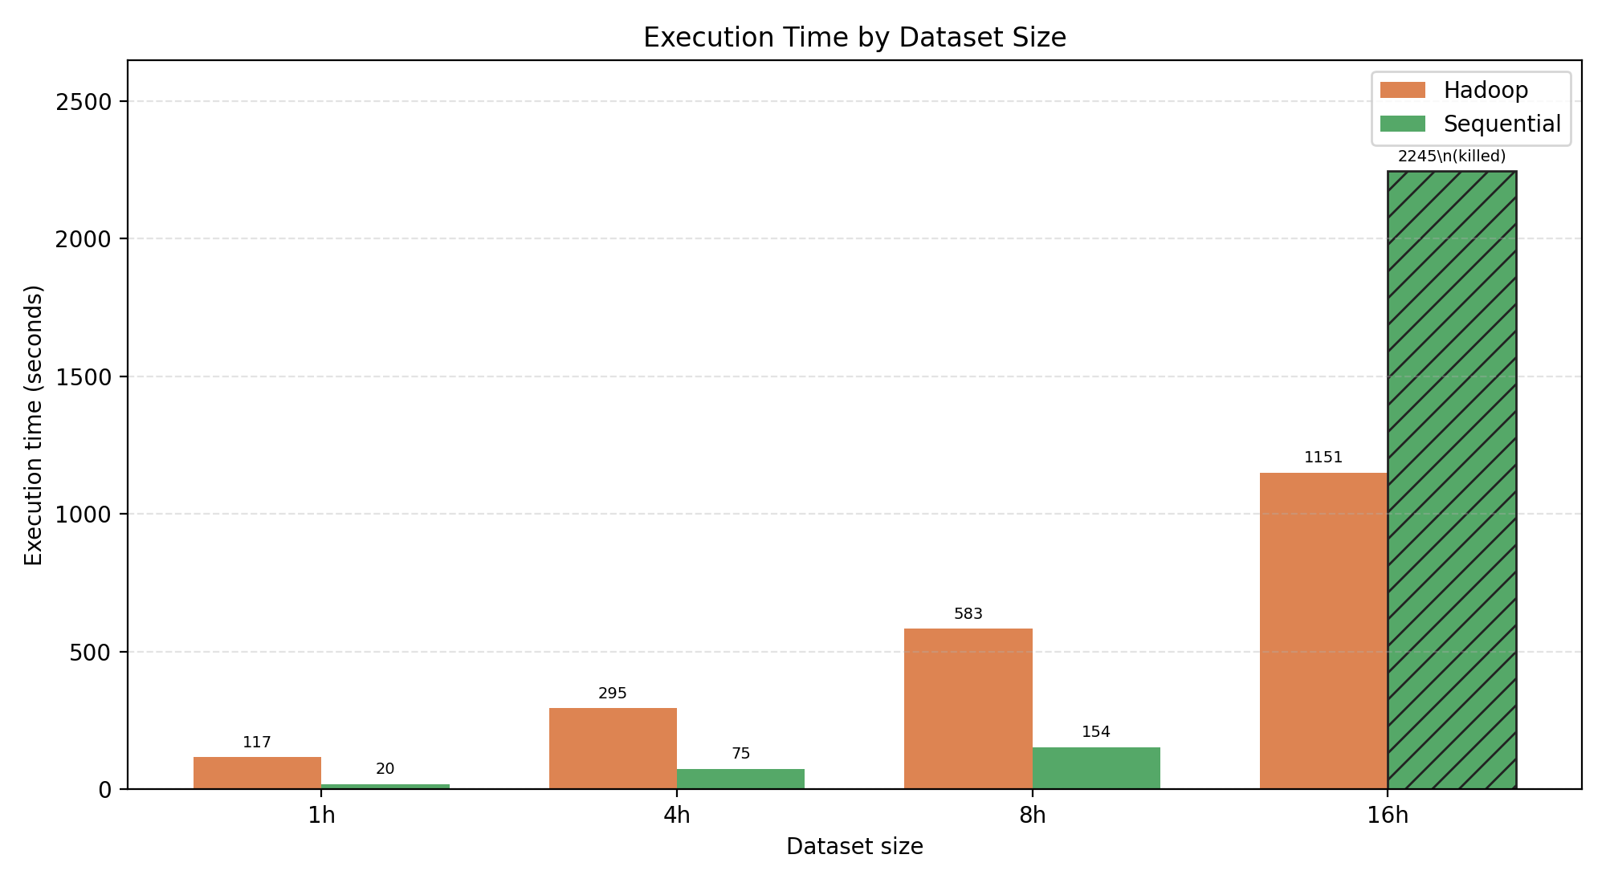
Execution Time by Dataset Size
Hadoop with 4 reducers vs Python sequential baseline
Sequential processing is faster on 1h, 4h, and 8h because the single-VM setup makes Hadoop startup, shuffle, and disk I/O overhead dominant. The 16h stress test shows the opposite scalability risk: Hadoop completes, while the Python process is killed under memory pressure.
Cloud Computing - Wikimedia Pageview Analytics

Slide 10
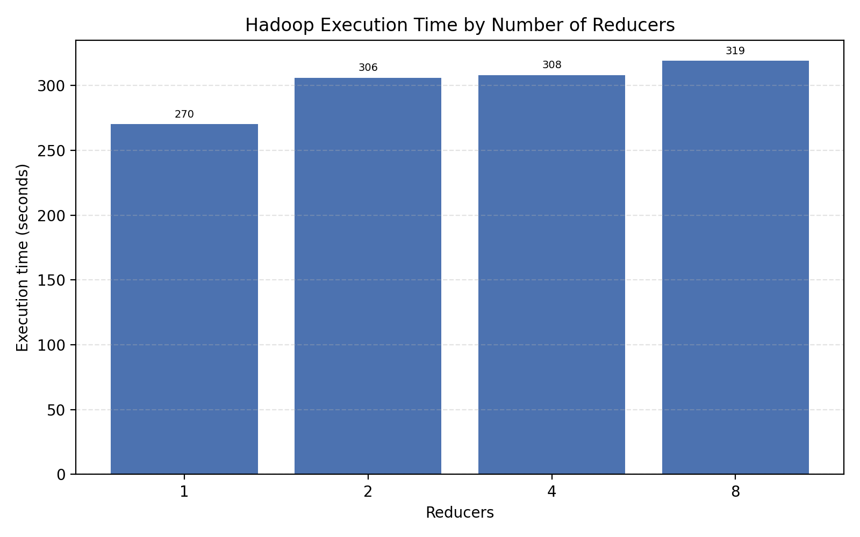
Execution Time by Reducers
Effect of reducer count on the 4h dataset
The one-reducer run is the fastest in this pseudo-distributed environment. Additional reducers introduce scheduling and shuffle overhead without enough physical parallelism to compensate.
Cloud Computing - Wikimedia Pageview Analytics

Slide 11
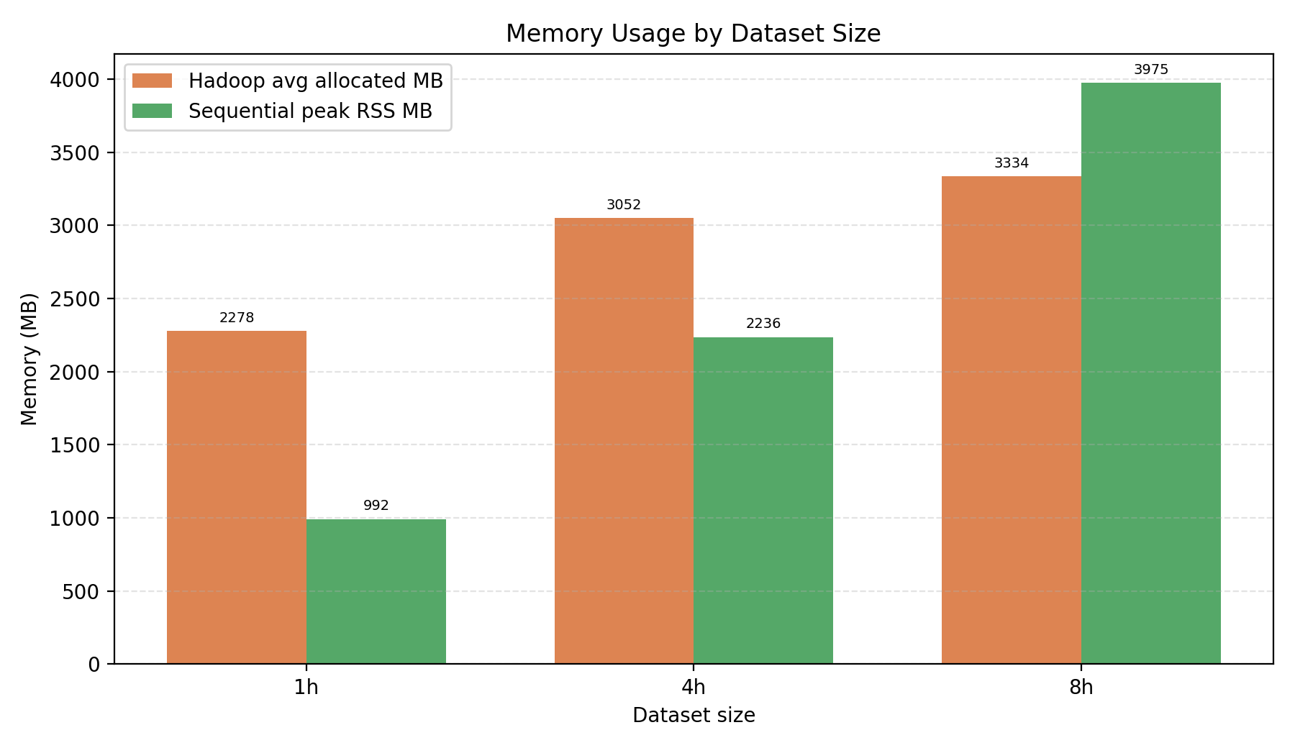
Memory Usage by Dataset Size
YARN allocation vs Python peak RSS
The two memory metrics are not identical: Hadoop reports average allocated YARN memory, while the sequential baseline reports peak process memory. The trend still shows that the Python baseline grows strongly with dataset size.
Cloud Computing - Wikimedia Pageview Analytics

Slide 12
Main Findings
What the experiments show
For small and medium inputs, the Python sequential baseline wins because it avoids distributed-system overhead.
Hadoop becomes more robust as the input grows because work is externalized through HDFS, YARN, and reducers.
The 16h test is the most important scalability signal: Hadoop completes, while the sequential process is killed.
Increasing reducers does not automatically improve performance on a single VM; the environment limits real parallelism.
Cloud Computing - Wikimedia Pageview Analytics

Slide 13
Live Execution Demo
Output Excerpt
Hadoop MapReduce run on the 1h Wikimedia Pageviews dataset
{
"summary": {
"total_views": 15459276
},
"top_projects_by_views": [
{"project": "en.m", "views": 5344906},
{"project": "en", "views": 3007383},
{"project": "zh", "views": 706567},
{"project": "ja.m", "views": 698698},
{"project": "es.m", "views": 504150},
{"project": "ja", "views": 345676},
{"project": "fr.m", "views": 311375},
{"project": "ru.m", "views": 271529},
{"project": "de.m", "views": 232317},
{"project": "it.m", "views": 228126}
],
"top_pages_by_views": [
{"page": "en|Main_Page", "views": 132524},
{"page": "en.m|Main_Page", "views": 83818},
{"page": "commons.m|-", "views": 40934},
{"page": "en|Nahui_Ollin", "views": 38512},
{"page": "en|Special:Search", "views": 19453},
{"page": "\"\"|-", "views": 15992},
{"page": "ja|メインページ", "views": 15715},
{"page": "hif|khaas:RecentChanges", "views": 14920},
{"page": "en.m|David_Allan_Coe", "views": 14697},
{"page": "zh|-", "views": 13428}
],
"views_by_hour": [
{"hour": "20260501-00", "views": 15459276}
]
}
Command
./scripts/run_hadoop_pageviews.sh
/home/hadoop/single_project/hadoop-pageviews
4
/user/hadoop/single_project/input/pageviews_1h
/user/hadoop/single_project/intermediate/demo_1h
/user/hadoop/single_project/output/demo_1h
10
Observed Run
Input: pageviews_1h
Files: 1 gzip hourly dump
Compressed size: 51.7 MiB
HDFS storage: 103.5 MiB (replication 2)
Reducers: 4
Output status: _SUCCESS
Output files: part-r-00000 ... part-r-00003
Because the demo uses 4 reducers, Hadoop writes multiple part-r files; each part contains the metric category assigned to that reducer.
Cloud Computing - Wikimedia Pageview Analytics

Slide 14
Conclusion
Final interpretation
The project satisfies the Hadoop implementation requirements with two cascaded non-iterative MapReduce jobs in Java.
The implementation includes custom Writable data, setup/cleanup methods, in-mapper combining, custom partitioning, and multi-reducer execution.
The sequential baseline is useful for comparison, but its memory behavior becomes a bottleneck at larger scale.
The final result demonstrates the trade-off between simple local execution and scalable batch processing on HDFS/YARN.
Cloud Computing - Wikimedia Pageview Analytics

