Slide 1
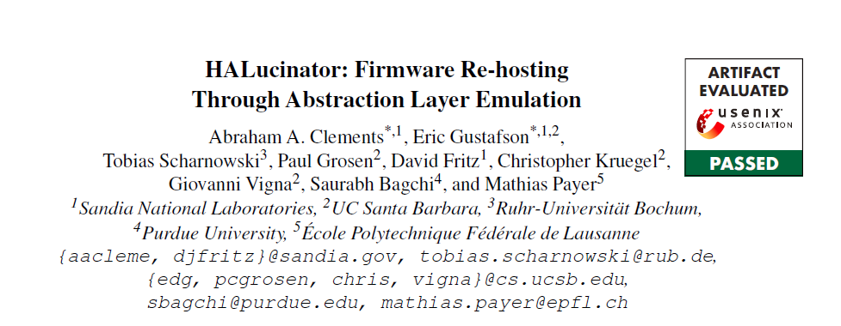
29th USENIX Security Symposium
(USENIX Security 20)
汇报：廖贤刚
时间：2022.1.28

Slide 2

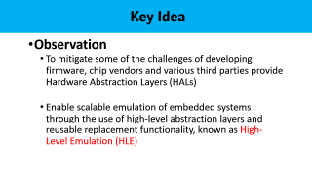
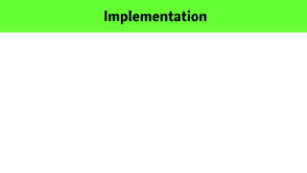
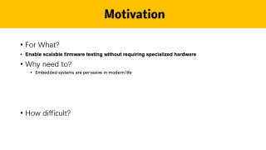
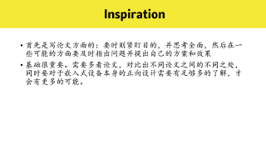
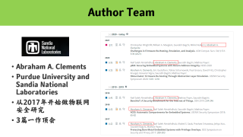
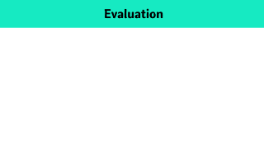
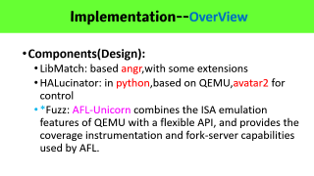
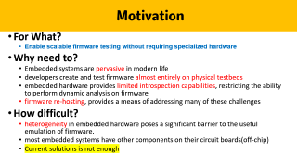
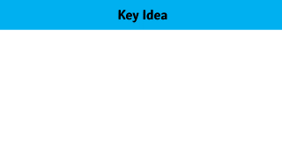
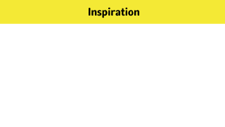

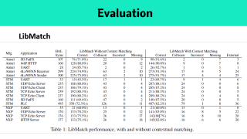
Author Team
Motivation
Key Idea
Implementation
Evaluation
Inspiration

Slide 3

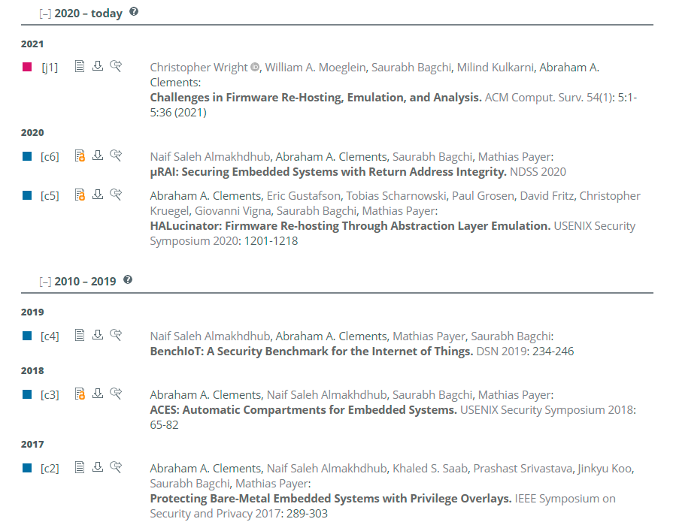

Abraham A. Clements
Purdue University and Sandia National Laboratories
从2017年开始做物联网安全研究
3篇一作顶会
Notes:
首先说明一下，因为这篇论文涉及到的作者人数太多，所以这里就没有对其按照作者的贡献进行一个介绍，首先介绍的是文章一作，然后可以看到他近期发表的一些论文也都和后面要说的几个人有有关系，同时参与，一起出现了很多次
查资料的网站：谷歌学术、领英、dblp、researchgate
网络安全的四大顶会或者是期刊：the top four conferences in security (i.e., the IEEE Symposium on Security and Privacy, the USENIX Security Symposium, the ACM Computer and Communications Security Conference (CCS), and the Network and Distributed Systems Symposium (NDSS))
Purdue University and Sandia National Laboratories 普渡大学和桑迪亚国家实验室

Slide 4
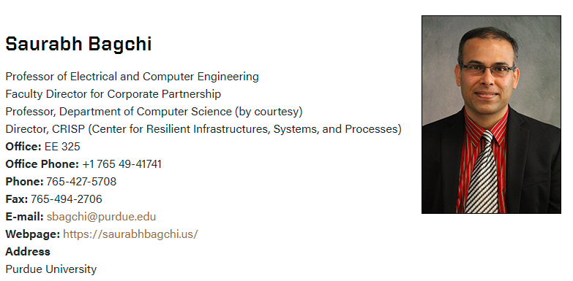

Author Team
Research : Dependable distributed systems, network security, reliable high performance computing, embedded wireless networks, bioinformatics.
Notes:
Saurabh Bagchi::Purdue University，是一个美籍印度裔，Director, CRISP (Center for Resilient Infrastructures, Systems, and Processes)
https://bagchi.github.io/Research/research_impact.html
普渡大学的可靠计算系统实验室 (DCSL) 研究如何构建可靠的、异构的、大规模分布式系统的问题，DCSL 是普渡大学工程学院弹性基础设施、系统和流程 (CRISP) 中心的创始实验室
而通过

Slide 5
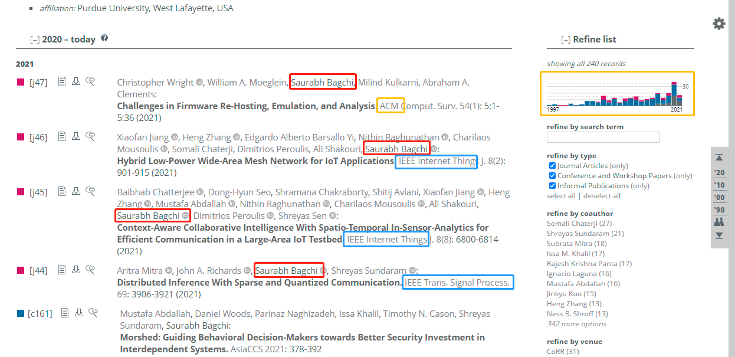
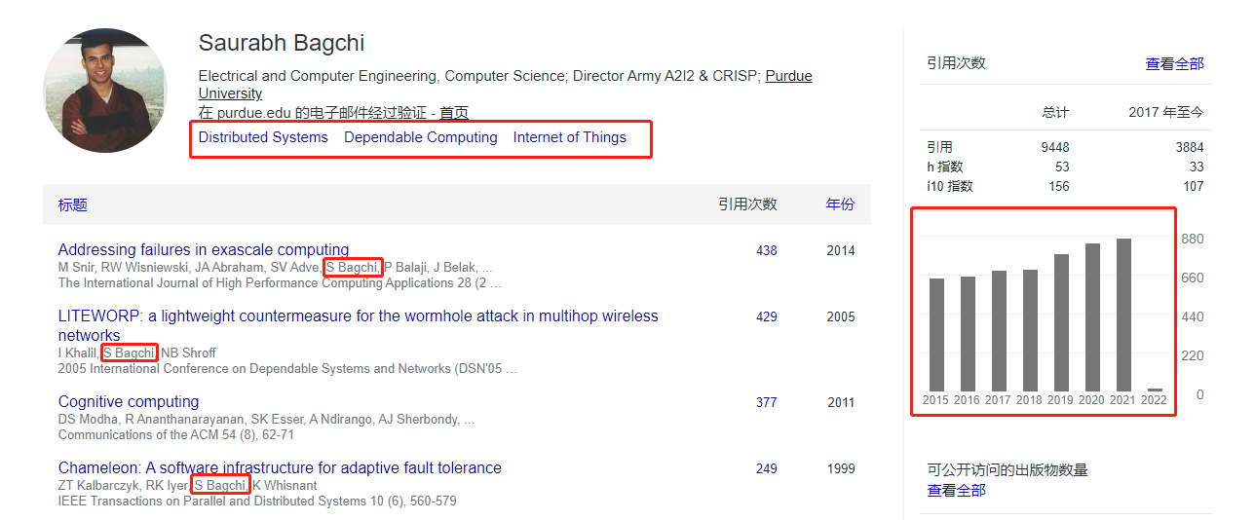
Author Team
Notes:
在作者序列中排名第8
但是查到其相关的引用量最高的是多年前的，在谷歌上面的是比较老，但是在dblp上面搜索还是比较全和新的

Slide 6

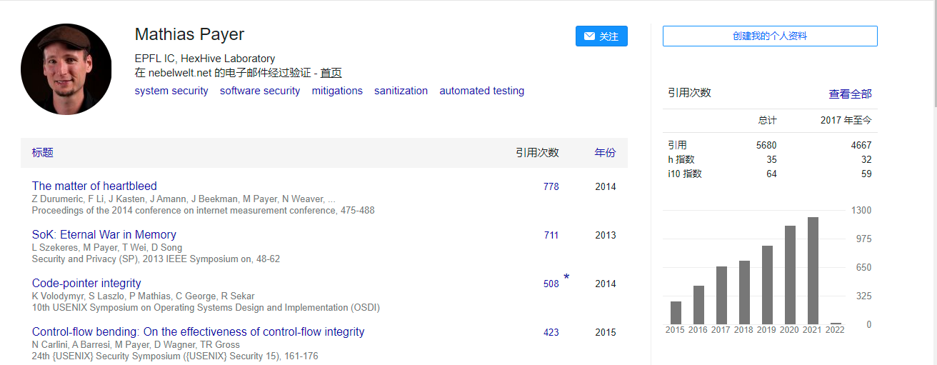
Author Team
Notes:
http://hexhive.epfl.ch/
在作者序列中排名第8
Mathias Payer::Mathias Payer is a security researcher and an assistant professor at the EPFL school of computer and communication sciences (IC), and adjunct associate professor at Purdue, leading the HexHive group.
Our research focuses on software and systems security. Despite efforts and improvements in bug discovery techniques, some exploitable vulnerabilities will remain

Slide 7
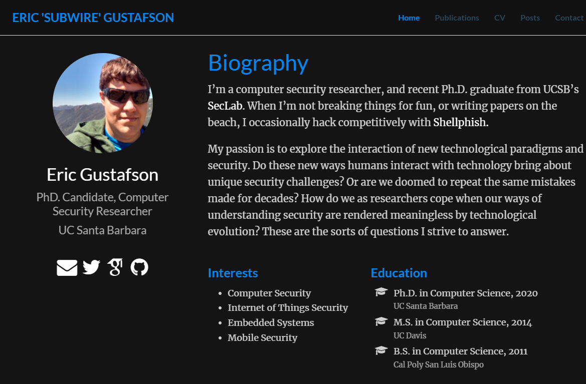
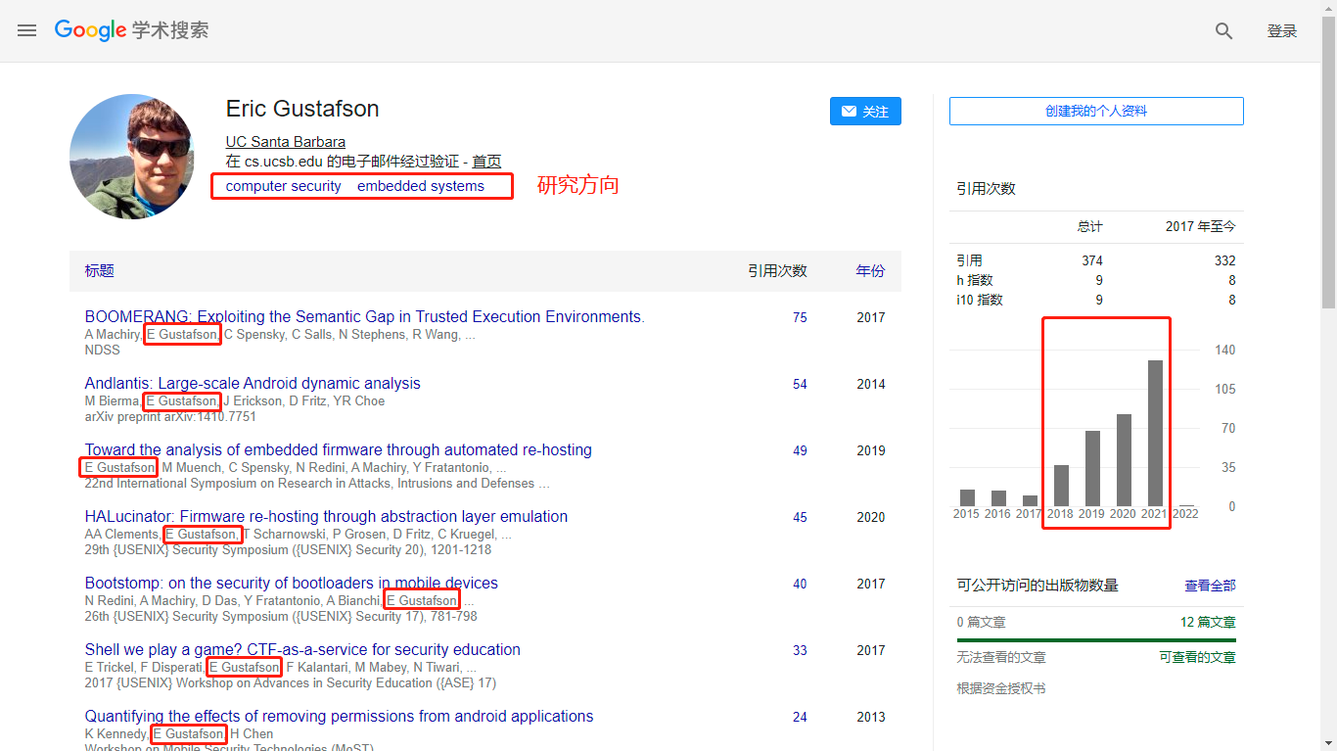
Notes:
h 指数是至少具有 h 个引用的刊物的数量，最多为 h。第二列中提供了此指标的“近期”版本，表示的是过去 5 年中至少具有 h 个新引用的刊物的数量，最多为 h。
i10 指数是具有至少 10 个引用的刊物的数量。第二列中提供了此指标的“近期”版本，表示的是过去 5 年中此类收录了至少 10 个新引用的刊物的数量。
http://www.subwire.net/ 个人简历来源
Shellphish is a team of hackers that was founded by Professor Giovanni Vigna at UC Santa Barbara in 2005 to participate in the DEF CON CTF with his graduate students.
可以看到二作可能是跟Giovanni Vigna有关系的，因为一个CTF竞赛的战队Shellphish，而这个战队是由第七位作者创立的

Slide 8

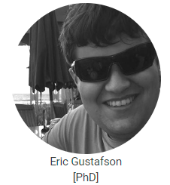
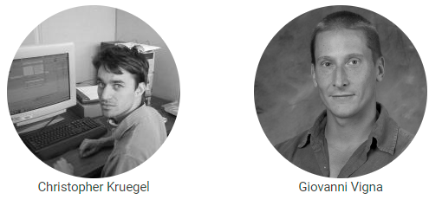

Our research focuses on determining how malware can be analyzed, detected, and blocked.
We developed a number of techniques that use emulation, simulation, and instrumentation to collect events associated with the execution of malware, and then analyze these events to identify malicious behavior.
alumni
Web: https://seclab.cs.ucsb.edu/
Faculty
Notes:
Eric Gustafson（二作）、Paul Grosen（四作）、Christopher Kruegel（第六位）、Giovanni Vigna（第七位） UCSB的四个人全是属于SecLab University of California, Santa Barbara的实验室，而且通过他们的讲述来说，不管是学生的质量还是发论文的数量上来说，这个实验室非常厉害：https://seclab.cs.ucsb.edu/ https://sites.cs.ucsb.edu/~vigna/index.html
根据官方介绍，这家实验室是主要是专注于分析、检测和阻止malware，因此该实验开发了许多技术，使用仿真、模拟和检测来收集与恶意软件执行相关的事件，然后分析这些事件以识别恶意行为。
按照给的信息来说，前两个人属于校友（已经毕业），后面两人属于老师
Paul Grosen::没有找到太多信息
Giovanni Vigna:: research focuses on vulnerability analysis, web security, malware analysis, and the security of mobile platforms.根据介绍，每一年的iCTF攻防大赛都是由他组织的

Slide 9
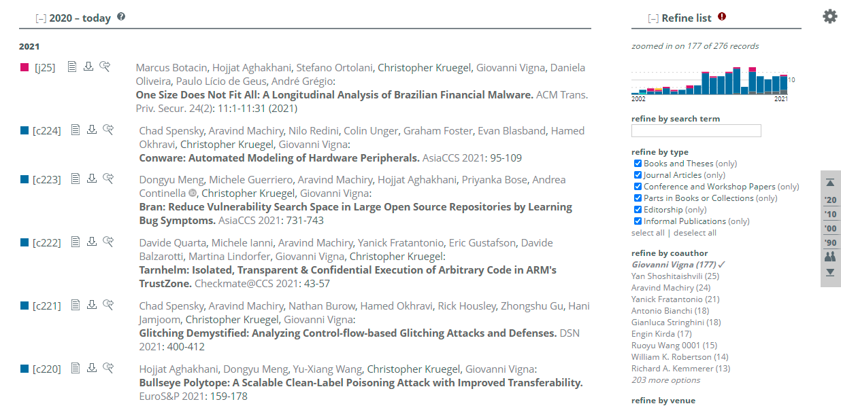
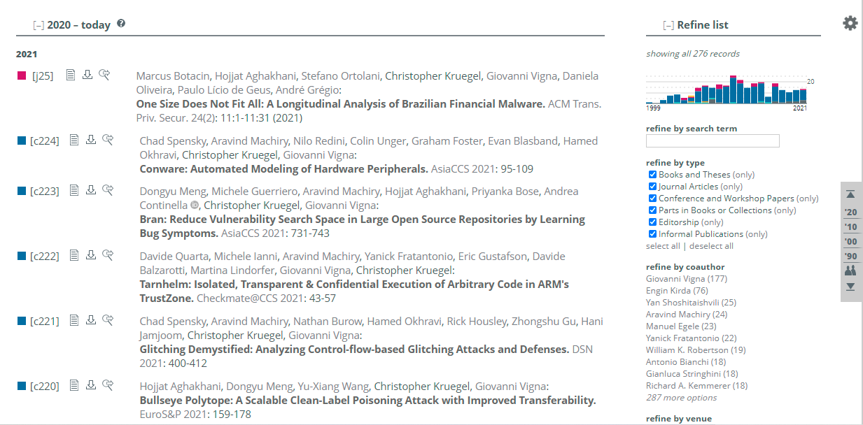
Author Team

Slide 10
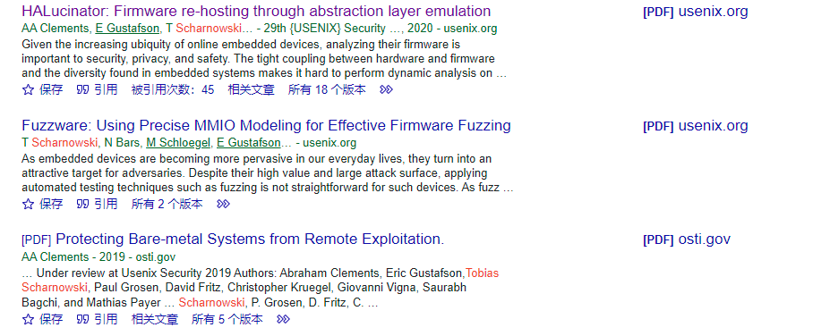
Author Team
Tobias Scharnowski
Ruhr-Universität Bochum
Notes:
Tobias Scharnowski 三作，没有找到太多的信息内容
Ruhr-Universität Bochum 波鸿鲁尔大学（德国的）

Slide 11
Motivation
For What?
Enable scalable firmware testing without requiring specialized hardware
Why need to?
Embedded systems are pervasive in modern life
developers create and test firmware almost entirely on physical testbeds
embedded hardware provides limited introspection capabilities, restricting the ability to perform dynamic analysis on firmware
firmware re-hosting, provides a means of addressing many of these challenges
How difficult?
heterogeneity in embedded hardware poses a significant barrier to the useful emulation of firmware.
most embedded systems have other components on their circuit boards(off-chip)
Current solutions is not enough
Notes:
For what? 模拟执行嵌入式系统固件（Rehosting）
Why Need to?
Heterogeneity:有很多不同厂家生产了专用的CPU，片上外设和内存布局也是不尽相同
为什么其他的solutions is not not enough?
如论文中提到：1.当前允许模拟各种硬件的解决方案依赖于设备的真实样本，其中模拟器将与不受支持的外围设备的交互转发到硬件，（36，43，58）比如说：SURROGATES，avatar，avatar2
2.其他技术侧重于记录并随后重放或建模来自硬件的数据，这允许缩放和共享这些执行，但必然需要从设备本身内部进行跟踪记录，从而将模拟器中的忠实执行限制为仅在程序中记录的路径，（22，32，54）比如说：panda，TARDIS

Slide 12
Key Idea
Observation
To mitigate some of the challenges of developing firmware, chip vendors and various third parties provide Hardware Abstraction Layers (HALs)
Enable scalable emulation of embedded systems through the use of high-level abstraction layers and reusable replacement functionality, known as High-Level Emulation (HLE)
Notes:
Hardware Abstraction Layers HAL:硬件抽象层，最先由微软为确保WindowsNT的稳定性和兼容性而提出，上层软件通过常规的通用接口访问MCU的某些资源，而不用去关心“是哪个MCU”在做的，模糊了最底层的函数实现。即忽略硬件细节。
本文则提出通过对于HAL函数的高级抽象，实现了固件和硬件之间的decouple（解耦合，可以理解为脱钩类似的想法，因为HAL跟硬件是紧耦合的）
STM32 之 HAL库：https://blog.csdn.net/xuzhexing/article/details/90137754
HAL 是为程序员提供高级硬件操作的软件库，同时隐藏固件执行所在的特定芯片或系统的详细信息，相当于做了一层封装，让硬件本身变得透明

Slide 13
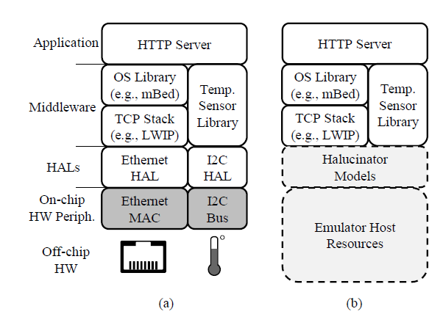
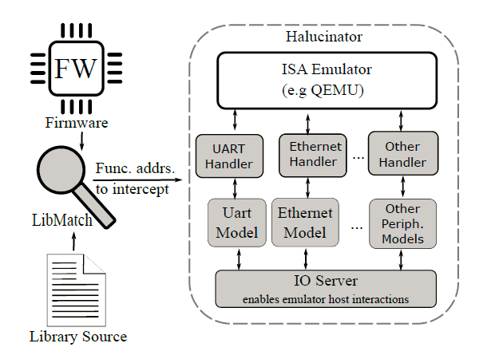
Key Idea
Notes:
按照这样的流程的话，我固件是在那一层啊？
由于最底层实现相对困难，因为其往往直接与硬件打交道，同时也伴随着大量的函数和协议的语义信息需要解构，
而对于middleware层，我们可能又无法准确的知道到底用了哪些libraries
这里可以解释一下为什么要用HAL层，而不再别的层进行操作。

Slide 14
Implementation--OverView
Components(Design):
LibMatch: based angr,with some extensions
HALucinator: in python,based on QEMU,avatar2 for control
*Fuzz: AFL-Unicorn combines the ISA emulation features of QEMU with a flexible API, and provides the coverage instrumentation and fork-server capabilities used by AFL.
Notes:
Extensions : Implementing LibMatch for the Cortex-M architecture required extending angr. We added support for Cortex-M’s calling conventions, missing instructions, function start detection and indirect jump resolution to angr. Angr is a binary analysis platform
AFL-Unicorn combines the ISA emulation features of QEMU with a flexible API, and provides the coverage instrumentation and fork-server capabilities used by AFL.
Inputs：
Executable binary image
basic parameters needed, such as : architecture, and generic memory layout

Slide 15
Implementation-- Design
Prerequisites:
obtain the complete firmware for the device
obtain the libraries, such as HALs, OS library, middleware, or networking stacks they want to emulate, and the toolchain typically used by that chip vendor to compile them
LibMatch
High-level emulation
Fuzzing with HALucinator

Slide 16
Implementation-- Step 1:Prerequisites
Prerequisites:
obtain the complete firmware for the device
obtain the libraries, such as HALs, OS library, middleware, or networking stacks they want to emulate, and the toolchain typically used by that chip vendor to compile them
How to obtain?
Official websites , from device/Open source

Slide 17
Implementation-- Step 2: LibMatch
This is the crucial Step in this Simulation system!!!
How to understand? --> function substitution
Match What?
Binary to Library
Database of HAL functions
extracting the control-flow graph of the unlinked binary object files of the libraries
plus an Intermediate Representation (IR) of their code
Notes:
找函数的系统或者是工具（24，33，35）：debin
进行函数比对的工具（21，28）：diaphora，
如何建立整个library,这里是一个问题，也是很重要的一个问题，
整个系统的核心就是做函数的替换，将HAL的功能自己手工实现（所以其实本文也一直再强调一个点，就是人工部分的内容其实并不复杂，在appendix里面也是使用一些函数复杂度的算法来衡量自己的工作量），然后对于一些外设部分的read和write进行捕获，然后也是自己编写function进行处理
LibMatch creates a database of HAL functions to match by extracting the control-flow graph of the unlinked binary object files of the libraries, plus an Intermediate Representation (IR) of their code(中间表示，指的是代码编译过程中会形成的中间文件，但是具体是怎么比较的呢？)
Collision来源于第二步的比较，因为HAL本身具有一些容易混淆的点：①HAL的函数名不同，其实作用相同，②函数体相同，但是其实作用不同
we use the libraries’ debugging information to extract the set of called function names
we gather the set of functions called by any function we were able to match exactly in step two, and name them based on the debug symbols in the
library objects
对于第三步其实不太理解，因为反复提到编译时的中间表示，但是这个文件我似乎没有见到过，而这里我需要进行讲解吗？拿个实例？？还有就是效果真的好吗？

Slide 18
Implementation-- Step 2: LibMatch
How?
Statistical comparison: number of basic blocks, control flow graph (CFG) edges, and function calls
Basic Block Comparison: compare the content of their basic blocks, in terms of an intermediate representation
Contextual Matching-->to resolve collisions
Caller context :
Callee context
Both of these processes occur recursively, as resolving conflicts in one function may lead to additional matches
Notes:
对于Caller context 和callee context而言，比较重要的是就是构建两个set，通过完全匹配的可以实现成功配对
LibMatch的结果是返回list of identified functions and their addresses, and makes note of collisions, in the event that a human analyst wishes to resolve them manually.

Slide 19
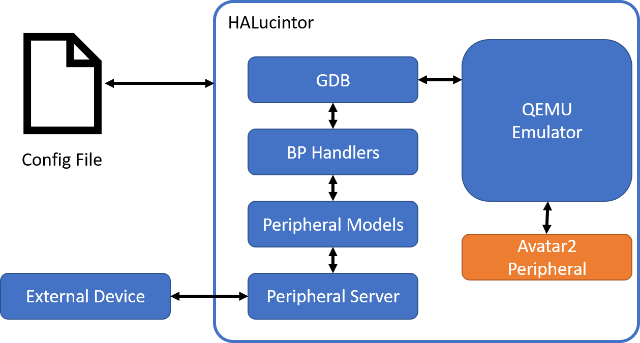
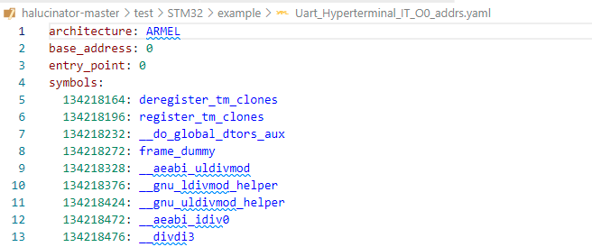
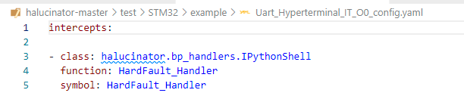
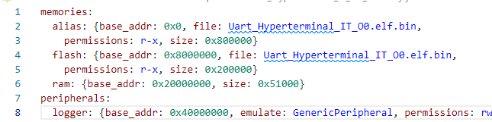
Implementation--OverView
Notes:
首先呢，一起来看看HALucinator的整个架构是怎样的，通过一个配置文件
Using this configuration file, HALucinator starts the emulator (QEMU) and connects
GDB to it. It then uses GDB to set breakpoints (BPs) at the location of all functions
to intercept, and registers a BP Handler to be executed when the breakpoint is hit.
The BP Handler reads/writes data from the emulator and manages the state to
make it appear the function executed as we desired. It then returns and execution
of the emulated firmware continues as if the function executed. The BP Handler
leverages a peripheral model that implements generic behaviors for peripherals
(e.g., Send ethernet frames, read/write serial data, etc). Going back to the UART
example, all UARTs send/receive data, but the HAL functions for various UARTs are
different. We implement sending and receiving data for a UART once in the peripheral
model. The BP Handlers handle the differences in the HAL functions and are responsible
for extracting the data from the emulator and passing it to the peripheral model.
The Peripheral Models then communicate with the Peripheral Server which sends and
receives data from external devices. This enables controlling all the IO from a
single point and doing so in flexible way.

Slide 20
Implementation-- Step 3: HALucinator
Handles
Encode each HAL function’s semantics
How？
Run binary in HALucinator
Stuck or misbehavior, which functions contain the I/O operations
The process repeats, and successive handlers produce greater coverage and more accurate functionality
Implementation
As python classes
read and write the emulator’s registers or memory, call functions in the firmware itself, and interact with the peripheral models.
Manual effort
Notes:
因为HAL本身是跟硬件直接进行交互的，所以进行了前一步操作后如果要想替换HAL，这里需要进行对于HAL函数本身的函数输入具有了解，同时也需要对其进行交互的peripheral进行仿真
每一个handle对 HAL 函数的语义进行编码
almost all handlers are simple, falling into a few basic categories, such as performing trivial actions on a peripheral model, returning a constant value, or doing nothing at all.
Handlers are implemented as Python classes, with each function covering one or more functions in the firmware’s HAL or libraries.
HALucinator takes as inputs: the memory layout (i.e.,
size and location of Flash and RAM), a list of functions
to intercept with their associated handlers, and the list of
functions and addresses from LibMatch. It uses the addresses
of the functions to place a breakpoint on the first instruction
of each function to be intercepted, and registers the handler to
execute when the breakpoint is hit

Slide 21
Implementation-- Step 3: HALucinator
Handles
Implementing handlers is a manual task; therefore it is important to quantify the amount of effort required to emulate a system.
Notes:
Implementing handlers is a manual task; therefore it is important to quantify the amount of effort required to emulate a system.

Slide 22
Implementation-- Step 3: HALucinator
Peripheral models
Reflect aspects common to a peripheral type
Contain little actual logic
Implementation
As python classes
make full use of system libraries or the I/O server to implement the desired functionalities
Such as: time() to get a hardware real-time clock
Notes:
反映外围类型共同方面的外围模型。
使用 I/O 服务器通过在不更改仿真器配置的情况下促进多个用例来集中与仿真系统的外部通信,然后通过I/O server来进行调配数据分发
我们发现许多 MMIO 操作，特别是设置外设标志和配置的写入操作，可以安全地忽略，因为仿真器配置其资源独立于固件。

Slide 23
Implementation-- Step 3: HALucinator
I/O server:
centralizes external communication with the emulated system, by facilitating multiple use cases without changing the emulator’s configuration
The I/O server uses a publish/subscribe design pattern, to which peripheral models publish and/or subscribe to specific topics that they handle
centralizing all I/O enables a program to coordinate all external interactions of an emulated firmware
This enables powerful multiple interface instrumentation completely in software, and enables dynamic analysis to explore complex internal states of the firmware
Implementation
as a publish-subscribe system using the ZeroMQ messaging library
Notes:
反映外围类型共同方面的外围模型。
使用 I/O 服务器通过在不更改仿真器配置的情况下促进多个用例来集中与仿真系统的外部通信,然后通过I/O server来进行调配数据分发
我们发现许多 MMIO 操作，特别是设置外设标志和配置的写入操作，可以安全地忽略，因为仿真器配置其资源独立于固件。
publish-subscribe system：发布-订阅系统，The Publish Subscribe model allows messages to be broadcast to different parts of a system asynchronously.

Slide 24
Implementation-- Step 3: HALucinator
Peripheral Accesses Outside a HAL:
report all I/O outside handlers to the user.
all read operations to these areas will return zero, and all writes will be ignored
many MMIO operations can be safely ignored
Notes:
这是一个额外的情况发生的时候，就是可能会有
many MMIO operations, particularly write operations setting peripheral flags and configurations, can be safely ignored as the emulator configures its resources independent of the firmware

Slide 25
Implementation-- Step 4: Fuzz
AFL-Unicorn combines the ISA emulation features of QEMU with a flexible API, and provides the coverage instrumentation and fork-server capabilities used by AFL
Components(更像是model的优点功能方面)
Fuzzed input: dispense data from the fuzzer’s input stream to the handle
Termination: sending a signal to the fuzzer that the program did not crash during that execution
No-determination: HALucinator provides static handlers for randomness-producing functions(即是保持random特性，像rand()/time())
Timers:time()，We provide a Timer peripheral model, which ties the timer rate to the number of executed blocks, creating deterministic timer behavior, and fair execution of the timer抯 interrupt handlers and the main program, regardless of emulation speed
Crash Detection:
Input Generation
Notes:
Crash Detection：在这个处理的时候会让错误显现，同时，能够自行做出check，像是arguments的一些约束条件符不符合等，还提供了一个heap-checking implementation similar to ASAN
Input Generation: HALucinator’s fully-interactive mode can be used to interact with the device and log the return values of library calls of interest, which can be used to seed fuzzing

Slide 26
Implementation-- Step 4: Fuzz
AFL-Unicorn combines the ISA emulation features of QEMU with a flexible API, and provides the coverage instrumentation and fork-server capabilities used by AFL
Provides a special fuzz peripheral model, will dispense data from the fuzzer’s input stream to the handler.
Notes:
（American Fuzzy Lop）AFL-Unicorn 将 QEMU 的 ISA 仿真功能与灵活的 API 相结合，并提供 AFL 使用的覆盖检测和 fork-server 功能
它缺乏任何外围硬件支持，因此无法对固件进行模糊测试。 添加 HALucinator 的高级仿真提供了所需的外围硬件支持。 Unicorn 和 AFL-Unicorn 还特意去掉了中断的概念，这是模拟固件所必需的。 因此，我们添加了一个通用的中断控制器模型，它支持 ARM 的 Cortex-M 中断语义。
提供一个特殊的模糊外围模型，将数据从模糊器的输入流分配到处理程序。

Slide 27
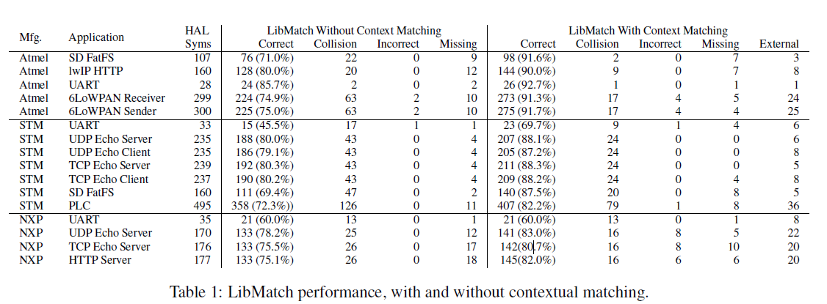
Evaluation
LibMatch
Notes:
对于实验结果做出解释说明：所有的STM都是使用命令gcc –Os 生成针对Cortex-M3的目标文件，Atmel使用Atmel Studio 7生成对于Cortex-M0的release版本，NXP都是在SDK的基础上之上编译位针对Cortex-M3的release版本，然后对于这些结果进行了一次Libmatch效果的比对
HAL symbols:指的是固件中目前所使用的HAL库函数数目
Correct：指通过Libmatch正确识别的函数数目
Collision，incorrect，missing则分别表示没有准确识别的函数的错误缘由
Collision：最为常见就是C++中虚函数，以及一些打桩stub函数（类似地，在许多基于 C++ 的 HAL 函数中，stub用于查找和调用对象本身的方法； 相同的代码可以存在于许多地方，这些函数的作用往往是作为中间查看一些变量值使用，所以他并不是真正要调用的函数，或者也有可能就是一些没有用的代码，只是为了在形式上满足编写要求，但是其实我看到网上的解释还不太一样），还有一些功能相同但是name不同的函数，还有一些包含一些相同的默认内容的interrupt handles，但是由于他们灭有被调用，所以不能通过context进行resolve，因此collision就非常高。
Incorrect：通常是由于程序在链接过程中被改了名，而这种情况是一些比较特殊的例子，就是对于在Libmatch中只有一项比对内容会出现。
Missing：通常有两种原因，一种是由于angr对于CFG的识别效果不好，二是由于固件覆盖了一些symbol，所以不能通过context来判断函数是不是属于external
External：是 HAL 库外部函数的数量，这些函数与上下文匹配标签正确匹配，论文中提到比如说main函数，C标准库中的函数malloc，free等。
可以看到，其实经过论文作者的方法改进，对于不同架构下的固件中函数的识别小姑均有不同程度的提升，同时作者还解释说，对于这些没有被正确匹配和冲突的函数在HLE时并没有被用到，所以不影响halucinator的性能。
In Table 1, the number of HAL symbols is the number of
library functions present in the firmware, while the ‘Correct’
column shows the number of those functions correctly
identified. The ‘Collision’, ‘Incorrect’, and ‘Missing’
columns delineate reasons LibMatch was unable to correctly
identify the unmatched functions. The last column, ‘External’
is the number of functions external to the HAL libraries that
LibMatch with context matching labels correctly.

Slide 28
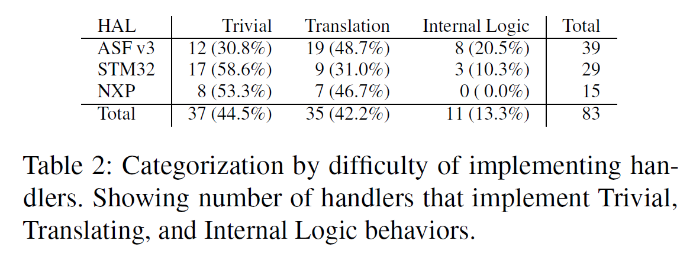
Evaluation
Scaling of High-Level Emulation
Notes:
文章将实验过程中边写的handle分成了三类：
Trivial handles（），只是简单返回一个constant，用于显示函数是否正确执行，而不选哟了解在固件中函数是怎么实现的，通常是在固件初始化的一些函数属于这一类
Translating handles：会接受他截获的函数的参数，同时对外围设备进行一次操作，而这里需要知道函数参数的意思，同时需要读传入model的值，将model返回的一些结果准确的写回到函数的一些参数中。
Internal logic：需要了解替换的函数的内在逻辑

Slide 29
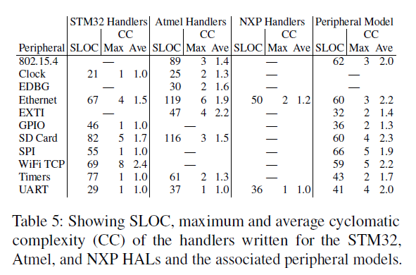
Evaluation
Code Complexity Metrics
we examine the amount of code—in source lines of code(SLOC)
Notes:
Implementing handlers is a manual task; therefore it is important to quantify the amount of effort required to emulate a system.
然后由于前面反复提到一个问题，该系统模型中最重要的一步就是对于HAL的模拟，但是这一步的工作量全是人工完成的，所以在论文中还对这部分的工作进行了额外的分析，对于源码复杂度进行度量。
软件源码复杂度度量方法主要有三种：代码行、 Helstead方法、McCabe方法（环形复杂度），而论文中则采用了一个非常方便理解的方法，利用了代码复杂度度量种的其中一个方法----每一个代码文件的代码行数
cyclomatic complexity (CC)：圈复杂度，软件源码某部分的圈复杂度就是这部分代码中线性无关路径的数量。其实就有点像有多少个if…else..

Slide 30
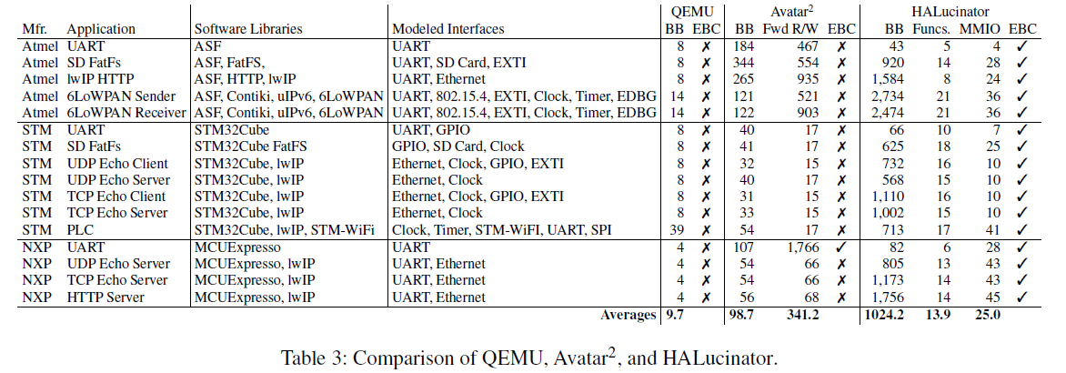
Evaluation
Interactive Emulation Comparison
Notes:
接着作者对于对于设备运行时的效果进行了一个对比，
QEMU：是在这个实验中使用 Avatar2 默认配置的 QEMU，在此配置下，对 QEMU 中不受支持的 MMIO 的任何访问都会出错。
Avatar2 ：在QEMU的基础上增加了对于MMIO（内存映射I/O，它是PCI规范的一部分）的处理，将所有 MMIO 转发到由调试器连接的真实板子上（Avatar2 was configured to execute the firmware in QEMU and forward all MMIO to a physical board connected by a debugger）。
HALucinator：则主要是与第二列的结果进行比对，因为该工具实现了对于MMIO的处理，For any MMIO that is executed, we implement a default MMIO handler that returns zero for reads and silently ignore writes。
BB:basic blocks executed，显示固件执行的多少，
EBC:external behaviour correct：shows if the external input and output behavior matches that observed from executing the firmware on physical hardware表示external 的输入和输出是否与在物理尸体上观察到的行为是否一致
Fwd R/W：显示avatar2正确执行内存请求的次数
Funcs：表明了halucinator成功截获的函数个数
MMIO：表明了在使用default MMIO中成功处理的地址数
可以看到HALucinator对于整个代码的覆盖度显著提升，同时支持了对于external behaviour的处理，使得仿真更加真实

Slide 31
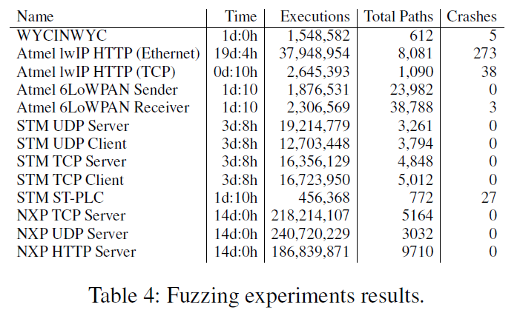
Evaluation
Fuzzing with HALucinator
ST-PLC:
buffer overflow
Atmel IwIP HTTP(Ethernet)：
1. Heap double-free in IwIP itself
2. Heap use-after-free
Atmel IwIP HTTP(TCP)
Get parser
Atmel 6LoWPAN Receiver:
Buffer overflow
Override,remote code execution
Notes:
ST-PLC:缓冲区溢出漏洞，导致代码的任意执行（新发现的漏洞）
Atmel IwIP HTTP(Ethernet)：而273也是一i那位这个原因，但是其实手动分类的话，主要还是37左右
Heap double-free in IwIP itself
Heap use-after-free
Atmel IwIP HTTP(TCP)
Get的请求解析过程中出现缓冲区过度读取，从而造成信息泄露
Atmel 6LoWPAN Receiver存在两个漏洞，
包重组是发生的缓冲区溢出
通过控制输入造成数据段数据被覆盖，然后造成远程代码执行漏洞， CVE-2019-8359， CVE-2019-9183

Slide 32
Evaluation
Contributions
We enable emulation of binary firmware using a generic system emulator (QEMU for us) without relying on the presence of the actual hardware. We achieve this through the novel use of abstraction libraries called HALs, which are already provided by vendors for embedded platforms.
We improve upon existing library matching techniques, to better locate functions for interception in the firmware.
We present HALucinator, a high-level emulation system capable of interactive emulation and fuzzing firmware through the use of a library of abstract handlers and peripheral models.
We show the practicality of our approach through case studies modeled on 16 real-world firmware samples, and demonstrate that HALucinator successfully emulates complex functionality with minimal effort. Through fuzzing the firmware, we find use-after-free, memory disclosure, and exploitable buffer overflow bugs resulting in CVE-2019-9183 and CVE-2019-8359 in Contiki OS

Slide 33
Inspiration
首先是写论文方面的：要时刻紧盯目的，并思考全面，然后在一些可能的方面要及时指出问题并提出自己的方案和效果
基础很重要。需要多看论文，对比出不同论文之间的不同之处，同时要对于嵌入式设备本身的正向设计需要有足够多的了解，才会有更多的可能。

Slide 34

谢谢聆听！

