Slide 1
LOWELL
GENERAL
HOSPITAL
Presented by
KPI ANALYSIS
& INSIGHTS
Lisha Bhowmik
BBA Graduate · Data & Business Analyst
Focus Areas Bed Occupancy · Staff Responsiveness · Unassisted Falls
Analyzing Patient Safety, Staff Performance
& Hospital Capacity (2020–2024)
Dataset Monthly data 2020–2024 | Source: HCAHPS / NDNQI / Internal
Tools Python · Pandas · SciPy · Matplotlib

Slide 2
PROBLEM STATEMENT
What operational challenge is Lowell General Hospital facing?
Mission: Lowell General Hospital is committed to putting patients first in everything we do — monitoring quality, safety, and responsiveness at all times.
The Core Issue
Our Objective
Fluctuating hospital capacity is creating a ripple effect on two critical outcomes: ① Patient dissatisfaction due to staff being stretched thin ② Patient safety risks from unassisted falls during high-occupancy periods
To investigate how hospital crowdedness (bed occupancy) impacts the nursing staff's ability to respond to patients — and whether that leads to preventable patient falls.
KPI 1 · CAPACITY
KPI 2 · SATISFACTION
KPI 3 · SAFETY
~96%
63%
2.60
Average Licensed Bed Occupancy Rate. Captured internally. Measures the % of licensed beds filled each day.
Formula: (Patients in Beds ÷ Licensed Beds) × 100
Staff Responsiveness Top Box Score. From HCAHPS Survey — patients rating call-button and bathroom help as 'Always' received.
Benchmark: 65%
Unassisted Patient Falls per 1,000 Patient Days. Captured by NDNQI — falls with no staff present to assist.
Formula: (Falls ÷ Patient Days) × 1,000

Slide 3
UNDERSTANDING THE KPIS
Key terms, formulas, and data sources explained
Average Licensed Bed Occupancy Rate
Staff Responsiveness Top Box Score
Unassisted Patient Falls per 1,000 Patient Days
Source: Internal Hospital Records
Source: HCAHPS Survey (post-discharge)
Source: NDNQI (National Database of Nursing Quality Indicators)
Formula: (No. of Patients in Licensed Beds per Day ÷ No. of Licensed Beds) × 100
Formula: (Patients answering 'Always' to both questions ÷ Total respondents) × 100
Formula: (No. of Unassisted Falls ÷ No. of Patient Days) × 1,000
A licensed bed is a hospital bed officially approved for patient use by regulatory authorities. This KPI tells us what percentage of those beds are occupied on any given day.
Why it matters: When occupancy approaches or exceeds 95%, the hospital is operating at near-maximum capacity. This leaves little room to handle surges, puts pressure on all departments, and directly stretches nursing staff — making it harder to respond quickly to patient calls.
HCAHPS stands for Hospital Consumer Assessment of Healthcare Providers and Systems — a standardized, publicly reported patient survey. The two Staff Responsiveness questions ask patients how quickly they got help after pressing the call button and how quickly they got help with the bathroom or bedpan.
'Top Box' means only 'Always' counts — partial responses like 'Usually' are not included. Industry benchmark is 65%. Falling below this signals patients feel staff are unavailable or delayed.
A patient fall is any unplanned descent to the floor — with or without injury. Unassisted means no staff member was present to catch or support the patient.
Patient Days normalizes fall counts by the total time patients spent in the hospital. For example, 100 patients each staying 3 days = 300 patient days. This allows fair comparison across time periods.
Why it matters: Unassisted falls are a direct patient safety signal — they are largely preventable with adequate staffing and proactive rounding.

Slide 4
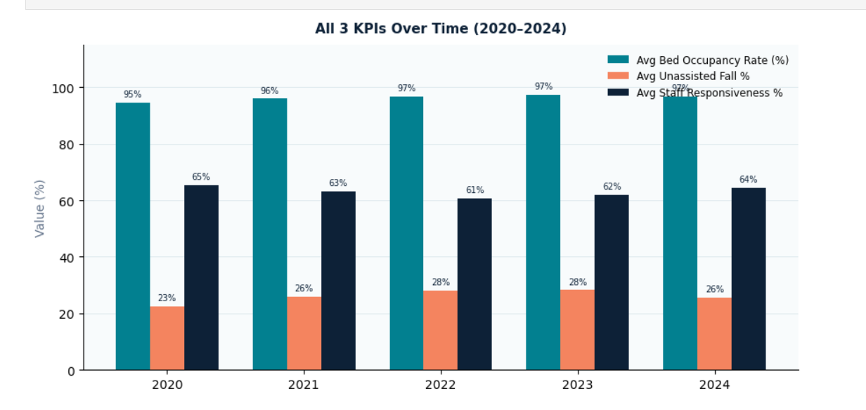
KPI OVERVIEW: ALL THREE METRICS AT A GLANCE (2020–2024)
A side-by-side yearly comparison of all three key performance indicators
Reading This Chart
Three bars per year show how each KPI moves together or diverges: ■ Teal Bed Occupancy — stays high (95–97%) across all years with little variation. ■ Orange Unassisted Fall %— rises from 23% (2020) to 28% (2022–23) before easing slightly. ■ Navy Staff Responsiveness % — drops from 65% in 2020 to a low of 61% in 2022, recovering to 64% by 2024. Key takeaway: As occupancy climbs, falls worsen and responsiveness deteriorates — in sync.
Why this chart: Before examining each KPI individually, this grouped view shows the directional relationship at a glance — all three metrics shift together, suggesting a systemic connection rather than isolated events.

Slide 5
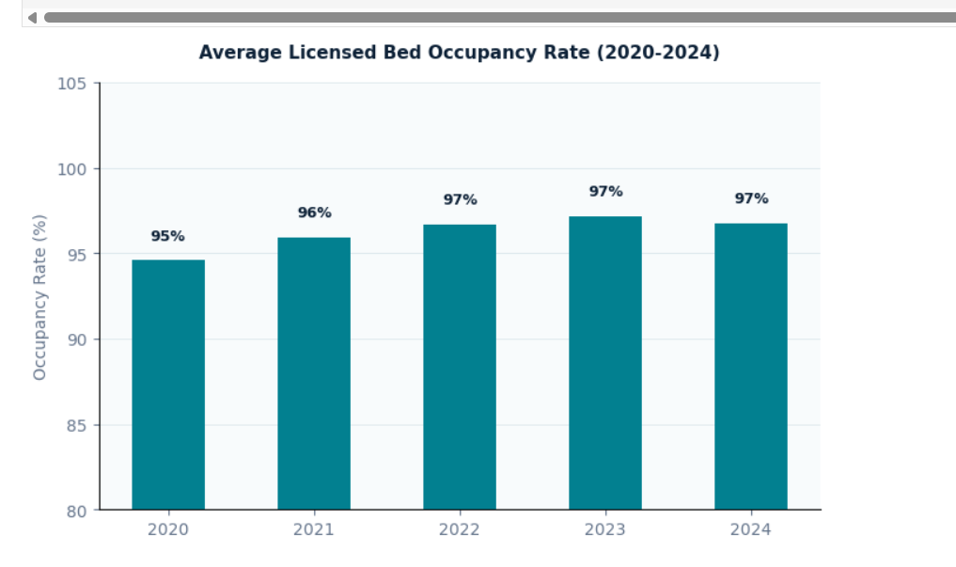
METRIC 1: AVERAGE LICENSED BED OCCUPANCY RATE (2020–2024)
Is the hospital operating at safe capacity levels?
What we see: Occupancy crept from 95% (2020) → 97% (2022–2024), staying consistently at the operational ceiling.
Why 95%+ is critical: Industry best practice recommends ~85% occupancy as the safe operating zone. Above 95%, hospitals struggle to surge capacity, clean rooms quickly, or deploy staff where needed.
The diagnostic question: Does this persistent high occupancy explain the staff responsiveness decline and rise in falls we see in later charts?
Benchmark context: National average bed occupancy for acute care hospitals typically ranges 65–75%. Lowell's 95–97% is operationally strained territory.

Slide 6
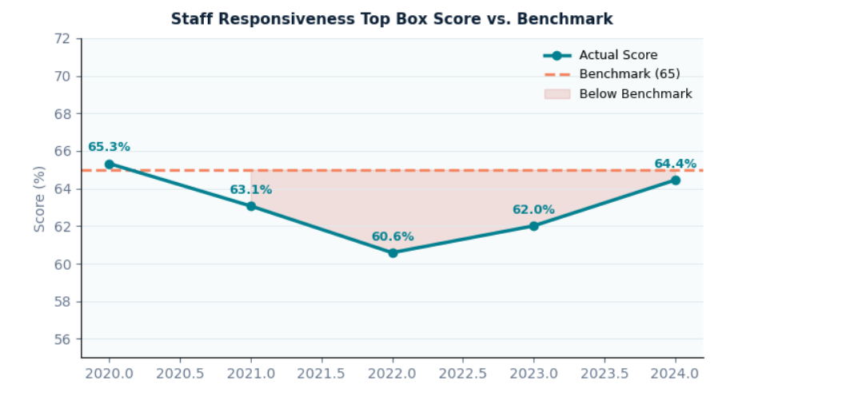
METRIC 2: STAFF RESPONSIVENESS TOP BOX SCORE VS. BENCHMARK
Are patients getting help as quickly as they need it?
65.3% 2020 — At benchmark
60.6% 2022 — Lowest point (−7% vs benchmark)
64.4% 2024 — Recovering (still below benchmark)
Benchmark: 65% is the national HCAHPS threshold. Scores below this indicate patients frequently wait longer than acceptable for call-button responses.
How to read the shaded area: The pink/red shading between the score line and the dashed benchmark line represents the 'below benchmark' zone. Wider shading = more patient dissatisfaction. The fact that Lowell crossed below in 2021 and only partially recovered by 2024 signals a structural issue, not a one-time blip.

Slide 7
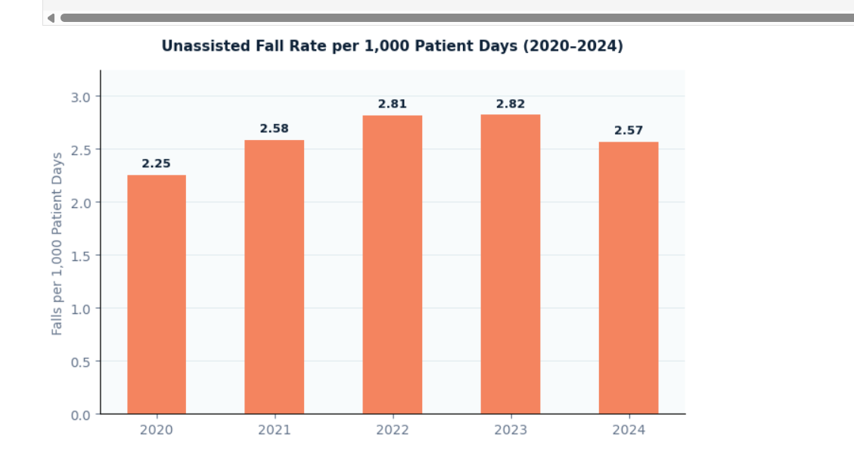
METRIC 3: UNASSISTED PATIENT FALL RATE PER 1,000 PATIENT DAYS
Are patients falling without staff present to assist?
2020 baseline: 2.25 Starting point — relatively lower fall rate before bed occupancy reached its peak.
2022–23 spike: 2.81–2.82 Highest recorded fall rates — coinciding exactly with the lowest staff responsiveness scores. Staff stretched too thin to prevent falls.
2024 improvement: 2.57 A slight recovery mirrors the partial rebound in staff responsiveness. Still above baseline — sustained action needed.
The 'per 1,000 patient days' unit normalizes for volume — it accounts for how many patients were in hospital and for how long, so comparisons across years are fair even if total patient volume changed.

Slide 8
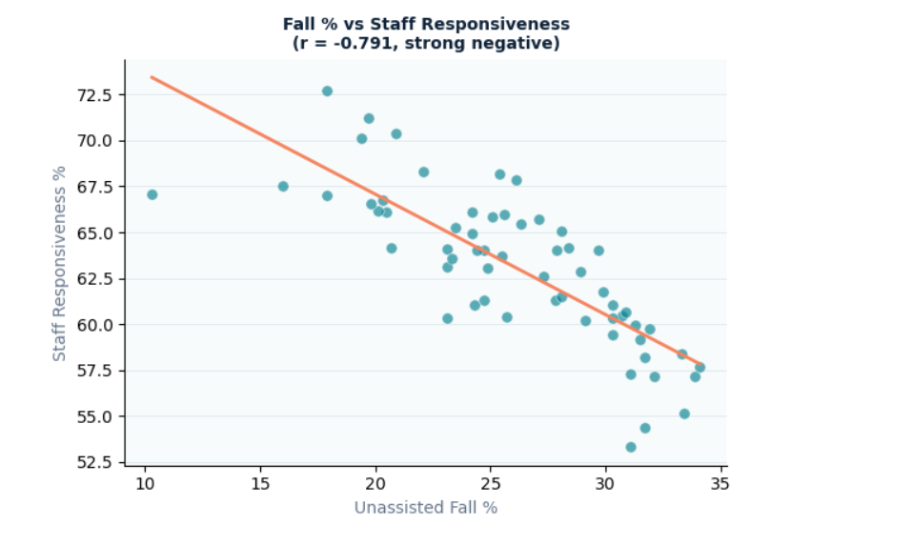
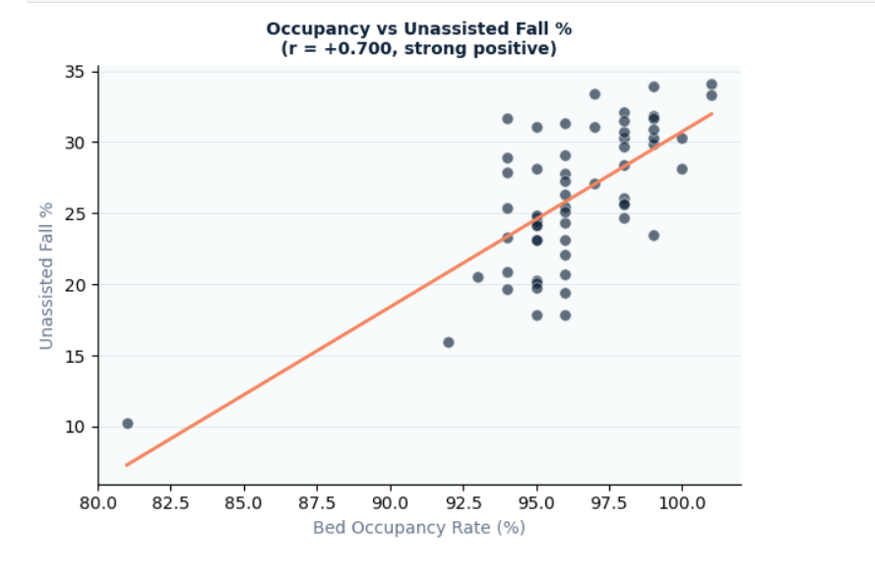
STATISTICAL ANALYSIS: HOW DO THE KPIS RELATE TO EACH OTHER?
Pearson correlation coefficients reveal the strength and direction of relationships
r = −0.791 | Strong Negative Correlation When unassisted falls increase, staff responsiveness drops sharply. Staff overwhelmed = patients falling unattended. Each 1% rise in fall rate coincides with a measurable dip in responsiveness score.
r = +0.700 | Strong Positive Correlation Higher bed occupancy directly drives more unassisted falls. As the hospital fills up, nursing staff are spread too thin — patients attempting to move independently without waiting for help.
How to read scatter plots: Each dot is one month of data. The orange diagonal line is the linear regression (trend line). Dots clustering tightly around this line indicate a strong relationship. The Pearson r value (−1 to +1) quantifies strength: |r| > 0.7 is considered a strong correlation.

Slide 9
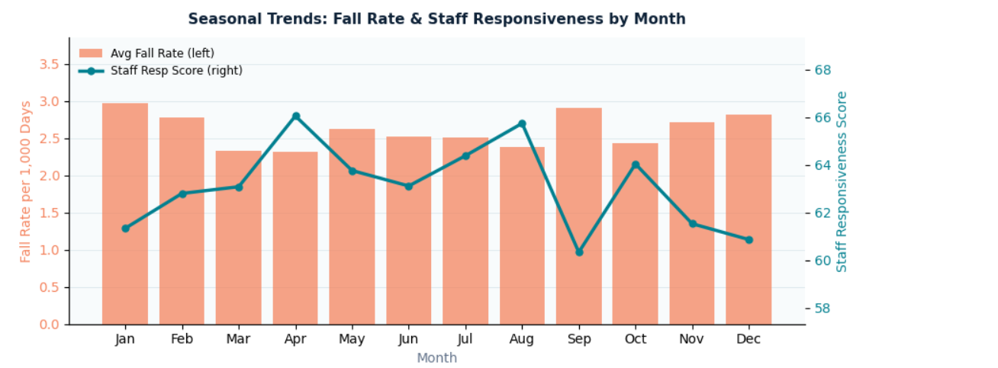
SEASONAL TRENDS: FALL RATE & STAFF RESPONSIVENESS BY MONTH
Are there predictable times of year when the hospital is most at risk?
Seasonal Patterns
High-risk months: Jan, Feb, Sep, Dec show elevated fall rates alongside lower staff responsiveness — a consistent inverse pattern across years. Lower-risk window: Mar–May and Jul–Aug see relatively better responsiveness scores with moderate fall rates. Why winter & year-end? Flu season drives higher admissions. Holiday staffing shortfalls reduce nurse availability. Year-end budget constraints may limit float pool access.
How to read: Orange bars (left axis) = average fall rate. Teal line (right axis) = average staff responsiveness score. When bars are tall and the line dips simultaneously, it confirms the inverse relationship is not just yearly — it repeats seasonally.
JAN
SEP
APR
DEC
High risk
Lowest resp.
Best resp.
High risk

Slide 10
SOLUTIONS & RECOMMENDATIONS
Data-driven actions for nursing staff and hospital leadership
01
Dynamic Staffing Models
02
Proactive Bathroom Rounding
03
Targeted Staff Training
When bed occupancy is forecasted to exceed 95%, automatically trigger additional support staff or float pool nurses specifically assigned to call-button coverage.
Data rationale: r = +0.700 between occupancy and falls confirms that overfill = under-support. Pre-emptive staffing breaks this chain.
During peak risk months (Jan, Sep, Dec) and during high-occupancy shifts, mandate scheduled nursing checks every 2 hours — proactively assisting patients before they attempt to move unassisted.
Data rationale: Monthly seasonal analysis shows fall rate spikes are predictable — they can be anticipated and staffed for, not just reacted to.
Train nursing staff on prioritization protocols during high-occupancy shifts — specifically how to triage call-button responses and bathroom requests to minimize time-to-response.
Data rationale: r = −0.791 between responsiveness and falls is the strongest signal in this dataset. Improving responsiveness even slightly during peak periods could yield significant fall reduction.

Slide 11
SUMMARY
Objective: Analyze how hospital capacity affects staff responsiveness and patient safety across 2020–2024 using three interconnected KPIs.
95–97%
Bed Occupancy
60.6%
Staff Responsiveness
Consistently at or above operational ceiling — no buffer for surges. National average is 65–75%.
Hit a critical low in 2022 — 7% below the 65% HCAHPS benchmark. Partial recovery to 64.4% by 2024.
2.82 peak
Unassisted Falls
−0.791
Correlation (r)
Worst in 2022–23, aligning precisely with the lowest responsiveness period. Improved slightly in 2024.
Strongest signal: responsiveness and falls are tightly linked. When one drops, the other spikes — predictably.
Conclusion: This analysis confirms that bed occupancy, staff responsiveness, and patient falls are not independent events — they form a chain reaction. Reducing falls requires breaking this chain upstream: through predictive staffing, proactive rounding protocols, and targeted training during high-risk periods. These interventions are low-cost, data-backed, and implementable without capital investment.

Slide 12
THANK YOU
Lisha Bhowmik
BBA Graduate · Data & Business Analyst
Open to questions and discussion
Lowell General Hospital KPI Analysis | Python · Pandas · SciPy · Matplotlib | 2020–2024

