Slide 1
Secure data hiding in images using Steganography
CAPSTONE PROJECT
Presented By: Rohan Nayakanti
Student Name : Rohan Nayakanti
College Name & Department : Jain University, Bachelor’s in Technology – Computer Science and Engineering (Cybersecurity)

Slide 2
OUTLINE
Problem Statement
Technology used
Wow factor
End users
Result
Conclusion
Git-hub Link
Future scope

Slide 3
Problem Statement
Develop an advanced steganography technique to securely embed and extract confidential text messages within digital images. The solution should ensure minimal distortion while maintaining high security. Implement an efficient encoding and decoding mechanism, ensuring robustness against common image manipulations like compression and resizing, while preserving data integrity and confidentiality.

Slide 4
Technology Used
Streamlit: Web app development for interactive UIs and dashboards.
PIL (Pillow): Image processing (open, manipulate, save images).
NumPy: Scientific computing, array/matrix operations.
io: Handling file streams and in-memory data.
PyQRCode: QR code generation.
Wave: Reading/writing .wav audio files.
Time: Time-related tasks (e.g., pauses, intervals).
PyCryptodome (AES): AES encryption/decryption, secure random bytes.
Base64: Encoding/decoding binary data to/from text.

Slide 5
Wow factors
AES-256 Encryption for Secure Messages
Multiple Image Format Support
Image Quality Preservation
Encoding Intensity Selection (Low, Medium, High)
Web-Based Sharing with QR Code Generation
AI-Based Hidden Message Detection
Dual-Mode Steganography (Image & Audio)
Mobile-Friendly UI
Steganalysis-Resistant Encoding

Slide 6
End users
Cybersecurity Enthusiasts & Researchers – Those experimenting with secure communication techniques.
Journalists & Whistleblowers – Individuals needing secure ways to share sensitive information.
Law Enforcement & Intelligence Agencies – For covert communication in high-security environments.
Privacy-Conscious Individuals – People who want to protect personal messages.
Software Developers & Ethical Hackers – Those integrating steganography into security tools.
Academicians & Students – Learning about cryptography, data hiding, and security concepts.

Slide 7
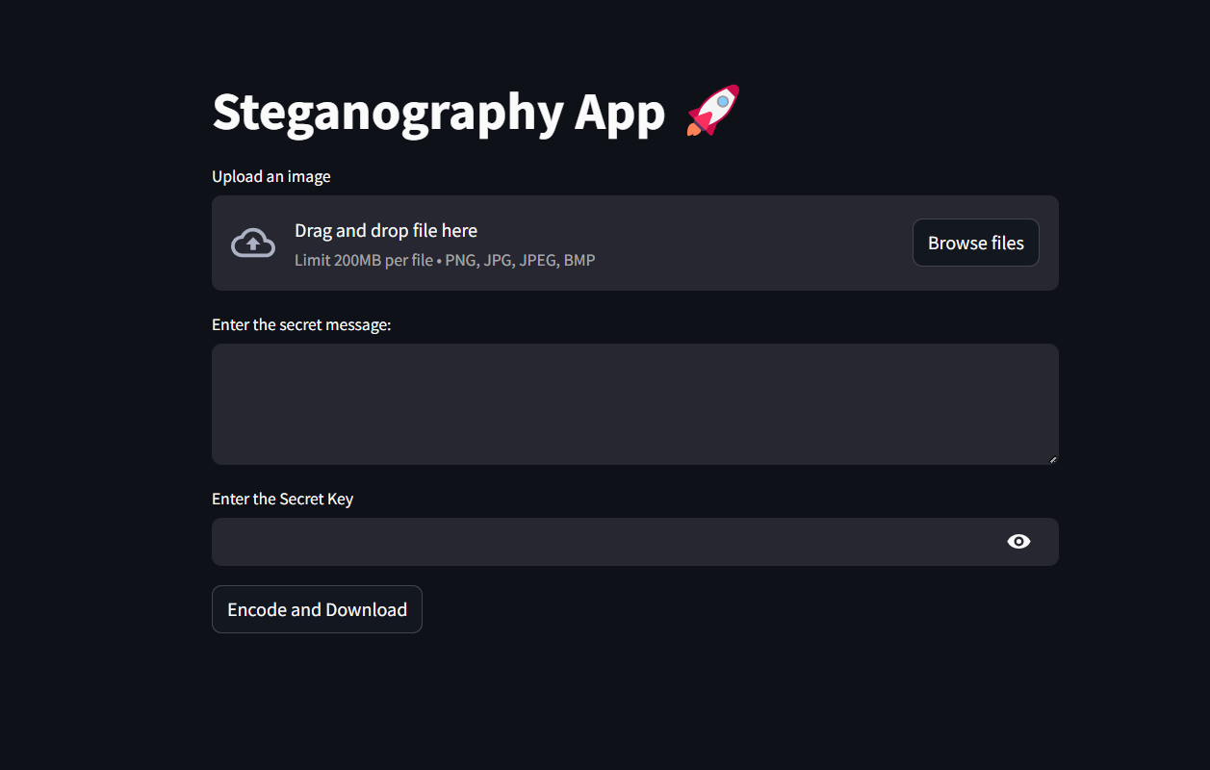
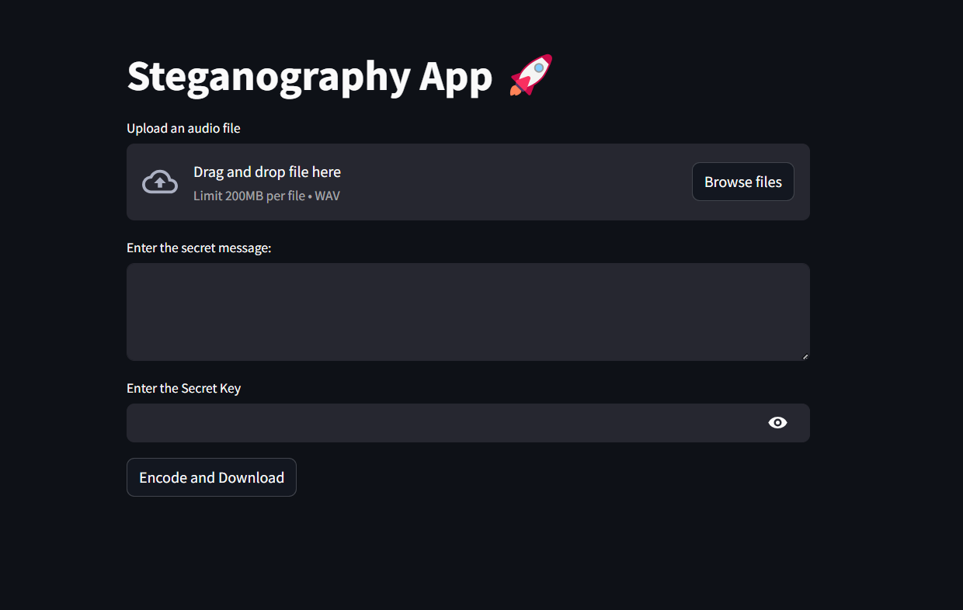
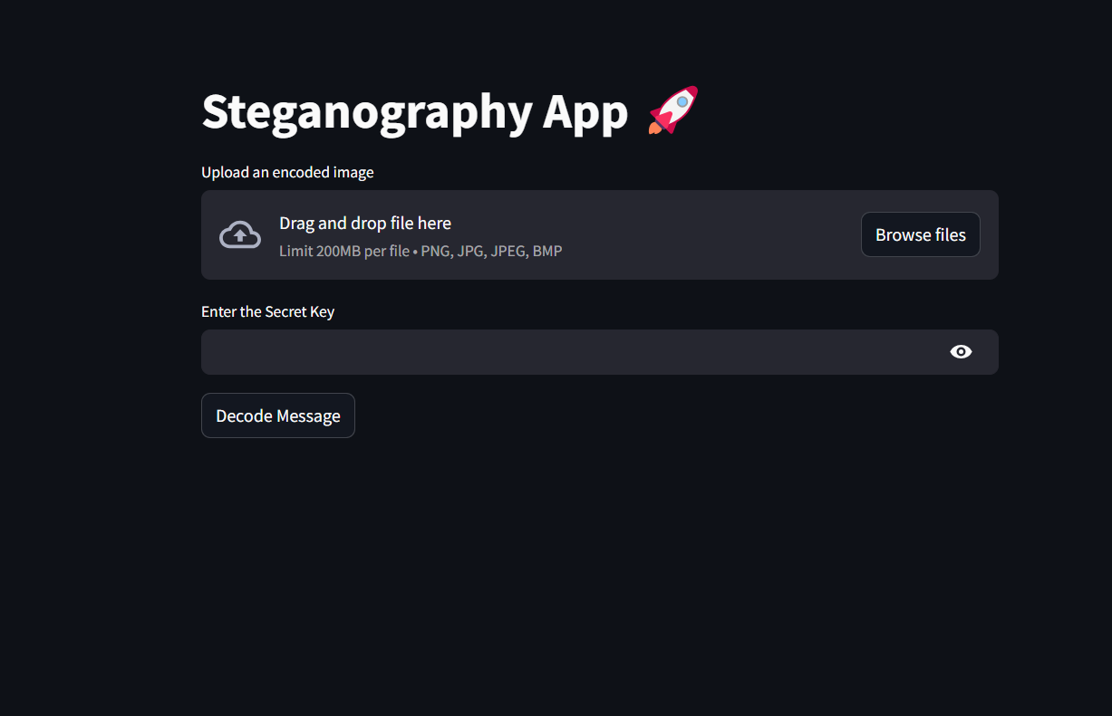
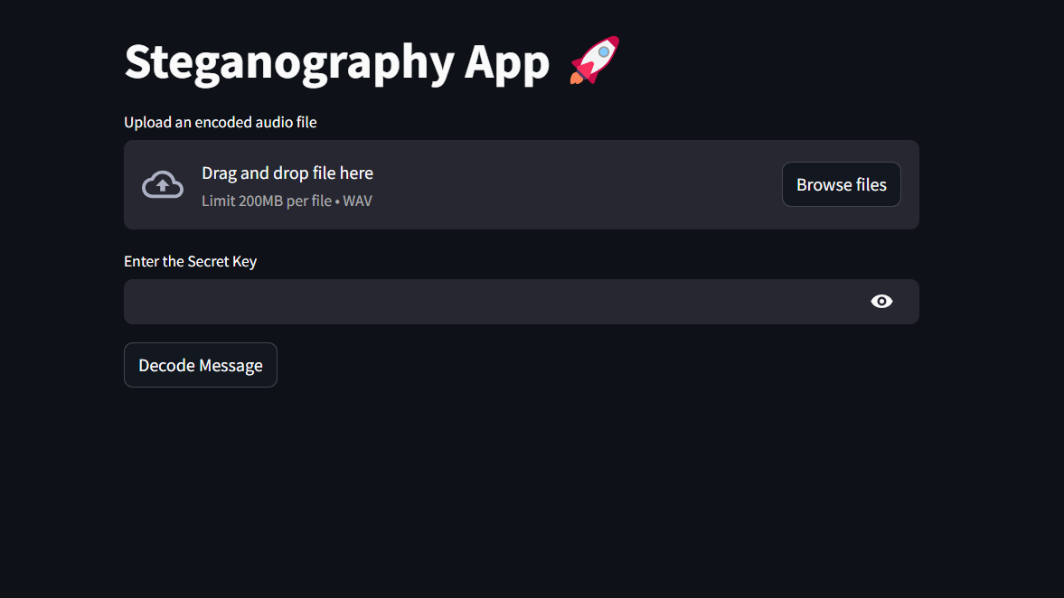
Results

Slide 8
Conclusion
This Steganography App provides a seamless and secure way to hide messages within images using AES-256 encryption. With an intuitive Streamlit-based GUI, users can encode and decode messages efficiently while maintaining privacy. The addition of a QR code generator for easy sharing and loading indicators for process estimation enhances the user experience.
This tool is ideal for cybersecurity enthusiasts, privacy-conscious users, and professionals dealing with sensitive information. By integrating modern encryption techniques with steganography, it ensures data confidentiality and security in real-world applications.

Slide 9
GitHub Link
https://github.com/ZealExorcist/Steganography_App.git

Slide 10
Future scope
Support for Video Steganography: Extend the tool to encode messages within video frames for enhanced security.
AI-Powered Steganalysis Resistance: Implement AI-based techniques to evade detection by steganalysis tools.
Multi-Layer Encryption & Encoding: Introduce multiple layers of encryption and encoding for higher security.
Cloud & Blockchain Integration: Store and retrieve encoded messages securely using blockchain or cloud storage.
Real-Time Messaging with Steganography: Develop a secure messaging platform using steganography for real-time communication.
Cross-Platform Support: Expand support for mobile devices and web-based usage.
Improved Performance & Compression: Optimize encoding/decoding algorithms for faster processing and smaller file sizes.

Slide 11
THANK YOU

