Slide 1
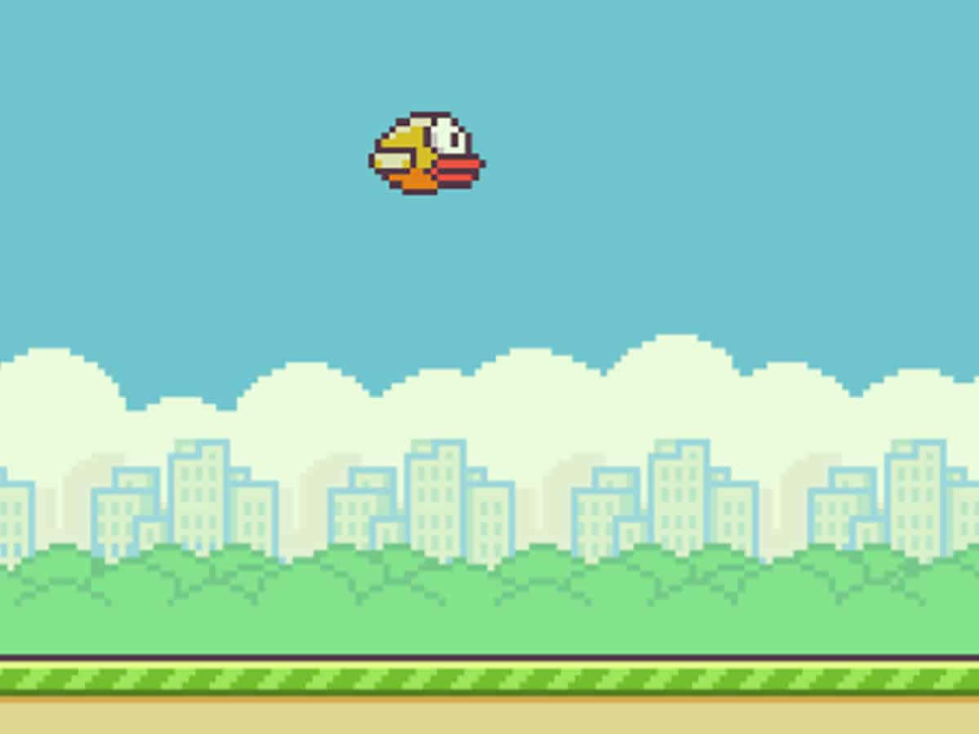
Flappy Bird Semester Project
By Dominick Irizarry

Slide 2

All Files in the Project
bird.py - handles gravity, velocity, flapping, and drawing the bird
game.py - manages game state (playing or game over), spawns pipes, checks for collisions, tracks the score and highscore
main.py - initializes pygame, runs the main game loop, and handles the game window
pipe.py - responsible for spawning all pipes, moving pipes, and detecting all off-screen pipes
requirements.txt - (just states pygame is required to run)

Slide 3
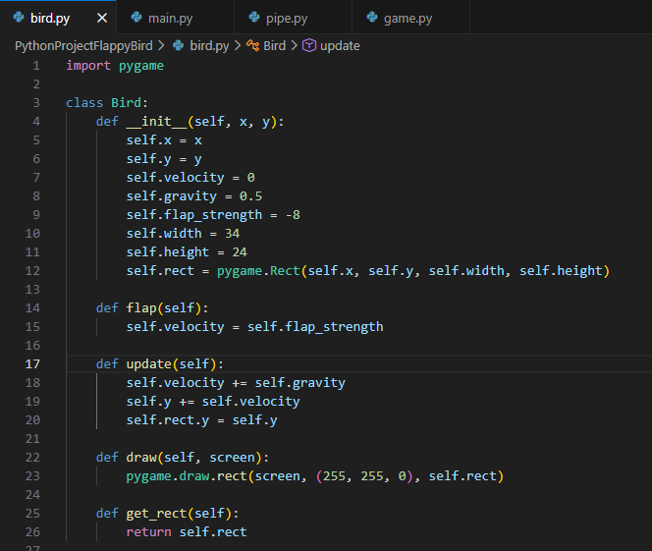
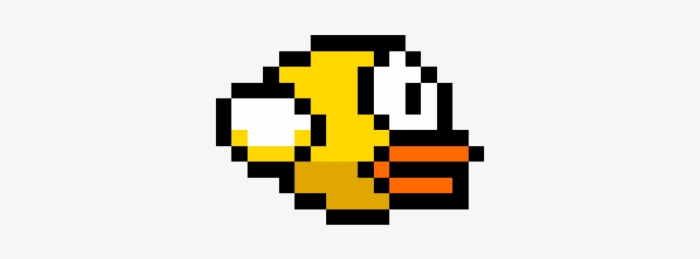
Code Snippet 1
handles gravity, velocity, and flapping physics
Notes:
__init__ — "Initializes the bird's position, velocity, gravity, and hitbox"
flap — "Sets velocity upward when spacebar is pressed"
update — "Applies gravity every frame and syncs the hitbox position"
draw — "Renders the bird as a yellow rectangle"
get_rect — "Returns the hitbox for collision detection

Slide 4
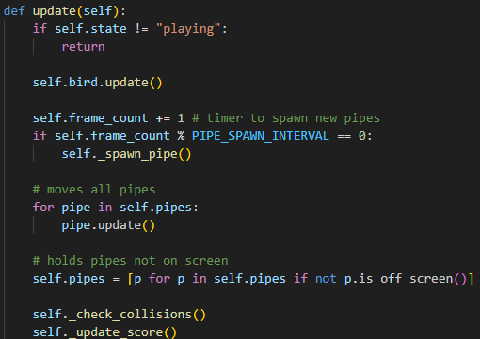
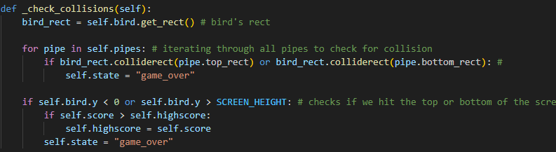
Code Snippet 2
From Game.py -
manages the game loop, pipe spawning timer, and collision detection
Notes:
For update:
first if — "if the game isn't playing we stop updating, so nothing moves on game over screen"
frame_count line — "we use a frame counter as a timer to spawn a new pipe every 90 frames"
for loop — "moves every pipe left each frame"
list comprehension — "automatically removes pipes that have gone off screen"
For _check_collisions:
bird_rect line — "grabs the bird's hitbox"
for loop — "checks every pipe to see if the bird overlaps with the top or bottom"
last if — "also checks if the bird flew off the top or bottom of the screen"
highscore lines — "saves the high score before switching to game over state"

Slide 5
Live Demo
Let's Play!

Slide 6
