Slide 1

AWS

Slide 2
Suggest server setup
Production
Staging
Testing

Slide 3
Production
Only changed when a release happens
Should always be working after first release
Very few people have access to this server

Slide 4
Staging
Used to make sure the solution works on staging before pushed to production
If done correctly, things that break should be caught on this server and not production
Similar access level to production

Slide 5
Testing
This is where feature branch testing should be done if it can not be done locally
Each dev member should have access to testing

Slide 6
Suggested roles
Owner
Admin
Dev

Slide 7
Common problems
Server not able to reach the internet
Server can not display games

Slide 8
Problem:Server can not reach internet
This is a networking problem.
Use an elatic IP, with auto assign public IP on. Make an internet gateway and attach it to your VPC
in your route tables, make sure 0.0.0.0/0 is in there
Ensure your EC2 instance is in a public subnet (a subnet with a route to the IGW)

Slide 9
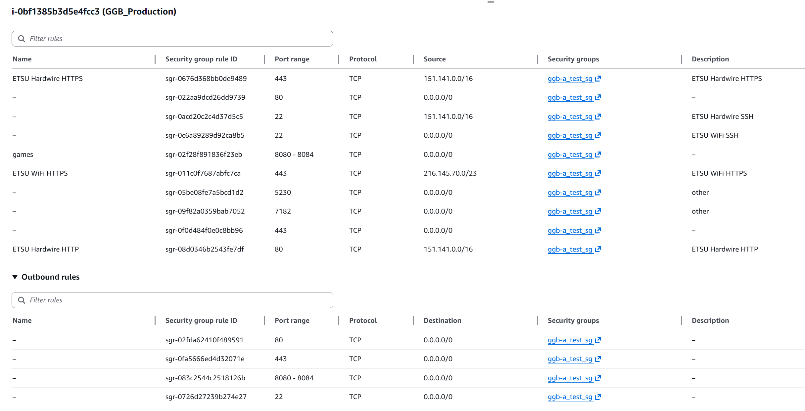

Slide 10
Problem:Server can not display games
Likely one of three issues
Ip mismatch: a lot of files require the ip address to match the servers. The deploy and ec2_init scripts when run should fix this
Ports no open: Look at the slide before to be sure the right ports are open
Docker compose not done: make sure you run docker start $(docker ps -aq) to start all containers

