Slide 1
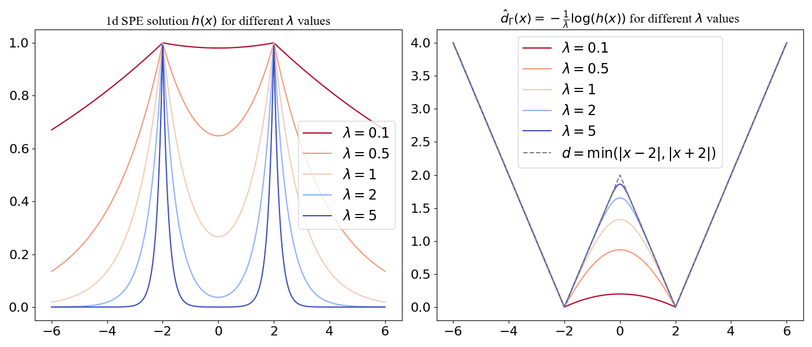
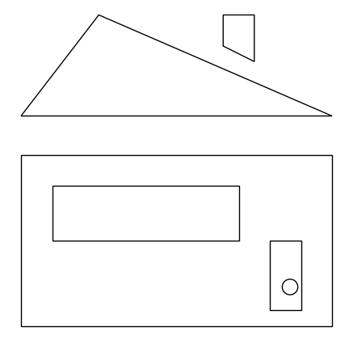
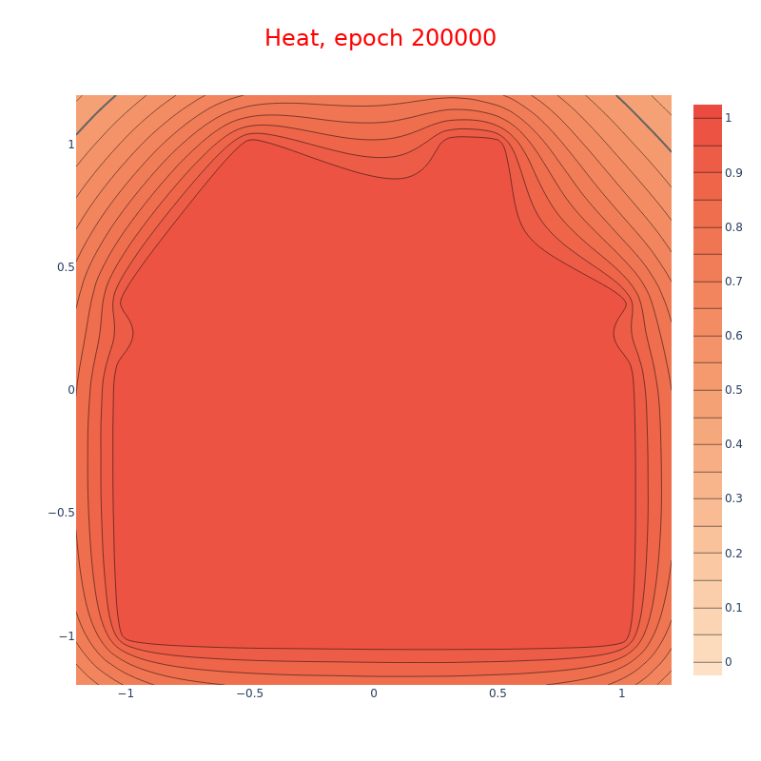
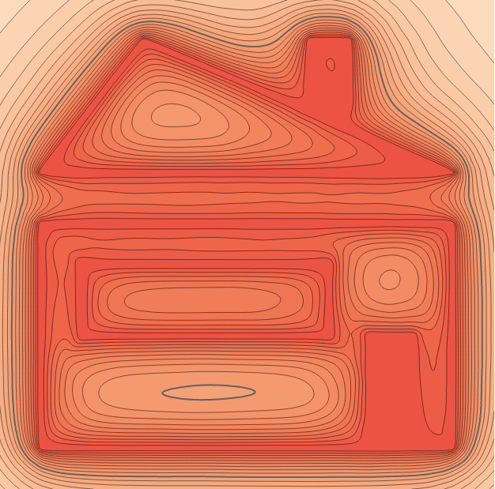
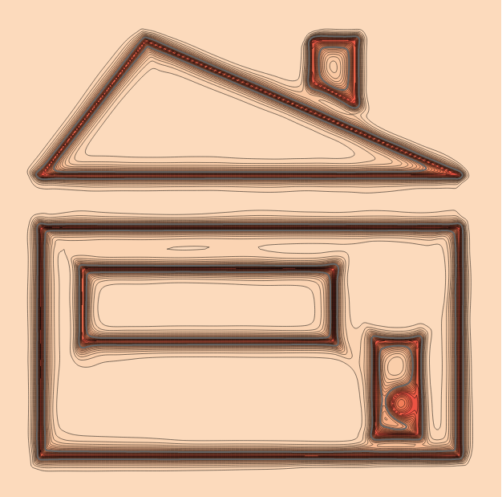




Solutions to the 1D SPE, $Γ=\{−2, 2\}$
Corresponding Reconstructions
Solutions to the 2D SPE, $Γ=$ Point Cloud “House” for Varying Absorption Coefficients
1.0
0.5
0.0
(a) Point Cloud “House”
(b) $λ=1$
(c) $λ=5$
(d) $λ=50$

