Slide 1
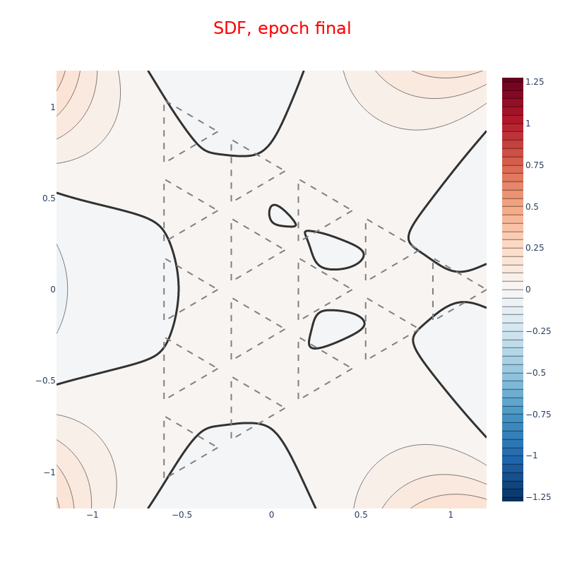
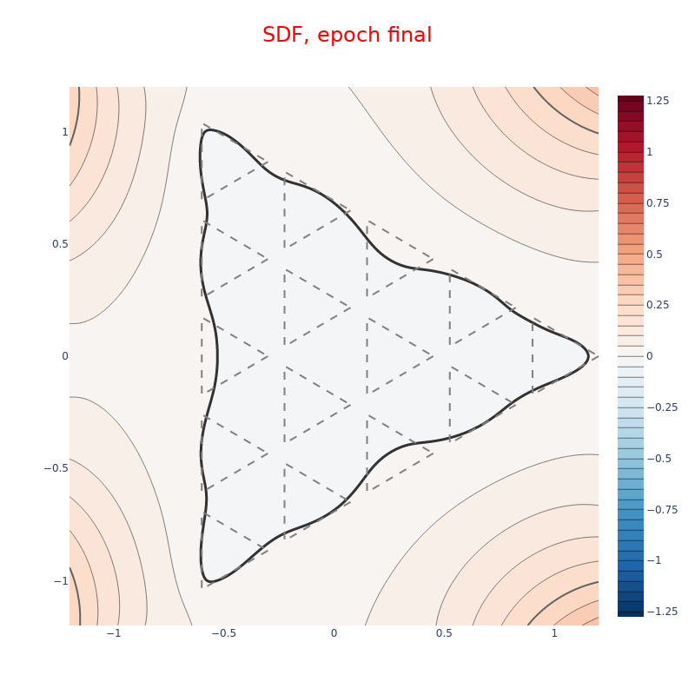
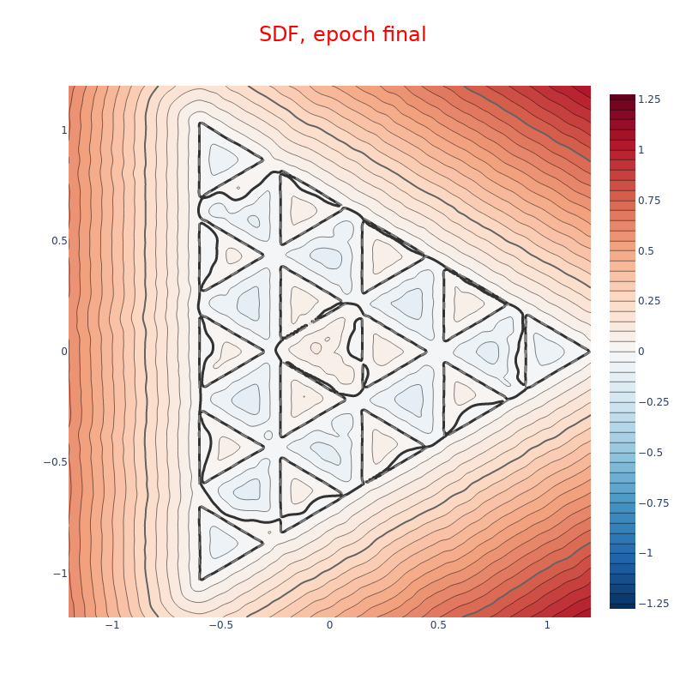
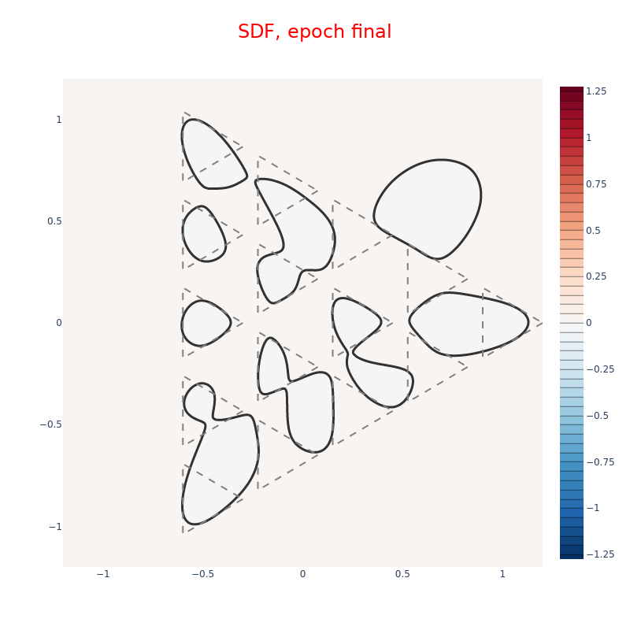
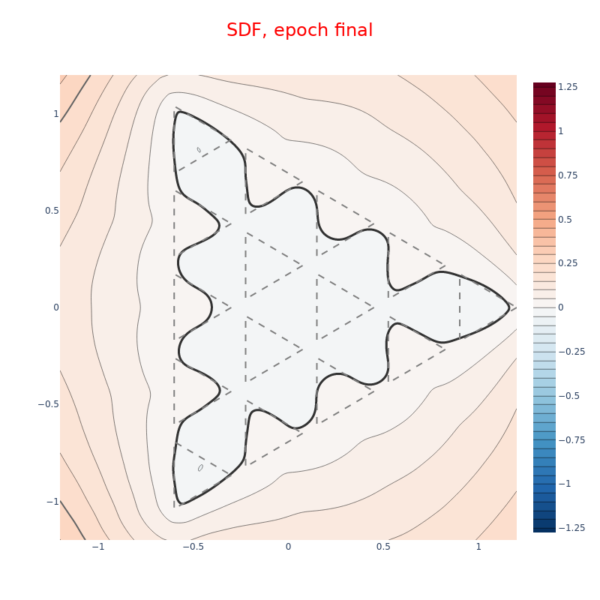
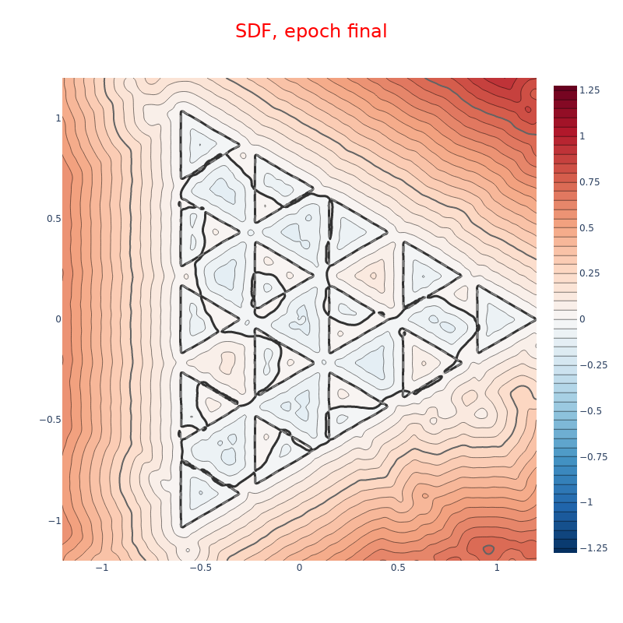
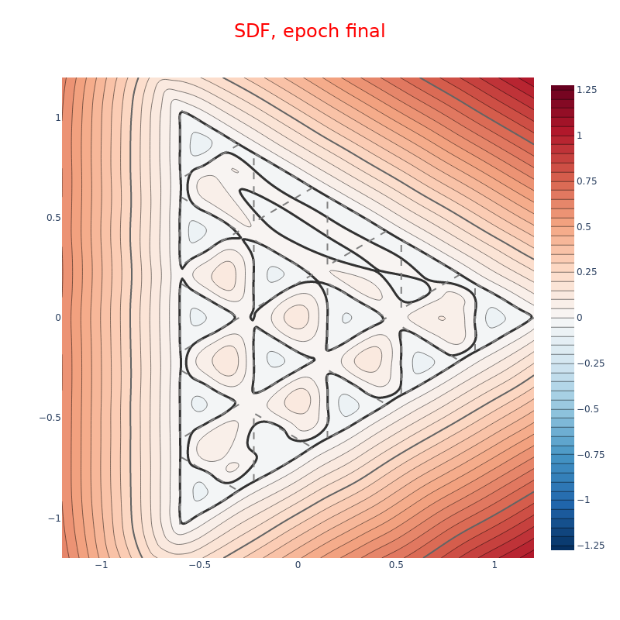
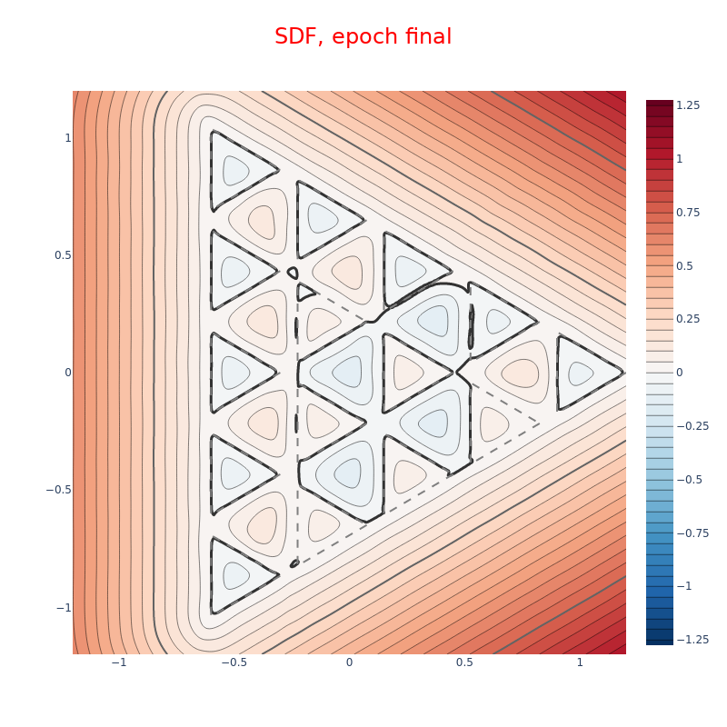
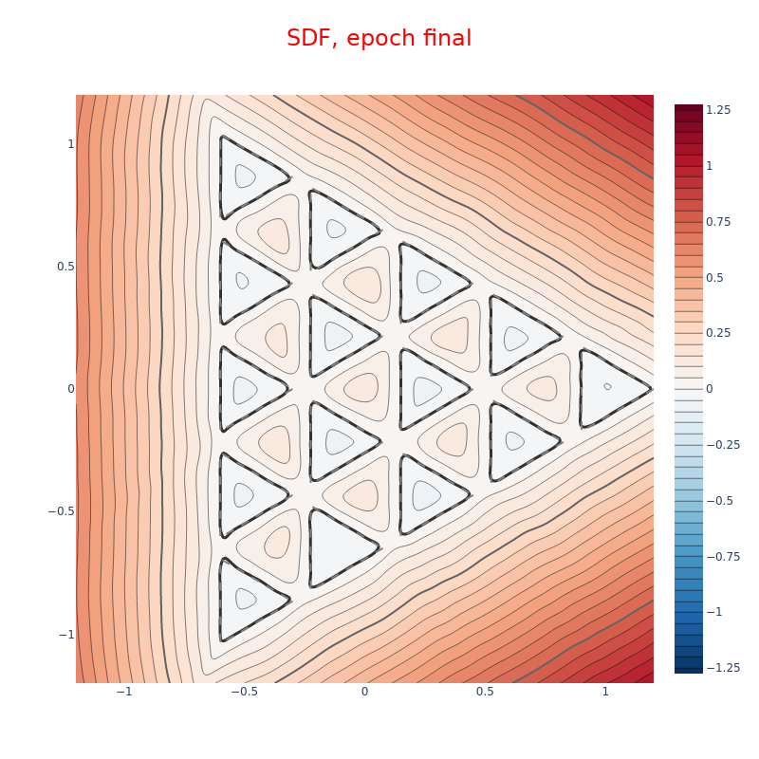

Slide 3
(a) DiGS losses w/o area loss
(b) DiGS losses
(c) Original DiGS
(d) StEik losses w/o area loss
(e) StEik losses
(f) Original StEik
(g) IGR losses
(h) SAL losses
(i) HotSpot losses

Slide 4
DiGS losses
w/o area loss
(b) DiGS losses
(c) Original DiGS
(d) StEik losses
w/o area loss
(e) StEik losses
(f) Original StEik
(g) IGR losses
(h) SAL losses
(i) HotSpot losses

