Slide 1
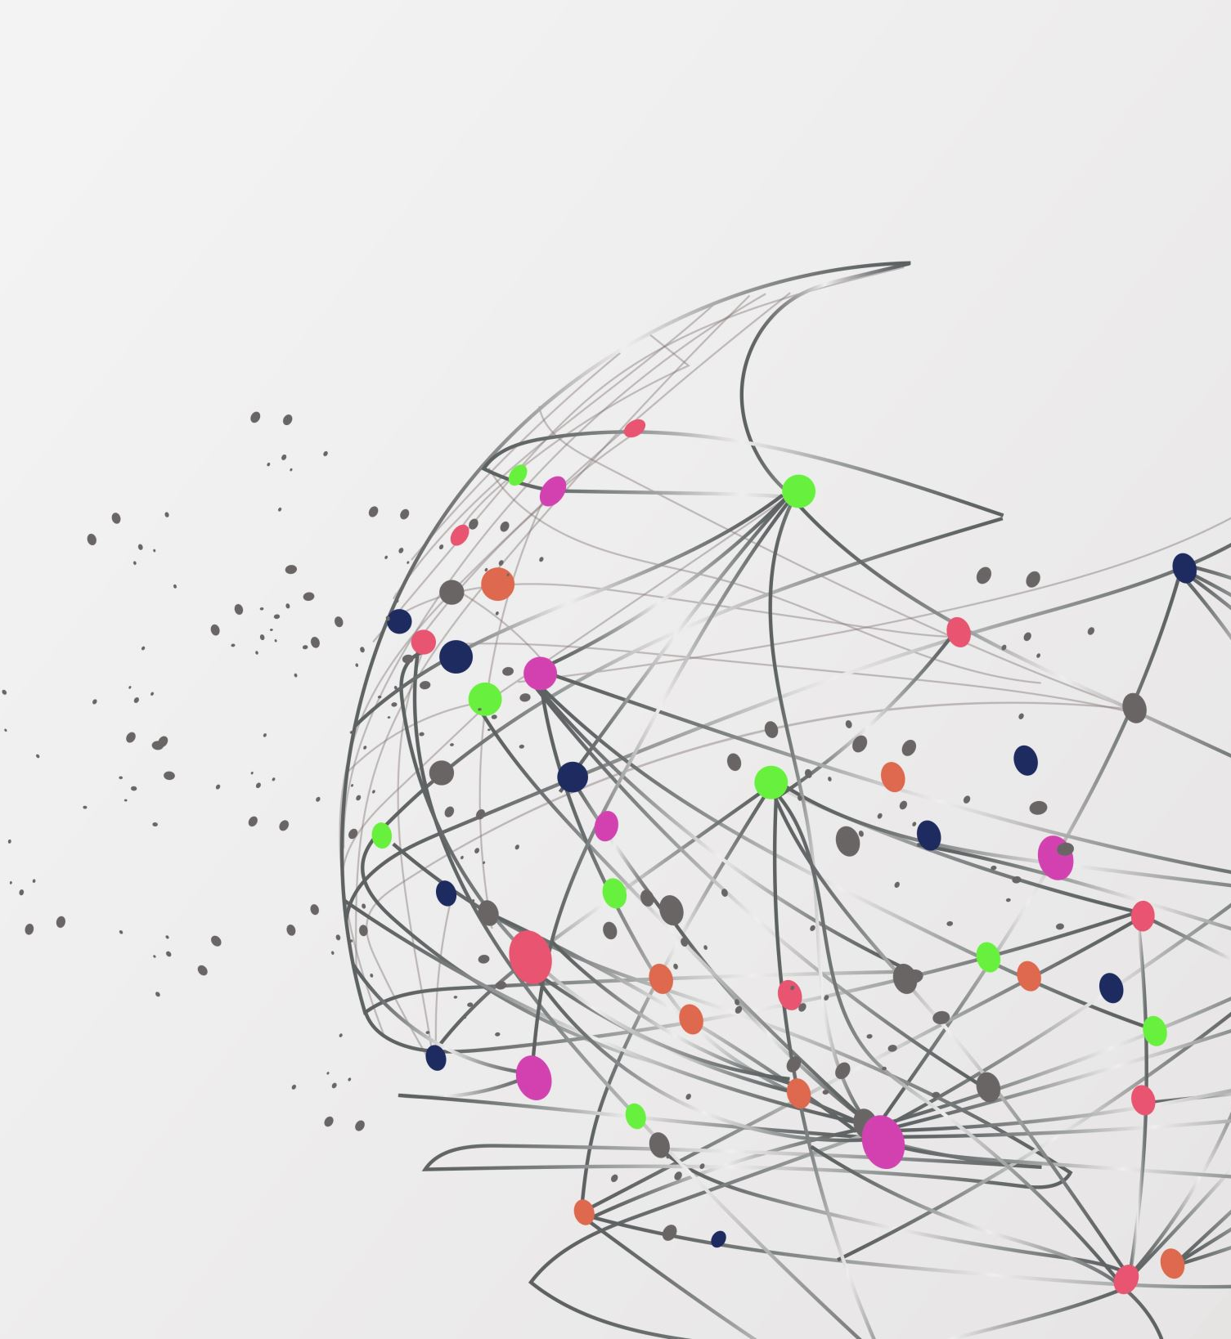
Asian Women Advancing AI
Learn & LeaD: RAG
Zeba Karkhanawala
AI Agents Developer Intern, Virgent AI
mailto:karkhanawalazeba@gmail.com

Slide 2
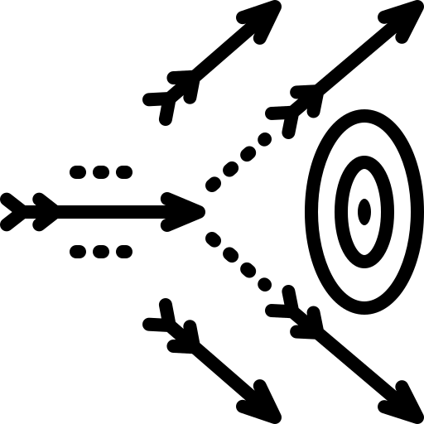




Challenges with Traditional ChatGPT for File-Based Queries
Cutoff Date
Static
Accuracy
Hallucination
ChatGPT lacks access to external data once trained, limiting its knowledge scope to the cutoff date.
Cannot dynamically ingest and process user-provided files during a session.
Struggles with answering questions accurately for large or complex documents without specific context.
May hallucinate information if the requested data is outside its training set.

Slide 3
Why RAG Is the Solution?
Real-Time Data Access
Combines generative AI with up-to-date information from external sources.
File Integration
Dynamically retrieves and processes information from large, complex documents.
Improved Accuracy
Provides grounded, evidence-backed answers by retrieving relevant context.
Scalability
Efficiently handles large datasets or documents without overwhelming memory constraints.

Slide 4
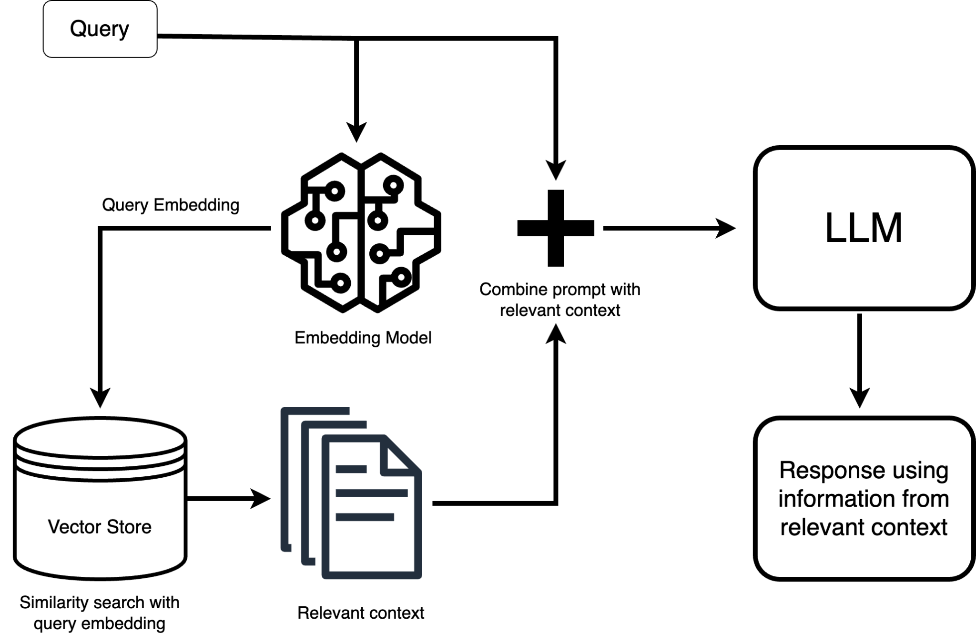
RAG Architecture Overview
RAG enhances LLM responses by combining them with relevant information retrieved from a knowledge base, leading to more accurate and contextual outputs.
1. Query Processing
- User query is converted to vector embedding
- Same embedding model processes both query and documents
2. Information Retrieval
- Query embedding used for similarity search in vector store
- Most relevant documents are retrieved as context
3. Response Generation
- Query and retrieved context combined into prompt
- LLM generates response using both prompt and context
- Final output combines retrieved information with LLM's knowledge
(Source)

Slide 5
Why RAG Stands Out?
Personalization
Tailor responses based on user context and retrieved data.
Dynamic Updates
Works with live databases, ensuring fresh and relevant information.
Data Privacy
Enables secure queries on private datasets, protecting sensitive information from external exposure.
Cost Efficiency
Reduces computation by focusing only on relevant parts of data. No need to train a Large Language Model.
Modularity
Flexibility to integrate with existing systems like CRMs, analytics tools, etc.

Slide 6
Limitations of rag
Data Quality Dependency
The system's output is only as good as its knowledge base - poor, outdated, or missing data leads to inaccurate or incomplete responses.
Computational Overload
Requires significant computational resources for both retrieval and generation, causing increased latency and higher operational costs
Retrieval Accuracy
The retrieval component may fail to fetch the most relevant information or misinterpret semantic relationships, leading to irrelevant responses
Context Integration
Systems struggle to seamlessly blend retrieved information with generated content, often producing disjointed or incoherent responses
and some more…

Slide 7




RAG in Action
Customer Support
Instant and accurate responses from support documentation or FAQs.
Healthcare
Medical diagnosis support by retrieving relevant studies and patient records.
Finance
Extracting insights from market reports, financial data, and client queries.
Education
Personalized tutoring by fetching information from course materials.
More Use Cases of RAG

Slide 8
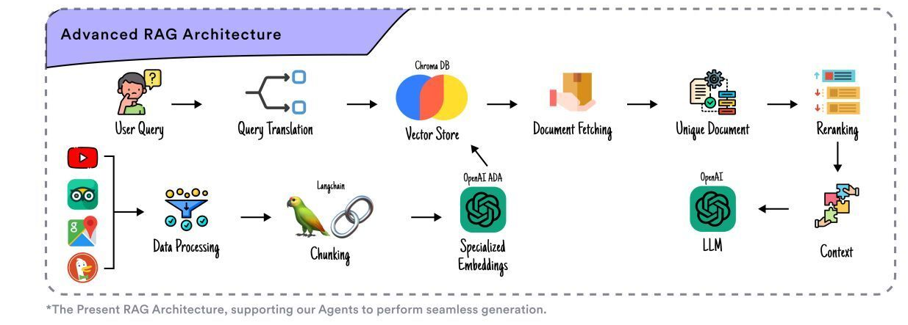
Intripid
Intripid, is an AI-powered travel planner. Based on your personality and your preferences it creates a travel itinerary for you for your trip.
What’s Next? is a website where you put your location and your preferences, and it will suggest you a place to go next.
What’s Next? https://dev.intripid.co/whats-next
(open on mobile)

Slide 9
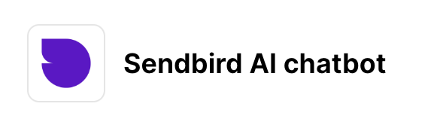

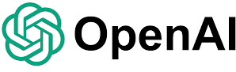
Industry level rag implementation example
+
Shopify Sendbird AI Chatbot using RAG to query Shopify's data
Morgan Stanley's RAG Architecture for Wealth Management
Read more: https://www.projectpro.io/article/rag-use-cases-and-applications/1059

Slide 10
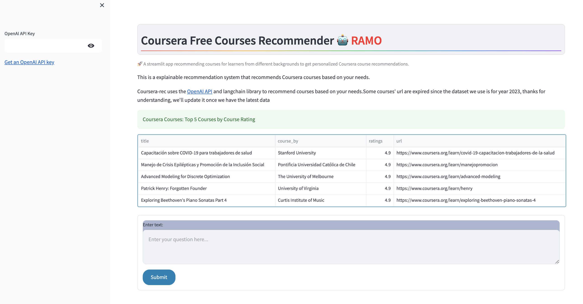
RAMO: Retrieval-Augmented Generation for Enhancing MOOCs Recommendations

Slide 11
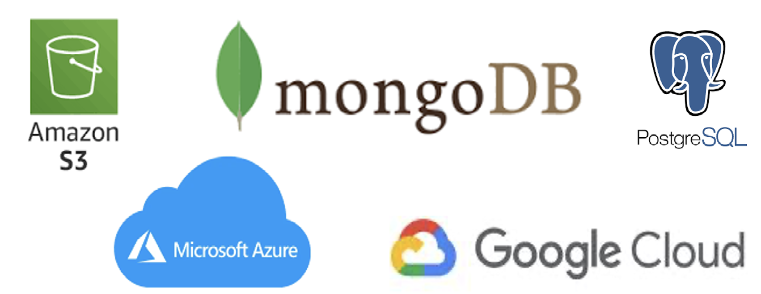
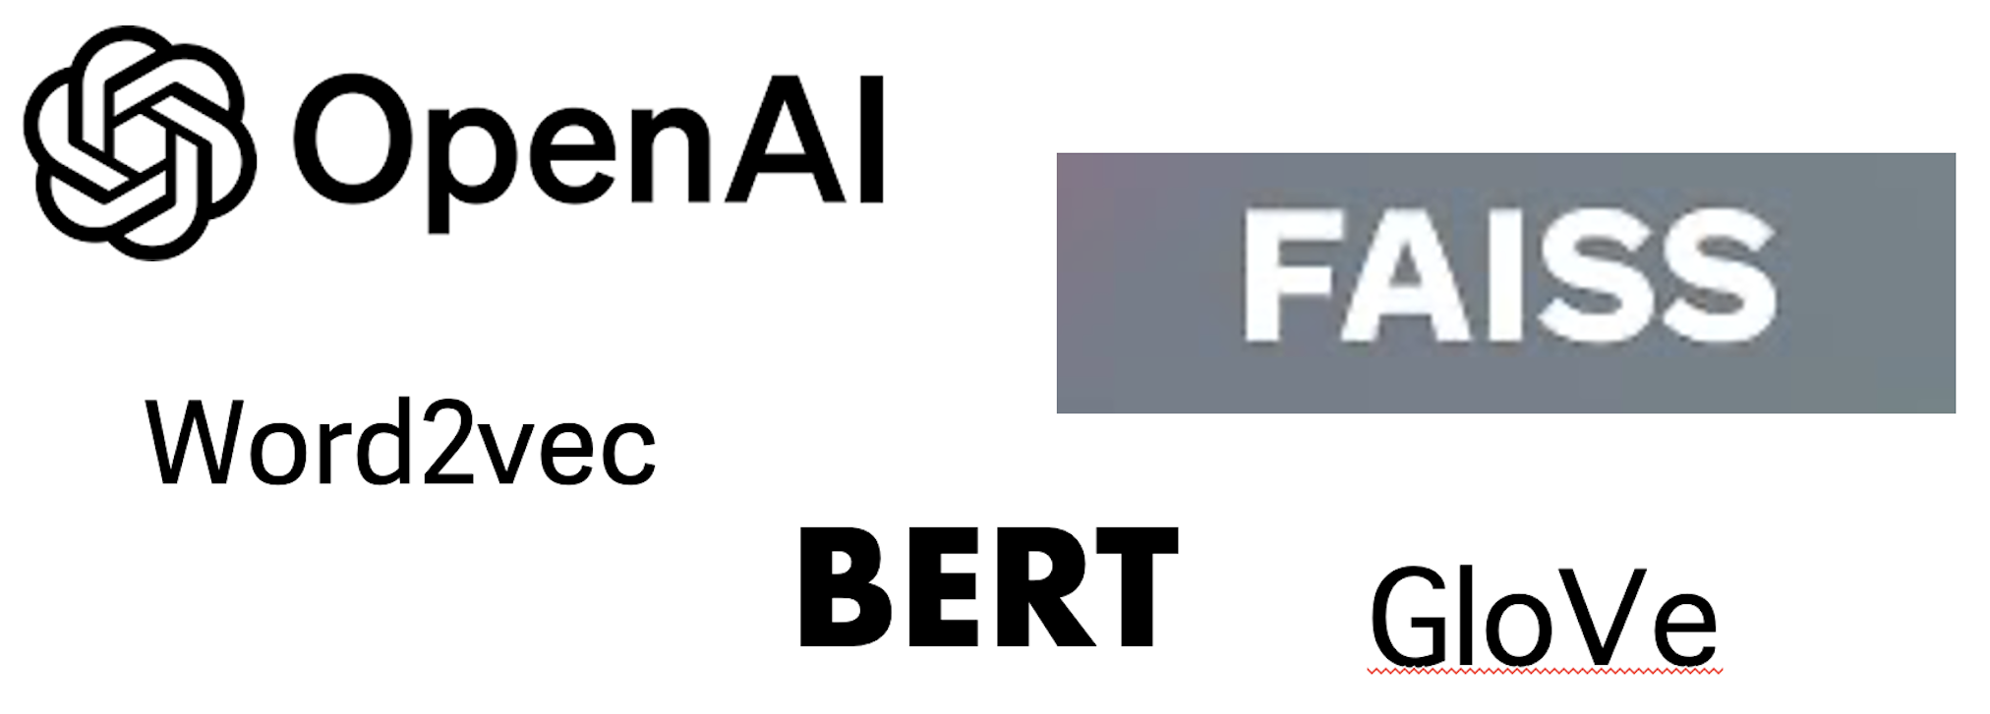
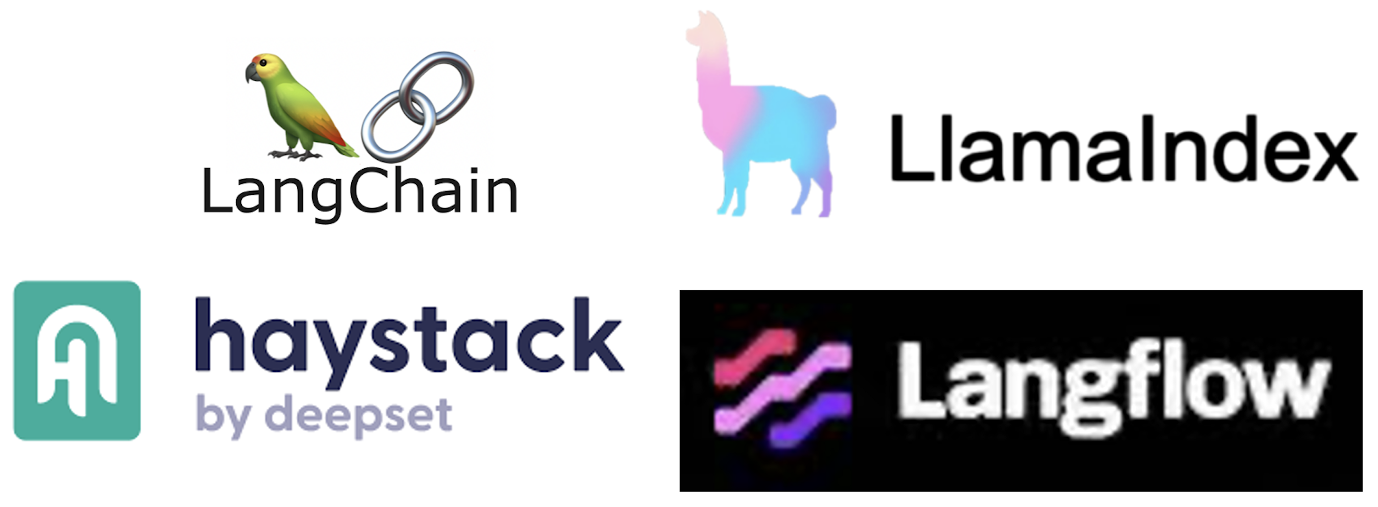
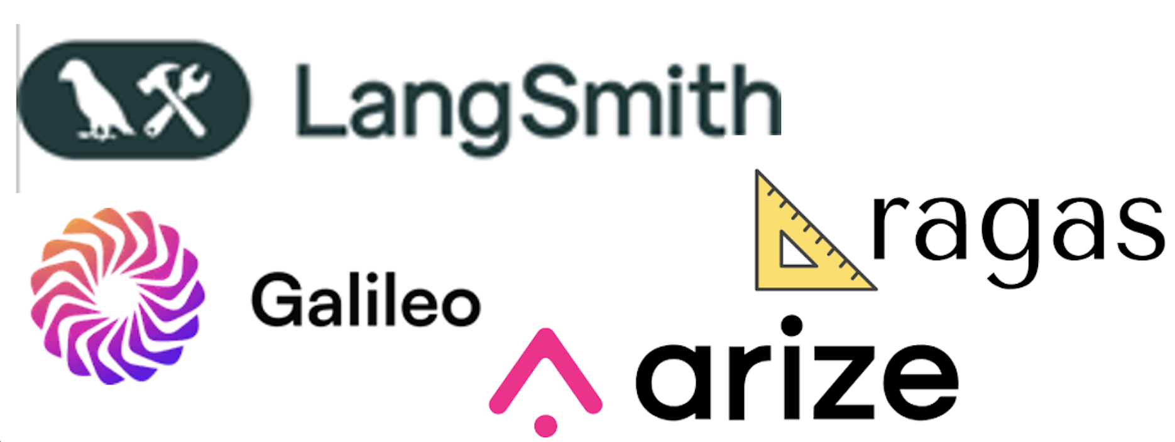
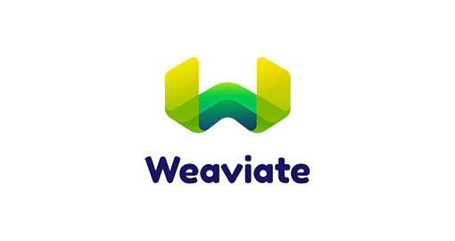


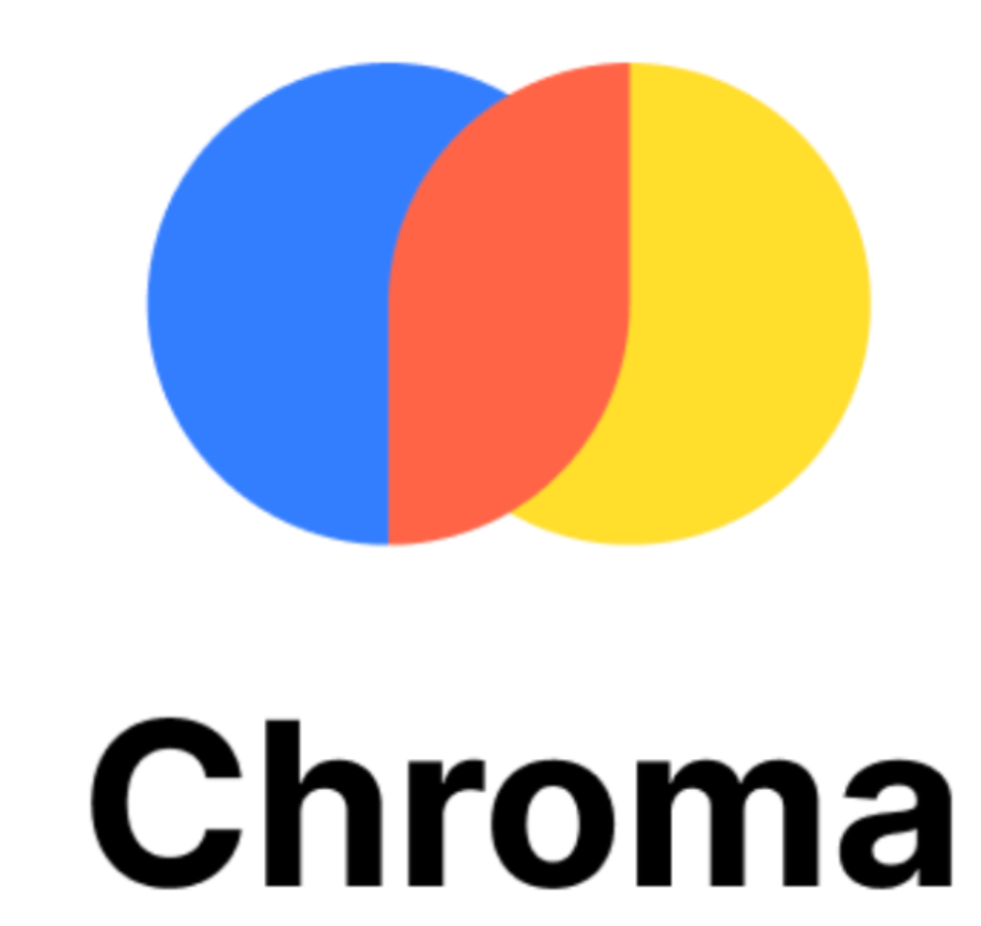
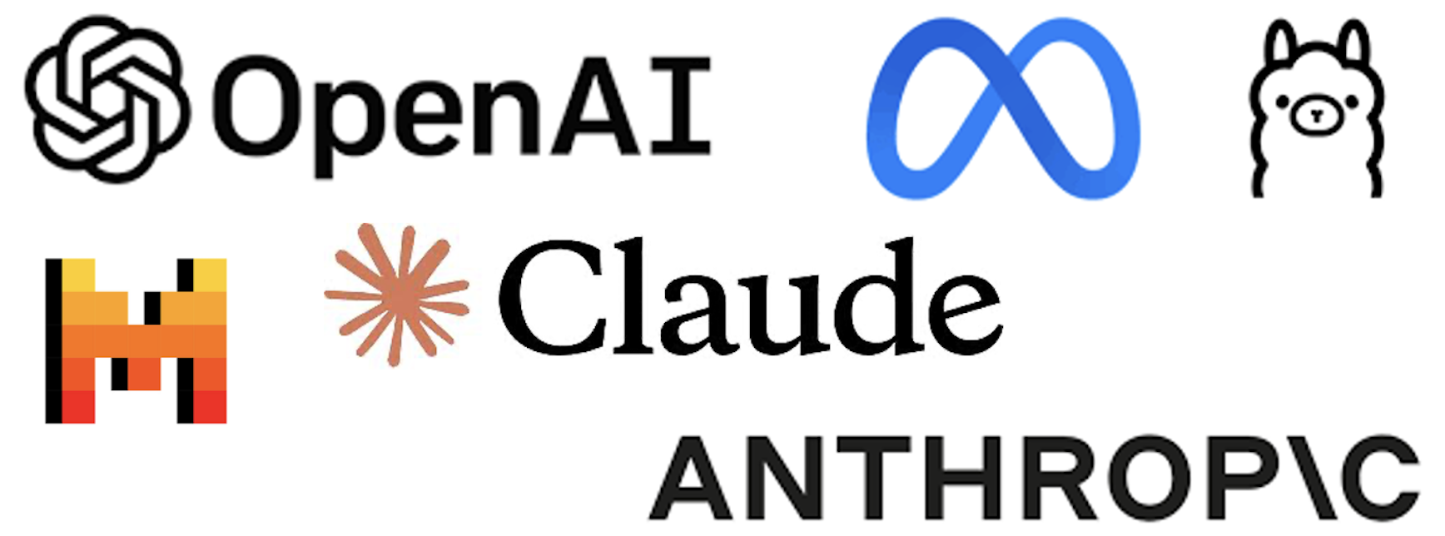
Tech stack for rag
Data Store
Vector Embedding Models
Data, stored in raw format in the Data Store is then converted to vector embeddings, stored in a Vector Store by passing through Vector Embedding Models.
LLM Frameworks
Evaluation & Monitoring
User Query
Vector Stores
Retrieved Documents
Large Language Models
Augmented Prompt
Output

Slide 12
Rag evaluation
Context Relevance
Measures how well retrieved documents align with the user's query. High context relevance indicates the system is fetching the most appropriate information needed to answer the question.
Answer Relevance
Assesses if the final response directly addresses the user’s question with appropriate information. It measures both semantic alignment and completeness of the answer relative to the query.
Groundedness/Faithfulness
Evaluates if the generated response is factually supported by the retrieved context, ensuring every statement can be traced back to source documents. This prevents hallucination and maintain factual accuracy.

Slide 13
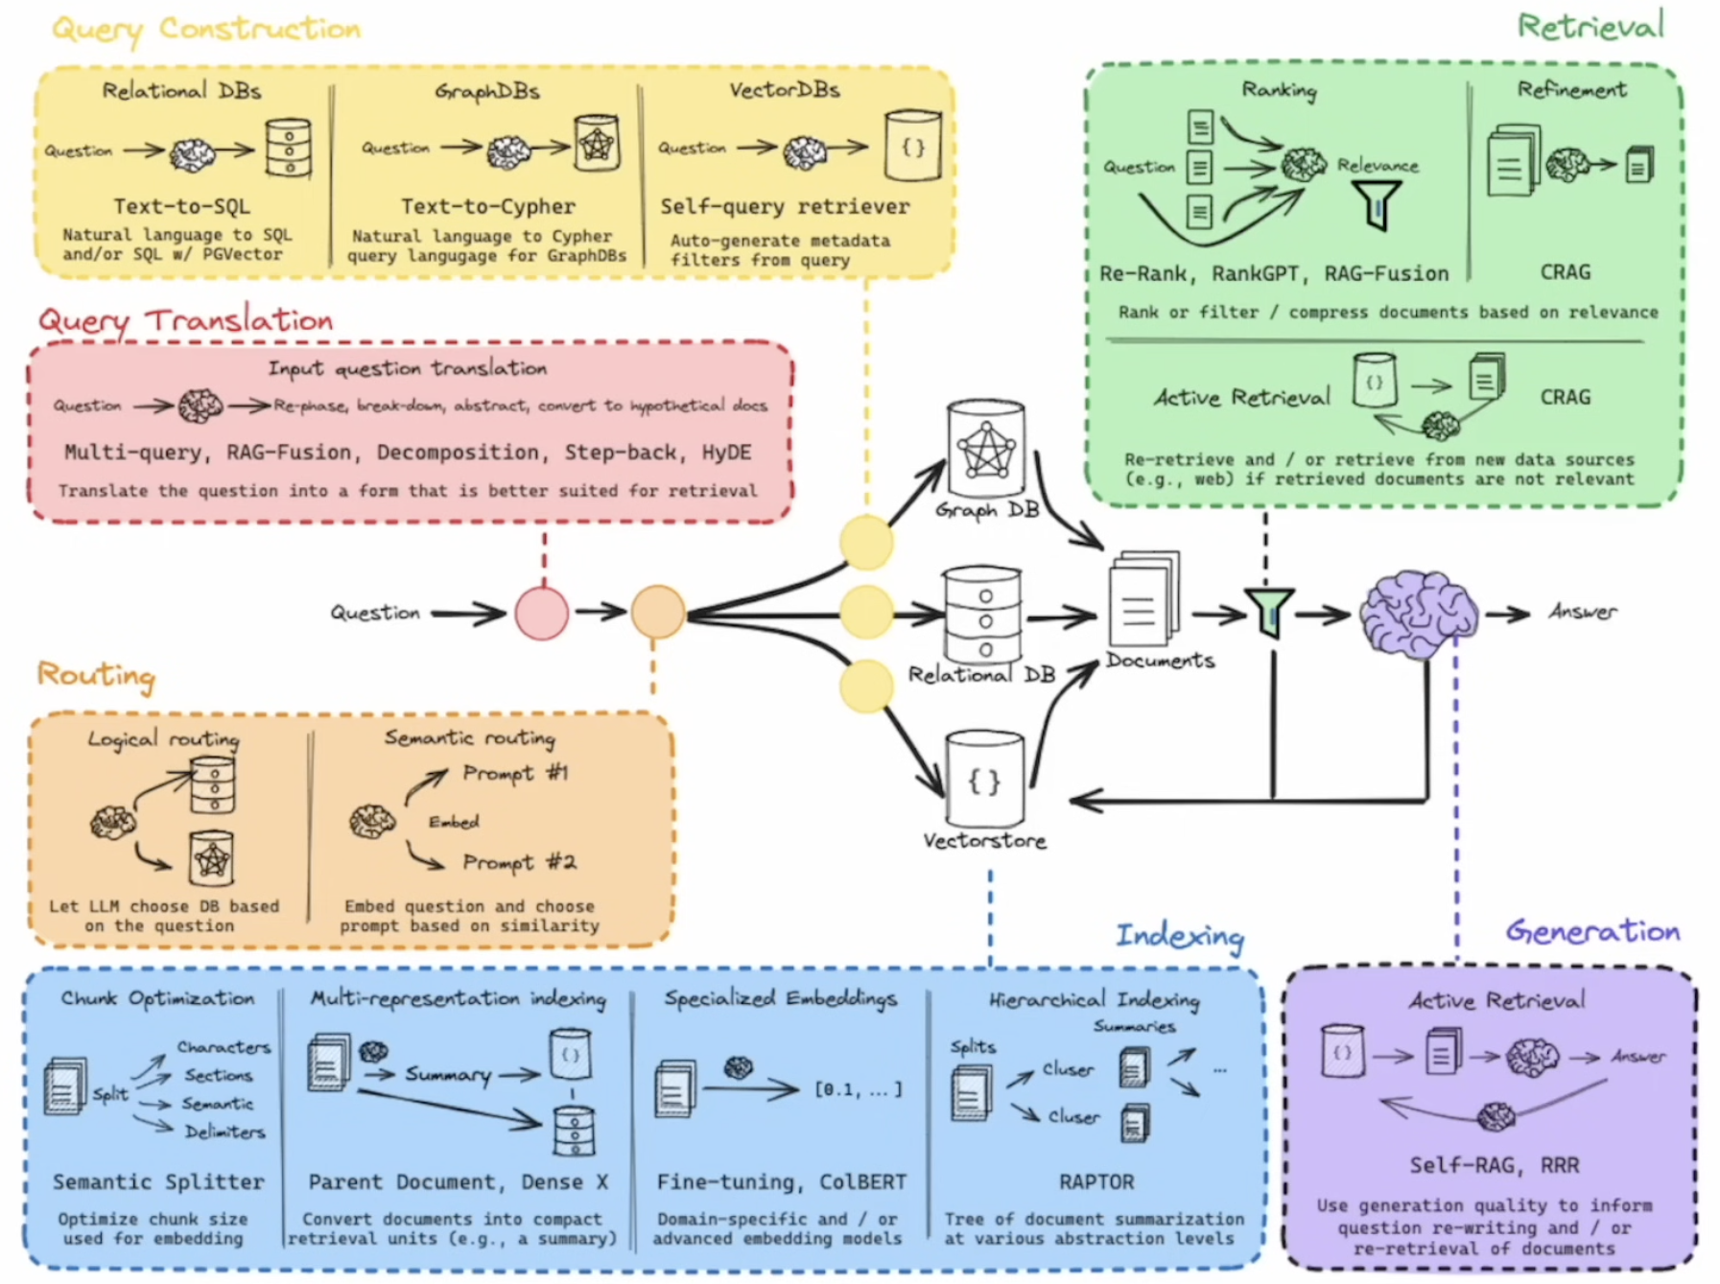
Improving the RAG
Watch this video to understand the above diagram

Slide 14
That’s not it…
CAG
Corrective RAG
Fusion RAG
Speculative RAG
Graph RAG
Self RAG
Agentic RAG
Modular RAG
Radio RAG
Read more on this: https://www.projectpro.io/article/rag-architecture/1079

Slide 15
Demo Time!

Slide 16
Let’s build this together?
Workshop: 12th February 2025, 8 PM EST
Pre-requisites:
Laptop (obviously ☺)
OpenAI API Key – we’ll share a document detailing the steps!
Google Drive account – any Gmail account would do!
Install GitHub (optional – needed only when deploying the chatbot on Streamlit Cloud)
GitHub Installation Instructions for Windows 11: https://www.youtube.com/watch?v=AdzKzlp66sQ
GitHub Installation Instructions for Mac: https://www.youtube.com/watch?v=p0Js7IF17yI

Slide 17
References & resources
Learn RAG from Scratch: https://www.youtube.com/watch?v=sVcwVQRHIc8
Top 7 RAG Use Cases and Applications to Explore in 2025: https://www.projectpro.io/article/rag-use-cases-and-applications/1059.
What is RAG: htt ps://www.clarifai.com/blog/what-is-rag-retrieval-augmented-generation
DataCamp Course: RAG using LangChain by Meri Nova
Comprehensive Guide to RAG Tech Stack: https://www.useparagon.com/blog/comprehensive-guide-to-the-rag-tech-stack
What is RAG Architecture? https://www.projectpro.io/article/rag-architecture/1079
5-day Gen AI Intensive Course with Google and Kaggle: https://www.kaggle.com/learn-guide/5-day-genai#GenAI

Slide 18
Thank you!
Any questions?

