Slide 1

Insight Harbor
Title
Background
Introduction
ERD
Relational Schema
Physical Database Design
Business Transactions
DATABASE MANAGEMENT SYSTEM
Section 0501: Project Team 06
#
Ariz Shaikh | Palak Tandel | Sneha Murali | Zeba Karkhanawala
Date: 12/10/23

Slide 2


Title
Background
Introduction
ERD
Relational Schema
Physical Database Design
Business Transactions
Robert H. Smith School of Business
Masters Program Office
Admissions Office
USERS
UMD Faculty Directory - Faculty Table
UMD Networth - Program (Fees) & Course Table
UMD Articles - Rank Table
Yocket - Program Table
LinkedIn - Alumni & Faculty Table
US News - Rank Table
Q.S. World University of Ranking - Rank Table
Financial Times - Rank Table
Eduniversal Ranking - Rank Table
Bloomberg - Rank Table
Fortune - Rank Table
DATA SOURCES

Slide 3

Title
Background
Introduction
ERD
Relational Schema
Physical Database Design
Business Transactions
Mission Statement
To thoroughly investigate the Smith School of Business's program rank, faculty composition, and curriculum to create a useful database for the school's records and insights.
Mission Objective
To determine the total number of faculties possessing a PhD degree.
To ascertain the details of the faculty who are alumni of the University of Maryland.
To find out the total number of alumni for each program.
To identify the rank sources, ranks, program names, program types, and program years for the Business Analytics program.
To find the average number of years of work experience for all the faculties in each program.
To determine how many faculties from MSQF and MS in Finance have a PhD in Finance.
To find out all the details of the faculties in the MSMA program having a PhD in Marketing.
To discover the new courses offered for Batch of Fall 2023 which were not a part of the curriculum for the Batch of Fall 2022.
To find out which professor teaches how many courses in 2022 and 2023.
To find the total number of alumni for each program as per the year and batch.
To find out which and how many Smith school programs were ranked under the top 10 over the years.
To determine the employers of the Smith School of Business.
To determine the tuition fee for the courses offered in Fall 2023.

Slide 4
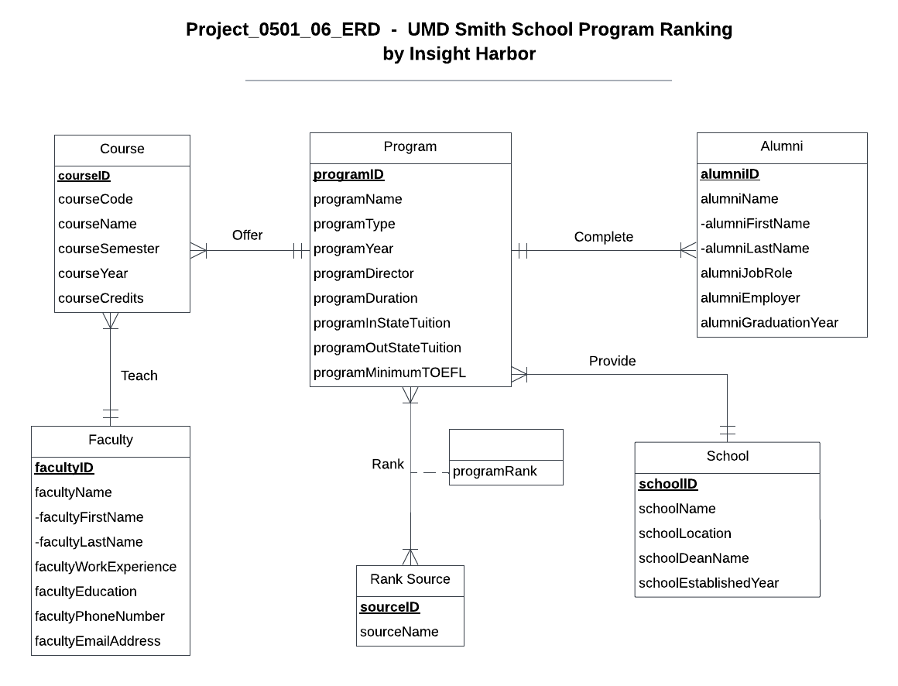
Conceptual Database Design
Title
Background
Introduction
ERD
Relational Schema
Physical Database Design
Business Transactions
School
Program
Course
Faculty
Alumni
Rank Source

Slide 5
Logical Database Design - Relational Schema
Title
Background
Introduction
ERD
Relational Schema
Physical Database Design
Business Transactions
School (schoolID, schoolName, schoolLocation, schoolDeanName, schoolEstablishedYear)
Program (programID, programName, programType, programYear, programDirector, programDuration, programInStateTuition, programOutStateTuition, programMinimumTOEFL, schoolID)
Faculty (facultyID, facultyFirstName, facultyLastName, facultyWorkExperience, facultyEducation, facultyPhoneNumber, facultyEmailAddress)
Course (courseID,courseCode, courseName, courseCredits, courseSemester, courseYear, programID, facultyID )
Alumni (alumniID, alumniFirstName, alumniLastName, alumniJobRole, alumniEmployer, alumniGraduationYear, programID)
Rank Source (sourceID, sourceName)
Rank (sourceID, programID, programRank)

Slide 6

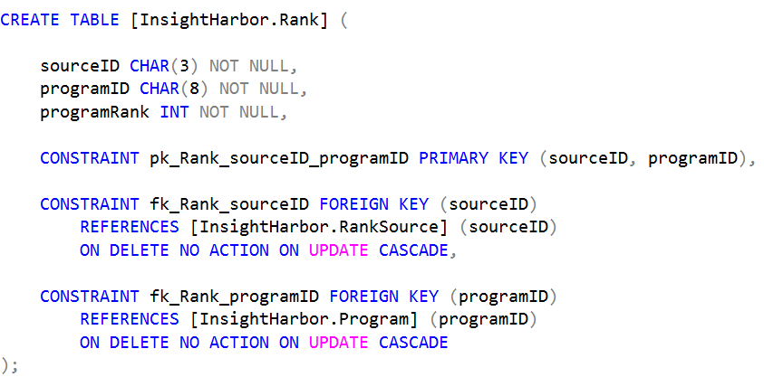
Physical Database Design
Title
Background
Introduction
ERD
Relational Schema
Physical Database Design
Business Transactions
programRank
Rank Source
Program
Rank

Slide 7

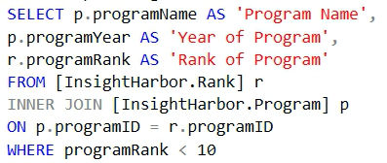
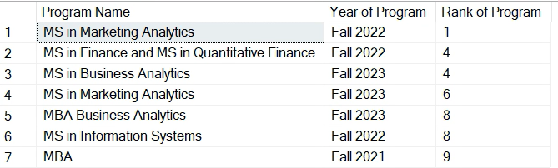
Title
Background
Introduction
ERD
Relational Schema
Physical Database Design
Business Transactions
Which Smith school programs were ranked under the top 10 over the years?

Slide 8
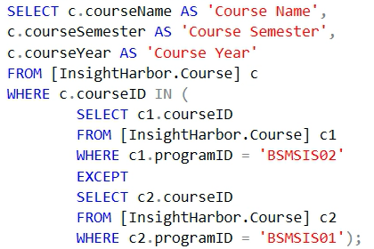
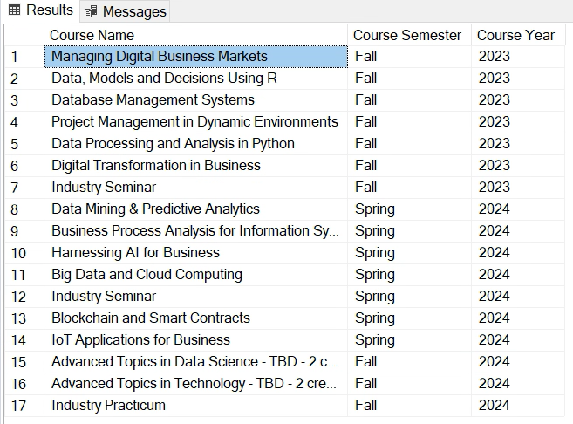
Title
Background
Introduction
ERD
Relational Schema
Physical Database Design
Business Transactions
What are the new courses in the MSIS program offered for the Fall 2023 Batch that were not part of the curriculum for the Fall 2022 Batch?

Slide 9
#ThankYou
Title
Background
Introduction
ERD
Relational Schema
Physical Database Design
Business Transactions

