Slide 1
🏠 House Price Prediction
A Machine Learning Regression Project
Jeba Charoliya
Tools: Python, Scikit-learn, Streamlit, Pandas

Slide 2
Problem Statement
Predict house prices based on historical data
Helps buyers/sellers set realistic price expectations
Supports real estate companies in decision-making

Slide 3
Dataset Summary
Dataset: Ames Housing (Kaggle)
Rows: ~1,460 | Columns: 81
Key Features Used:
- OverallQual
- GrLivArea
- GarageCars
- FullBath
- YearBuilt

Slide 4
Model Building
Data Cleaning & EDA
Feature Selection & Scaling
Applied Algorithms: Linear Regression
Evaluation Metrics:
- R² Score: 0.89
- RMSE: ~25,000

Slide 5
Visualizations & Insights
Correlation heatmap
Scatter plot of GrLivArea vs SalePrice
Feature importance bar chart

Slide 6
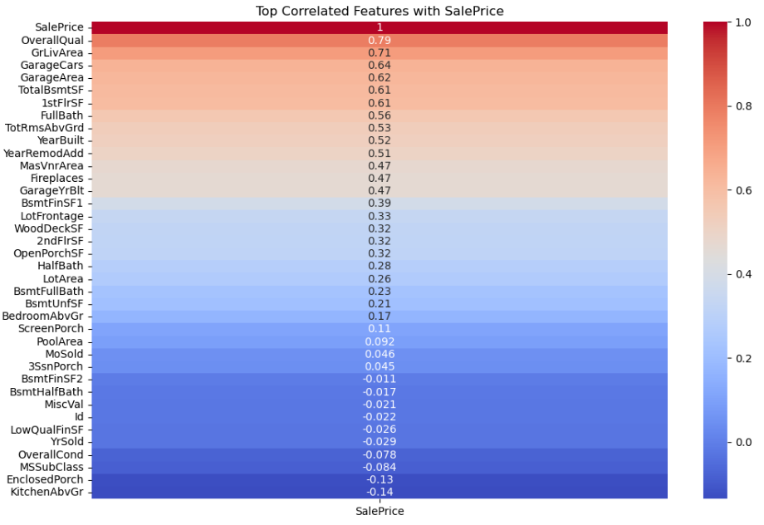
Correlated Features with SalePrice

Slide 7
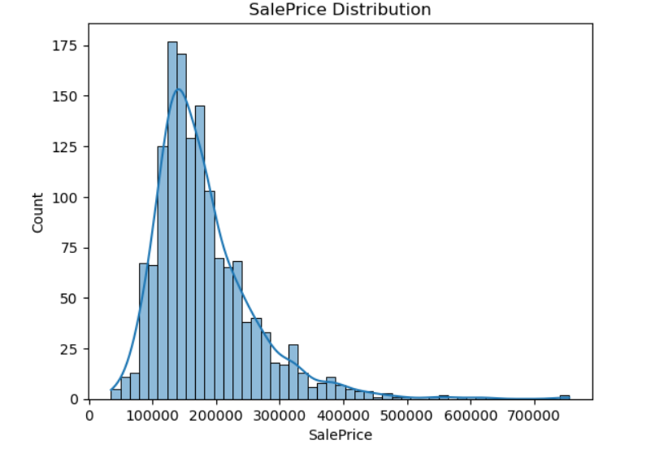
Sale Price Distribution

Slide 8
Streamlit Dashboard
Built an interactive UI using Streamlit
Takes user inputs → Predicts price in real time
Simple design with user-friendly inputs

Slide 9
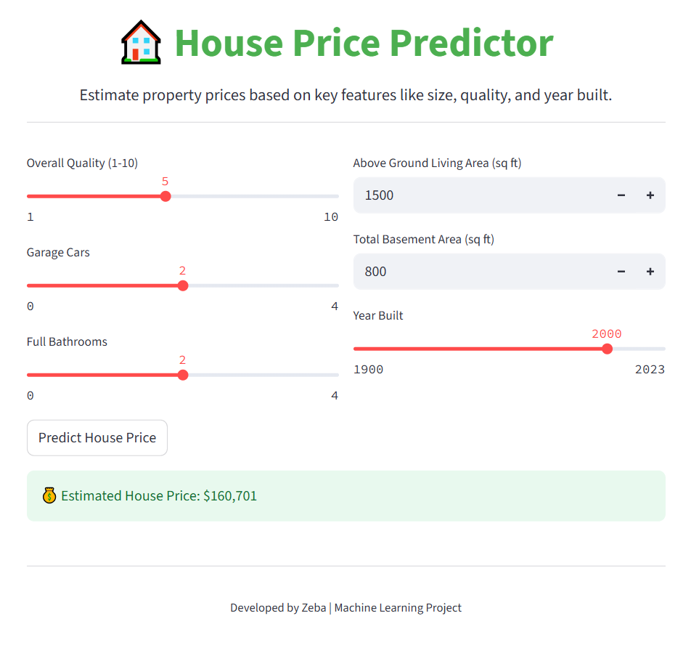
Dashboard

Slide 10
Conclusion & Next Steps
Model performs well with high accuracy
Can be improved with advanced models (XGBoost)
Future Work:
- Hyperparameter tuning
- Web deployment
- Real-time data integration

