Slide 1


Dash Python
Build Interactive Web Applications with Dash in Python
Your data needs Dash
Zeba Samiya

Slide 2
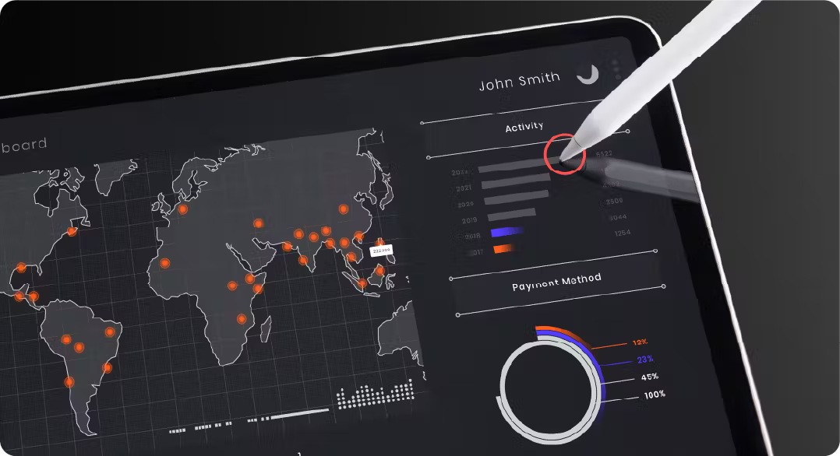
What is DASH?
Definition:
Dash is a Python framework for creating interactive web applications and dashboards.
Highlights:
Fully Python-based—no need for CSS, JavaScript, or HTML.
Perfect for finance, machine learning, healthcare, and real-time analytics.
Used by professionals in diverse fields.
Examples:
Link to Dash Gallery to showcase inspiring applications.

Slide 3
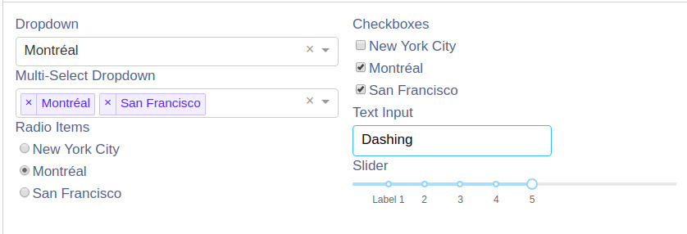
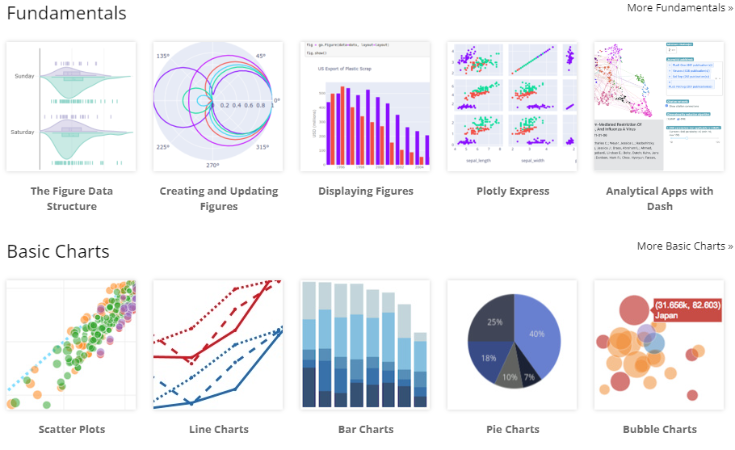
Three pillars of Dash
1. Components: Dash provides a rich library of pre-built components like dropdowns, sliders, graphs, and more, which you can use to build the user interface of your dashboard. These components are built on top of React.js and are easily customizable.

Slide 4
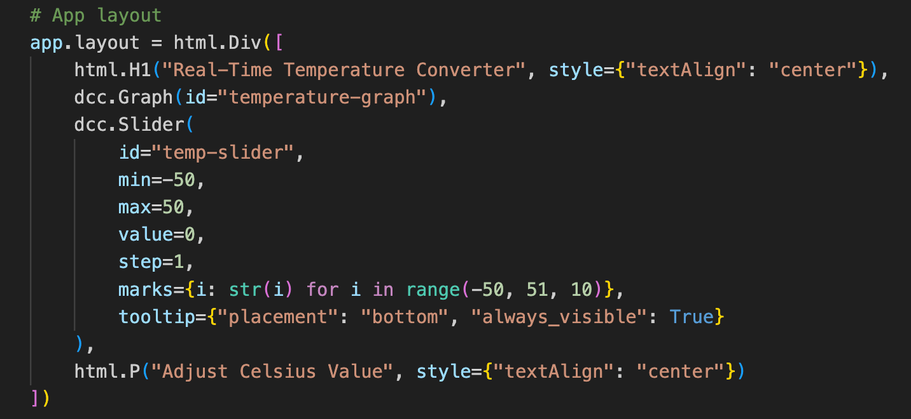
2. Layout: The layout defines the structure and arrangement of your dashboard's components. You create the layout using Dash's HTML-like syntax, which allows you to combine HTML elements with Dash components.

Slide 5
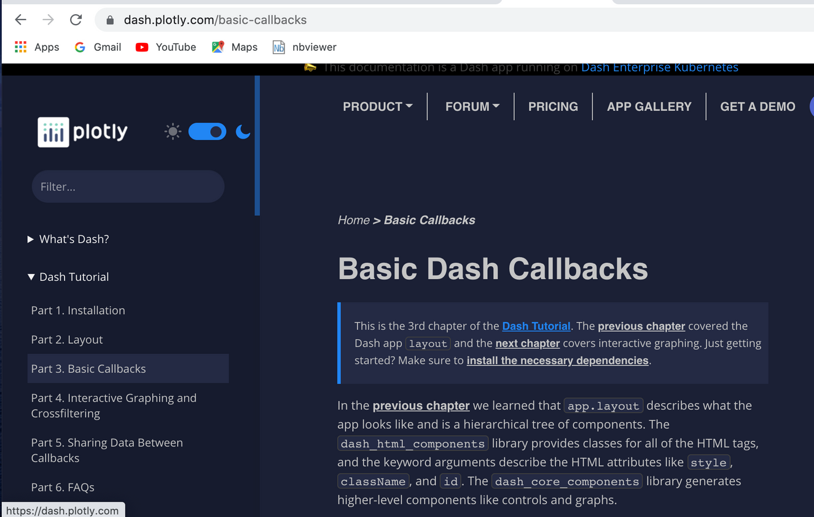
3. Callbacks: Callbacks enable interactivity in your dashboard. They define how the output of one component changes based on the input of another component. You can use callbacks to update graphs, tables, or any other component in response to user actions.

Slide 6




Installation
In your terminal, install dash.
1.
This also brings along the plotly graphing library. This library is under active development, so install and upgrade frequently.
2.
3.
Access your app in the browser at http://127.0.0.1:8050.

Slide 7
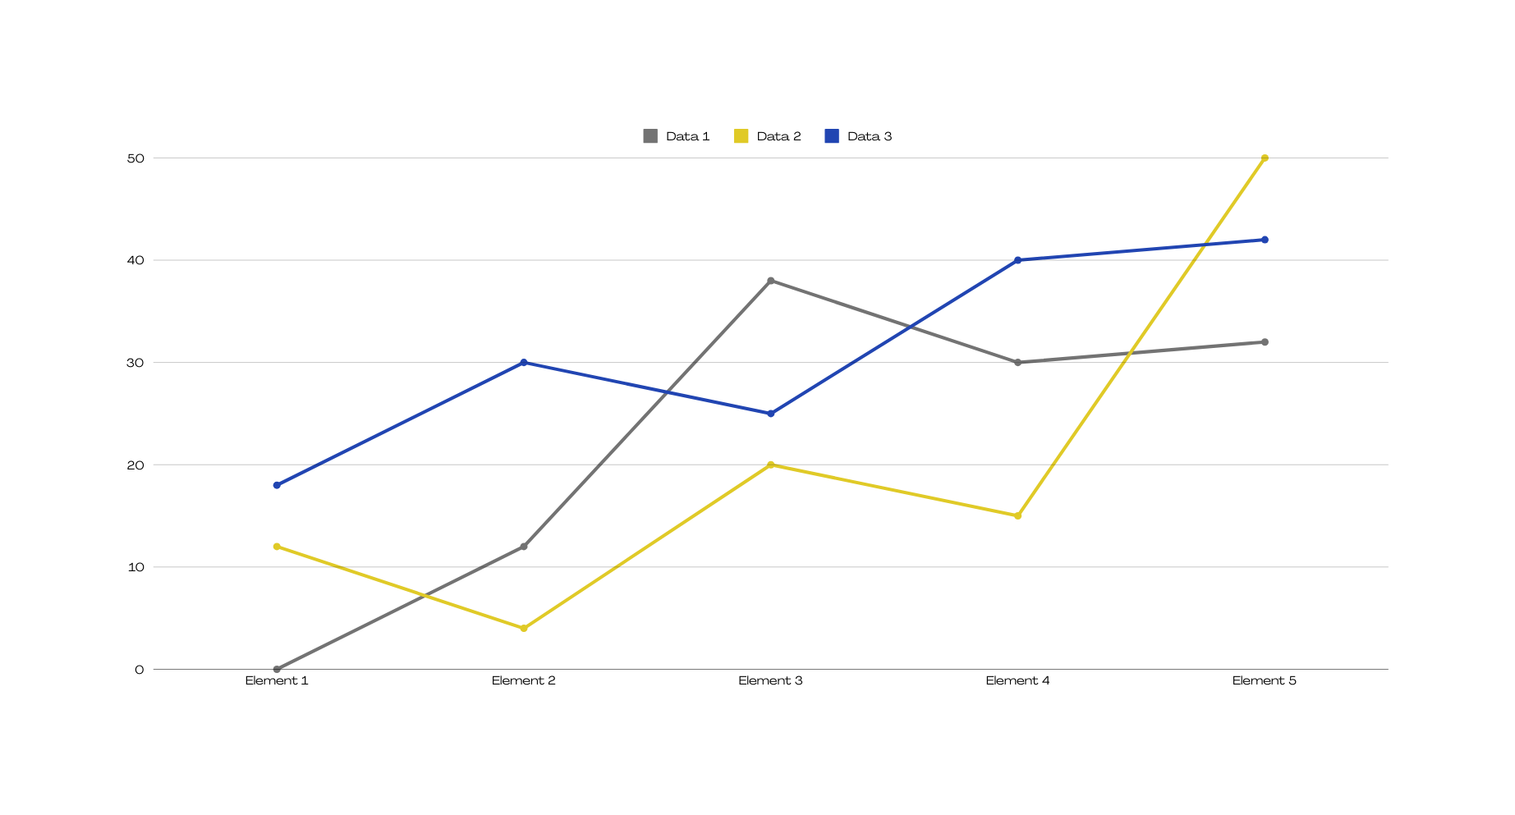
Ready? Now, let's see an example of minimal dash app!

Slide 8
Conclusion
In conclusion, Dash makes it easy to build interactive web apps using just Python. With its powerful combination of Dash Components, Plotly Graphs, and Callbacks, you can turn data into dynamic, engaging dashboards without needing to learn complex web development tools. It’s a great solution for anyone looking to make their data more interactive and accessible. I encourage you to explore Dash and start creating your own interactive applications!

Slide 9
Thanks

