Slide 1
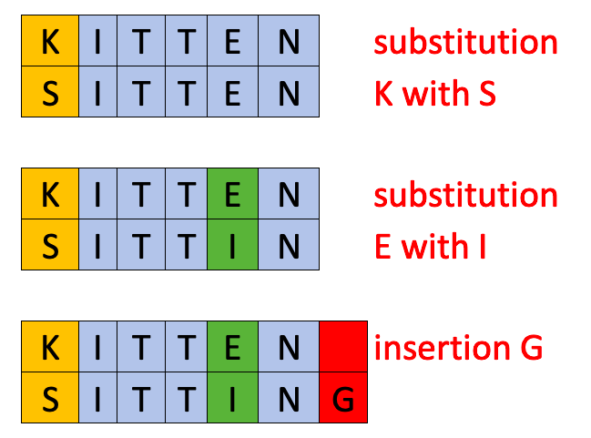
Classification of Arbitrary Data in Existing Databases
Steven Callahan
This application of program synthesis attempts to find patterns in existing databases to make the addition of further entries, particularly those with a different format than the original, automatic.
THE PROBLEM
LEVENSHTEIN DISTANCE
Given a database of n rows, each with m columns, how arbitrary can we make future entries that will still be entered into the database correctly?
PRE-BUILT TYPES
What problem is being addressed?
Certain entries in databases have a very high frequency of appearing, so classification would greatly improve by specifying these specific categories of data instead of leaving it up to the generic typing to catch. Some of these types are as follows:
First Names
Last Names
For these entries, each entry in a column is compared to a list of common names.
If most entries in the column meet a variable similarity score, based on levenshtein distance to account for typos, the respective label will be applied.
More types can be easily added as necessary to further improve classification.
A metric used to derive a similarity index between strings. This example has a levenshtein distance of 3.
CATEGORIES
To aid in classification, we use a “category” data structure, which is has the following attributes:
Items: Represents a column of data in the database.
Label: Represents the classification the synthesizer has given to the data. This could be a generic or pre-built type.
Each database is parsed into m categories, and it is assumed that each future entry will have m elements such that every category will have an item added for each new entry into the database.
SIMILARITY SCORE
Similarity(s1, s2) = 1 – (levenshtein(s1, s2) / (len(s1) + len(s2))
Similarity measures the levenshtein distance relative to the length of the two strings, so longer strings (which are more likely to have typos) will still match well.
How the similarity between strings is compared
The data structure we use to manage the database
GENERIC STRINGS
GENERIC TYPES - NUMBERS
Specifying common types in databases to improve classification
To classify strings that don’t meet the criteria of a pre-built type, we loop through every item in every generic string category and place the new string in the category that contains the string with the highest similarity score.
To classify numbers that don’t meet the criteria of a pre-built type, we model the numbers in a column as a distribution and assign the new number to the category in which it has the lowest standard deviation.
ARBITRARY INPUT
Input can be shuffled in any order but is assumed to have a common delimiter, such as a space or comma, which can split it into m elements.
Further cleaning is also done to remove additional punctuation and blank space..
How to classify numeric types that don’t fit other criteria
How to classify string types that don’t fit other criteria
How arbitrary is the input?

