Slide 1
Zebra RFID + Impinj Gen2X
Android Sample App User Guide
Notes:
Welcome!

Slide 2
Zebra RFID + Gen2X: Android SDK Overview
Notes:
Today, we’re excited to give you a first look at the Zebra Gen2X Q3 Android SDK Release.

Slide 3
Zebra RFID + Gen2X
Zebra Gen2X: Android SDK & Sample Application
Zebra’s Android SDK Now Supports Powerful Gen2X Features!
Protected Mode
Impinj Protected Mode is a feature that enhances the security and privacy of RAIN RFID (UHF) tags by preventing unauthorized tracking or access to tag data. This mode allows tags to be read only by trusted readers that have the correct access credentials.
TagFocus
TagFocus suppresses all previously read tags, allowing readers to focus on capturing data from tags that haven't been read yet.
Tag Quieting
Tag Quieting explicitly mutes selected tags before inventory scans, ensuring they remain silent until reactivated – reducing congestion and improving read performance.
FastID
FastID enables the impinj tags to backscatter their EPC and TID in a single response for inventory.
Inventory Protocol : Gen2X inventory enhanced performance
Inventory protocol enables selection of protocol to determine which tags to participate in inventory (e.g., Gen2, Gen2X).
Supported Devices: RFD40, RFD90, EM45 and TC53e-RFID, TC22R
Notes:
This latest release is packed with powerful features that enhance the functionality, security, and efficiency of Zebra’s RFID solutions. Let’s dive into what’s new and how these features can transform your operations.
First, let’s talk about Protected Mode.
This is a groundbreaking feature, powered by Impinj, that enhances the security and privacy of RAIN RFID (UHF) tags. With Protected Mode, businesses can ensure that their tags are only readable by trusted readers that have the correct access credentials. This means unauthorized tracking or data access is prevented, giving you greater control over your RFID ecosystem and protecting sensitive information from prying eyes.
Next, we have TagFocus.
This feature is all about efficiency. In environments where there are large numbers of tags, it’s common for readers to repeatedly scan the same tags. TagFocus solves this by suppressing all previously read tags, enabling the reader to concentrate solely on unread tags. This significantly reduces redundancy, improves scanning speed, and ensures your data collection is as accurate and efficient as possible.
Finally let’s look at Tag Quieting.
This feature is designed to reduce tag congestion during inventory scans. By explicitly muting selected tags, Tag Quieting ensures that these tags remain silent until they are reactivated. This allows readers to focus on the tags that matter most at any given time, improving read performance and making your RFID system more streamlined and effective.
These advanced Gen2X features—Protected Mode, TagFocus, and Tag Quieting—are supported across a range of Zebra RFID devices, including:
RFD40
RFD90
EM45
TC53e-RFID

Slide 4
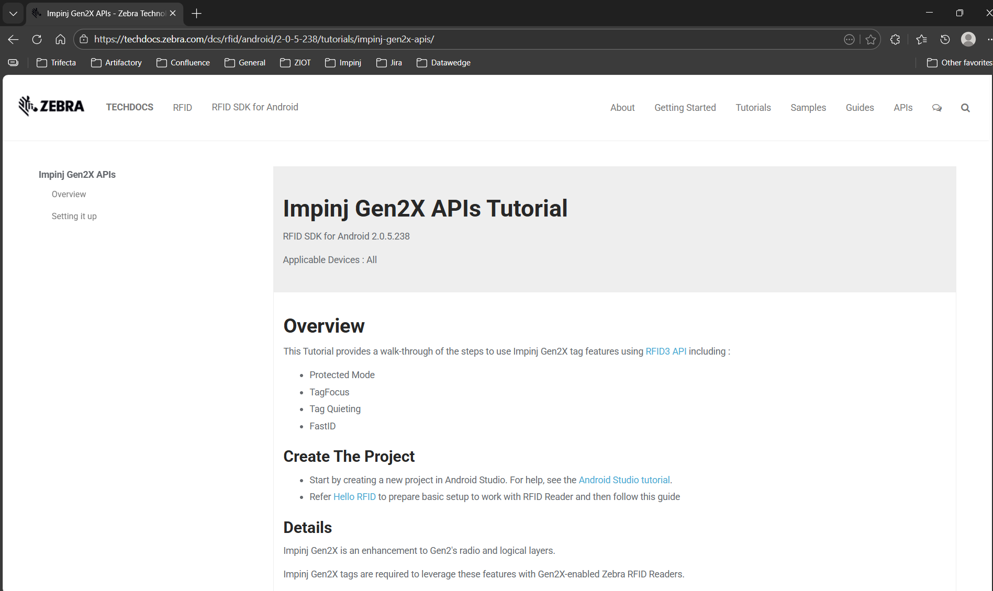
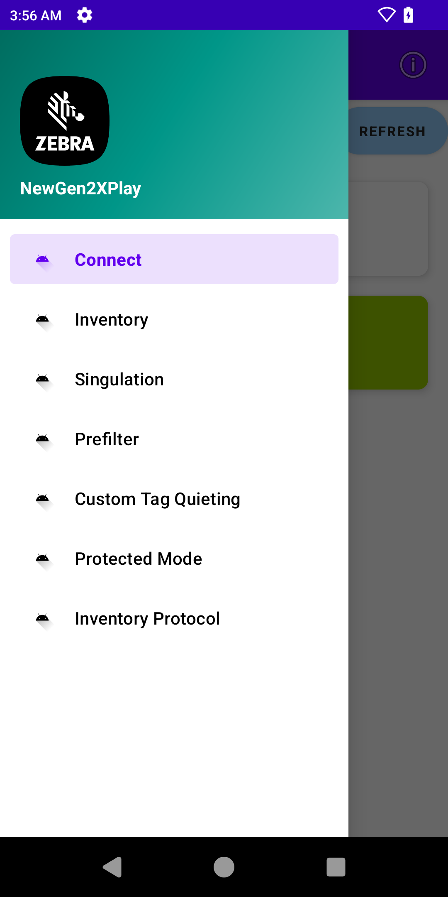
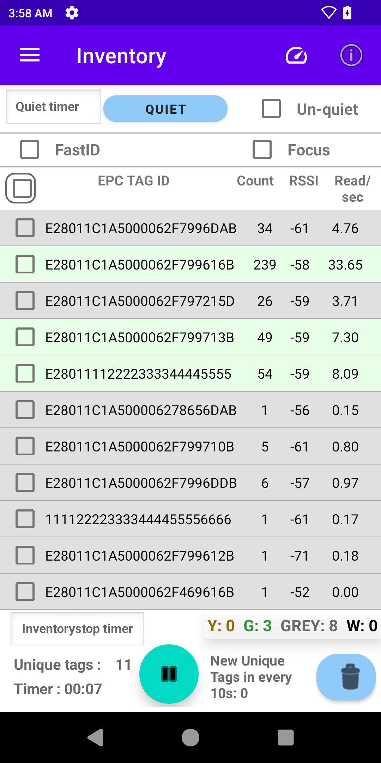
Zebra RFID + Gen2X
Zebra Gen2X: Android SDK & Sample Application
TechDocs Tutorials
Sample Application + User Guide
And more!
Gen2X Demo Videos
Optimizing Gen2X with Zebra RFID Readers: Best Practices and Strategies
Notes:
As part of our commitment to helping you get the most out of the Zebra Gen2X Android SDK Release, we’ve prepared a range of resources to support your journey. These resources are designed to make it easier for you to integrate, implement, and optimize the powerful Gen2X features in your applications."
We have our TechDocs Tutorials-comprehensive, step-by-step guides that walk you through the process of integrating and using the Gen2X features. Whether you’re new to RFID technology or an experienced developer, these tutorials provide clear instructions and solutions to common challenges, ensuring a smooth development experience.
Next, we’ve created a sample application to demo Gen2X features, allowing you to see them in action and understand how they work in real-world scenarios.
It includes sample code to give you a jumpstart on your own development- saving time and effort while building your applications.
And that’s not all! We’re also working on additional resources that will be available soon including:
Demo Videos to showcase the Gen2X features in action, providing easy-to-follow visual demonstrations for better understanding.
We’ll also be sharing a guide to help you maximize the performance, security, and efficiency of your RFID solutions using Gen2X
With these resources, we’re making it easier than ever to learn, develop, and optimize with Gen2X. Whether you’re just getting started or looking to refine your RFID systems, we’ve got you covered. Stay tuned for updates and take advantage of these tools to unlock the full potential of Zebra Gen2X technology

Slide 5
NewGen2xPlay Sample App – Getting Started
Notes:
Now that we’ve covered an overview of the Gen2X features and SDK, let’s focus on the purpose and practical use of the NewGen2XPlay sample application

Slide 6
Zebra RFID + Gen2X
Zebra Gen2X: Android SDK & Sample Application
What You Need to Know About This Sample App
The NewGen2xPlay sample application is provided solely for demonstration purposes to showcase the features of Impinj Gen2X extensions. The application, source code and accompanying guide are designed to help users explore these features and understand their configuration and functionality.
Please note the following:
  Demo Purpose: This sample application is intended as a proof-of-concept tool and should not be used in production environments or as a fully developed solution.
  Source Code Usage: The shared source code is provided as a starting point to accelerate the integration of Gen2X features into your existing applications or solutions. It is the user's responsibility to evaluate, customize, and test the code for their specific use cases.
  Prerequisites: Ensure you have the required hardware, compatible software, and Gen2X-enabled RFID tags as outlined in the guide before using the sample application.
By using the NewGen2xPlay sample application, you acknowledge and agree to these terms and understand that it is a demonstration tool, not a production-ready application.
End User License Agreement (Unrestricted Software)
Notes:
This tool is designed specifically for demonstration purposes to showcase the features of Impinj Gen2X extensions. It's a proof-of-concept application, along with source code and a guide, to help you explore these features and understand how to configure and use them effectively.
Now, a few important points to keep in mind:
Demo Purpose: This is not a production-ready solution. It’s meant as a learning and demonstration tool only.
Source Code: We’ve shared the source code as a starting point to help you integrate Gen2X features into your own applications. But remember, it’s your responsibility to customize, test, and adapt it to your needs.
Prerequisites: Before you get started, make sure you have the required hardware, compatible software, and Gen2X-enabled RFID tags, all of which are detailed in the guide.
By using this sample application, you agree to these terms and understand its intended purpose as a demonstration tool. For more details, refer to the End User License Agreement provided with the software.

Slide 7
Zebra RFID + Gen2X
Zebra Gen2X: Android SDK Sample Application (NewGen2XPlay) User Guide
The NewGen2xPlay sample application demonstrates Impinj Gen2X features including Protected Mode, TagFocus, and Tag Quieting.
This guide includes:
  Navigation Overview
  General Configuration– (Connect, Inventory, Singulation, Prefilter)
  Gen2X Feature Demo: Tag Focus
  Gen2X Feature Demo: Tag Quieting
  Gen2X Feature Demo: Protected Mode
  Gen2X Feature Demo: Fast ID
  Gen2X enhanced inventory performance
  Each feature section includes step-by-step configuration and instructions to demonstrate the
  feature using the feature-specific screens.
What do I need to use the sample application?
Mobile Computer w/ Android 10 and later + Zebra RFID Reader (RFD40 or RFD90)
-OR-
Zebra RFID-Enabled Mobile Computer (EM45, TC53e-RFID)
NewGen2xPlay sample application (download from TechDocs)
Gen2X-enabled RFID tags (http://www.impinj.com/Gen2X)
Notes:
The NewGen2XPlay sample application is a powerful tool designed to demonstrate the advanced capabilities of Impinj Gen2X features, including Protected Mode, TagFocus, and Tag Quieting.
This guide provides a complete walkthrough, starting with a navigation overview to familiarize you with the application interface, followed by general configuration instructions for tasks like connecting to a reader, performing inventories, configuring singulation, and setting prefilters. It also includes step-by-step demonstrations for the three Gen2X features—TagFocus, Tag Quieting, and Protected Mode—each with detailed instructions to guide you through the feature-specific screens and configurations.
To use this sample application, you’ll need a mobile computer with Android 10 or later paired with a Zebra RFID Reader like the RFD40 or RFD90, or a Zebra RFID-enabled mobile computer such as the EM45 or TC53e-RFID.
Additionally, you’ll need the NewGen2XPlay sample application, which can be downloaded from Zebra’s TechDocs, and Gen2X-enabled RFID tags available from Impinj. With these tools and the instructions provided, you’ll be ready to explore how these features can enhance your RFID workflows and optimize performance.

Slide 8
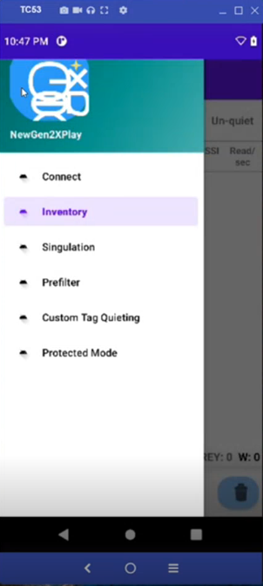
Zebra RFID + Gen2X
Zebra Gen2X: Android SDK Sample Application (NewGen2XPlay) User Guide
Navigation
The navigation drawer shows the operations that can be performed using the sample app including:
  Connect: Connect to an RFID Reader
  Inventory : Read Tags and apply Gen2X features
  Singulation: Manage Singulation Settings
  Prefilter: Manage Prefilters
  Custom Tag Quieting: Manager filters for Tag Quieting
  Protected Mode: Enable/Disable Protected Mode
Notes:
The navigation drawer in the NewGen2XPlay sample application provides quick access to key operations, making it easy to configure and demonstrate the app’s capabilities.
Connect allows you to establish a connection with an RFID reader, which is essential for performing all other operations.
Inventory lets you read tags and apply Gen2X features like Tag Quieting, TagFocus, and Protected Mode, showcasing the app’s core functionality.
With Singulation, you can manage settings to fine-tune how tags are inventoried and how the reader interacts with them.
The Prefilter option enables you to set and manage prefilters, narrowing down the tags being read to specific subsets.
Tag Quieting helps you reduce redundant reads by managing filters to silence unnecessary tags, improving performance in dense environments.
Finally, Protected Mode allows you to enable or disable Protected Mode, securing tags with a PIN to ensure privacy and control over sensitive data.
These navigation options provide full control over the app’s features, allowing you to easily configure and demonstrate the power of Gen2X technology.

Slide 9
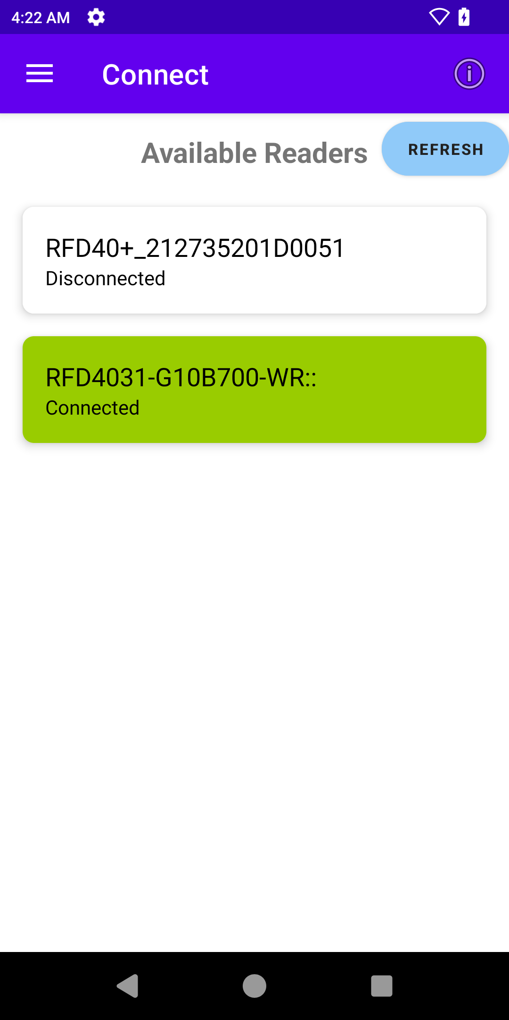

Zebra RFID + Gen2X
Zebra Gen2X: Android SDK Sample Application (NewGen2XPlay) User Guide
Connect
  Connect displays all the available readers that are ready to connect.
  Click on the reader name to connect to the reader.
  Click Refresh to refresh the list of available readers that are ready to connect.
  -> icon for app version info.
Notes:
Now that we’ve explored the navigation drawer and its role in giving you quick access to the app’s key operations, let’s start with the first step: Connect.
Establishing a connection with an RFID reader is the foundation for everything else you’ll do in the app. Without this connection, you won’t be able to perform inventory, apply Gen2X features, or configure other settings.
Connect displays all available RFID readers that are ready to connect. Simply click on the reader name to establish a connection.
If needed, use the Refresh button to update the list of available readers.

Slide 10

Zebra RFID + Gen2X
Zebra Gen2X: Android SDK Sample Application (NewGen2XPlay) User Guide
Inventory
The Inventory screen can be used to read tags and compare behaviors/performance using different configurations and features. This screen can be used both for standard Gen2v2 tag inventory as well as demonstrating and testing Gen2X features. This section describes general features of the screen – please refer to specific feature sections for detailed instructions for each feature.
This screen has 4 areas:
Icon for total read rate (total read / total time).
Gen2X Feature Options – enable/disable options, Quiet timer
Inventory Tag Display – display read tags including count, RSSI and read/sec
Inventory Summary Bar - inventory stop timer and counts by category
Unique Tags Bar (including Start/Stop and Clear) – timer, unique tag count and tags/10s
Notes:
The Inventory screen allows you to read tags and compare performance using different configurations and features. It supports both standard Gen2v2 tag inventory and testing of Gen2X features. While this section outlines the general screen layout, refer to specific feature sections for detailed instructions.
The screen is divided into four key areas:
Gen2X Feature Options – Enable or disable features and set the Quiet timer.
Inventory Tag Display – View read tags, including count, RSSI, and reads per second.
Inventory Summary Bar – Track the inventory stop timer and tag counts by category.
Unique Tags Bar – Includes Start/Stop and Clear buttons, along with the timer, unique tag count, and tags read per 10 seconds.

Slide 11

Zebra RFID + Gen2X
Zebra Gen2X: Android SDK Sample Application (NewGen2XPlay) User Guide
Inventory
Gen2X Feature Options
  Focus – enables TagFocus feature
  Quiet timer – timer for which the quiet filter is applied (default 2s)
  Quiet button – quiets selected tags
  Un-quiet – select to un-quiet inventoried tags
  FastID – enables FastID feature
Notes:
Gen2X Feature Options on the Inventory screen allow you to control key features:
Focus: Enables the TagFocus feature to prioritize unread or weaker tags.
Quiet Timer: Displays the duration for which the quiet filter is applied.
Quiet Button: Quiets selected tags to reduce redundant reads.
Un-quiet: Allows you to un-quiet previously inventoried tags.

Slide 12
Zebra RFID + Gen2X
Zebra Gen2X: Android SDK Sample Application (NewGen2XPlay) User Guide
Inventory
Inventory Tag Display
  EPC TAG ID – EPC value read from tag
  Count – Number of times read in this inventory cycle
  RSSI - Received Signal Strength Indicator
  Read/sec – reads per second in this inventory cycle
  Colors
    Green: Tags which have the read / sec greater than the average
    Grey: Tags which have read/sec less than the average
    Yellow: Tags which were quieted
    White: Non quieted tags which are not participating in the current round
Notes:
The Inventory Tag Display provides key details about the tags being read, including their EPC value, read count, signal strength (RSSI), and reads per second.
Tags are color-coded for quick status identification: Green for above-average reads per second, Grey for below-average, Yellow for quieted tags, and White for non-participating tags. \

Slide 13
Zebra RFID + Gen2X
Zebra Gen2X: Android SDK Sample Application (NewGen2XPlay) User Guide
Inventory
Inventory Summary Bar
  Inventory Stop Timer – Set a time limit to automatically stop inventory after the specified duration
  Tag Counts by Category
    Y: Yellow
    G: Green
    GREY: Grey
    W: White
Notes:
The Inventory Summary Bar provides an overview of inventory progress, including the stop timer and tag counts by category.
Tags are categorized as Yellow for quieted tags, Green for tags with above-average reads per second, Grey for below-average reads, and White for non-participating tags.

Slide 14
Zebra RFID + Gen2X
Zebra Gen2X: Android SDK Sample Application (NewGen2XPlay) User Guide
Inventory
Unique Tags Bar
  Unique Tags Count - Total number of unique RFID tags read
  Timer: Elpsed inventory runtime
  New Unique Tags in every 10s: Number of previously unread tags detected within a rolling 10-second interval
Notes:
The Unique Tags Bar provides a summary of unique tags read during the inventory process.
It includes the total Unique Tags Count, a Timer to track inventory duration, and the number of New Unique Tags detected every 10 seconds, offering a clear view of tag discovery over time.

Slide 15
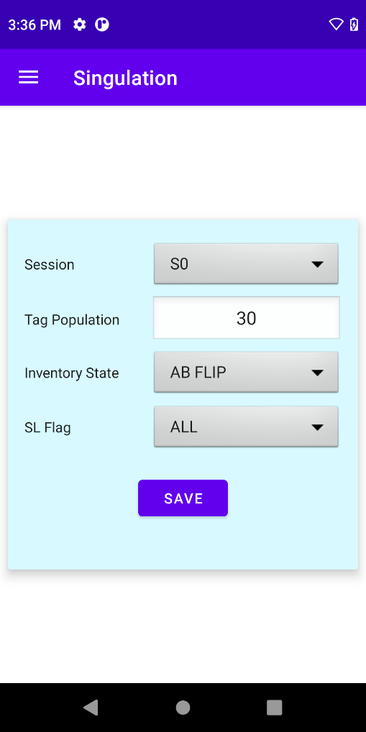
Zebra RFID + Gen2X
Zebra Gen2X: Android SDK Sample Application (NewGen2XPlay) User Guide
Singulation
This page provides options to customize how RFID tags are filtered and managed during inventory operations.
  Select Session
  Enter Tag Population
  Select Inventory State
  Select SL Flag
  Click the Save button to save Singulation settings
  To learn more about singulation, please see:
  https://techdocs.zebra.com/dcs/rfid/android/2-15/tutorials/singulation/
Notes:
The Singulation page allows you to customize how RFID tags are filtered and managed during inventory operations.
You can select the Session, enter the Tag Population, choose the Inventory State, and set the SL Flag.
Once configured, click Save to apply the settings.
For more details on singulation, visit techdocs.zebra.com.

Slide 16
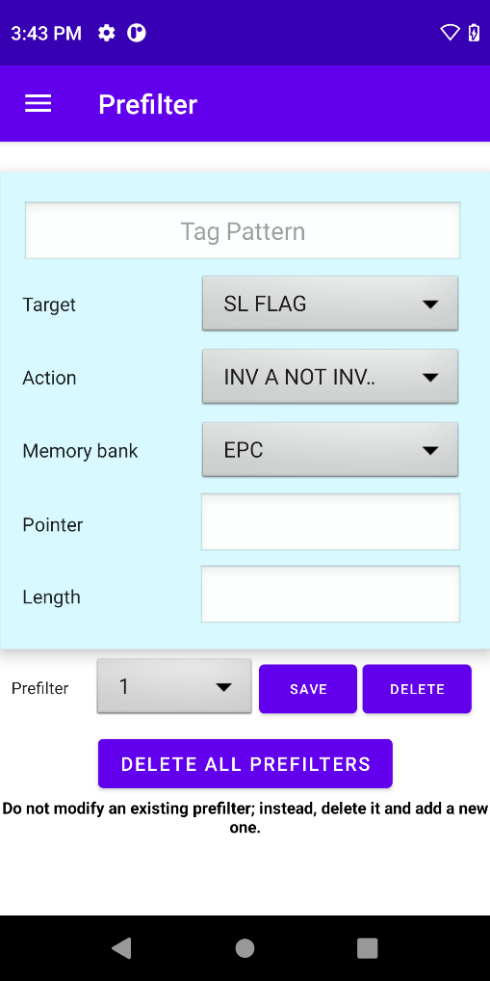
Zebra RFID + Gen2X
Zebra Gen2X: Android SDK Sample Application (NewGen2XPlay) User Guide
Pre-filter
On the prefilter page, the user can save up to 4 prefilters
To add a prefilter:
  Select Prefilter Number
  Select Target, Action, Memory Bank
  Enter Pointer and Length (the bit numbers of the tag)
  Click Save
To modify a prefilter:
  Prefilters cannot be modified - please delete the prefilter and create a new one.
To delete a single prefilter (for 1-4 prefilter):
  Select prefilter
  Click the Delete button prefilter
To delete ALL Prefilters (or if >4 prefilters):
  Click DELETE ALL PREFILTERS to delete all existing prefilters at once (up to 32 prefilters)
Notes:
The Prefilter page allows users to manage up to 4 prefilters for tag filtering.
To add a prefilter, select the Prefilter Number, choose the Target, Action, and Memory Bank, enter the Pointer and Length, and click Save.
Prefilters cannot be modified directly, so to make changes, you must delete the existing prefilter and create a new one.
To delete a single prefilter, select it and click the Delete button.
To delete all prefilters, use the DELETE ALL PREFILTERS option, which removes up to 32 prefilters at once.

Slide 17
Gen2X Feature Demo: TagFocus
Notes:
Let’s take a closer look at the Gen2X Feature Demo: TagFocus and how it enhances RFID performance in dense tag environments.

Slide 18
Zebra RFID + Gen2X
Zebra Gen2X: Android SDK Sample Application (NewGen2XPlay) User Guide
Gen2X Feature Demo: TagFocus
What is TagFocus?
  Tag Focus is a feature designed to enhance RFID tag filtering and focus on specific tags in dense tag environments.
  When to use TagFocus?
  TagFocus is most beneficial when the RFID reader is overwhelmed by the number of tags responding simultaneously. This typically occurs when there are several hundreds or thousands of tags in the read field. Below this threshold, the normal session-based reading may already perform adequately without noticeable differences.
How to Demo:
    Setup Tags for Demo (recommend at least 100 tags)
    Inventory Without TagFocus
    Inventory With TagFocus
    Observe and Compare Results
Expected Results:
  Without TagFocus: Higher count per tag, slower to read ALL tags
  With TagFocus: Lower count per tag, quicker to read ALL tags
Notes:
TagFocus is a specialized feature designed to improve RFID tag filtering by prioritizing specific tags, allowing the reader to focus more effectively in situations where there are large numbers of tags in the field. This feature is particularly beneficial when the reader is overwhelmed by hundreds or even thousands of tags responding simultaneously. In smaller tag populations, the standard session-based reading is often sufficient and may not show noticeable differences.
To demonstrate the impact of TagFocus, you’ll want to set up at least 100 tags to create a meaningful comparison. Start by performing an inventory without enabling TagFocus, allowing you to observe how tags behave under normal conditions. Then, enable TagFocus and perform another inventory. During this process, take note of how the feature impacts the speed and efficiency of reading tags.
The expected results highlight the difference:
Without TagFocus, you’ll see higher read counts per tag, but it will take longer to inventory all tags. With TagFocus, the reader focuses more efficiently, resulting in lower read counts per tag but a much quicker process to read all tags in the field.

Slide 19
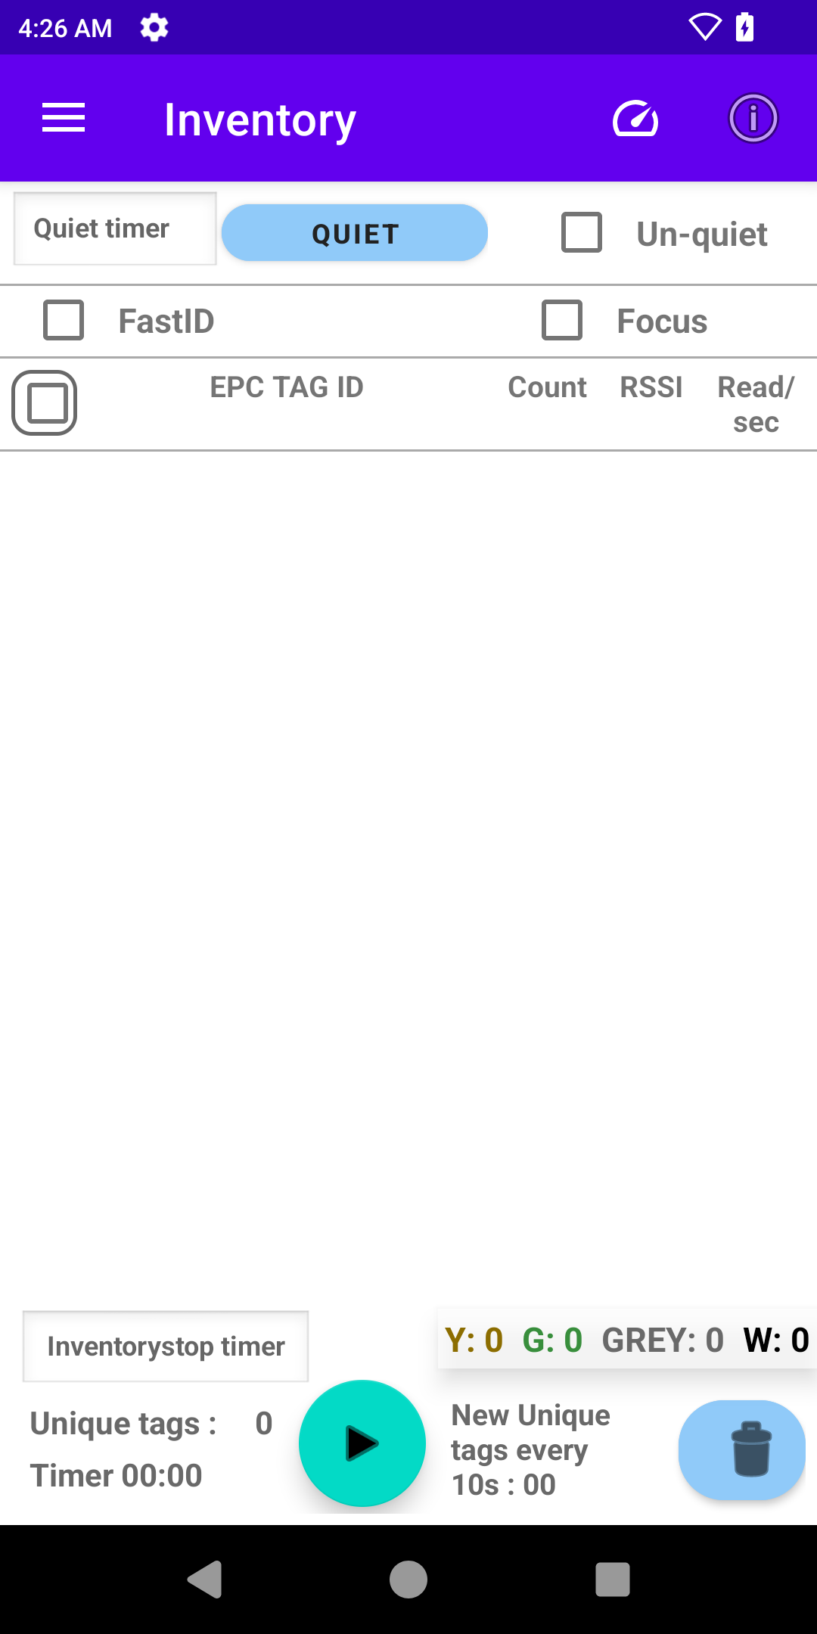
Zebra RFID + Gen2X
Zebra Gen2X: Android SDK Sample Application (NewGen2XPlay) User Guide
Gen2X Feature Demo: TagFocus
1. Setup Tags for Demo
  Arrange Gen2X-enabled tags in the test area
  Note the total number of tags available
2. Inventory Without TagFocus
  Configure using Singulation and/or Prefilters to match your current application (or leave as default)
  Ensure the TagFocus checkbox is NOT checked
  Click the inventory start button
  Read tags for desired period OR until all Unique tags are read
  Click the Stop button and observe:
    Timer
    Unique Tags
    New Unique Tags in every 10s
    Count per tag (generally expect to see this vary with some tags having very high read/sec and others having very low)
Notes:
To demonstrate the TagFocus feature, follow these steps to compare its performance with and without the feature enabled.
Step 1: Setup Tags for the Demo
Start by arranging Gen2X-enabled tags in your test area and note the total number of tags available for the demonstration. This will help you measure and compare the results accurately.
Step 2: Inventory Without TagFocus
Before enabling TagFocus, configure the system using Singulation and/or Prefilters to align with your current application setup, or simply leave the settings as default. Ensure that the TagFocus checkbox is NOT checked.
Begin the inventory process by clicking the Start button, allowing the reader to scan tags for a set period or until all unique tags are read. Once the inventory is complete, click the Stop button and observe the following key metrics:
The Timer, which tracks the duration of the inventory process.
The total number of Unique Tags read.
The count of New Unique Tags detected every 10 seconds.
The Count per Tag, which typically varies, with some tags showing very high reads per second and others much lower.
By carefully observing these metrics, you’ll establish a baseline of how the system performs without TagFocus, providing a point of comparison for when the feature is enabled.

Slide 20
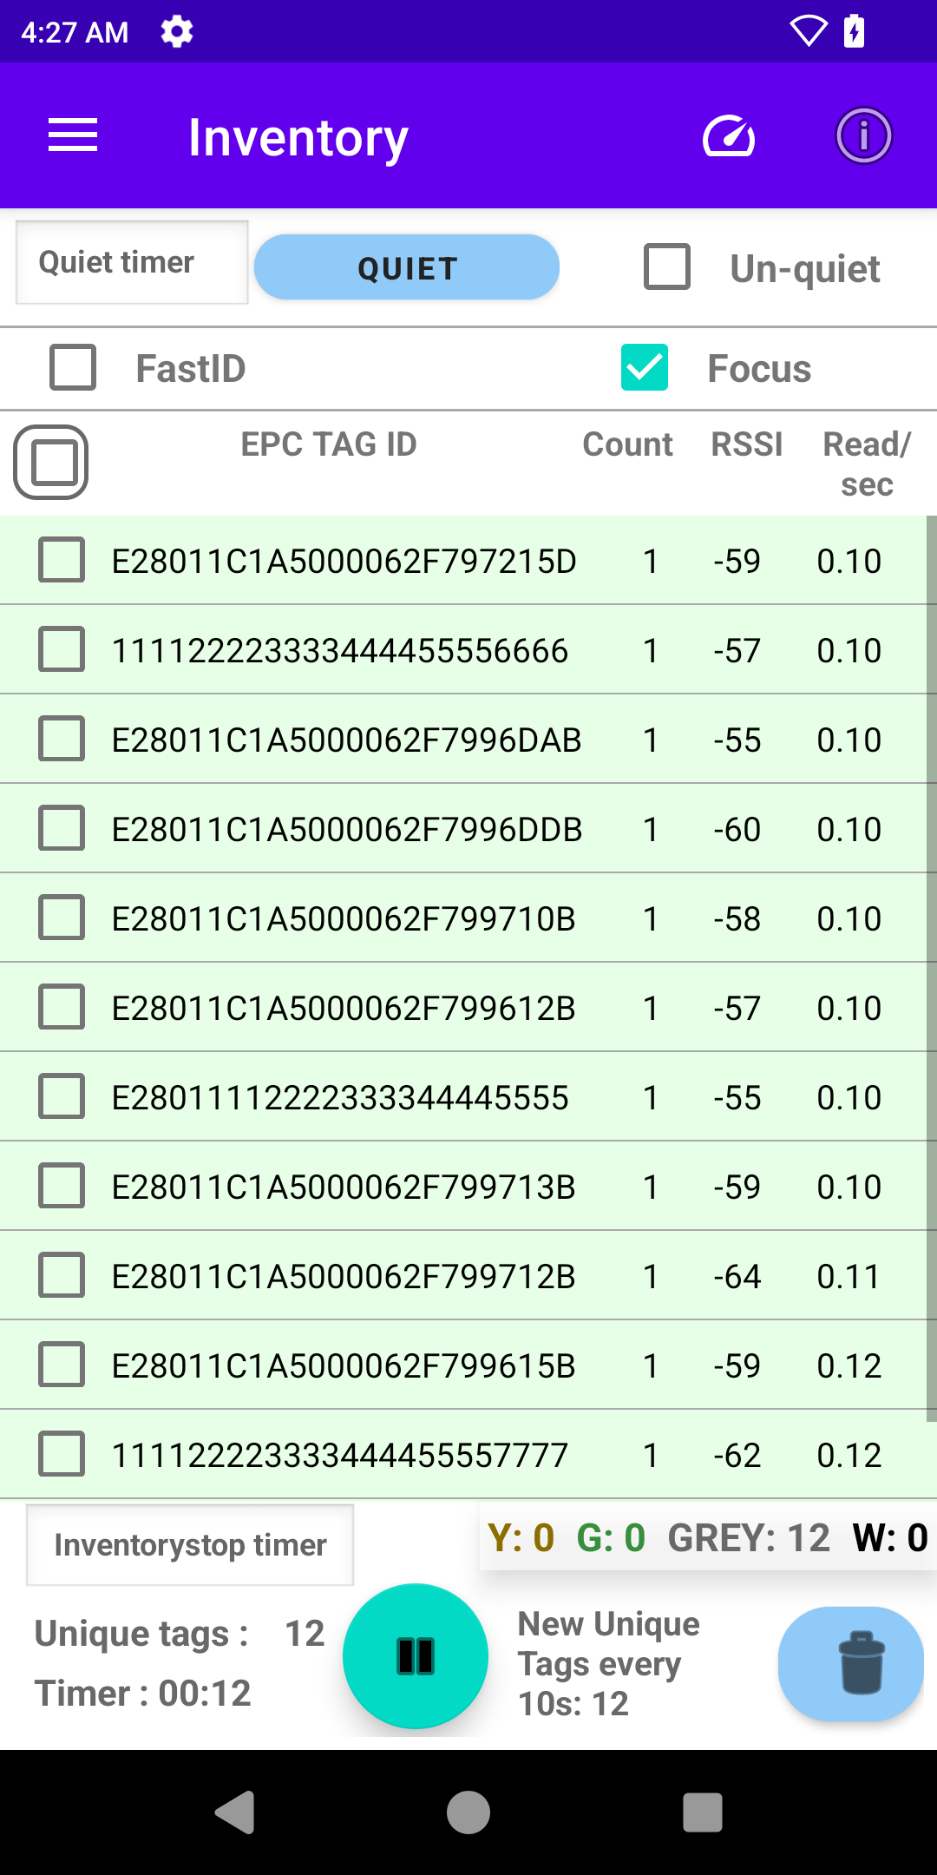
Zebra RFID + Gen2X
Zebra Gen2X: Android SDK Sample Application (NewGen2XPlay) User Guide
Gen2X Feature Demo: TagFocus
3. Inventory With TagFocus
  Clear the results using the Clear button
  Select the TagFocus checkbox to enable TagFocus (checked)
  Click the inventory start button
  Read tags for desired period OR until all unique tags are read
  Click the Stop button and observe:
    Timer
    Unique Tags
    New Unique Tags in every 10s
    Count per tag (generally expect to be 1 with some tags reading 2-3x if they do not receive the select command in the first round)
4. Observe and Compare Results
Was there a difference in the total number of tags read?
Did TagFocus result in less reads/tag?
Were all tags read faster with TagFocus enabled?
Note: In low-density tag environments, the benefit of TagFocus may not be perceptible because the reader can already handle the limited number of tags without significant redundancy or delays.
Notes:
To continue the TagFocus demonstration, we’ll now enable the feature and compare the results to the baseline established earlier.
Step 3: Inventory With TagFocus
Start by clearing the previous results using the Clear button. Then, enable TagFocus by selecting the checkbox. This ensures the feature is active for the next inventory cycle.
Click the Start button to begin the inventory process with TagFocus enabled. Allow the reader to scan tags for the same set period or until all unique tags are read. Once the inventory is complete, click the Stop button and observe the key metrics again:
The Timer, to see how long the inventory process took.
The total number of Unique Tags read.
The count of New Unique Tags detected every 10 seconds.
The Count per Tag, which you’ll generally expect to be 1. However, some tags may be read 2-3 times if they do not receive the select command in the first round.
Step 4: Observe and Compare Results
Now, compare the results from the two inventories:
Was there a difference in the total number of tags read?
Did enabling TagFocus result in fewer reads per tag?
Were all tags read faster when TagFocus was enabled?
It’s important to note that in low-density tag environments, the benefit of TagFocus may not be as noticeable. In these cases, the reader can typically handle the limited number of tags without significant redundancy or delays. However, in high-density environments, the improvements in speed and efficiency with TagFocus enabled should be clear.

Slide 21
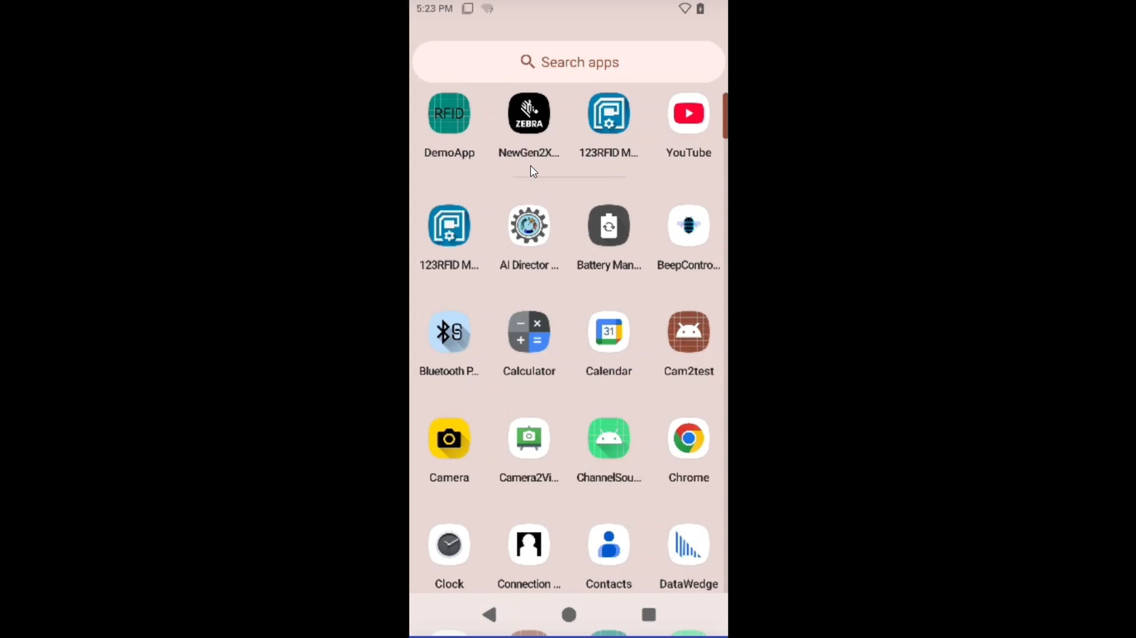
TagFocus Demo

Slide 22
Gen2X Feature Demo: Tag Quieting
Notes:
Let’s explore the Gen2X Feature Demo: Tag Quieting, a powerful tool for managing large tag populations and improving inventory performance.

Slide 23
Zebra RFID + Gen2X
Zebra Gen2X: Android SDK Sample Application (NewGen2XPlay) User Guide
Gen2X Feature Demo: Tag Quieting
What is Tag Quieting?
  Tag Quieting provides a dynamic solution to tag clutter by allowing system integrators to control when tags participate in inventory rounds, Quieting individual tags reduces the total number of tags responding in an inventory round, which results in performance improvements.
When to use Tag Quieting?
  A medium- to large-sized tag population (100+ tags)
  A requirement for multiple tag events involving the same tag(s)
  The presence of a subpopulation of tags that can be identified as strays or meet defined criteria suitable for quieting
  How does Tag Quieting differ from TagFocus?
  TagFocus uses a fixed configuration to suppress tags for faster inventory rates, while Tag Quieting provides a more configurable approach (designed to augment an existing solution), allowing users to dynamically control when tags participate in inventory rounds for greater flexibility in managing tag populations.
Notes:
What is Tag Quieting?
Tag Quieting is a feature that helps reduce tag clutter by allowing system integrators to control when individual tags participate in inventory rounds. By quieting specific tags, the total number of tags responding during an inventory round is reduced, leading to significant performance improvements in terms of speed and efficiency.
When to Use Tag Quieting?
Tag Quieting is most effective in scenarios with:
Medium- to large-sized tag populations, typically 100 or more tags.
A requirement to handle multiple tag events involving the same tag(s), such as repeated reads over time.
The presence of a subpopulation of tags that can be identified as strays or meet specific criteria suitable for quieting.
How Does Tag Quieting Differ from TagFocus?
While both features aim to improve inventory performance, their approaches are different:
TagFocus uses a fixed configuration to suppress tags and achieve faster inventory rates.
Tag Quieting, on the other hand, is more dynamic and configurable, allowing users to control exactly when tags participate in inventory rounds. This flexibility makes it ideal for augmenting existing solutions and tailoring tag behavior to specific operational needs.

Slide 24
Zebra RFID + Gen2X
Zebra Gen2X: Android SDK Sample Application (NewGen2XPlay) User Guide
Gen2X Feature Demo: Tag Quieting
  How to Demo:
    This demonstrates the functionality to quiet and unquiet tags. To use Tag Quieting effectively, your application will need to decide which tags to quiet and when – such as after specific reads, location changes, manifest matches, or high RSSI. Quieting can be triggered by inventory rounds, time intervals, new tags, or cycle time limits.
    Setup Gen2X Enabled Tags (recommend at least 100 tags)
    Inventory Without Quieted Tags
    Quiet Selected Tags
    Un-quiet Tags
    Observe and Compare Results
Expected Results:
  Without Tag Quieting: Most tags will have multiple reads with some tags having very high read/sec and others having very low reads/sec
  With Tag Quieting: Quieted Tags have no reads after quieting, there may be an increase in counts and read/sec for un-quieted tags
Notes:
Here’s how to demonstrate Tag Quieting:
Start by setting up at least 100 Gen2X-enabled tags to get meaningful results.
Run an inventory without quieting any tags to observe the baseline behavior.
Select and quiet specific tags in your inventory.
Then, un-quiet those tags to restore their visibility.
Throughout the process, observe and compare the results to understand the impact.
Here’s what you should expect to see:
Without Tag Quieting: You’ll notice that most tags are read multiple times. Some tags may have very high read rates per second, while others may have much lower rates.
With Tag Quieting: Quieted tags will stop being read entirely, which allows the system to focus on the remaining un-quieted tags. This often results in increased counts and read rates for the un-quieted tags.

Slide 25
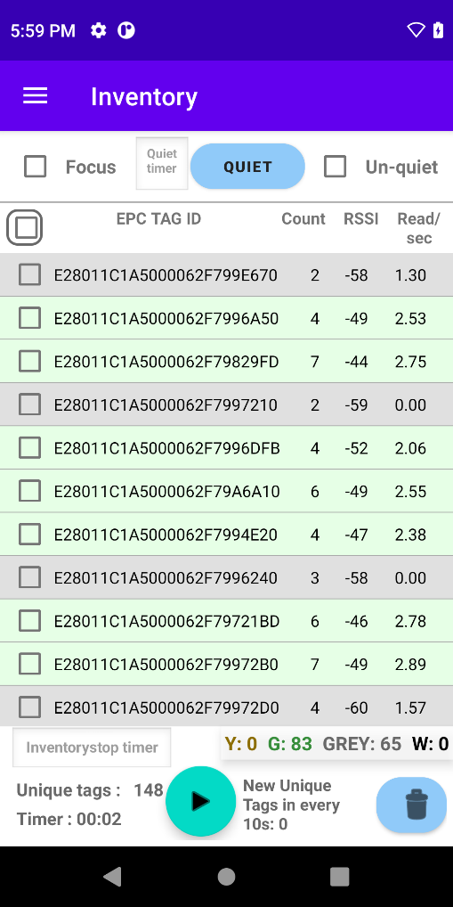
Zebra RFID + Gen2X
Zebra Gen2X: Android SDK Sample Application (NewGen2XPlay) User Guide
Gen2X Feature Demo: Tag Quieting
1. Setup tags for Demo
  Arrange Gen2X-enabled tags in the test area
  Note the total number of tags available
2. Inventory Without Quieted Tags
  Configure using Singulation and/or Prefilters to match your current application (or leave as default)
  Ensure the TagFocus and Un-quiet checkboxes are NOT checked
  Click the inventory start button
  Read tags for desired period OR until all unique tags are read
  Click the Stop button and observe:
    Timer
    Unique Tags
    New Unique Tags in every 10s
    Count per tag (generally expect to see this vary with some tags having very high read/sec and others having very low)
Notes:
Now, let’s go through the first part of the Tag Quieting Demo—setting up and running inventory without quieted tags.
Step 1: Setup Tags for the Demo
Arrange your Gen2X-enabled tags in the test area.
Take note of the total number of tags available for the demo.
Step 2: Inventory Without Quieted Tags
Configure the settings using Singulation or Prefilters to match your application—or leave the defaults.
Make sure the TagFocus and Un-quiet checkboxes are unchecked.
Click the Start Inventory button to begin reading tags.
Let the inventory run for your desired period or until all unique tags are read.
Finally, click Stop and observe key metrics:
Timer: How long the inventory process ran.
Unique Tags: The total number of unique tags detected.
New Unique Tags in every 10 seconds: How many new tags were read during each interval.
Count per Tag: You’ll generally see variation here, with some tags showing high read rates per second and others showing lower rates.
This gives us a baseline to compare against when we introduce Tag Quieting in the next steps.

Slide 26
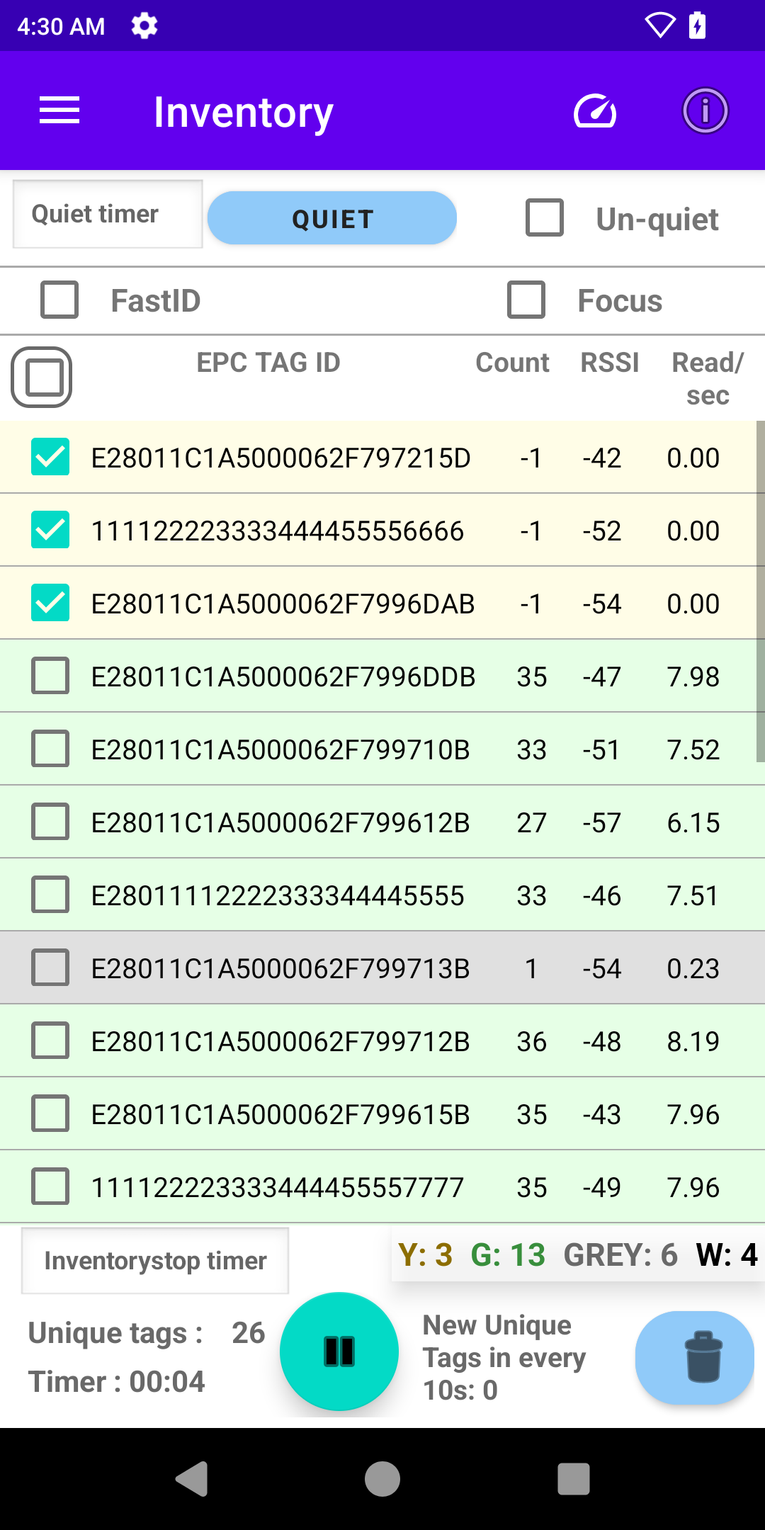
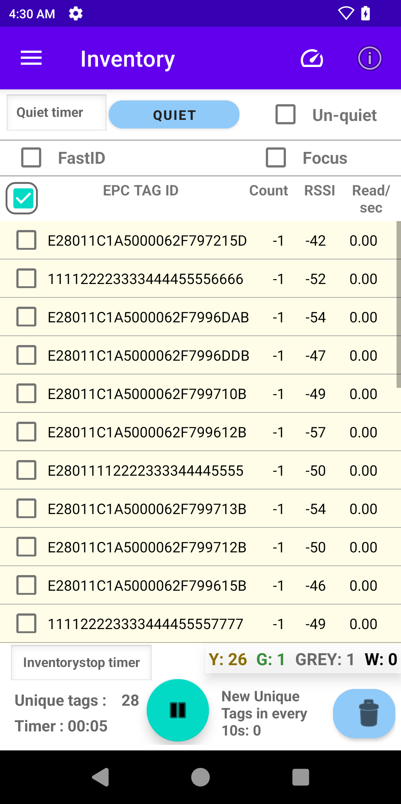
Zebra RFID + Gen2X
Zebra Gen2X: Android SDK Sample Application (NewGen2XPlay) User Guide
Gen2X Feature Demo: Tag Quieting
3a. Quiet Selected Tags (up to 31 tags)
  Clear the screen and begin the inventory again (do NOT stop yet)
  Select tags to quiet by checking the box next the EPC Tag ID
  Press the “Quiet’ Button to quiet the tags
  Selected tags will be quieted, changed to Yellow and count set to -1 to differentiate from the other tags.
  ----OR-----
3b. Quiet All Inventoried Tags
  Clear the screen and begin the inventory again (do NOT stop yet)
  From the inventory screen, check the ‘select all’ box at the top of the tag list
  Press the “Quiet’ Button to quiet the tags
    31 non-quieted tags are automatically selected every 2 seconds by default, and tag quieting continues until either the Stop button is pressed, or the timer runs out. Note: The user can also specify a custom timer greater than 2s
Quiet Selected Tags
Quiet All Tags
Notes:
Now, let’s move on to the next part of the Tag Quieting Demo—quieting tags. You have two options here, depending on your use case:
Option 1: Quiet Selected Tags (up to 31 tags)
Start by clearing the screen and restarting the inventory process—but don’t stop it yet.
Select specific tags to quiet by checking the box next to their EPC Tag ID.
Then, press the ‘Quiet’ button to quiet those tags.
You’ll notice the selected tags change to yellow with their count set to -1, making them easy to differentiate from other tags.
Option 2: Quiet All Inventoried Tags
Again, clear the screen and restart the inventory process—but keep it running.
On the inventory screen, check the ‘Select All’ box at the top of the tag list.
Press the ‘Quiet’ button to quiet all the tags.
By default, 31 non-quieted tags are selected every 2 seconds for quieting, and this process will continue until you either press Stop or the timer runs out.
If needed, you can set a custom timer to extend this interval beyond 2 seconds.
This step demonstrates the flexibility of Tag Quieting, whether you need to target specific tags or quiet all tags efficiently.
Now, let’s observe the results in the next step.

Slide 27
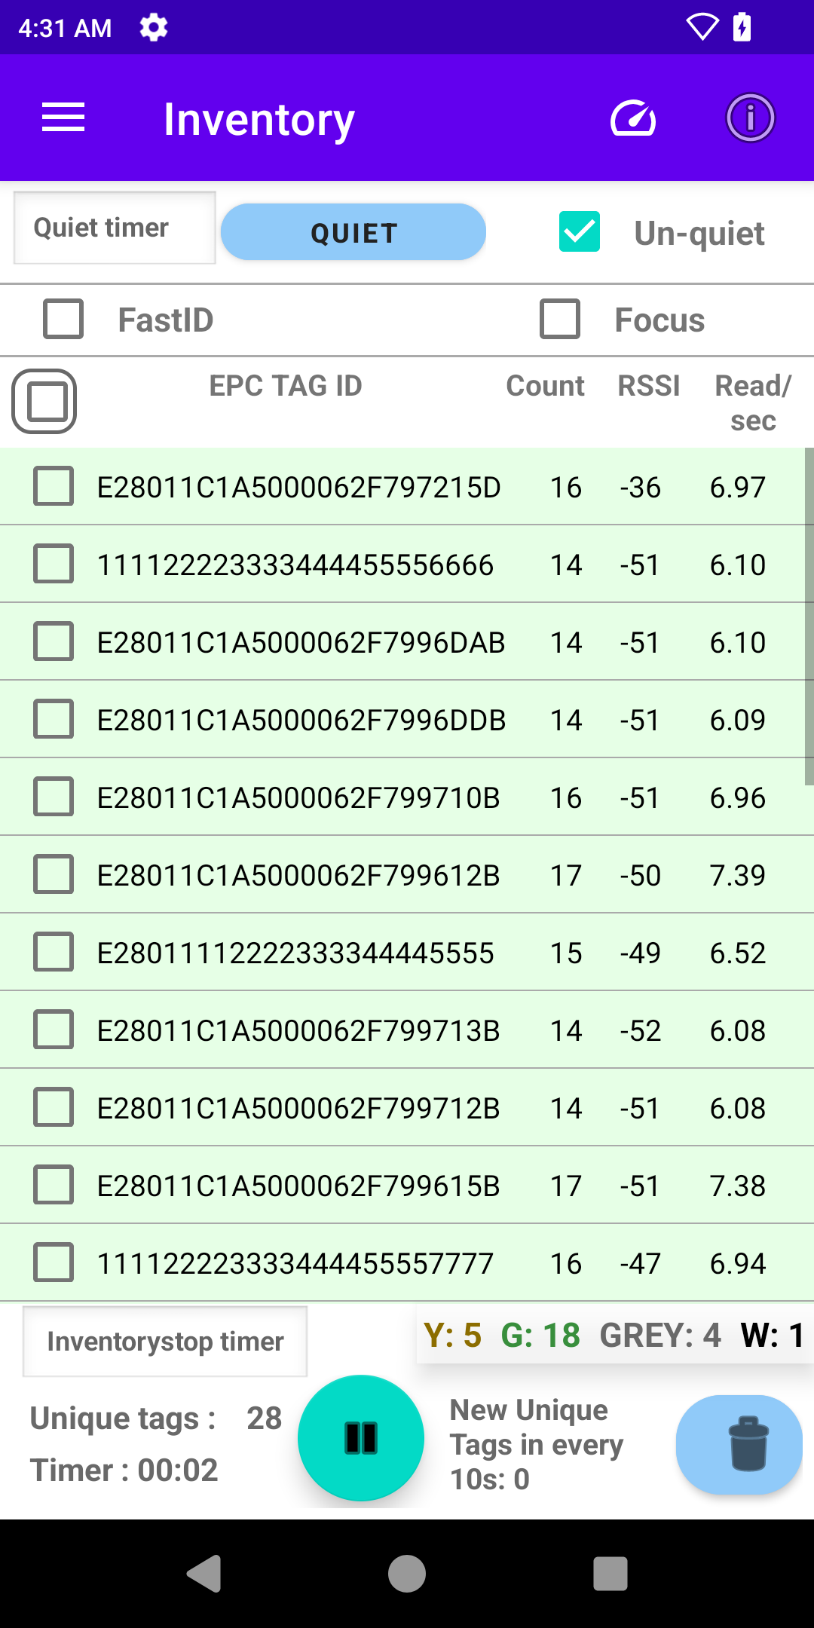
Zebra RFID + Gen2X
Zebra Gen2X: Android SDK Sample Application (NewGen2XPlay) User Guide
Gen2X Feature Demo: Tag Quieting
4. Un-quiet Tags
  If Inventory is not stopped, press the Stop button
  Select the checkbox
  Select the Un-quiet checkbox to un-quiet tags (checked)
  Click the inventory start button
  All the tags which were quieted will be un-quieted (change from yellow to green/grey)
5. Observe and Compare Results
Quieted tags are changed to Yellow and count set to -1
Non-quieted tags will continue to be read and an increase in count and read/sec may be observed.
Tag Quieting shows the most noticeable difference in environments with 100+ tags, where controlling interference and focusing on relevant tags improves system performance and reduces redundant data processing. In smaller-scale environments, its impact may be less pronounced.
Notes:
Next, let’s look at how to Un-quiet Tags and observe the results.
Step 4: Un-quiet Tags
If the inventory is still running, press the Stop button to pause it.
Select the checkbox next to the tags you want to un-quiet.
Then, check the ‘Un-quiet’ checkbox to restore those tags.
Click the Start Inventory button again, and you’ll see that all previously quieted tags are now un-quieted. They will change from yellow back to green or grey, indicating they are active again.
Step 5: Observe and Compare Results
Quieted tags will appear in yellow with their count set to -1, confirming they are silenced.
Non-quieted tags will continue to be read, and you may notice an increase in counts and reads per second for these tags.
The impact of Tag Quieting is most noticeable in environments with 100 or more tags, where it reduces interference and improves system performance by focusing on relevant tags.
In smaller-scale environments, the differences may be less pronounced, but it still demonstrates the feature's ability to manage tag reads effectively.
This concludes the demo for Tag Quieting, showcasing how it enhances performance by reducing redundant data and streamlining tag management.

Slide 28
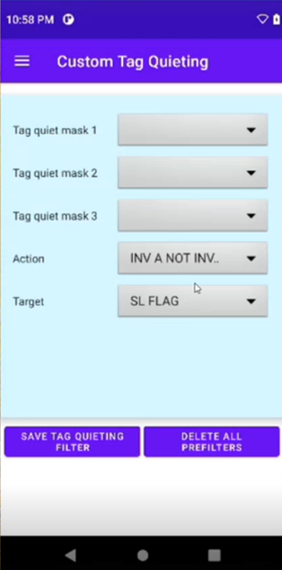
Zebra RFID + Gen2X
Zebra Gen2X: Android SDK Sample Application (NewGen2XPlay) User Guide
Gen2X Feature Demo: Tag Quieting
Custom Tag Quieting
The demo application provides the ability to manage tag quieting filters – this is not required for basic demonstration of Tag Quieting but may be used by advanced users to test configurations.
For more information, please see Zebra TechDocs Tutorials- Impinj Gen2X APIs: https://techdocs.zebra.com/dcs/rfid/
Notes:
The application provides advanced users with the ability to manage tag quieting filters. While this feature isn’t required for a basic demonstration of Tag Quieting, it can be used to test and experiment with different configurations for more complex use cases.
If you’d like to dive deeper into the technical details and learn how to configure these advanced settings, please see the Zebra TechDocs Tutorials for Impinj Gen2X APIs.

Slide 29
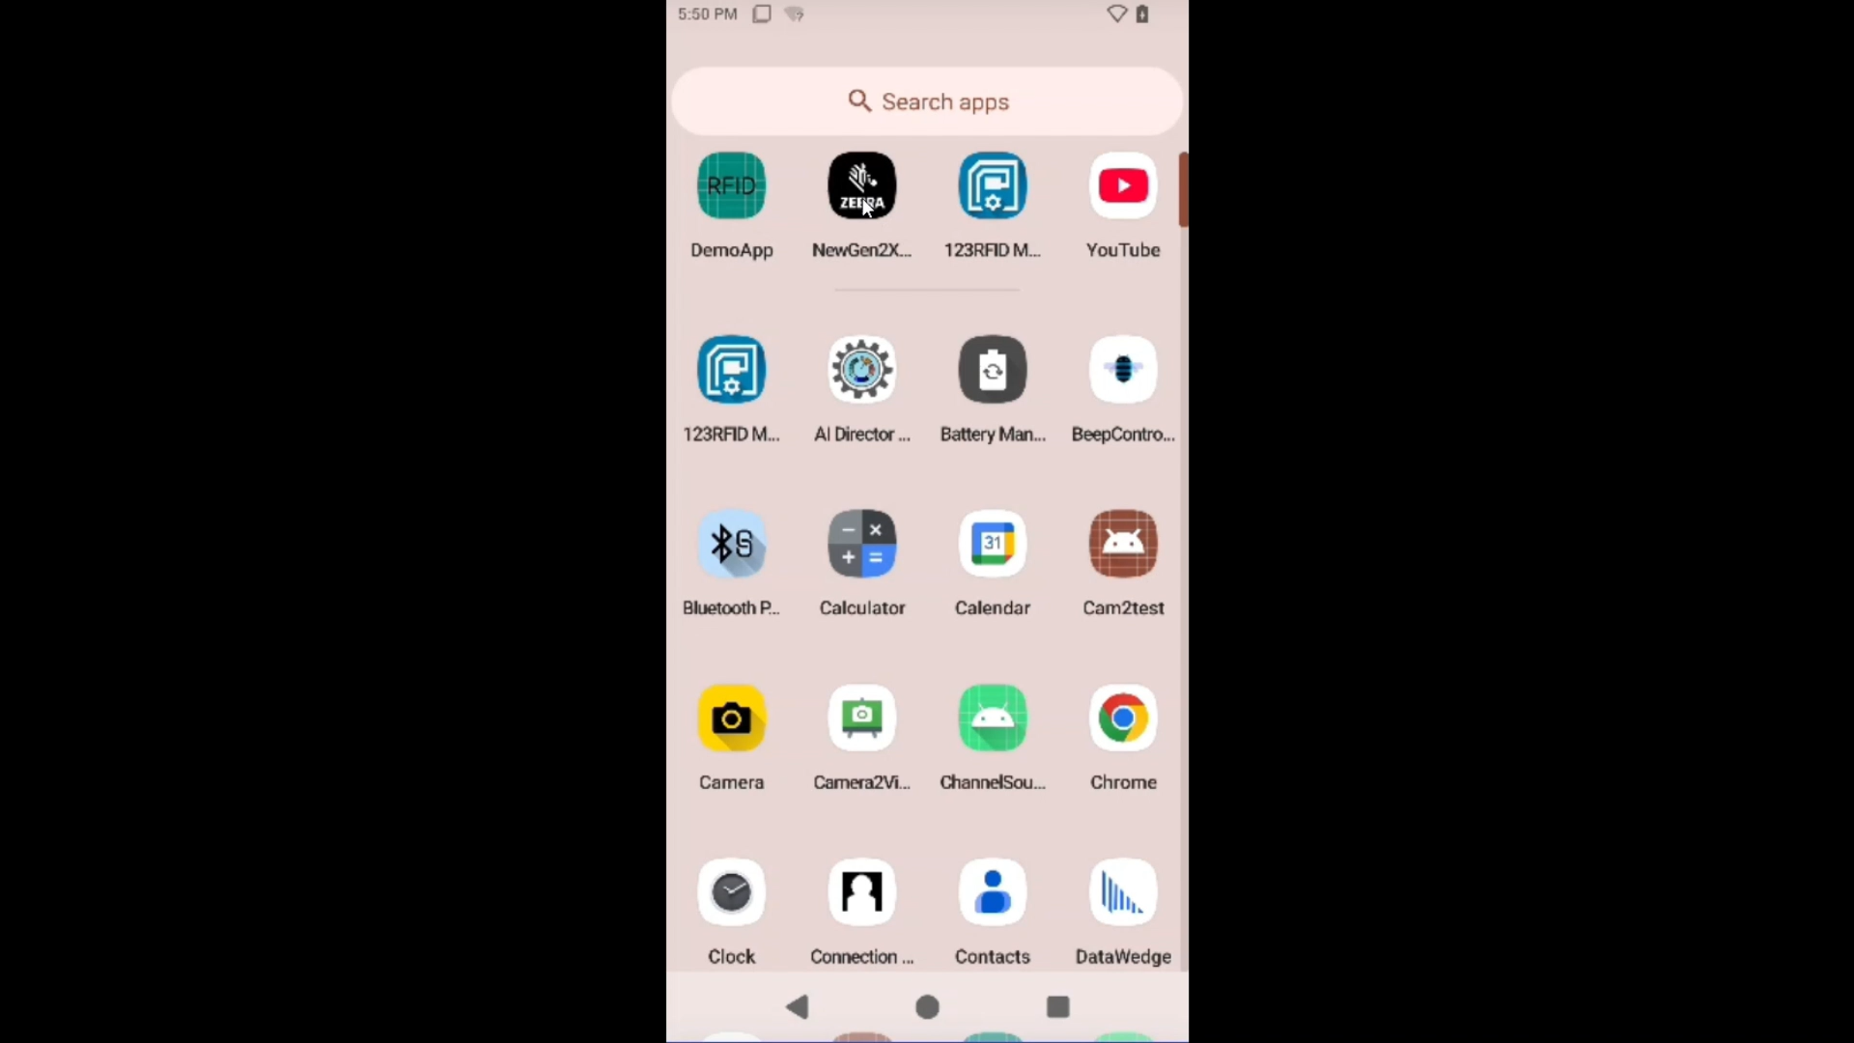
Tag Quieting Demo

Slide 30
Gen2X Feature Demo: Protected Mode
Notes:
Now, let’s discuss the Gen2X Feature Demo: Protected Mode, a powerful feature designed to enhance security and control over RFID tag data.

Slide 31
Zebra RFID + Gen2X
Zebra Gen2X: Android SDK Sample Application (NewGen2XPlay) User Guide
Gen2X Feature Demo: Protected Mode
What is Protected Mode?
  Protected Mode is a feature that hides a tag from RFID readers unless the correct 32-bit PIN/Password is provided.
  Protected tags can still be inventoried by readers that supply the correct PIN/Password, and users can toggle the tag's status between protected and unprotected as needed.
When to use Protected Mode?
  Protected Mode is useful for scenarios where controlling access to RFID tag data is critical for security, privacy, or operational efficiency. It is ideal for applications like protecting sensitive data, preventing unauthorized tracking, enhancing privacy, verifying authenticity, securing access control, and streamlining workflows in controlled environments.
Notes:
What is Protected Mode?
Protected Mode is a feature that hides a tag from RFID readers unless the correct 32-bit PIN or password is provided. While protected, tags remain invisible to unauthorized readers but can still be inventoried by readers that supply the correct credentials. Users can easily toggle a tag’s status between protected and unprotected as needed.
When to Use Protected Mode?
Protected Mode is ideal for scenarios where controlling access to RFID tag data is critical. It’s particularly useful in applications such as:
Protecting sensitive data, like personal or business information stored on tags.
Preventing unauthorized tracking of tags in public or unsecured environments.
Enhancing privacy for individuals or assets.
Verifying authenticity to combat counterfeiting in industries like retail or pharmaceuticals.
Securing access control, such as for RFID-enabled badges or credentials.
Streamlining workflows in controlled environments where specific tags need restricted visibility.
Protected Mode is an essential tool for enhancing security, ensuring privacy, and maintaining operational efficiency in a variety of RFID applications.

Slide 32
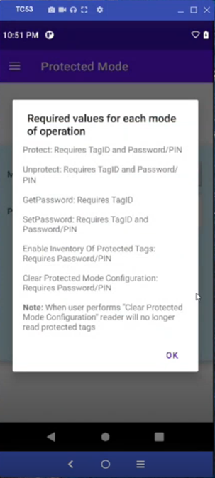
Zebra RFID + Gen2X
Zebra Gen2X: Android SDK Sample Application (NewGen2XPlay) User Guide
Gen2X Feature Demo: Protected Mode
  How to Demo:
    This demonstrates how to protect tags, verify their invisibility without the PIN/Password, inventory them using the correct PIN/Password, and unprotect them.
    Setup Gen2X Enabled Tags
    Inventory Without Protected Tags
    Protect Selected Tags
    Inventory w/ Protected Tags Invisible (demonstrates how protected tags are ‘invisible’ to readers)
    Inventory w/ Protected Tags Visible (demonstrates how protected tags are visible with the correct PIN/Password)
    Clear Protected Tag Configuration
    Unprotect Tags
Expected Results:
  Once tags are protected, they will not be visible to ‘standard’ inventory rounds
  Protected tags are visible with the correct PIN/Password
  Tags can be protected and unprotected multiple times
Notes:
How to Demo Protected Mode:
Setup Gen2X Enabled Tags: Start by arranging your tags for the demo.
Inventory Without Protected Tags: Run a standard inventory to establish a baseline where all tags are visible.
Protect Selected Tags: Select specific tags and apply Protected Mode to secure them with a PIN or password.
Inventory with Protected Tags Invisible: Run inventory again, and you’ll notice that the protected tags are now invisible to the reader.
Inventory with Protected Tags Visible: Use the correct PIN or password during inventory, and the previously invisible tags will now become visible to the reader.
Clear Protected Tag Configuration: Reset the reader by clearing Protected Mode configuration.
Unprotect Tags: Finally, unprotect the tags to restore them to standard visibility.
Expected Results:
Once tags are protected, they will not appear in standard inventory rounds, demonstrating their invisibility.
Protected tags become visible when the correct PIN or password is used, showing how secure access can be controlled.
Tags can be seamlessly protected and unprotected multiple times, giving you flexibility for various applications.

Slide 33
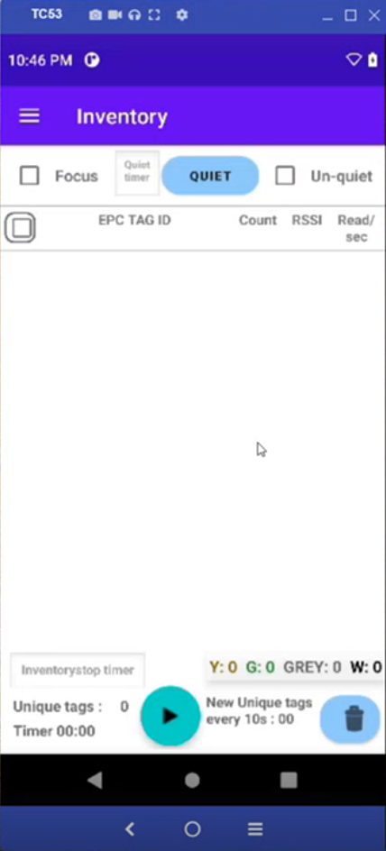
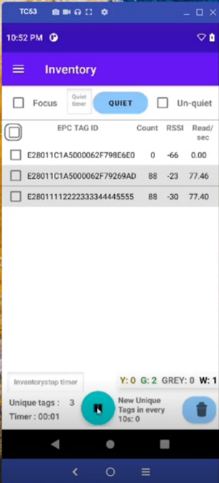
Zebra RFID + Gen2X
Zebra Gen2X: Android SDK Sample Application (NewGen2XPlay) User Guide
Gen2X Feature Demo: Protected Mode
1. Setup tags for Demo
  Arrange Gen2X-enabled tags in the test area (ensure that none have been previously protected with Protected Mode)
2. Inventory Without Protected Tags
  Configure using Singulation and/or Prefilters to match your current application (or leave as default)
  Ensure the TagFocus, FastID and Un-quiet checkboxes are NOT checked
  Click the inventory start button
  Read tags for desired period OR until all unique tags are read
  Click the Stop button and observe:
    Unique Tags (all tags in field of view should display)
Notes:
Let’s begin the first steps of the Protected Mode Demo by setting up the tags and running an inventory without any tags being protected.
Step 1: Setup Tags for the Demo
Arrange your Gen2X-enabled tags in the test area.
Make sure none of the tags have been previously protected with Protected Mode to ensure a clean setup.
Step 2: Inventory Without Protected Tags
Configure the settings using Singulation and/or Prefilters to match your application—or leave the defaults.
Ensure the TagFocus and Un-quiet checkboxes are unchecked.
Click the Start Inventory button to begin reading tags.
Let the inventory run for your desired period or until all unique tags in the field of view are read.
Once done, click Stop and observe the results:
Check the Unique Tags count to ensure all tags in the field of view are displayed.
This step establishes a baseline inventory where all tags are visible, which will help us compare the results once Protected Mode is applied. Now, let’s move on to the next steps to protect the tags.

Slide 34
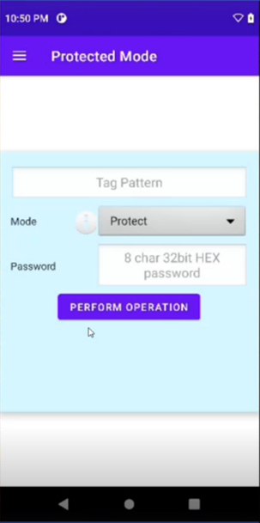
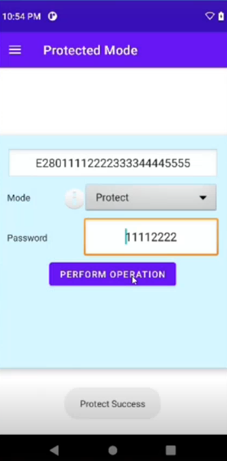
Zebra RFID + Gen2X
Zebra Gen2X: Android SDK Sample Application (NewGen2XPlay) User Guide
Gen2X Feature Demo: Protected Mode
3. Protect Selected Tags
  Select the Protected Mode page from the navigation menu
  Enter the EPC Tag Id (the application will auto complete based on previously inventoried tags)
  Select Mode; Protect
  Enter the PIN/Password
  Click Perform Operation
  Protect Success displays to confirm tag is protected
Notes:
Now, let’s move on to the next step in the Protected Mode Demo: protecting selected tags.
Step 3: Protect Selected Tags
First, navigate to the Protected Mode page from the app’s navigation menu.
Enter the EPC Tag ID for the tag you want to protect. The application will auto-complete this field based on the tags you previously inventoried, making it quick and easy.
Select the Mode as Protect to enable Protected Mode for the tag.
Enter the PIN or Password you’ll use to secure the tag.
Finally, click the Perform Operation button to apply Protected Mode.
Once the operation is complete, you’ll see a Protect Success message confirming that the tag has been successfully protected.
This step demonstrates how easy it is to secure tags with a PIN, ensuring they’re protected and inaccessible during standard inventory rounds. Next, we’ll test the invisibility of these protected tags.

Slide 35
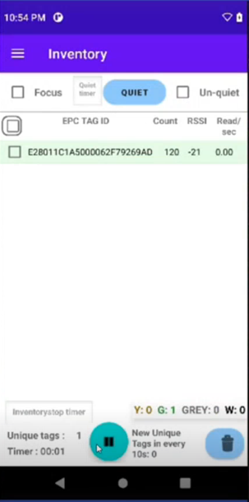
Zebra RFID + Gen2X
Zebra Gen2X: Android SDK Sample Application (NewGen2XPlay) User Guide
Gen2X Feature Demo: Protected Mode
4. Inventory With Protected Tags Invisible
  This step demonstrates how protected tags are ‘invisible’ to readers that do not provide the PIN/Password
  Configure using Singulation and/or Prefilters to match your current application (or leave as default)
  Ensure the TagFocus and Un-quiet checkboxes are NOT checked
  Click the inventory start button
  Read tags for desired period OR until all unique tags are read
  Click the Stop button and observe:
    Unique Tags - only unprotected Tags are inventoried and displayed in the list
Notes:
Now, let’s test the invisibility of protected tags by running an inventory without providing the PIN or password.
Step 4: Inventory with Protected Tags Invisible
Configure the settings using Singulation and/or Prefilters to match your application—or leave the defaults.
Make sure the TagFocus and Un-quiet checkboxes are unchecked.
Click the Start Inventory button to begin reading tags.
Let the inventory run for your desired period or until all unique tags are read.
When finished, click the Stop button and observe the results:
Check the Unique Tags count—this time, you’ll see that only the unprotected tags are inventoried and displayed in the list.
This step demonstrates how Protected Mode ensures that secured tags remain invisible to readers that do not have the correct PIN or password, providing a strong layer of security for sensitive tag data. Next, we’ll see how to make these protected tags visible again by using the correct PIN.

Slide 36
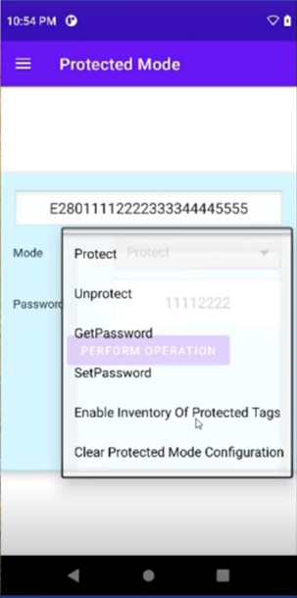
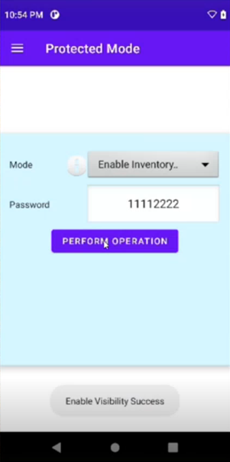
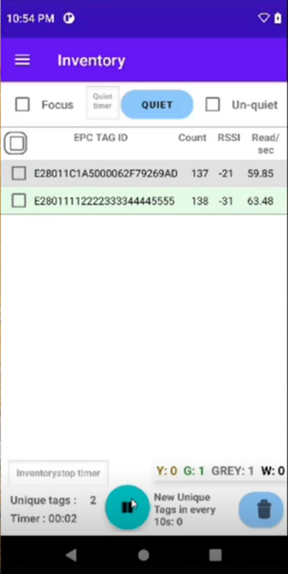
Zebra RFID + Gen2X
Zebra Gen2X: Android SDK Sample Application (NewGen2XPlay) User Guide
Gen2X Feature Demo: Protected Mode
5. Inventory With Protected Tags Visible
  This step demonstrates how protected tags are visible with the correct PIN/Password.
  From the Protected Mode screen, select Enable Inventory of Protected Tags
  Enter the PIN/Password
  Click Perform Operation
  Enable Visibility Success displays to confirm
  Return to Inventory Screen
  Clear the Inventory
  Click the inventory start button
  Read tags for desired period OR until all unique tags are read
  Click the Stop button and observe:
    Unique Tags - All tags (both protected and unprotected) are inventoried and displayed in the list
Notes:
Next, let’s demonstrate how protected tags become visible when the correct PIN or password is used during inventory.
Step 5: Inventory with Protected Tags Visible
Go to the Protected Mode screen and select the option to Enable Inventory of Protected Tags.
Enter the PIN or Password that was used to protect the tags.
Click Perform Operation, and a Enable Visibility Success message will confirm that the protected tags are now accessible.
Return to the Inventory screen, clear the inventory, and start fresh.
Click the Start Inventory button and let it run for your desired period or until all unique tags are read.
When finished, click the Stop button and observe the results:
Check the Unique Tags count—you’ll now see that all tags, both protected and unprotected, are inventoried and displayed in the list.
This step highlights how Protected Mode allows controlled access to secure tags, ensuring they’re only visible to readers with the correct PIN or password.

Slide 37
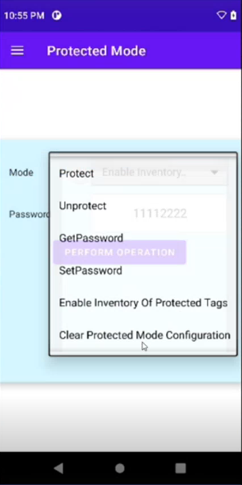
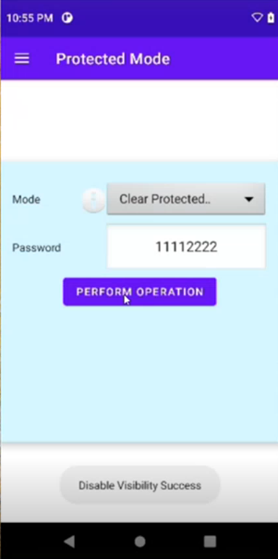
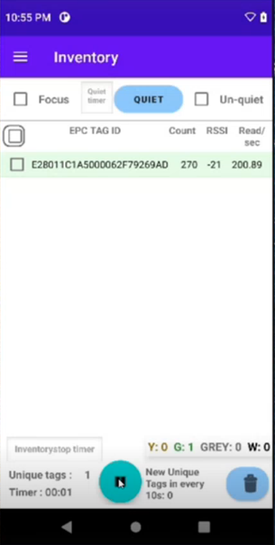
Zebra RFID + Gen2X
Zebra Gen2X: Android SDK Sample Application (NewGen2XPlay) User Guide
Gen2X Feature Demo: Protected Mode
6. Clear Protected Mode Configuration
  From the Protected Mode secreen, select Clear Protected Mode Configuration
  Enter the PIN/Password
  Click Perform Operation
  Disable Visibility Success displays to confirm
  Repeat #4 Inventory With Protected Tags Invisible
  (only unprotected Tags are inventoried and displayed in the list)
Notes:
To clear the Protected Mode configuration:
Navigate to the Protected Mode screen and select Clear Protected Mode Configuration.
Enter the PIN or Password that was used to protect the tags.
Click Perform Operation, and you’ll see a Disable Visibility Success message confirming that the Protected Mode has been cleared.
Now, repeat the earlier step—Inventory with Protected Tags Invisible—to verify the results.
Run an inventory without entering the PIN or password, and confirm that only the unprotected tags are inventoried and displayed in the list.

Slide 38
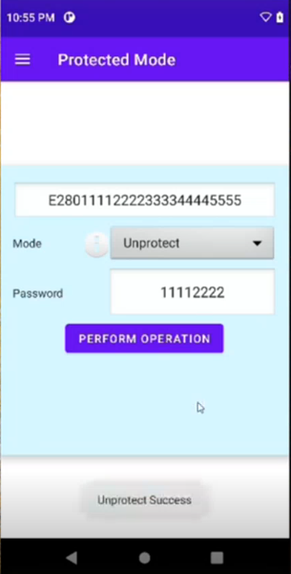
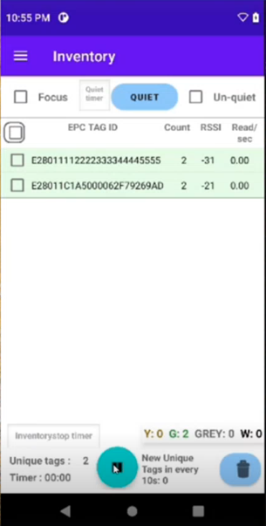
Zebra RFID + Gen2X
Zebra Gen2X: Android SDK Sample Application (NewGen2XPlay) User Guide
Gen2X Feature Demo: Protected Mode
7. Unprotect Selected Tags
  From the Protected Mode screen, enter the EPC Tag ID (the application will auto complete based on previously inventoried tags)
  Select Protect Mode; Unprotect
  Enter the PIN/Password
  Click Perform Operation
  Unprotect Success displays to confirm
  Repeat #2 Inventory Without Protected Tags
  (all tags in field of view should display)
Notes:
Finally, let’s go through the process of unprotecting selected tags to fully restore their visibility and functionality.
Step 7: Unprotect Selected Tags
From the Protected Mode screen, enter the EPC Tag ID of the tag you want to unprotect. The application will auto-complete this field based on the tags previously inventoried.
Select the Protect Mode option as Unprotect.
Enter the PIN or Password used to protect the tag.
Click Perform Operation, and you’ll see an Unprotect Success message confirming the tag is now unprotected.
To verify, repeat the earlier step—Inventory Without Protected Tags.
Run an inventory, and all tags in the field of view, including the previously protected ones, should now be visible in the list.
This step completes the Protected Mode demo, demonstrating how easily tags can be unprotected and restored to their standard state.

Slide 39
Gen2X Feature Demo: FastID
Notes:
Let’s take a closer look at the Gen2X Feature Demo: FastID and how it enhances RFID performance in dense tag environments.

Slide 40
Zebra RFID + Gen2X
Zebra Gen2X: Android SDK Sample Application (NewGen2XPlay) User Guide
Gen2X Feature Demo: FastID
What is FastID?
  FastID enables the impinj tags to backscatter their EPC and TID in a single response for inventory.
How to Demo:
    Setup Tags for Demo
    Inventory With FastID
    Observe the Results
Expected Results:
  Without FastID: EPC is backscattered for inventory
  With FastID: EPC+TID is backscattered for inventory

Slide 41

Zebra RFID + Gen2X
Zebra Gen2X: Android SDK Sample Application (NewGen2XPlay) User Guide
Gen2X Feature Demo: FastID
1. Setup Tags for Demo
  Arrange Gen2X-enabled tags in the test area
2. Inventory Without FastID
  Configure using Singulation and/or Prefilters to match your current application (or leave as default)
  Ensure the FastID checkbox is NOT checked
  Click the inventory start button
  Read tags for desired period OR until all Unique tags are read
  Click the Stop button and observe:
    Timer
    Unique Tags
    New Unique Tags in every 10s
    Count per tag (generally expect to see this vary with some tags having very high read/sec and others having very low)

Slide 42
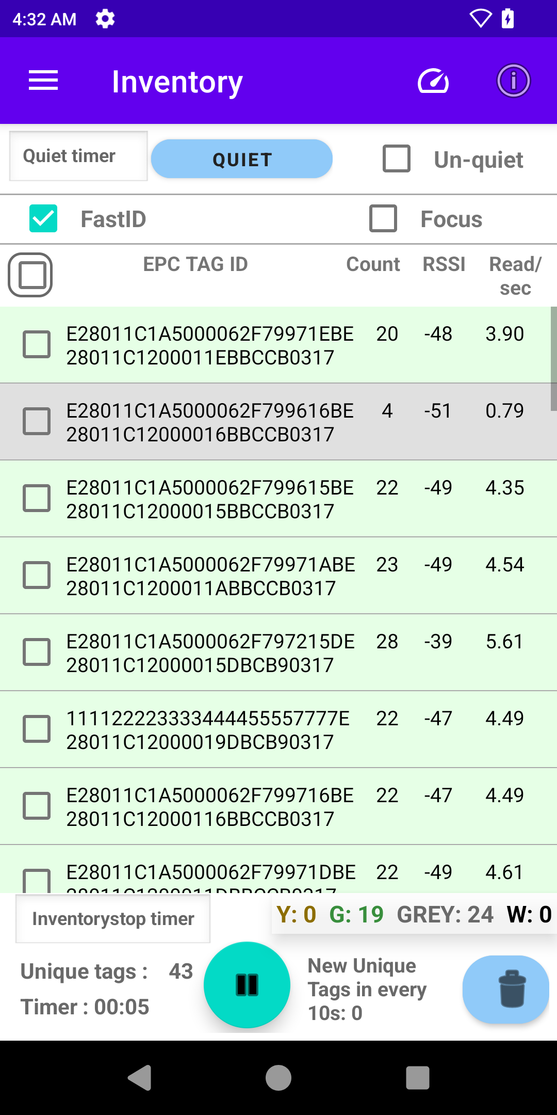
Zebra RFID + Gen2X
Zebra Gen2X: Android SDK Sample Application (NewGen2XPlay) User Guide
Gen2X Feature Demo: FastID
3. Inventory With FastID
  Clear the results using the Clear button
  Select the FastID checkbox to enable FastID (checked)
  Click the inventory start button
  Read tags for desired period OR until all unique tags are read
  Click the Stop button and observe:
    Timer
    Unique Tags
    New Unique Tags in every 10s

Slide 43

FastID Demo

Slide 44
Gen2X Feature Demo: Gen2X enhanced inventory performance using Inventory Protocol

Slide 45
Zebra RFID + Gen2X
Zebra Gen2X: Android SDK Sample Application (NewGen2XPlay) User Guide
    Setup Tags for Demo
Gen2X Feature Demo: Gen2X enhance inventory performance
What is Inventory Protocol mode?
  Inventory protocol enables selection of protocol mode to determine which tags to participate in inventory.
  SDK supports 3 modes for inventory protocol.
    Gen2 :- Inventory all tags (Gen2 and Gen2X).
    Gen2X :- Inventory only Gen2X tags.
    Hybrid :- Inventory all tags with better read rate,
    Note : FastID feature is not supported when inventory protocol is set to Gen2X mode .

Slide 46
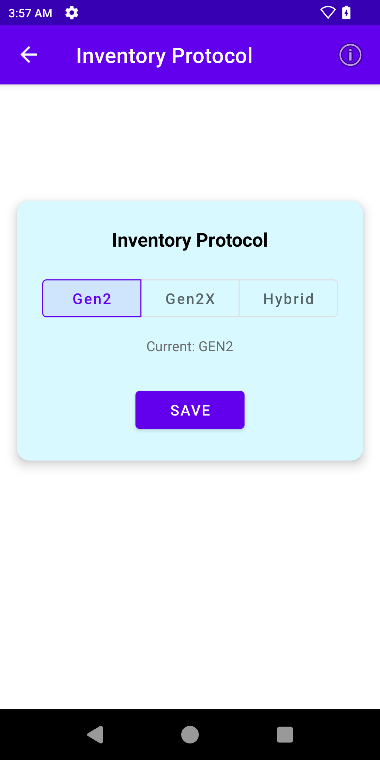
Zebra RFID + Gen2X
Zebra Gen2X: Android SDK Sample Application (NewGen2XPlay) User Guide
Gen2X Feature Demo: Inventory Protocol
1. Setup Tags for Demo
  Arrange both Gen2 and Gen2X-enabled tags in the test area
2. Inventory Protocol selection
Configure using Singulation and/or Prefilters to match your current application (or leave as default)
  Select the protocol
  Click the save button

Slide 47
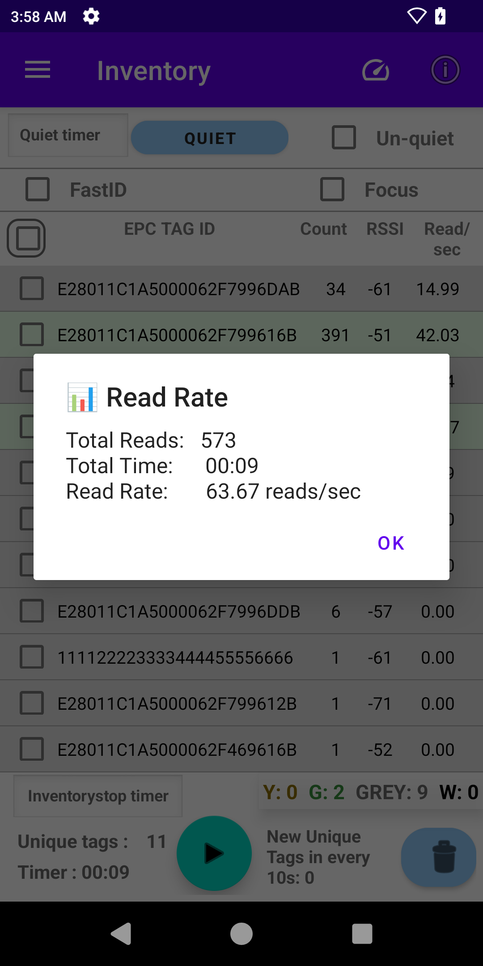
Zebra RFID + Gen2X
Zebra Gen2X: Android SDK Sample Application (NewGen2XPlay) User Guide
Gen2X Feature Demo: Inventory protocol
3. Inventory with selected inventory protocol
  Clear the results using the Clear button
  Click the inventory start button
  Read tags for desired period OR until all unique tags are read
  Click the Stop button and observe:
    Timer
    Unique Tags
    New Unique Tags in every 10s.
  Click and Observe the read rate (total reads / total time) by performing inventory using three different inventory protocol modes.
  TagFocus and Quiet can also be performed using three inventory protocol modes.

Slide 48
Zebra RFID + Gen2X
Zebra Gen2X: Android SDK Sample Application (NewGen2XPlay) User Guide
Zebra’s “NewGen2XPlay” Sample Application demonstrates key Gen2X features, providing users with powerful tools to optimize RFID performance.
This sample application enables users to test and compare Gen2X features to standard RFID operations, helping optimize workflows and maximize efficiency.
Features like Tag Quieting and TagFocus are particularly valuable for managing large tag populations in high-density environments.
Protected Mode ensures data security and controlled tag visibility, making it ideal for sensitive use cases.
Notes:
To wrap up, Zebra’s ‘NewGen2XPlay’ Sample Application provides a clear demonstration of the advanced capabilities of Gen2X features, offering powerful tools to optimize RFID performance.
Here are the main takeaways from the application:
Tag Quieting simplifies inventory in dense environments by silencing unnecessary tags, ensuring faster and more accurate reads.
TagFocus enhances efficiency by prioritizing unread or weaker tags, helping capture the most challenging tags in large populations.
Protected Mode secures sensitive data by requiring a PIN for tag visibility, making it ideal for applications where privacy and security are critical.
Leverage the insights gained with these demos to explore how Gen2X features can enhance your RFID applications!

Slide 49
Thank You!
Notes:
Thank you!

