Slide 1
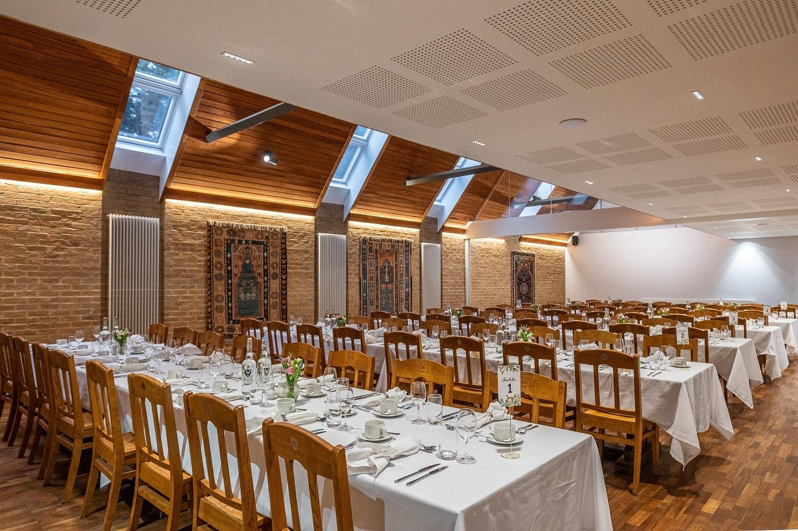
Hall Dining Management Database
Abdullah Al Naeem
1909029

Slide 2
Introduction:
In the educational realm, the efficient management of student services, especially dining facilities, is fundamental to ensuring a positive and fulfilling campus experience. This project outlines the development and implementation of a comprehensive Hall Dining Management System tailored specifically to our institution.
The system will manage basic student information, monthly payment records, dining manager details, daily dining budgets, student feedback, and guest meal information through dedicated database tables, namely 'basicInfo,'
'monthlyPayment,' 'managerInfo,' 'perDayBudget,' 'studentFeedback,' and 'guestMeal.'

Slide 3
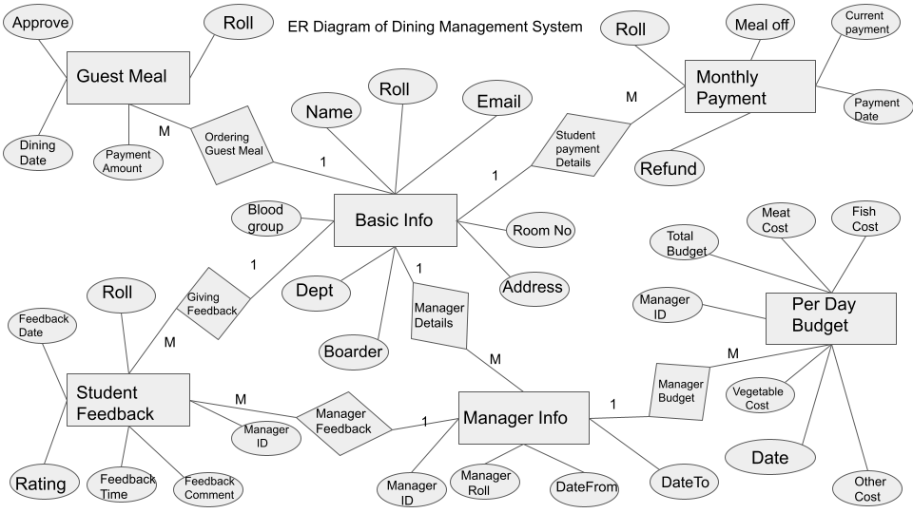

Slide 4
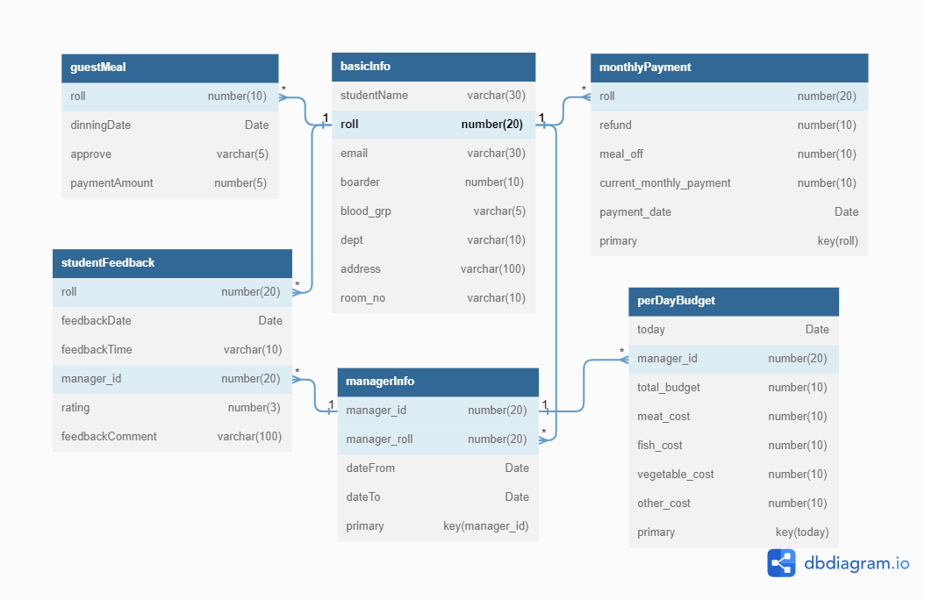

Slide 5
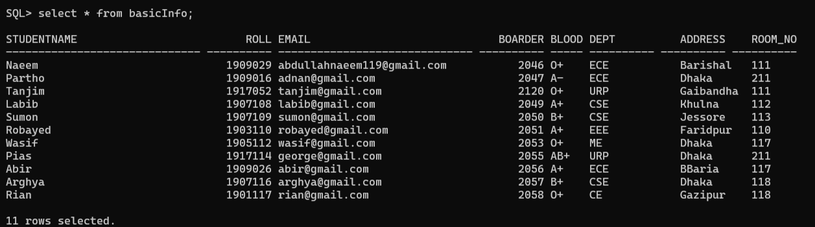
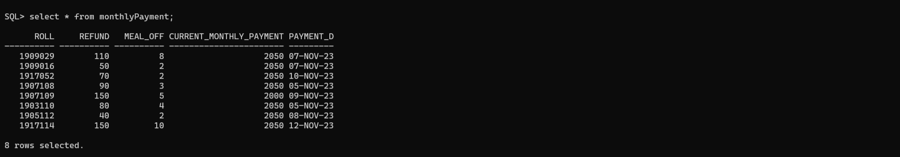
Student’s Basic Info Table
2. Student’s Monthly Payment Table

Slide 6
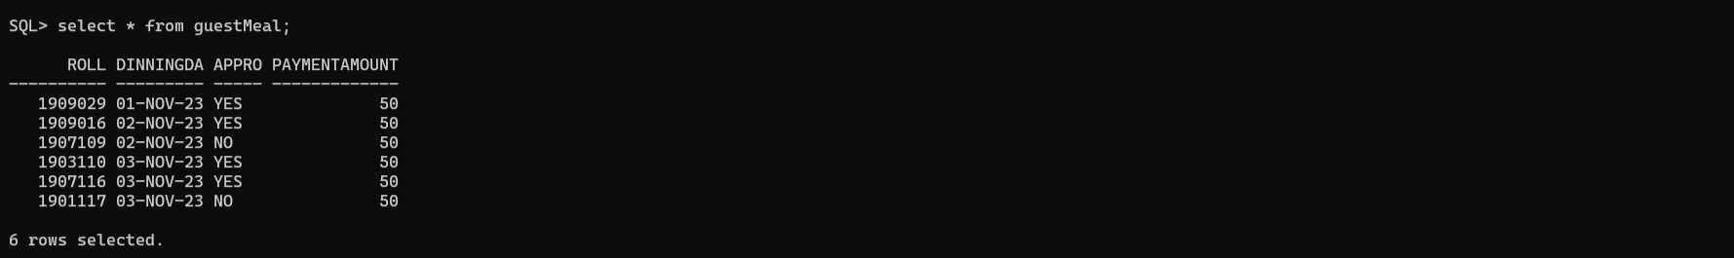
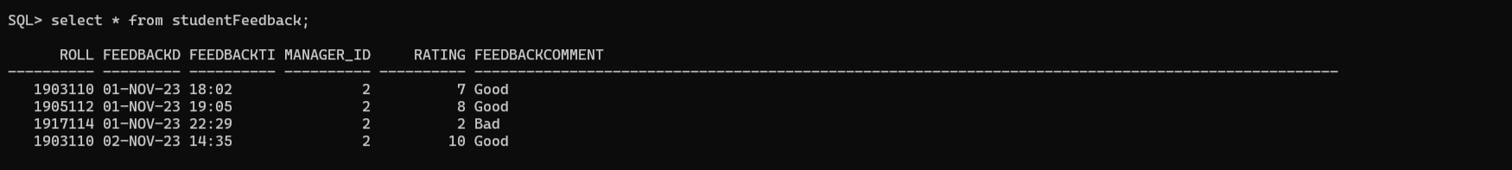
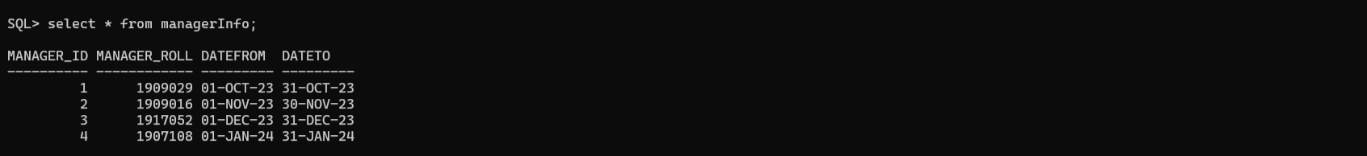
3. Guest Meal’s Data Table
4. Student’s Feedback Table
5. Manager Info Table

Slide 7
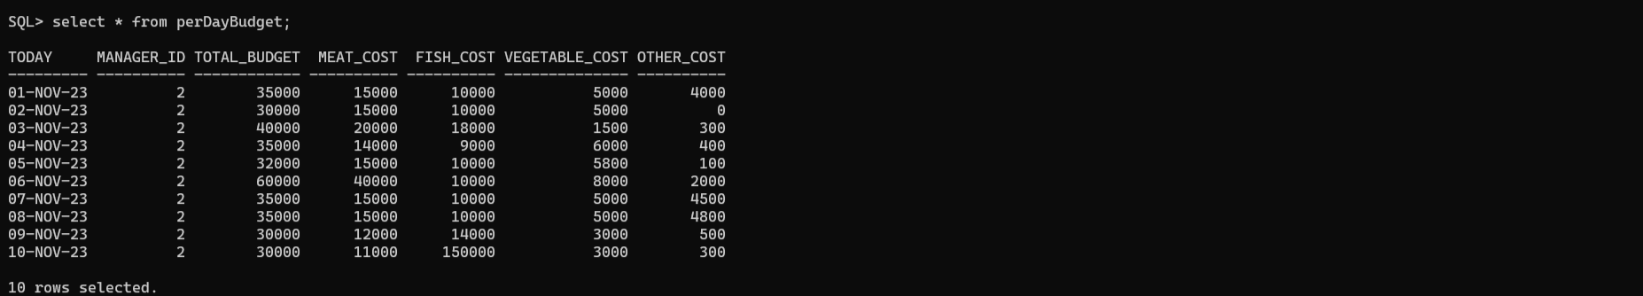
6. Per Day Budget Table

Slide 8
Thank You

