Slide 1
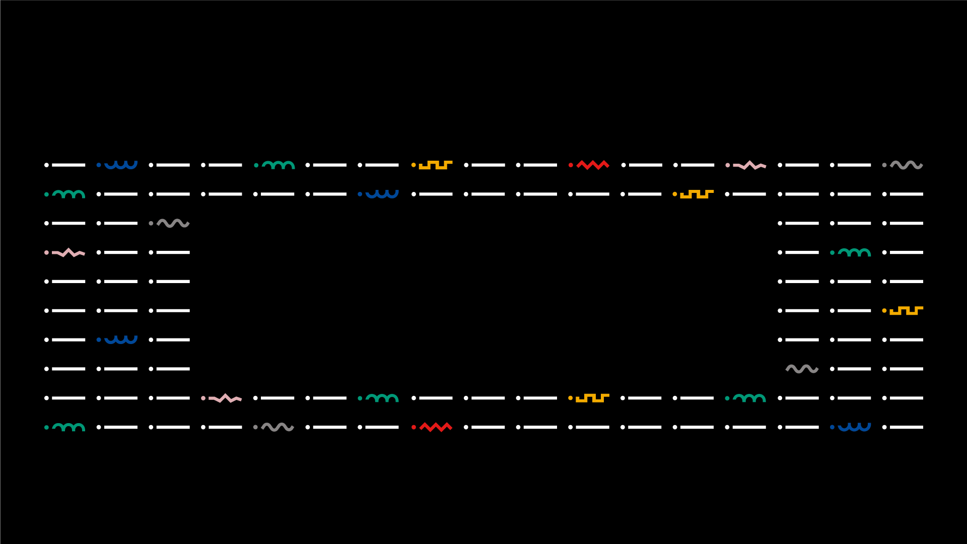

COLAB4FOOD
Licenciatura em ENGENHARIA INFORMÁTICA / Degree Informatics engineering
Património App
N.º 23456 – João Marques;
N.º 23442 – José Lima
Orientador(es):
Professor Doutor António Cruz, Professor José Evaristo
Licenciatura em Engenharia Informática | Escola Superior de Tecnologia e Gestão| Unidade Curricular: Projeto III | Ano Letivo 2022/2023

Slide 2


■ Summary
Degree IN Informatics engineering
1. Introduction and Objectives
2. Technologies, tools, libraries, methodology and project management
2.1 Programming Environment
3. Use Cases, Users Analysis, Class Diagram
3.1 Use Cases
3.2 Class Diagram / E-R Diagram
4. Practical Case/Project Developed
5. Difficulties and future features
6. Reviews
7. Conclusion and Future Work
8. Bibliography and Web References
@José Lima, João Marques | Unidade Curricular: Projeto IV – Ano Letivo 2022/2023 – COLAB4FOOD
- 2 -

Slide 3
■ 1. Introduction and Objectives
Degree IN Informatics engineering
■ Conduct a survey of requirements and subsequent development of an application that allows the registration of equipment
■ Insert information about equipment (description, brand, purchase price, location, etc.)
■ Allow access to information by different types of users (viewer, editor, admin)
■ Allow the request/allocation of equipment
@José Lima, João Marques | Unidade Curricular: Projeto IV – Ano Letivo 2022/2023 – COLAB4FOOD
- 3 -

Slide 4
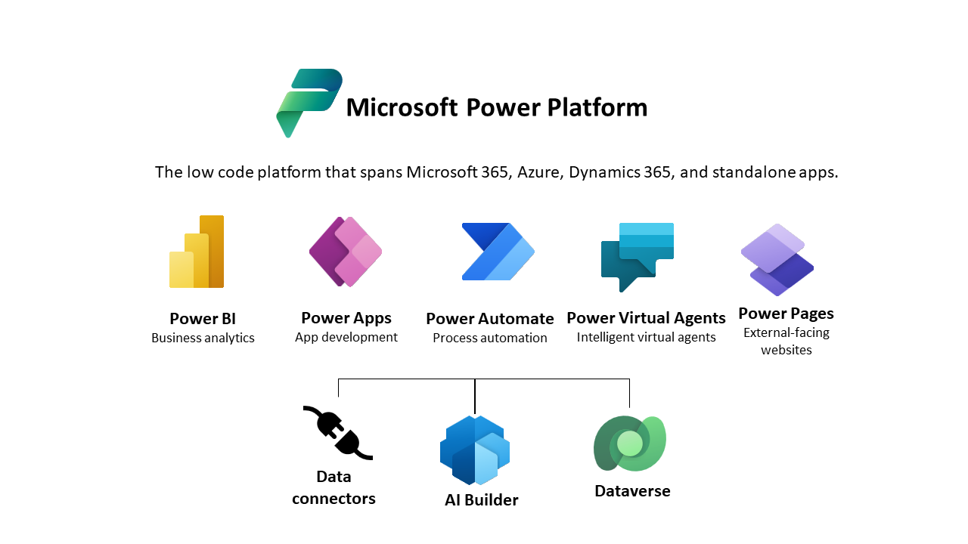
■ 2.Technologies, tools and libraries
Degree IN Informatics engineering
@José Lima, João Marques | Unidade Curricular: Projeto IV – Ano Letivo 2022/2023 – COLAB4FOOD
- 4 -

Slide 5


■ 2.1. Programming Environment
Degree IN Informatics engineering
@José Lima, João Marques | Unidade Curricular: Projeto IV – Ano Letivo 2022/2023 – COLAB4FOOD
- 5 -

Slide 6
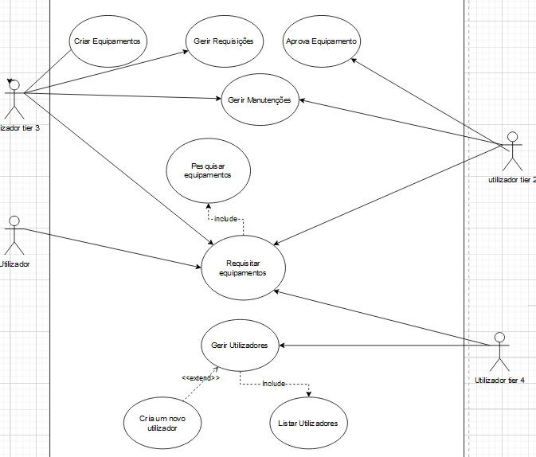
■ 3.2. Use Case Diagram
Degree IN Informatics engineering
@José Lima, João Marques | Unidade Curricular: Projeto IV – Ano Letivo 2022/2023 – COLAB4FOOD
- 6 -

Slide 7
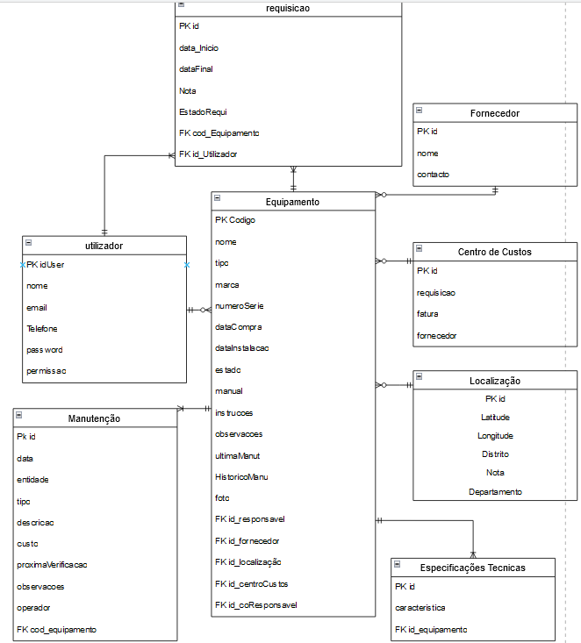
■ 3.3. Class Diagram / E-R Diagram
Degree IN Informatics engineering
@José Lima, João Marques | Unidade Curricular: Projeto IV – Ano Letivo 2022/2023 – COLAB4FOOD
- 7 -

Slide 8
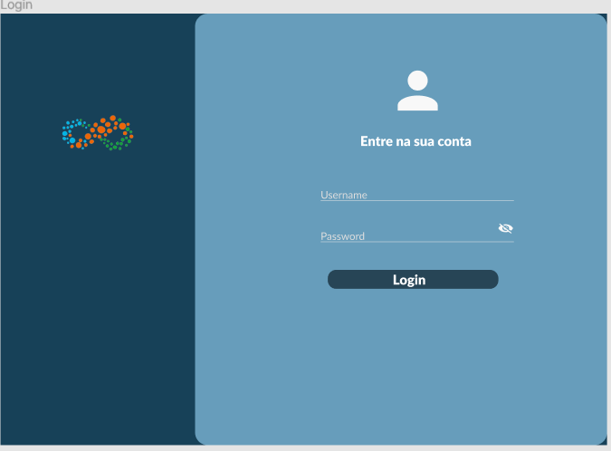
■ 4. Practical Case/Project Developed
Degree IN Informatics engineering
@José Lima, João Marques | Unidade Curricular: Projeto IV – Ano Letivo 2022/2023 – COLAB4FOOD
- 8 -

Slide 9
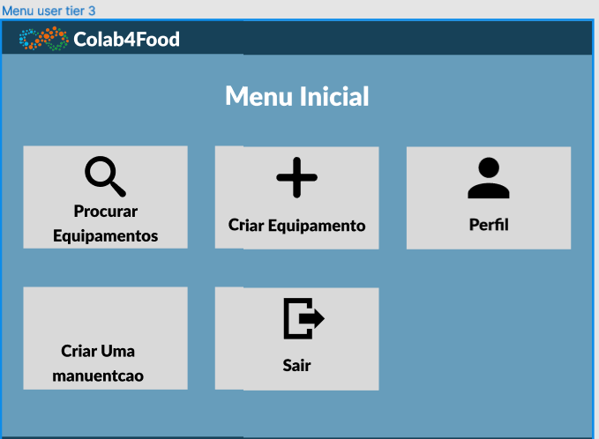
■ 4. Practical Case/Project Developed
Degree IN Informatics engineering
@José Lima, João Marques | Unidade Curricular: Projeto IV – Ano Letivo 2022/2023 – COLAB4FOOD
- 9 -

Slide 10
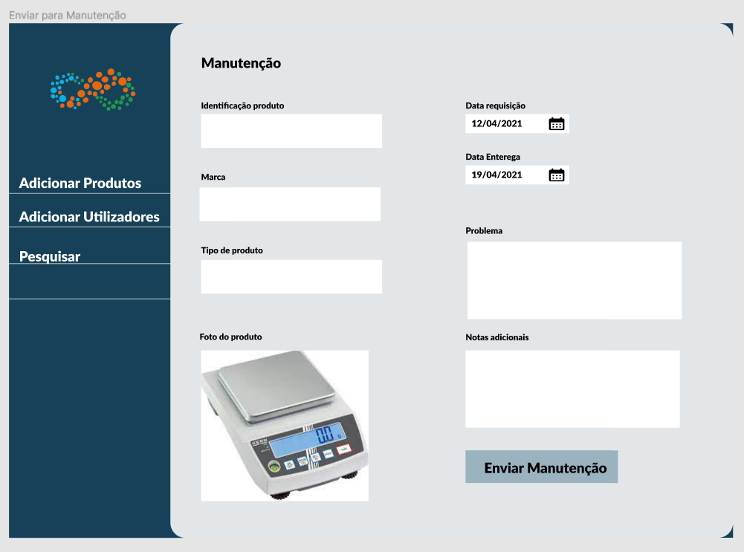
■ 4. Practical Case/Project Developed
Degree IN Informatics engineering
@José Lima, João Marques | Unidade Curricular: Projeto IV – Ano Letivo 2022/2023 – COLAB4FOOD
- 10 -

Slide 11
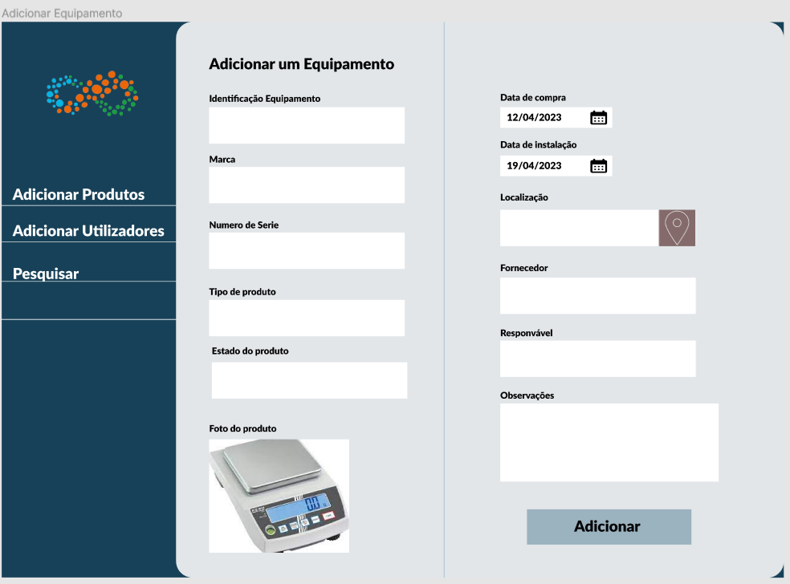
■ 4. Practical Case/Project Developed
Degree IN Informatics engineering
@José Lima, João Marques | Unidade Curricular: Projeto IV – Ano Letivo 2022/2023 – COLAB4FOOD
- 11 -

Slide 12
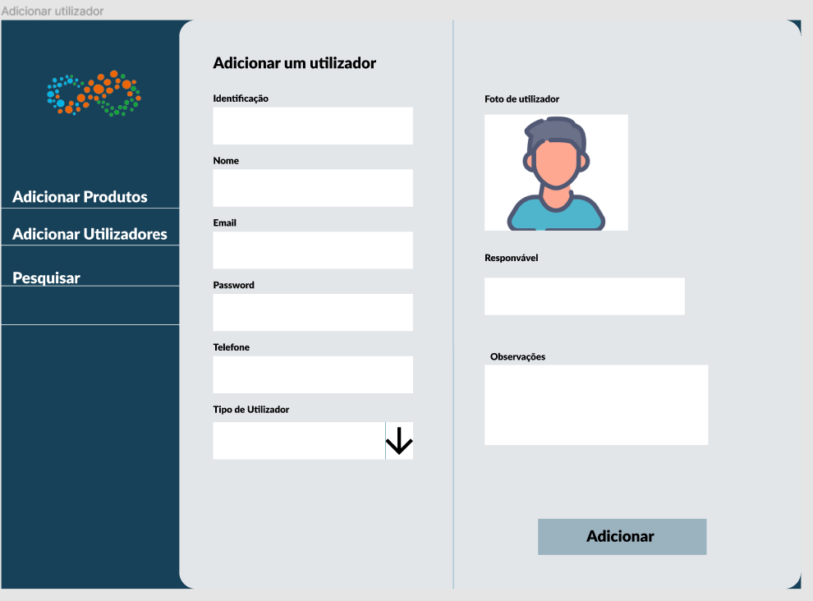
■ 4. Practical Case/Project Developed
Degree IN Informatics engineering
@José Lima, João Marques | Unidade Curricular: Projeto IV – Ano Letivo 2022/2023 – COLAB4FOOD
- 12 -

Slide 13
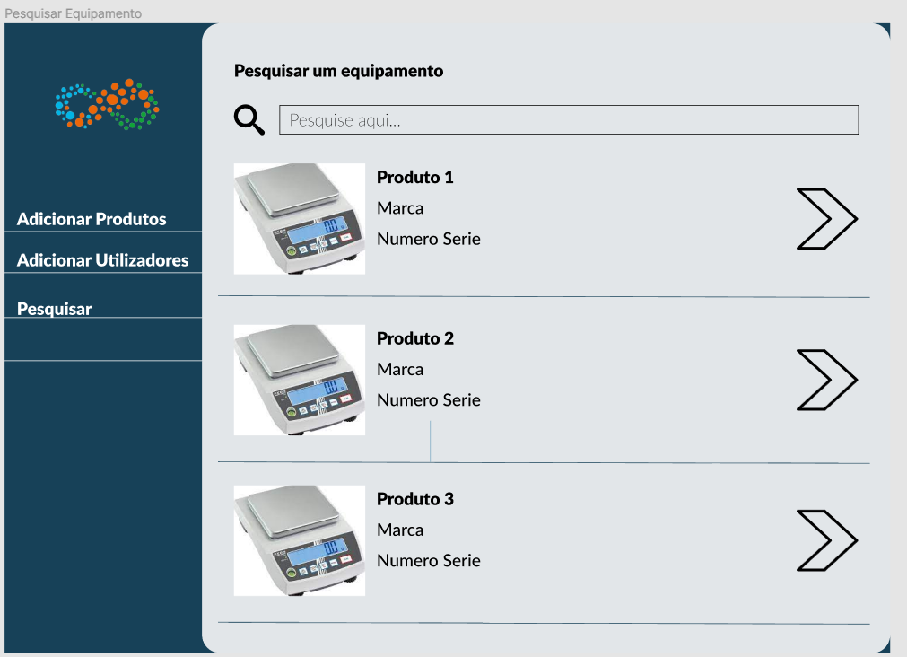
■ 4. Practical Case/Project Developed
Degree IN Informatics engineering
@José Lima, João Marques | Unidade Curricular: Projeto IV – Ano Letivo 2022/2023 – COLAB4FOOD
- 13 -

Slide 14
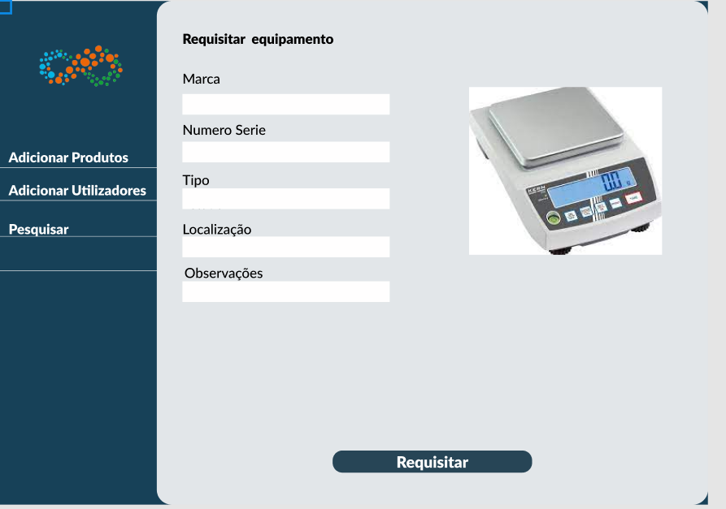
■ 4. Practical Case/Project Developed
Degree IN Informatics engineering
@José Lima, João Marques | Unidade Curricular: Projeto IV – Ano Letivo 2022/2023 – COLAB4FOOD
- 14 -

Slide 15
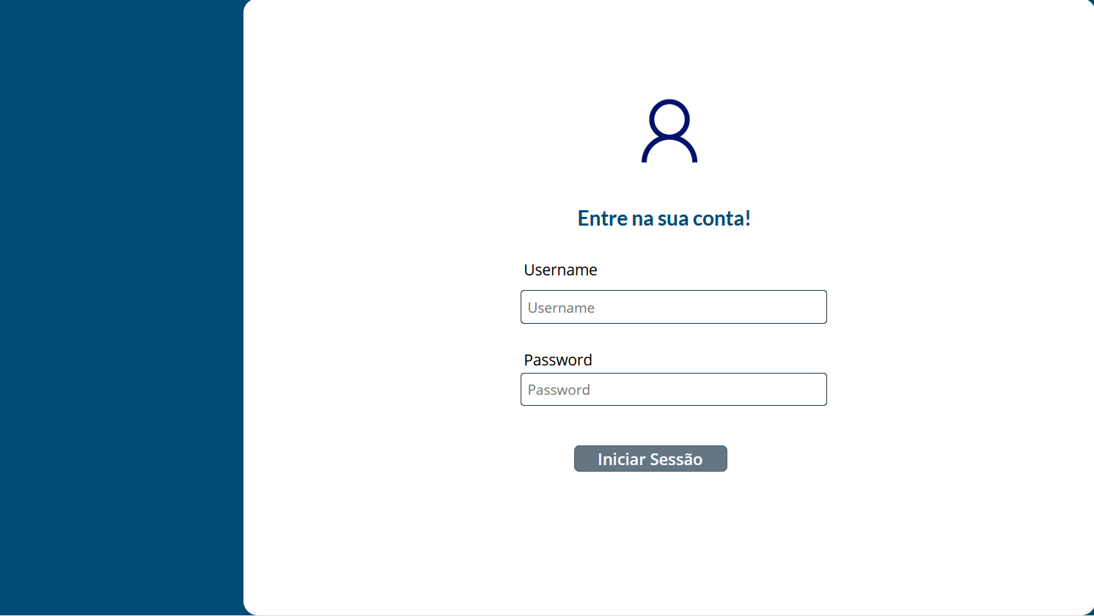
■ 5. Practical Case/Project Developed
Degree IN Informatics engineering
■ FUNCTIONALITY lOGIN:
@José Lima, João Marques | Unidade Curricular: Projeto IV – Ano Letivo 2022/2023 – COLAB4FOOD
- 15 -

Slide 16
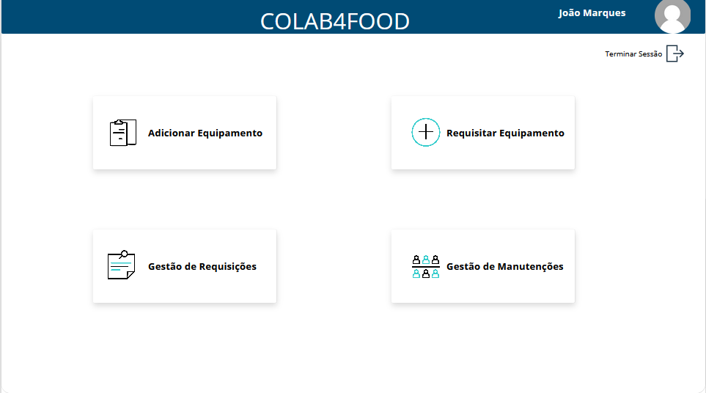
■ 5. Practical Case/Project Developed
Degree IN Informatics engineering
■ APP MAIN PAGE:
@José Lima, João Marques | Unidade Curricular: Projeto IV – Ano Letivo 2022/2023 – COLAB4FOOD
- 16 -

Slide 17
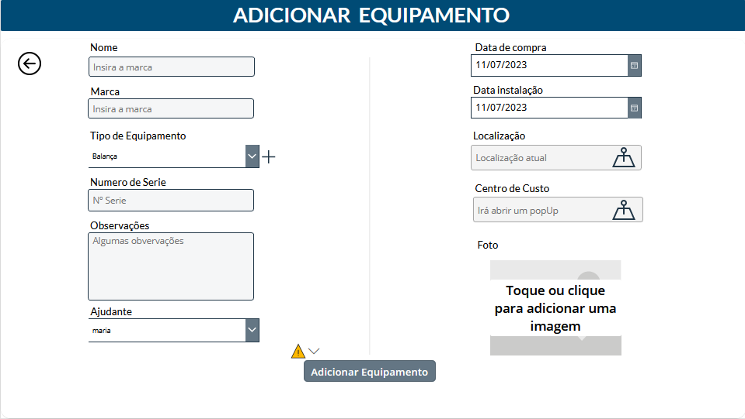
■ 5. Practical Case/Project Developed
Degree IN Informatics engineering
■ FUNCTIONALITY ADD EQUIPAMENT:
@José Lima, João Marques | Unidade Curricular: Projeto IV – Ano Letivo 2022/2023 – COLAB4FOOD
- 17 -

Slide 18
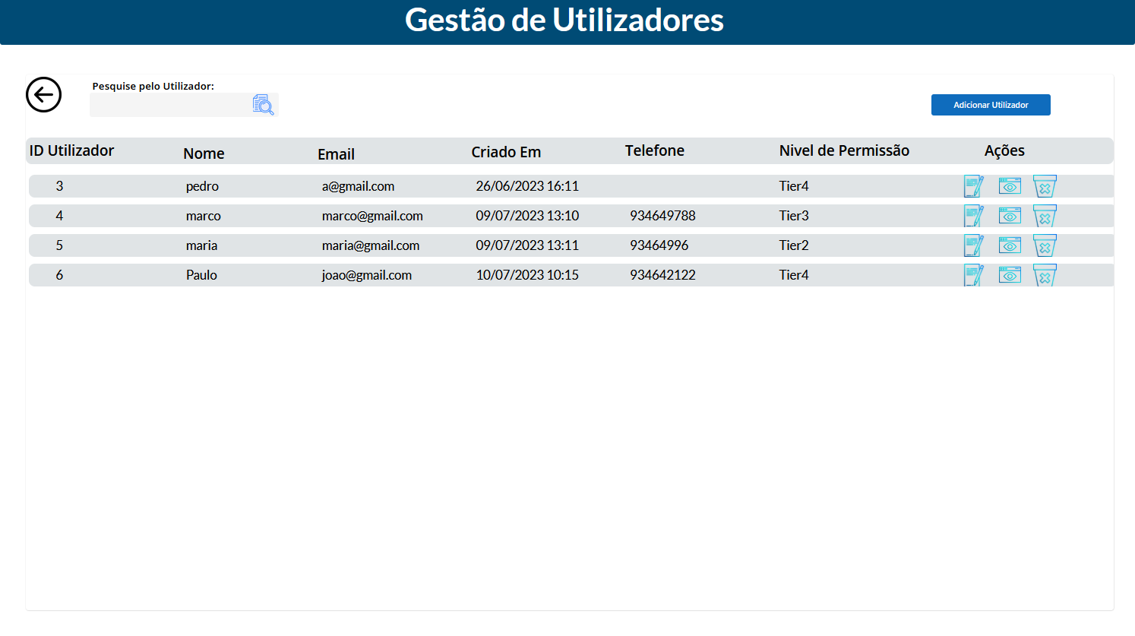
■ 5. Practical Case/Project Developed
Degree IN Informatics engineering
■ FUNCTIONALITY USER MANAGEMENT:
@José Lima, João Marques | Unidade Curricular: Projeto IV – Ano Letivo 2022/2023 – COLAB4FOOD
- 18 -

Slide 19
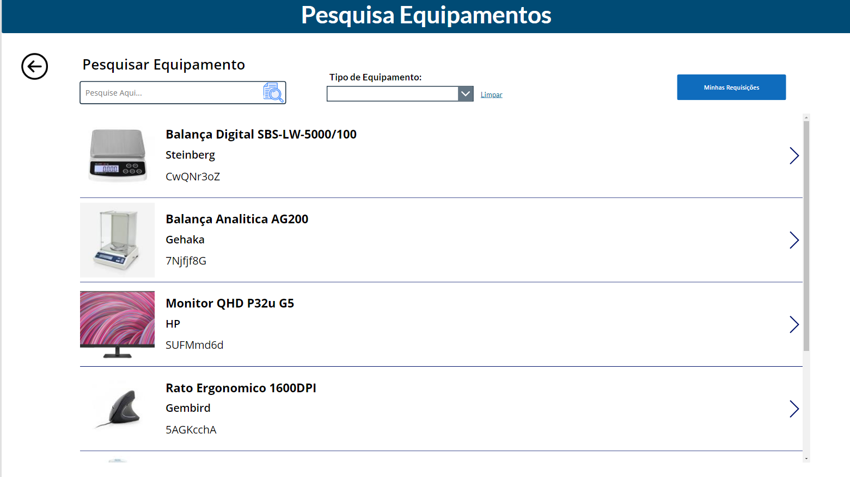
■ 5. Practical Case/Project Developed
Degree IN Informatics engineering
■ FUNCTIONALITY Search equipment:
@José Lima, João Marques | Unidade Curricular: Projeto IV – Ano Letivo 2022/2023 – COLAB4FOOD
- 19 -

Slide 20
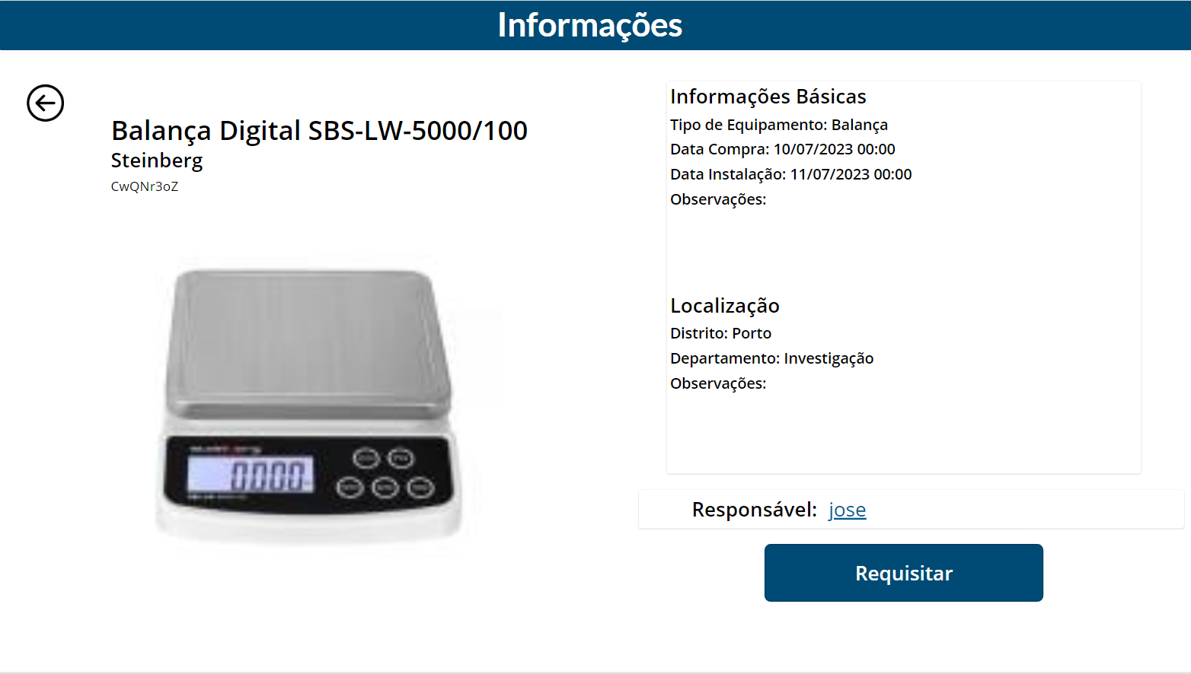
■ 5. Practical Case/Project Developed
Degree IN Informatics engineering
■ FUNCTIONALITY Equipment page:
@José Lima, João Marques | Unidade Curricular: Projeto IV – Ano Letivo 2022/2023 – COLAB4FOOD
- 20 -

Slide 21
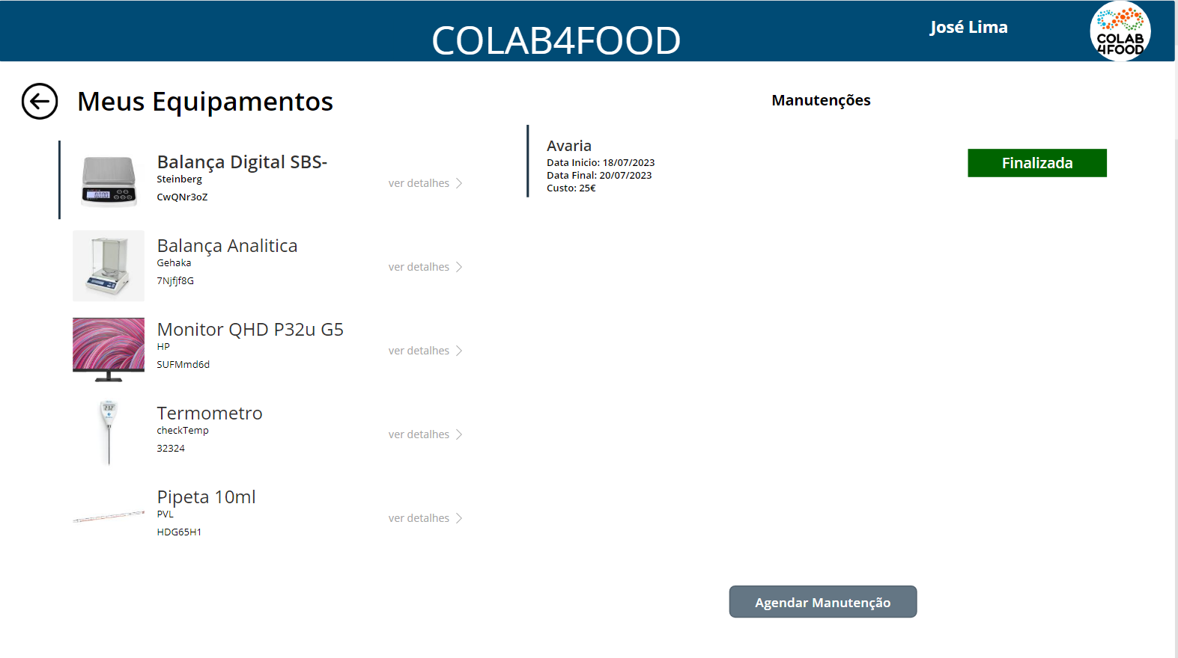
■ 5. Practical Case/Project Developed
Degree IN Informatics engineering
■ FUNCTIONALITY My equipments page tier 2 user:
@José Lima, João Marques | Unidade Curricular: Projeto IV – Ano Letivo 2022/2023 – COLAB4FOOD
- 21 -

Slide 22
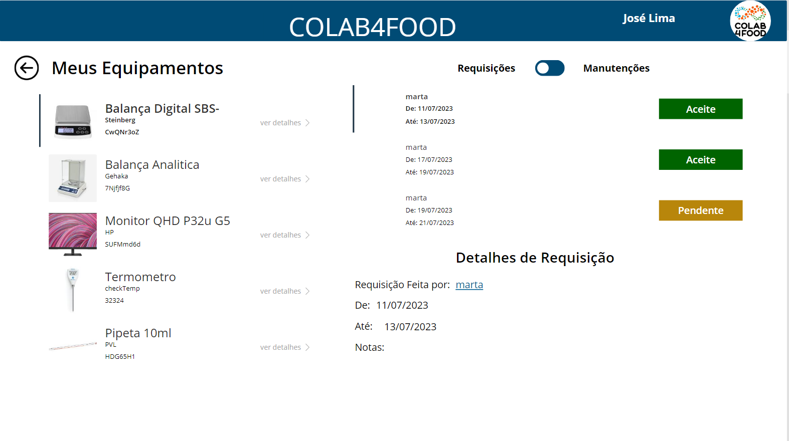
■ 5. Practical Case/Project Developed
Degree IN Informatics engineering
■ FUNCTIONALITY My equipments page tier 3 user:
@José Lima, João Marques | Unidade Curricular: Projeto IV – Ano Letivo 2022/2023 – COLAB4FOOD
- 22 -

Slide 23
■ 6. Difficulties & future features
Degree IN Informatics engineering
Difficulties: ■ Recently PowerApps updated the way their formulas are written, and replaced comma (,) with semicolon (;) making it difficult to find updated tutorials and documentation.
■ We found it difficult to understand the errors, there was little information about the error itself
@José Lima, João Marques | Unidade Curricular: Projeto IV – Ano Letivo 2022/2023 – COLAB4FOOD
- 23 -
Notes:
Tiago 1º Luís 2º

Slide 24
■ 7. REVIEWS
Degree IN Informatics engineering
■ 85.7% “Eu gostaria de usar esta aplicação frequentemente.”
■ 85.7% Discorda de “Acho a aplicação desnecessariamente complexa”
■ 42.9% Concorda totalmente de “Achei a aplicação fácil de usar”
■ 100% Concorda totalmente de “Acho que as funcionalidades da aplicação estão bem implementadas”
■ 42.9% Discorda totalmente de “Acho que havia demasiada inconsistência na aplicação” ■ 28.6% “Acho que precisaria de apoio técnico para conseguir usar a aplicação”
■ 28.6% Discorda totalmente Achei a aplicação muito difícil de usar
@José Lima, João Marques | Unidade Curricular: Projeto IV – Ano Letivo 2022/2023 – COLAB4FOOD
- 24 -
Notes:
Tiago 1º Luís 2º

Slide 25
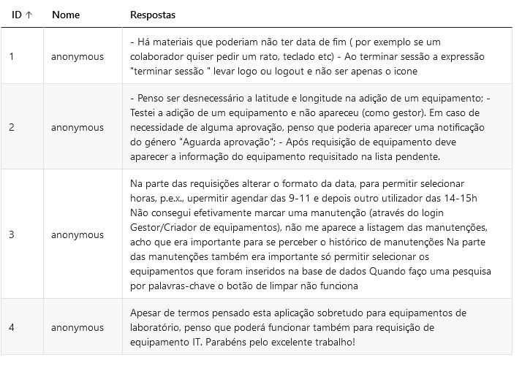
■ 7. REVIEWS
Degree IN Informatics engineering
@José Lima, João Marques | Unidade Curricular: Projeto IV – Ano Letivo 2022/2023 – COLAB4FOOD
- 25 -
Notes:
Tiago 1º Luís 2º

Slide 26
■ 9. Future Work
Degree IN Informatics engineering
■ Simplify the addition of equipment: Remove unnecessary fields, such as latitude and longitude, to make the adding process more straightforward and intuitive.
■ Approval notifications: Implement notifications to inform users when an equipment request is awaiting approval.
■ User interface improvements: Refine the layout and design of the application to improve the user experience and make it more intuitive and visually pleasing.
■ Develop a notification system, so the equipment responsible knows when someone created a request, and the user knows when the request was accepted.
■ Develop a “status” for each equipment, so everyone knows when the equipment is available to request or not.
@José Lima, João Marques | Unidade Curricular: Projeto IV – Ano Letivo 2022/2023 – COLAB4FOOD
- 26 -

Slide 27
■ 8. Conclusion
Degree IN Informatics engineering
■ We would like to express our deep gratitude to my supervisors, José Evaristo and António Cruz, for their invaluable support and guidance during these 5 months of project development. We would also like to thank the company Colab4Food for the opportunity to participate in this project. It is important to highlight that the development of projects like this is an ongoing process. Based on user feedback and the company's ever-evolving needs, we are committed to continuing to improve and refine the application to better meet expectations and requirements. Thanks again to everyone involved in this project, including our advisors and the company Colab4Food. This experience was enriching and motivates us to constantly seek improvements and innovations in future projects.
@José Lima, João Marques | Unidade Curricular: Projeto IV – Ano Letivo 2022/2023 – COLAB4FOOD
- 27 -

Slide 28
■ 10. Bibliography and Web References
Degree IN Informatics engineering
■ Microsoft Power Apps documentation: https://learn.microsoft.com/en-us/power-apps/ ■ Youtube: https://www.youtube.com/@RezaDorrani ■ Stack Overflow: https://stackoverflow.com/
@José Lima, João Marques | Unidade Curricular: Projeto IV – Ano Letivo 2022/2023 – COLAB4FOOD
- 28 -
Notes:
Tiago (acabar referencias)

Slide 29
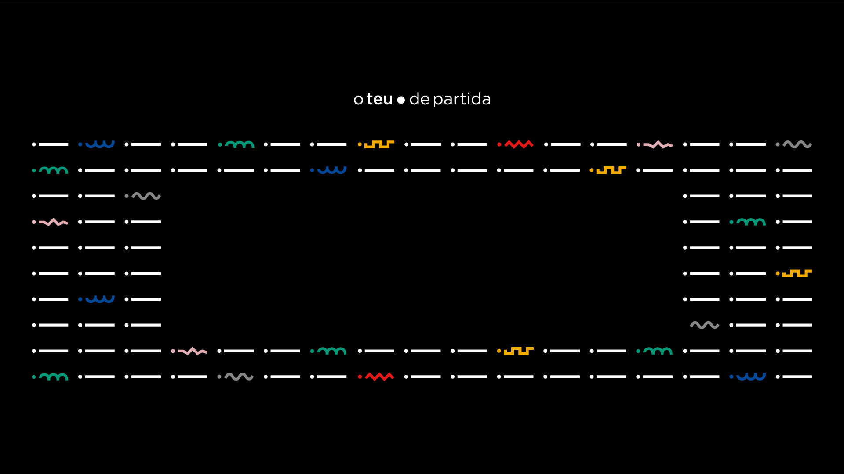
www.ipvc.pt

