Slide 1


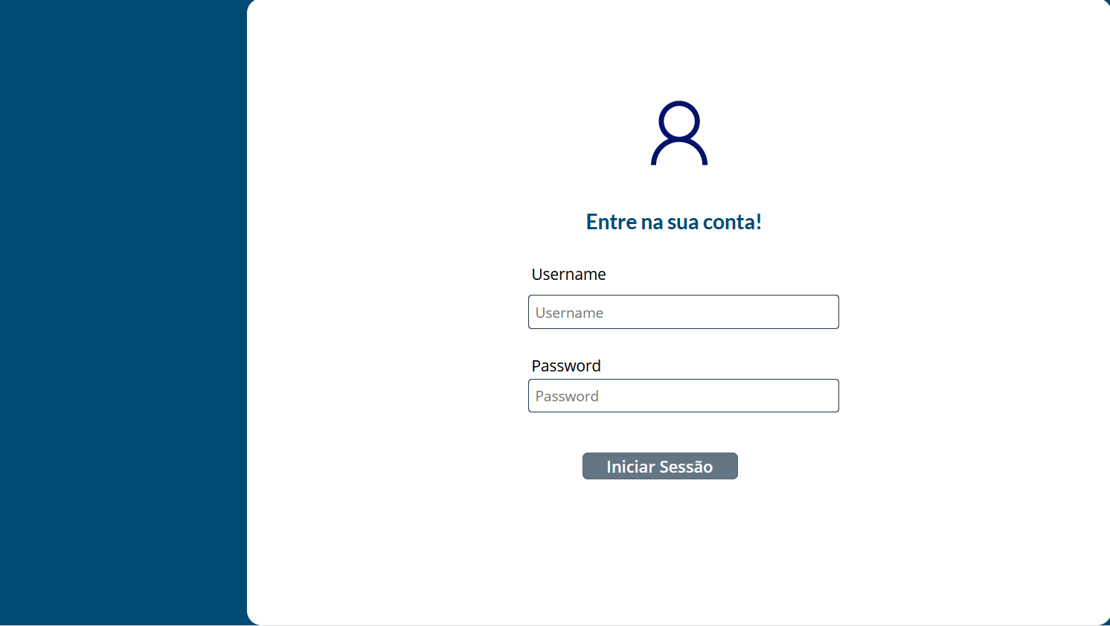
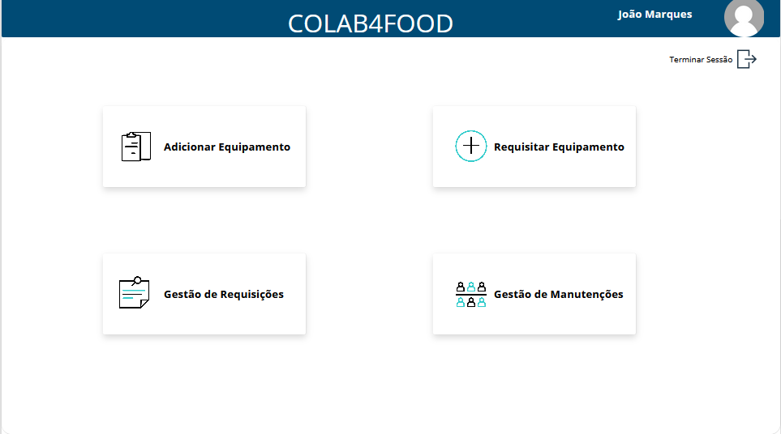
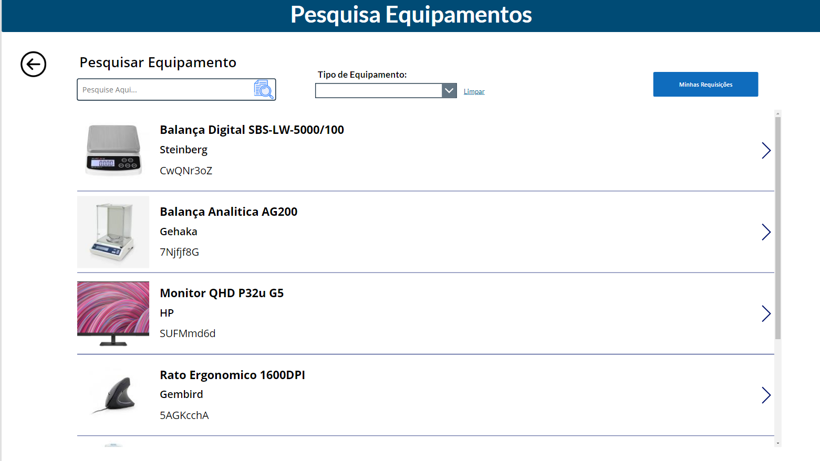
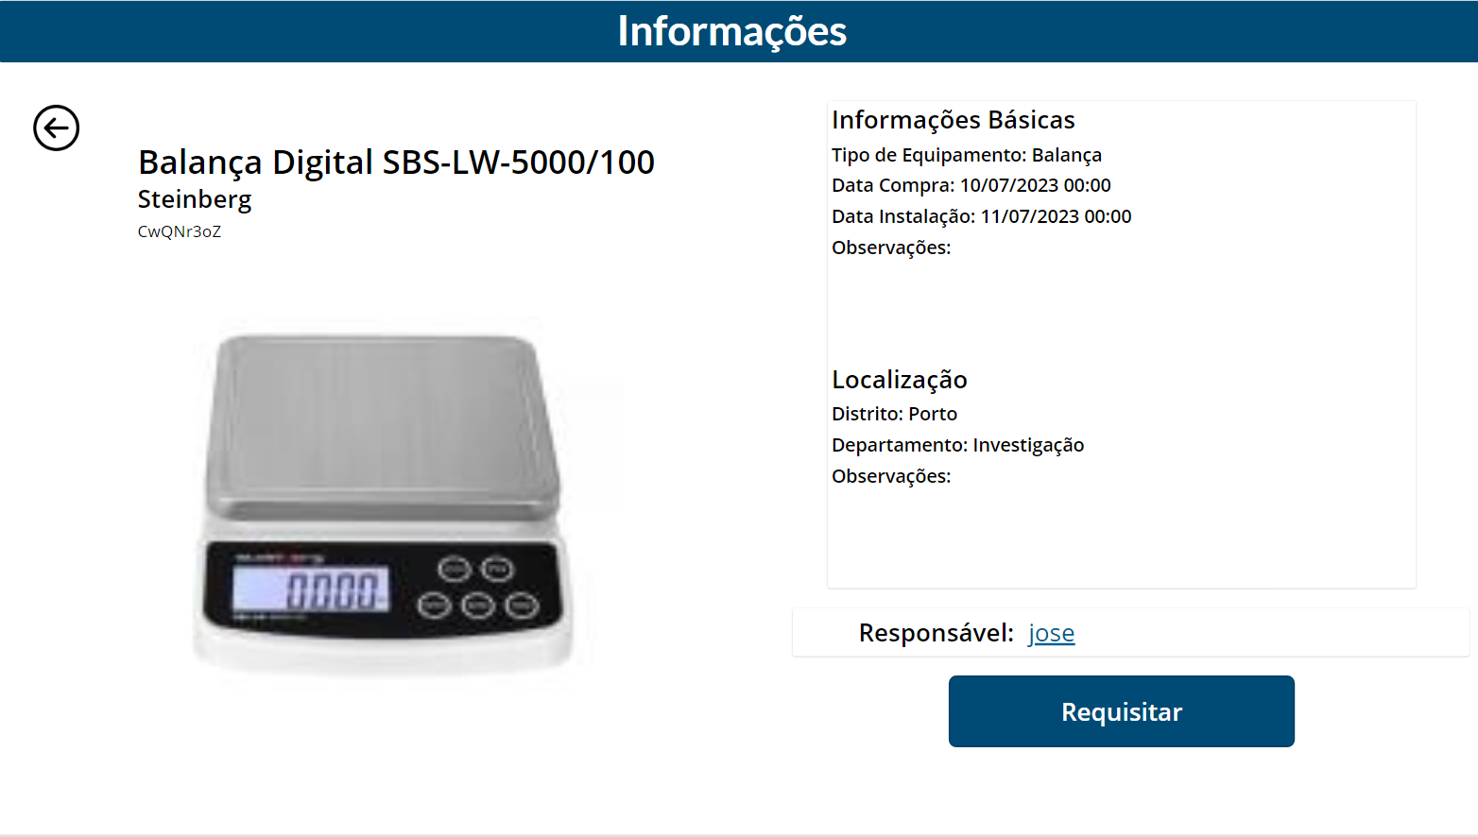
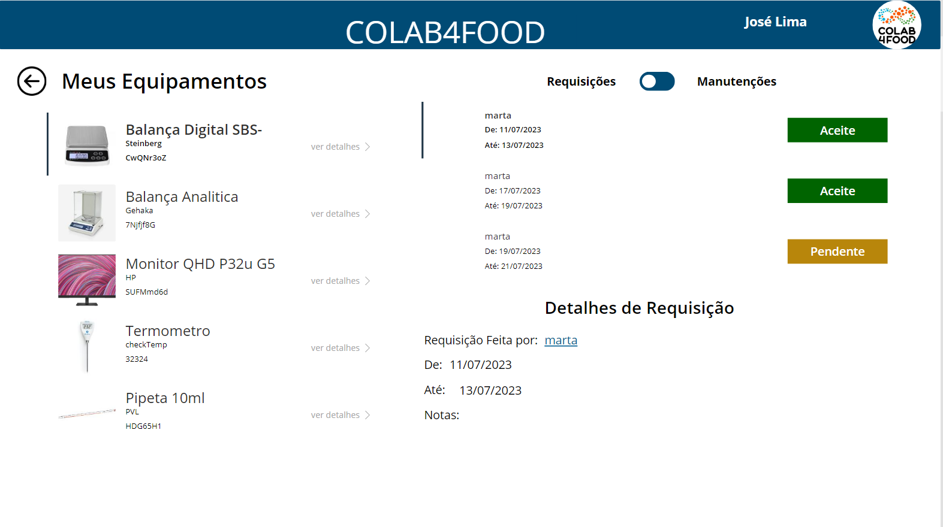
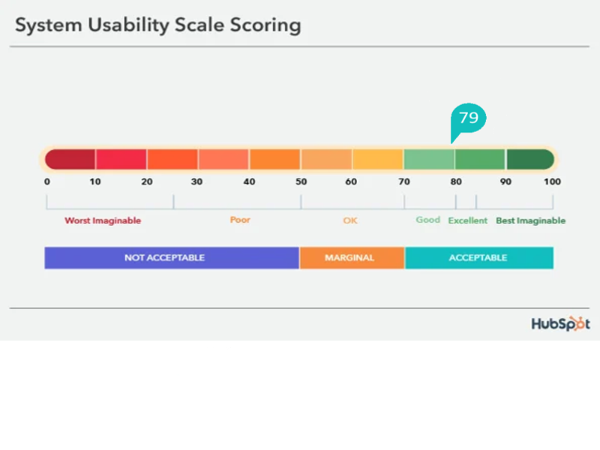
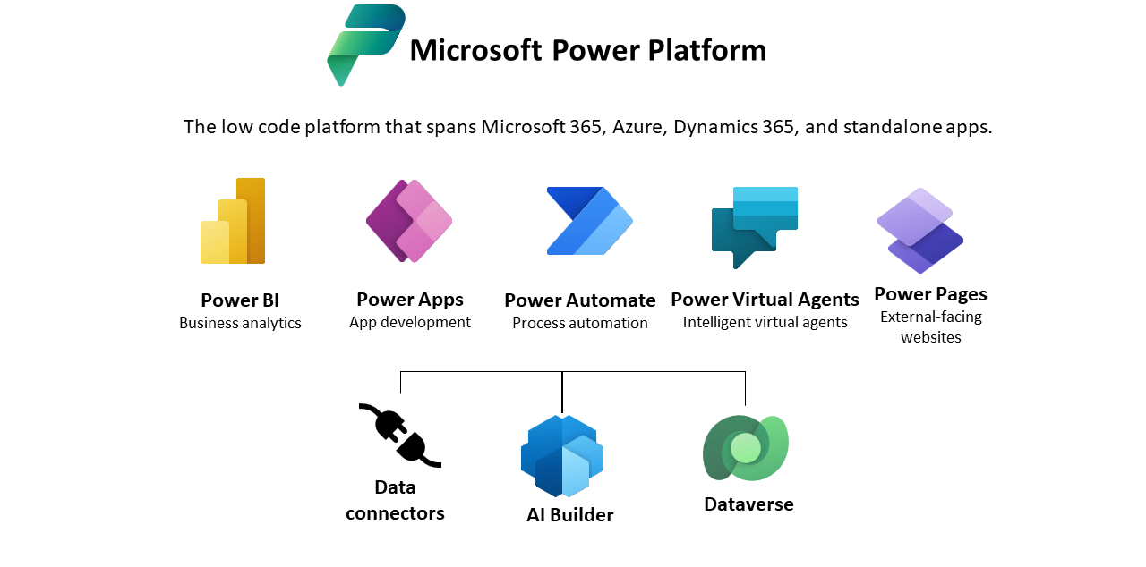


Introduction
Equipment Request Application
João Marques, José Lima
Licenciatura em
ENGENHARIA INFORMÁTCA
Instituto Politécnico de Viana do Castelo
Curricular Unit: Projeto IV
As third year students from the Degree in Informatics Engeneering at Instituto Politecnico de Viana do Castelo, was proposed to us to develop na application with PowerPlatform, where employees could request equipments that they need.
Objectives
Login Page
App Main Page
The application has as her main objetve, let users request equipments that they want, making it a easier task for everyone, for both the person that wants the equipment and the responsible for the equipment.
We have four tiers of users, that would be the normal user, helper, responsible and admin.
The responsible is able to create new equipments, and also managins his requests and maintences.
All the four tiers of users would be able to request equipments.
The helper is also able to help responsible, reviewing the equipment that the responsible add, making sure is everyithing allright with the equipment infos, and also being able to help managing equipment maintences.
Admin is able to manage both users and providers.
Search Equipment Funcionality
Equipment Page
My Equipments Page
System Usability Score (SUS)
Conclusion
Tools and Technologies Used
We would like to express our deep gratitude to my supervisors, José Evaristo and António Cruz, for their invaluable support and guidance during these 5 months of project development. We would also like to thank the company Colab4Food for the opportunity to participate in this project.
Based on user feedback and the company's ever-evolving needs, we are committed to continuing to improve and refine the application to better meet expectations and requirements. Thanks again to everyone involved in this project, including our advisors and the company Colab4Food.
This experience was enriching and motivates us to constantly seek improvements and innovations in future projects.
Professor Doutor António Cruz,
Professor José Evaristo,
ANO LETIVO 2022/2023;
Advisors:
References
Power Apps: https://powerapps.microsoft.com/en-us/
Youtube: https://www.youtube.com/@RezaDorrani
Stack Overflow: https://stackoverflow.com/
Apoios:

