Slide 1
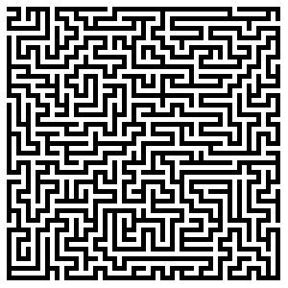
CS 5/7320 Artificial Intelligence Solving problems by searching AIMA Chapter 3
Slides by Michael Hahsler based on slides by Svetlana Lazepnik with figures from the AIMA textbook.
This work is licensed under a Creative Commons Attribution-ShareAlike 4.0 International License.

Slide 2
Contents
What are search problems?
State space
Tree search
Uninformed search
Informed search

Slide 3
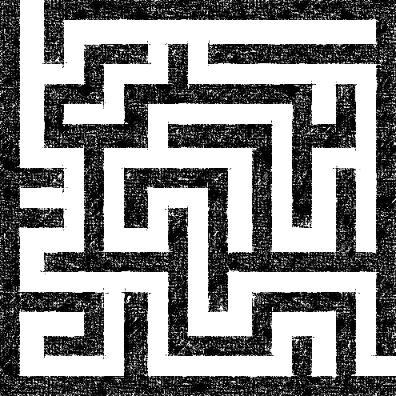
What are search problems?
We will consider the problem of designing goal-based agents in known, fully observable, and deterministic environments.
Example:
Start
Goal

Slide 4
What are search problems?
We will consider the problem of designing goal-based agents in , known, fully observable, deterministic environments.
For now, we consider only a discrete environment using an atomic state representation (states are just labeled 1, 2, 3, …).
The state space is the set of all possible states of the environment and some states are marked as goal states.
Initial state
Goal state
Phases:
Search: the process of looking for the sequence of actions that reaches a goal state.
Execution: Once the agent begins executing the search solution in a deterministic, known environment, it can ignore its percepts (open-loop system).

Slide 5
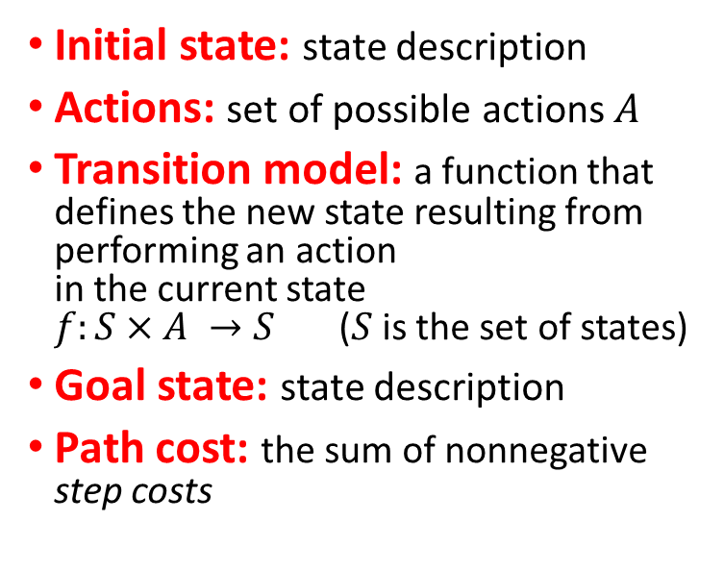
Search problem components
Initial state: state description
Actions: set of possible actions $A$
Transition model: a function that defines the new state resulting from performing an action in the current state $f:S×A →S$ ($S$ is the set of states)
Goal state: state description
Path cost: the sum of nonnegative step costs
Initial state
Transitions
Actions: {N, E, S, W}
1
g
i
4
a
Goal state
z
Discretization grid
Notes:
The state space is typically too large to be enumerated or it is continuous. Therefore, the problem is defined by initial state, actions and the transition model and not the set of all possible states.
The optimal solution is the sequence of actions (or equivalently a sequence of states) that gives the lowest path cost for reaching the goal.

Slide 6
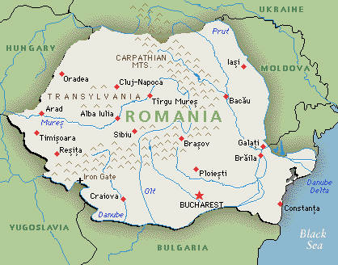
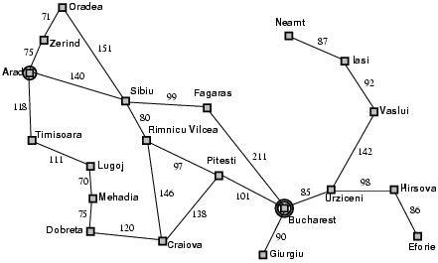
Example: Romania Vacation
On vacation in Romania; currently in Arad
Flight leaves tomorrow from Bucharest
Initial state: Arad
Actions: Drive from one city to another.
Transition model and states: If you go from city A to city B, you end up in city B.
Goal state: Bucharest
Path cost: Sum of edge costs.
State Space: Defined by initial state, actions and transition model
Distance in miles

Slide 7
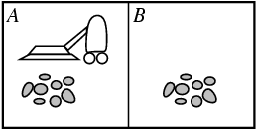
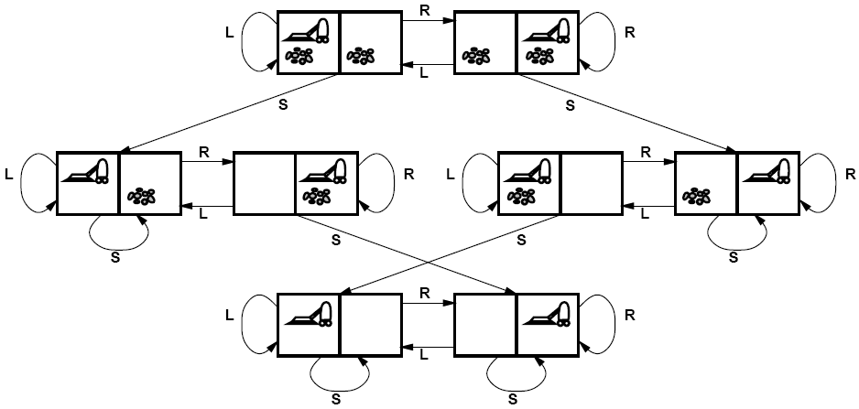
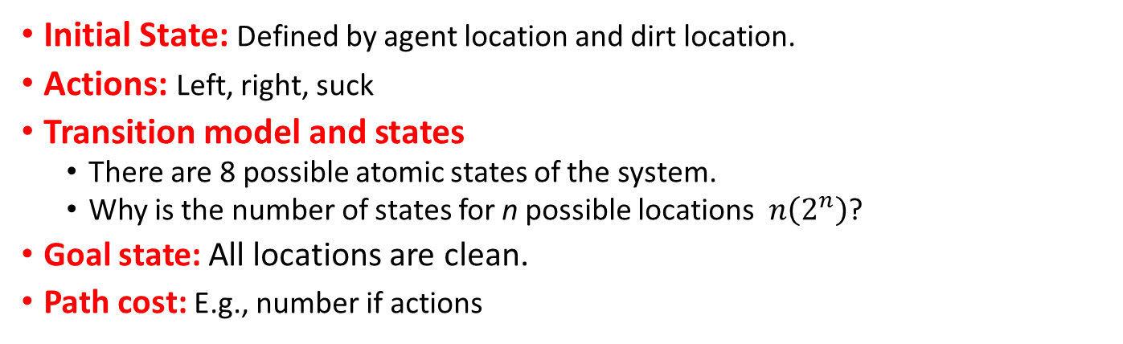
Example: Vacuum world
State Space
Goal states
Initial State: Defined by agent location and dirt location.
Actions: Left, right, suck
Transition model and states
There are 8 possible atomic states of the system.
Why is the number of states for n possible locations $n\left(2^{n}\right)$?
Goal state: All locations are clean.
Path cost: E.g., number if actions

Slide 8
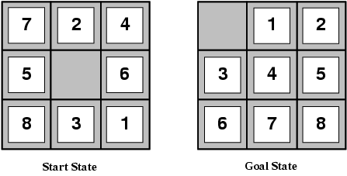
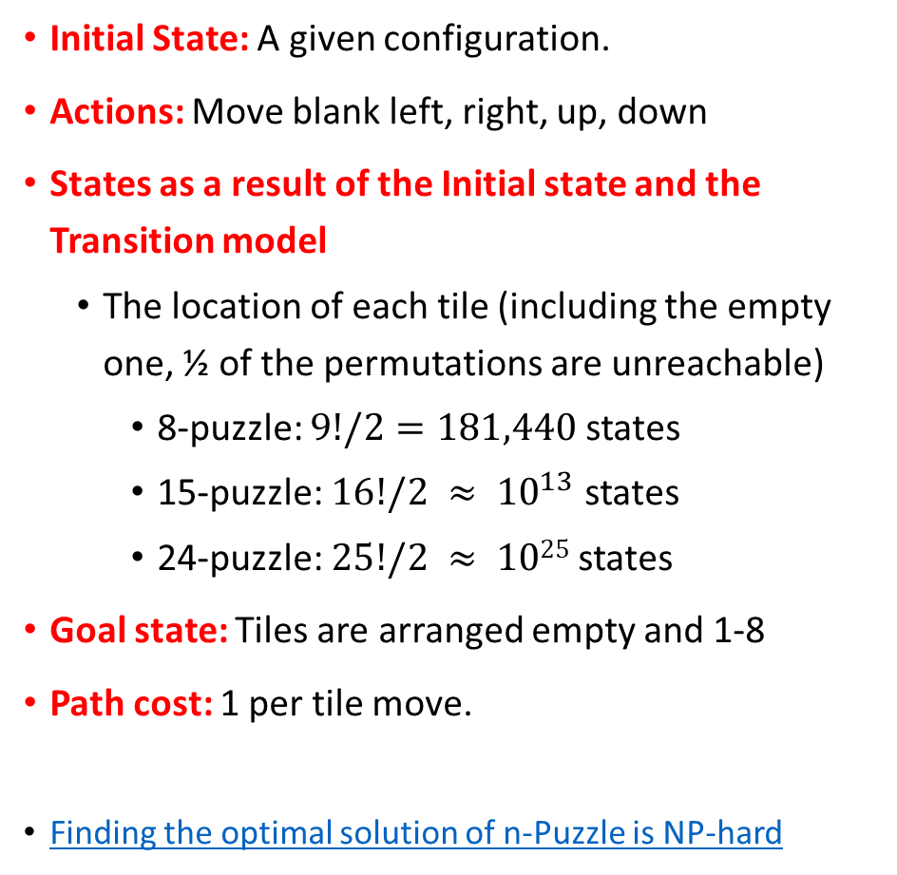
Example: Sliding-tile puzzle
Initial State: A given configuration.
Actions: Move blank left, right, up, down
States as a result of the Initial state and the Transition model
The location of each tile (including the empty one, ½ of the permutations are unreachable)
8-puzzle: $9!/2=181,440$states
15-puzzle: $16!/2 ≈ {10}^{13}$ states
24-puzzle: $25!/2 ≈ 1025$states
Goal state: Tiles are arranged empty and 1-8
Path cost: 1 per tile move.
Finding the optimal solution of n-Puzzle is NP-hard

Slide 9
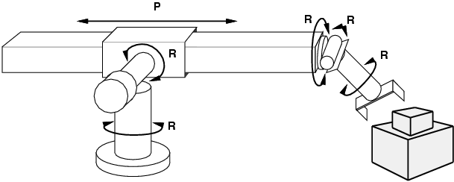
Example: Robot motion planning
Initial State: Current arm position.
States: Real-valued coordinates of robot joint angles.
Actions: Continuous motions of robot joints.
Goal state: Desired final configuration (e.g., object is grasped).
Path cost: Time to execute, smoothness of path, etc.

Slide 10
Solving search problems
Given a search problem definition
Initial state
Actions
Transition model
Goal state
Path cost
How do we find the optimal solution (sequence of actions/states)?
State space
Initial state
Goal states

Slide 11
Solving search problems
Given a search problem definition
Initial state
Actions
Transition model
Goal state
Path cost
How do we find the optimal solution (sequence of actions/states)?
State space
Initial state
Construct a search tree for the state space graph!
Goal states

Slide 12
Search tree
Root node = Starting state
Superimpose a “what if” tree of possible actions and outcomes (states) on the state space graph.
The Root node represents the starting state.
An action child node is reached by an edge representing an action. The corresponding state is defined by the transition model.
Trees have no cycles or redundant paths. Cycles in the search space need to be broken. Removing redundant paths improves search efficiency.
A path through the tree corresponds to a sequence of actions (states).
A solution is a path ending in a node representing a goal state.
Nodes vs. states: Each node represents a state of the environment. It contains the data structure that creates the search tree.
Edge = Action
Child node
Redundant
path
Cycle
…
…
…
…
Solution path
Node representing a Goal state

Slide 13
Differences between typical Tree search and AI search
Typical tree search
Assumes a given tree that fits in memory.
Trees have no cycles or redundant paths.
AI tree/graph search
The search space is too large to fit into memory.
Builds parts of the tree from initial state and transition function.
Memory management is very important.
The search space is typically a complicated graph. Memory-efficient cycle checking is very important to avoid infinite loops or minimize searching parts of the search space multiple times.
Redundant paths are often too memory-expensive to check.

Slide 14
Tree Search Algorithm Outline
Initialize the frontier (set of unexplored know nodes) using the starting state/root node.
While the frontier is not empty:
Choose a frontier node to expand according to search strategy.
If the node represents a goal state, return it as the solution.
Else expand the node (i.e., apply all possible actions to the transition model) and add its children nodes representing the newly reached states to the frontier.

Slide 15
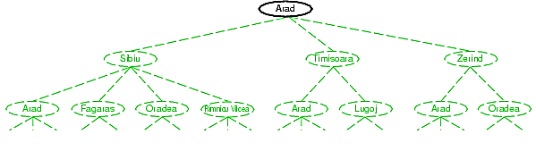
Tree search example
Frontier

Slide 16
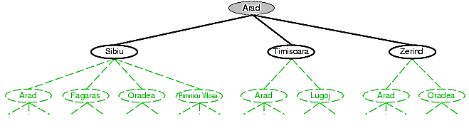
Tree search example
Expand Arad
Frontier

Slide 17
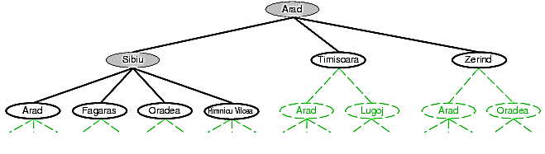
Tree search example
Expand Sibiu
Frontier
Example of a redundant path

Slide 18
Search strategies
A search strategy is defined by picking the order of node expansion.
Strategies are evaluated along the following dimensions:
Completeness: does it always find a solution if one exists?
Optimality: does it always find a least-cost solution?
Time complexity: how long does it take?
Space complexity: how much memory does it need?
Worst case time and space complexity are measured in terms of the size of the state space n. Metrics used if the state space is only implicitly defined by initial state, actions and a transition function are:
d: depth of the optimal solution (= number of actions needed)
m: the number of actions in any path (may be infinite with loops)
b: maximum branching factor of the search tree (number of successor nodes for a parent)

Slide 19

Uninformed Search

Slide 20
Uninformed search strategies
The search algorithm/agent is not provided information about how close a state is to the goal state.
It blindly searches until it finds the goal state by chance.
Algorithms:
Breadth-first search
Uniform-cost search
Depth-first search
Iterative deepening search

Slide 21
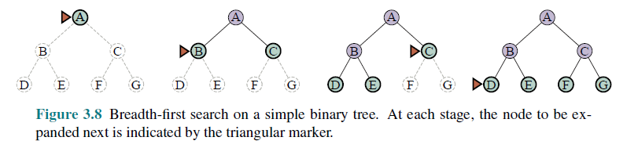
Breadth-first search (BFS)
Expansion rule: Expand shallowest unexpanded node in the frontier (first added).
Frontier data structure: holds references to the green nodes (green) and is implemented as a FIFO queue.
Reached data structure: holds references to all visited nodes (gray and green) and is used to prevent visiting nodes more than once (cycle checking).

Slide 22
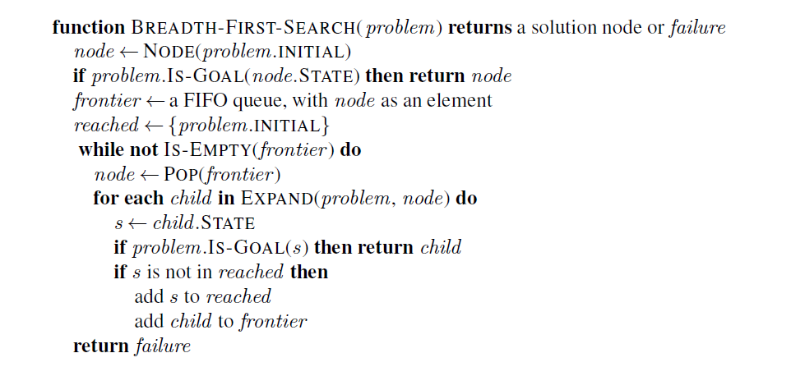
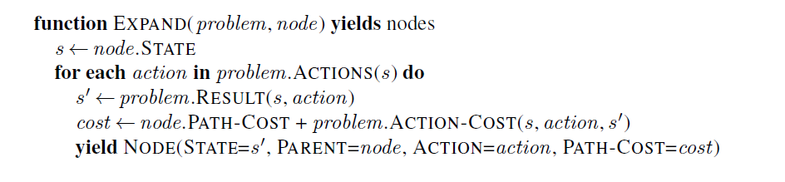
Implementation: BFS
reached makes sure we do not visit nodes twice (e.g., in a loop). Fast lookup is important.
Node structure: Yield can also be implemented by returning a list of Nodes.

Slide 23
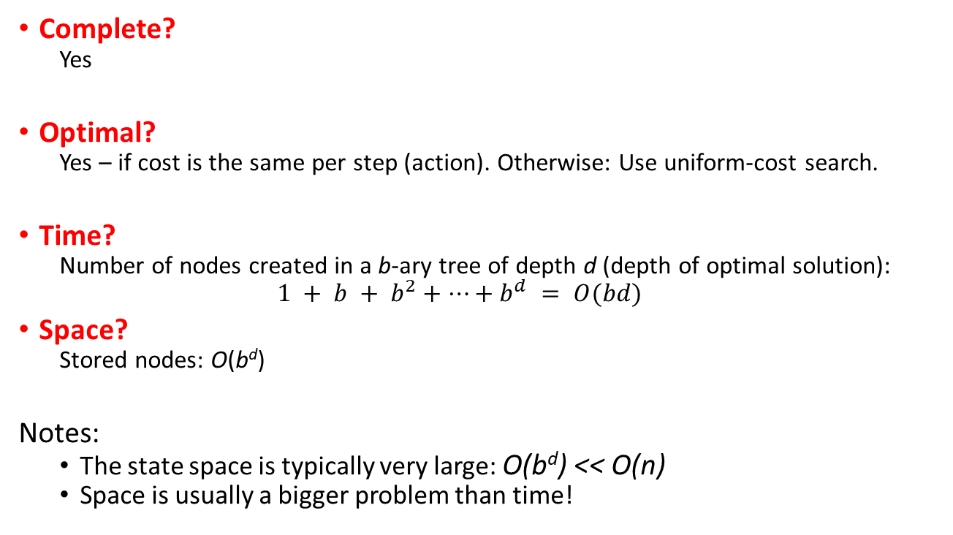
Properties of breadth-first search
d: depth of the optimal solution
m: max. depth of tree
b: maximum branching factor
Complete?
Yes
Optimal?
Yes – if cost is the same per step (action). Otherwise: Use uniform-cost search.
Time?
Number of nodes created in a b-ary tree of depth d (depth of optimal solution):
$$1 + b + b^{2}+…+b^{d} = O(bd)$$
Space?
Stored nodes: O(b^{d})
Notes:
The state space is typically very large: O(b^{d}) << O(n)
Space is usually a bigger problem than time!

Slide 24

Breadth-first search
Time and Space: $O\left(b^{d}\right)$ - all paths to the depth of the goal are expanded
A
expanded
b = 2
d = 2
m = 4
Goal
B
C
D
E
F
G
C
Goal

Slide 25
Uniform-cost search (= Dijkstra’s shortest path algorithm)
A best-first search strategy: Expand least-cost unexpanded node
Implementation: frontier is a queue ordered by path cost (priority queue)
Breadth-first search is a special case when all step costs all equal.
Complete?
Yes, if all step cost is greater than some positive constant ε>0
Optimal?
Yes – nodes expanded in increasing order of path cost
Time?
Number of nodes with path cost ≤ cost of optimal solution (C*) is O(b^{1+C*/ ε}).
This can be greater than O(b^{d}): the search can explore long paths consisting of small steps before exploring shorter paths consisting of larger steps
Space?
O(b^{1+C*/ ε})
See Dijkstra's algorithm on Wikipedia
d: depth of the optimal solution
m: max. depth of tree
b: maximum branching factor

Slide 26
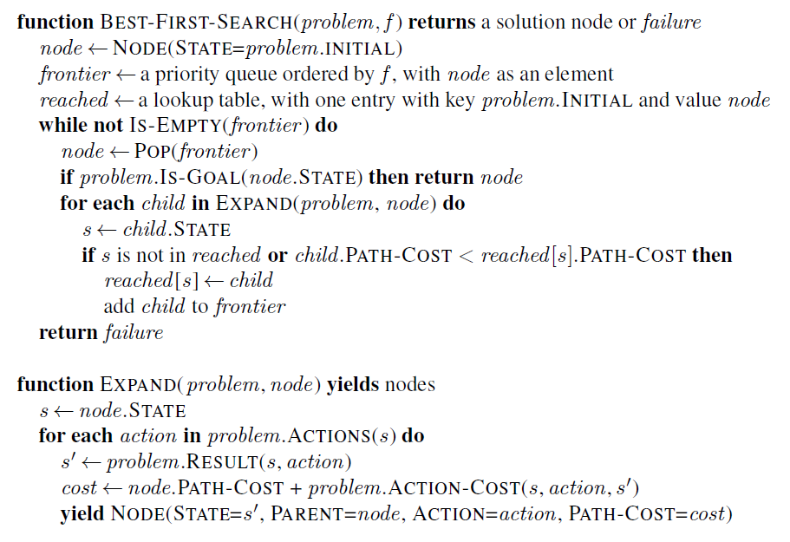

Implementation: Best-First-Search Strategy
The order for expanding the frontier (can be implemented as a priority queue) and this check is the difference to BFS! It visits a node again if it can be reached by a better (cheaper) path.

Slide 27
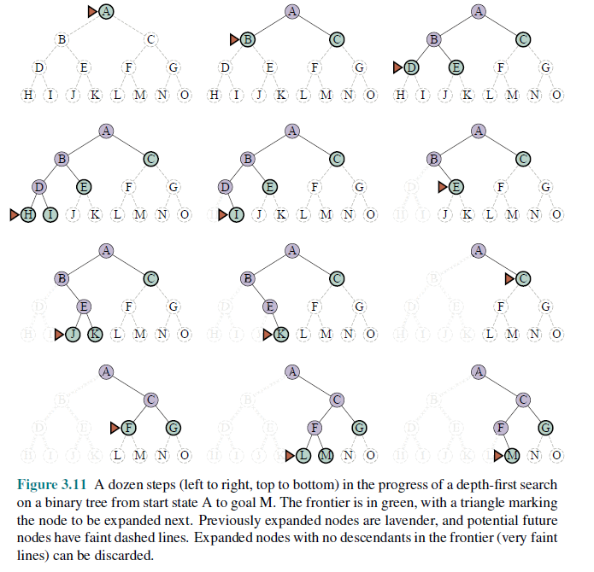
Depth-first search (DFS)
Expansion rule: Expand deepest unexpanded node in the frontier (last added).
Frontier: stack (LIFO)
Reached: No reached data structure! Cycle checking can only check the current path and the frontier. This may lead to infinite loops!

Slide 28
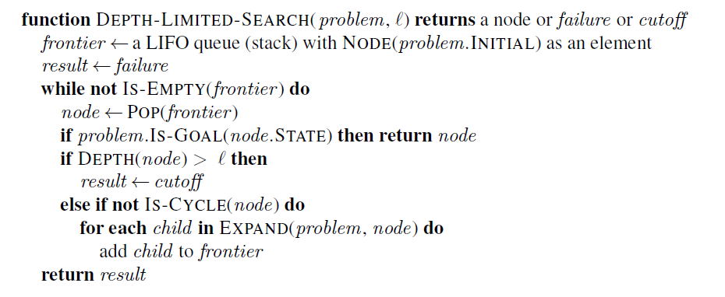
Implementation: DFS
DFS could be implemented like BFS/Best-first search and just taking the last element from the frontier (LIFO).
However, to reduce the space complexity to O(bm), the reached data structure needs to be removed! Options:
Recursive implementation (cycle checking is a problem).
We can use a search tree where the abandoned branches are removed from memory (cycle checking is only done against the current path). This is similar to Backtracking search.
DFS-SEARCH
If we only keep the current branch in memory, then we can only check against the path from the root to the current node to prevent cycles.

Slide 29
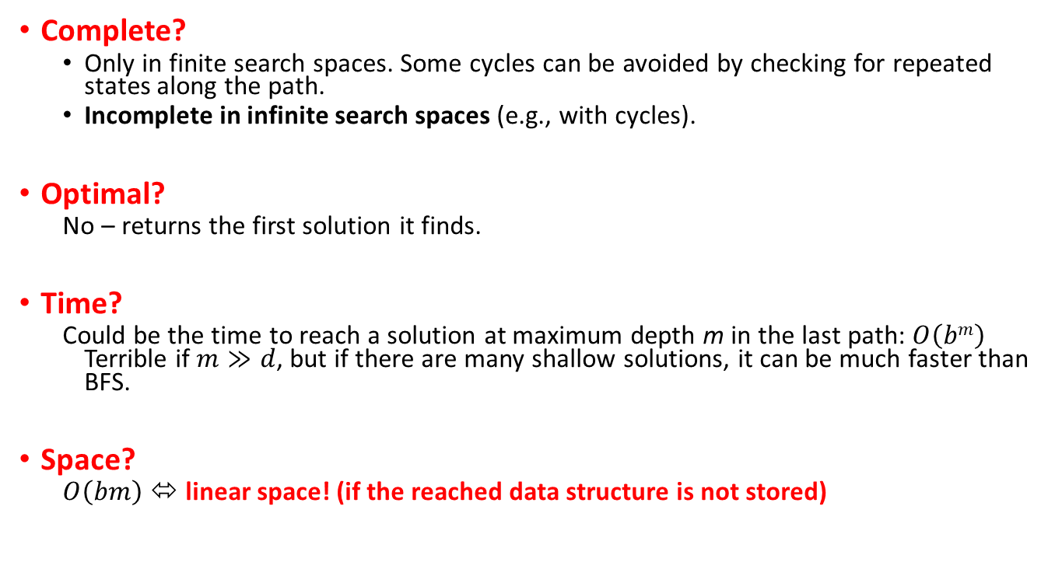
Properties of depth-first search
Complete?
Only in finite search spaces. Some cycles can be avoided by checking for repeated states along the path.
Incomplete in infinite search spaces (e.g., with cycles).
Optimal?
No – returns the first solution it finds.
Time?
Could be the time to reach a solution at maximum depth m in the last path: $O\left(bm\right)$ Terrible if $m≫d$, but if there are many shallow solutions, it can be much faster than BFS.
Space?
$O\left(bm\right)$ ⬄ linear space! (if the reached data structure is not stored)
d: depth of the optimal solution
m: max. depth of tree
b: maximum branching factor
This makes DFS into the workhorse of AI.

Slide 30

Depth-first search
Time: $O(bm)$ – worst case is expanding all paths.
Space: $O(bm)$ - if it only stores the frontier nodes and the current path.
A
d = 2
b = 2
C
Goal
B
m = 4
G
F
E
D
DFS finds this goal first ⬄ Not optimal!
H
Goal
Note: The order in which we add new nodes to the frontier can change what goal we find!

Slide 31
Iterative deepening search (IDS)
Can we get
DFS’s good memory footprint, and
BFS’s optimality guaranty?
Use depth-restricted DFS and gradually increase the depth.
Check if the root node is the goal.
Do a DFS searching for a path of length 1
If there is no path to the goal of length 1, do a DFS searching for a path of length 2
If there is no path of length 2, do a DFS searching for a path of length 3
…

Slide 32
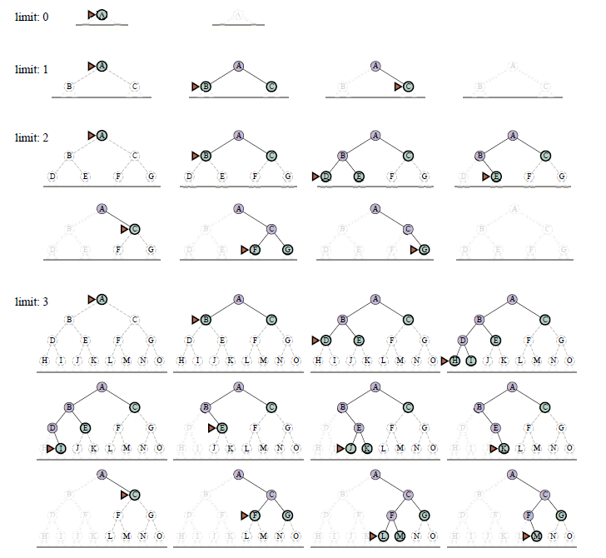
Iterative deepening search (IDS)

Slide 33
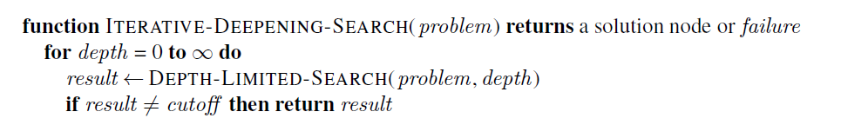
Implementation: IDS

Slide 34
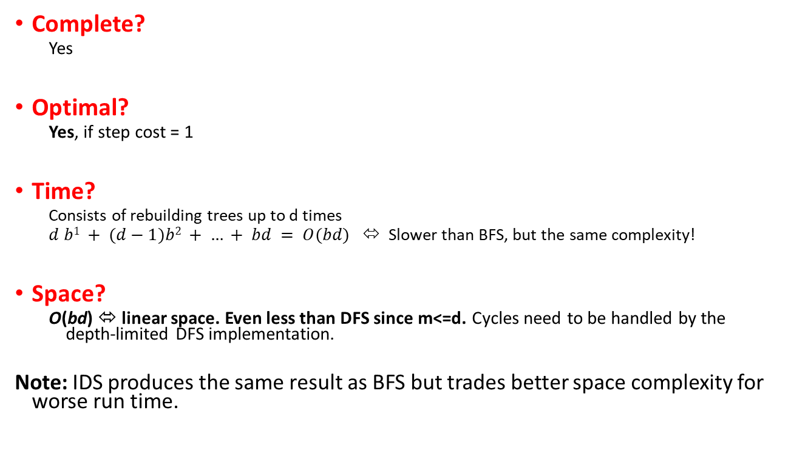
Properties of iterative deepening search
Complete?
Yes
Optimal?
Yes, if step cost = 1
Time?
Consists of rebuilding trees up to d times
$d b1 + (d−1)b2 + … + bd = O(bd)$⬄ Slower than BFS, but the same complexity!
Space?
O(bd) ⬄ linear space. Even less than DFS since m<=d. Cycles need to be handled by the depth-limited DFS implementation.
Note: IDS produces the same result as BFS but trades better space complexity for worse run time.
d: depth of the optimal solution
m: max. depth of tree
b: maximum branching factor

Slide 35
Informed Search

Slide 36
Informed search
AI search problems are typically very large. We would like to improve efficiency by expanding as few nodes as possible.
The agent can use additional information in the form of “hints” about how promising different states/nodes are to lead to the goal. These hints are derived from
information the agent has (e.g., a map) or
percepts coming from a sensor.
The agent uses a heuristic function to rank nodes in the frontier and select the most promising state in the frontier for expansion using a best-first search strategy.
Algorithms:
Greedy best-first search
A* search

Slide 37

Heuristic function
Heuristic function $h(n)$estimates the cost of reaching a node representing the goal state from the current node $n$.
Examples:
Euclidean distance
Manhattan distance
Start state
Start state
Goal state
Goal state

Slide 38
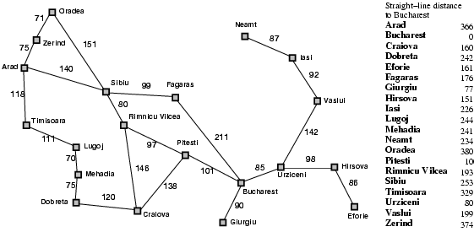
Heuristic for the Romania problem
h(n)

Slide 39

Greedy best-first search example
Expansion rule: Expand the node that has the lowest value of the heuristic function h(n)
h(n)=

Slide 40
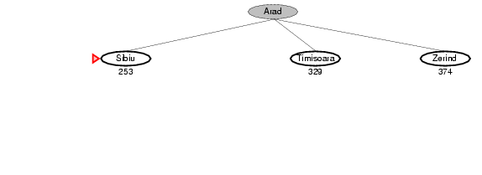
Greedy best-first search example

Slide 41
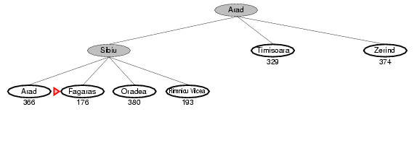
Greedy best-first search example

Slide 42
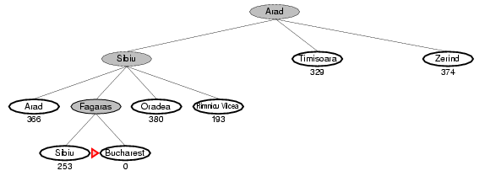
Greedy best-first search example
Total:
140 + 99 + 211 = 450 miles

Slide 43
Properties of greedy best-first search
Complete?
Yes – Best-first search if complete in finite spaces.
Optimal?
No
Total:
140 + 99 + 211 = 450 miles
Alternative through Rimnicu Vilcea:
140 + 80 + 97 + 101 = 418 miles

Slide 44
Implementation of greedy best-first search
Best-First Search
Expand the frontier using $$f\left(n\right)=h(n)$$
Expand the frontier using 𝑓(𝑛)=ℎ(𝑛)

Slide 45
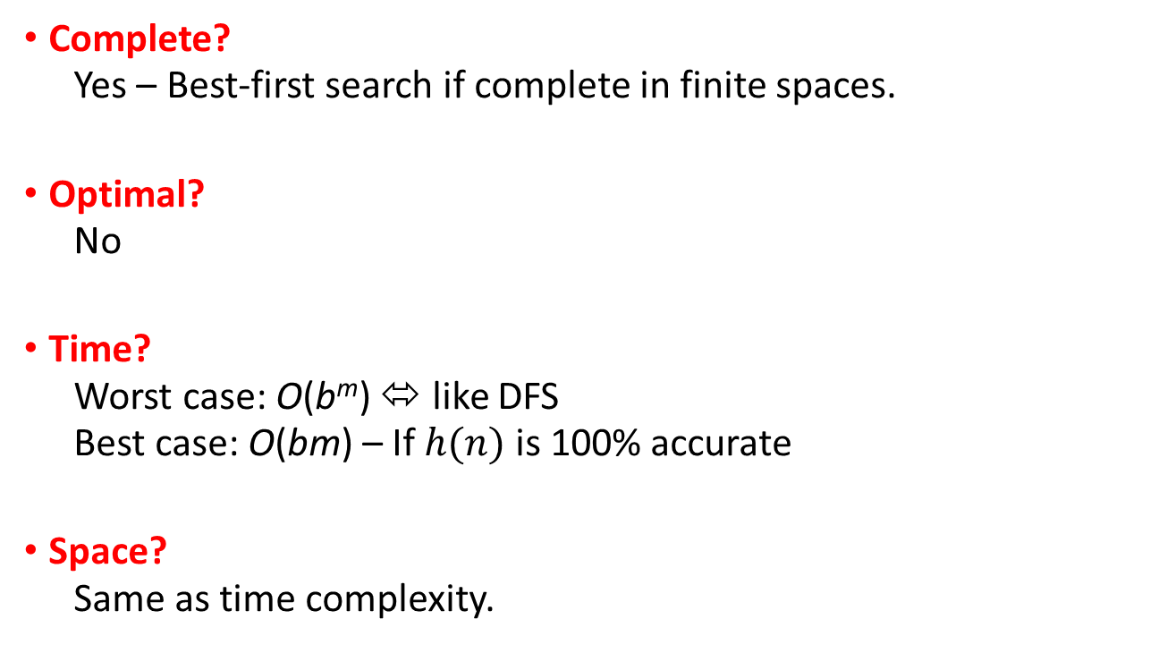
Properties of greedy best-first search
Complete?
Yes – Best-first search if complete in finite spaces.
Optimal?
No
Time?
Worst case: O(b^{m}) ⬄ like DFS
Best case: O(bm) – If $h(n)$ is 100% accurate
Space?
Same as time complexity.
d: depth of the optimal solution
m: max. depth of tree
b: maximum branching factor

Slide 46
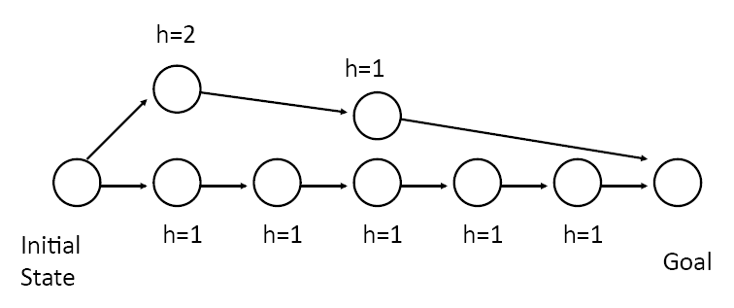
How can we fix the optimality problem with greedy best-first search?
Greedy best-first will go this way!

Slide 47
A* search
g(n) = 3
n
`
Idea: Take current path cost into account and avoid further expanding paths that are already very expensive.
The evaluation function f(n) is the estimated total cost of the path through node n to the goal:
f(n) = g(n) + h(n)
g(n): cost so far to reach n (path cost)
h(n): estimated cost from n to goal (heuristic)
Note: For greedy best-first search we just use f(n) = h(n).
Notes:
Dates back to 1968

Slide 48

A* search example
Expansion rule: Expand the node with the smallest f(n)
f(n) = g(n) + h(n) =

Slide 49
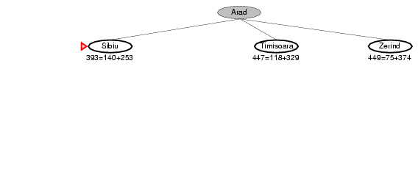
A* search example
f(n) = g(n) + h(n)

Slide 50
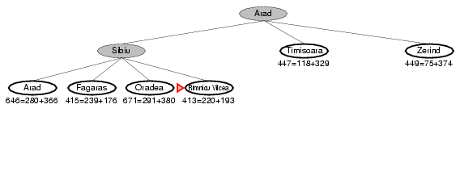
A* search example
f(n) = g(n) + h(n)

Slide 51
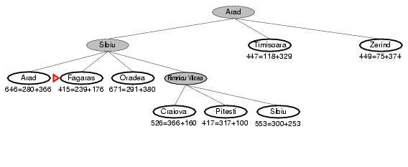
A* search example
f(n) = g(n) + h(n)

Slide 52
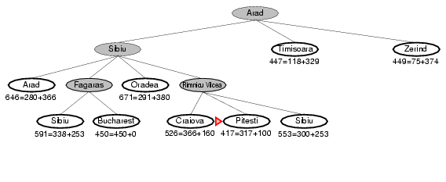
A* search example
f(n) = g(n) + h(n)

Slide 53
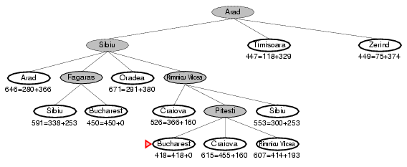
A* search example
f(n) = g(n) + h(n)

Slide 54
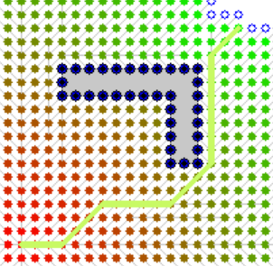
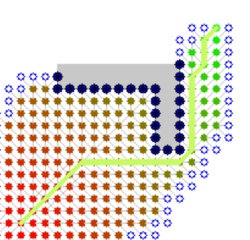
An animation of A* search
BFS
A*
Source: Wikipedia
Note: The path cost is equivalent!

Slide 55
Implementation of A* Search
Best-First Search
Expand the frontier using $$f\left(n\right)=g\left(n\right)+h(n)$$
Expand the frontier using 𝑓(𝑛)=𝑔(𝑛)+ℎ(𝑛)

Slide 56
Admissible heuristics
Definition: A heuristic h(n) is admissible if for every node n, h(n) ≤ h*(n), where h*(n) is the true cost to reach the goal state from n.
I.e., an admissible heuristic is a lower bound and never overestimates the true cost to reach the goal.
Example: straight line distance never overestimates the actual road distance.
Theorem: If h(n) is admissible, A* is optimal.

Slide 57
Proof of Optimality of A*
f(n) = g(n) + h(n)
f(n*) = g(n*) + 0 = C*
n* (goal)
n
f(n) ≥ f(n*) ⬄ f(n) ≥ C*
n’ (other goal)
g(n') ≥ f(n) ⬄ g(n') ≥ C*
Suppose A* terminates its search at n*.
It has found a path whose actual cost f(n*) = g(n*) + 0 is lower than the estimated cost f(n) of any path going through any frontier node.
Since f(n) is an optimistic estimate, it is impossible for n to have a successor goal state n’ with g(n’) < C*.

Slide 58
Guarantees of A*
A* is optimally efficient
No other tree-based search algorithm that uses the same heuristic can expand fewer nodes and still be guaranteed to find the optimal solution.
Any algorithm that does not expand all nodes with f(n) < C* (the lowest cost of going to a goal node) risks missing the optimal solution.

Slide 59
Properties of A*
Complete?
Yes
Optimal?
Yes
Time?
Number of nodes for which f(n) ≤ C* (exponential)
Space?
Same as time complexity.

Slide 60
Designing heuristic functions
Heuristics for the 8-puzzle
h₁(n) = number of misplaced tiles
h₂(n) = total Manhattan distance (number of squares from desired location of each tile)
h₁(start) = 8
h₂(start) = 3+1+2+2+2+3+3+2 = 18
Are h₁ and h₂ admissible?
1 needs to move 3 positions

Slide 61
Heuristics from relaxed problems
A problem with fewer restrictions on the actions is called a relaxed problem.
The cost of an optimal solution to a relaxed problem is an admissible heuristic for the original problem.
If the rules of the 8-puzzle are relaxed so that a tile can move anywhere, then h₁(n) gives the shortest solution.
If the rules are relaxed so that a tile can move to any adjacent square, then h₂(n) gives the shortest solution.
h₁(start) = 8
h₂(start) = 3+1+2+2+2+3+3+2 = 18

Slide 62
Heuristics from relaxed problems
What relaxations are used in these two cases?
Euclidean distance
Manhattan distance
Start state
Start state
Goal state
Goal state

Slide 63
Heuristics from subproblems
Let h₃(n) be the cost of getting a subset of tiles (say, 1,2,3,4) into their correct positions. The final order of the * tiles does not matter.
Small subproblems are often easy to solve.
Can precompute and save the exact solution cost for every or many possible subproblem instances – pattern database.
*
*
*
*
*
*
*
*

Slide 64
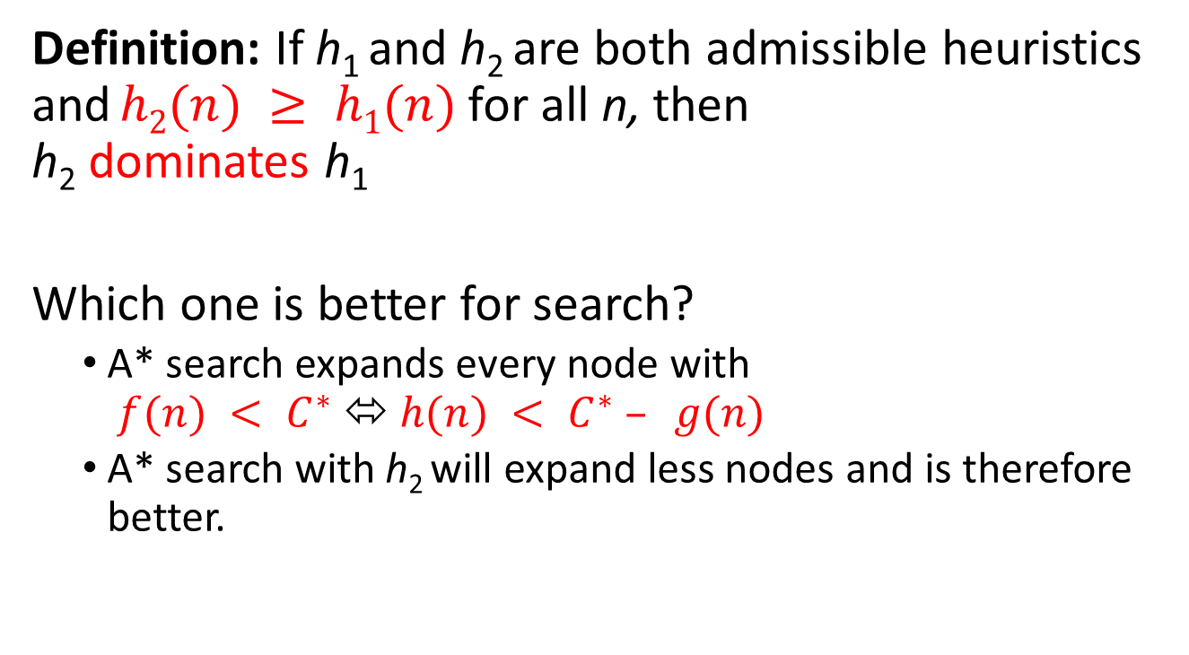
Dominance
Definition: If h₁ and h₂ are both admissible heuristics and $h2(n) ≥ h1(n)$for all n, then h₂ dominates h₁
Which one is better for search?
A* search expands every node with $f(n) < C^{∗}$⬄ $h(n) < C^{∗} – g(n)$
A* search with h₂ will expand less nodes and is therefore better.

Slide 65
Dominance
Typical search costs for the 8-puzzle (average number of nodes expanded for different solution depths d):
d=12 IDS = 3,644,035 nodes A*(h₁) = 227 nodes A*(h₂) = 73 nodes
d=24 IDS ≈ 54,000,000,000 nodes A*(h₁) = 39,135 nodes A*(h₂) = 1,641 nodes

Slide 66
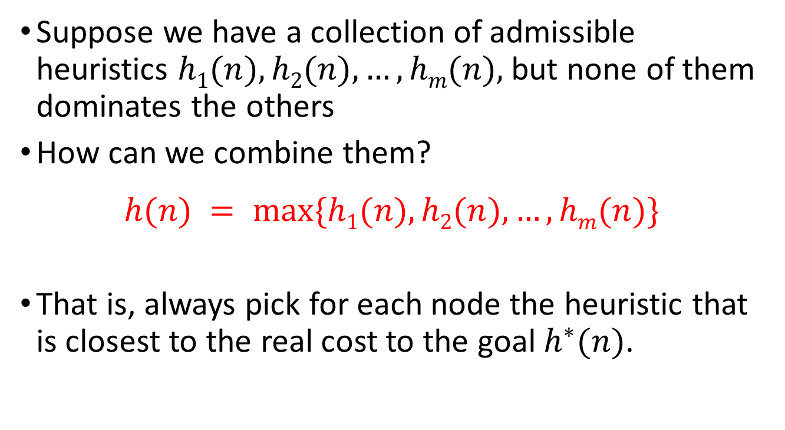
Combining heuristics
Suppose we have a collection of admissible heuristics $h1(n), h2(n), …, hm(n),$but none of them dominates the others
How can we combine them?
$$h(n) = max⁡\{h1(n), h2(n), …, hm(n)\}$$
That is, always pick for each node the heuristic that is closest to the real cost to the goal $h^{∗}(n)$.

Slide 67

Satisficing Search: Weighted A* search
Often it is sufficient to find a “good enough” solution if it can be found very quickly or with way less computational resources.
We could use inadmissible heuristics in A* search that sometimes overestimate the optimal cost to the goal slightly.
It potentially reduces the number of expanded nodes significantly.
This will break the algorithm’s optimality guaranty!
$$f\left(n\right)=g\left(n\right)+W×h(n)$$
A* search: $g\left(n\right)+h\left(n\right)$ $(W=1)$
Uniform cost search: $g\left(n\right)$ $(W=0)$
Greedy best-first search: $h\left(n\right)$ $\left(W=∞\right)$
Weighted A* search: $g\left(n\right)+W×h\left(n\right)$ $(1<W<∞)$

Slide 68
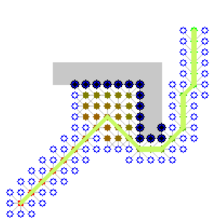
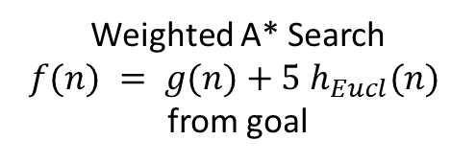
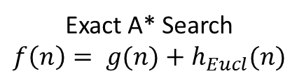
Example of weighted A* search
Exact A* Search $$f\left(n\right)= g(n)+h_{Eucl}(n)$$
Weighted A* Search
$$f(n) = g(n)+5 h_{Eucl}(n)$$ from goal
Source: Wikipedia

Slide 69
Memory-bounded search
The memory usage of A* (search tree and frontier) can still be exorbitant.
How can we make A* more memory-efficient while maintaining completeness and optimality?
Iterative deepening A* search.
Recursive best-first search, SMA*: Forget some subtrees but remember the best f-value in these subtrees and regenerate them later if necessary.
Problems: memory-bounded strategies can be complicated to implement, suffer from “thrashing” (regenerating forgotten nodes).

Slide 70
Uninformed search strategies
Algorithm | Complete? | Optimal? | Time complexity | Space complexity
BFS
Uniform-cost Search
DFS
IDS
Yes
If all step costs are equal
O(b^{d})
O(b^{d})
Yes
Yes
Number of nodes with g(n) ≤ C*
In finite spaces (cycles checking)
No
O(b^{m})
O(bm)
More with cycles
Yes
If all step costs are equal
O(b^{d})
O(bd)
More with cycles
b: maximum branching factor of the search tree
d: depth of the optimal solution
m: maximum length of any path in the state space
C*: cost of optimal solution
Notes:
When is UCS equivalent to BFS?
Can the complexity of UCS exceed the complexity of BFS?
How to make DFS complete?
When is DFS better than BFS?

Slide 71
All search strategies
Algorithm | Complete? | Optimal? | Time complexity | Space complexity
BFS
Uniform-cost Search
DFS
IDS
Greedy best-first Search
A* Search
Yes
If all step costs are equal
O(b^{d})
O(b^{d})
Yes
Yes
Number of nodes with g(n) ≤ C*
In finite spaces (cycles checking)
No
O(b^{m})
O(bm) more with cycles
Yes
If all step costs are equal
O(b^{d})
O(bd)
More with cycles
In finite spaces (cycles checking)
Depends on heuristic
Worst case: O(b^{m})
No
Best case: O(bd)
Yes
Yes
Number of nodes with g(n)+h(n) ≤ C*

Slide 72
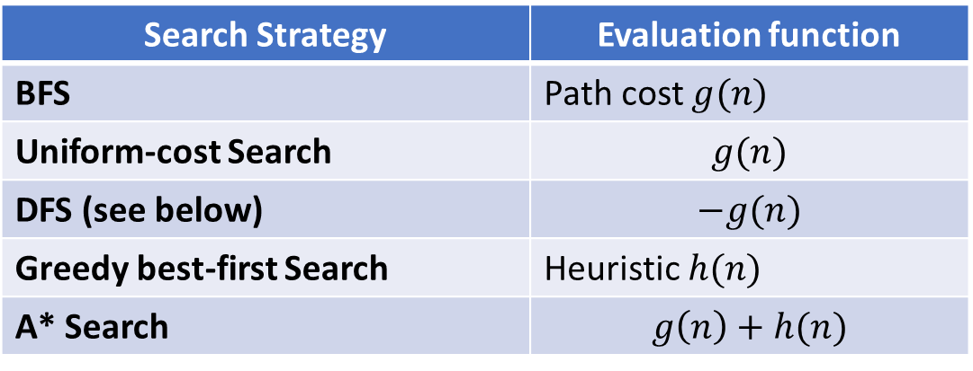
Implementation as Best-first Search
All discussed search strategies can be implemented using Best-first search.
Best-first search expands always the node with the minimum value of an evaluation function.
Only DFS is typically implemented differently to save memory.
Search Strategy | Evaluation function
BFS | Path cost $g(n)$
Uniform-cost Search | $$g(n)$$
DFS (see below) | $$−g(n)$$
Greedy best-first Search | Heuristic $h(n)$
A* Search | $$g\left(n\right)+h(n)$$

