Slide 1

CS 5/7320 Artificial Intelligence Adversarial Search and Games AIMA Chapter 5
Slides by Michael Hahsler with figures from the AIMA textbook
This work is licensed under a Creative Commons Attribution-ShareAlike 4.0 International License.
"Reflected Chess pieces" by Adrian Askew

Slide 2

Games
Games typically confront the agent with a competitive (adversarial) environment affected by an opponent (strategic environment).
We will focus on
two-player zero-sum games with
deterministic game mechanics and
perfect information (i.e., fully observable environment).
We call the two players:
Max tries to maximize his utility.
Min tries to minimize Max’s utility since it is a zero-sum game.

Slide 3
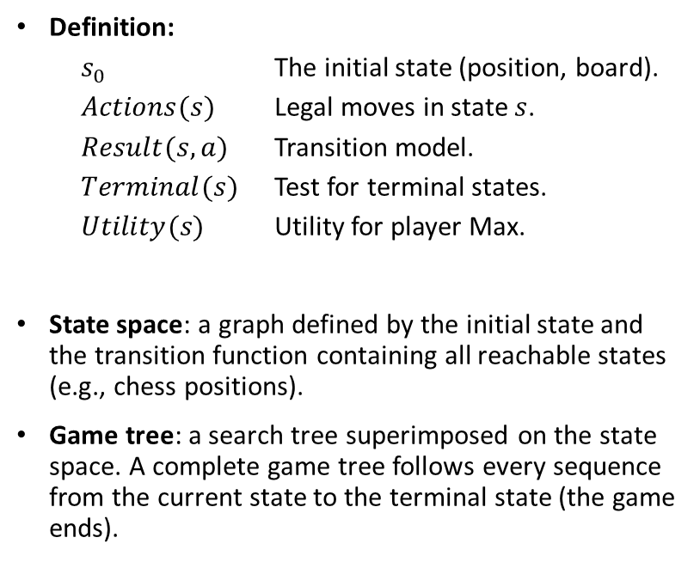
Definition of a Game
Definition:
$s_{0}$ The initial state (position, board).
$Actions(s)$ Legal moves in state $s$.
$Result(s,a)$ Transition model.
$Terminal(s)$ Test for terminal states.
$Utility(s)$ Utility for player Max.
State space: a graph defined by the initial state and the transition function containing all reachable states (e.g., chess positions).
Game tree: a search tree superimposed on the state space. A complete game tree follows every sequence from the current state to the terminal state (the game ends).

Slide 4
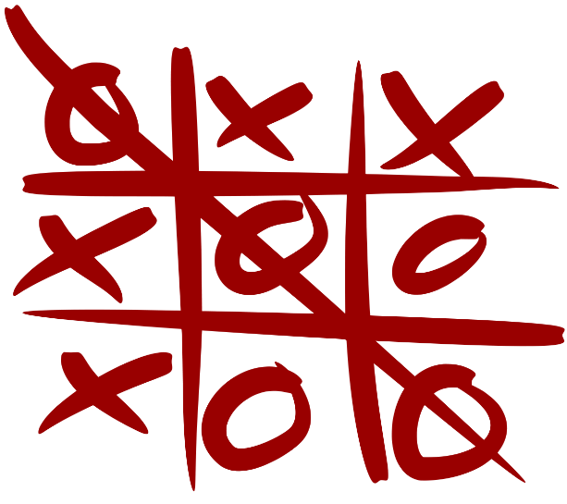
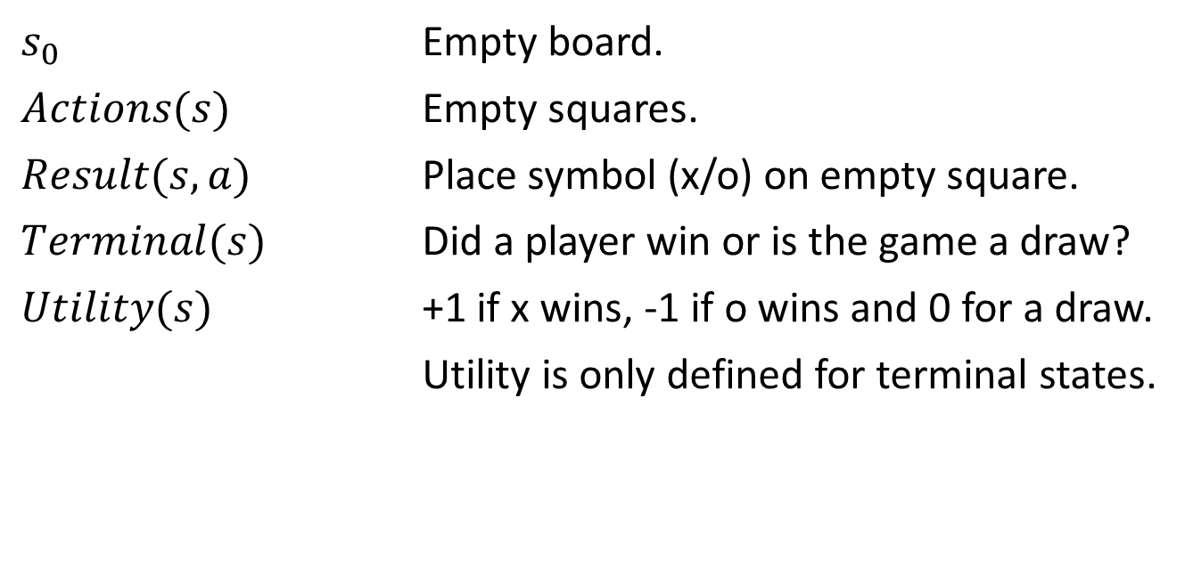
Example: Tic-tac-toe
$s_{0}$ Empty board.
$Actions(s)$ Empty squares.
$Result(s,a)$ Place symbol (x/o) on empty square.
$Terminal(s)$ Did a player win or is the game a draw?
$Utility(s)$ +1 if x wins, -1 if o wins and 0 for a draw.
Utility is only defined for terminal states.
Here player x is Max and player o is Min.

Slide 5
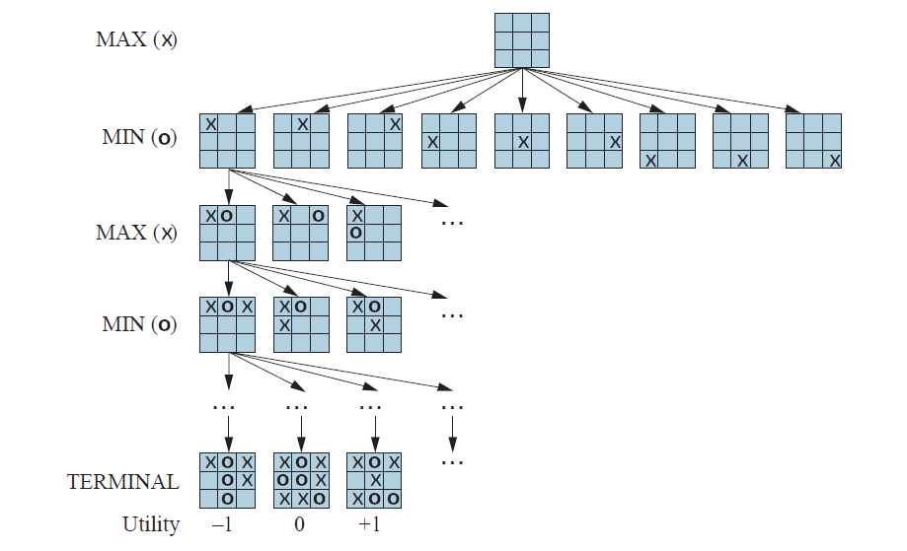


Tic-tac-toe: Partial Game Tree
# of nodes
1
9
$$9×8$$
The state space is a little smaller than:
$$3^{9}=19,683$$
Why is the complete game tree size much larger? A little smaller than:
$$1\left(9\right)\left(9× 8\right)\left(9×8×7\right)…\left(9!\right)=\text{986,409}$$

Slide 6
Methods for Adversarial Games
Exact Methods
Model as nondeterministic actions: The opponent is seen as part of an environment with nondeterministic actions. Non-determinism is the result of the unknown moves by the opponent. We consider all possible moves by the opponent.
Find optimal decisions: Minimax search and Alpha-Beta pruning where each player plays optimal to the end of the game.
Heuristic Methods (game tree is too large)
Heuristic Alpha-Beta Tree Search:
Cut off game tree and use heuristic for utility.
Forward Pruning: ignore poor moves.
Monte Carlo Tree search: Estimate utility of a state by simulating complete games and average the utility.

Slide 7
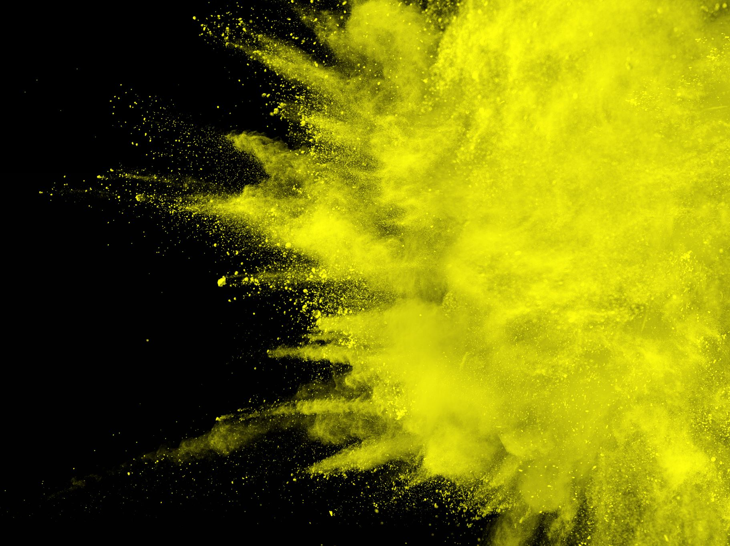
Nondeterministic Actions
Recall AND-OR Search from AIMA Chapter 4

Slide 8
Methods for Adversarial Games
Exact Methods
Model as nondeterministic actions: The opponent is seen as part of an environment with nondeterministic actions. Non-determinism is the result of the unknown moves by the opponent. We consider all possible moves by the opponent.
Find optimal decisions: Minimax search and Alpha-Beta pruning where each player plays optimal to the end of the game.
Heuristic Methods (game tree is too large)
Heuristic Alpha-Beta Tree Search:
Cut off game tree and use heuristic for utility.
Forward Pruning: ignore poor moves.
Monte Carlo Tree search: Estimate utility of a state by simulating complete games and average the utility.

Slide 9
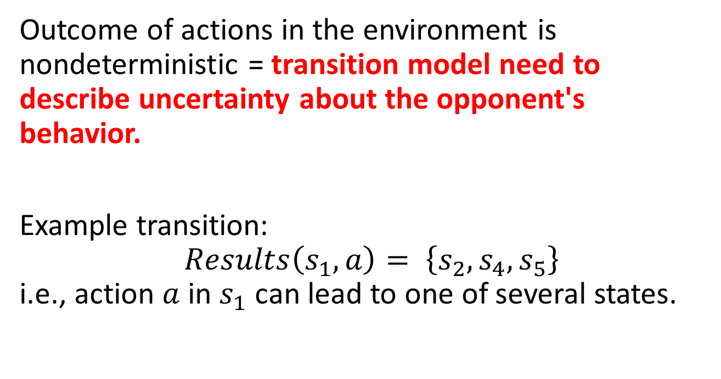
Nondeterministic Actions
Each action consists of the move by the player and all possible (i.e., nondeterministic) responses by the opponent.
Outcome of actions in the environment is nondeterministic = transition model need to describe uncertainty about the opponent's behavior.
Example transition: $Results\left(s_{1},a\right)= \left\{s_{2},s_{4},s_{5}\right\}$ i.e., action $a$ in $s_{1}$ can lead to one of several states.

Slide 10
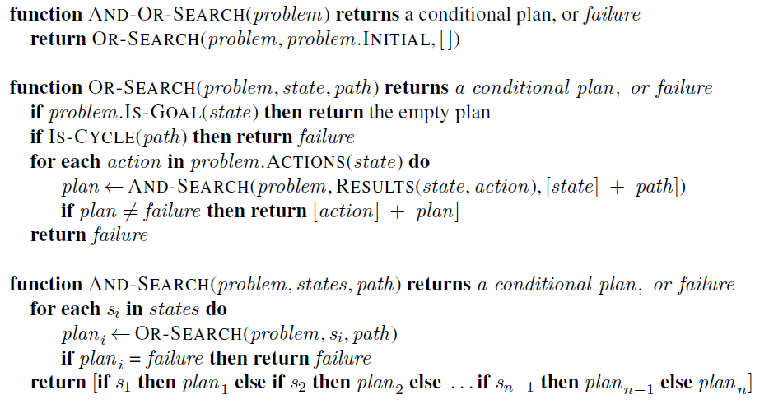
AND-OR DFS Search Algorithm
= nested If-then-else statements
// don’t follow loops
my moves
// check all possible actions
all states that can result from opponent’s moves
// check all possible current states
abandon subtree if a loss is found
Go through
opponent
moves
And-Or Search searches the whole tree till it finds a subtree that leads only to goal nodes.
BFS and A* search can also be used to search an AND-OR tree.

Slide 11
Tic-tac-toe: AND-OR Search
We play MAX and decide on our actions (OR). MIN’s actions introduce non-determinism (AND).
Pick an action that leads
to only win leaves.
OR
AND
Objective: Find a subtree that has only win leaf nodes (utility +1). We can abandon the subtree if we find a loss (utility -1).
We consider all opponent’s moves in the AND stage. This includes MIN’s best move. We call playing always the best move playing optimally.
OR
AND

Slide 12

Optimal Decisions
Minimax Search and Alpha-Beta Pruning

Slide 13
Methods for Adversarial Games
Exact Methods
Model as nondeterministic actions: The opponent is seen as part of an environment with nondeterministic actions. Non-determinism is the result of the unknown moves by the opponent. We consider all possible moves by the opponent.
Find optimal decisions: Minimax search and Alpha-Beta pruning where each player plays optimal to the end of the game.
Heuristic Methods (game tree is too large)
Heuristic Alpha-Beta Tree Search:
Cut off game tree and use heuristic for utility.
Forward Pruning: ignore poor moves.
Monte Carlo Tree search: Estimate utility of a state by simulating complete games and average the utility.

Slide 14
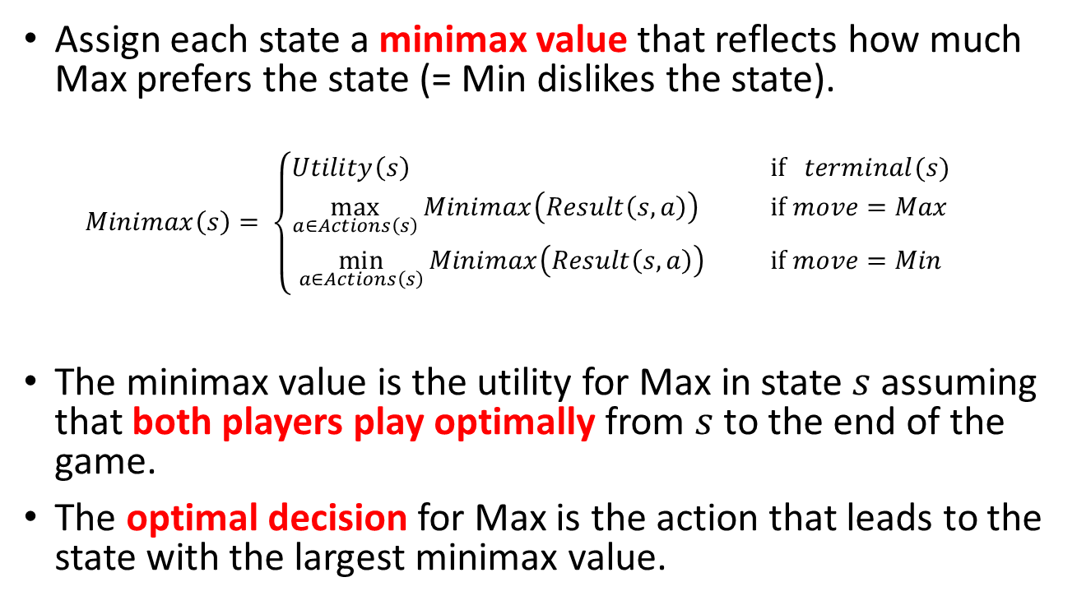
Idea: Minimax Decision
Assign each state a minimax value that reflects how much Max prefers the state (= Min dislikes the state).
$$Minimax\left(s\right)= \left\{\begin{aligned}Utility\left(s\right) \text{if} terminal(s) \\ \max_{a∈Actions\left(s\right)}{Minimax\left(Result\left(s,a\right)\right)}{} \text{if} move=Max \\ \min_{a∈Actions\left(s\right)}{Minimax\left(Result\left(s,a\right)\right) } \text{if} move=Min\end{aligned}\right.$$
The minimax value is the utility for Max in state $s$ assuming that both players play optimally from $s$ to the end of the game.
The optimal decision for Max is the action that leads to the state with the largest minimax value.

Slide 15
Minimax Search
= minimax value (MV)

Slide 16
Minimax Search : Back-up Minimax Values
MV
MV
MV
MV
MV
MV
MV
MV
MV
min
MV
MV
MV
max
MV
MV
MV
min
…
= minimax value (MV)

Slide 17
Minimax Search: Decision
Pick action that leads to the largest MV
MV
MV
MV
MV
MV
MV
MV
MV
MV
MV
MV
MV
MV
MV
MV
= minimax value (MV)

Slide 18
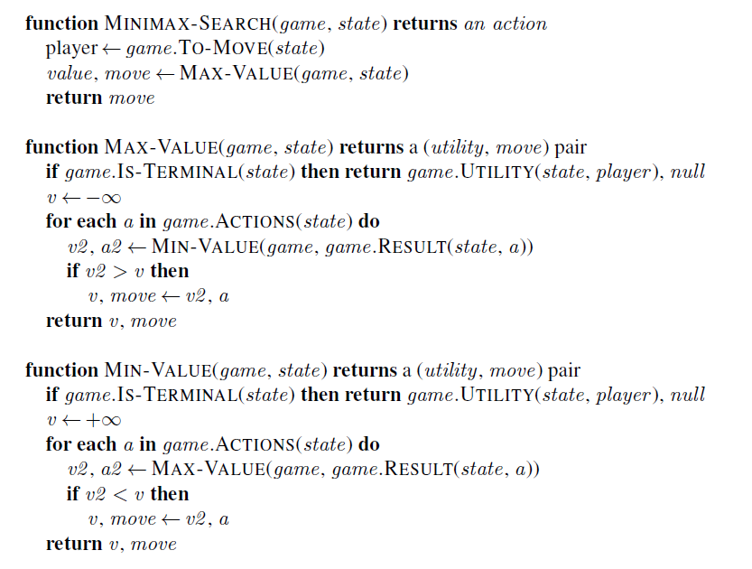
Approach: Follow tree to each terminal node and back up minimax value.
Note: This is just a generalization of the AND-OR Tree Search and returns first action of the conditional plan.
Represents OR Search
Represents AND Search

Slide 19
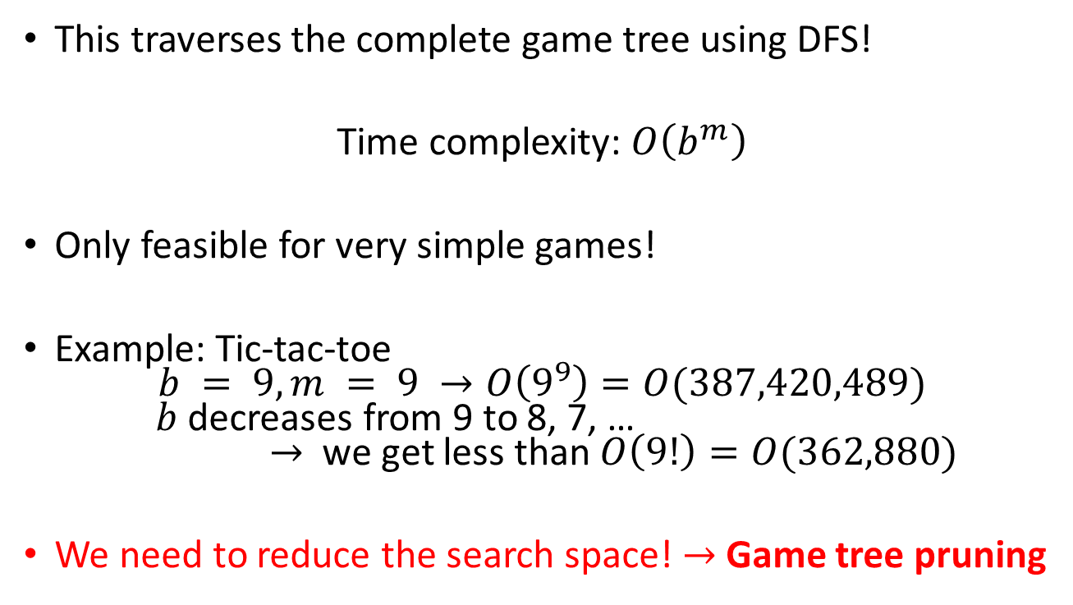
Issue: Game Tree Size
b: branching factor
m: max depth of tree
This traverses the complete game tree using DFS!
Time complexity: $O\left(b^{m}\right)$
Only feasible for very simple games!
Example: Tic-tac-toe $b = 9, m = 9 →O\left(9^{9}\right)=O(387,420,489)$ $b$ decreases from 9 to 8, 7, … $→$ we get less than $O\left(9!\right)=O(362,880)$
We need to reduce the search space! $→$Game tree pruning

Slide 20
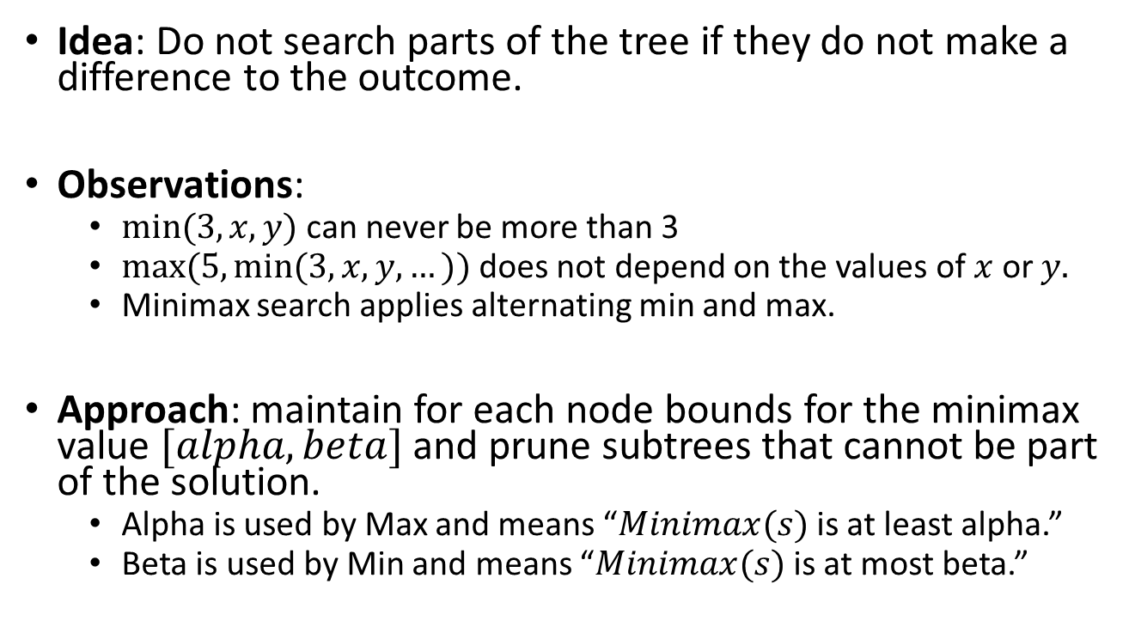
Alpha-Beta Pruning
Idea: Do not search parts of the tree if they do not make a difference to the outcome.
Observations:
$min⁡(3, x, y)$can never be more than 3
$max⁡(5, min⁡(3, x, y, …))$does not depend on the values of $x$ or $y.$
Minimax search applies alternating min and max.
Approach: maintain for each node bounds for the minimax value $[alpha, beta]$and prune subtrees that cannot be part of the solution.
Alpha is used by Max and means “$Minimax(s)$is at least alpha.”
Beta is used by Min and means “$Minimax(s)$is at most beta.”

Slide 21
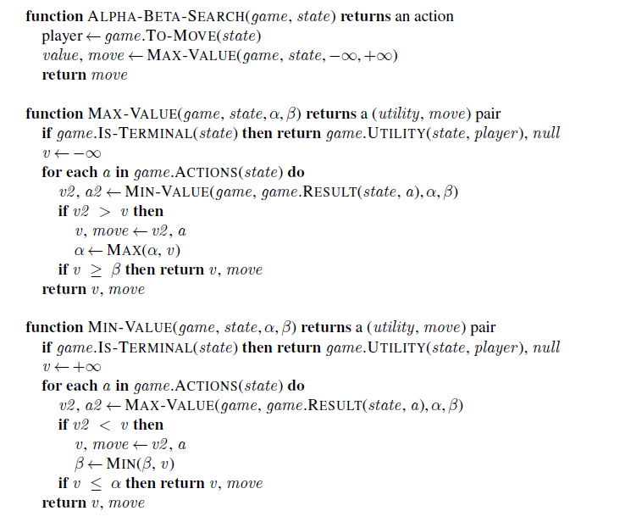
= minimax search + pruning
Notes:
Pruning can be made more effective by move ordering: Check known good moves first to get a good bound early.
Optimal decision algorithms still scale poorly!

Slide 22

Heuristic Alpha-Beta Tree Search

Slide 23
Methods for Adversarial Games
Exact Methods
Model as nondeterministic actions: The opponent is seen as part of an environment with nondeterministic actions. Non-determinism is the result of the unknown moves by the opponent. We consider all possible moves by the opponent.
Find optimal decisions: Minimax search and Alpha-Beta pruning where each player plays optimal to the end of the game.
Heuristic Methods (game tree is too large)
Heuristic Alpha-Beta Tree Search:
Cut off game tree and use heuristic for utility.
Forward Pruning: ignore poor moves.
Monte Carlo Tree search: Estimate utility of a state by simulating complete games and average the utility.

Slide 24
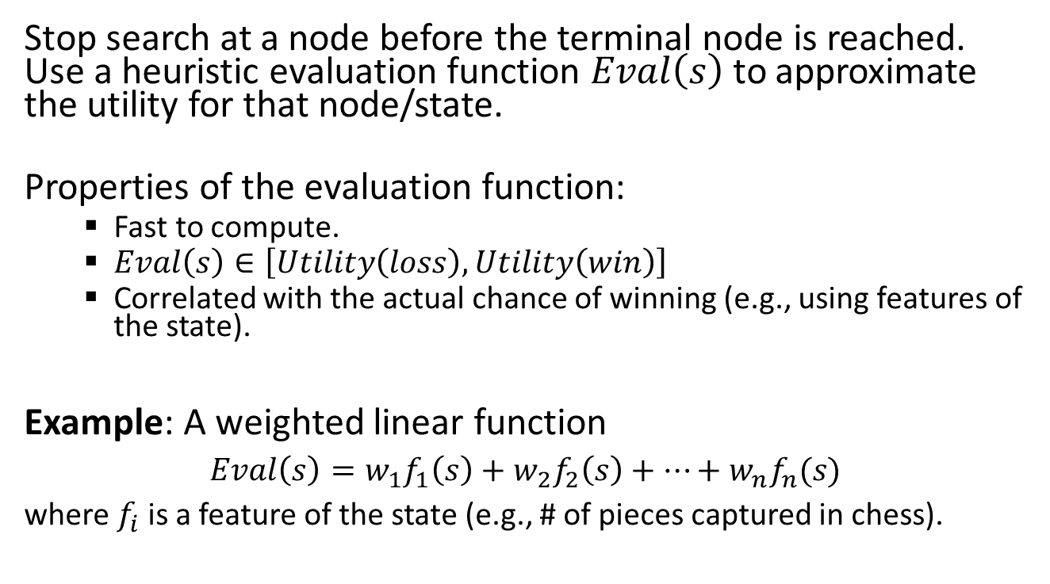
Idea: Cutting off search
Stop search at a node before the terminal node is reached. Use a heuristic evaluation function $Eval\left(s\right)$ to approximate the utility for that node/state.
Properties of the evaluation function:
Fast to compute.
$Eval\left(s\right)∈\left[Utility\left(loss\right),Utility\left(win\right)\right]$
Correlated with the actual chance of winning (e.g., using features of the state).
Example: A weighted linear function
$Eval\left(s\right)=w_{1}f_{1}\left(s\right)+w_{2}f_{2}\left(s\right)+⋯+w_{n}f_{n}(s)$
where $f_{i}$is a feature of the state (e.g., # of pieces captured in chess).

Slide 25
Heuristic Alpha-Beta Tree Search: Cutting off search
depth
0
HMV = heuristic minimax value
1
HMV
HMV
HMV
HMV
HMV
HMV
HMV
HMV
HMV
2
Eval
Eval = heuristic to estimate of the minimax value/utility of the state.
Eval
Eval
3
Cut search off at depth =2

Slide 26
Idea: Forward pruning
Prune moves that appear poor. Poor can be evaluated in several ways:
Low evaluation value after shallow search.
Past experience.
Issue: May prune important moves.

Slide 27
Heuristic Alpha-Beta Tree Search: Forward Pruning Example
x … pruned
x
x
x
x
x
x
HMV
HMV
HMV
HMV
HMV
HMV
HMV
HMV
HMV
Eval
Eval
Eval
Perform search on these.
Perform Cut-off search.
Choose the n best actions using the heuristic minimax value and prune the rest.
Explore the chosen actions using regular Alpha-Beta Tree search with move ordering.
Cut search off at depth =2

Slide 28

Monte Carlo Tree Search (MCTS)

Slide 29
Methods for Adversarial Games
Exact Methods
Model as nondeterministic actions: The opponent is seen as part of an environment with nondeterministic actions. Non-determinism is the result of the unknown moves by the opponent. We consider all possible moves by the opponent.
Find optimal decisions: Minimax search and Alpha-Beta pruning where each player plays optimal to the end of the game.
Heuristic Methods (game tree is too large)
Heuristic Alpha-Beta Tree Search:
Cut off game tree and use heuristic for utility.
Forward Pruning: ignore poor moves.
Monte Carlo Tree search: Estimate utility of a state by simulating complete games and average the utility.

Slide 30
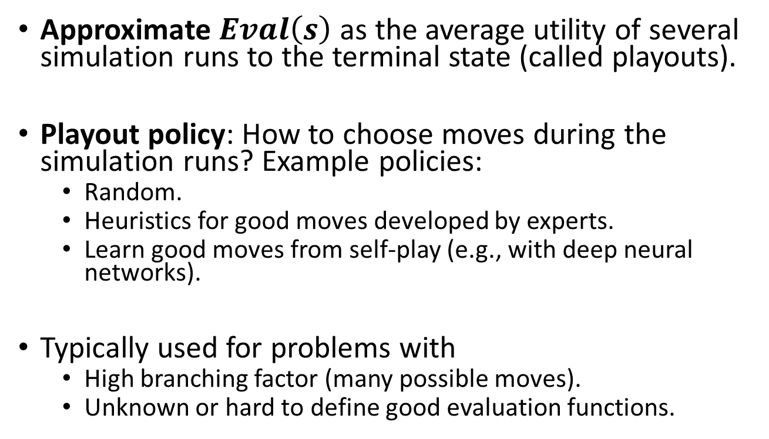
Idea
Approximate $Eval\left(s\right)$ as the average utility of several simulation runs to the terminal state (called playouts).
Playout policy: How to choose moves during the simulation runs? Example policies:
Random.
Heuristics for good moves developed by experts.
Learn good moves from self-play (e.g., with deep neural networks).
Typically used for problems with
High branching factor (many possible moves).
Unknown or hard to define good evaluation functions.

Slide 31
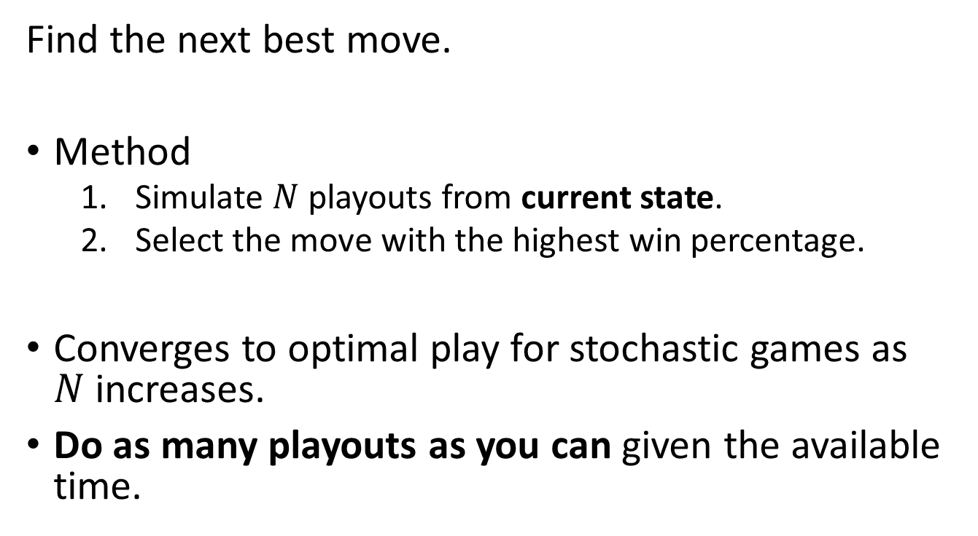
Pure Monte Carlo Search
Find the next best move.
Method
Simulate $N$ playouts from current state.
Select the move with the highest win percentage.
Converges to optimal play for stochastic games as $N$increases.
Do as many playouts as you can given the available time.

Slide 32
Monte Carlo Tree Search
Plan ahead and build a game tree using simulation.
Select the starting state for playouts to focus on important parts of the game tree. It is a tradeoff between:
Exploration: search from states that currently have few playouts.
Exploitation: more playouts for states that have done well to get more accurate estimates.

Slide 33
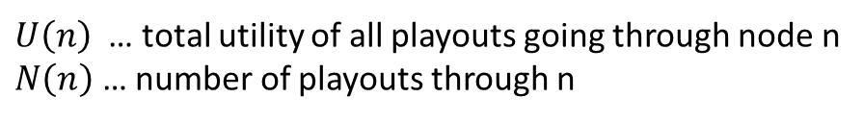
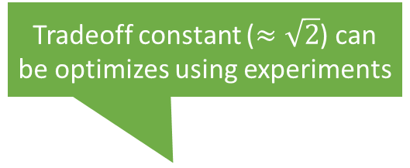
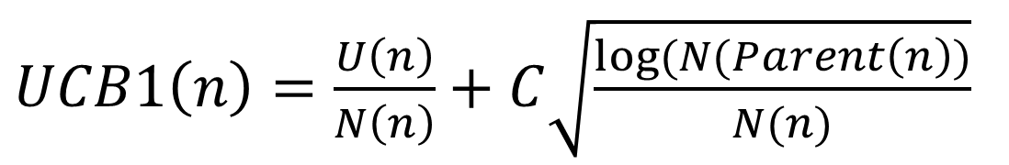
Selection using Upper Confidence Bounds applied to Trees (UCT)
Tradeoff constant ($≈\sqrt{2}$) can be optimizes using experiments
$UCB1\left(n\right)=\frac{U\left(n\right)}{N\left(n\right)}+C\sqrt{\frac{log⁡(N(Parent\left(n\right))}{N(n)}}$
Average utility (=exploitation)
High for nodes with few playouts (=exploration)
$U\left(n\right)$ … total utility of all playouts going through node n
$N\left(n\right)$ … number of playouts through n
Policy: Select leaf with highest UCB1 score.

Slide 34
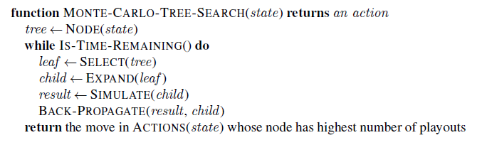
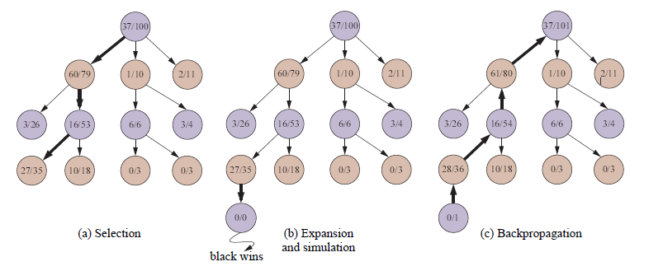
Highest UCB1 score
UCB1 selection favors win percentage more and more.
White
Wins/Playouts
Black
White
Black
White
Note: the simulation path is not recorded!

Slide 35

Stochastic Games
Games With Random Events

Slide 36
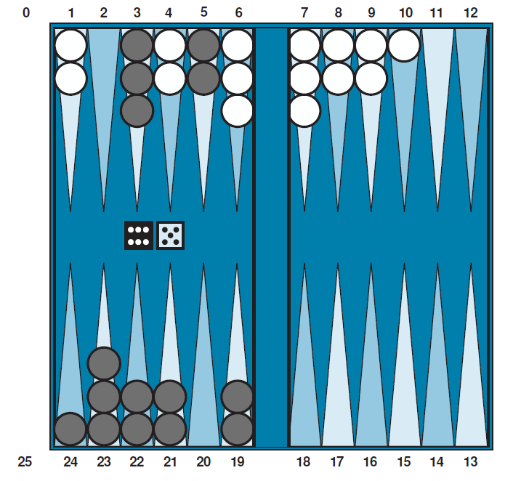
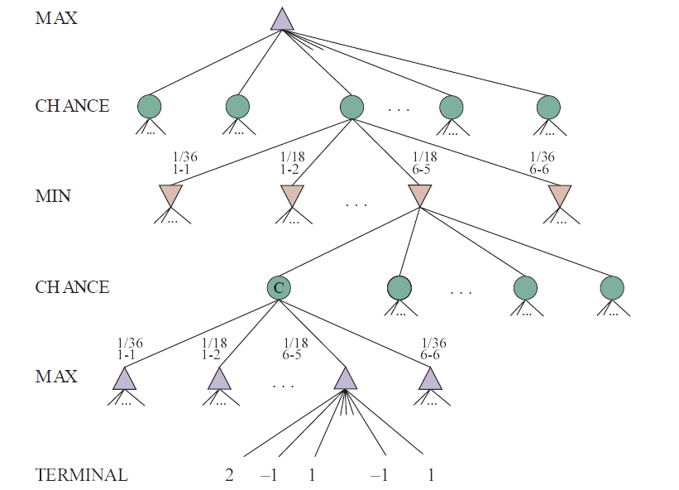
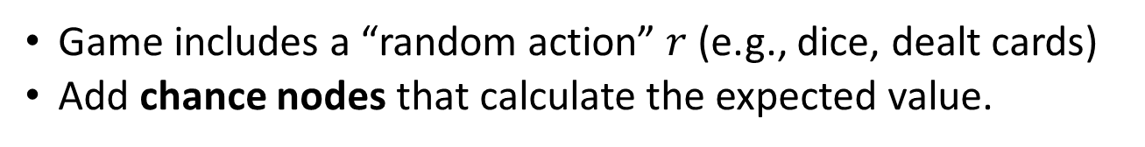
Stochastic Games
Game includes a “random action” $r$ (e.g., dice, dealt cards)
Add chance nodes that calculate the expected value.
Backgammon

Slide 37
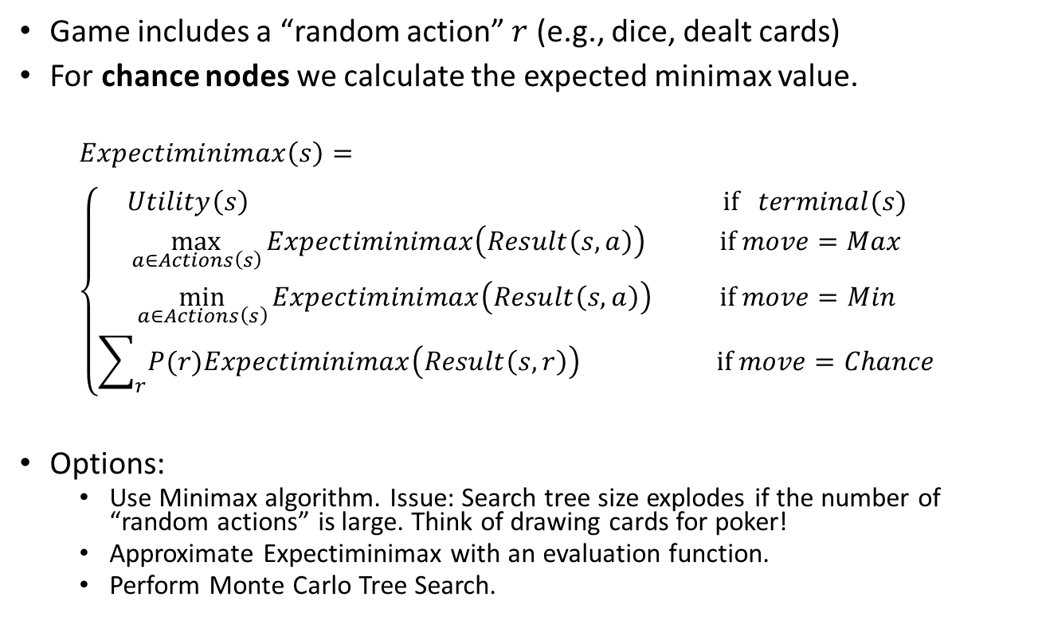
Expectiminimax
Game includes a “random action” $r$ (e.g., dice, dealt cards)
For chance nodes we calculate the expected minimax value.
$$Expectiminimax\left(s\right)= \\ \left\{\begin{aligned}Utility\left(s\right) \text{if} terminal(s) \\ \max_{a∈Actions\left(s\right)}{Expectiminimax\left(Result\left(s,a\right)\right)}{} \text{if} move=Max \\ \min_{a∈Actions\left(s\right)}{Expectiminimax\left(Result\left(s,a\right)\right) } \text{if} move=Min \\ \sum_{r}{P(r)Expectiminimax\left(Result\left(s,r\right)\right) } \text{if} move=Chance\end{aligned}\right.$$
Options:
Use Minimax algorithm. Issue: Search tree size explodes if the number of “random actions” is large. Think of drawing cards for poker!
Approximate Expectiminimax with an evaluation function.
Perform Monte Carlo Tree Search.

Slide 38
Conclusion
Nondeterministic actions:
The opponent is seen as part of an environment with nondeterministic actions. Non-determinism is the result of the unknown moves by the opponent. All possible moves are considered.
Optimal decisions:
Minimax search and Alpha-Beta pruning where each player plays optimal to the end of the game.
Choice nodes and Expectiminimax for stochastic games.
Heuristic Alpha-Beta Tree Search:
Cut off game tree and use heuristic evaluation function for utility (based on state features).
Forward Pruning: ignore poor moves.
Monte Carlo Tree search:
Simulate complete games and calculate proportion of wins.
Learn playout policy using self-play and deep learning.
Use modified UCB1 scores to expand the game tree.
Scale only for tiny problems!
State of the Art

