Slide 1
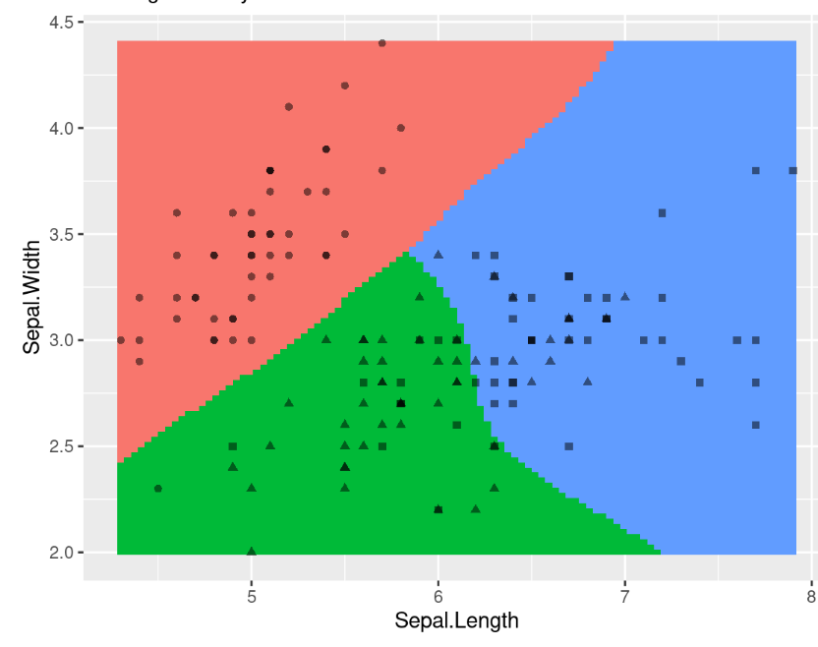
CS 5/7320 Artificial Intelligence Learning from Examples AIMA Chapter 19
Slides by Michael Hahsler Based on slides by Dan Klein, Pieter Abbeel, Sergey Levine and A. Farhadi. All CS188 materials are at http://ai.berkeley.edu with figures from the AIMA textbook.
This work is licensed under a Creative Commons Attribution-ShareAlike 4.0 International License.
Notes:
Please retain proper attribution, including the reference to ai.berkeley.edu. Thanks!

Slide 2
Learning from Examples: Machine Learning
Up until now: hand-craft algorithms to make rational/optimal or at least good decisions. Examples: Search strategies, heuristics.
Learning: Improve performance after making observations about the world. That is, learn what works and what doesn’t.
Machine learning: how to build a model from data/experience
Supervised Learning: Learn a function to map input to output. Examples:
Use a naïve Bayesian classifier to distinguish between spam/no spam
Learn a playout policy to simulate games (current board -> good move)
Reinforcement Learning: Learn from rewards/punishment (e.g., winning a game).
Learning vs. hard coding the agent function
Designer cannot anticipate all possible future situations.
Designer may have examples but does not know how to program a solution.

Slide 3

Supervised Learning
1+1=2

Slide 4



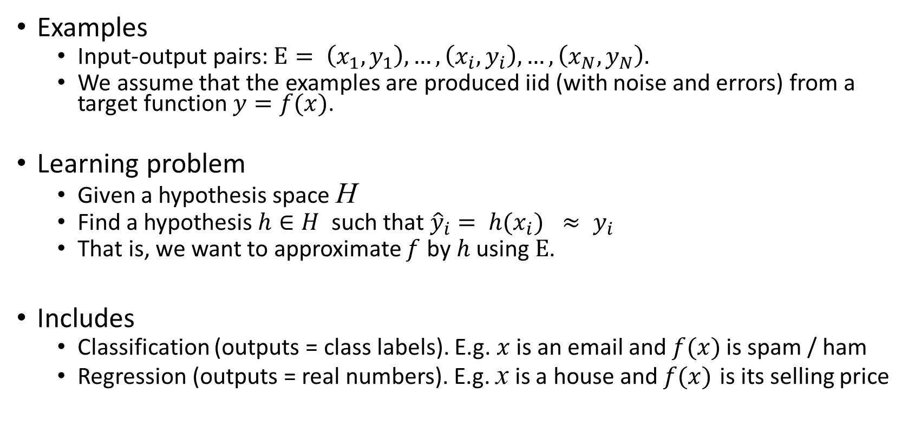
Supervised Learning
Examples
Input-output pairs: $E= \left(x_{1},y_{1}\right),…, \left(x_{i}, y_{i}\right),…,\left(x_{N},y_{N}\right).$
We assume that the examples are produced iid (with noise and errors) from a target function $y=f(x)$.
Learning problem
Given a hypothesis space H
Find a hypothesis $h∈H$ such that ${\hat{y}}_{i}= h(x_{i}) ≈ y_{i}$
That is, we want to approximate $f$ by $h$ using $E$.
Includes
Classification (outputs = class labels). E.g. $x$ is an email and $f(x)$ is spam / ham
Regression (outputs = real numbers). E.g. x is a house and $f(x)$ is its selling price
$$f$$

Slide 5
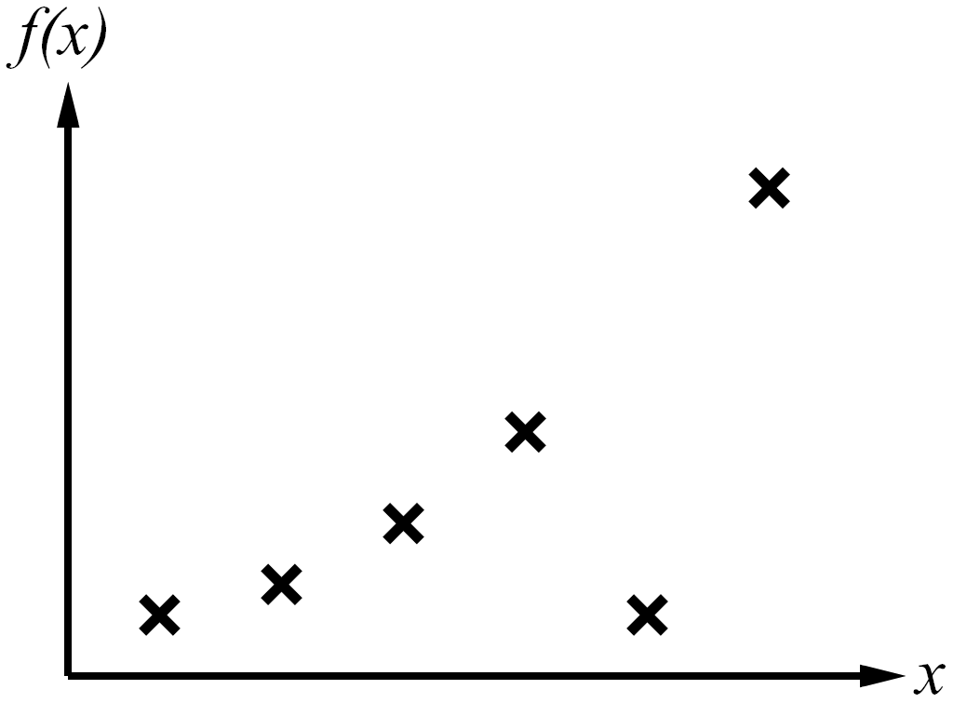
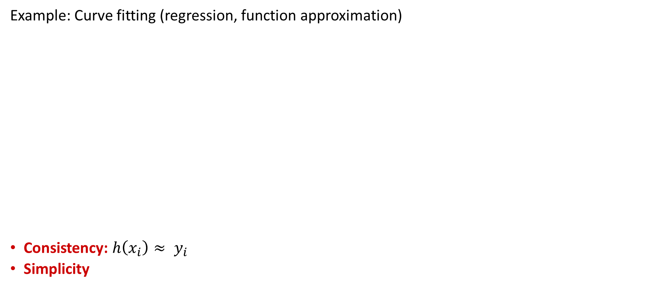

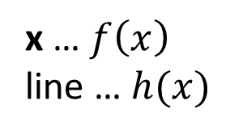
Consistency vs. Simplicity
Example: Curve fitting (regression, function approximation)
Consistency: $h\left(x_{i}\right)≈ y_{i}$
Simplicity
y
y
x … $f\left(x\right)$
line … $h(x)$
Examples
$$\overline{y}$$
Very simple, but not very consistent with the data!

Slide 6
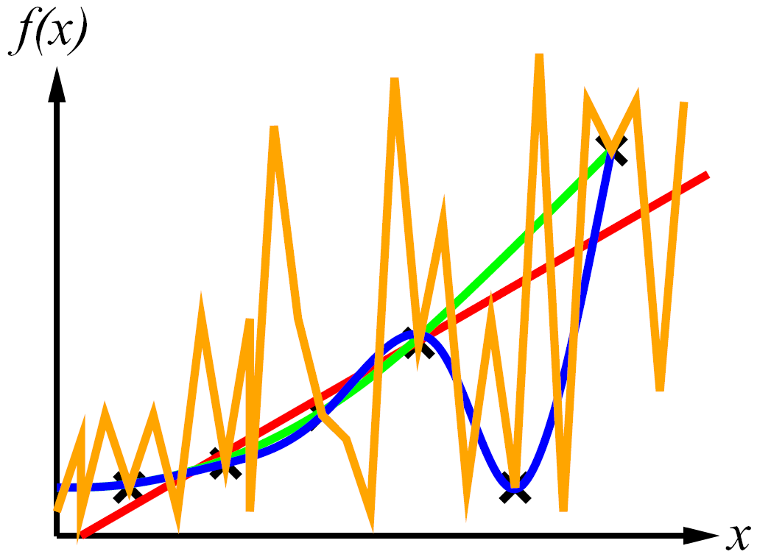
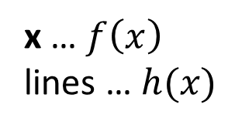
Consistency vs. Simplicity
Example: Curve fitting (regression, function approximation)
Consistency: $h\left(x_{i}\right)≈ y_{i}$
Simplicity
y
y
x … $f\left(x\right)$
lines … $h(x)$
Examples

Slide 7
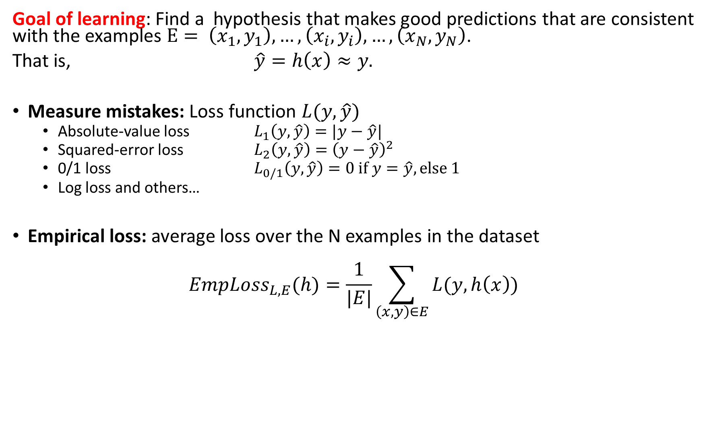
Consistency and Loss
Goal of learning: Find a hypothesis that makes good predictions that are consistent with the examples $E= \left(x_{1},y_{1}\right),…, \left(x_{i}, y_{i}\right),…,\left(x_{N},y_{N}\right)$.
That is, $\hat{y}=h\left(x\right)≈y.$
Measure mistakes: Loss function $L(y, \hat{y})$
Absolute-value loss $L_{1}\left(y, \hat{y}\right)=|y−\hat{y}|$
Squared-error loss $L_{2}\left(y, \hat{y}\right)={\left(y−\hat{y}\right)}^{2}$
0/1 loss $L_{0/1}\left(y, \hat{y}\right)=0 if y=\hat{y}, else 1$
Log loss and others…
Empirical loss: average loss over the N examples in the dataset
$$EmpLoss_{L,E}(h)=\frac{1}{|E|}\sum_{\left(x,y\right)∈E}{L(y, h\left(x\right))}$$
For Regression
For Classification

Slide 8

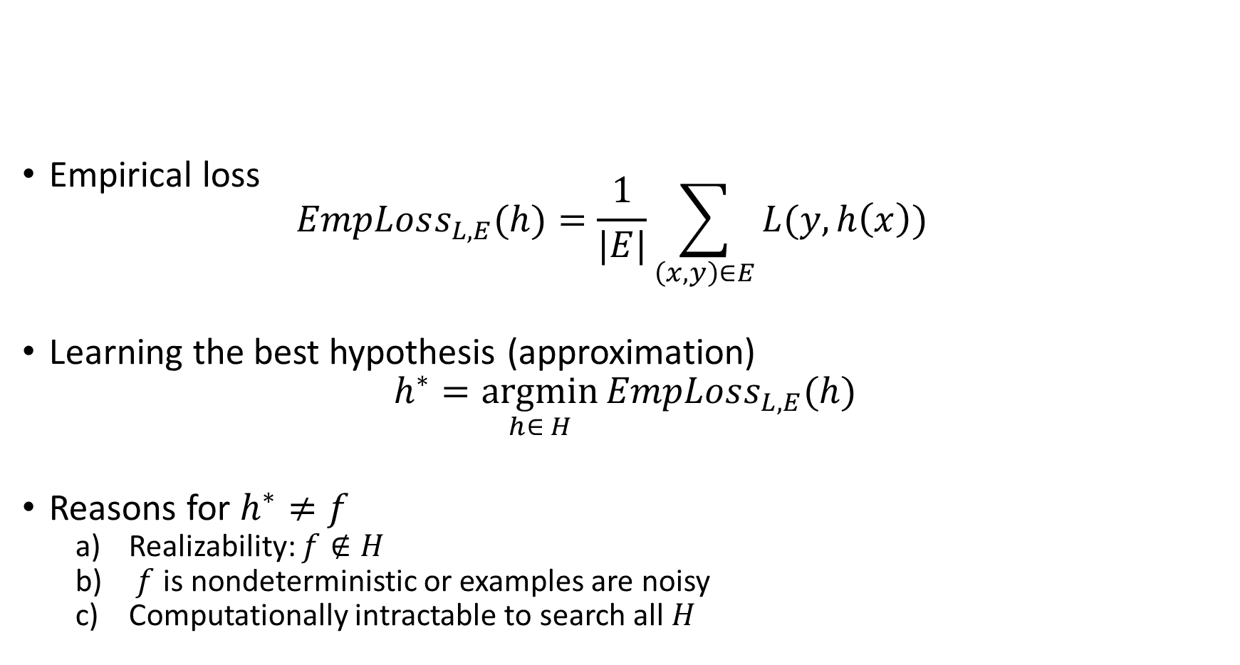

Consistency and Loss
Empirical loss $EmpLoss_{L,E}(h)=\frac{1}{|E|}\sum_{\left(x,y\right)∈E}{L(y, h\left(x\right))}$
Learning the best hypothesis (approximation)
$$h^{∗}=\underset{h∈ H}{argmin}{EmpLoss_{L,E}(h)}$$
Reasons for $h^{∗}≠f$
Realizability: $f∉H$
$f$ is nondeterministic or examples are noisy
Computationally intractable to search all $H$
$$f$$
Loss
$$h^{∗}$$

Slide 9
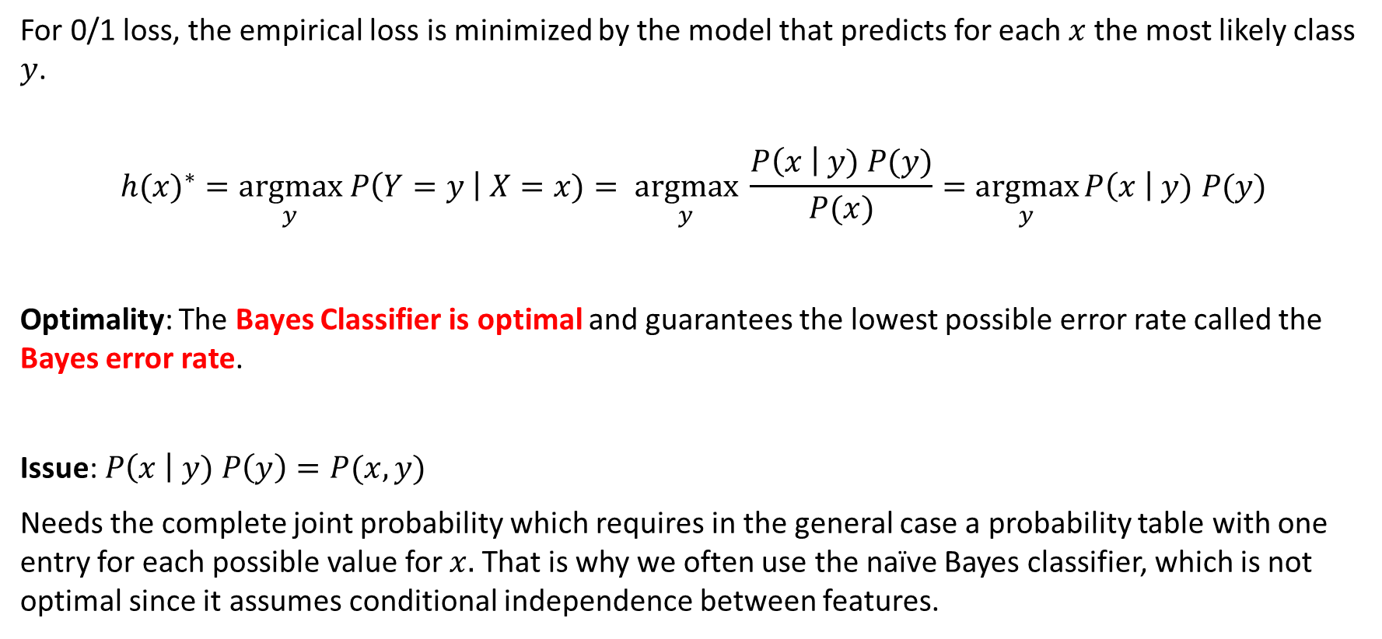
Example: Bayes Classifier
For 0/1 loss, the empirical loss is minimized by the model that predicts for each $x$ the most likely class $y$.
$${h(x)}^{∗}=\underset{y}{argmax} P\left(Y=y \right| X=x)= \underset{y}{argmax} \frac{P\left(x \right| y) P(y)}{P(x)}=\underset{y}{argmax}{P\left(x \right| y) P(y)}$$
Optimality: The Bayes Classifier is optimal and guarantees the lowest possible error rate called the Bayes error rate.
Issue: $P\left(x \right| y) P\left(y\right)=P(x,y)$
Needs the complete joint probability which requires in the general case a probability table with one entry for each possible value for $x.$ That is why we often use the naïve Bayes classifier, which is not optimal since it assumes conditional independence between features.

Slide 10
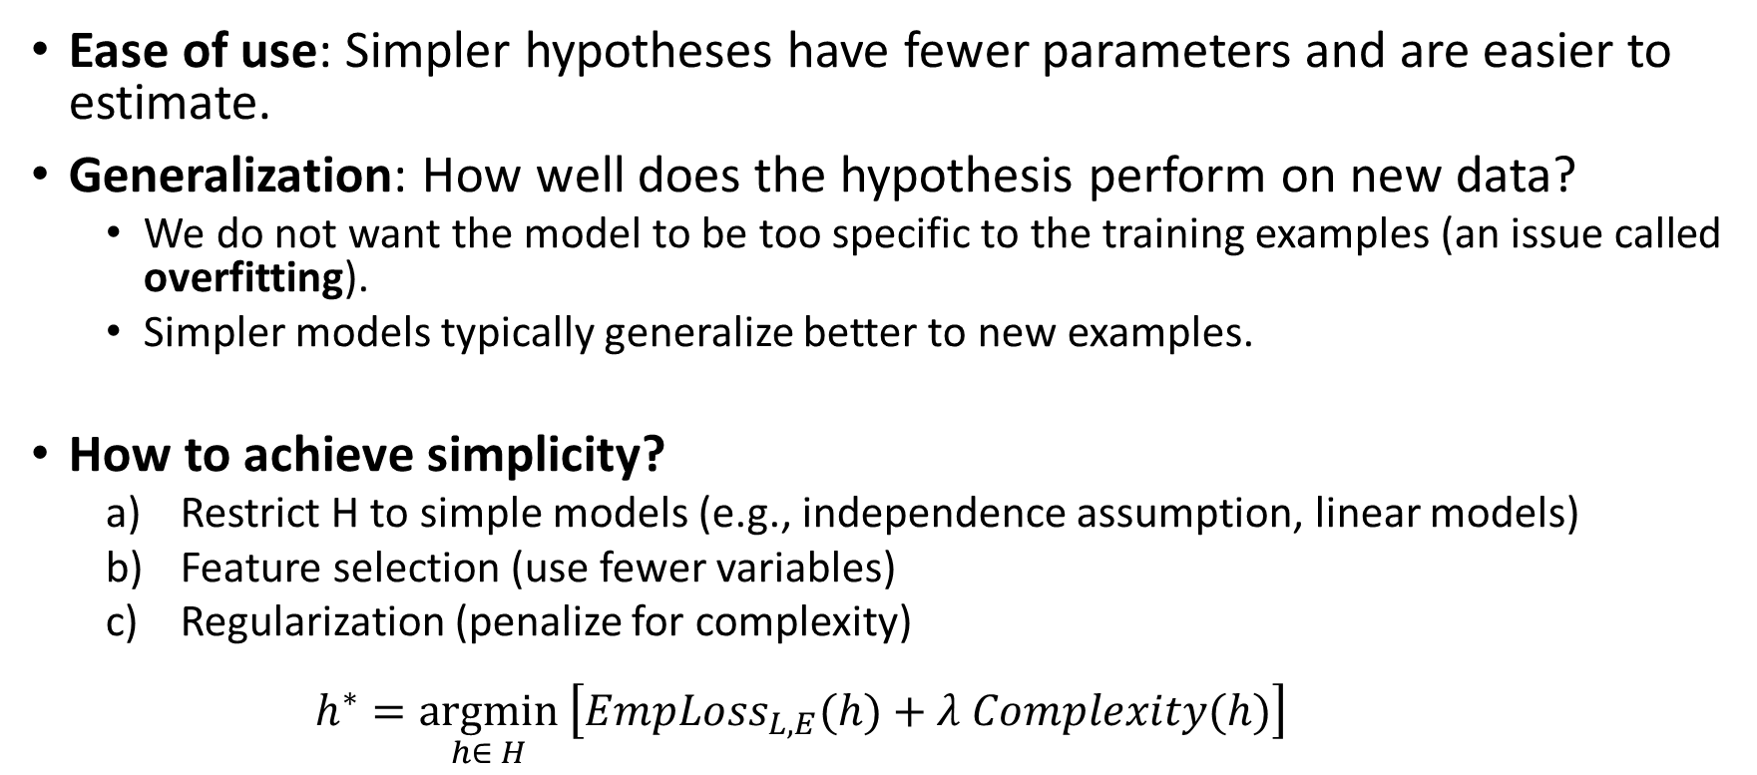
Simplicity
Ease of use: Simpler hypotheses have fewer parameters and are easier to estimate.
Generalization: How well does the hypothesis perform on new data?
We do not want the model to be too specific to the training examples (an issue called overfitting).
Simpler models typically generalize better to new examples.
How to achieve simplicity?
Restrict H to simple models (e.g., independence assumption, linear models)
Feature selection (use fewer variables)
Regularization (penalize for complexity) $h^{∗}=\underset{h∈ H}{argmin}\left[EmpLoss_{L,E}(h)+λ Complexity(h)\right]$
Penalty term

Slide 11
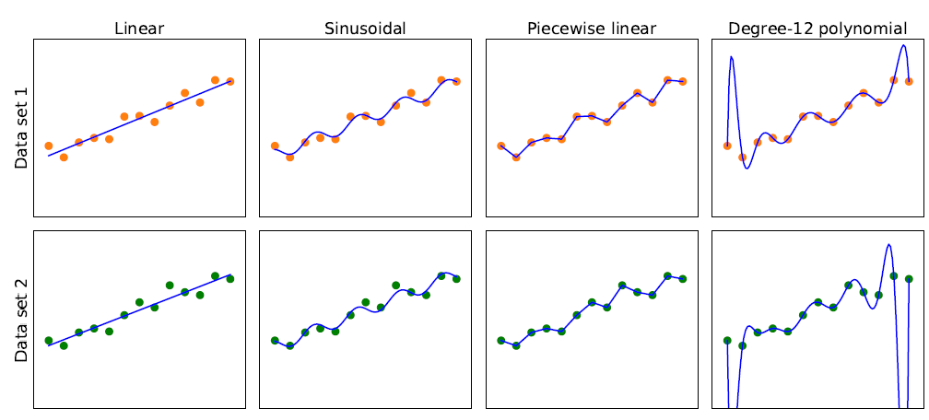
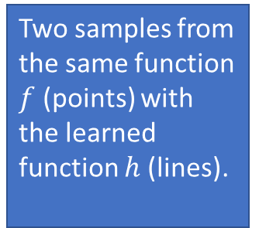
Model Selection: Bias vs. Variance
Overfitting
Simpler
More consistent
Two samples from the same function $f$ (points) with the learned function $h$ (lines).
High Bias: restrictions by the model class Low
Low Variance: difference in the model due to slightly different data. high

Slide 12

Data

Slide 13
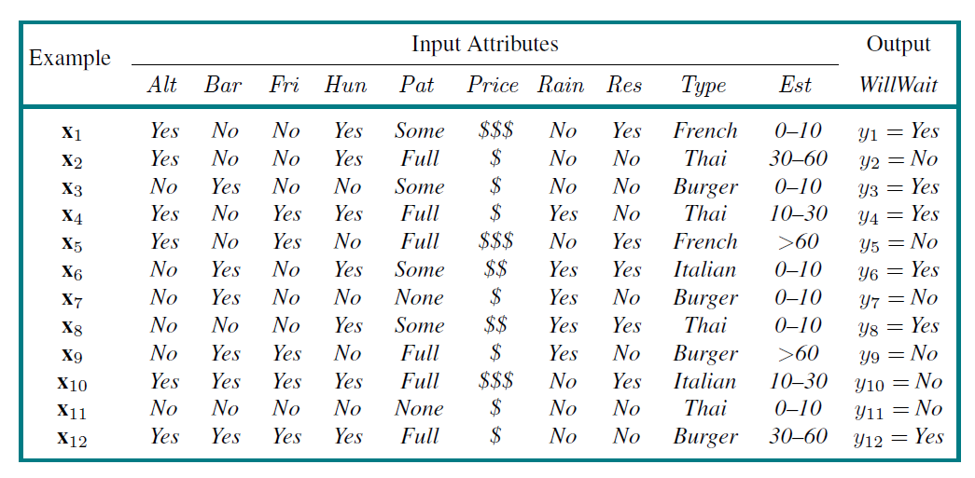
The Dataset
Features
Variables
Attributes
Class
Label
Examples
Instances
Observations
Alternative
Hungry
Patrons
Reservation
Wait time
Find a hypothesis (called “model”) to predict the class given the features.

Slide 14
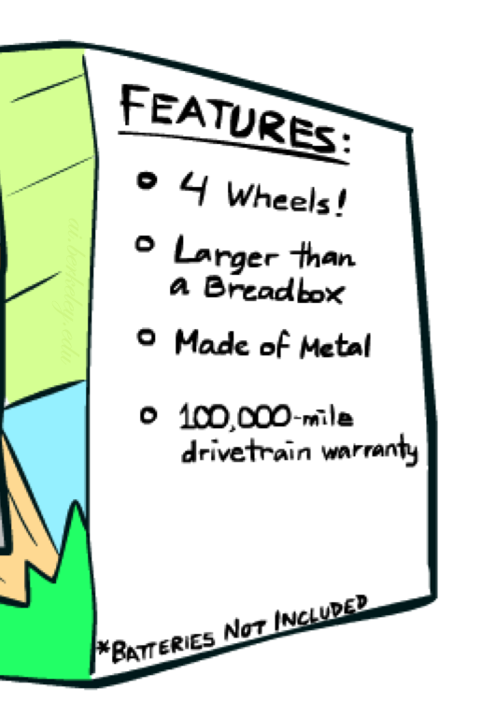
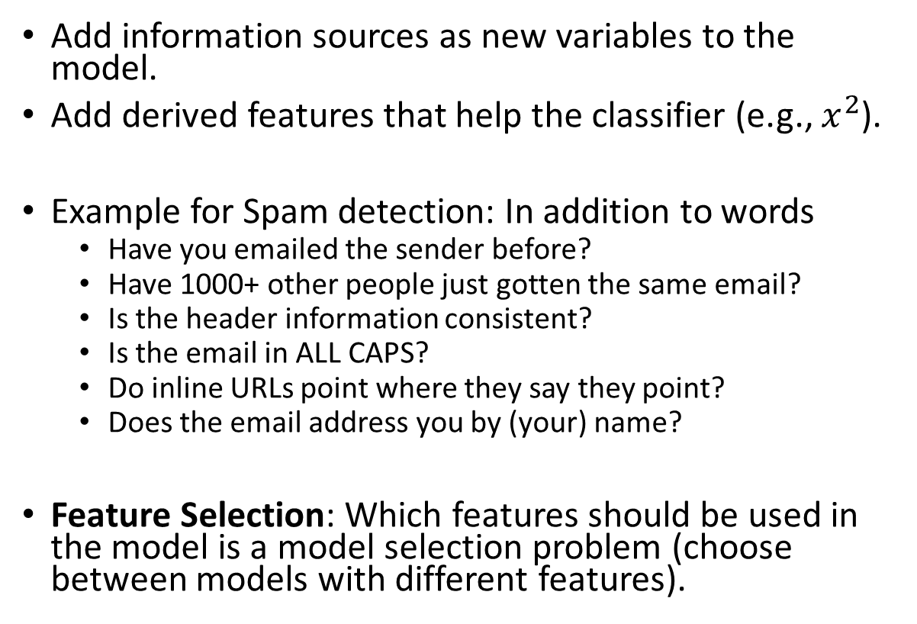
Feature Engineering
Add information sources as new variables to the model.
Add derived features that help the classifier (e.g., $x^{2}$).
Example for Spam detection: In addition to words
Have you emailed the sender before?
Have 1000+ other people just gotten the same email?
Is the header information consistent?
Is the email in ALL CAPS?
Do inline URLs point where they say they point?
Does the email address you by (your) name?
Feature Selection: Which features should be used in the model is a model selection problem (choose between models with different features).

Slide 15

Training and Testing

Slide 16
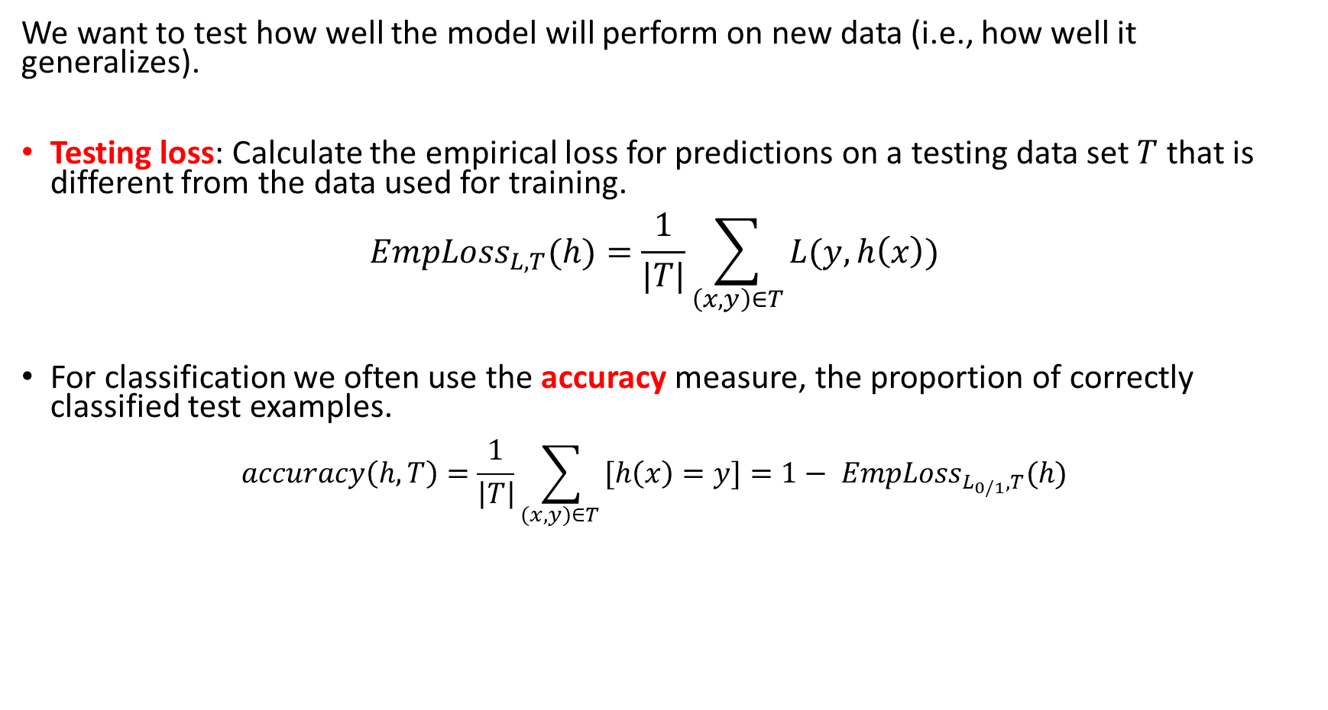
Model Evaluation
We want to test how well the model will perform on new data (i.e., how well it generalizes).
Testing loss: Calculate the empirical loss for predictions on a testing data set $T$ that is different from the data used for training. $EmpLoss_{L,T}(h)=\frac{1}{|T|}\sum_{\left(x,y\right)∈T}{L(y, h\left(x\right))}$
For classification we often use the accuracy measure, the proportion of correctly classified test examples. $accuracy\left(h, T\right)=\frac{1}{\left|T\right|}\sum_{(x,y)∈T }{[h\left(x\right)=y]}=1− EmpLoss_{L_{0/1},T}(h)$
$\left[c\right]$ is an indicator function returning 1 if $c = True$and otherwise 0

Slide 17
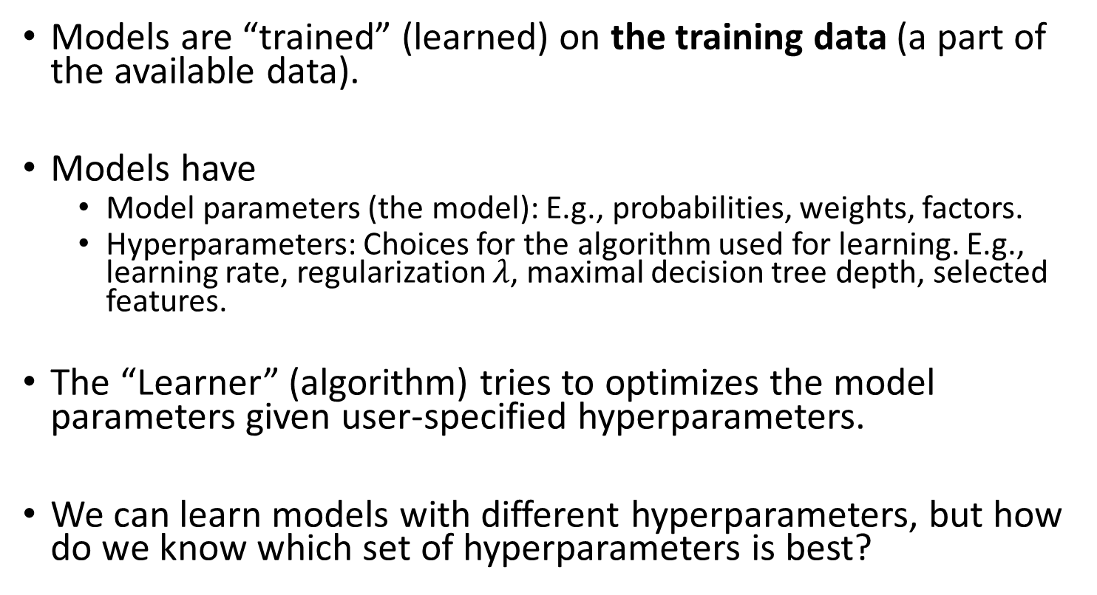
Training a Model
Training
Data
Models are “trained” (learned) on the training data (a part of the available data).
Models have
Model parameters (the model): E.g., probabilities, weights, factors.
Hyperparameters: Choices for the algorithm used for learning. E.g., learning rate, regularization $λ$, maximal decision tree depth, selected features.
The “Learner” (algorithm) tries to optimizes the model parameters given user-specified hyperparameters.
We can learn models with different hyperparameters, but how do we know which set of hyperparameters is best?
Validation
Data
Test
Data

Slide 18
Hyperparameter Tuning/Model Selection
Learn models using the training set and different hyperparameters.
Often a grid of possible hyperparameter combinations or some greedy search is used.
Evaluate the models using the validation data and choose the model with the best accuracy. Selecting the right type of model, hyperparameters and features is called model selection.
Learn the final model using all training and validation data.
Notes:
The validation set was not used for training, so we get generalization accuracy.
If no model selection is necessary, then no validation set is used.
Training
Data
Validation
Data
Test
Data

Slide 19
Testing a Model
Training
Data
Validation
Data
After the model is selected, the final model is evaluated against the test set to estimate the final model accuracy.
Very important: never “peek” at the test set during learning!
Test
Data

Slide 20
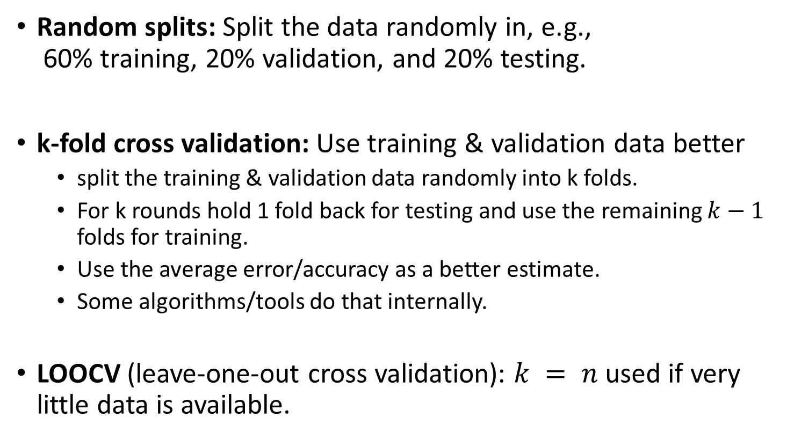
How to Split the Dataset
Random splits: Split the data randomly in, e.g., 60% training, 20% validation, and 20% testing.
k-fold cross validation: Use training & validation data better
split the training & validation data randomly into k folds.
For k rounds hold 1 fold back for testing and use the remaining $k−1$ folds for training.
Use the average error/accuracy as a better estimate.
Some algorithms/tools do that internally.
LOOCV (leave-one-out cross validation): $k = n$used if very little data is available.
Training
Data
Validation
Data
Test
Data

Slide 21
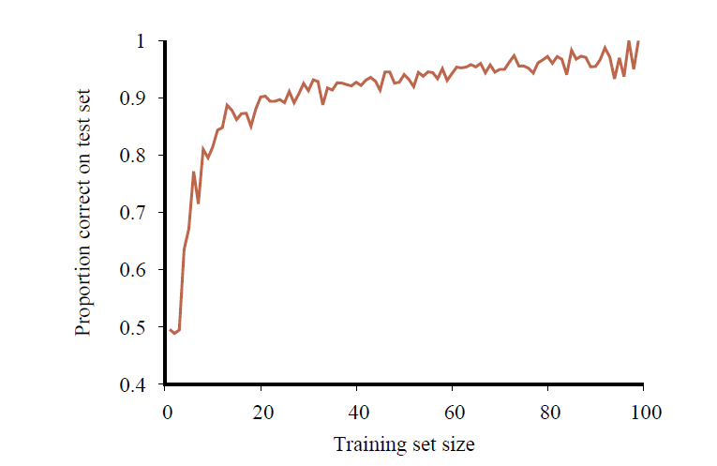
Learning Curve: The Effect the Training Data Size
Accuracy of a classifier when the amount of available training data increases.
More data is better!
Accuracy

Slide 22

Comparing to a Baselines
First step: get a baseline
Baselines are very simple “straw man” model.
Helps to determine how hard the task is.
Helps to find out what a “good” accuracy is.
Weak baseline: The most frequent label classifier
Gives all test instances whatever label was most common in the training set.
Example: For spam filtering, give every message the label “ham.”
Accuracy might be very high if the problem is skewed (called class imbalance).
Example: If calling everything “ham” gets already 66% right, so a classifier that gets 70% isn’t very good…
Strong baseline: For research, we typically compare to previous work as a baseline.

Slide 23

Types of Models
Regression: Predict a number
Classification: Predict a label

Slide 24
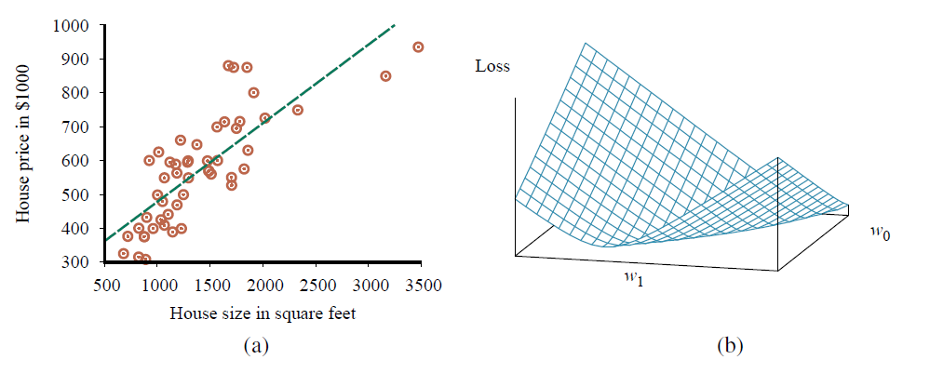
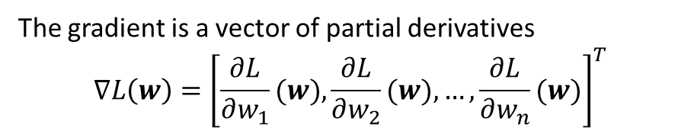
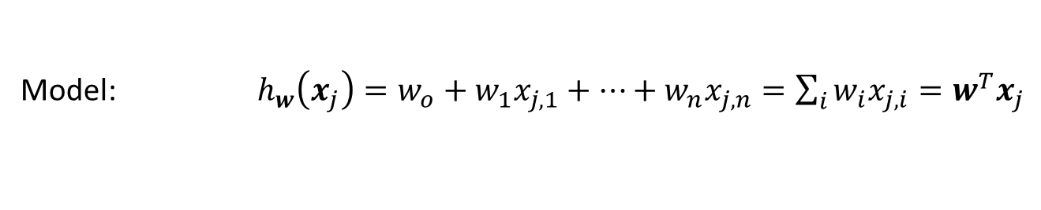


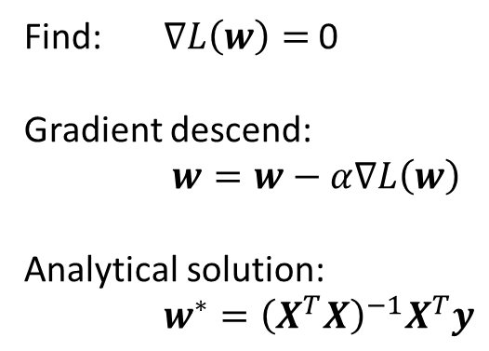



Regression: Linear Regression
Model: $h_{w}\left(x_{j}\right)=w_{o}+w_{1}x_{j,1}+…+w_{n}x_{j,n}=\sum_{i}{w_{i}x_{j,i}}=w^{T}x_{j}$
Empirical Loss: $L\left(w\right)={\left\|Xw−y\right\|}^{2}$
Squared error loss over the whole data matrix $X$
The gradient is a vector of partial derivatives $$∇L\left(w\right)={\left[\frac{∂L}{∂w_{1}}(w),\frac{∂L}{∂w_{2}}(w),…,\frac{∂L}{∂w_{n}}(w)\right]}^{T}$$
Gradient: $∇L\left(w\right)=2X^{T}\left(Xw−y\right)$
Find: $∇L\left(w\right)=$ 0
Gradient descend:
$w=w−α∇L\left(w\right)$
Analytical solution:
$w^{∗}={\left(X^{T}X\right)}^{−1}X^{T}y$
$$∇L\left(w\right)$$
$$w$$
Pseudo inverse

Slide 25
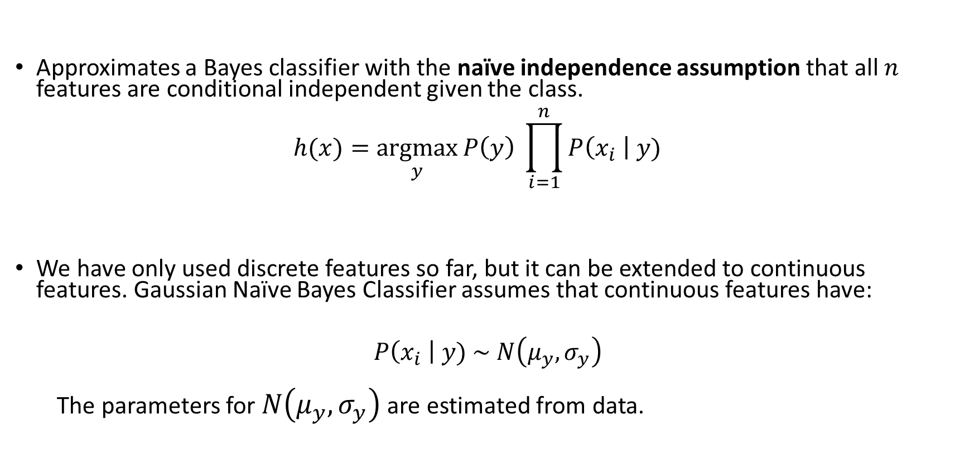
Naïve Bayes Classifier
Approximates a Bayes classifier with the naïve independence assumption that all $n$ features are conditional independent given the class. $h(x)=\underset{y}{argmax}{P\left(y\right) \prod_{i=1}^{n}{P\left(x_{i} \right| y)}}$
We have only used discrete features so far, but it can be extended to continuous features. Gaussian Naïve Bayes Classifier assumes that continuous features have:
$$P\left(x_{i} \right| y) \sim N\left(μ_{y},σ_{y}\right)$$
The parameters for $N\left(μ_{y},σ_{y}\right)$ are estimated from data.

Slide 26
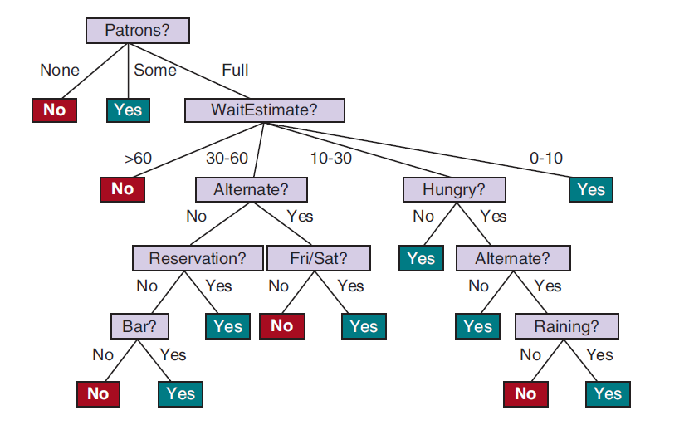
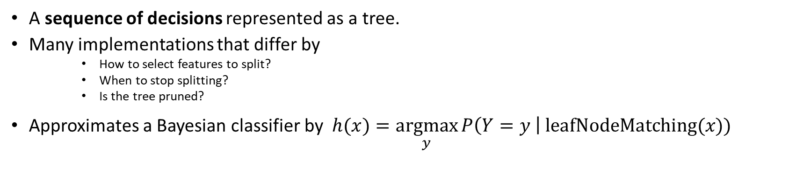
Decision Trees
A sequence of decisions represented as a tree.
Many implementations that differ by
How to select features to split?
When to stop splitting?
Is the tree pruned?
Approximates a Bayesian classifier by $h(x)=\underset{y}{argmax}{P\left(Y=y \right| \text{leafNodeMatching}(x)) }$

Slide 27
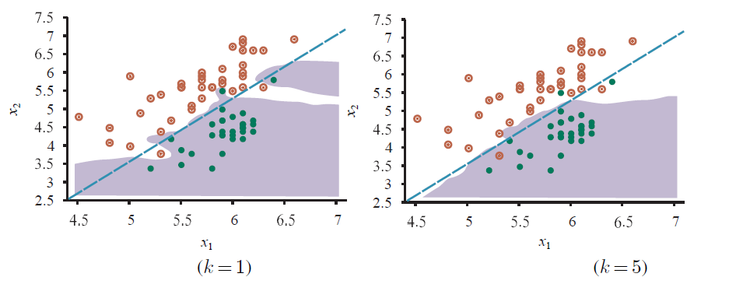
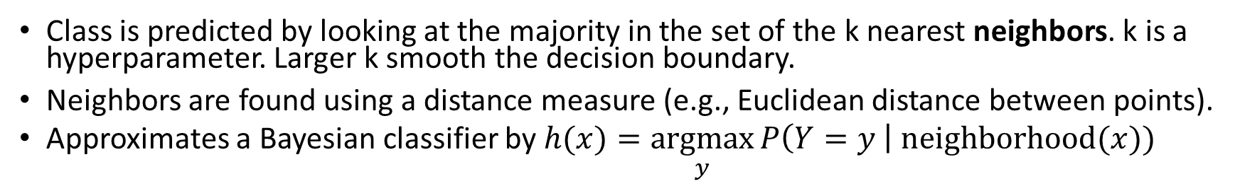
K-Nearest Neighbors Classifier
Class is predicted by looking at the majority in the set of the k nearest neighbors. k is a hyperparameter. Larger k smooth the decision boundary.
Neighbors are found using a distance measure (e.g., Euclidean distance between points).
Approximates a Bayesian classifier by $h(x)=\underset{y}{argmax}{P\left(Y=y \right| \text{neighborhood}(x)) }$

Slide 28
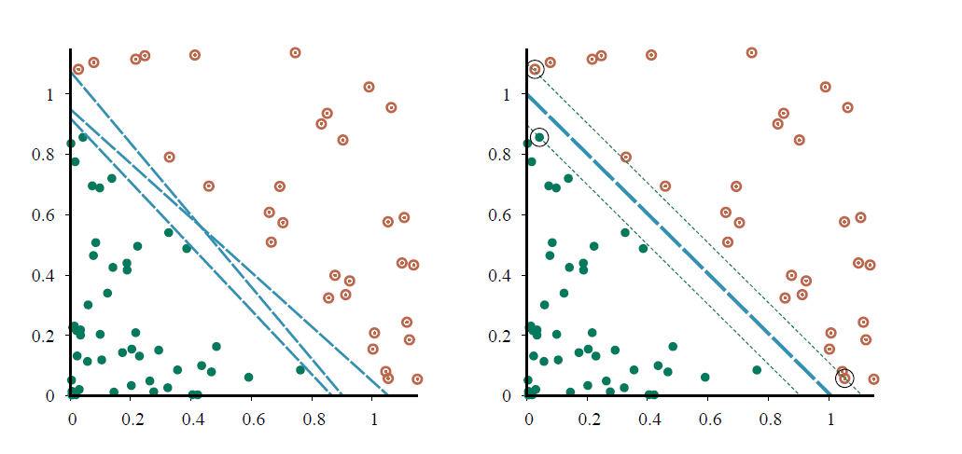
Support Vector Machine (SVM)
Margin
Decision boundary
Linear classifier that finds the maximum margin separator using only the “support vectors” and quadratic optimization.
The kernel trick can be used to learn non-linear decision boundaries.

Slide 29
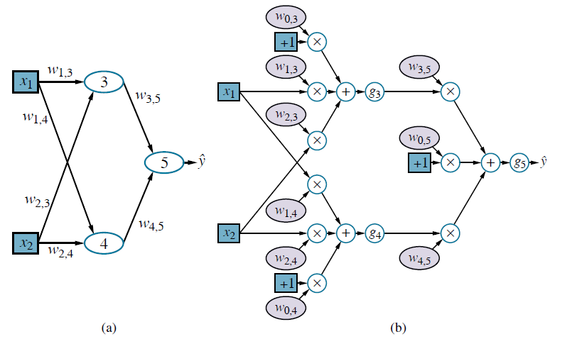
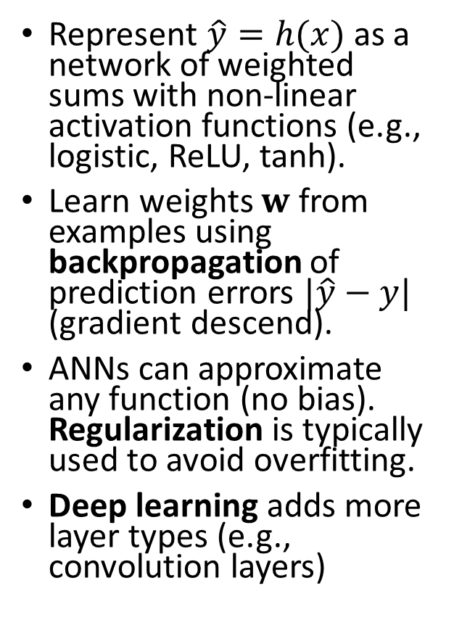
Artificial Neural Networks/Deep Learning
Hidden Layer
Computational graph
Represent $\hat{y}=h(x)$ as a network of weighted sums with non-linear activation functions (e.g., logistic, ReLU, tanh).
Learn weights $w$ from examples using backpropagation of prediction errors $|\hat{y}−y|$ (gradient descend).
ANNs can approximate any function (no bias). Regularization is typically used to avoid overfitting.
Deep learning adds more layer types (e.g., convolution layers)
Bias
Non-linear activation function

Slide 30
Other Models and Methods
Many other models exist
Generalized linear model (GLM): A model family that includes linear regression and the classification method logistic regression.
Often used methods
Regularization: enforce simplicity by using a penalty for complexity.
Kernel trick: Let a linear classifier learn non-linear decision boundaries ( = a linear boundary in a high dimensional space).
Ensemble Learning: Use many models and combine the results (e.g., random forest, boosting).

Slide 31

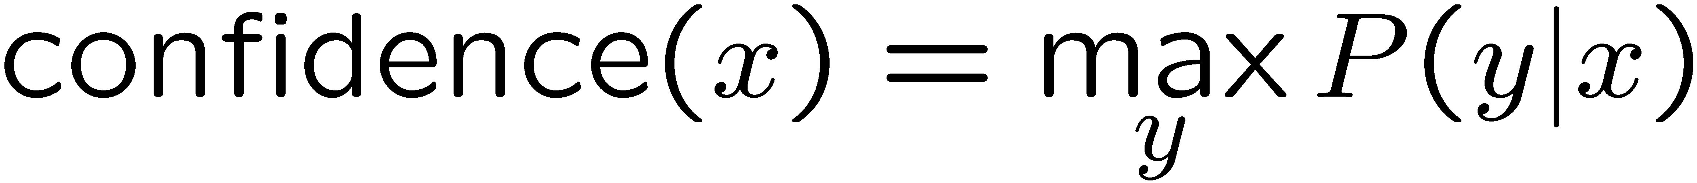

Confidences from a Classifier
The confidence of a probabilistic classifier:
Posterior over the top label
Represents how sure the classifier is of the classification
Any probabilistic model will have confidences
No guarantee confidence is correct
Calibration
Weak calibration: higher confidences mean higher accuracy
Strong calibration: confidence predicts accuracy rate
What’s the value of calibration?

