Slide 1
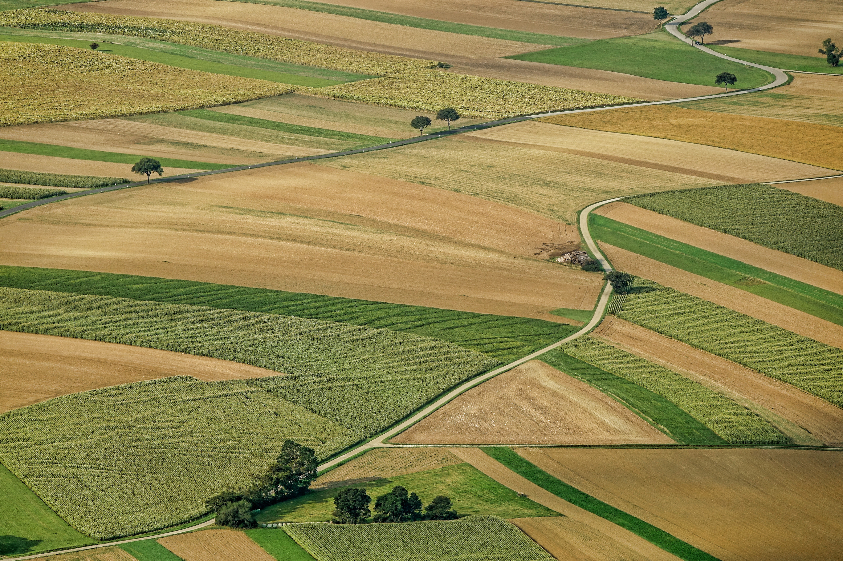

Green IT
TP 1
Compar’AI
Presented by
Elseline Zonon
Sivasankar BHUSARAM

Slide 2
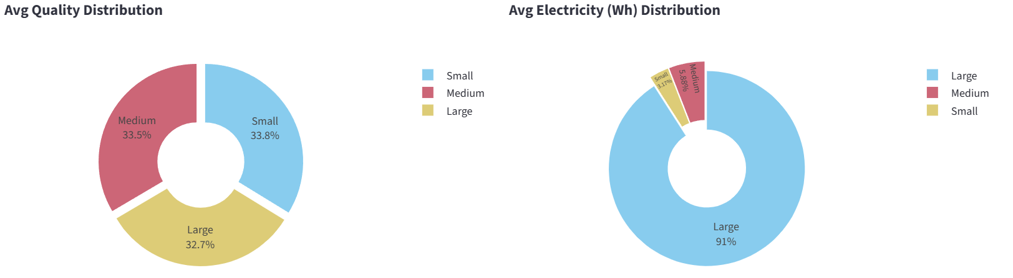
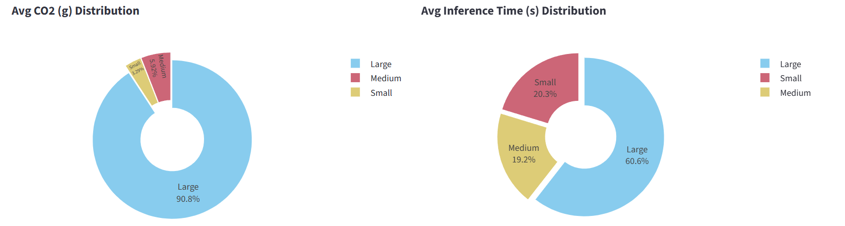
View by model - category
General view
Here we can see the different average quality, electricity consumption , average CO2 and average inference time per model category.
The visualization shows that Medium models combine quality, speed, and low energy impact, Small models are very efficient but slightly less powerful, and Large models offer high quality at the cost of high energy and CO₂ consumption.

Slide 3
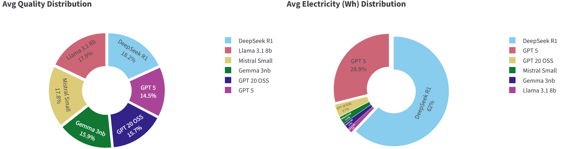
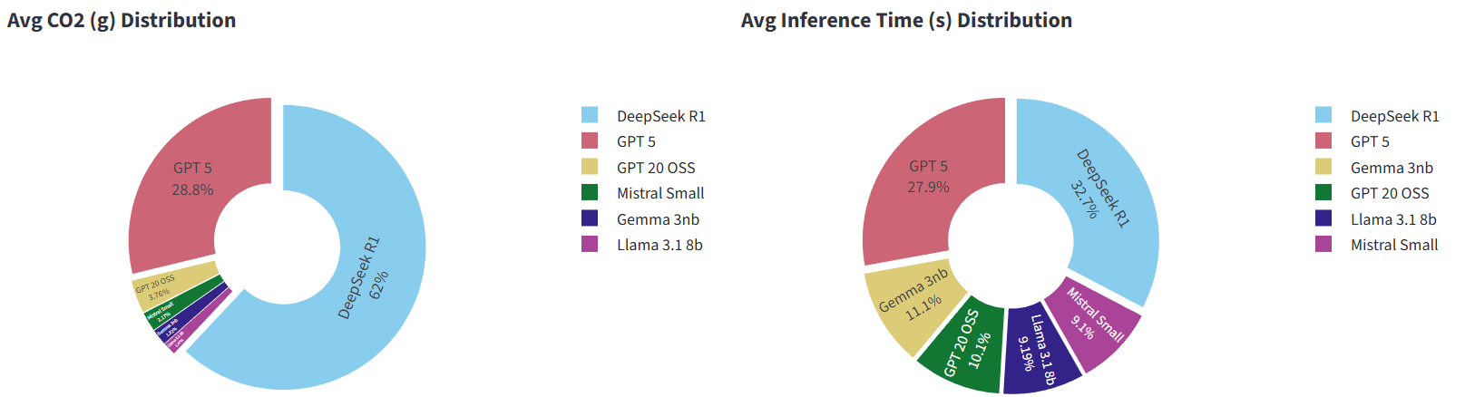
View by model
General view
Here we can see the different average quality, electricity consumption , average CO2 and average inference time per model category.
Deepseek proves to be the most resource-intensive while offering quality.

Slide 4
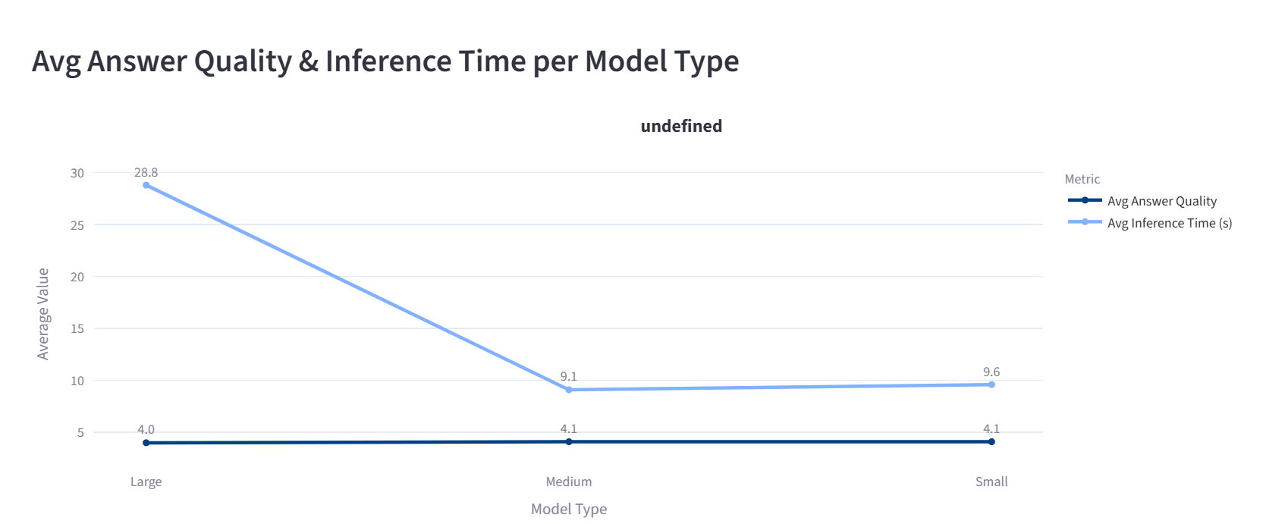
General
view
The visualization shows that Medium models offer the best compromise between average response quality and inference time, while Large models are slower without a proportional gain in quality.

Slide 5
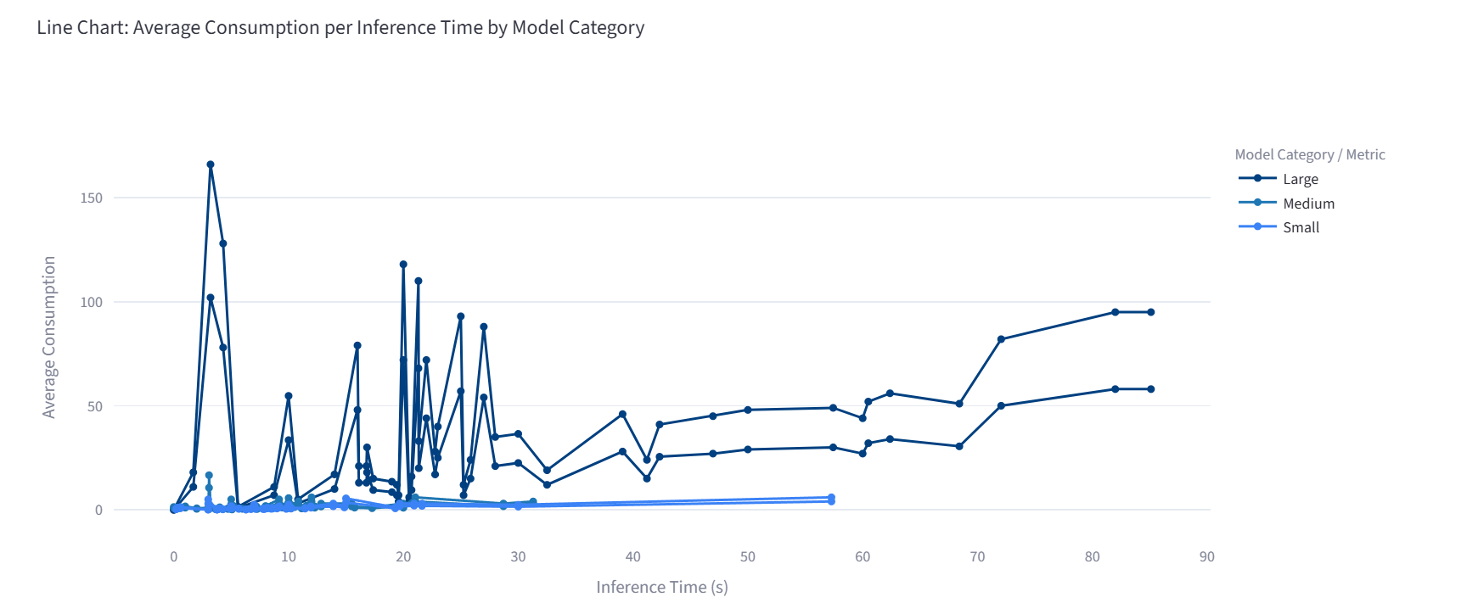
The visualization shows that average inference consumption increases with model size, being low for Small models, moderate for Medium models, and very high for Large models.

Slide 6
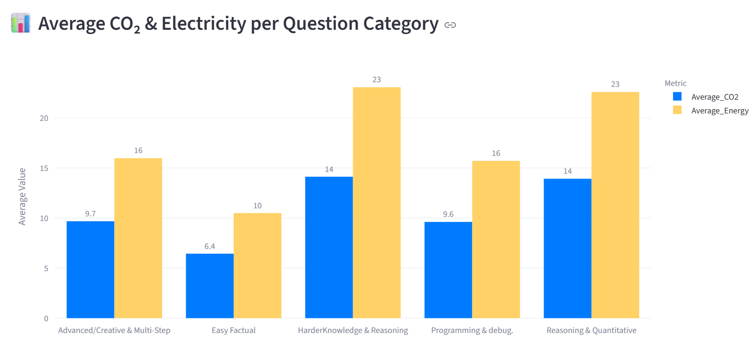
Part 2:
The visualization reveals that simple questions generate little carbon footprint and electricity consumption, while complex or multi-step questions lead to a significant increase in electricity consumption and CO₂ emissions, especially for large models.
Prioritizing

Slide 7
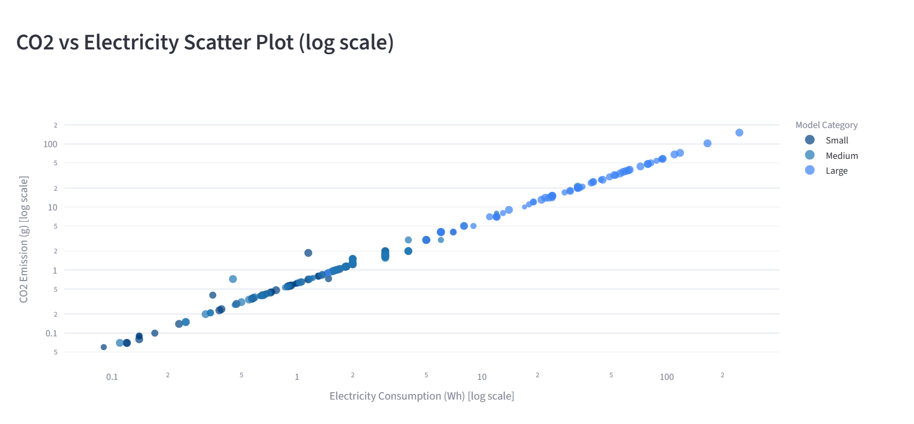
View by model
Here we can see the consumption CO2 and electricity per model type.

Slide 8
Green IT
Conclusion
This analysis highlights the relationship between language model performance and their environmental impact.
The results show that Medium models offer the best balance between quality, execution speed, and carbon footprint, making them the optimal choice for most use cases.
Conversely, Small models are distinguished by their energy efficiency, although they may have certain limitations in terms of accuracy on complex tasks, reasoning for example.
But, Large models, although powerful and effective on advanced question, they have a high ecological cost, which raises questions about their relevance for everyday use.

