Slide 1
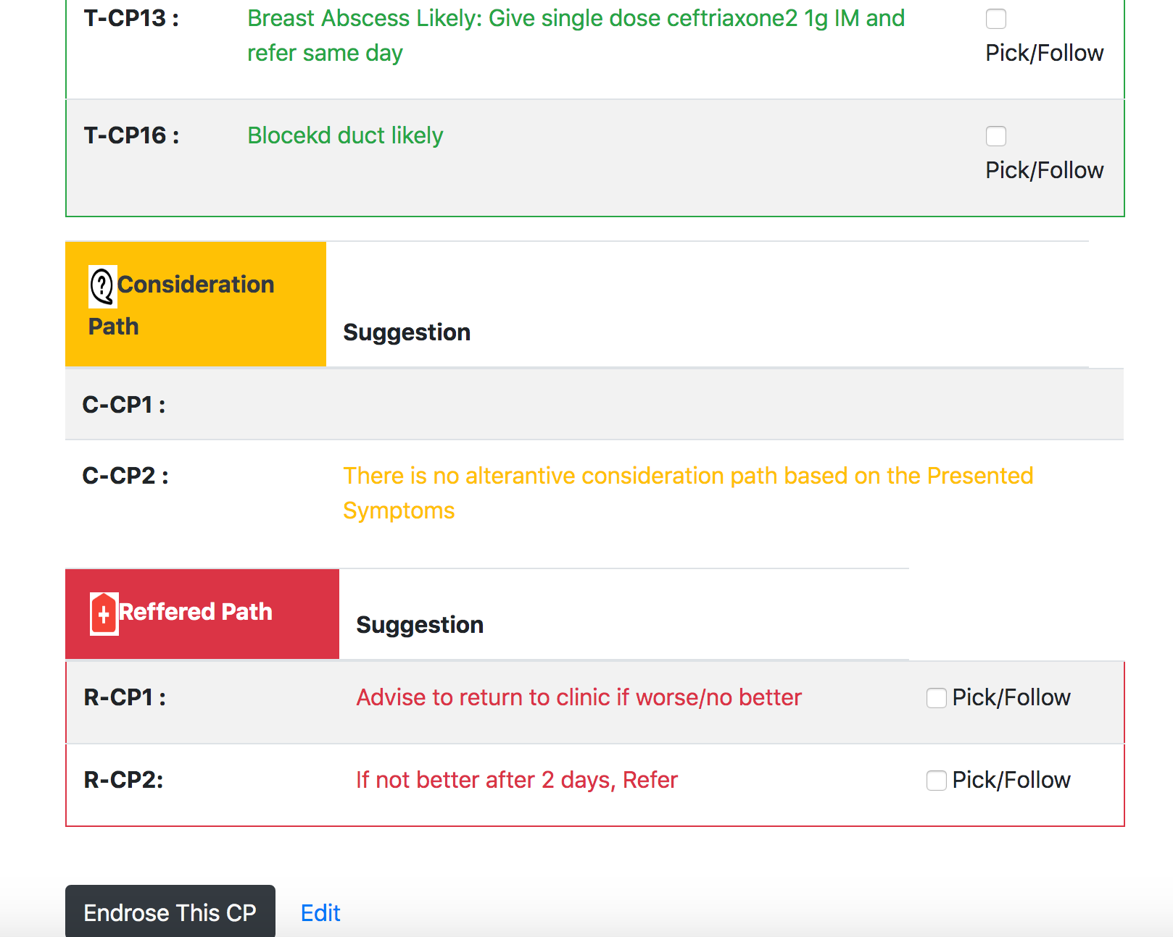

Wireless Feto-maternal Vital Sign Monitoring and Follow-up for Resource Limited Setting
Dr. Rediet Adamu¹, Geletaw Sahle², Zegeye Kelkilew³,Yeneneh Yirga¹ and Gizat Molla⁴ ¹Medical Doctor at JUSH Department of Surgery,, ²Ph.D Fellow VUB, Belgium & Lec. JiT , ³ Senior Software Developer , ⁴ Ph.D and Research Assistant in University of South Australia
INTRODUCTION
In a constrained environment:
Following the paper-based clinical guideline is a traditional practice and the only choice utmost,
The service is challenged to deliver accurate and inadequate evidence for decision making, and
The service is suboptimal.
The chosen context:
Addressing the Top-N diseases that challenges the health professional at Jimma health center (Ethiopia).
(At the moment): Pregnant patients and breast symptoms but the solution can be easily generalized to other contexts.
Challenges:
Infrastructure, data readiness, adaptability and so on
METHOD
Step 1: Conducting Case Study
site selection, verification and service assessment
understanding the context & prioritize the diseases
understanding the CGs & working principles
Step 2: Designing the CDSS-CP
Input Design
didn’t promote lengthy inputs rather try to promote inputs based on options, combo box, drop down selection and so on to minimize input error, and
ease of access and comfortable usability from mobile and tablet device,
Path Generation
Followed 2 approaches
CG based
Learning from data (on-going)
Generate the N possible paths (plan of care) based on the inputs
Output: treatable, referred and consideration path.
Techniques: Rule-Based
Currently: Probabilistic Model Experimented
Path Visualization
Color coded: green, yellow and red colored coded visualization is used/adopted for treatable, consideration and referred path respectively
Path Selection
Picking the optimal pathway based on
rules and principles
cost and time
patient preference
Step 3: Feedback
to build adaptive model
RESULTS
The CDSS-CP:-
Input: collecting the sign and symptoms. Since; the focus is on low resource setting, the CDSS-CP:
didn’t promote lengthy inputs rather try to promote inputs based on options, combo box, drop down selection and so on to minimize input error, and
try to promote ease of access and comfortable usability from mobile and tablet device,
Path Exploration: Based on the input the CDSS-CP try to generate the N possible paths (plan of care) i.e. treatable, referred and consideration path.
Currently: Rule-Based & Probabilistic Model Experimented
Path Visualization: green, yellow and red colored coded visualization is used/adopted for treatable, consideration and referred path respectively.
Picking (Following) the optimal Path:
.
PRINTING
Illini Union Document Services can print posters on a variety of materials, including fabric and polypropylene. For pricing and other information, contact Document Services at 217-333-9350 or send an e-mail.
Plan ahead; allow three business days to complete the order. Other dimensions are available; the charge is by square foot.
Captions set in a serif style font such as Times, 18 to 24 size, italic style.
Duis autem vel eum iriure dolor in hendrerit in vulputate velit esse molestie consequat.
Captions set in a serif style font such as Times, 18 to 24 size, italic style.
Duis autem vel eum iriure dolor in hendrerit in vulputate velit esse molestie consequat.
CONCLUSIONS
We have created this template with scientific researchers in mind and with the help of feedback we have received. We encourage any comments or suggestions so that we can continue to update and improve this template. To make a suggestion contact:
creativeservices@illinois.edu
AIMs
This research (in progress paper) addresses to:
Introduce a low cost automated clinical pathway in low resource setting
The clinical decision support system clinical pathway (CDSS-CP) will promote an automated, interactive, applicable & adaptive principles.
Assist the organization of the care processes by
generating the pathway or plan of care for treatment or referral service
based on AI
assisting to pick/follow the optimal path or care map
without
Deliver optimal care by:
Reducing delay,
Minimizing cost, and
Improving patient outcomes.
Captions set in a serif style font such as Times, 18 to 24 size, italic style.
Duis autem vel eum iriure dolor in hendrerit in vulputate velit esse molestie consequat.
Captions set in a serif style font such as Times, 18 to 24 size, italic style.
Duis autem vel eum iriure dolor in hendrerit in vulputate velit esse molestie consequat.
Fig. CDSS-CP Visualization Dashboard
ACKNOWLEDGEMENT
MD4SG for the travel grant
NASCERE(Network for Advancement of Sustainable Capacity in Education and Research in Ethiopia) program who have assisted us in the work to date and will continue to assist us as we move forward with the planned activities.
Our collaborator Prof. Jef Van den Ende from the Universiteit Antwerpen.
Captions set in a serif style font such as Times, 18 to 24 size, italic style.
Duis autem vel eum iriure dolor in hendrerit in vulputate velit esse molestie consequat.
Captions set in a serif style font such as Times, 18 to 24 size, italic style.
Duis autem vel eum iriure dolor in hendrerit in vulputate velit esse molestie consequat.

Slide 2






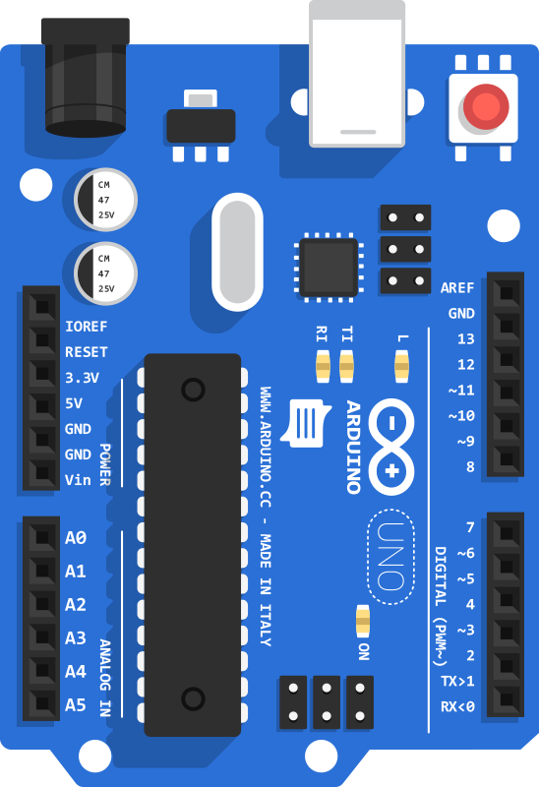

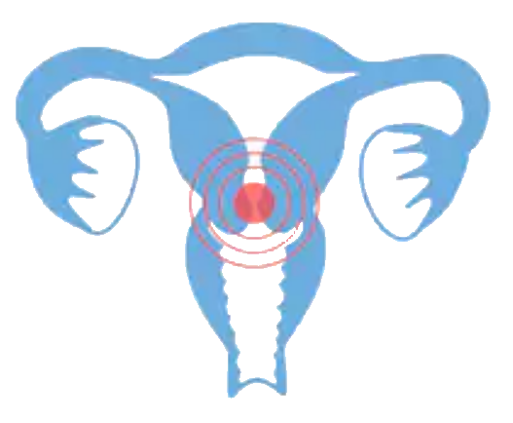










Wireless Feto-maternal Vital Sign Monitoring and Follow-up for Resource Limited Setting
Dr. Rediet Adamu¹, Geletaw Sahle², Zegeye Kelkilew³,Dr. Yeneneh Yirga¹ and Gizat Molla⁴ ¹Medical Doctor at JUSH Department of Surgery,, ²Ph.D Fellow VUB, Belgium & Lec. JiT , ³ Senior Software Developer , ⁴ Ph.D and Research Assistant in University of South Australia
Introduction
Hardware & Software Components
Method
Maternal and neonatal mortality related to childbirth is one of the big challenges of the developing world and its reduction is a key international development goal.
Fetal heart rate, uterine contraction, maternal blood pressure, body temp, heart-rate and oxygen concentration are crucial in determining the wellbeing of a laboring mother and the fetus.
Many of the defacto feto-maternal monitoring instruments such as Cardiotocography (CTG) are expensive, grid dependent and hard to maintain.
Our idea is to construct a wireless feto-maternal vital sign monitoring and alerting system for low-resource setting.
In which sensors are attached to a laboring mother non-invasively, collects vital sign data in real-time.
After the real-time data is being processed by the rechargeable battery powered microprocessor and later sent for visualization in a wireless manner for a health care professional or a central nurse station.
The visualization is based on the WHO standard known as the partogram which is a composite graphical depiction of key data during labor, which can be viewed by mobile phones, tablets and computers in a wireless manner.
Maternal Heart Rate & SpO2
Maternal Body Temp
Maternal Blood Pressure
1
2
Vital-sign collection
FHR → piezo based contact microphone
UC → surface electrode
MHR → MAX10302 optical biosensor
MBT → Thermistor
MBP → air-pressure sensor
Signal Processing
FHR → Band pass filter
UC → Band pass filter
Ensures noise cancelation and better signal quality
Fetal Heart Rate
4
3
Rechargeable Power Source
Data Transmission
All the logged data is sent to the central system via wireless manner (wifi or 3G)
Ensures the data reached to the central system in real-time.
Data Logging
All processed data will be stored to SD card module with timestamp before its sent.
Ensures data persistency
Microcontroller
Uterine Contraction
Real-time Data logger
5
Real-time Dashboard
Data Analytics &Visualization
All data is sent to a Real-time Database → InfluxDB
Analytics & Visualization →Graphana
Ensures a meaningful representation of the collected data
Aims
Wireless Communication Medium
Reference
Introduce a low cost, portable vital-sign monitoring device in low resource setting
The device will promote an automated, accurate, and efficient vital sign collection.
Assist the health care process by:
Automating the vital-sign collection and monitoring based on Internet of Things.
Reducing health care professional burnout
Deliver optimal care by:
Reducing errors in the vital-sign collection.
Producing a real-time vital-sign data of the fetus and the mother to the health care professional at his/her vicinity.
Minimizing cost of device ownership, and
Improving patient outcomes
Active alerting upon occurrence of risky vital signs
Sensors variety, cost and accuracy increased tremendously to attain low cost device
3D printing became more available and cheap
Lawn JE, Kinney M, Lee AC,CM, Donnay F, Paul VK, Bhutta ZA, M and Darmstadt GL, “Reducing intrapartum-related deaths and disability: can the health system deliver”, 107 supplement 1:s123-40, s140-2. Doi: 10.1016, Oct 2009.
Aamir Sweha, M.D., and Trevor W. Hacker, M.D., Mercy healthcare Sacramento, California, Jim Nuovo, M.D., University of California Davis, school of Medicine, Davis, California, “Interpretation of the electronic fetal heart rate during labour”, 59(9):2487-2500, May 1 1999.
Vichal P.M, Appaji M Abhishek, Dr. Manish Arora “Device for Intrapartum Materno-Fetal care” , 6(8): 1217-1223, Aug 2015.
Captions set in a serif style font such as Times, 18 to 24 size, italic style.
Duis autem vel eum iriure dolor in hendrerit in vulputate velit esse molestie consequat.
Mobile Phone
Real-time Database and Data Processing
Tablet
Future Directions
Integrate Cervical Dilatation optical measurement to the initial design.
Integrate Artificial Intelligence for labor predication.
Produce final all in one prototype.
Large scale production of the device.
Finding a business strategy for its sustainability.
Acknowledgment
The authors acknowledges Armauer Hansen Research Institute (AHRI)
For organizing Grand Challenge Ethiopia for funding this project, Jimma University for being a host institution and Bill & Melinda Gate foundation for sponsoring this event.
Captions set in a serif style font such as Times, 18 to 24 size, italic style.
Duis autem vel eum iriure dolor in hendrerit in vulputate velit esse molestie consequat.
Captions set in a serif style font such as Times, 18 to 24 size, italic style.
Duis autem vel eum iriure dolor in hendrerit in vulputate velit esse molestie consequat.
Get this poster at:
Contact: Dr. Rediet Adamu, rediet.adamug@gmail.com, Jimma University, Ethiopia.

