Slide 1
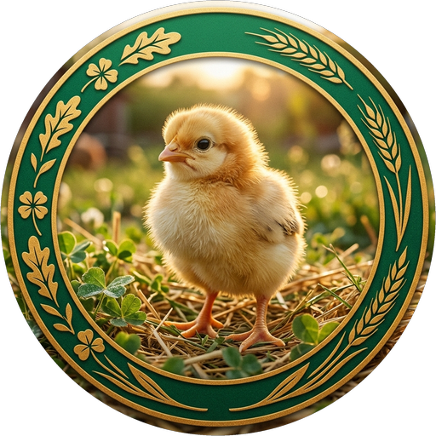
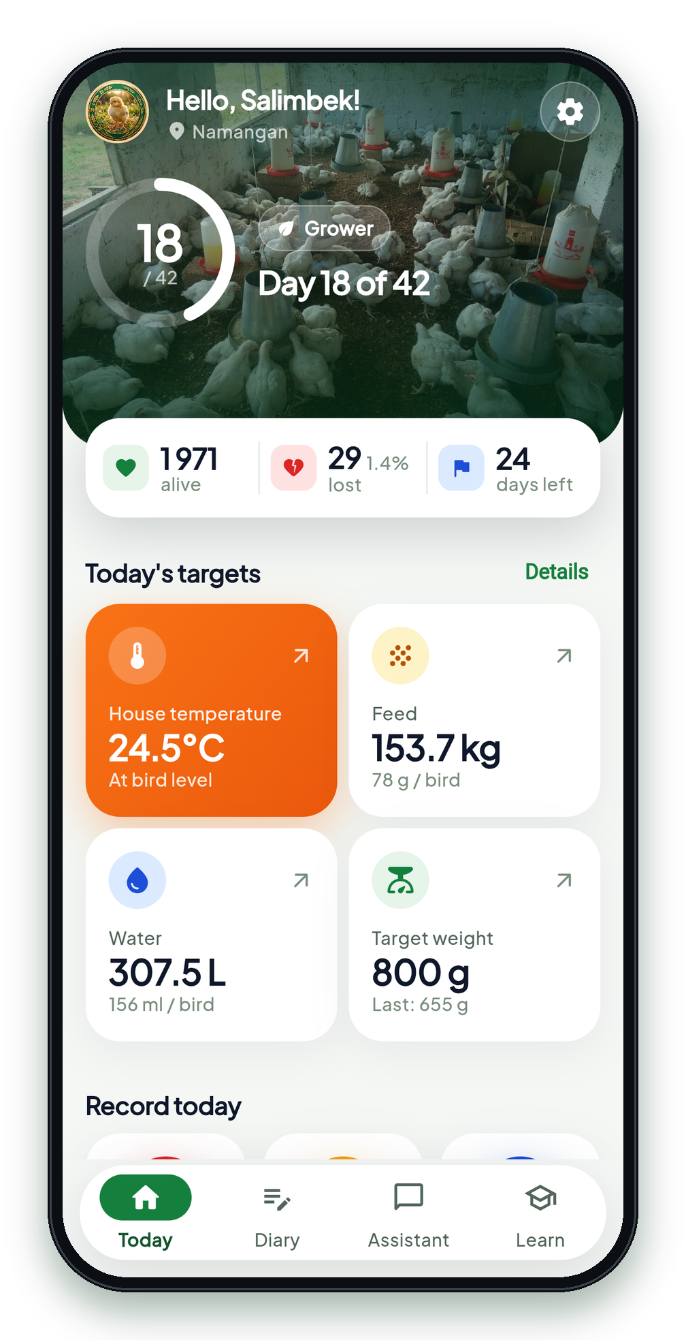
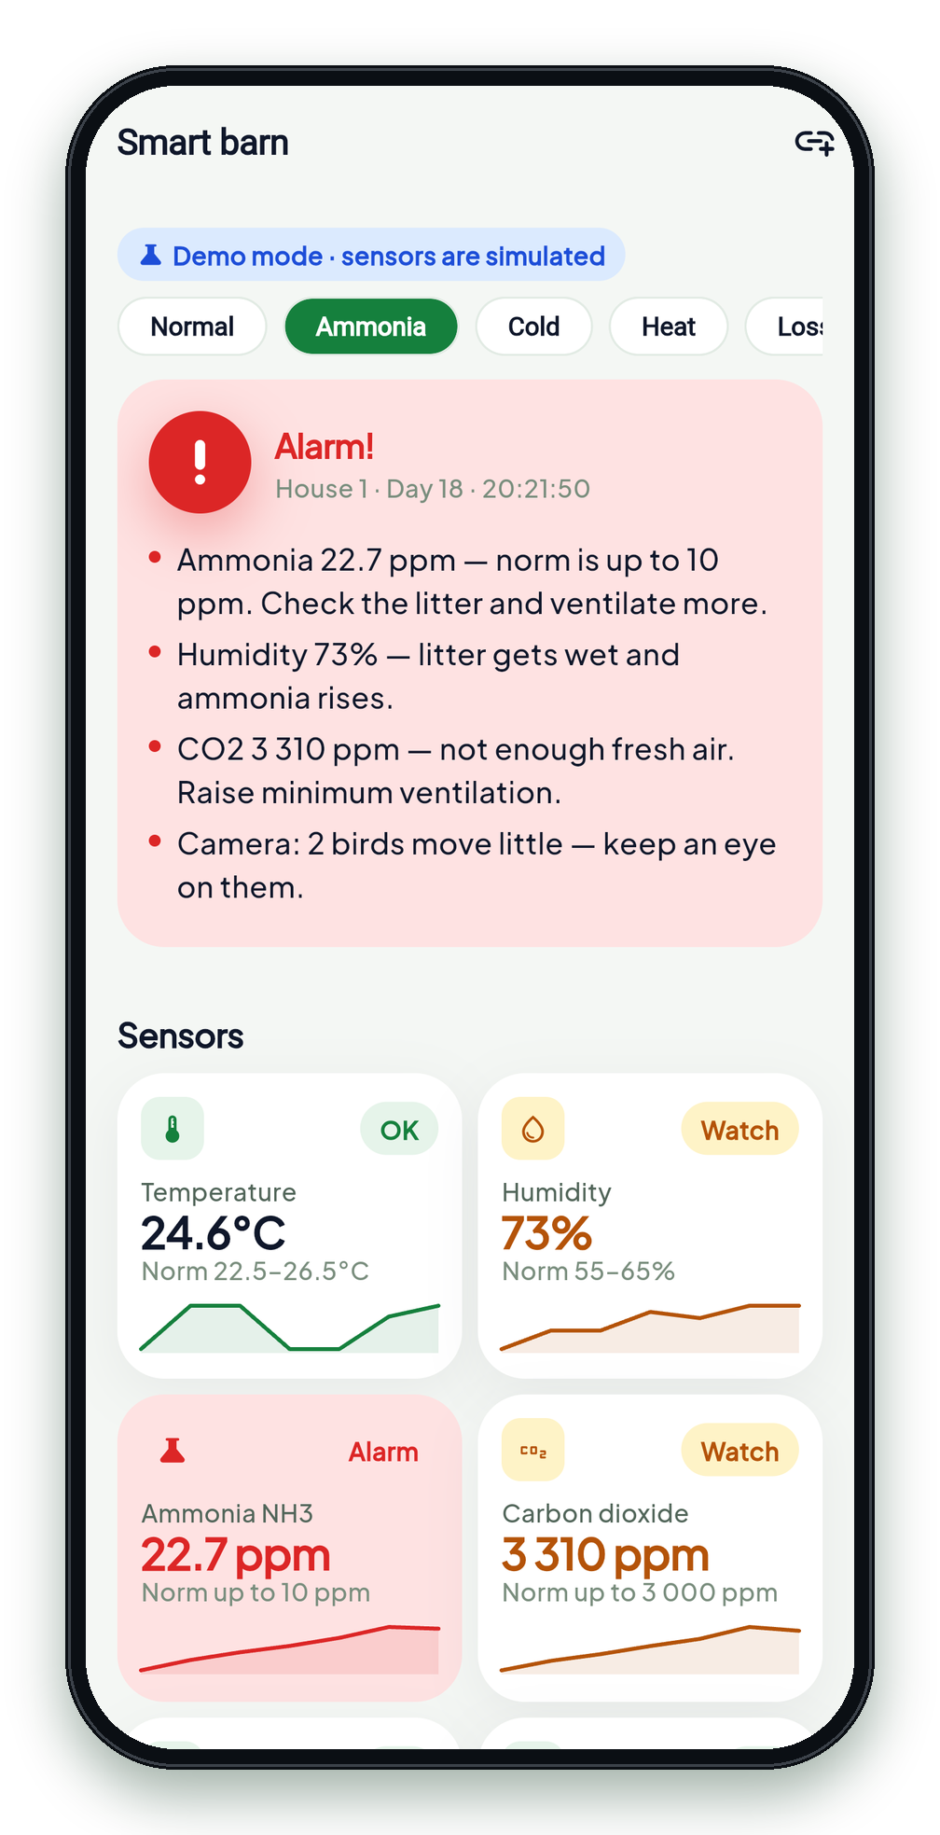
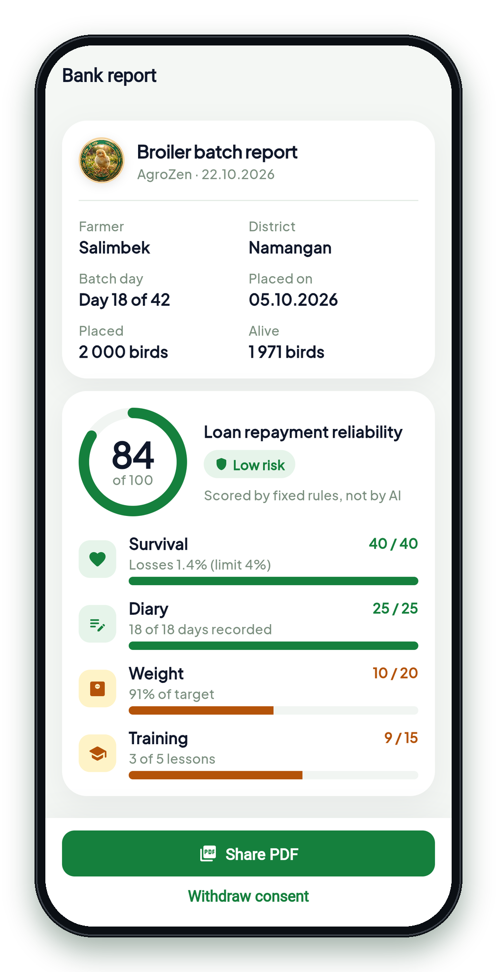
STUDEXPO-2026
Mobile apps and artificial intelligence
AgroZen
An AI mentor in your smartphone for beginner poultry farmers
Working MVP · Android
3 languages
Works offline
Smart barn sensors
Reports for banks
Salimbek Zamalitdinov · Ulugbek Kodirov
Namangan State Technical University
Notes:
AgroZen is a working Android app: an AI mentor that guides a beginner broiler farmer through the 42-day cycle. New this autumn: a smart-barn monitor for sensors and AI cameras, and reports for banks.

Slide 2
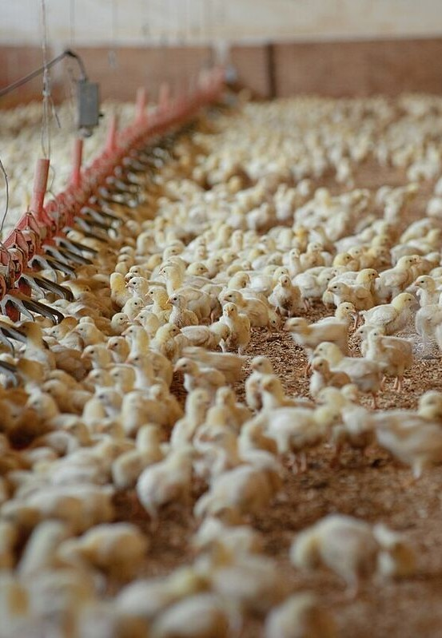



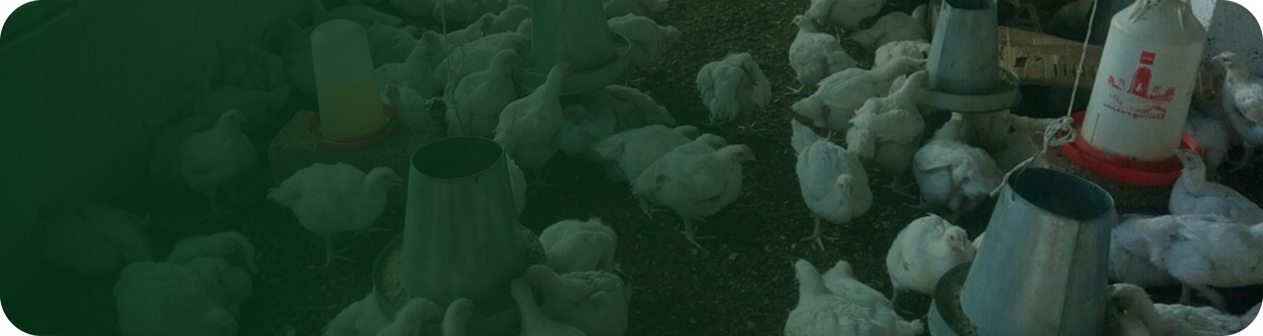

THE PROBLEM
Loan taken, flock lost
No knowledge
A beginner doesn't know the norms for temperature, feeding and vaccination.
The first 14 days are the most dangerous
One microclimate mistake leads to mass mortality — and nobody measures ammonia or CO2.
The specialist is far away
There is no vet nearby at the moment a question comes up.
2017
Families got loans to raise chickens. Reportedly, many couldn't repay, and banks cut such loans.
The birds are gone. The debt remains.
People lose money not because of laziness, but because of mistakes no one warned them about.
From 1 August 2026
Concessional poultry loans are back: up to 10 years at 10% a year.
2
Notes:
2017: chicken loans for low-income families went wrong. From August 2026 the state again gives concessional poultry loans. A beginner without knowledge loses the flock in the first two weeks and keeps the debt.

Slide 3

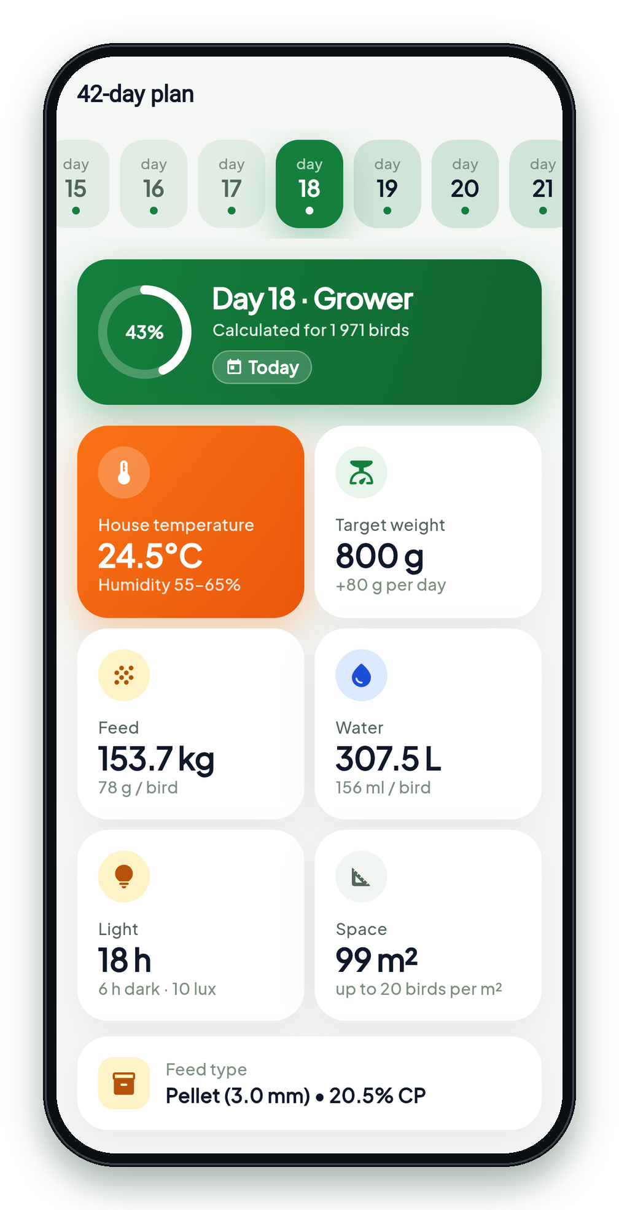
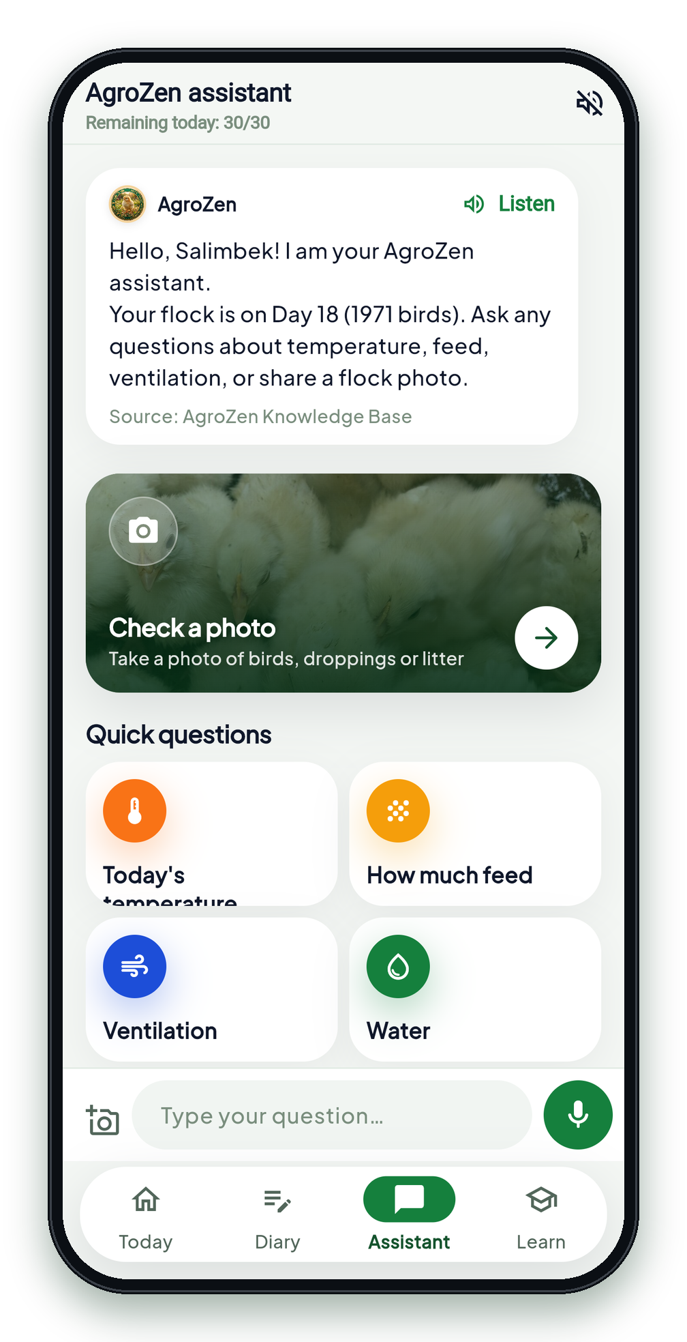
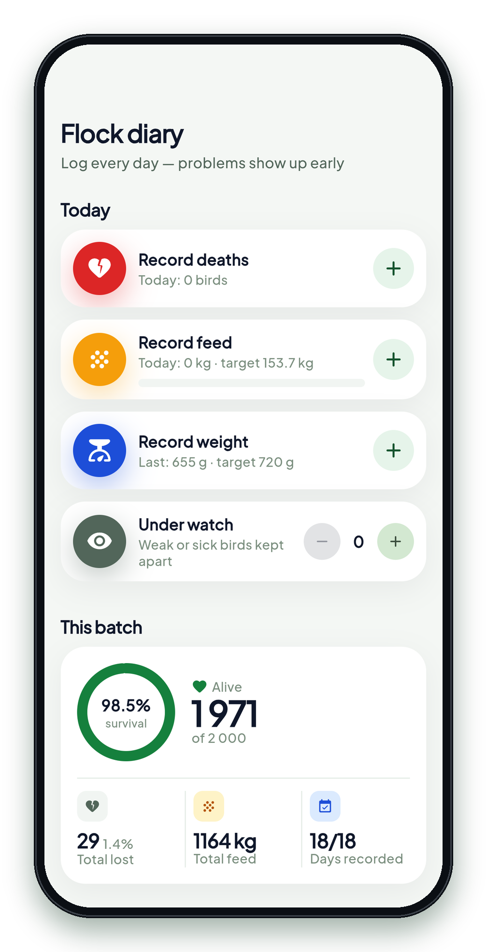
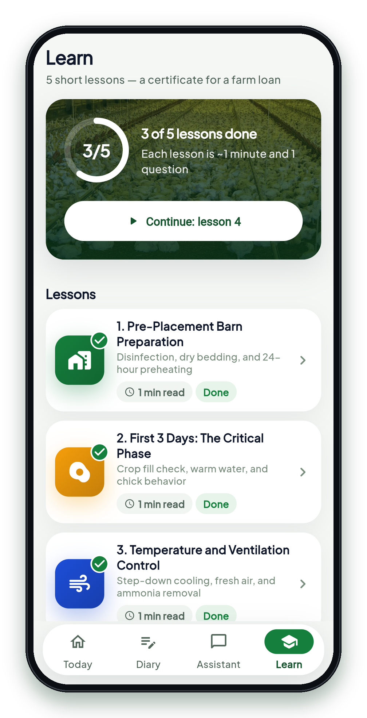





THE SOLUTION
AgroZen guides the farmer through all 42 days
Today
Targets for temperature, feed and water
42-day plan
Ross-308 / Cobb-500 for every day
AI assistant
Voice, text or photo, in your language
Flock diary
Losses above the norm: the vet's number
Course
5 lessons and a certificate for a loan
3
Notes:
Five screens a farmer uses every day: today's targets, the 42-day plan, the AI assistant that answers by voice, the diary with alerts and the course that ends with a certificate for a concessional loan.

Slide 4
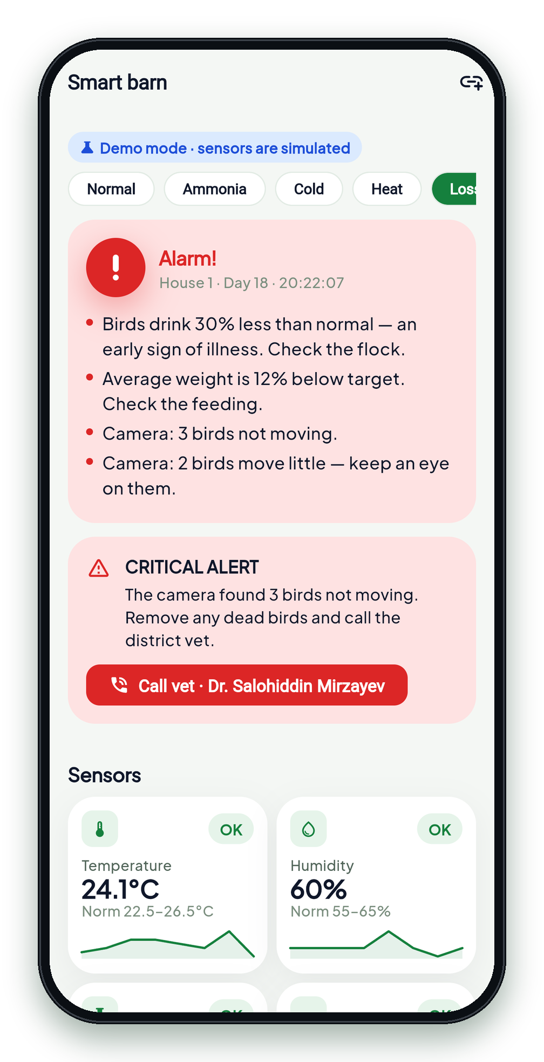
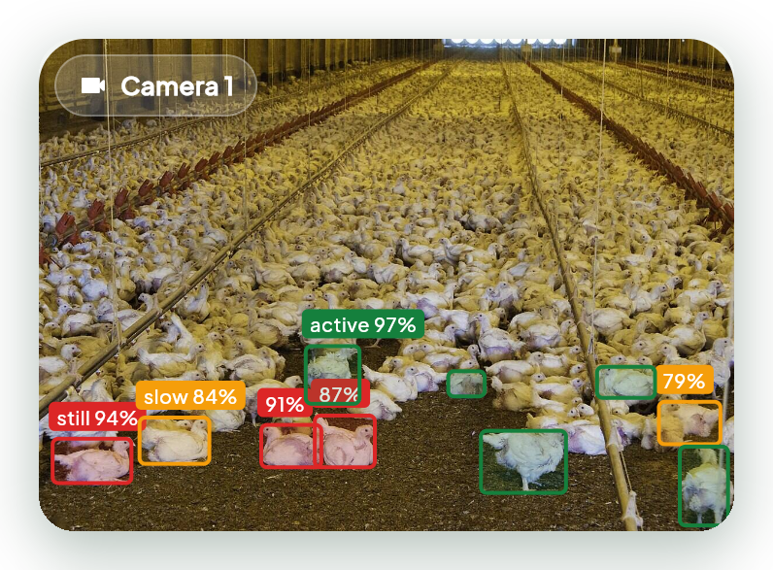


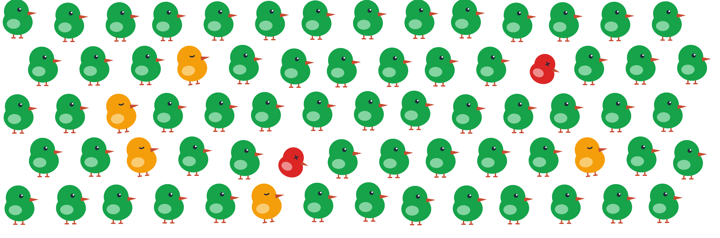




NEW · SMART BARN PROTOTYPE
The AI camera colours every bird by its health
Active
Moves, eats and drinks
Moving little
An early sign: watch it
Not moving
Remove it, call the vet
Flock at a glance
ESP32 sensors
Jetson edge AI
Ross-308 rules
Alert · vet · fans
63 active · 5 watch · 2 not moving
NH3 up to 10 ppm · CO2 up to 3 000 ppm · fans switch on by themselves. Demo mode today; hardware goes into two pilot farms in 2027.
4
Notes:
In the app open Smart barn and press 'Losses'. The camera colours every bird: green is active, amber moves little and needs watching, red has stopped moving — and the vet's number appears. Press 'Ammonia' to show the sensors: NH3 passes 10 ppm and the fans switch on. All checks are plain code against the Ross-308 norms.

Slide 5
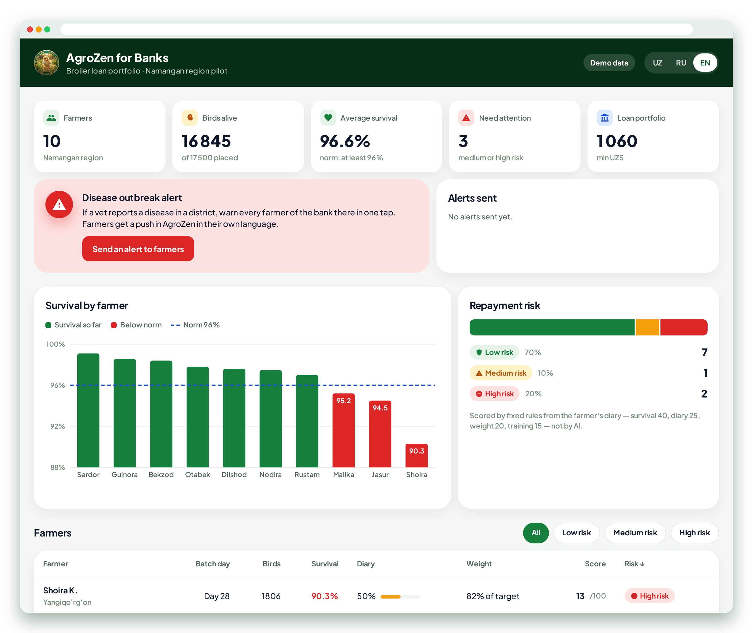



NEW · FOR BANKS
Banks see how the flock is doing — and trust the loan
Farmer's consent
Built from the diary, sent as a PDF only after the farmer agrees.
Score 0–100
Survival, diary, weight, training: fixed rules, not AI.
Disease alert
One tap warns every farmer of the bank in a district.
Free for farmers. Banks and microfinance pay: a trained farmer is more likely to repay.
Bank dashboard: 10 pilot farmers, survival against the norm, risk and a district disease alert
5
Notes:
The farmer agrees, and the app turns the diary into a one-page PDF with a score out of 100. The bank's dashboard shows all its farmers: who is on track, who needs attention, and it can warn every farmer in a district about a disease. This is how AgroZen pays for itself.

Slide 6









THE RESULT
Not a concept: the app already works
AgroZen assistant
Answers only from a verified knowledge base
42 days
of norms, one plan for every day
5 lessons
a course with tests and a certificate
My chicks are crowding under the heater. What should I do?
voice · text · photo
That is a sign of cold. On day 3 the house should be 31.5°C — raise the heating and check that the chicks spread evenly.
Source: AgroZen knowledge base · Ross-308
13 regions
vet contacts across Uzbekistan
260 tests
check norms, alerts and scores
Flutter
Supabase + Gemini
Works offline
uz · ru · en
Not in the base? "Call your district vet."
No diagnoses, no medicines, no dosages — ever.
Alerts are counted by plain code against the norms — they never depend on an AI answer.
6
Notes:
Everything shown is in the Android app today, in three languages and offline. 260 automated tests check the norms, the alerts and the bank score. The assistant answers only from the knowledge base; outside it, it sends the farmer to the district vet and never names medicines.

Slide 7



NEXT STEP
A pilot with 10 farmers and a bank in Namangan region
92–95%
flock survival
80%+
days with diary entries
96%+
AI answers matching the norms
Target figures per flock (42 days).
Sensors and AI cameras in two pilot farms
Download and try it
Android app
zedrubilan.github.io/agrozen
Bank dashboard with real pilot data
Then laying hens, sheep and cattle, greenhouses
Salimbek Zamalitdinov, project lead
+998 93 211 59 13 · salzamov@gmail.com
Thank you!
Notes:
Next: a pilot with ten farmers and one bank in Namangan region, with sensors and cameras in two farms. Scan the QR code to install the app. Thank you!

