Slide 1
AIN SHAMS UNIVERSITY — MSc LITERATURE DEFENSE & ROADMAP
Biomechanical & Neuromuscular Hand Grasp Synergies
From High-DoF Biological Redundancy to Minimal-Actuator Prosthetic & Exoskeleton Control
Researcher: Eng. Mohamed Zedan (Teaching Assistant, BUC — MSc Candidate, Mechatronics Dept., Ain Shams University)
Supervision Committee: Prof. Dr. Mohamed Hamdy Abdelhafez & Dr. Mohamed Ibrahim Awad (Ain Shams University)
Scope Synthesized: 18 Peer-Reviewed Studies & 2026 Benchmarks (2019–2026) | KIN-MUS UJI, Ninapro DB2 & Encord EMG-1
Core Mathematical Anchors: PCA (Kinematic), NMF (Muscular), MMF (Cross-Domain), JGKSE (ORQ/IRQ > 90%) & Simscape Multibody

Slide 2
Problem Statement & Ain Shams Institutional Baseline
2 / 12
Bridging the Curse of Dimensionality in Hand Biomechanics & Clinical Rehabilitation
21–27 DoFs
Human Hand Kinematics
Controlled by 34+ extrinsic/intrinsic muscles
33 Grasps
Feix Grasp Taxonomy
Full ADL precision & power repertoire
85% ± 5.1%
Ain Shams Glove (2021)
Sarwat, Maged & Awad (Sensors 2021)
K_min ≤ 4
Target Actuation Bound
VAF ≥ 90% + Force-Closure Stability
1. The Engineering & Clinical Bottleneck
• Fully actuated dexterous hands (16–22 motors) suffer from excessive weight, cost, high cognitive burden, and prosthetic abandonment.
• Naive 1-DoF grippers fail multi-axis precision grasps and cause compensatory shoulder/trunk motions.
• Purely geometric synergy reduction often sacrifices critical individual joints (thumb opposition & palm arch CMC).
• Raw sEMG amplitude decoders drift across sessions and under changing grip forces (Low/Medium/High).
2. Upgrading the Ain Shams Data Glove (Sarwat & Awad, 2021)
• Department Baseline (MDPI Sensors 2021, Dr. Mohamed I. Awad & Dr. Shady Maged): 10 flex sensors (MCP/PIP), 5 fingertip FSRs, 1 6-axis IMU.
• Achieved 85% (±5.1%) post-stroke rehabilitation classification accuracy using raw supervised ML features.
• Thesis Evolution: Transform this hardware baseline from passive exercise classification into a neuro-mechanical synergy architecture.
• Replace heuristic sensor mapping with rigorous PCA, NMF, MMF, and JGKSE synergy manifolds validated in Simscape.
Ain Shams University | Mechatronics Engineering Dept. | Eng. Mohamed Zedan | Supervised by Prof. Dr. Mohamed Hamdy Abdelhafez & Dr. Mohamed Ibrahim Awad

Slide 3
Supervisors' Core Directives & Research Questions
3 / 12
Strict Mathematical & Biomechanical Framing (Prof. Dr. Mohamed Hamdy & Dr. Mohamed I. Awad)
RQ1: Cross-Domain Kinematic–Muscular Coupling
• Question: What is the biomechanical & mathematical relationship linking joint Kinematic Synergies (S_kin) and forearm Muscle Synergies (W_EMG) across Feix grasp taxonomies?
• Kinematic Decomposition: Q - Q_bar = U * Sigma * V^T (PCA eigengrasps)
• Muscular Decomposition: min || E_EMG - W * H ||_F^2 s.t. W >= 0, H >= 0 (NMF)
• Cross-Domain Bridge: Mixed Matrix Factorization (MMF) jointly factorizes signed angles & non-negative sEMG into shared activations H_shared.
RQ2: Minimal Actuators & Mechanical Stability
• Question: What is the minimum number of actuators / DoFs (K_min ≤ 4) sufficient to reproduce daily grasps with VAF ≥ 90% and high mechanical stability?
• Global Fidelity Criterion: VAF(K) = (1 - ||Q - Q_hat||_F^2 / ||Q||_F^2) * 100% ≥ 90%
• Local Joint Fidelity (JGKSE): Overall ORQ > 90% AND Individual IRQ_i > 90% for ≥ 90% of joints (preserving thumb & CMC joints).
• Stability Verification: Contact force closure & slip resistance verified in Simulink / Simscape Multibody.
Strict Scope Constraints & Reference Benchmarks
• Methodological Scope: Zero 'gadget / graduation project' framing — strictly focused on neuro-biomechanical synergy extraction, dimensionality bounds, and dynamic force-closure validation.
• Multi-Dataset Cross-Validation: KIN-MUS UJI (28 subjects, 26 ADLs, 18 CyberGlove DoFs + 7 sEMG — locally analyzed), Ninapro DB2 (28 subjects, 20 grasps via MMF), and Encord EMG-1 (8ch-mocap, 2000 Hz sEMG + 120 Hz OptiTrack).
Ain Shams University | Mechatronics Engineering Dept. | Eng. Mohamed Zedan | Supervised by Prof. Dr. Mohamed Hamdy Abdelhafez & Dr. Mohamed Ibrahim Awad

Slide 4
Pillar 1: Kinematic Synergies & Subspace Invariance
4 / 12
Proving Low-Dimensional Linear Subspaces Across Large Cohorts & Dexterous Tasks
Study | Cohort & Setup | Method | Verified Dimensionality & Variance Findings
Jarque-Bou et al. (2019) JNER | 77 subjects, 20 grasps, 17-DoF CyberGlove II | PCA kinematic synergies | First 3 PCs explain >50% variance; 12 PCs explain >80%. Defines universal palmar flexion & thumb opposition primitives.
Bazina et al. (2024) MDPI Robotics | KIN-MUS UJI dataset: 23 ADLs, 16 finger DoFs | Inter-joint linear dependency (30 clusters) | Reduces 16 flexion/extension DoFs by up to 11 DoFs, leaving 5–15 independent DoFs (median 12) across ADLs.
West & Hogan (2024) IEEE BioRob | 7 subjects, 19-DoF glove @ 200 Hz (Wire-harness) | PCA + VAF grasp vs. tool use | First 2 PCs explain >80% variance in reach-to-grasp; active manipulation adds DoFs atop the shared grasp core.
West & Hogan (2025) IEEE ICRA | 20-DoF kinematics: 7 wire- harness + 5 expert pianists | VAF-CI & Subspace Principal Angles | First 3–4 kinematic synergies span a statistically invariant subspace at VAF ≥ 90% (<5% marginal gain) — Anchors K_min ≤ 4.
Key Takeaway for RQ2
• West & Hogan (2025) VAF-CI geometry proves that across both industrial manufacturing (wire-harness) and extreme dexterity (classical piano), a conserved 3-to-4 dimensional synergy basis captures the essential biomechanical workspace — mathematically justifying K_min ≤ 4.
Ain Shams University | Mechatronics Engineering Dept. | Eng. Mohamed Zedan | Supervised by Prof. Dr. Mohamed Hamdy Abdelhafez & Dr. Mohamed Ibrahim Awad

Slide 5
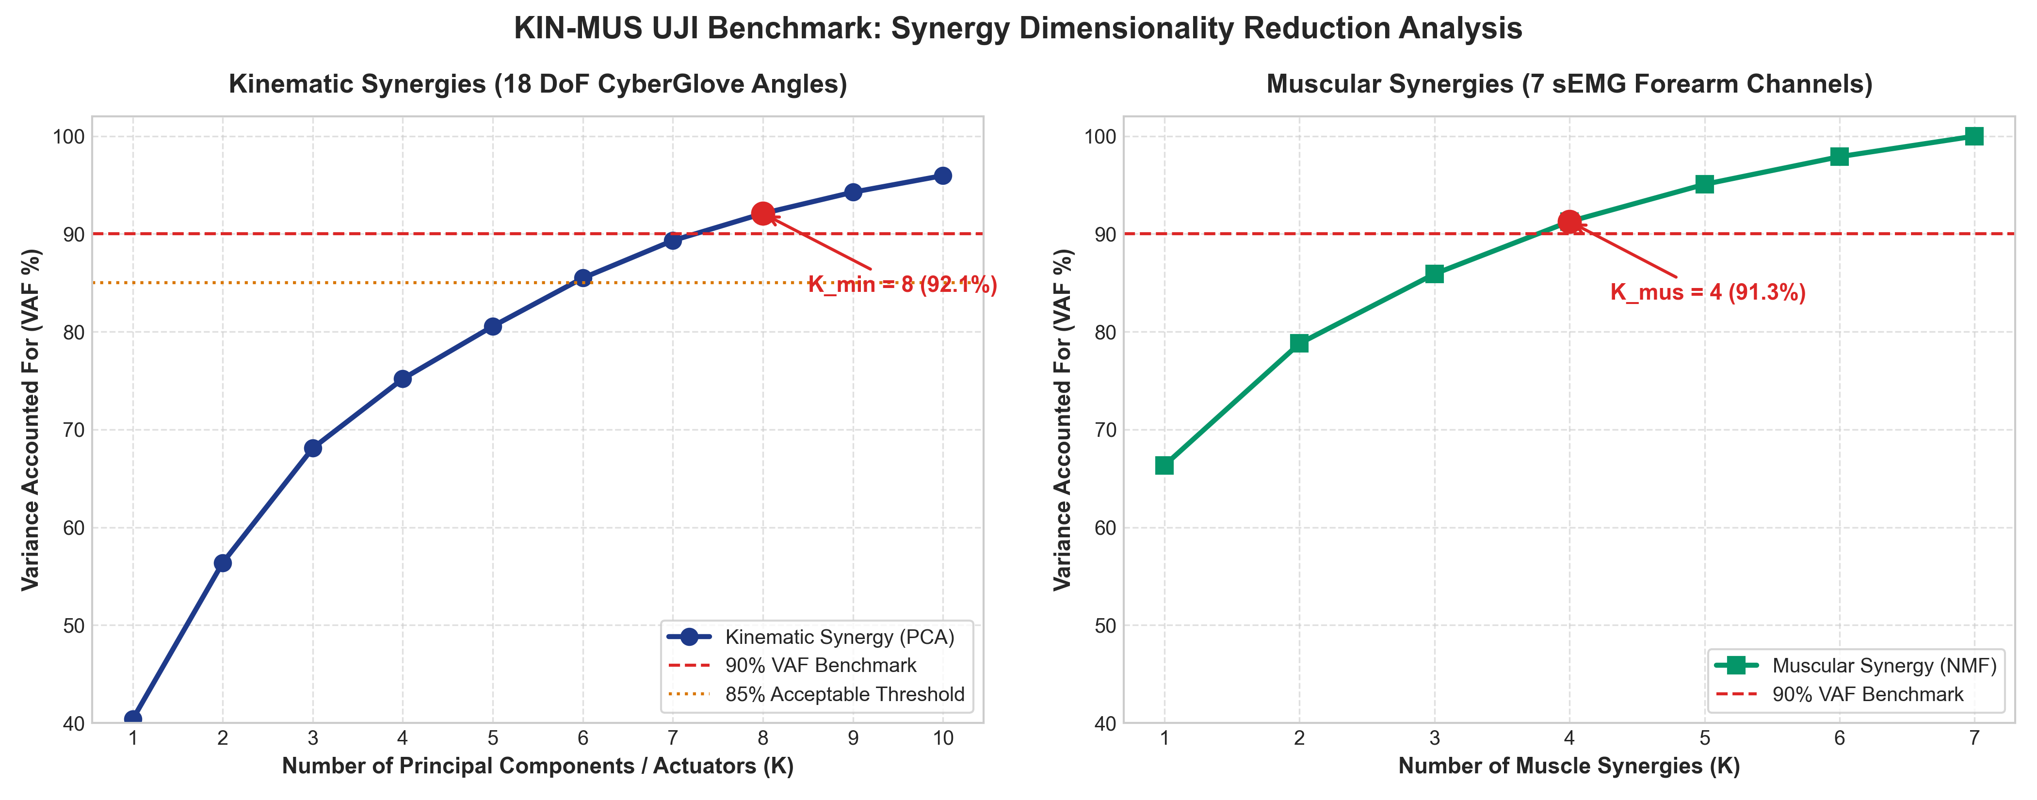
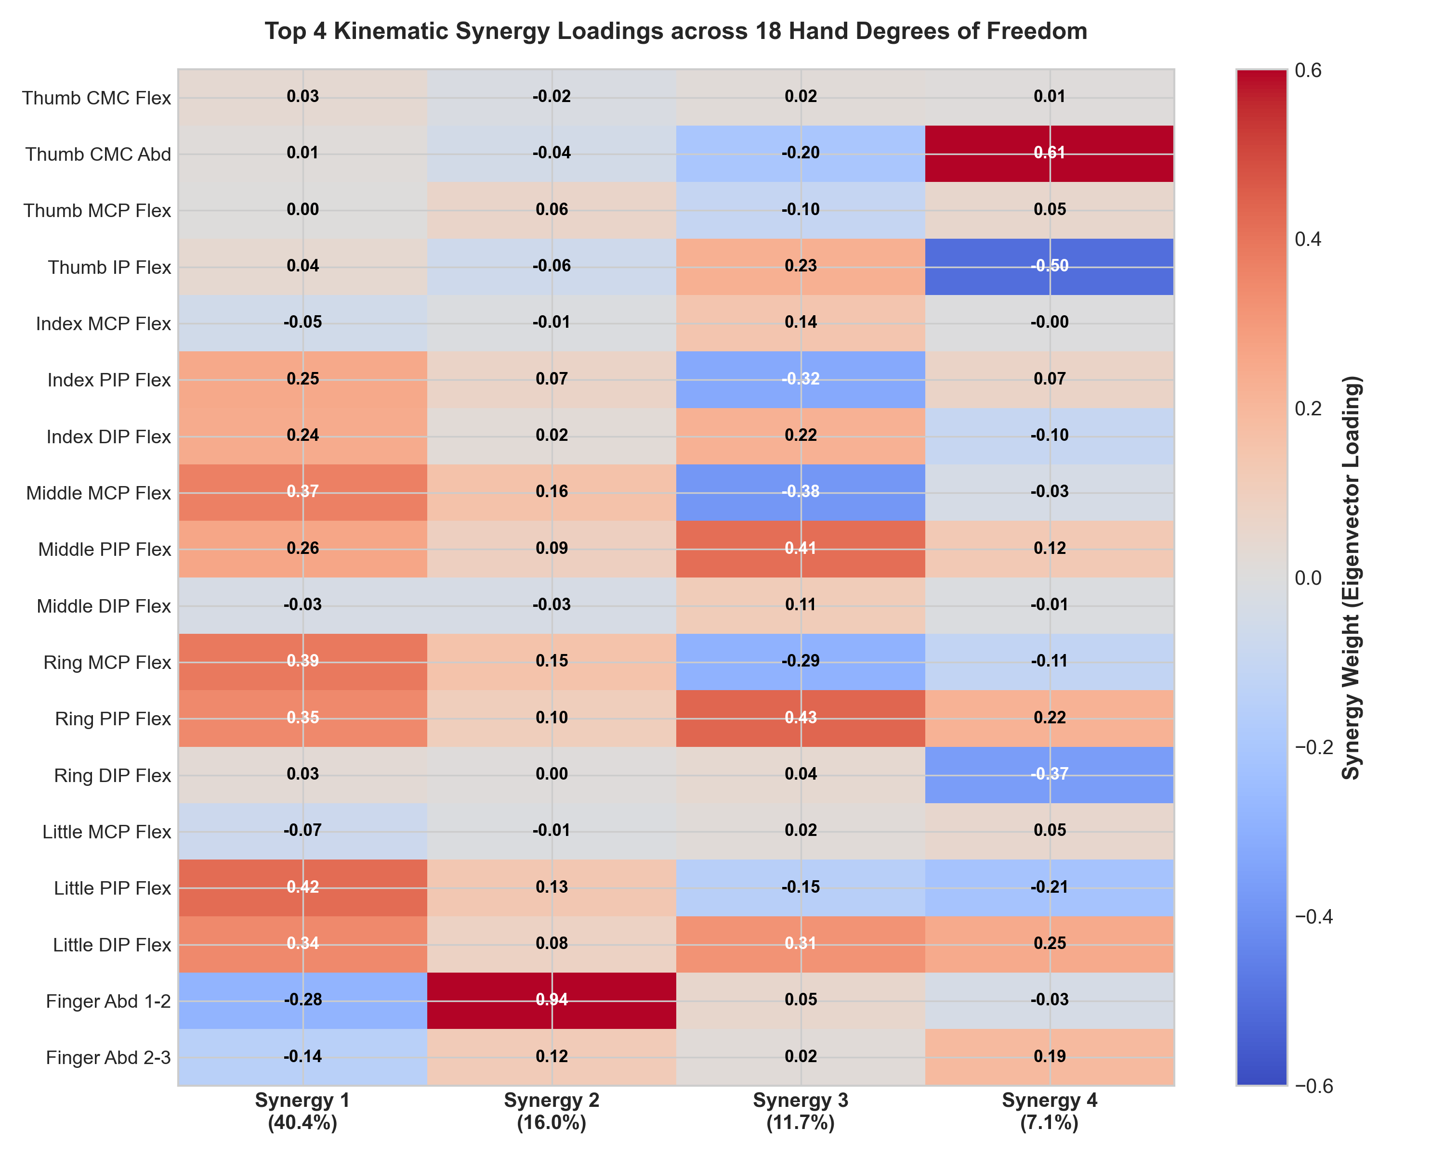
Empirical Baseline Analysis on Local KIN-MUS UJI Dataset
5 / 12
Direct PCA Extraction Across 28 Subjects, 26 Daily Activities (ADLs) & 18 Joint DoFs
Cumulative VAF Elbow Observation
• Sharp variance saturation occurs at K = 3 to 4 synergies across the 18 calibrated CyberGlove DoFs.
• Higher components (K > 6) encode fine per-joint noise or object-specific micro-adjustments.
Anatomical Synergy Coupling Weights
• PC1–PC2: Synchronized MCP/PIP flexion across index–little fingers paired with thumb CMC/MCP flexion.
• PC3–PC4: Selective thumb opposition/abduction & MCP-PIP counter-rotation for precision pinch.
Ain Shams University | Mechatronics Engineering Dept. | Eng. Mohamed Zedan | Supervised by Prof. Dr. Mohamed Hamdy Abdelhafez & Dr. Mohamed Ibrahim Awad

Slide 6
Pillar 2: Muscle Synergies (NMF) & Cross-Domain MMF Coupling
6 / 12
Linking Forearm sEMG Motor Modules to Kinematic Posture Under Variable Forces (RQ1 Core)
Teng et al. (2021) — IEEE TNSRE
• Tested 6 grasps across 3 force levels (Low, Medium, High).
• Intra-force accuracy: 90.2%–91.4% across classifiers.
• Overall accuracy: 85.8% (MSC+DFTR).
• Cross-force generalization: NMF Muscle Synergy Classification (78.1%–78.7%) significantly beat LDA (68.4%–76.9%, p < 0.05).
• Impact: NMF synergy vectors W provide force-invariant grasp representations.
Scano et al. (2023) — IEEE Access ★ RQ1
• Dataset: 28 subjects, 20 grasps (6 reps) from Ninapro DB2.
• Introduced Mixed Matrix Factorization (MMF) to handle signed joint angles alongside non-negative sEMG envelopes simultaneously.
• Extracted 7 unified kinematic-muscular synergies per subject with mean R² > 0.75.
• Impact: Direct algorithmic blueprint for answering RQ1 across Feix taxonomies.
Meattini (2023) & Olikkal (2022)
• Meattini et al. (2023, IEEE RA-L): Self-supervised NMF (W ∈ R^{8×2}) + DNN mapping 8-ch sEMG to 3 grasp primitives (AR10 hand) without MoCap labels.
• Verified Performance: R² = 0.8423, nMSE = 0.1355, RMSE = 0.0735.
• Olikkal et al. (2022) & Yeung/Farina (2022): Tensor/SVD + Kalman filtering ensures smooth real-time trajectory stability despite sEMG drift.
Ain Shams University | Mechatronics Engineering Dept. | Eng. Mohamed Zedan | Supervised by Prof. Dr. Mohamed Hamdy Abdelhafez & Dr. Mohamed Ibrahim Awad

Slide 7
Pillar 3: Underactuated Hardware & Joint-Group Synergies (JGKSE)
7 / 12
Comparing K=1 SoftHand, K=2 Mini X-Hand & 2026 SX-Hand (33/33 Feix Taxonomy Coverage)
Metric / Feature | Li et al. (2022) BPI SoftHand | Sun et al. (2022) Mini X-Hand | Chu et al. (2026) SX-Hand [IEEE T-RO]
Actuators (K) | K = 1 actuator | K = 2 actuators | K = 12 actuators (grouped synergy mapping)
Joints / Architecture | 15 joints / 19 DoFs; 3D-printed (~£65) | 5 fingers + differential palm mechanism | 21 joints incl. movable Ring/Little CMC palm
Synergy Method | Adaptive + Soft Synergies (series springs) | Mechanical embedding of 2 Eigengrasps | JGKSE: ORQ > 90% & IRQ > 90% (≥90% joints)
Quantitative Result | Passive compliant adaptation to shapes | Reproduces 29 / 33 Feix grasps (~88%) | ORQ = 96.3±1.5%, min IRQ = 94.6±2.7% 33/33 Feix (100%), 10/10 Kapandji, 20 kg load
Critical Engineering Insight Linking Sun (2022) & Chu (2026) to Our MSc Thesis
• Why K=2 stops at 29/33 Feix grasps: global PCA sacrifices thumb opposition and palm arch CMC flexion (which alone drive >40% of precision functionality).
• Solution for RQ2: Retaining global flexion eigengrasps (1–2 actuators) PLUS JGKSE-isolated thumb/CMC actuation enables 100% Feix coverage within K_min ≤ 4.
Ain Shams University | Mechatronics Engineering Dept. | Eng. Mohamed Zedan | Supervised by Prof. Dr. Mohamed Hamdy Abdelhafez & Dr. Mohamed Ibrahim Awad

Slide 8
Musculoskeletal Modeling & Simscape Dynamic Force Validation
8 / 12
Why Kinematic Synergies Alone Fail Under Load — Integrating Lapresa et al. (2022 & 2024)
Lapresa et al. (2022) — OpenSim Baseline
• Validated the OpenSim ARMS Hand_Wrist_Model (26 anatomical DoFs) across reach-to-grasp trials.
• Achieved subject-specific optical marker Inverse Kinematics tracking error < 5 mm.
• Role: Provides anatomically accurate joint axes, moment arms, and tendon excursion constraints prior to hardware prototyping.
Lapresa et al. (2024) — Force Synergies & Simscape
• Recorded Vicon kinematics + fingertip contact pressures across 8 subjects performing 21 reach-to-grasp tasks.
• LDA Classifier: Distinguished power vs. precision grasps with 89% accuracy.
• Simulink & Simscape Multibody Validation: Proved grasp stability increases significantly when coupling force synergies with kinematic synergies.
Thesis Dynamic Verification Protocol (Answering Prof. Dr. Mohamed Hamdy's Stability Mandate)
• In Simulink / Simscape Multibody, we will test our K_min ≤ 4 JGKSE + MMF synergy manifold under simulated object mass, friction μ, and external perturbation torques.
• Success Criteria: Zero slip / drop events across canonical Feix power (cylindrical/spherical) and precision (tripod/pinch) test objects at VAF ≥ 90%.
Ain Shams University | Mechatronics Engineering Dept. | Eng. Mohamed Zedan | Supervised by Prof. Dr. Mohamed Hamdy Abdelhafez & Dr. Mohamed Ibrahim Awad

Slide 9
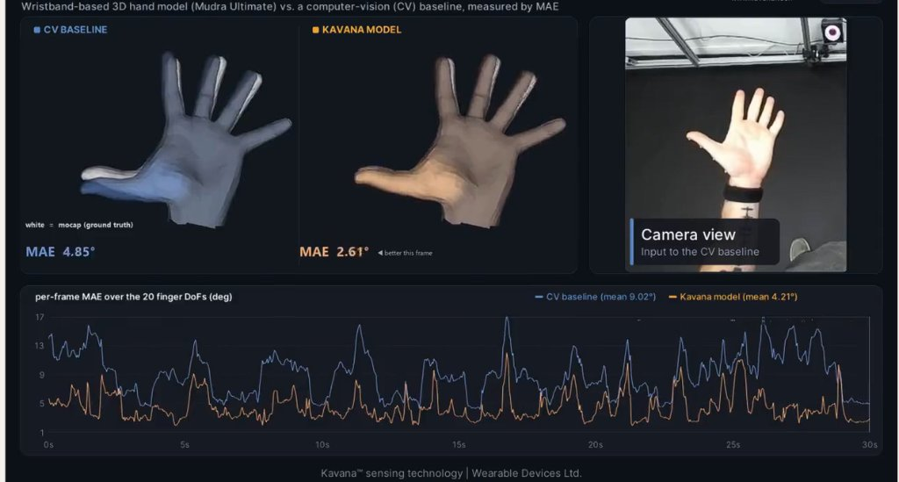
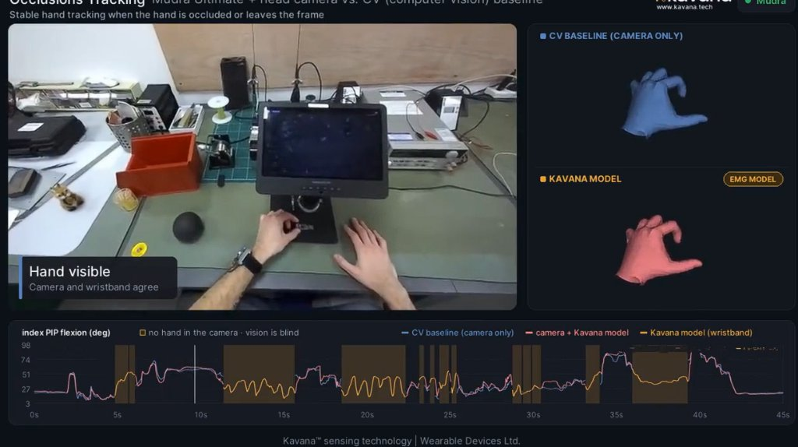
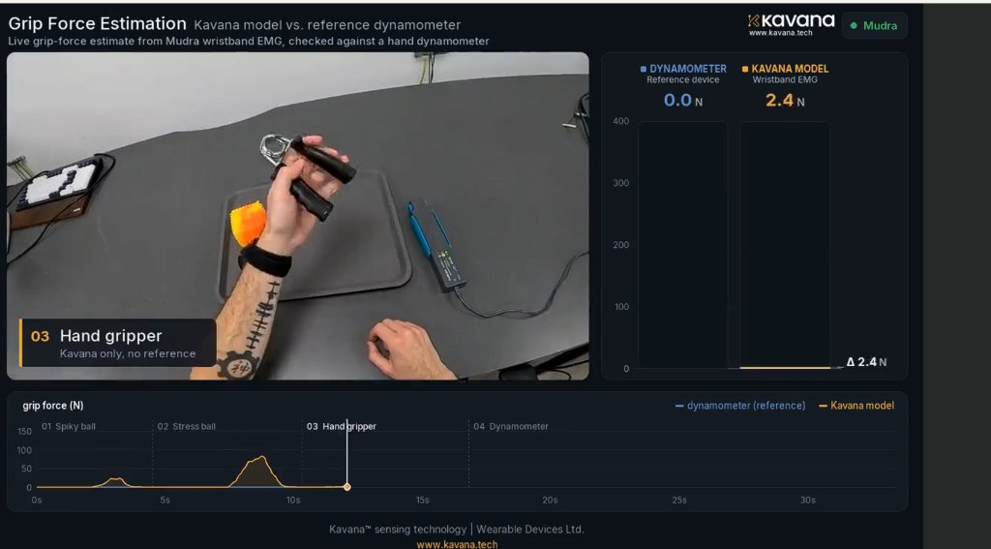
2026 Breakthrough Benchmark: Encord EMG-1 & Kavana Wristband
9 / 12
100-Hour Open sEMG–MoCap Dataset Verified Locally on Take OP-001/s003/02
100 Hours
EMG-1 Benchmark
8ch-mocap: 12 subj, 920 takes @ 2kHz
MAE 4.21°
vs. 9.02° CV Baseline
53.3% error reduction across 20 DoFs
100% Immune
Visual Occlusion Test
Continuous tracking when camera blind
0–80 N
Isometric Grip Force
Wrist EMG vs hand dynamometer
Direct Integration into Our MSc Pipeline (Verified Local Data)
• Locally cloned encord-team/EMG-1 & downloaded take OP-001/s003/02 (take.h5 16.93 MB, take.c3d 1.34 MB, automatic_est.h5 2.88 MB) — 8-ch sEMG @ 2000 Hz + 23 OptiTrack markers @ 120 Hz.
• Bridges a key historical gap: pairs high-density wrist sEMG with ground-truth 3D finger kinematics and force regimes, complementing KIN-MUS UJI for cross-dataset MMF validation.
Ain Shams University | Mechatronics Engineering Dept. | Eng. Mohamed Zedan | Supervised by Prof. Dr. Mohamed Hamdy Abdelhafez & Dr. Mohamed Ibrahim Awad

Slide 10
Temporal Synergy Primitives & 2026 VLA Foundation Models
10 / 12
From PCA + ProMPs (Pham et al., 2026) to Latent Action Bottlenecks (NVIDIA GR00T 2, Nov 2026)
Pham et al. (2026) — Robot. Auton. Syst. (PCA + ProMPs)
• Dataset: 20-DoF haptic exoskeleton glove across 13 contact-rich cleaning tasks (5 train, 8 unseen), deployed on Shadow Hand.
• Spatial PCA + Temporal Probabilistic Movement Primitives (ProMPs) encode time-varying trajectories inside the synergy manifold.
• Results: 5 PCs (15 DoFs) and 7 PCs (20 DoFs) capture ≥ 90% variance with < 10% average joint reconstruction error.
• Generalization: Nearest-expert ProMP selection outperforms convex blending on 8 unseen manipulation tasks.
NVIDIA GEAR Lab (Nov 2026) — GR00T 2 Whitepaper
• 135-page blueprint scaling Vision-Language-Action (VLA) models across humanoid & 20–22 DoF dexterous hands.
• Architecture: VQ-VAE Latent Action Quantization + Conditional Flow Matching transformers projecting into compact action manifolds.
• Theoretical Confirmation: Even 2026 billion-parameter robotics foundation models depend on a low-dimensional latent action bottleneck (synergy space) to prevent contact instability across embodiments.
Synergy Convergence Across Classical Control & Modern Foundation AI
• Whether controlling an underactuated prosthetic with 4 DC motors or training Flow-Matching VLA policies on 22-DoF hands, dimensionality reduction into an orthonormal/non-negative synergy bottleneck is mathematically indispensable.
Ain Shams University | Mechatronics Engineering Dept. | Eng. Mohamed Zedan | Supervised by Prof. Dr. Mohamed Hamdy Abdelhafez & Dr. Mohamed Ibrahim Awad

Slide 11
18-Paper Master Taxonomy Synthesis & Identified Research Gaps
11 / 12
Pinpointing Exactly Where Existing Literature Stops and Where Our MSc Thesis Begins
Pillar | Representative Studies | Core Contribution | Unresolved Gap Addressed by Our MSc
1. Kinematic & Modeling | Jarque-Bou 19, Lapresa 22/24, Bazina 24, West & Hogan 24/25 | Invariant 3–4D subspace (VAF≥90%); OpenSim <5mm; 16→5–15 DoFs | Lacks simultaneous sEMG muscle coupling & hardware actuator allocation check
2. Muscular & MMF | Teng 21, Yeung 22, Olikkal 22, Scano 23, Meattini 23, EMG-1 26 | Force-robust NMF (85.8%); MMF 7 synergies (R²>0.75); MAE 4.21° | Extracted MMF synergies not compressed to K_min≤4 physical tendon topology
3. Hardware Design | Li 22 (K=1), Sun 22 (K=2), Chu 26 (K=12 SX-Hand) | K=2 gives 88% Feix; JGKSE+CMC gives 100% Feix (K=12) | Gap between K=2 (88%) & K=12 (100%) leaves K_min≤4 optimal zone unexplored
4. ASU Baseline & AI | Sarwat & Awad 21, Pham 26 (ProMPs), NVIDIA GR00T 2 | ASU Data Glove (85% rehab); ProMPs & VQ-VAE synergy bottlenecks | ASU Glove uses raw 16-sensor ML; needs MMF + JGKSE + Simscape upgrade
Unified Ain Shams MSc Thesis Novelty Statement
• First unified framework combining Mixed Matrix Factorization (MMF) + Joint-Group Synergy Extraction (JGKSE with Palm CMC) + Simscape Multibody Force-Closure Validation to achieve ≥90% VAF & >90% IRQ within K_min ≤ 4 actuators.
Ain Shams University | Mechatronics Engineering Dept. | Eng. Mohamed Zedan | Supervised by Prof. Dr. Mohamed Hamdy Abdelhafez & Dr. Mohamed Ibrahim Awad

Slide 12
Proposed MSc Thesis Execution Roadmap (4 Phases)
12 / 12
Actionable Engineering Pipeline from Mathematical Extraction to Ain Shams Prototype Validation
Phase 1: Cross-Domain Math
• Run PCA, NMF & MMF on local KIN-MUS UJI (28 subj, 26 ADLs) & Encord EMG-1 (8ch-mocap).
• Map coupling weights across Feix power vs. precision grasps (RQ1).
• Compute VAF-CI & Principal Angles.
Phase 2: K_min ≤ 4 Optimization
• Apply JGKSE (Chu 2026) enforcing ORQ > 90% AND IRQ_i > 90%.
• Determine minimal K ≤ 4 synergy split: Power Flexion + Precision Pinch + Thumb/CMC Arch.
• Verify 100% Feix reachability.
Phase 3: Simscape Dynamics
• Build parametric 21-DoF hand model in Simulink / Simscape Multibody.
• Simulate K_min ≤ 4 tendon routing & compliant springs under external loads (Lapresa 2024).
• Validate contact force closure.
Phase 4: ASU Integration
• Integrate synergy decoder with Ain Shams Data Glove architecture (Sarwat & Awad 2021).
• Benchmark real-time inference latency & force estimation stability.
• Publish & Defend MSc Thesis.
Ready for Committee Review & Immediate Phase 1 Execution
• All 18 baseline papers synthesized, KIN-MUS UJI & EMG-1 datasets staged locally — ready for Dr. Mohamed Hamdy & Dr. Mohamed Awad approval to launch Phase 1 MMF + JGKSE experiments.
Ain Shams University | Mechatronics Engineering Dept. | Eng. Mohamed Zedan | Supervised by Prof. Dr. Mohamed Hamdy Abdelhafez & Dr. Mohamed Ibrahim Awad

