Slide 1

The Iron Bank
CSE 4302
Object Oriented Programming Lab project
Team members:
1. Md. Zahidul Islam,160041010
2. Shafkat Rahman Farabi,160041002
3. Ha-mim Hamid,160041047
4. Faiyaz Mahmud Samin,160041009

Slide 2
About the Project
The project is about a banking system which includes using the system as various kinds of users with various level privileges.
One can enter the program as Admin, Employee or Customer. These 3 kinds of users will have different privileges.
Admin is the one with most number of privileges. An admin can add new admins, employees & customers or modify their information. He can get a record of all the events like creation or deletion of customers by him or other employees. He can access all the accounts and see the information of that account or other user’s profile.
The project was written using c++

Slide 3
Employees can add new customers or modify customer information. He can see all the customer details except the private ones.
Customers can add their accounts. Logging in an account, they can withdraw, deposit money. They can even transfer money to others account.
All of the above access methods will be protected with passwords and they will be stored using encryption methods.
Id’s of the all the users will be generated automatically by the program uniquely.

Slide 4
Classes:
Admin : This is a derived class of Employee. This class stores all the information of the admin like Id, name, address, contact, passwords etc. and contains the methods that belong to employee and also its others extra methods.
Employee : This class stores all the information of the Employee. Its has class members like id, name , password, contact etc. It’s methods add or delete customer, show transactions etc.
Customer : Customer class stores all the information of customers like id, name, password, contacts etc. Customers have methods that manipulate their accounts.
Accounts : accounts stores information like id, customer id, type, amount etc. It has methods like deposit_money, withdraw_money, transfer_money etc.

Slide 5
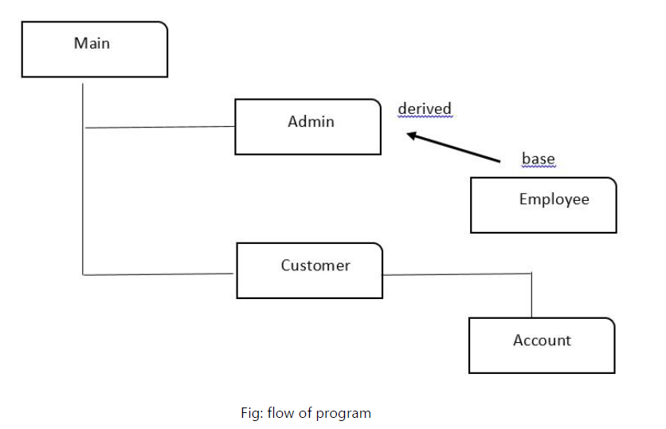
Relationship of the classes in the program

Slide 6
Implementation:
The program first displays selection menu to log in as admin, employee or customer. They are shown different menus when logged in. Access is secured by taking a Password. The characters of the password are not shown in the console while typing.
The admin class is made derived of employee because it contain all the members and methods of employee plus some extra privileges. The Customer performs transaction on their account which are promptly stored in file . Every customer, account, admin, employee are objects of their individual classes.
The id’s automatically generated when new user is created by keeping a track of how much id is generated till now. They are shown right after creation and used to log in later on. The program does not use one file rather a large group of files sum up the program so that the whole program is organized and easily accessed. The information are stored initially in multiple files and they will shifted into multiple tables in oracle database.
Passwords & sensitive info’s will be made encrypted while storing. Various utility functions will be made so that every user can access the information according to their roles.

Slide 7
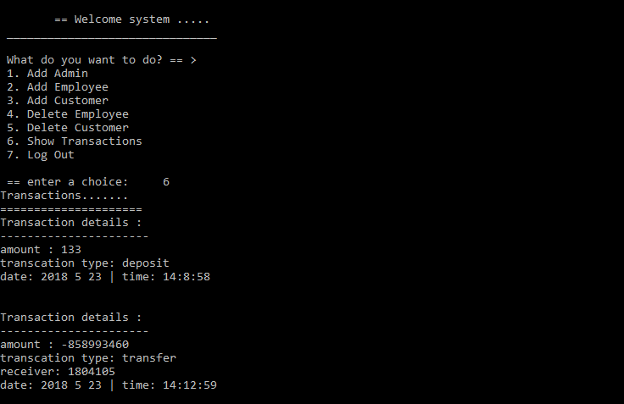
Sneak peak at the application:

Slide 8
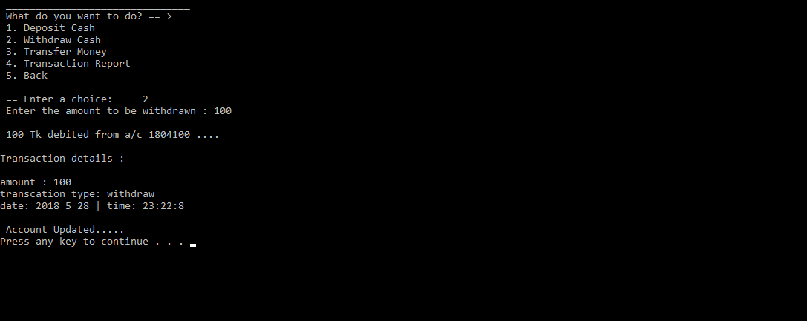
Picture:transaction of money:

Slide 9
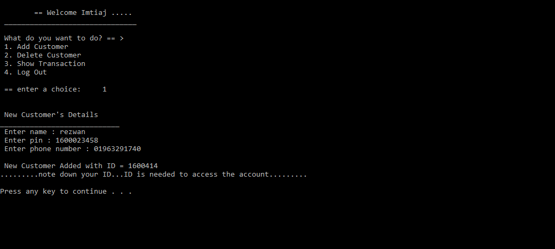
Employee interface:

Slide 10
THANK YOU!

