Slide 1
CSE463 COMPUTER VISION, SECTION 03, SUMMER 2026
Cross-Surface Generalization in U-Net Based Crack Segmentation
A study of encoder backbones, loss functions and classical preprocessing
Zawad Ahsan and Yeamin Alam, BRAC University. Instructor: Dr. Md. Ashraful Alam.
QUESTION 1
QUESTION 2
How much do the encoder, loss and preprocessing matter?
How far does performance fall on a surface never seen in training?
Notes:
PRESENTER 1. About 1:30.
Good morning, everyone. We are Zawad Ahsan and Yeamin Alam from BRAC University. This is our CSE463 project on crack segmentation. I will present the problem, the data and the method. My teammate will present the results.
Cracks in roads and buildings need regular inspection. In Bangladesh, this inspection is often manual and slow. A segmentation model can help. It looks at a photo and labels every pixel as crack or not crack. The output shows where each crack is and what shape it has.
Most crack research improves the network architecture. The training setup stays fixed. Testing is also done on data where every surface type appears in both the training set and the test set. That leaves two questions open.
The first question is this. How much does performance depend on the encoder, the loss function and the input preprocessing, instead of the architecture?
The second question is this. How far does performance fall when the model meets a surface it never saw in training?
We answer both questions with one controlled study of twelve trained models.

Slide 2
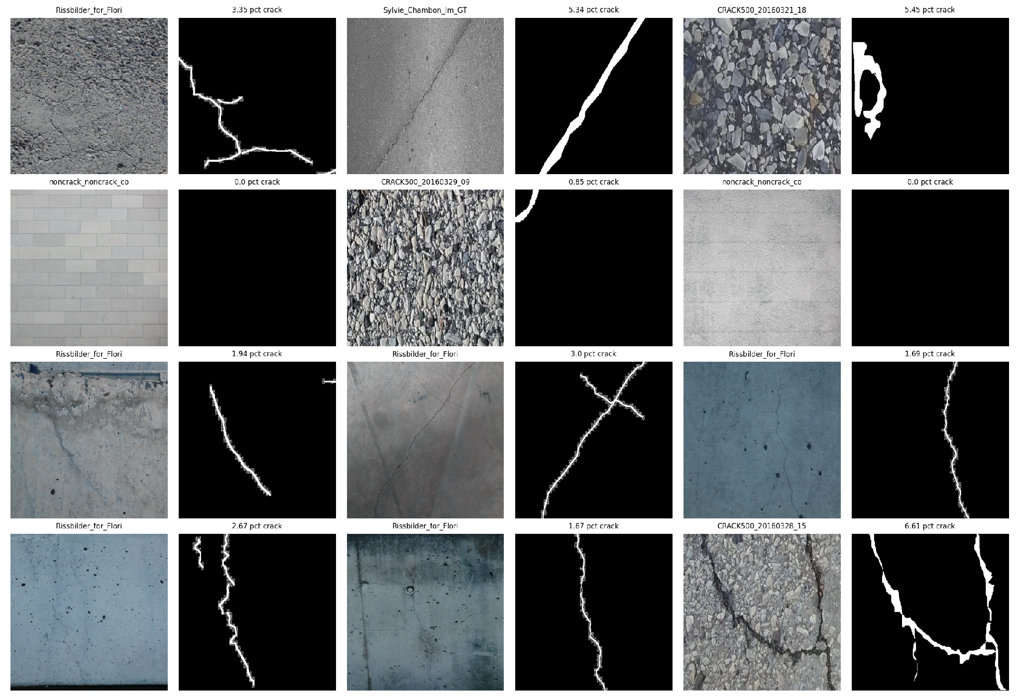
Data: 11,298 images, audited before training
3.67%
26.23:1
of all pixels are crack
background to crack pixels
331
48
exact duplicate files removed
test images copy training images
CFD, forest and Sylvie hold the same 118 images, so groups follow surface family, not filename.
Cross-Surface Generalization in U-Net Based Crack Segmentation
2 / 6
Notes:
PRESENTER 1. About 1:35.
Now the data. We used a public Kaggle crack dataset. It has 11,298 images. Each image is 448 by 448 pixels and comes with a pixel mask. The dataset merges many sources, and it includes both wall surfaces and pavement surfaces. The picture on the left shows sample images with their masks.
Before training, we audited the data. We found four things.
First, cracks are rare. Only 3.67 percent of all pixels are crack. That is 26 background pixels for every crack pixel. A model that predicts background everywhere would get about 96 percent pixel accuracy and zero Dice. So we do not use pixel accuracy. We use Dice, IoU, precision and recall.
Second, 331 files were exact duplicates. We removed them.
Third, 48 of the 1,695 official test images are exact copies of training images. That is 2.83 percent of the test set. We removed those 48 images and report every score on the clean test set of 1,647 images.
Fourth, three filename prefixes, CFD, forest and Sylvie, contain the same 118 images. So a filename is not a reliable source label. For the cross-surface test, we group images by surface family instead. The families are wall, pavement and mixed.

Slide 3
Method: five stages and a size-matched control
Twelve runs. Each stage keeps the winner of the previous stage.
STAGE A
STAGE B
STAGE C
STAGE D
STAGE E
Encoder
Loss
Input
Hold out
Seeds
U-Net scratch
VGG16-UNet
ResNet50-UNet
Dice
Tversky
BCE
Raw RGB
CLAHE
Edge stack
Wall
Pavement
Size-matched control
Seed 101
Seed 202
Best model
FIXED BUDGET
SIZE-MATCHED CONTROL
150 steps per epoch, 10 epochs, at most 1,500 updates per run
4,054 random mixed images, the same size as the wall holdout
Cross-Surface Generalization in U-Net Based Crack Segmentation
3 / 6
Notes:
PRESENTER 1. About 1:35. Hand over to Presenter 2 at the end.
Now the method. We trained twelve models in five stages. Each stage keeps the winner of the previous stage. A full grid of all combinations would need 27 runs, so this staged design is a compute limit.
Stage A compares three encoders. One is a U-Net trained from scratch. The other two use VGG16 and ResNet50, both pretrained on ImageNet. Stage B compares three loss functions: Dice, Tversky and binary cross-entropy. Stage C compares three inputs: raw RGB, contrast enhanced CLAHE, and an edge stack that adds a Laplacian channel. Stage E repeats the best model with two more seeds.
Stage D is our main experiment. We train without one surface family and then test on that family. We hold out wall once and pavement once.
A low score there could mean domain shift. It could also mean the model simply had less training data. So we added a size-matched control. It trains on 4,054 random images that mix all surfaces. That is the same size as the wall holdout. Any gap that remains is domain shift.
Every run gets the same budget: 150 steps per epoch, 10 epochs, and at most 1,500 updates. Now my teammate will show the results.

Slide 4
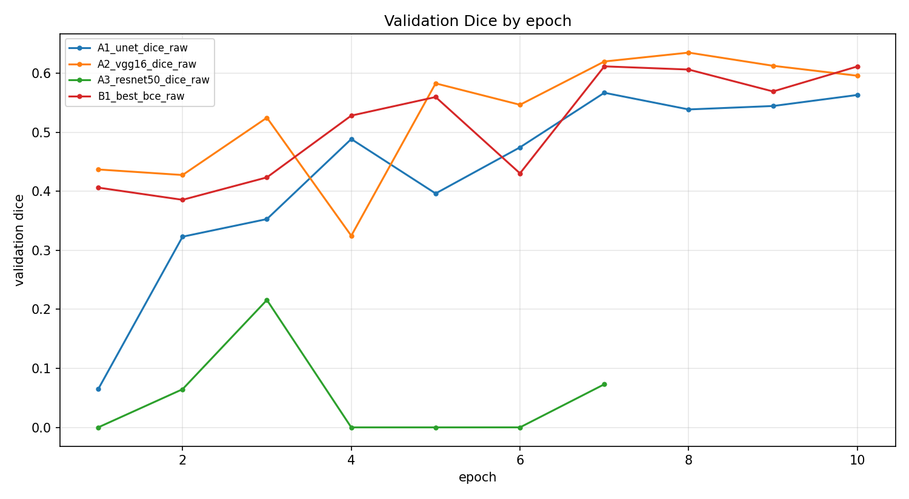
Ablation: VGG16, Dice loss and raw input win
Run | Model or change | Dice | Prec. | Rec.
A1 | U-Net from scratch | 0.5980 | 0.5632 | 0.6373
A2 | VGG16-UNet (base) | 0.6707 | 0.6437 | 0.6999
A3 | ResNet50-UNet | 0.2246 | 0.1351 | 0.6674
B1 | BCE loss | 0.6436 | 0.6807 | 0.6104
B2 | Tversky loss | 0.6651 | 0.5905 | 0.7613
C1 | CLAHE input | 0.6317 | 0.5747 | 0.7012
C2 | Edge input | 0.6538 | 0.6228 | 0.6880
ResNet50 (A3) peaks at epoch 3, falls to 0.0 after unfreezing at epoch 4, and stops at epoch 7.
0.6807
0.7613
Shaded row: best Dice, 0.6707. B rows change the loss and C rows change the input, both from A2. Clean test set, 1,647 images.
BCE: highest precision
Tversky: highest recall
Cross-Surface Generalization in U-Net Based Crack Segmentation
4 / 6
Notes:
PRESENTER 2. About 2:00.
Thank you. Here are the ablation results. All scores are on the clean test set.
The pretrained VGG16 encoder with Dice loss and raw input reaches 0.6707 Dice. The U-Net from scratch reaches 0.5980. So pretraining adds 0.073 Dice, even though crack images look very different from ImageNet photos.
ResNet50 reaches only 0.2246. The training curve on the right shows what happened. Its validation Dice peaks at epoch 3, while the encoder is still frozen. At epoch 4 the encoder is unfrozen, and validation Dice drops to zero. Early stopping ends the run at epoch 7. So the reported score comes from epoch 3. We have not tested the cause. The candidates are the learning rate, the batch normalization layers and the input scaling.
Now the loss functions. With this class imbalance, we expected binary cross-entropy to collapse. It did not. It reaches 0.6436 Dice, with the highest precision, 0.6807, and the lowest recall. Tversky reaches 0.6651, close to Dice, and it has the highest recall, 0.7613. In inspection, a missed crack costs more than a false alarm, so that operating point is useful.
Finally, handcrafted inputs did not help. Raw RGB beats both the edge stack and CLAHE for this encoder.
We also repeated the best model with two more seeds. Test Dice was 0.6707, 0.6650 and 0.6734. So we do not read anything into differences below about 0.004.

Slide 5
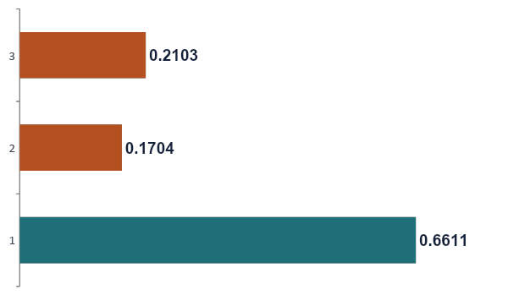
Unseen surfaces cost about 0.45 to 0.49 Dice
Test Dice, VGG16-UNet, Dice loss, raw input
GAP TO CONTROL
0.4907 for wall and 0.4508 for pavement
RECALL ON THE UNSEEN SURFACE
Only 0.1016 and 0.1289, so few cracks are found
WALL IS NOT SIMPLY HARDER
With wall in training, wall images score 0.6337 Dice
Cross-Surface Generalization in U-Net Based Crack Segmentation
5 / 6
Notes:
PRESENTER 2. About 1:30.
This is our main result. When we train without wall and test on wall, Dice is 0.1704. When we train without pavement and test on pavement, Dice is 0.2103.
The size-matched control reaches 0.6611. It has the same training size as the wall holdout. So the gap is 0.4907 for wall and 0.4508 for pavement. The training size is matched, so we attribute these gaps to domain shift and not to data volume.
Look at what fails. Precision on the unseen surface is moderate, about 0.53 and 0.57. Recall collapses to 0.10 and 0.13. The model predicts very few crack pixels on the new surface. It learned how cracks look on the surfaces it saw, and it does not carry that over.
Wall is not simply a harder surface. When wall is in the training set, wall images score 0.6337 Dice. To our knowledge, this is the first measured cross-surface gap on this dataset.
The practical point is clear. A score measured on mixed surfaces, like 0.66 for the control, does not predict how the model behaves on a new surface. That one is 0.17 to 0.21.

Slide 6
Takeaways, limits and next steps
1
Pretrained VGG16 wins
LIMITS
Dice loss and raw RGB give 0.6707 test Dice.
ResNet50 collapse cause is untested
One seed per ablation run
Two surface families held out
2
A new surface is the bigger risk
Dice falls to 0.17 and 0.21, against 0.66 for the control.
NEXT STEPS
Transformer backbones
Tversky weight search
CRF post-processing
More held-out families
3
The benchmark has data problems
48 test images copy training images. Removing them changed Dice by +0.0074.
Thank you.
Cross-Surface Generalization in U-Net Based Crack Segmentation
6 / 6
Notes:
PRESENTER 2. About 1:15.
To sum up. First, a pretrained VGG16 encoder with Dice loss and raw RGB input gives the best score, 0.6707 Dice. Second, a new surface type is the bigger risk. It costs about 0.45 to 0.49 Dice. Third, the benchmark has data problems. The official test set holds 48 images that copy training images. Removing them changed our score by plus 0.0074. So for our model the leak did not inflate the score, but it is still a validity problem. This matters for real use, because an inspection model will meet surfaces that its training data did not cover.
There are limits. The cause of the ResNet50 collapse is untested. Each ablation run used one seed. And we held out only two surface families.
For next steps, we plan to test transformer backbones, search over the Tversky weights, add CRF post-processing and hold out more surface families.
Thank you. We are happy to take your questions.

