Slide 1





https://kenya-health-access.vercel.app/
2026
KHAP
KENYA HEALTH ACCESS PLATFORM
USSD . SMS . Web Access to Health Facilities
Connecting every Kenyan to healthcare — anytime, anywhere
Presenter: LORENZO KIBET KIPROTICH

Slide 2
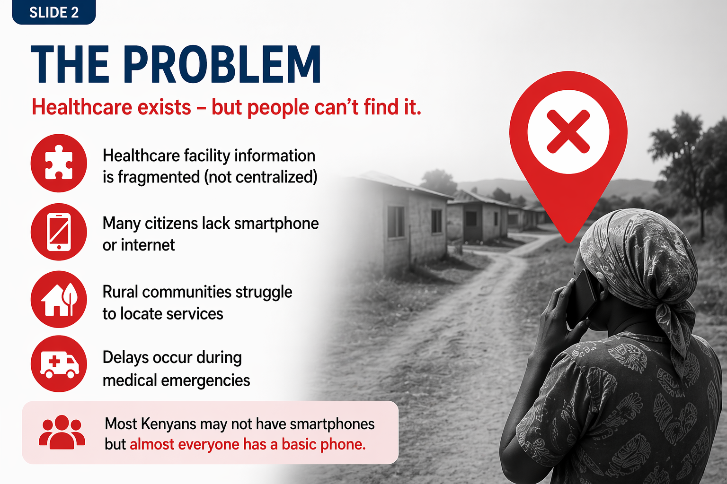
Problem
Health care access challenge
Healthcare exists but people can’t find it.
Healthcare facility information is fragmented (not centralized)
Many citizens lack smartphone or internet
Rural communities struggle to locate services
Delays occur during medical emergencies

Slide 3
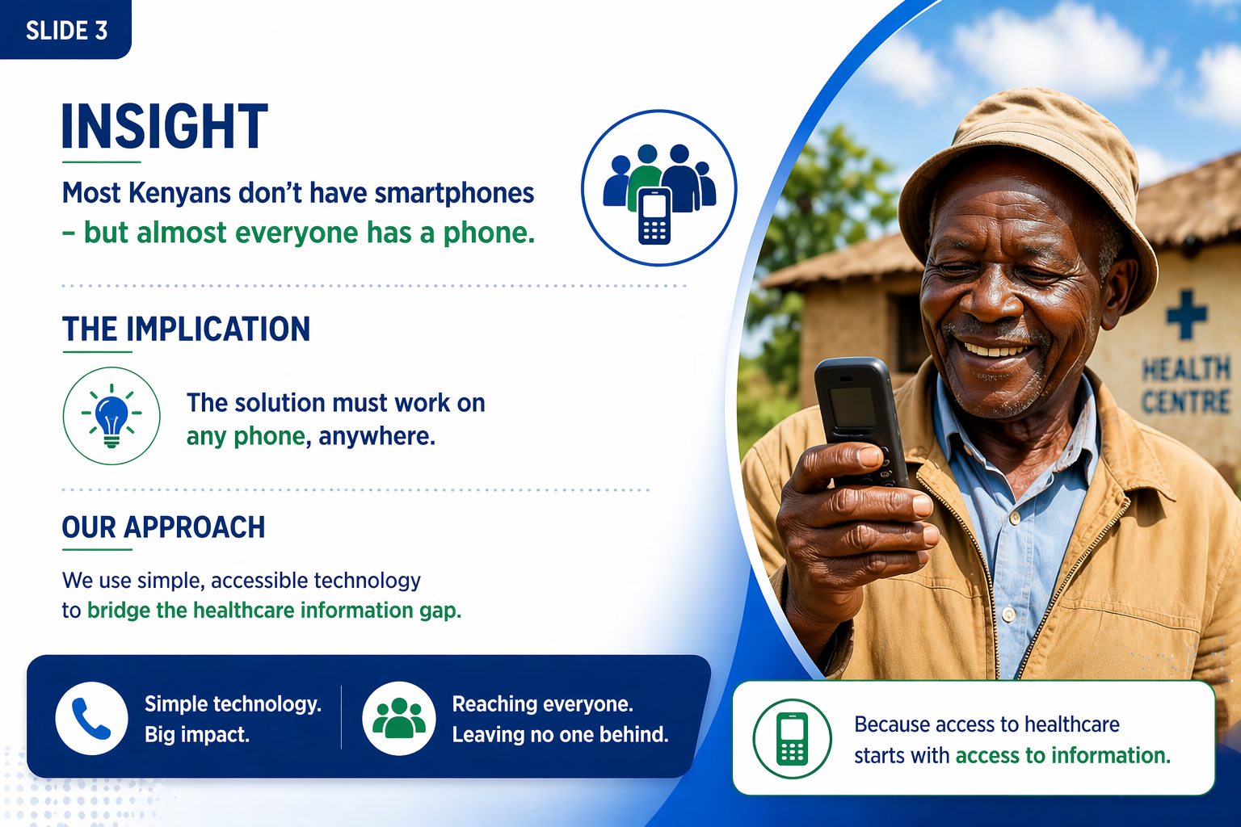
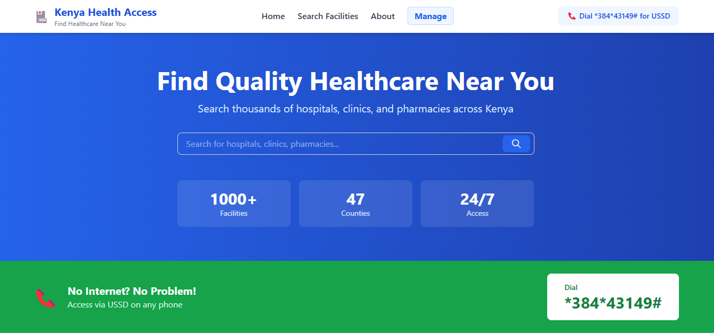
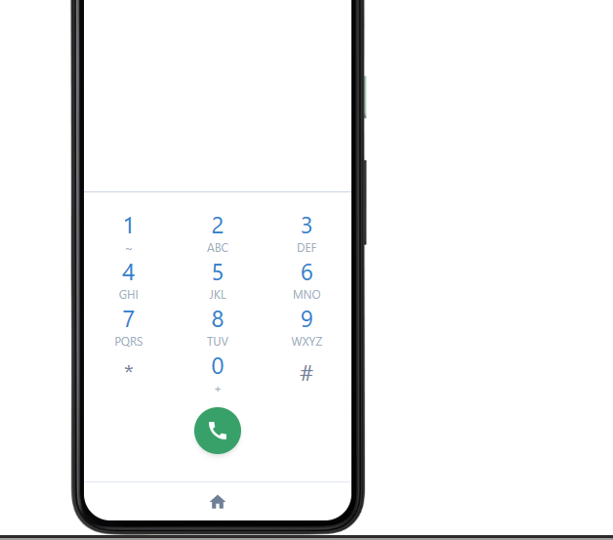
Insight and solution
Most Kenyans don’t have smartphones but almost everyone has a phone.
Verification: A single source of truth via Admin Portal vetted by professionals
We built a multi-channel healthcare access platform.
A Healthcare access platform available through:
USSD *384*43149#
• USSD • SMS • Web • API

Slide 4
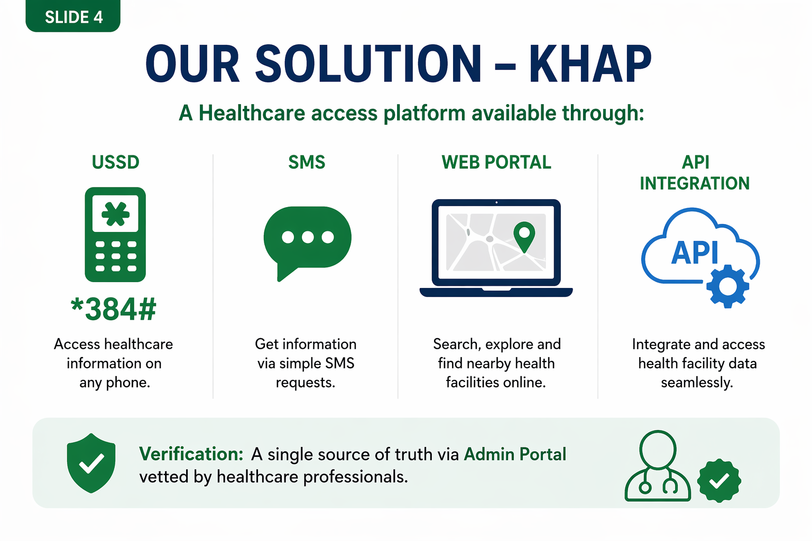
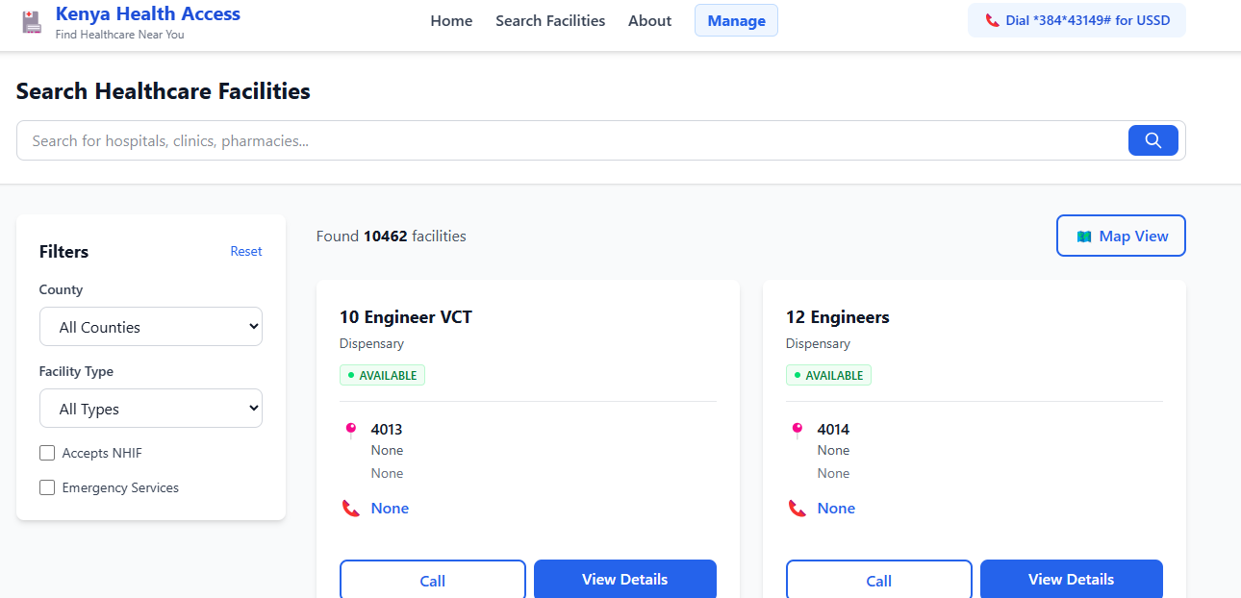
How it works
Dial *384#
Select county
Select Service needed
View nearest facilities displayed
This turns any phone into a healthcare navigation tool
https://kenya-health-access.vercel.app/

Slide 5
Users and beneficiaries
Patients and Citizens. Quickly locate nearby Healthcare services.
Rural communities. Access health care information without internet.
Government and NGOs. Better health care planning and data visibility.
Community health workers. Guide patients to appropriate facilities.
Support field work and referrals.

Slide 6
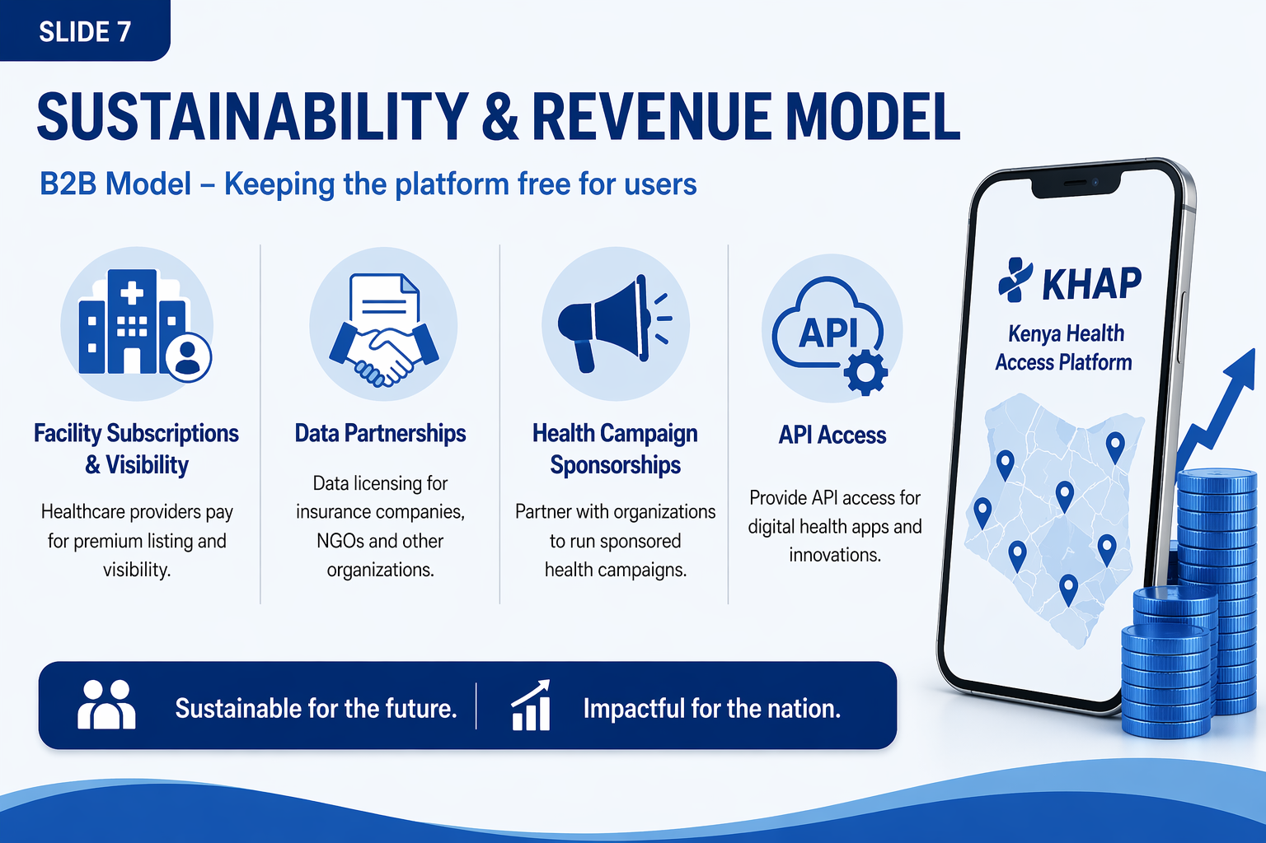
Sustainability and scalability
B2B Model: Data licensing for insurance companies and NGOs
Listings. Subscription based visibility for healthcare providers
Health Campaign Sponsorship
Api Access for Digital Health Apps

Slide 7
Vision Roadmap
Phase 1: National Access
Ussd platform and national facility database
Basic health information services
Phase 2: Smart health services
Ambulance integration and telemedicine
Planning to integrate a multilingual USSD system
Mobile health applications
Phase 3: Intelligent health platform
Ai health guidance and regional expansion
Predictive Healthcare data insights
Our goal : Make health care discovery accessible to everyone
From directory → to national health infrastructure

Slide 8
Asks and why this wins
We are ready to move from prototype to real-world deployment
Partnerships with telecom operators
Collaboration with health facilities
Support for deployment and scaling pilot test
Inclusive technology
Data driven health care access
Real world national impact
Scalable across Kenya and Africa

Slide 9
Health access should be simple
Any phone, Any location
Instant access to Healthcare
Lorenzo
2026
Healthcare Presentation
TEAM
Victor Muiruri
Lorenzo Kibet
Zedrick Biwott
Thank
You
Kenya Health Access Platform
https://kenya-health-access.vercel.app/

