Slide 1
Addis Ride Demand — Model Report
Best model: Ensemble: CatBoost + MLP (blended)
Models compared: 14 (+ grid: 79 cells (13 families × 2 encoders × 3 scalers = 78, plus CatBoost native = 79))
Features: 57 | Rolling-origin folds: 4
Raw RMSE 8.35 · MAE 5.74 · R² 0.904
Trimmed RMSE 8.35 · R² 0.904

Slide 2
1 · Problem, data & clock
Forecast hourly trips, 12 Addis zones, 1–14 Nov 2025 (4,032 zone-hours).
Three raw tables: trips (~85k rows), hourly weather (~7.5k), events calendar (165).
Mixed weather clock: 6,806 UTC 'Z' rows vs 732 local DD/MM rows.
Proof: 659/732 local rows coincide with a Z-row shifted +3 h; temp peaks 15:00 EAT.
One row = one zone + one hour; row count invariant across both joins (84,614).

Slide 3
2 · Features (how many, which)
57 features: events 17, history 15, calendar 11, weather 11, trend 2, zone 1.
Lags: lag_336h (14-day same-slot lag), lag_672h (28-day same-slot lag) → 14-day & 28-day same-slot history.
Rolling rain: rain_3h_sum, rain_6h_sum, rain_24h_sum.
Recent windows: hist_zone_recent_7d, hist_zone_recent_14d, hist_zone_recent_28d, hist_zone_recent_56d.
Short 24/48 h lags excluded — unknown beyond day 1 of a 14-day horizon.
Operational columns (drivers/wait/fare) excluded — consequences, not causes.

Slide 4
3 · Baselines (D1)
Mean predictor: RMSE 27.54, MAE 20.69, R² -0.038.
Seasonal-naive (zone × dow × hour): RMSE 11.30, MAE 7.36, R² 0.825.
Trimmed seasonal-naive RMSE 11.30.
Best model beats the seasonal-naive RMSE by 26.1%.

Slide 5
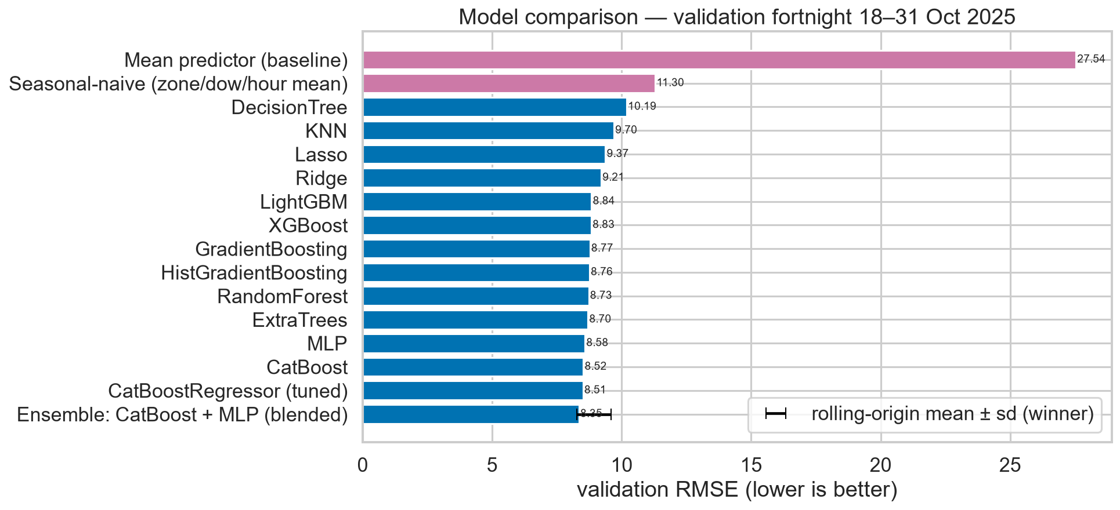
4 · Model comparison (D2)
14 model families + 2 baselines ranked.
Extended experiment: 79 cells (13 families × 2 encoders × 3 scalers = 78, plus CatBoost native = 79).
Winner: Ensemble: CatBoost + MLP (blended).
Boosted trees & MLP cluster within ~2%; linear/KNN are clearly worse.
CatBoost + MLP make the least-correlated errors → the blend wins.

Slide 6
5 · Ablation (D5)
4 configurations on identical splits:
calendar+zone+trend: RMSE 9.663, trimmed R² 0.8722
calendar+zone+trend+weather: RMSE 9.283, trimmed R² 0.8820
calendar+zone+trend+events: RMSE 8.720, trimmed R² 0.8959
calendar+zone+trend+weather+events: RMSE 8.386, trimmed R² 0.9037
Both joins (weather + events) improve the score → both were worth the effort.

Slide 7
6 · Rolling-origin validation (D3)
4 expanding folds, 14-day validation windows:
Model RMSE 8.926 ± 0.660.
Seasonal-naive RMSE 11.782.
2025-07-01: model 8.87 | naive 10.73
2025-08-05: model 8.68 | naive 11.43
2025-09-10: model 9.85 | naive 13.87
2025-10-17: model 8.30 | naive 11.11

Slide 8
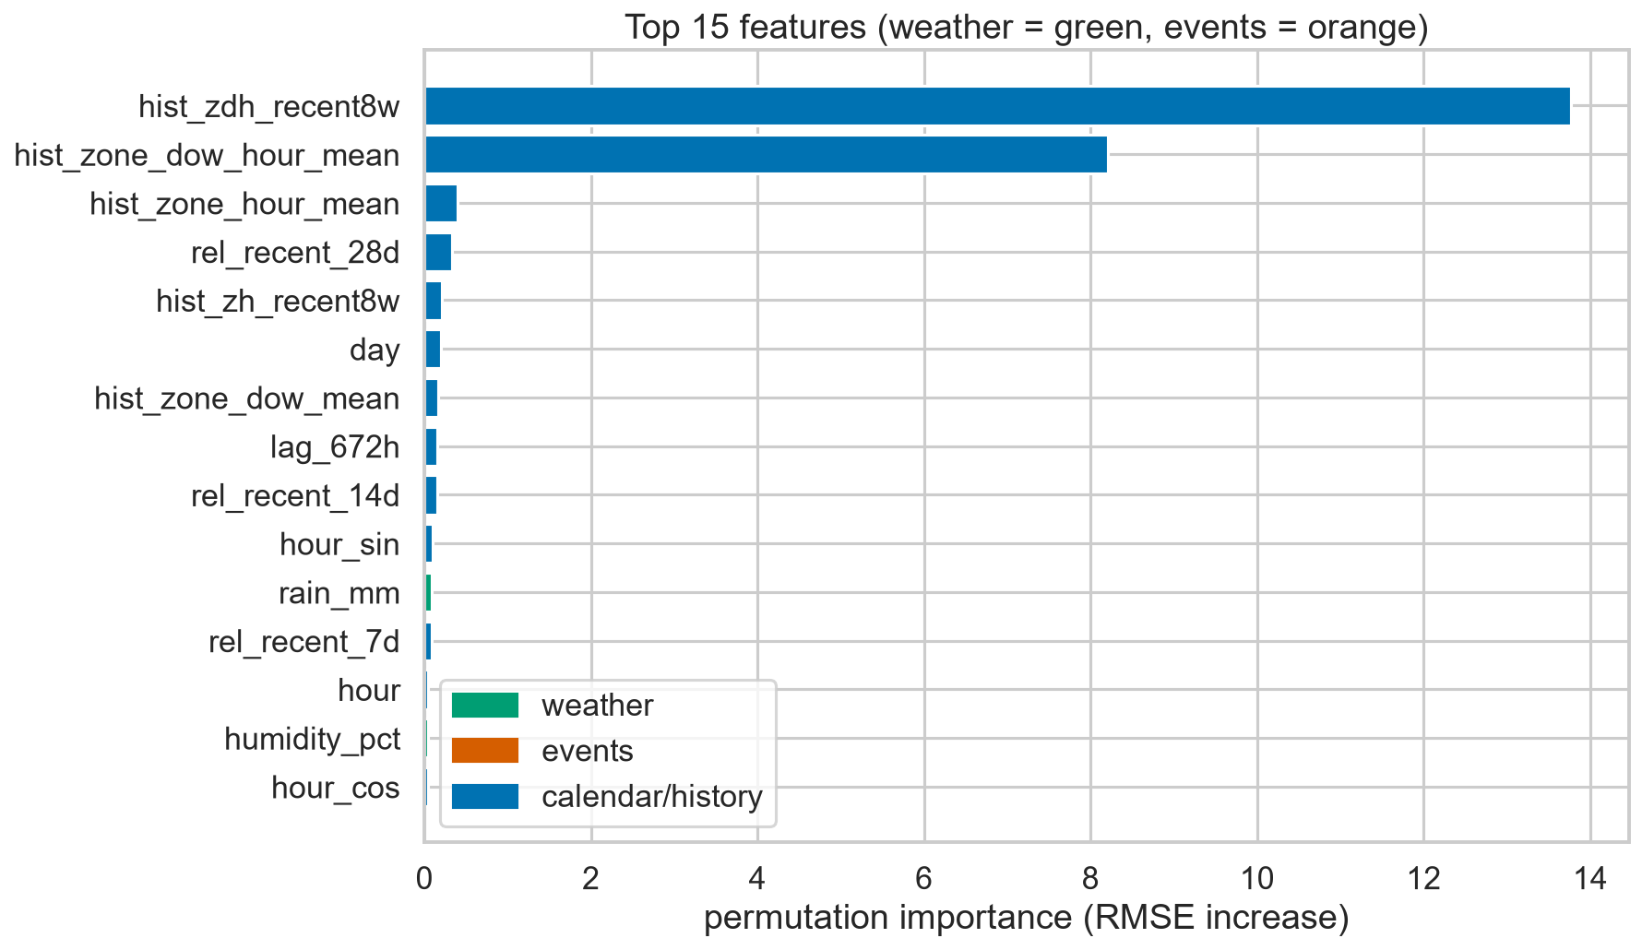
7 · Error analysis, score & demo
Largest residuals are unlisted crowding events & evening-peak timing (not in the calendar).
Held-out fit over every zone-hour: R² 0.904.
D9: a typical zone-hour is missed by ~5.7 trips.
Demo (E): streamlit run app/app.py — zone + date → 24-h curve, drivers, fares.
Next: quantile prediction intervals; a road-traffic feed for the evening peak.

