Slide 1

Cognitive Decline Risk Factors
in U.S. Older Adults
Geographic, Behavioral & Socioeconomic Patterns - CDC BRFSS 2015-2022
Zivar Murphy | DATA 205- CRN 32036 - Capstone | Spring 2026 | Prof. Lori Perine

Slide 2

The Growing Burden of Alzheimer's Disease
People Living with Clinical Alzheimer's Disease (U.S.)
Annual Cost of Alzheimer's & Dementia Care (U.S.)
6.07M
13.85M
$450B
→
$3.3T
→
2020
2060
2020
2060
128% increase · Rajan et al., Alzheimer's & Dementia (2021)
Formal + informal care · Nandi et al., npj Aging (2024)
Formal care alone: $196B (2020) → $1.4T (2060). Informal caregiving adds another $254B in 2020 — borne by families.
This project identifies which states face the highest burden and which factors explain it — providing a data-driven foundation for where intervention dollars could have the greatest
The questions this project addresses:
This project identifies which states face the highest burden and which factors explain it, providing a data-driven foundation for where intervention could have the greatest impact
Cognitive Decline Risk Factors in U.S. Older Adults · DATA 205 Capstone · Spring 2026 · Zivar Murphy

Slide 3
Project Goal, Data Sources & Tools
Goal: Analyze how health, behavioral, and socioeconomic factors influence cognitive decline among older U.S. adults, and provide insights for policymakers to identify high-risk populations.
Primary Dataset: CDC BRFSS
American Community Survey, 5-Year Estimates
2018–2022 (DP03_0062E)
% adults with bachelor’s degree+ (DP02_0068PE)
Secondary Dataset: Census ACS
Tools & Libraries
Alzheimer's Disease & Healthy Aging Data, 2015-2022
Python · Pandas · NumPy · Matplotlib
284,142 rows × 31 columns
Seaborn · Plotly · Scikit-learn · SciPy
Survey-based, state-level, adults 45+
CDC SODA2 API · GitHub Pages
Loaded live via CDC SODA2 API
🔗 data.cdc.gov/Healthy-Aging/hfr9-rurv
🔗 api.census.gov/data/2022/acs/acs5/profile
🔗 github.com/ZeeMurphy/Data_205_Capstone
Data Pairing Type
Contextual Pairing: CDC health data is enriched with Census socioeconomic context. Both datasets are joined at the state level using the state abbreviation as the common key.
Respondents: Adults aged 45+ (ages 45–64 and 65+) · Self-reported survey data — not clinical diagnoses
Cognitive Decline Risk Factors in U.S. Older Adults · DATA 205 Capstone · Spring 2026 · Zivar Murphy

Slide 4
Data Cleaning & Preprocessing
1
Filtered 59 locations → 51 jurisdictions
Removed U.S. territories (Puerto Rico, Guam) and regional rollups (Midwest, South…). Kept 50 states + D.C. only.
2
Stratification fix (critical)
Filtered Stratification2 = NaN to keep only the 'Overall' row per state-year-question. Without this, sex/race breakdowns were averaged in , underestimating all correlations.
3
Selected 9 variables
1 outcome (cognitive decline) + 8 risk factors: poor health, inactivity, mental distress, disability, smoking, binge drinking, depression, unhealthy days.
4
Pivot table + state-level aggregation
Pivoted to state × year format. Computed state averages (one value per state across all years reported) for correlation analysis.
5
Merged with Census data
Joined CDC state averages with ACS income and education data for socioeconomic analysis (RQ10–11).
6
Converting data types
CDC API returns values as text, Data_Value, and YearStart converted to numeric via pd.to_numeric(errors='coerce').
Cognitive Decline Risk Factors in U.S. Older Adults · DATA 205 Capstone · Spring 2026 · Zivar Murphy

Slide 5
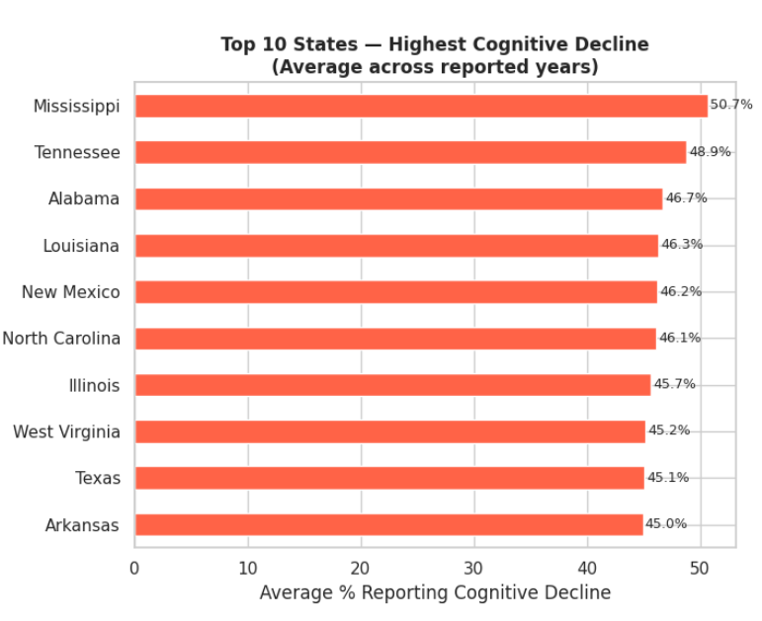
EDA: State Variation and Age Group Differences
RQ1
Which states have the highest cognitive decline? rates?
RQ2
Do rates differ between the 50–64 and 65+ age groups?
RQ2: Average Cognitive Decline by Age Group
50.7%
50
44.1%
Tennessee
48.9%
40
29.9%
30
46.4%
20
10
0
Ages 50–64
Ages 65+
Surprising: 50–64 group reports HIGHER rates than 65+.
Why? Midlife adults may report subjective memory concerns earlier.
This does NOT mean 65+ have less decline clinically.
Arkansas
8 of the top 10 states are Southern.
Lowest: Iowa 27.7% · Minnesota 28.9% · Maine 30.0%5k
Cognitive Decline Risk Factors in U.S. Older Adults · DATA 205 Capstone · Spring 2026 · Zivar Murphy

Slide 6

RQ4-RQ9: Health & Behavioral Risk Factor Correlations
← Negative association
Pearson r with cognitive decline
Positive association →
Poor Health
0
r = 0.80***
Disability
r = 0.69***
Unhealthy Days
r = 0.67***
Mental Distress
r = 0.67***
Physical Inactivity
r = 0.63***
Smoking
r = 0.50***
Depression
r = 0.42*
Binge Drinking
r = −0.51***
*** p<0.001 * p<0.05 · Bonferroni correction applied · N=51 states
Cognitive Decline Risk Factors in U.S. Older Adults · DATA 205 Capstone · Spring 2026 · Zivar Murphy

Slide 7
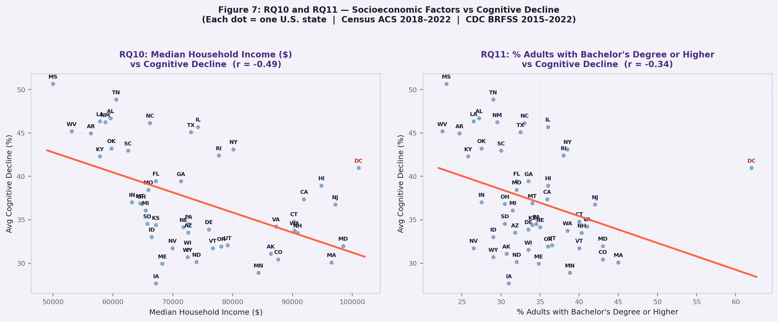
EDA: Socioeconomic Factors (Census ACS Data)
R10
Does median household income relate to cognitive decline?
R11
Does higher education reduce cognitive decline?
• r = -0.49 · Moderate negative - higher income → lower cognitive decline.
• r = −0.34 · Weak negative - more education → lower cognitive decline.
Cognitive Decline Risk Factors in U.S. Older Adults · DATA 205 Capstone · Spring 2026 · Zivar Murphy

Slide 8
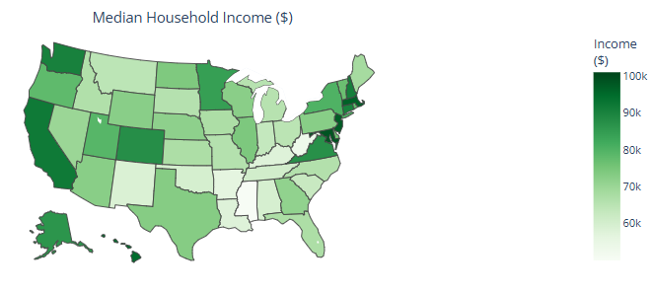
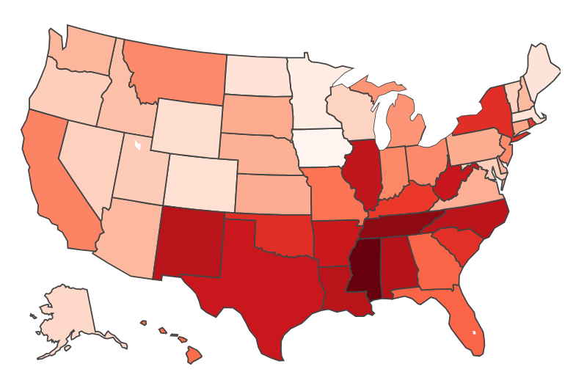
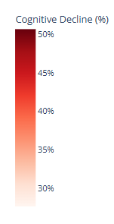
Average Cognitive Decline Rate by State (2015-2022)
Cognitive Decline Risk Factors in U.S. Older Adults · DATA 205 Capstone · Spring 2026 · Zivar Murphy

Slide 9
RQ12: Multiple Linear Regression
R12
Which combination of factors best predicts cognitive decline?
Model Details
R² = 0.742
Predictors: 8 health/behavioral + income + education (standardized)
N = 51 states · OLS regression
74.2% of variation in cognitive decline explained by the full model
All predictors jointly significant
Note: High multicollinearity (Poor Health ↔ Unhealthy Days r=0.94) - individual coefficients unstable
→ Use correlation results for individual relationships
Key Takeaway
Health and behavioral factors TOGETHER explain 74% of state-level variation in cognitive decline. No single factor dominates - the burden is multifactorial. Poor health status and disability are the most consistently strong individual predictors based on bivariate correlations.
Cognitive Decline Risk Factors in U.S. Older Adults · DATA 205 Capstone · Spring 2026 · Zivar Murphy

Slide 10
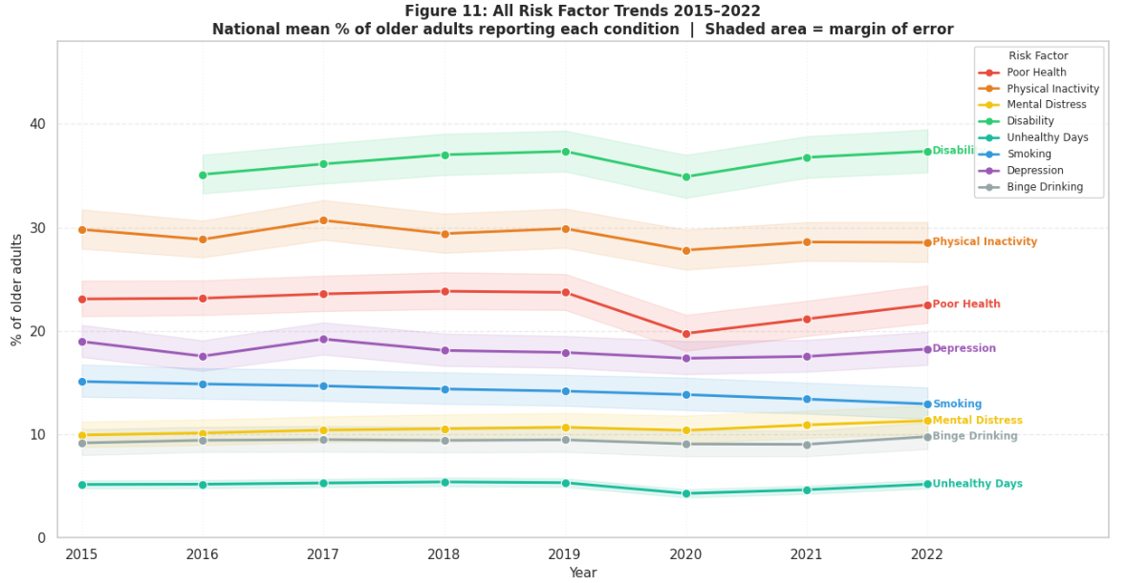
RQ13: Risk Factor Trends 2015-2022
RQ13
Are conditions getting better or worse over the years?
2015 → 2022 Summary
Factor
2015
2022
Change
Disability
35.1%
37.4%
+2.2 pp
Mental Distress
9.9%
11.3%
+1.4 pp
Binge Drinking
9.2%
9.8%
+0.6 pp
Unhealthy Days
5.2%
5.2%
0.0 pp
Poor Health
23.1%
22.5%
−0.6 pp
Depression
19.0%
18.2%
−0.7 pp
Physical Inactivity
29.8%
28.6%
−1.3 pp
Smoking
15.1%
12.9%
−2.2 pp
Shaded area = margin of error
Key finding: No factor changed dramatically. Most remained persistently elevated; the sustained burden, not a worsening trend, drives concern.
Cognitive Decline Risk Factors in U.S. Older Adults · DATA 205 · CRN 32036 · Capstone · Spring 2026 · Zvar Murphy

Slide 11
Final Data Product: Interactive Dashboard
CDC BRFSS data + state resources in one shareable HTML
https://zeemurphy.github.io/Data_205_Capstone_Project/analysis/dashboard/cognitive_decline_das
Link in the project README on GitHub
https://github.com/ZeeMurphy/Data_205Capstone_Project
hboard.html
Interactive Dashboard
What it does
✦ Interactive U.S. choropleth map (Plotly.js)
✦ 10 switchable variables via dropdown
✦ Click/select any state → detailed panel
✦ Real CDC BRFSS data, all 51 jurisdictions
✦ Risk factor bar chart vs. national average
✦ State-specific resources for older adults:
· Alzheimer's Association chapter
· State health/aging department
· State aging helpline
· Medicaid HCBS waivers & benefit programs
✦ National resources: Medicare, NIA, ACL, BenefitsCheckUp
Cognitive Decline Risk Factors in U.S. Older Adults · DATA 205 Capstone · Spring 2026 · Zivar Murphy

Slide 12
Key Findings Summary
What the data tells us about cognitive decline across U.S. states
Geography matters
Age surprise
Mississippi (50.7%) vs Iowa (27.7%) , a 23-point gap. Southern states bear the heaviest burden.
Adults 45- 64 report MORE decline than 65+ (44.1% vs 29.9%, p<0.001, d=3.00). Mid-life risk is underappreciated.
Self-reported poor health is the #1 predictor
SES is protective
r = 0.80 with cognitive decline, the strongest individual correlate, followed by disability (r=0.69) and mental distress (r=0.67).
Higher income (r=−0.49) and education (r=−0.45) both associated with lower cognitive decline rates.
Risk factors are not improving
Strong joint prediction
7 of 8 risk factors trending upward 2015–2022 nationally. Only smoking is declining. Future cognitive decline burden may increase.
R²=0.742, health, behavioral & SES factors together explain 74% of state-level variation in cognitive decline.
Cognitive Decline Risk Factors in U.S. Older Adults · DATA 205 Capstone · Spring 2026 · Zivar Murphy

Slide 13
References & Acknowledgements
Data Sources
CDC BRFSS : Alzheimer's Disease and Healthy Aging Data (2015–2022). data.cdc.gov/Healthy-Aging/hfr9-rurv
U.S. Census Bureau: ACS 5-Year Estimates (2018–2022). api.census.gov/data/2022/acs/acs5/profile
Academic References
Heymann D, et al. The association between alcohol use and the progression of Alzheimer's disease. Current Alzheimer Research. 2016;13(12):1356–1362.
CDC Healthy Aging Program. Subjective Cognitive Decline , A Public Health Issue. 2019.
Alzheimer's Association. 2024 Alzheimer's Disease Facts and Figures. alz.org/alzheimers-dementia/facts-figures
Chêne, G., Beiser, A., Au, R., Preis, S.R., Wolf, P.A., Dufouil, C. and Seshadri, S. (2015), Gender and incidence of dementia in the Framingham Heart Study from mid-adult life. Alzheimer's & Dementia, 11: 310-320. https://doi.org/10.1016/j.jalz.2013.10.005
Tools & Libraries
Python · Pandas · NumPy · Matplotlib · Seaborn · Plotly · Scikit-learn · SciPy · CDC SODA2 API · U.S. Census ACS API · HTML/CSS/JS · GitHub Pages
Acknowledgements
Prof. Perine, DATA 205 Capstone · Montgomery College · Spring 2026
Cognitive Decline Risk Factors in U.S. Older Adults · DATA 205 Capstone · Spring 2026 · Zivar Murphy

Slide 14
Thank You
Questions & Discussion
284K
rows loaded
173
state-year obs.
r=0.54
strongest predictor
(poor health)
2 APIs
CDC + Census
GitHub: github.com/ZeeMurphy/Data_205_Capstone_Project
Data: data.cdc.gov/Healthy-Aging/hfr9-rurv | api.census.gov/data/2022/acs/acs5/profile
Cognitive Decline Risk Factors in U.S. Older Adults · DATA 205 Capstone · Spring 2026 · Zivar Murphy

