Slide 1
Home Mortgage PREDICTION MODEL
BY Group G:-
Nikeeta Akbari
Nikita Marathe
Rohit Tiwari
Zeeshan Khan

Slide 2
CONTENT
Introduction
Objective
Dataset Information
Hardware Specifications
Machine Learning Model in Azure studio
Data Transformation – Manipulation
Feature Selection
Machine Learning Model in DataBricks
Summary Table
References

Slide 3
Introduction
What is HMDA data?
Each year thousands of banks and other financial institutions report data about mortgages to the public, thanks to the Home Mortgage Disclosure Act, or “HMDA” for short.
What you can find in HMDA data?
Dataset includes information about the loan - the loan amount, the type of loan, loan purpose name (buying a home, refinancing an existing mortgage, or for home improvements).
Secondly, dataset also includes demographic information on applicants’ race, ethnicity, and sex.
Thirdly, dataset also has information about the property, the location of property and data about the lender.
Finally, dataset has information about action taken on the application – Approved or denied.

Slide 4
OBJECTIVE
Our goal is to build a machine learning predictive model to predict if the home mortgage application will be approved or denied.
This model will help to show if an applicant is fit to apply for home mortgage.
Also, it shows whether lenders are serving the housing needs of their communities.
Shed light on lending patterns that could be discriminatory.

Slide 5
Dataset Information
Name - Home Mortgage Disclosure Act (HMDA)
Dataset Source - https://www.consumerfinance.gov/data-research/hmda/explore
Size – 2.21 GB
Years – 2017 and 2016
States – California and Washington
Dataset Format - CSV

Slide 6
Hardware Specifications
Azure ML Studio Hardware Specifications
Max number of modules per experiment – 100
Max storage space – 10 GB
Execution/performance – Single Node
DataBricks Cluster Hardware Specifications
Memory – 6GB Memory , 0.88 Cores, 1 DBU
DataBricks Runtime Version – 4.0 (includes Apache Spark 2.3.0, Scala 2.11)
Python Version - 2

Slide 7
Machine Learning Model in Azure ML studio
Size of Dataset – 46.1 MB
Algorithms used – Two-Class Logistic Regression and Two-Class Decision Forest
Label Column – Action Taken Name (contains decision like approved or denied)
Split – 70% train and 30% test
Data manipulation tasks Performed
Clean Missing Data Module - Specifies how to handle values that are missing from a dataset.
Select Columns in Dataset Module - Selects columns to include in a dataset or exclude from a dataset in an operation.

Slide 8
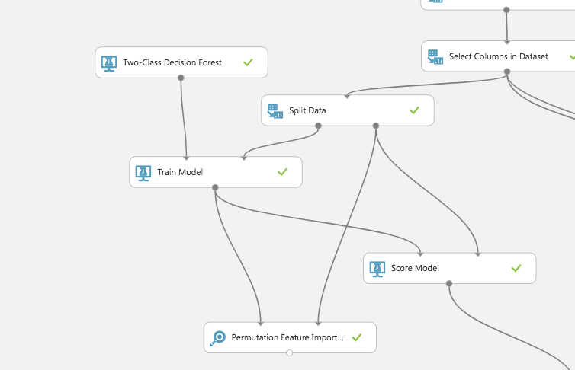
Feature Selection tasks Performed
The permutation feature importance - Computes the permutation feature importance scores of feature variables given a trained model and a test dataset.

Slide 9
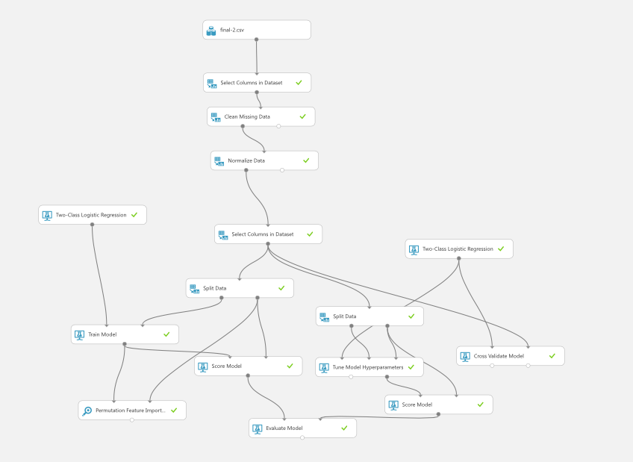
Two-Class Logistic Regression Model

Slide 10
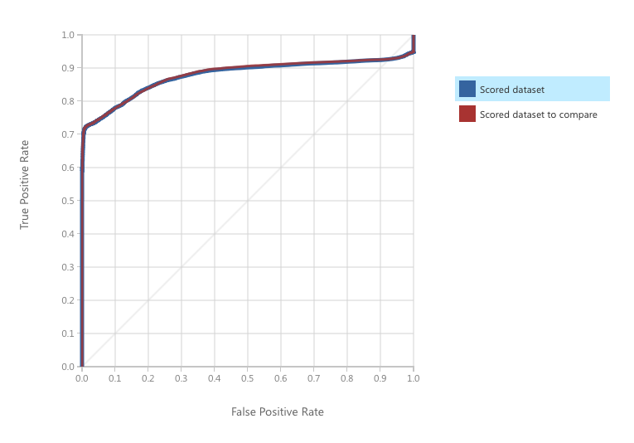
Model performance
To assess the performance of the models we measured the area under a ROC curve which is 0.878

Slide 11
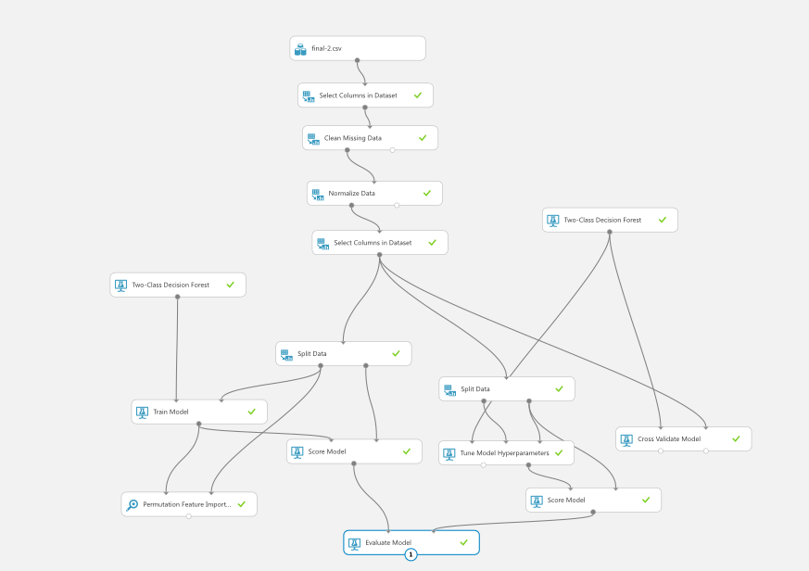
Two-Class Decision Forest Model

Slide 12
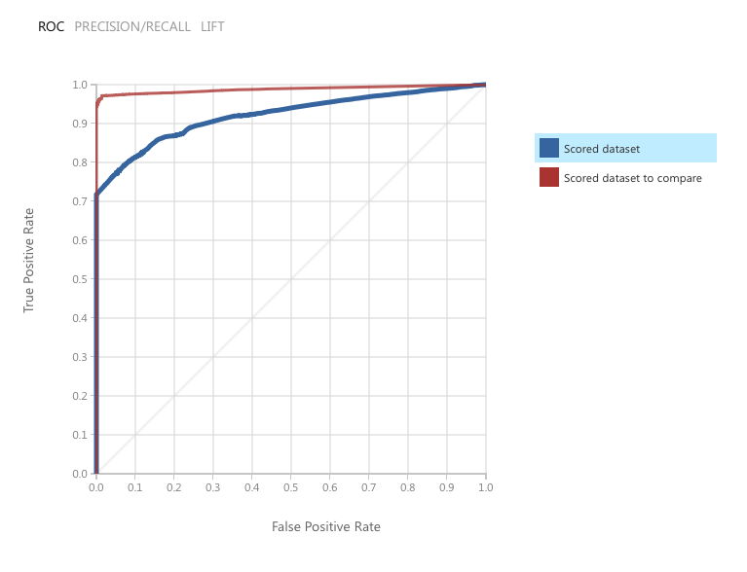
Model performance
To assess the performance of the models we measured the area under a ROC curve which is 0.922

Slide 13
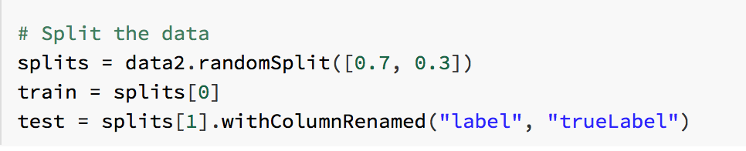
Machine Learning Model in DataBricks
Algorithms used – Logistic Regression
Label Column – Action Taken Name (contains decision like approved or denied).
Split – 70% train and 30% test

Slide 14
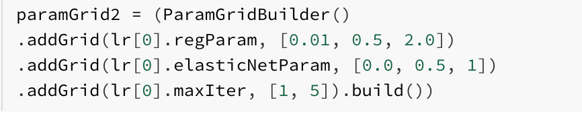
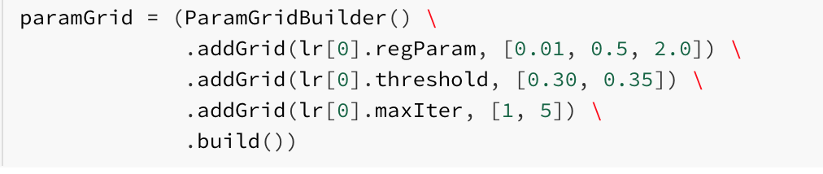
Evaluation
Tune Parameters
We used TrainValidationSplit with Threshold parameters and elastic-net parameters to evaluate each combination of parameters defined in a ParameterGrid against a subset of the training data in order to find the best performing parameters.

Slide 15
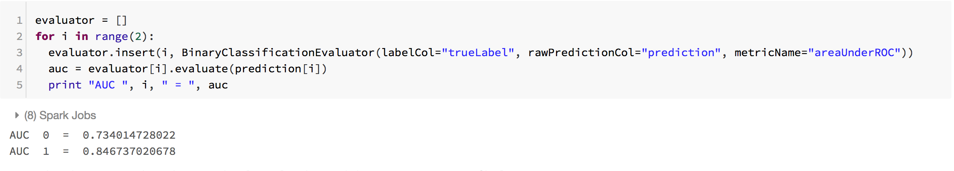
Model performance
To assess the performance of the models with threshold parameters TrainValidationSplit and elastic-net parameters TrainValidationSplit, we measured the area under a ROC curve for both these models.

Slide 16
Summary TABLE
Azure ML Studio VS Spark in Databricks
Azure ML Studio : Two-Class Logistic Regression | Spark : Two-Class Logistic Regression
AUC – 0.87 | AUC – 0.85
Azure ML Studio Two-Class Logistic Regression VS Azure ML Studio Two-Class Decision Forest
Azure ML Studio : Two-Class Logistic Regression | Azure ML Studio : Two-Class Decision Forest
AUC – 0.87 | AUC – 0.92

Slide 17
References
Dataset Source - https://www.consumerfinance.gov/data-research/hmda/explore
Azure ML Studio - https://studio.azureml.net/
Azure Microsoft Docs - https://docs.microsoft.com/en-us/azure/machine-learning/studio-module-reference/machine-learning-studio-algorithm-and-module-help
DataBricks - https://community.cloud.databricks.com/login.html

Slide 18
GITHUB LINK
LINK - https://github.com/Zeebag/CIS-5560-Big-Data-Project..git

Slide 19
THANK YOU!
Any Questions?

