Slide 1
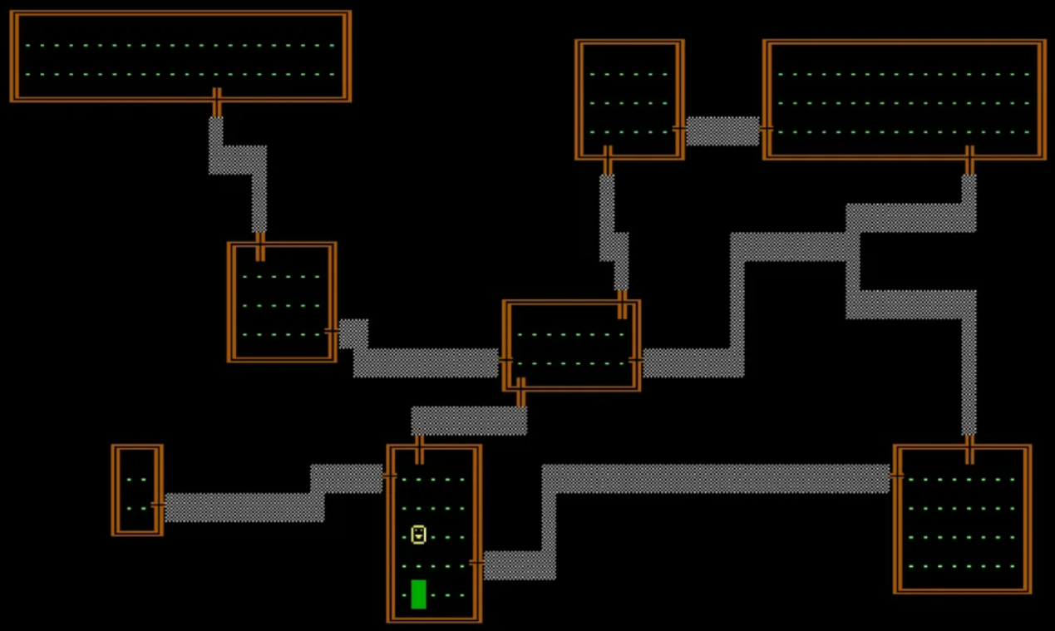
The Intelligent Rogue Game
CPT204 Advanced OO Programming
Group 98
Zheyuan Cao 2141805
Yanqing Fei 2143430

Slide 2
01
Object-Oriented Programming (OOP) Principles
02
Monster Algorithm
03
Monster Algorithm Analysis
CONTENT
Rogue Algorithm
04
05
Rogue Algorithm Analysis
Notes:
291795b4-cc1d-4b34-985b-0243b1223ca5.5

Slide 3




OOP Principles
Encapsulation
02
Inheritance
Bonding of states (attributes) and behaviors (methods) of the object while hiding the corresponding internal implementation details.
Allows a class (subclass or derived class) to inherit and modify the fields and methods form another class
03
01
Abstraction
Polymorphism
Focuses on defining high-level and necessary class attributes and functionalities while ignoring underlying code implementation
04
Behavior variances on various object states, which means that the same interface can be extended to different implementations in programming

Slide 4
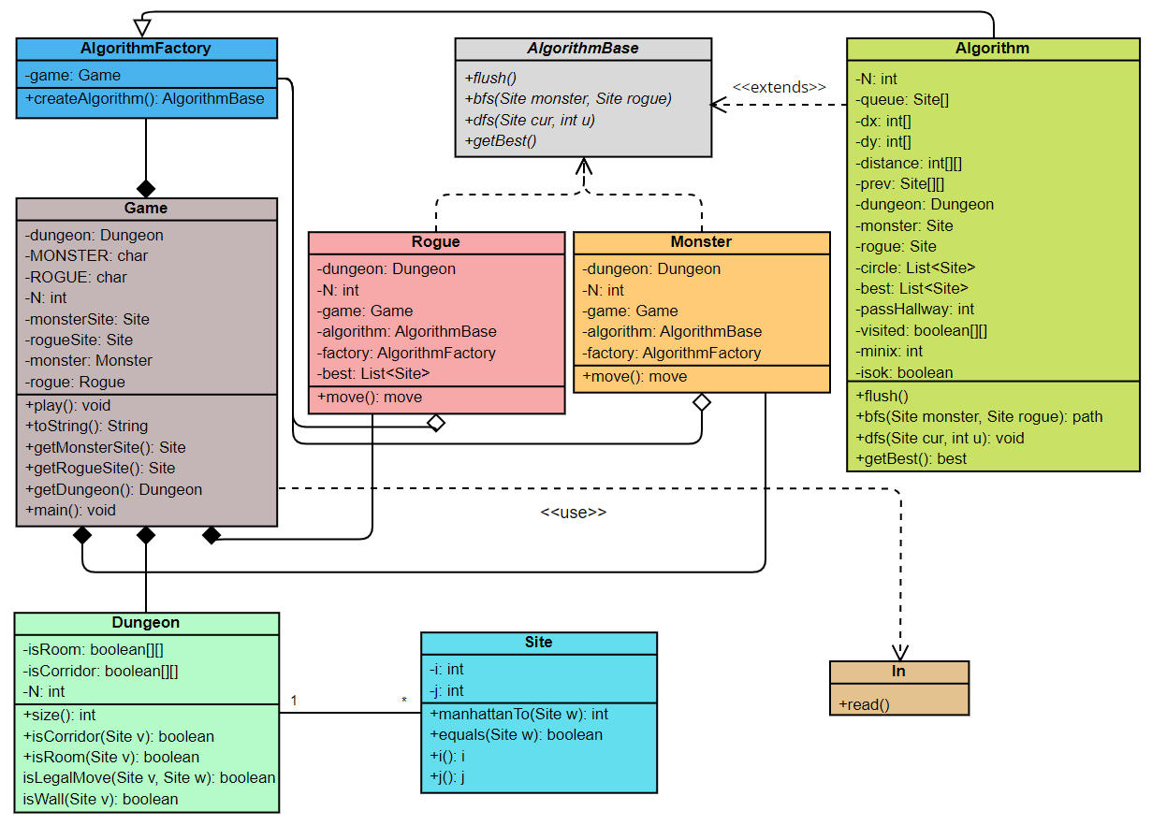
OOP Principles
System Class Diagram
Encapsulation
Inheritance
Encapsulation promotes the modularity of the program. For example, Monster and Rogue are two characters that encapsulate the behavior and movement strategies during the game. Each class maintains a factory object to instantiate the BFS and DFS algorithms while the move() method defines the logic of escape or chase
Polymorphism
Inheritance enhances the code reusability, promotes the program scalability and facilitates the maintenance process. For example, AlgorithmBase is a superclass that defines the basic structure and methods such as bfs() and dfs() for its subclass to inherit and implement.
Abstraction
Polymorphism implements via the overriding and overloading. For instance, the characters make strategy according to the BFS or DFS, which requires the overriding to the moving method defined previously.
Abstraction simplifies the system design and relevant maintenance such that different classes can conduct various kinds of implementation dependents on needs.

Slide 5
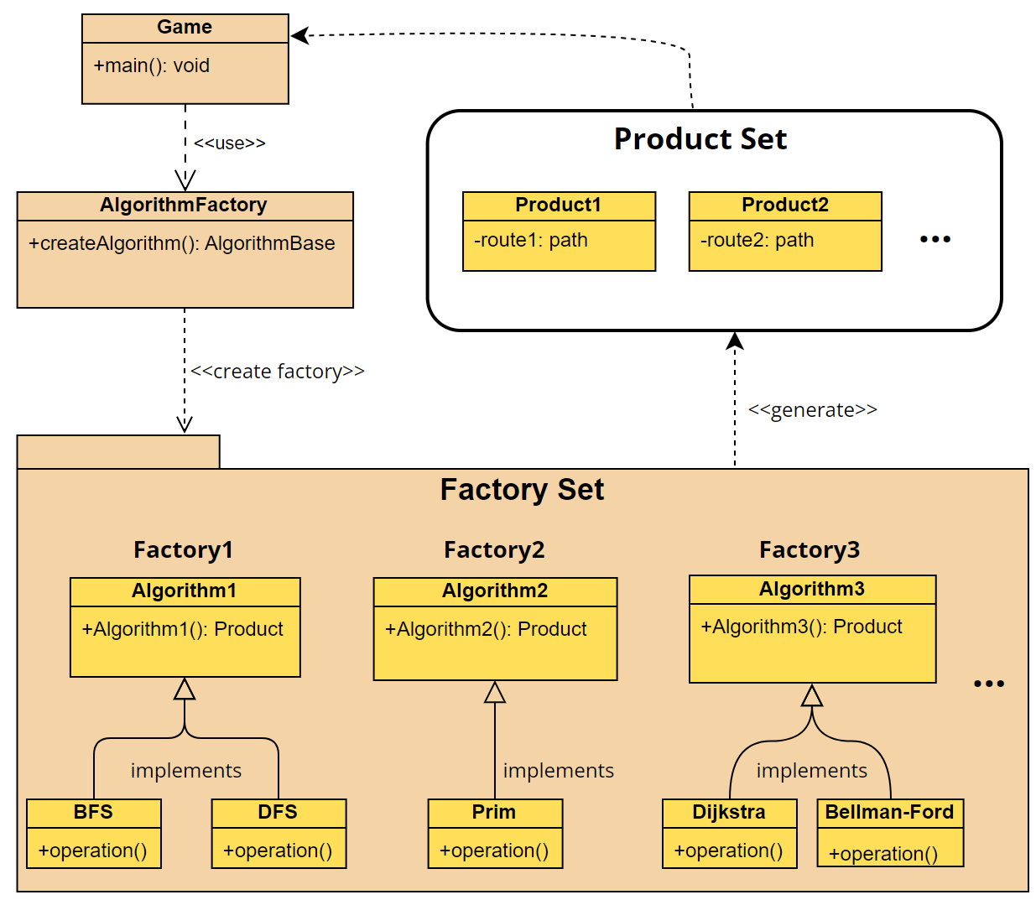
Design Pattern — Factory Pattern
Factory Pattern
Factory pattern is a creational design pattern that defines an interface for creating objects without the need to specify concrete classes, postponing the process of class instantiation to subclasses. Specifically, in this project, the factory pattern showed in sketch left is implemented by AlgorithmFactory class which receives a game object and returns a concrete algorithm instance through the method createAlgorithm().

Slide 6
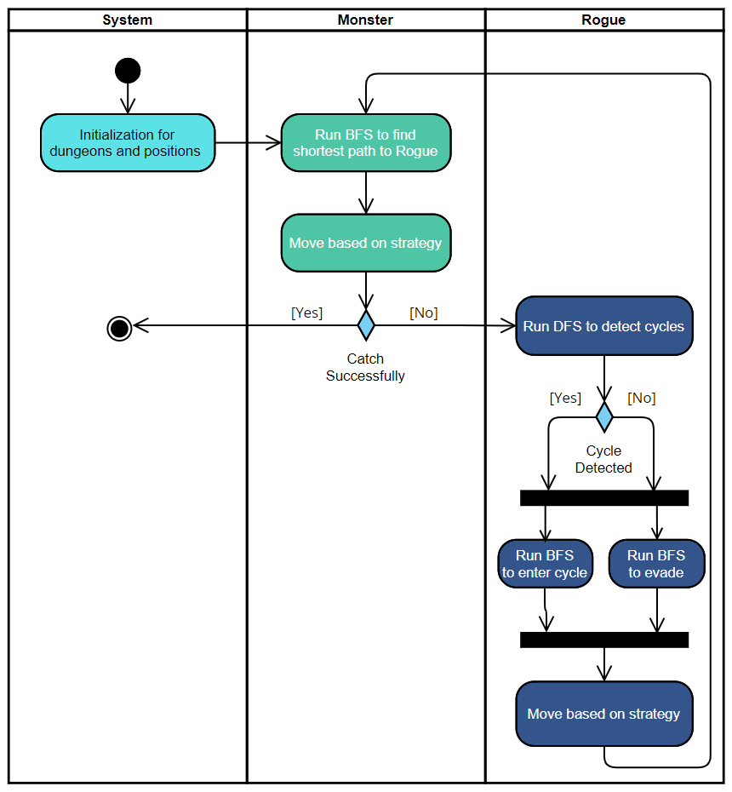




Overall Game Logic
BFS
BFS
DFS
Monster
Chasing
Rogue
Escaping
Game

Slide 7
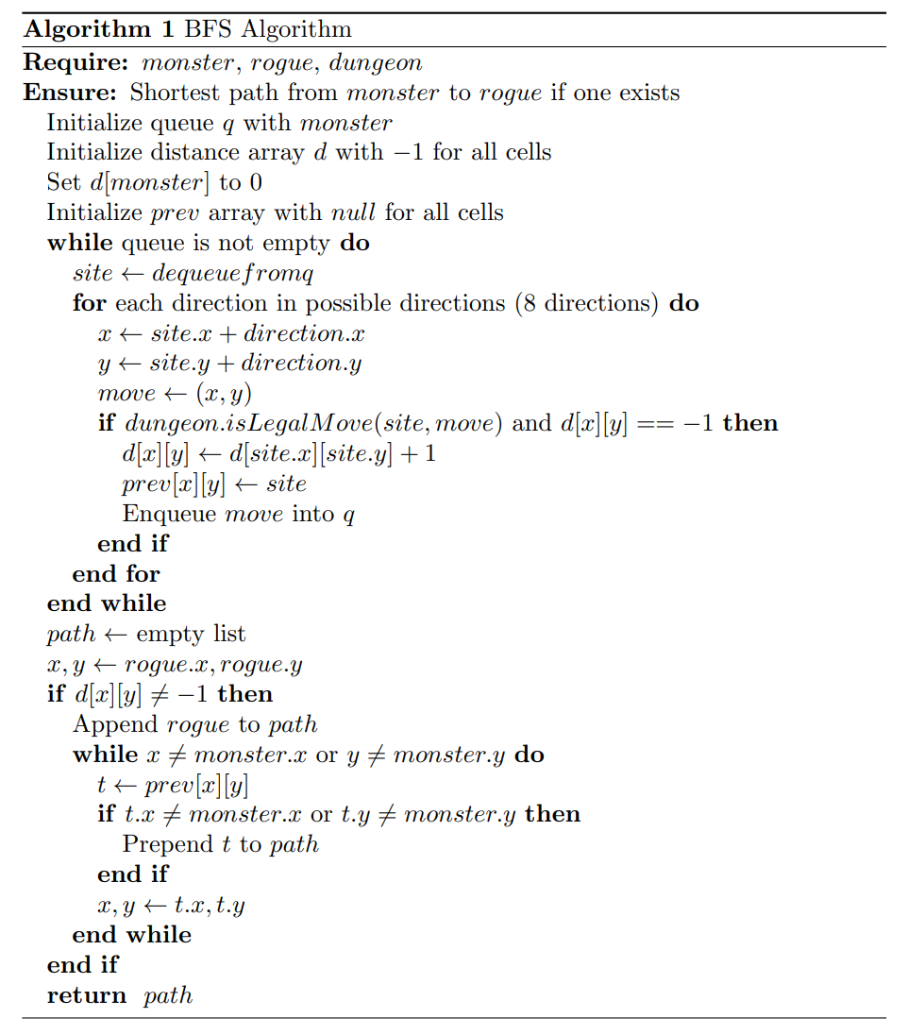
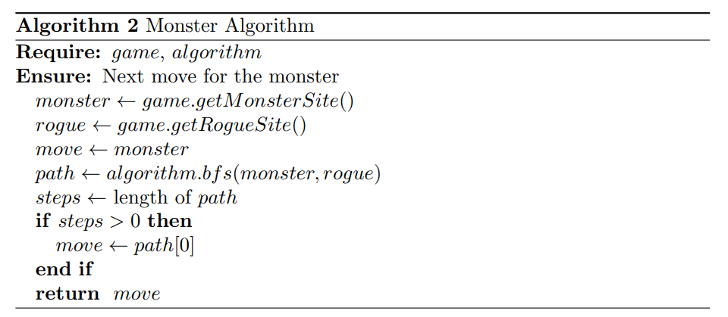
Pseudo Codes
Monster Algorithm Analysis
BFS and Monster Implementation
Time and Space Efficiency
 | Time Complexity | Space Complexity
BFS | O(n^2) | O(n^2)
Monster | O(n^2) | O(n^2)
Efficiency
Algorithm
Notes:
d57d9205-e63f-48e0-97b3-52ba7d053e85.source.default.zh-Hans

Slide 8
Monster Algorithm
S
W
Strength
Weakness
Discovery of minimum length
Reliability and simplicity of pathfinding
High space complexity
Performance and efficiency in large dungeons
O
C
Optimality
Correctness
Minimal number of moves
Level by level searching
Systematic exploration of all possible paths in a breadth-first manner
Distance array helps record and backtrack route
Notes:
2723b812-8882-4e28-9952-c5a3686829f6.source.default.zh-Hans

Slide 9
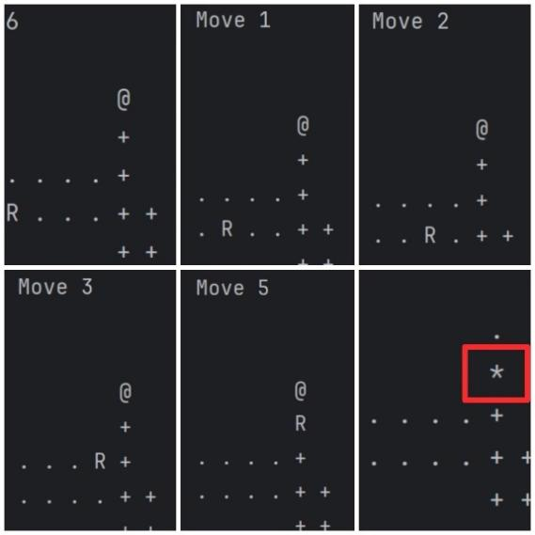
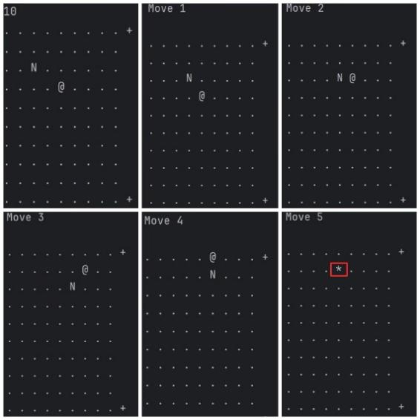
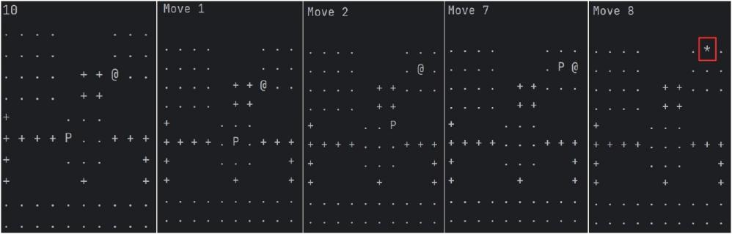
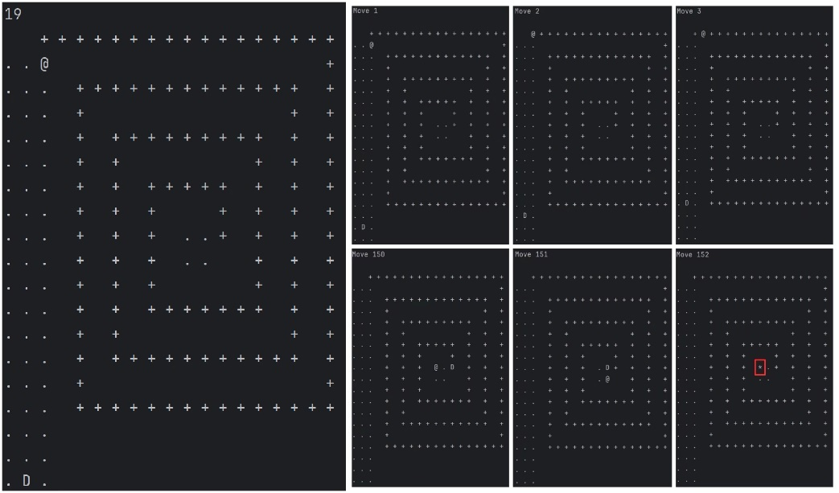
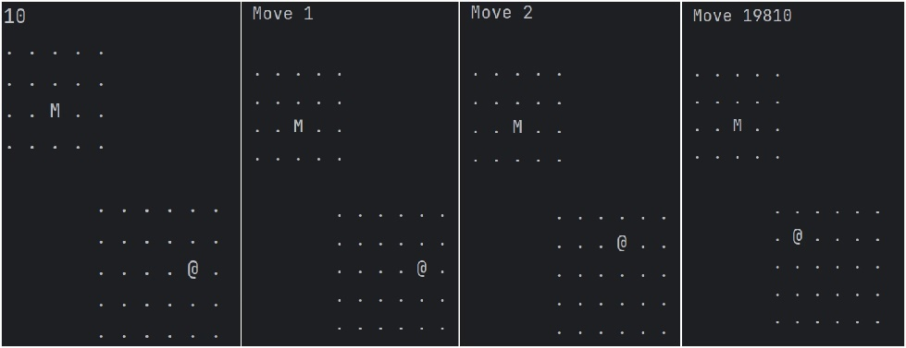
Dungeon Test Results
Central Monster, Edge or Corner Rogue – Dungeon P, R
Close Proximity in Open Space
– Dungeon N
Central Monster, Edge or Corner Rogue – Dungeon P, R
Narrow Corridor with Limited Exits – Dungeon D
Separate Space
– Dungeon M
Notes:
4fd6be85-9dd5-4a60-8bfd-af79d9085002.source.default.zh-Hans

Slide 10
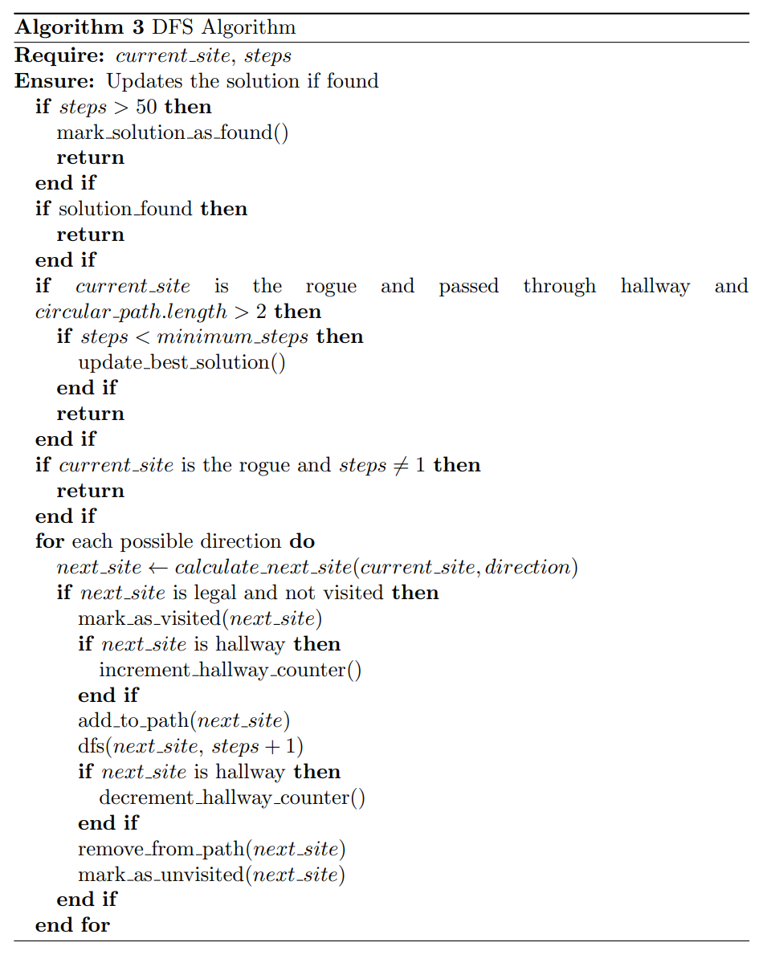
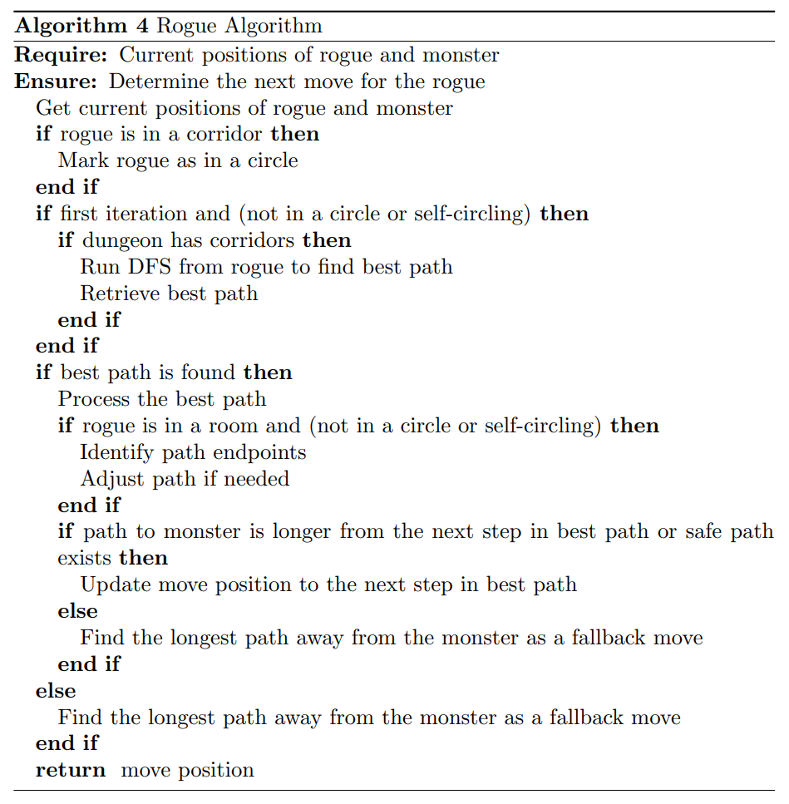
Pseudo Codes
Rogue Algorithm Analysis
DFS and Rogue Implementation
Time and Space Efficiency
 | Time Complexity | Space Complexity
DFS | O(2^n) | O(n^2)
Rogue | O(2^n) | O(n^2)
Efficiency
Algorithm

Slide 11
Rogue Algorithm
S
W
Strength
Weakness
Determinie the shortest path
Maintain a safe distance
Discover corridor-connected cycles
High space complexity
Dependence on the dungeon structure
O
C
Optimality
Correctness
Adaptive strategy
Dynamic decision-making
Pruning efficiency
BFS identifies shortest path to certain sites
DFS provides the cycle detection
Notes:
2723b812-8882-4e28-9952-c5a3686829f6.source.default.zh-Hans

Slide 12
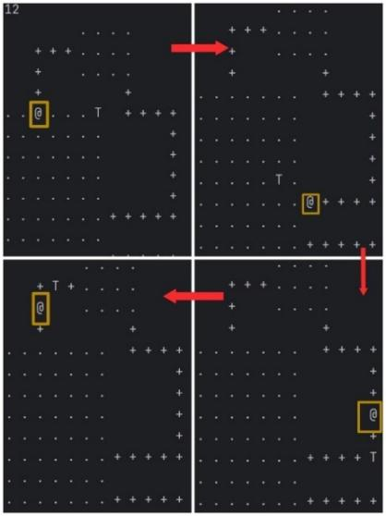
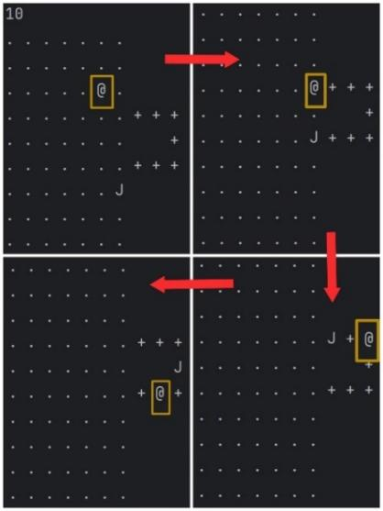
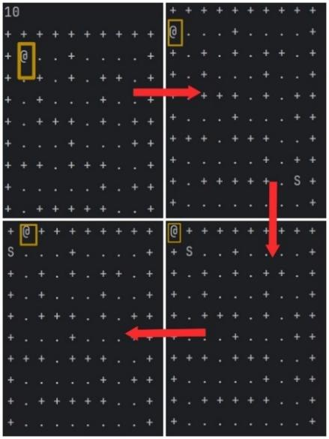
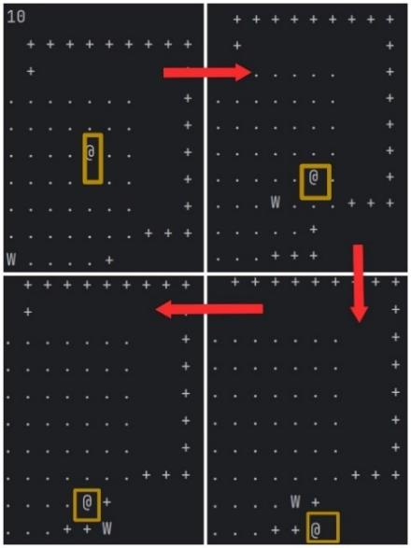
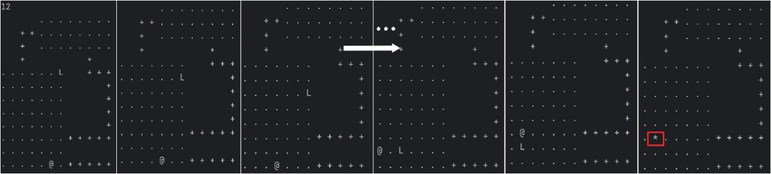
Dungeon Test Results
Initially Distant and Complex Terrain
– Dungeon Test 2, Test 3
Immediate Access to Cycles
– Dungeon Test 1, J
Dungeon Test 1
Dungeon J
Dungeon Test 2
Dungeon Test 3
Monster Location Near the Cycle Entrance – Dungeon L
Monster Location Near the Cycle Entrance
– Dungeon L
Notes:
4fd6be85-9dd5-4a60-8bfd-af79d9085002.source.default.zh-Hans

Slide 13
Thanks

