Slide 1
Shopping mart
Develop By:
Krunal D. Akbari (M1)
Id : 19bcuos048
Developed at : Ocanmtech
Internal Guide External Guide
Prof. Minaz Shaikh Manoj Hirapra

Slide 2
Contents
About system
System requirements
Hardware and software configuration
Feature and tools
Detail Description of system
Diagrams
Screen shorts
Testing data
Scope and limitation
Future expectation

Slide 3
About the system
Title | Shopping mart
Definition | Shopping mart is project where the user can buy the product from shop without going to the shop
Objective | 1. create a website that can add remove and change the product 2. user can buy them and if needed they can cancel.
Tools and technology | Front-end : html css js Back-end : django mysql
Operating system | Windows 10 or above
Submit to | Dharmsinh Desai University

Slide 4
Browsers who support
chrome 66.0 or about
Mozilla Firefox 71
Microsoft Edge 88
Front End
HTML
CSS
JavaScript
Back end :
Django

Slide 5
Hardware and Software Configuration (Client)
Hardware Configuration | Description
Processor | Intel i3 and above
RAM | 1 GB or more

Slide 6
Software specification
Software specification | Description
Operating System | Windows 10
Back end | Python & Django framework

Slide 7
Feature and tools Used
Django
Django is a framework to build the web application easier and faster with lots and lots of functionality

Slide 8
Feature and tool used
Python
Python is a high level,general-purpose programming Language. Its design philosophy emphasizes code readability with the use of significant indentation. Its language consider and object-oriented approach aim to help programme write clear, logical code for small- and large-scale projects.
Python is dynamic-typed and garbage-collected It supports multiple programming paradigms, including structured (particularly procedural), object-oriented and functional programming. It is often described as a "batteries included" language due to its comprehensive standard library.

Slide 9
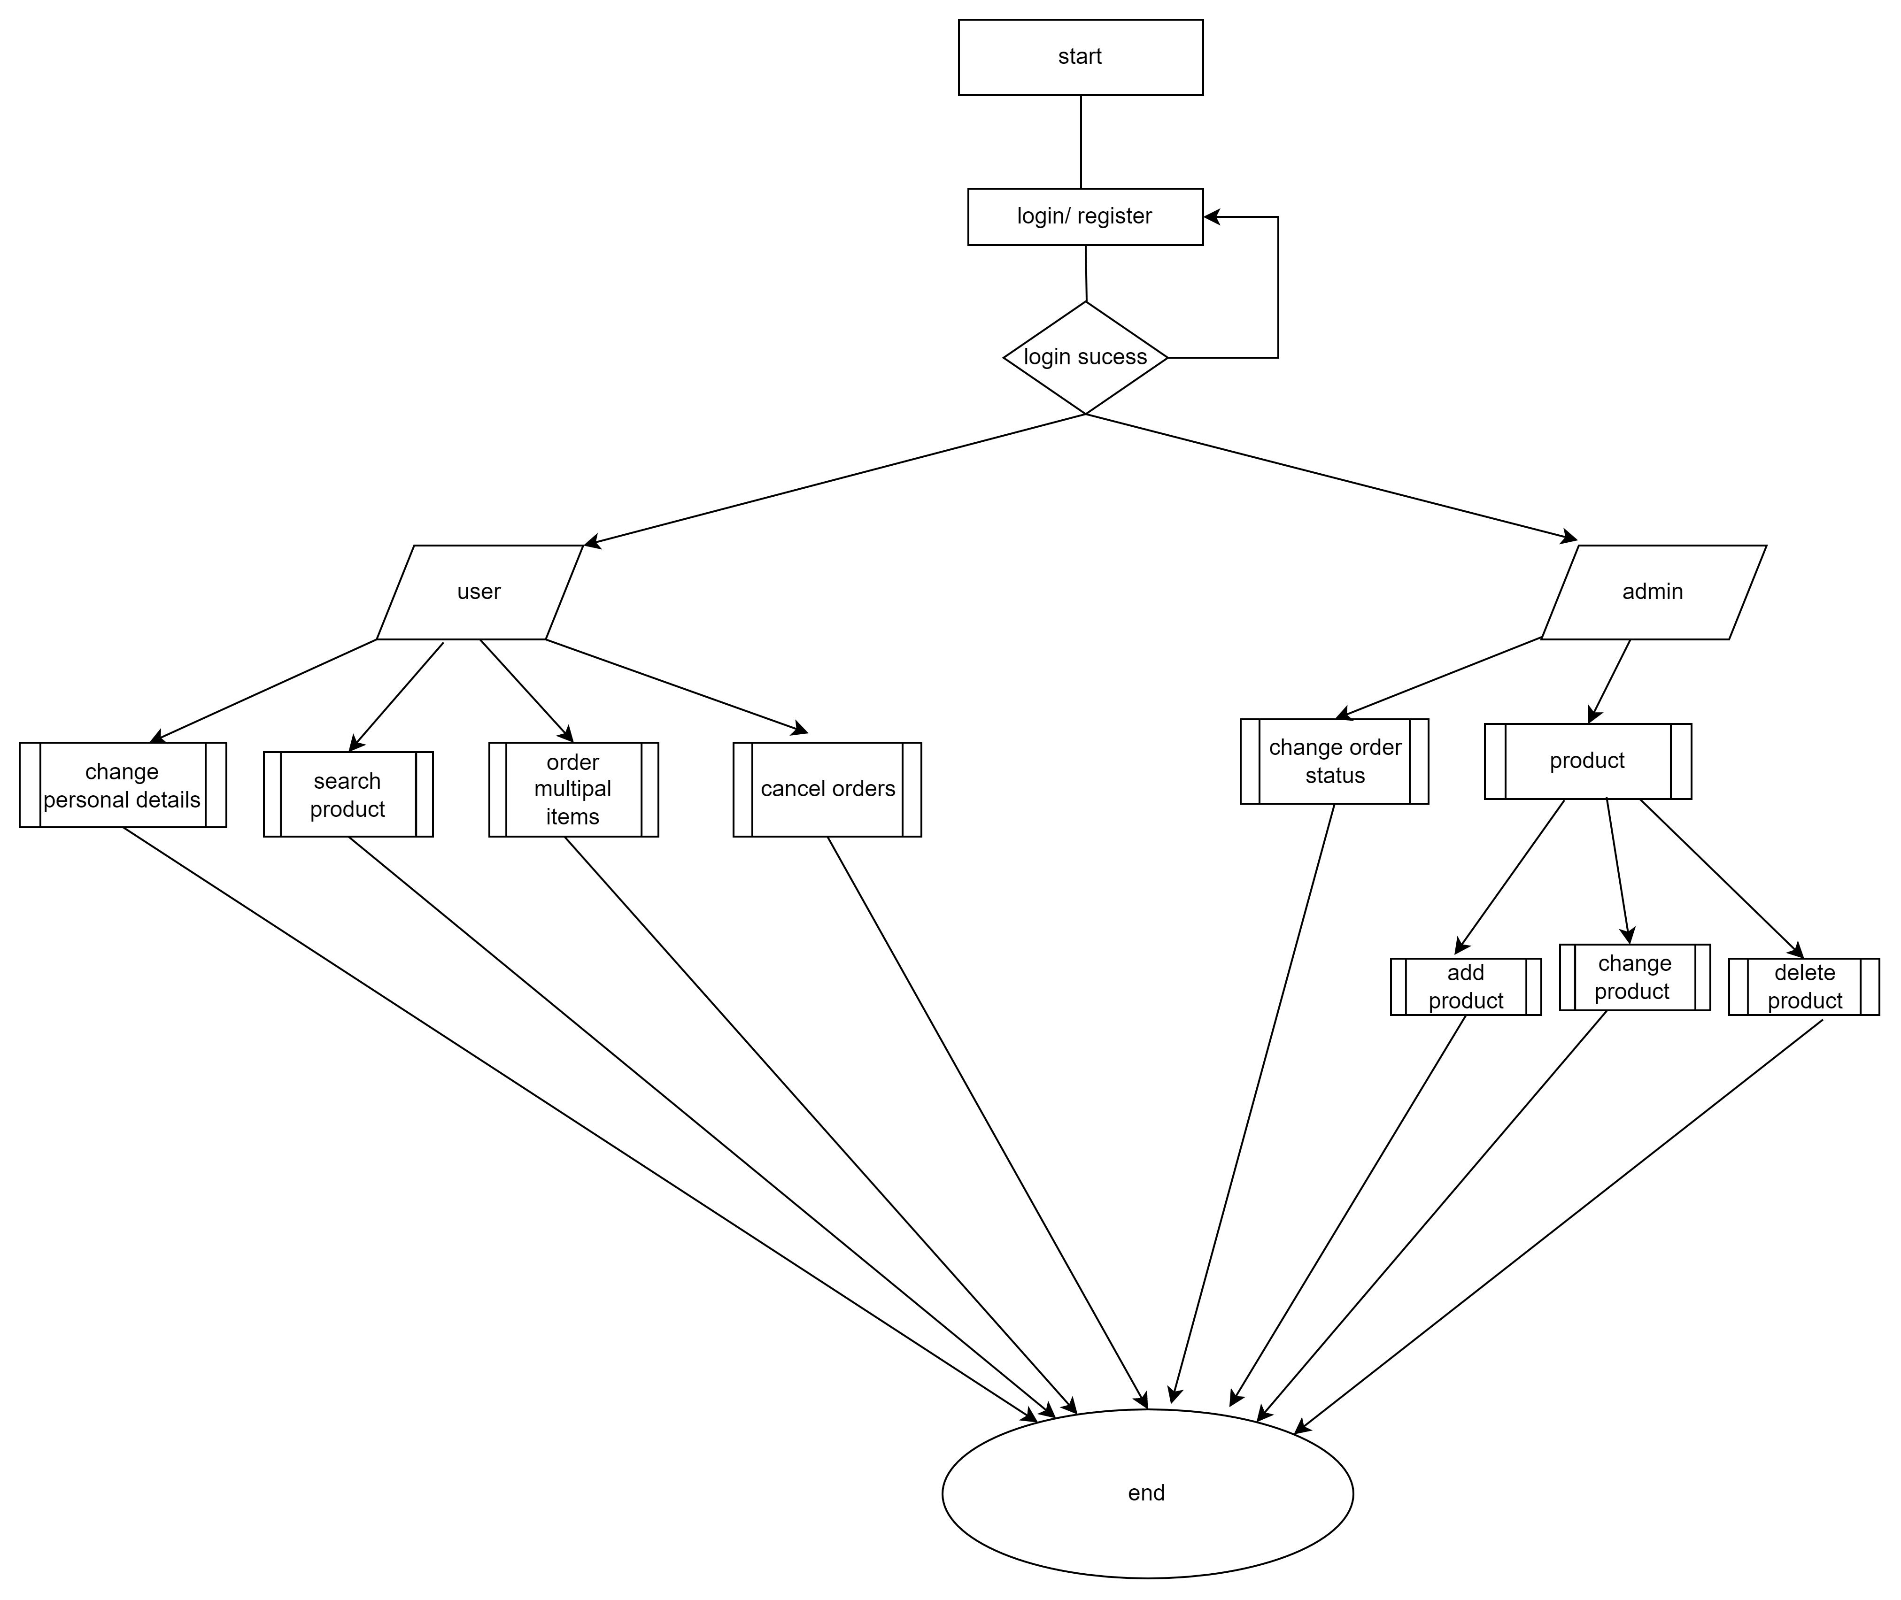
Flow Chart

Slide 10
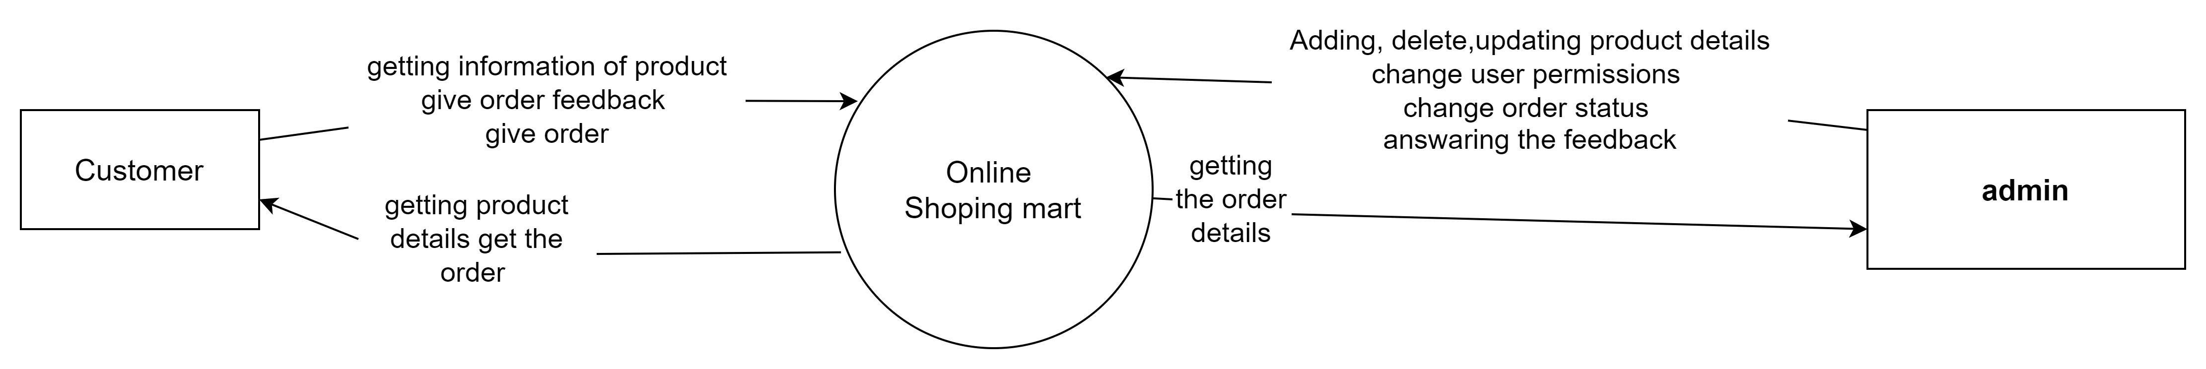
Context level DFD

Slide 11
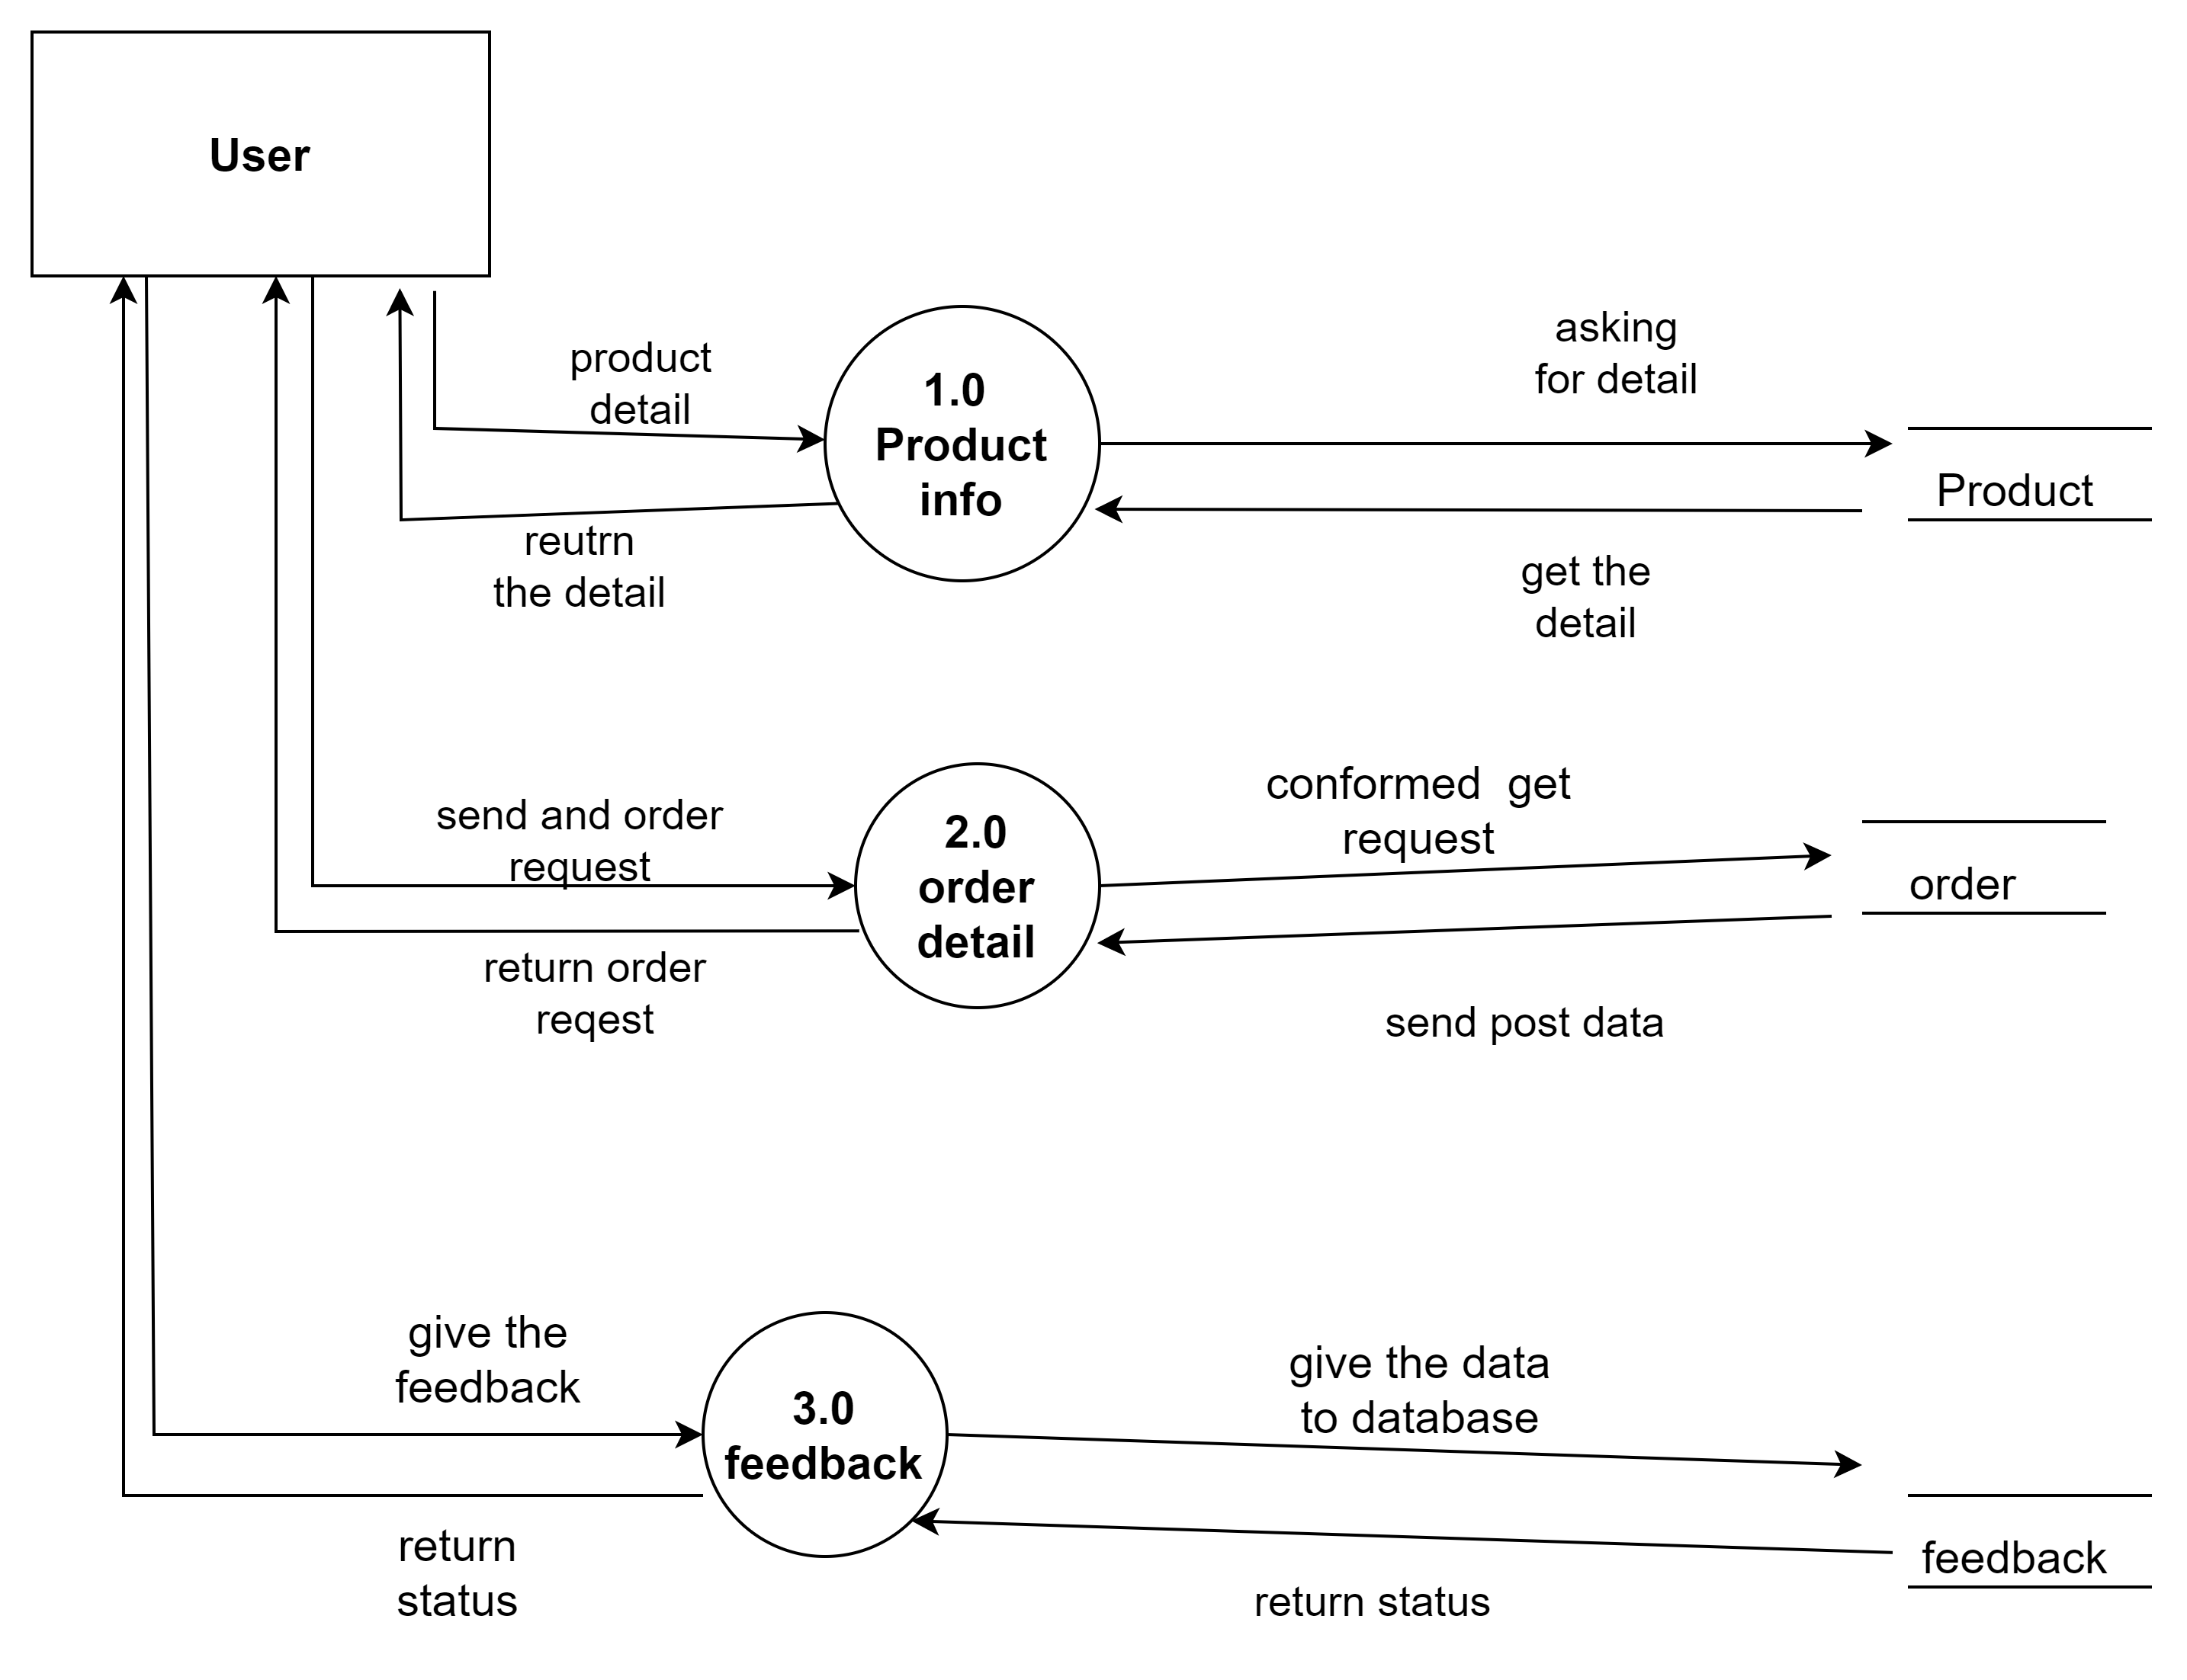
1st level User DFD

Slide 12
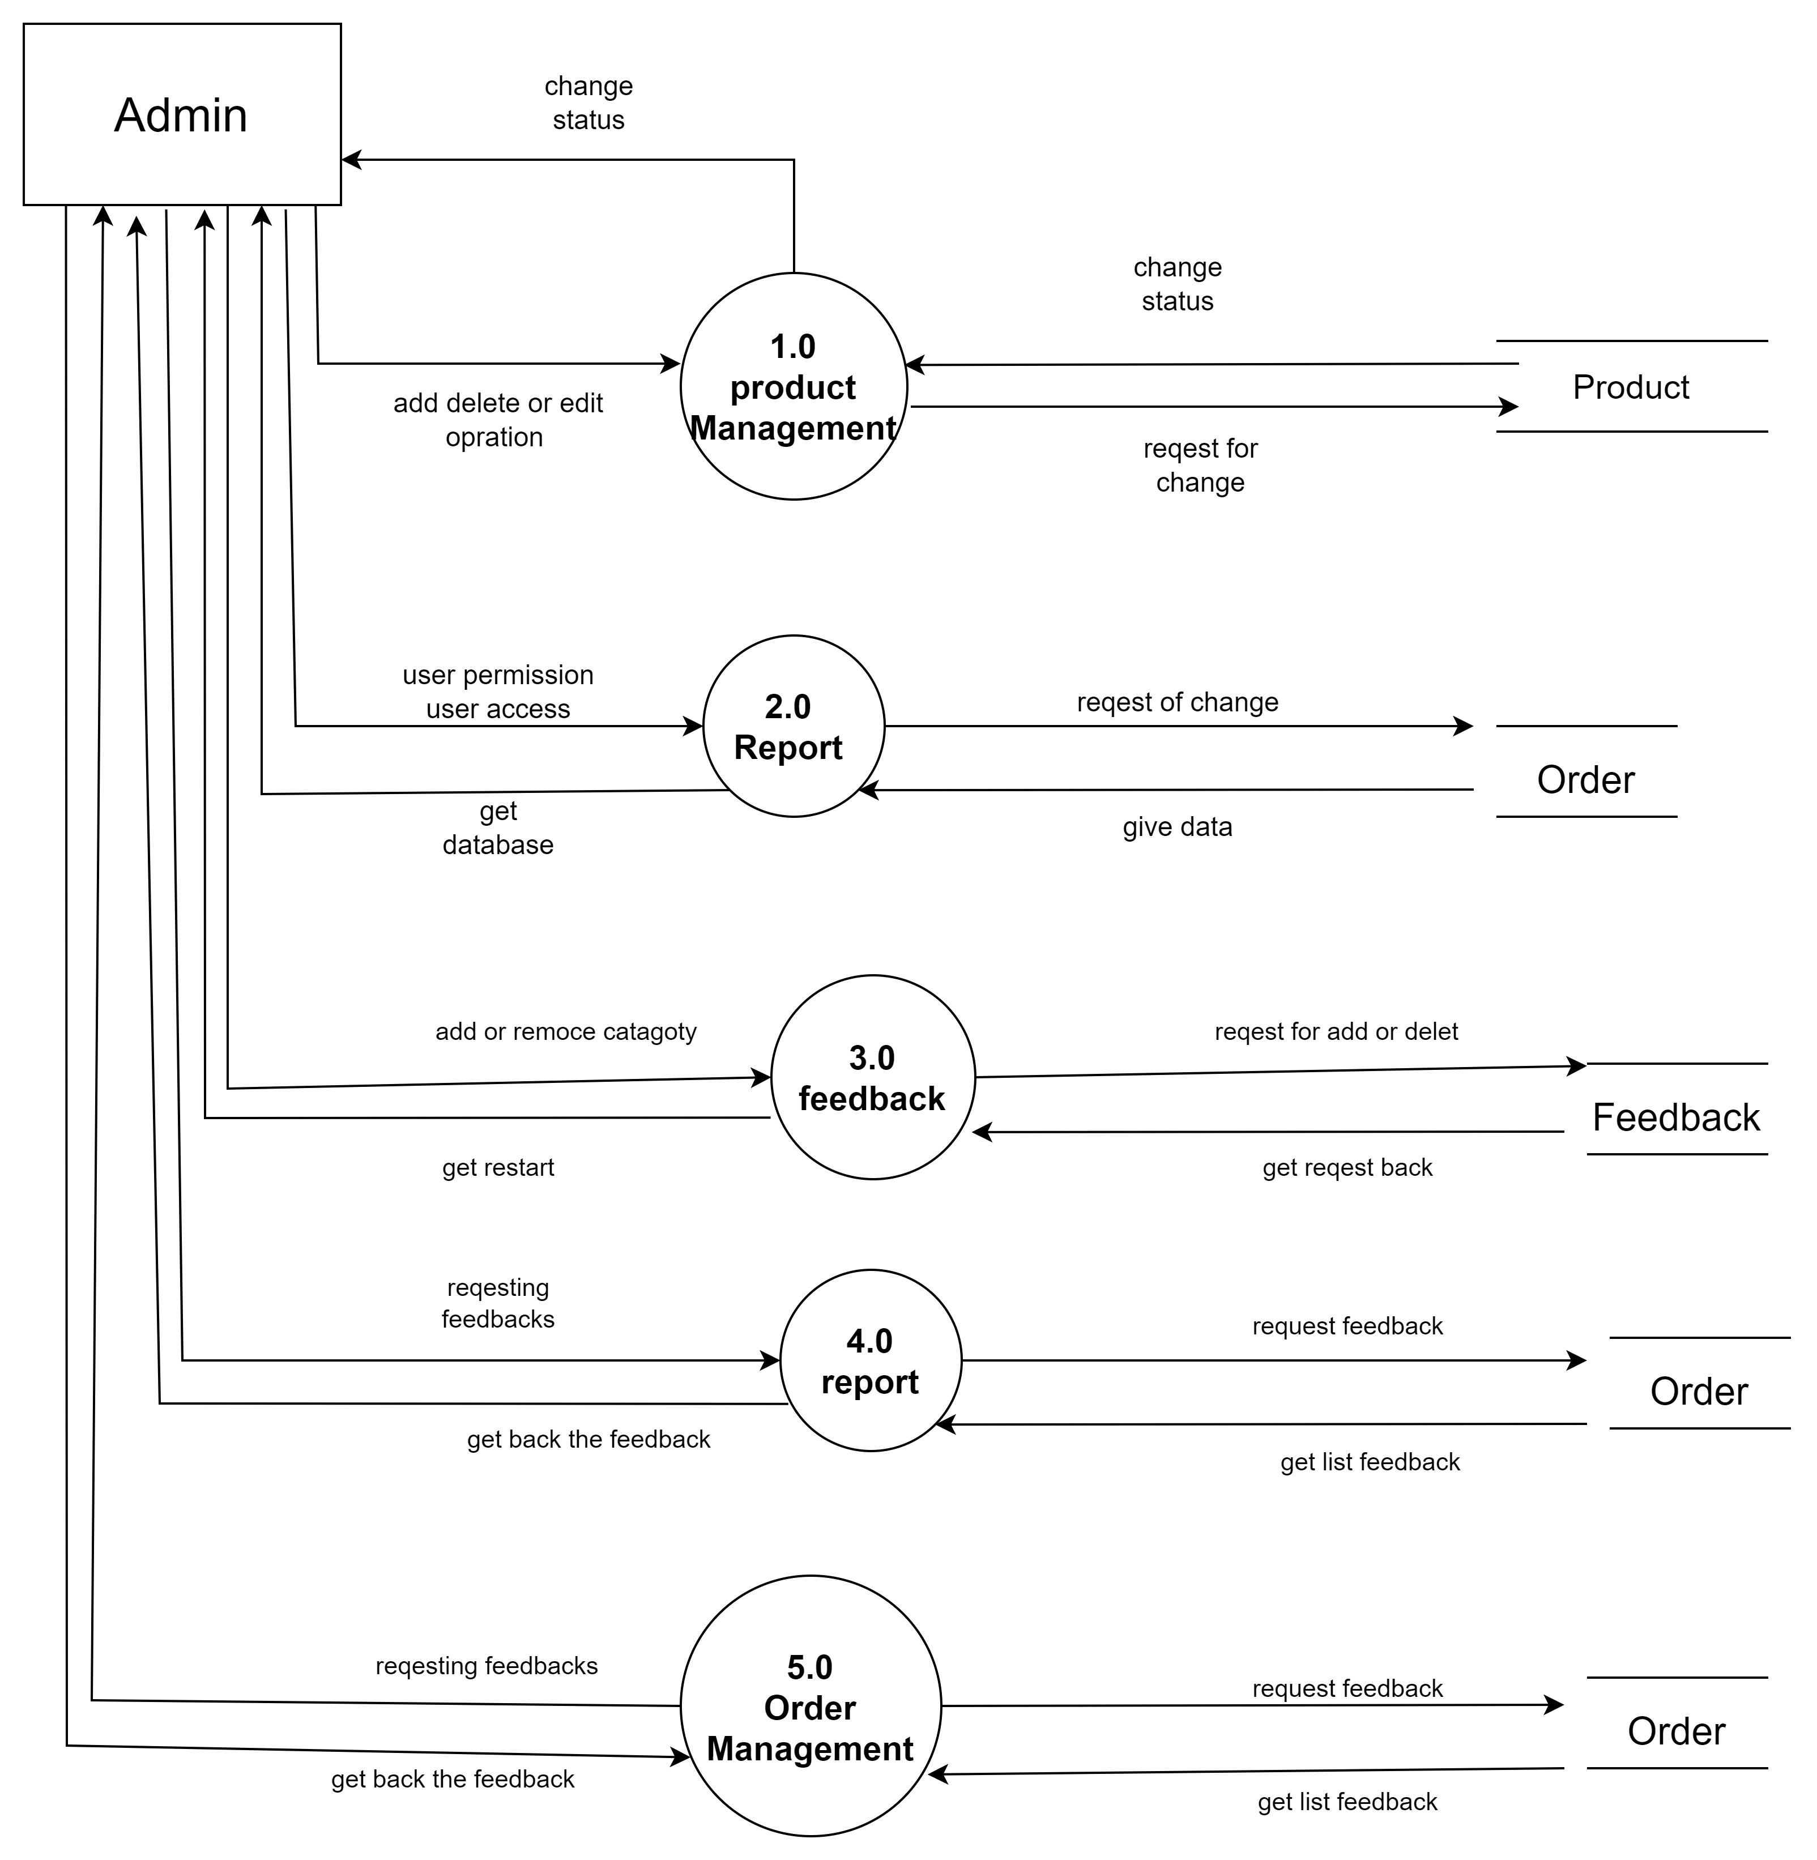
1st level Admin DFD

Slide 13
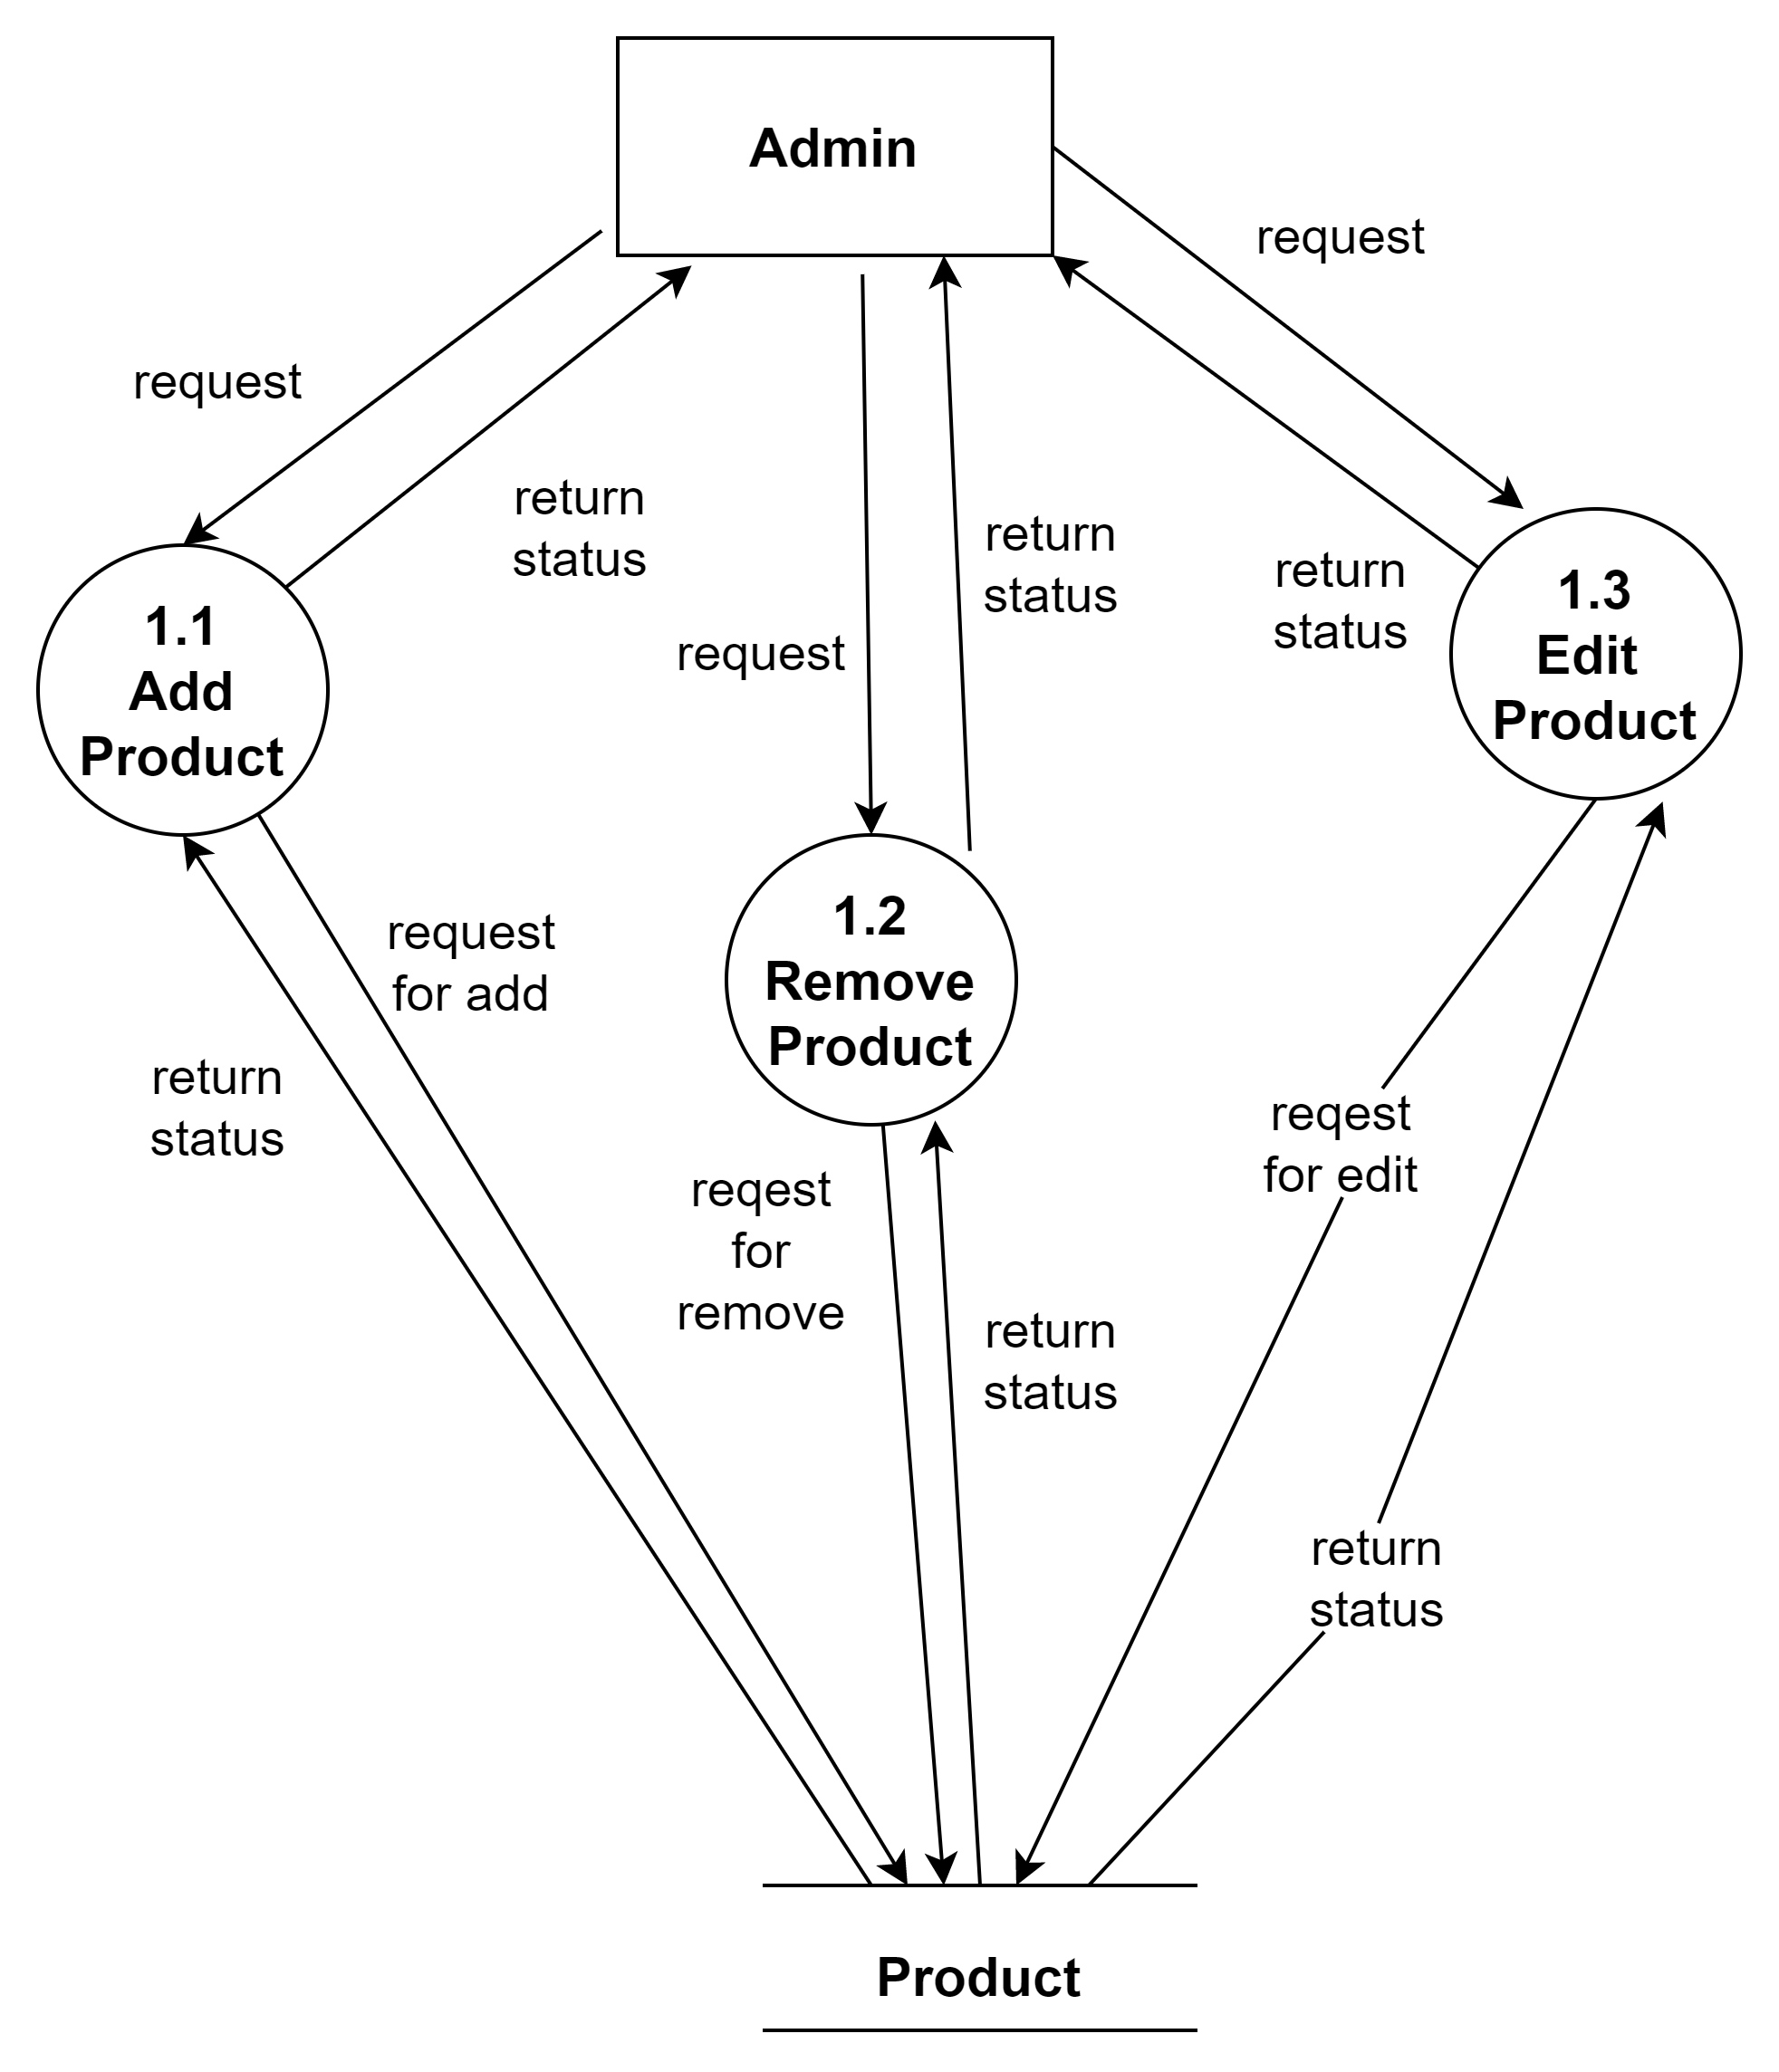
2nd level Product DFD

Slide 14
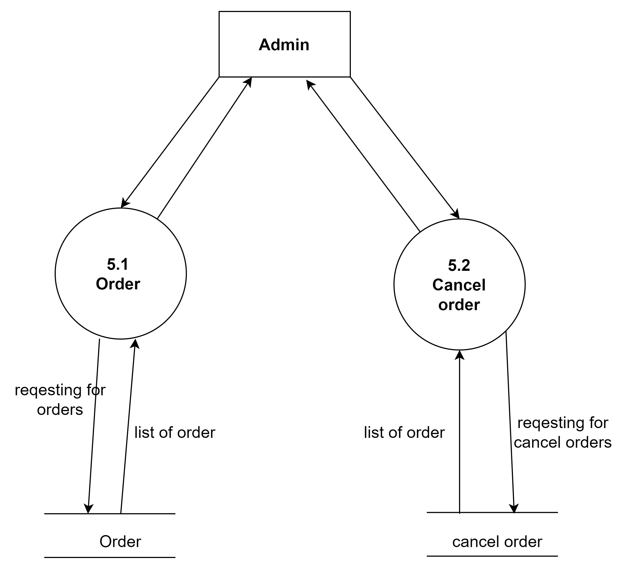
2nd level Order DFD

Slide 15
Data Dictionary
User Table
Field Name | Datatype (Size) | Constraint | Sample value | Description of field
User Id | Integer | Primary Key, auto increment | 1 | Stores the User Id.
User Name | Varchar(150) | NOT NULL | Krunal | Stores the name of User.
Password | Varchar(255) | Not null | krunal@11 | Store the password.
email-id | Varchar(50) | Not null | Krunal@gmail.com | Store the gmail id.
First name | Varchar(150) | Null | Null | First name is optional
Last name | Varchar(150) | Null | Null | Last name is optional
Groups | Foreign key | Null | Null | This can be null user cant be in any group
Permission | Foreign key | Null | Accessible -admin site | This is give the permission to user as admin

Slide 16
Data Dictionary
User Table
Is staff | Boolean | Not null | TRUE | This means user is allowed to the admin site
is_active | Boolean | Not null, default True | FALSE | That means user are allow or not that means the user will be not allow to use the site with this account.
is_superuser | Boolean | Not-null, Default False | TRUE | This means give the permission without asking this any permission.
Last_login | Datetime | Not null | 29-03-2022 10:01 | This will save time and date of the last login
Date_joined | Datetime | Not null | 2-03-2022 05:01 | This will save the time and date of account created

Slide 17
Data Dictionary
Customer name
Field Name | Data type (Size) | Constraint | Sample value | Description of field
Customer Id | Integer | Primary key | 01 | Store the Customer id
User id | Integer | Foreign key | 1 | Stores the User id.
Customer name | Varchar(150) | NOT NULL | Krunal Akbari | Stores the customer name.
Address | Varchar(150) | NOT NULL | 43,vishalnagar society surat | Stores the Customer address
Number | Char(10) | NOT NULL | 1122334455 | Stores the customer number.
Image | Image | Null True | Image-icon.png | This is store the user image/profile photo
State | Varchar(150) | Not null | Gujarat | This will store the state name

Slide 18
Data Dictionary
Product name
Field Name | Data type (Size) | Constraint | Sample value | Description of field
Product_id | Integer | Primary key, auto increment | 1001 | Stores the product id.
Product_name | Varchar(150) | NOT NULL | phone | Stores the product name.
price | Float | NOT NULL | 10000 | Stores the product price.
Product_category_name | Varchar(50) | Not null | Electronic | Stores the product category name.
Product_stock | Integer | NOT NULL | 30 | Stores the product stock.
Discount | Integer | NOT NULL | 60 | Stores the product discount
Description | Varchar(255) | Not null | Product description | This will store the description of product

Slide 19
Data Dictionary
Order Detail Table
Field Name | Data type (Size) | Constraint | Sample value | Description of field
Order-Id | Integer | Primary Key, auto increment | 01 | Store the order Id.
Customer id | Integer | Foreign key | 1 | User the customer id
Order status | Varchar(10) | Not null | Process | Store the state of the order
Order_Completed | Boolean | Not null | FALSE | Store the order is completed or not.
Order date | Date | Not Null | 2020/12/01 | Store the order date
Transfection-id | Varchar(150) | Not Null | AReAe4ASe5839 | Store the transfection id if the payment made
Expected time | Date time | Null | 10/10/22 | Store the date expected delivery time

Slide 20
Data Dictionary
Order Item Table
Field Name | Data type (Size) | Constraint | Sample value | Description of field
Order Item Id | Integer | Primary Key | 1 | Primary key of table
Product id | Integer | Foreign key | 01 | Store the order Id.
Order id | Char(6) | Foreign key | 10101 | Stores the User Id.
Quantity | Char(6) | Foreign key | 111 | Store the product id.
Date_added | Date | Not null | 21/02/2021 | Stores the order item date.

Slide 21
Data Dictionary
Cancel Order
Field Name | Data type (Size) | Constraint | Sample value | Description of field
Cancel Order Id | Integer | Primary key | 1 | Store the Cancel Order Id
Customer Id | Integer | Foreign key | 01 | Store the order Id.
Date_ordered | Char(6) | Foreign key | 10101 | Stores the User Id.
Trisection_id | Char(3) | NOT NULL | 01 | Stores the transfection id.
Cancel order_time | Date time | NOT NULL | 29-03-2022 12:20:00 PM | Stores the cancel order time.

Slide 22
Data Dictionary
Favourite detail
Field Name | Data type (Size) | Constraint | Sample value | Description of field
Favourite-id | Integer | Not null | 1 | Store the id
Customer id | Integer | Foreign -key | Krunal | Foreign key to the customer
Date-added | Date time | Not null auto now add | 29-03-2022 10:10 | Store the current time

Slide 23
Data Dictionary
Favorite Item Detail
Field Name | Data type (Size) | Constraint | Sample value | Description of field
Favourite Item id | Integer | Primary Key, auto increment | 1 | Store Favourite Item Id
Favourite-id | Integer | Foreign key | 1 | Store the id
Customer id | Foreign -key | Not null | Krunal | Foreign key to the customer
Date-added | Date time | Not null auto now add | 29-03-2022 10:10 | Store the current time

Slide 24
Data Dictionary
Complain Table
Field Name | Data type (Size) | Constraint | Sample value | Description of field
Complain-id | Integer | Primary Key, auto increment | 1 | Store the id
Customer id | Integer | Foreign -key | Krunal | Foreign key to the customer
Product id | Integer | Foreign -key | Phone | Store the product id
Date-complain | Date time | Not null auto now add | 29-03-2022 10:10 | Store the current time
Complain | Varchar(200) | Not null | This product has some issue | Complain of the customer about product

Slide 25
Data Dictionary
Feedback Table
Field Name | Data type (Size) | Constraint | Sample value | Description of field
Feedback id | Integer | Primary Key, auto increment | 1 | Store the id
Customer id | Foreign -key | Not Null | Krunal | Foreign key to the customer
Date-feedback | Date time | Not null auto now add | 29-03-2022 10:10 | Store the current time
Feedback | Varchar(200) | Not null | Feedback | Store the feedback of the user
Email | Varchar(150) | Not null | krunal@gmail.com | Store the email id of user
Phone no | Number(10) | Not null | 1122334455 | Store the user number for feedback

Slide 26
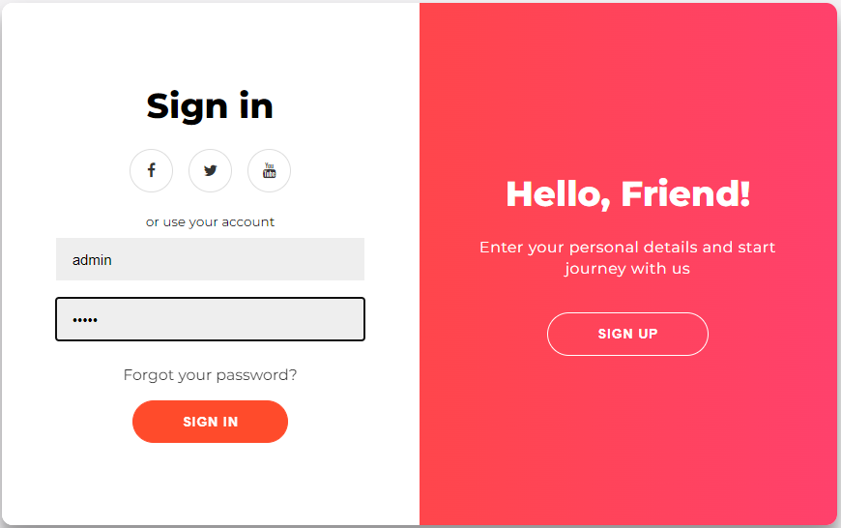
Screen Shorts
Login Screen

Slide 27
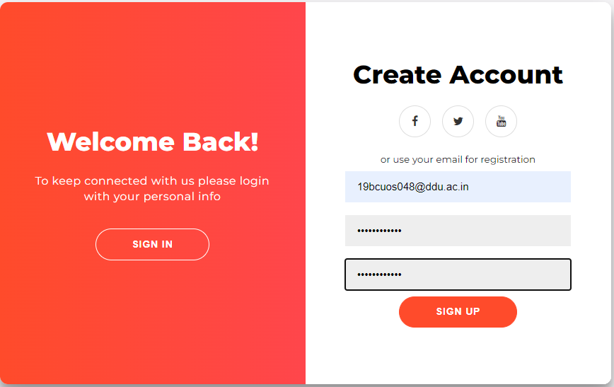
Screen Shorts
Sign in Screen

Slide 28
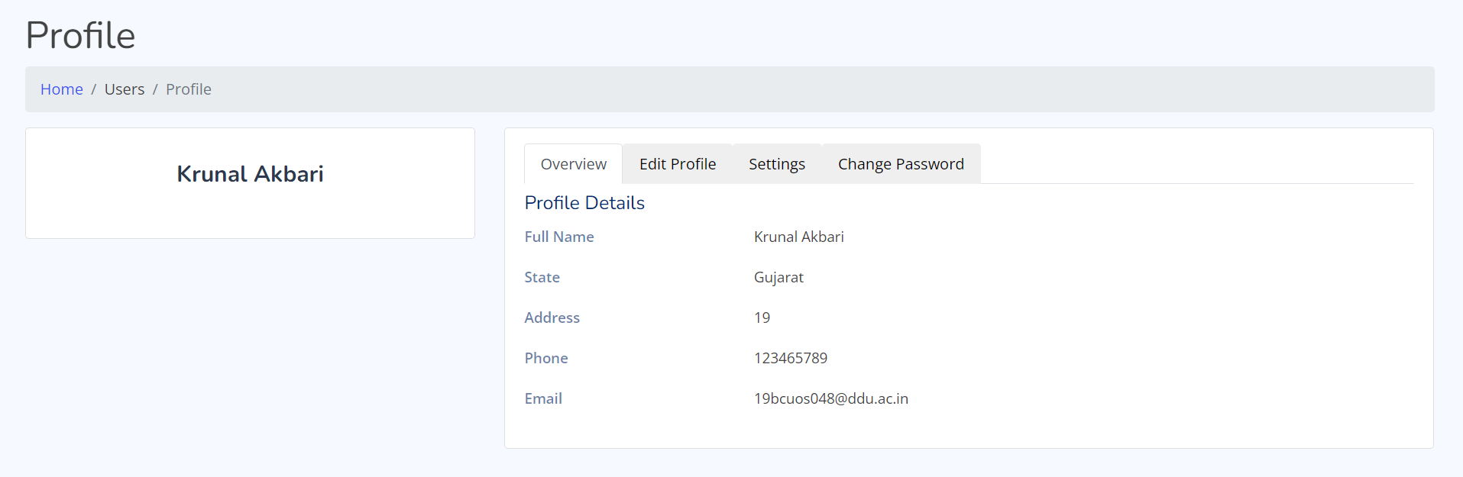
Screen Shorts
Profile Screen

Slide 29
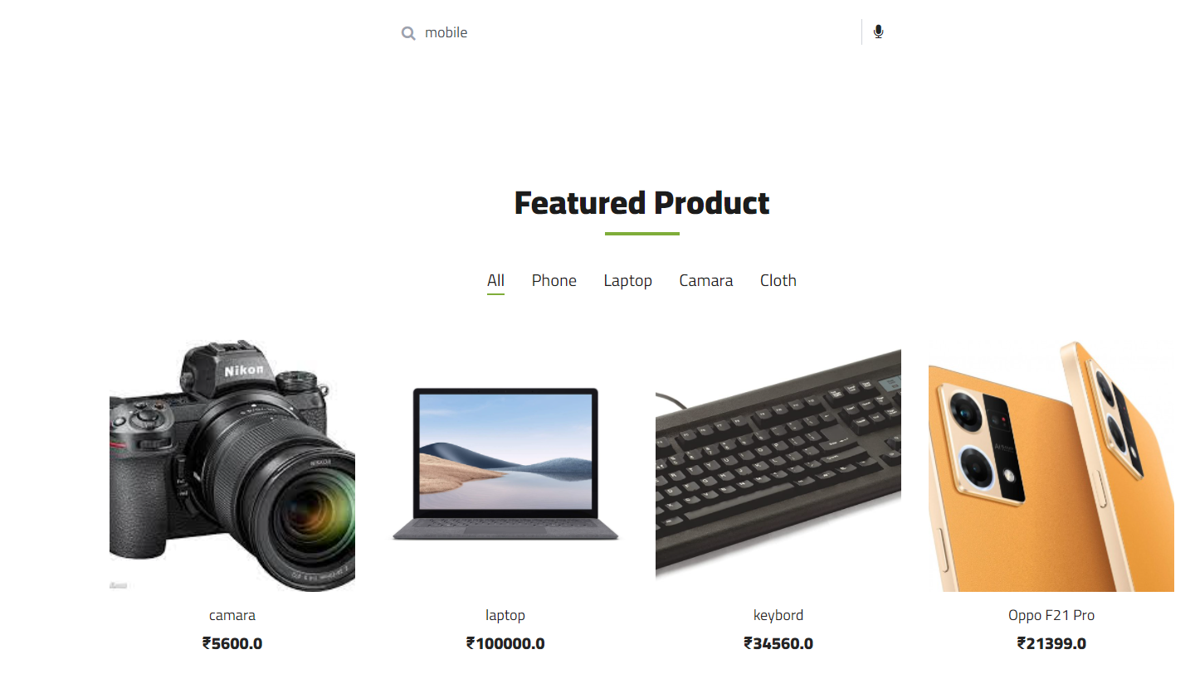
Screen Shorts
Home page Screen

Slide 30
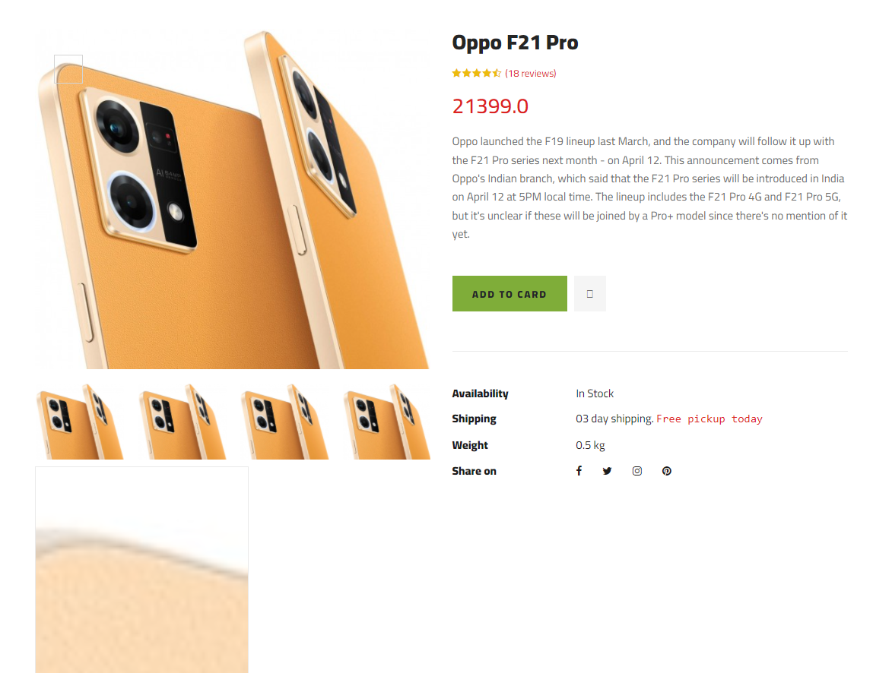
Screen Shorts
Product Detail Screen

Slide 31
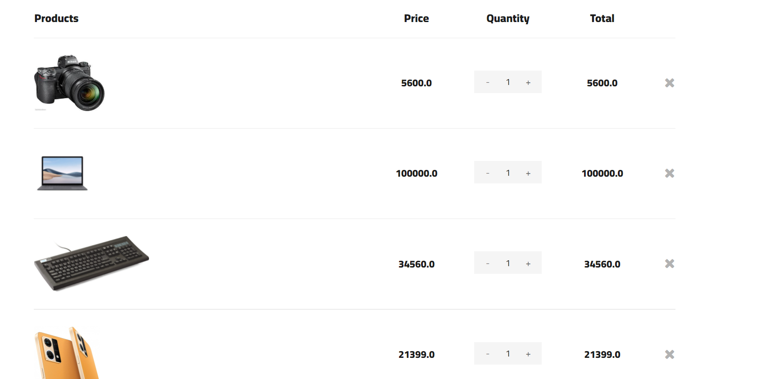
Screen Shorts
Cart Screen

Slide 32
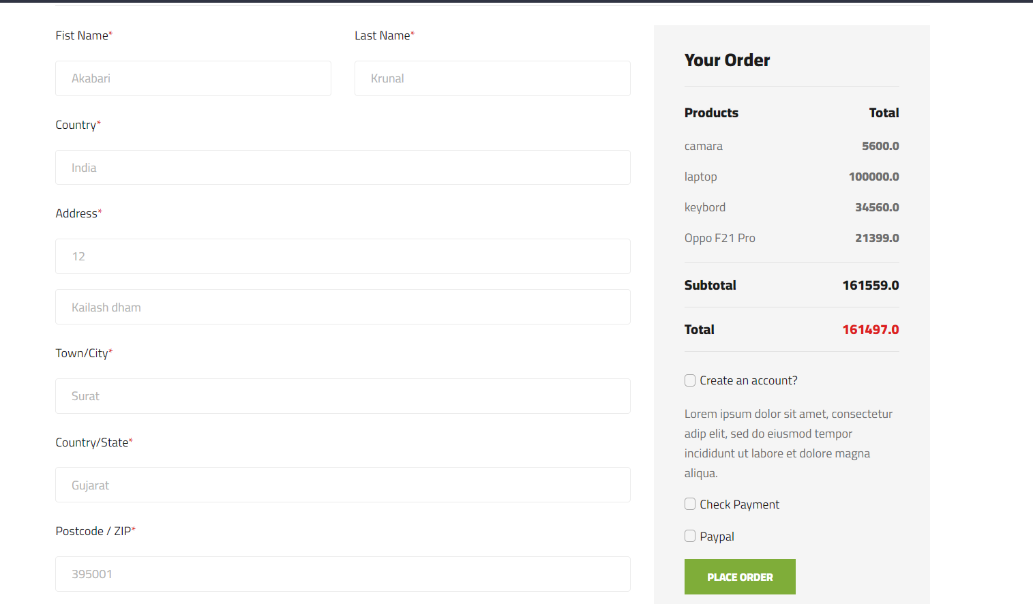
Screen Shorts
Checkout Screen

Slide 33

Screen Shorts
Payment Screen

Slide 34
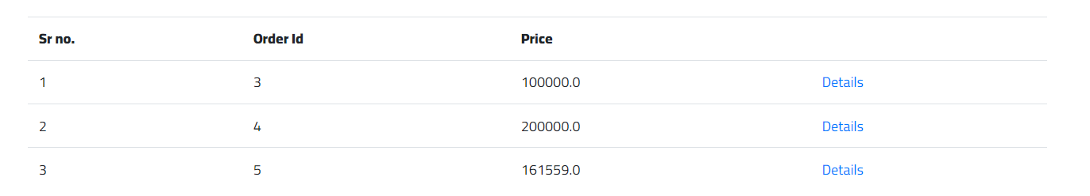
Screen Shorts
Order Detail list Screen

Slide 35
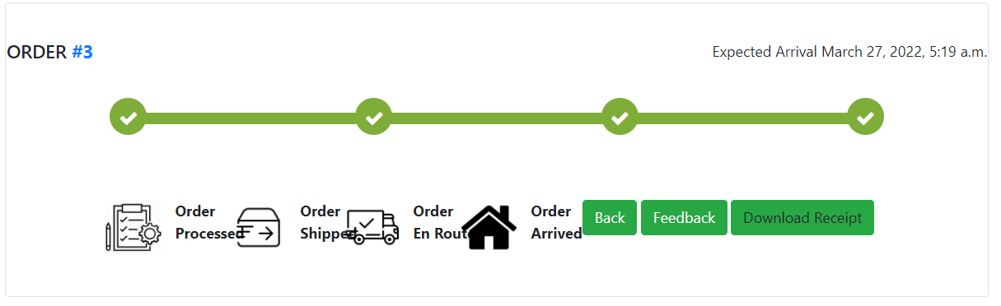
Screen Shorts
Order Detail Screen

Slide 36
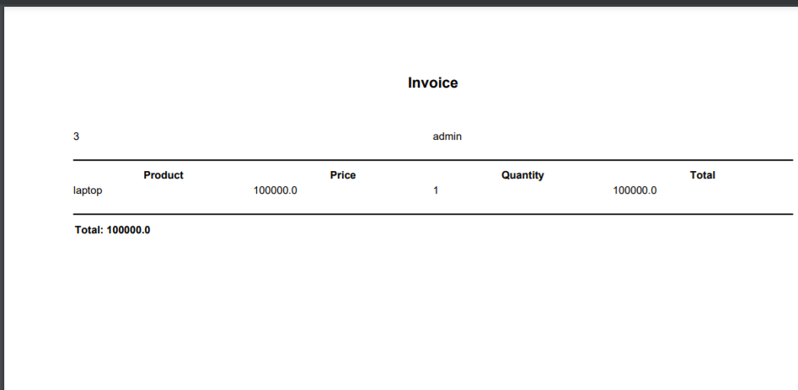
Screen Shorts
Order Detail Screen

Slide 37
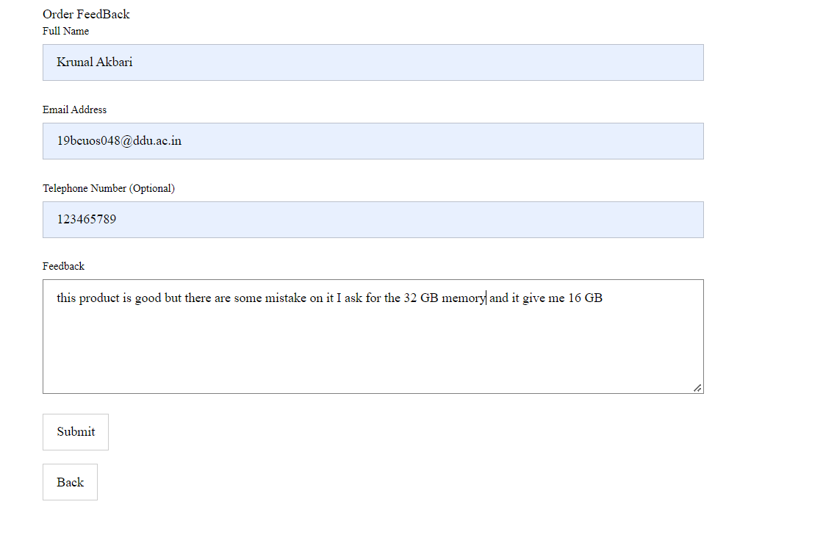
Screen Shorts
Order Feedback Screen

Slide 38
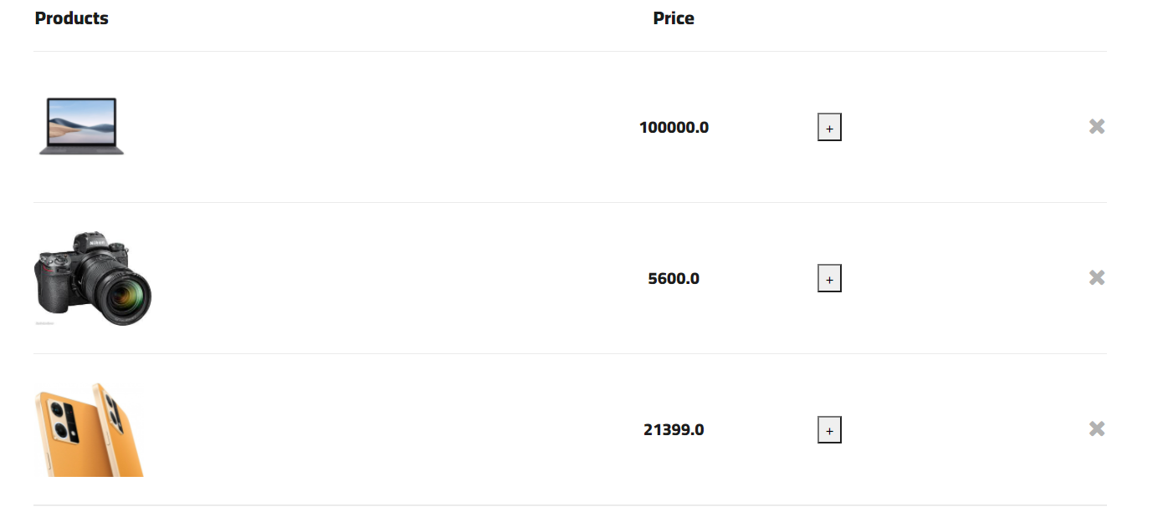
Screen Shorts
Favorite Item Screen

Slide 39
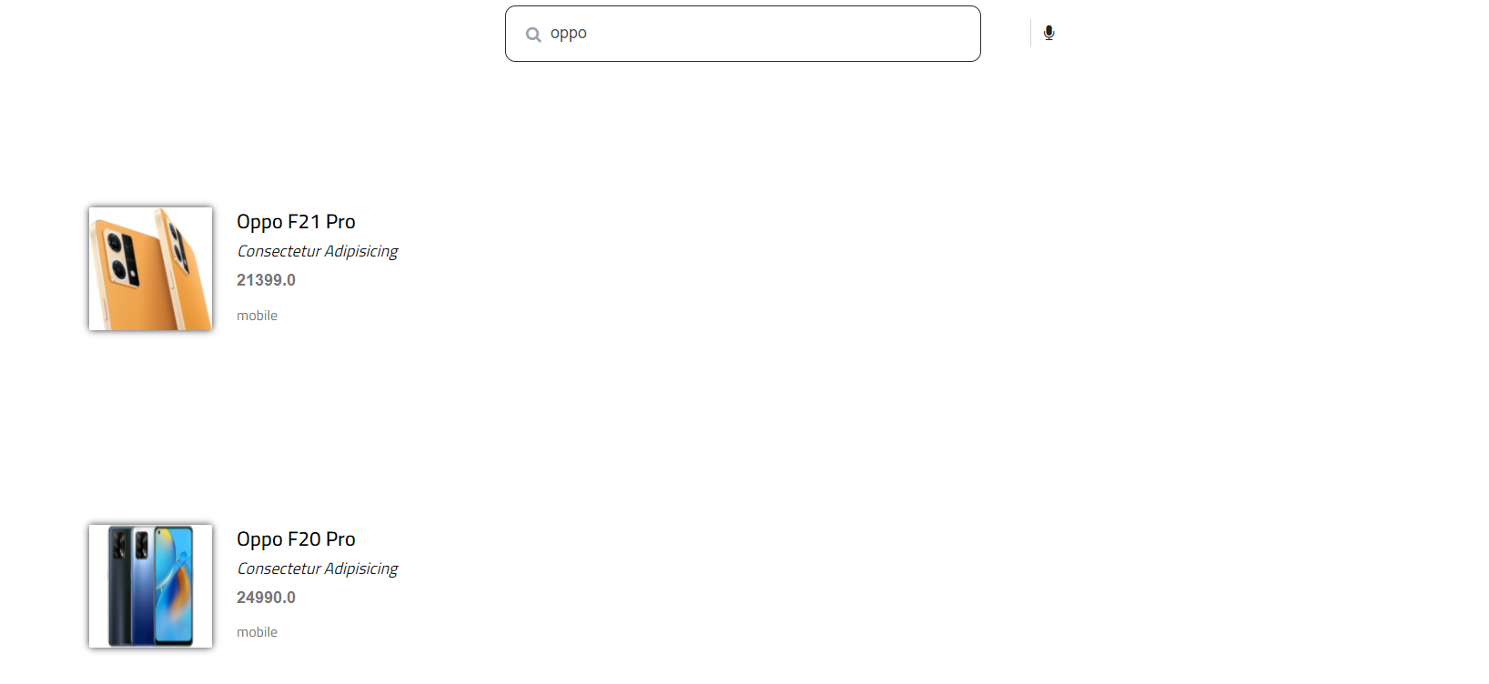
Screen Shorts
Search Screen

Slide 40
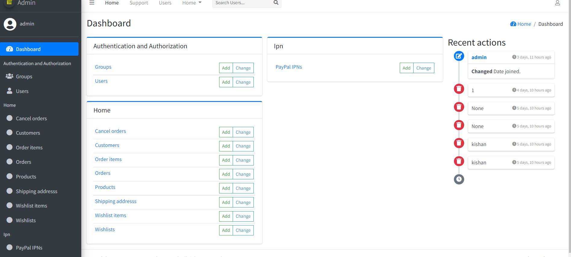
Screen Shorts
Dashboard

Slide 41
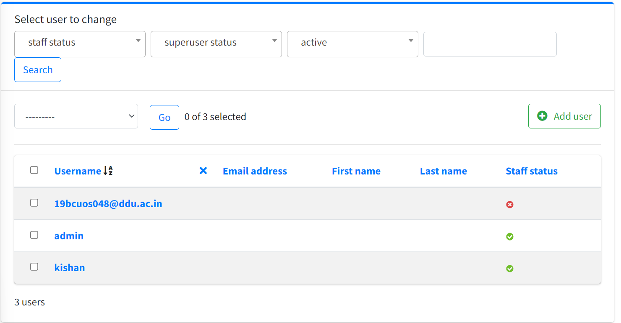
Screen Shorts
User

Slide 42
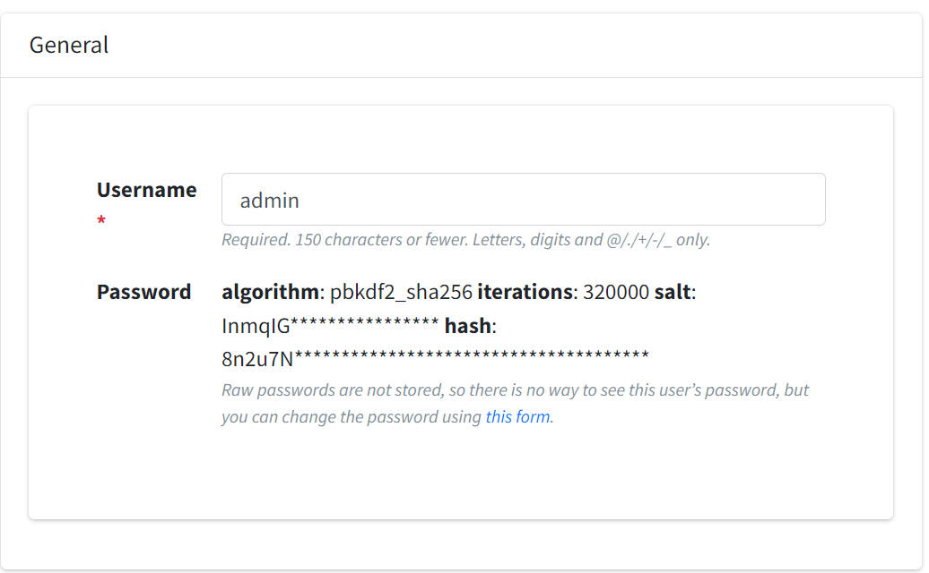
Screen Shorts
User (general)

Slide 43
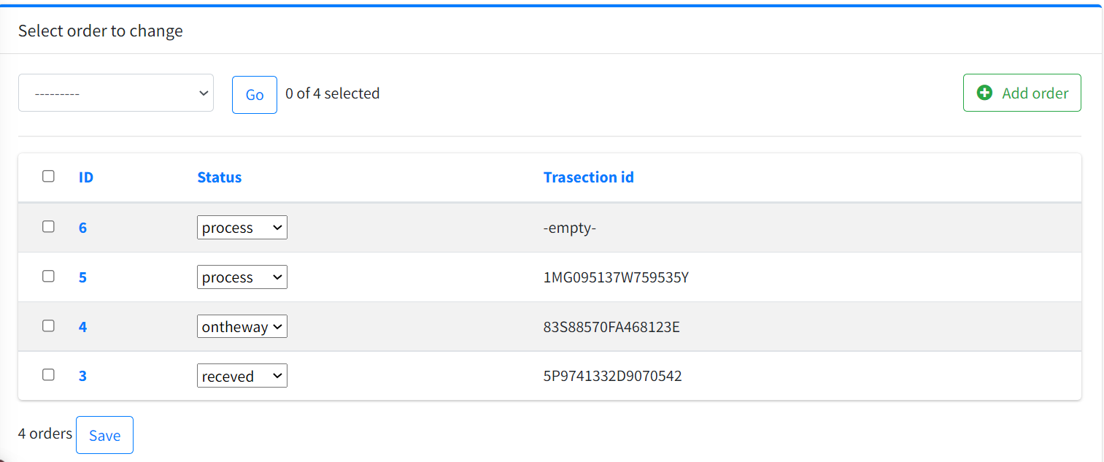
Screen Shorts
Order List

Slide 44
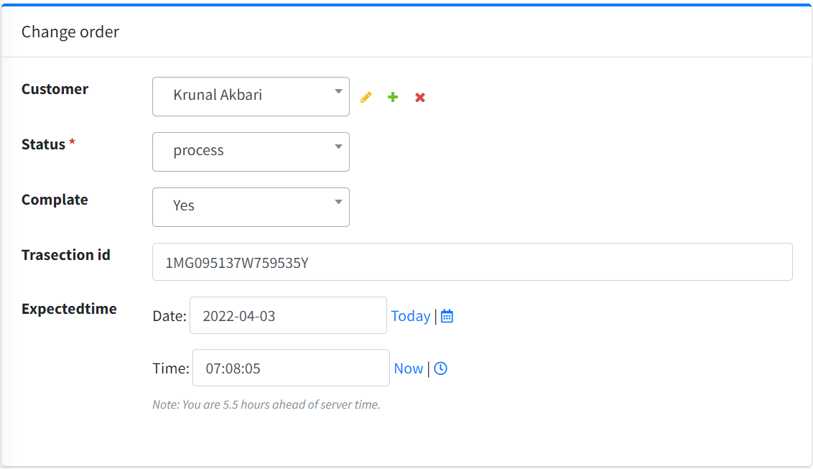
Screen Shorts
Order Item

Slide 45
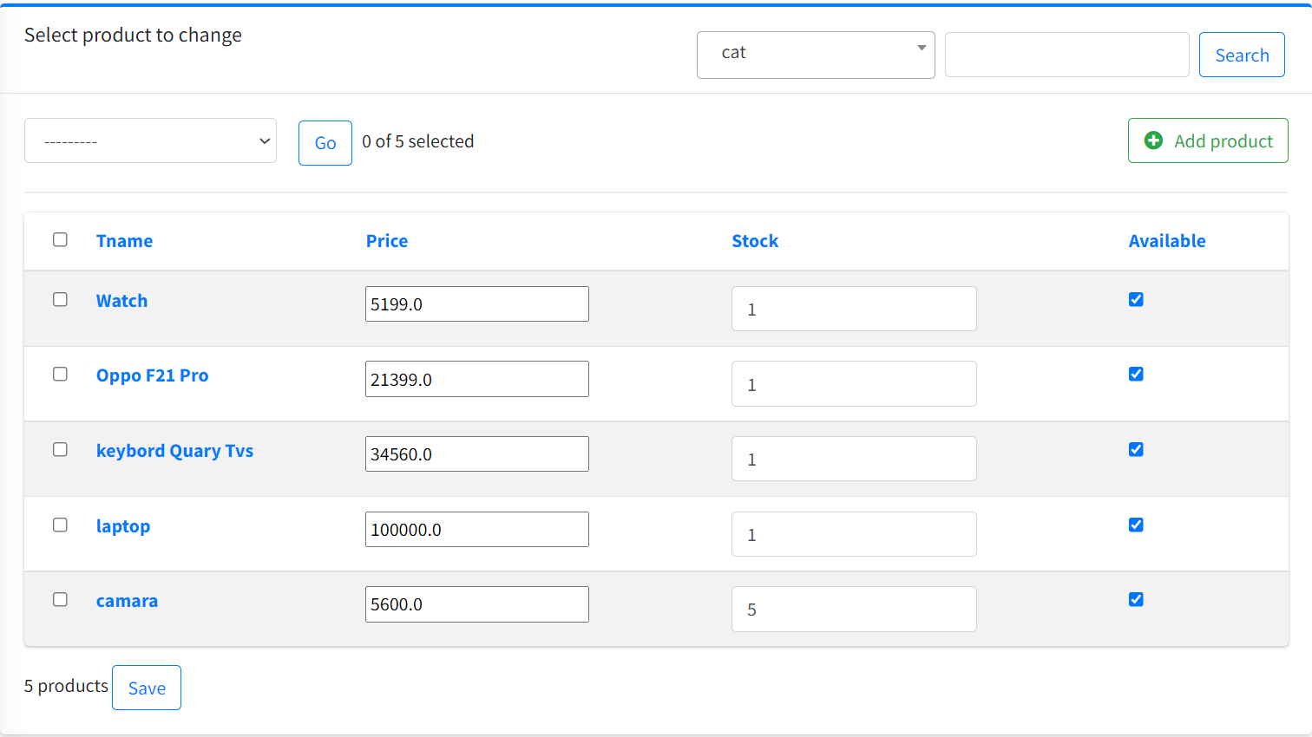
Screen Shorts
Product List

Slide 46
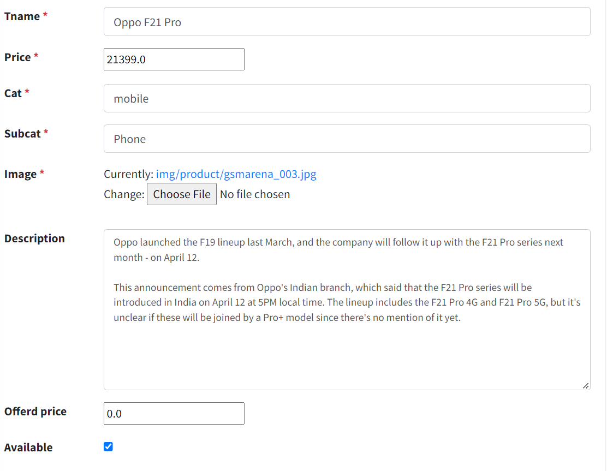
Screen Shorts
Product Detail

Slide 47
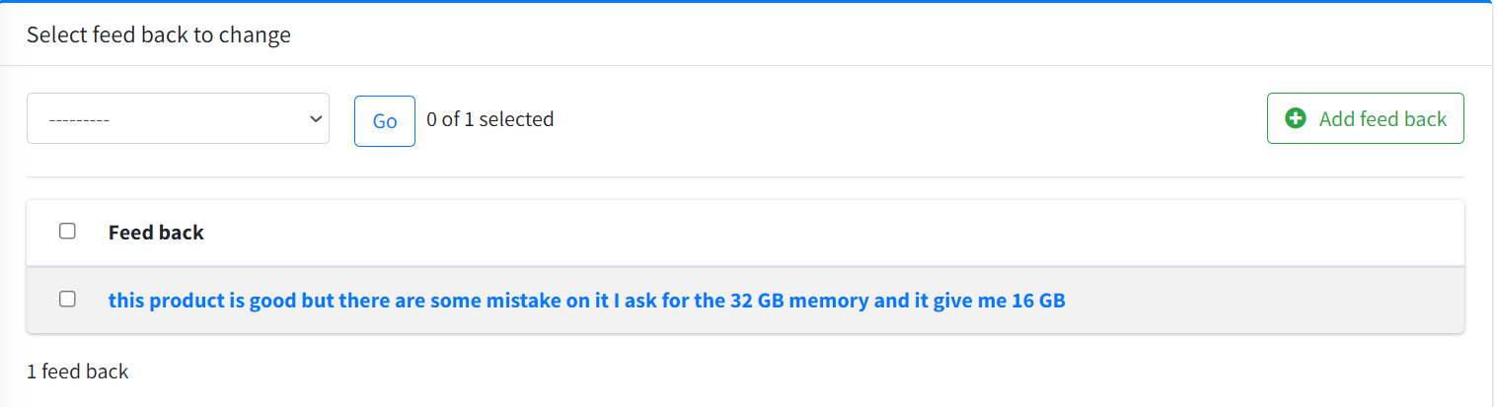
Screen Shorts
Feed Back Item

Slide 48
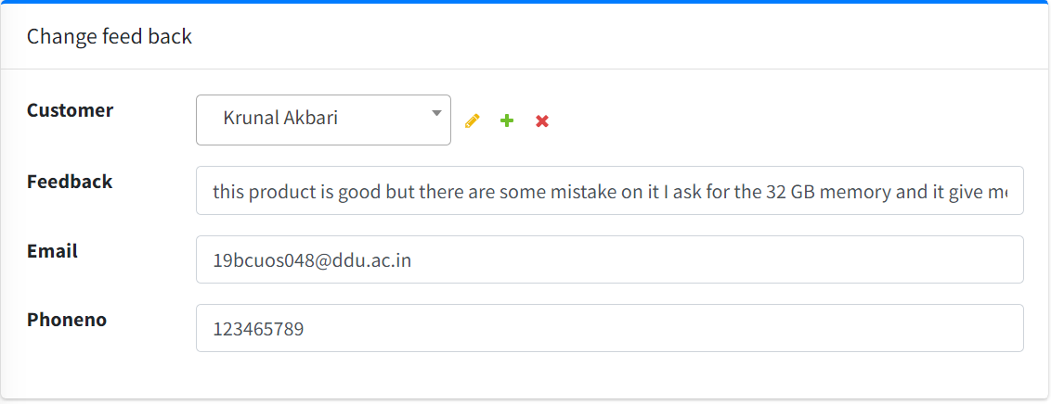
Screen Shorts
Feedback Contact

Slide 49
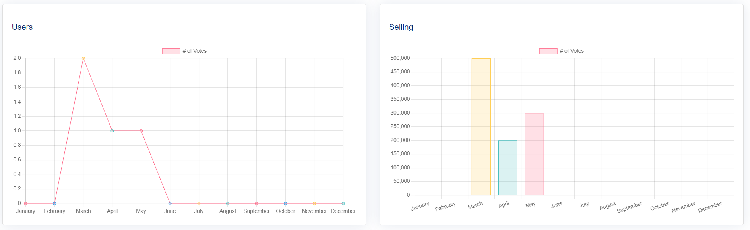
Screen Shorts
Char Page Contact

Slide 50
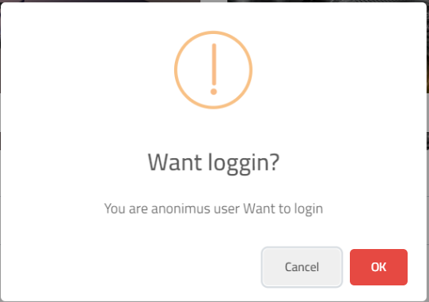
Screen Shorts
Login Alert Contact

Slide 51
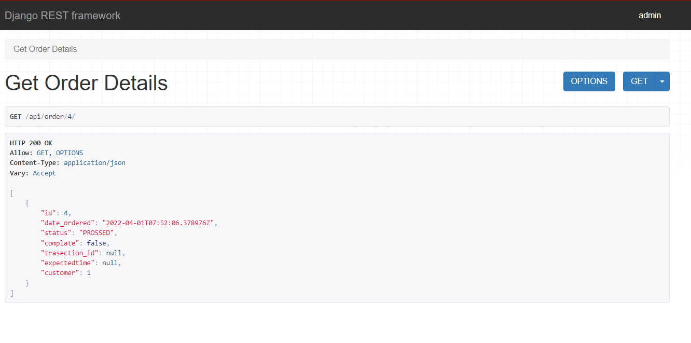
Screen Shorts
Order API Contact

Slide 52
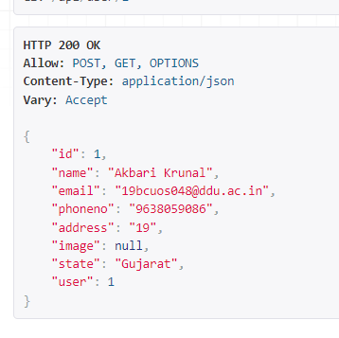
Screen Shorts
Customer Detila Contact

Slide 53
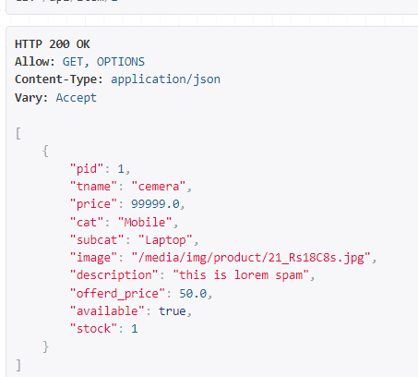
Screen Shorts
Customer Detail Contact

Slide 54
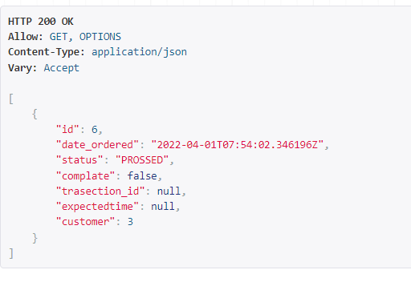
Screen Shorts
Order API

Slide 55
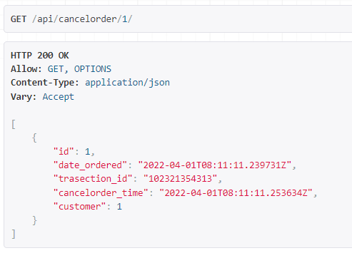
Screen Shorts
Cancel Order API

Slide 56
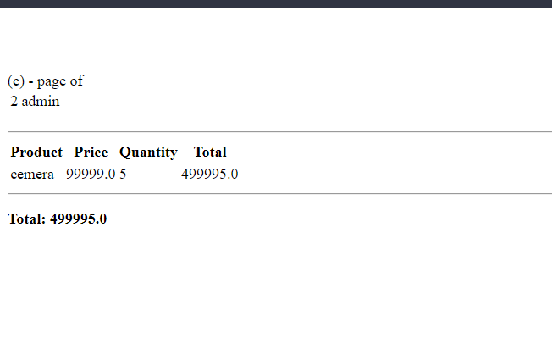
Screen Shorts
Receipt generate API

Slide 57
Scope and Limitation
Scope:
admin can identified the user about the order by email or phone no
manager group can be added to the certain permission for the handle order
User interface must be improved to be user friendly.
Delivery can also improve

Slide 58
Scope and Limitation
Limitation:
data is verified but not double entry with username
admin can ban the user but there is some reason to show
if more product to manage then there are not good ways
if order goes more then 1000 is nothing to manage
some error while adding new supper user with command line

Slide 59
Future Expansion
filter in order page for order id or order transaction id.
Data can be improved by the year and moths as wall as day
longing can be done by OTP and changed on the database can be change by the OTP as well
log is not created for every data if there is any crease or attaching there is no log for that
manager could be added as well as employee
bill are generated by the current time of price if price go up then user will have to pay more

