Slide 1


Madhav Institute of Technology & Science, Gwalior (M.P.), INDIA
Deemed University
(Declared under Distinct Category by Ministry of Education, Government of India)
NAAC ACCREDITED WITH A++ GRADE
TEAM LAKSHYA
PROJECT NAME: LedgerCore – Next-Gen FinTech Expense Management System
1
Zeel Kundariya
2
Rani Patel
3
Saptak Bhattacharyya
4
Anshu Shee

Slide 2
Madhav Institute of Technology & Science, Gwalior (M.P.), INDIA
Deemed University
(Declared under Distinct Category by Ministry of Education, Government of India)
NAAC ACCREDITED WITH A++ GRADE
PROBLEM STATEMENT
Organizations struggle with manual, error-prone expense tracking and reimbursement processes. Employees waste time on manual receipt entry, finance teams face delayed approvals and fraud risks from duplicate or inflated claims, and cross-border reimbursements are slowed by currency conversion hassles — leading to poor financial transparency and low trust in corporate expense systems.

Slide 3
Madhav Institute of Technology & Science, Gwalior (M.P.), INDIA
Deemed University
(Declared under Distinct Category by Ministry of Education, Government of India)
NAAC ACCREDITED WITH A++ GRADE
SOLUTION OVERVIEW
LedgerCore is a comprehensive FinTech platform that streamlines expense tracking, prevents fraud using AI, and automates payments and reimbursements through a secure, role-based workflow. It empowers Employees, Managers, and Admins with real-time visibility, automated receipt verification, and instant payouts — built for personal finance management, corporate finance, and financial inclusion.

Slide 4
Madhav Institute of Technology & Science, Gwalior (M.P.), INDIA
Deemed University
(Declared under Distinct Category by Ministry of Education, Government of India)
NAAC ACCREDITED WITH A++ GRADE
KEY FEATURES & BENEFITS
Smart Expense Tracking & Budgeting – Category-wise expense logging with interactive dashboards and automated budget-limit alerts for smarter personal finance
AI-Powered Fraud Prevention – OCR-based receipt verification and anomaly detection to flag duplicate/unusual expenses
Automated Payments – Instant simulated reimbursements with multi-currency support for global transactions, advancing financial inclusion
Role-Based Approval Workflow – Multi-tier approval (Employee → Manager → Admin) with real-time, color-coded status tracking
Admin & User Management – Secure directory management linking employees to managers with strict access control
Secure Data Persistence – Auto-saving local vault with one-click JSON backup/restore and admin reset controls

Slide 5
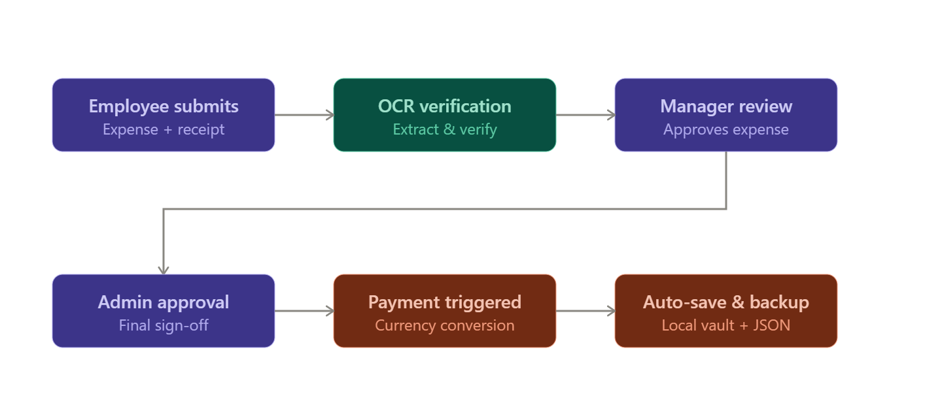
Madhav Institute of Technology & Science, Gwalior (M.P.), INDIA
Deemed University
(Declared under Distinct Category by Ministry of Education, Government of India)
NAAC ACCREDITED WITH A++ GRADE
ARCHITECTURE WORKFLOW DIAGRAM
Flow: Employee submits expense (with receipt) → OCR extracts & verifies details → Anomaly detection flags irregular claims → Manager reviews (MANAGER_APPROVED) → Admin gives final approval (APPROVED) → Payment gateway triggers reimbursement to employee's account, with multi-currency conversion applied → Data auto-saved to local vault with backup/export options.
1. Submit Expense
2. OCR Verify
3. Fraud Check
4. Manager Review
5. Admin Approval
6. Payment
7. Data Vault
Employee submits expense with receipt
OCR extracts & verifies receipt details
Anomaly detection flags irregular claims
Manager approves the claim
Admin gives final approval
Multi-currency reimbursement is triggered
Auto-saved with backup & export

Slide 6
Madhav Institute of Technology & Science, Gwalior (M.P.), INDIA
Deemed University
(Declared under Distinct Category by Ministry of Education, Government of India)
NAAC ACCREDITED WITH A++ GRADE
CONCLUSION & IMPACT
LedgerCore modernizes corporate expense management by combining AI-driven fraud prevention with a transparent, role-based approval system. By automating payments and reimbursements across multi-currency transactions, it reduces financial fraud, cuts down manual processing time, and promotes personal finance management and financial inclusion — making expense management faster, safer, and more accessible for organizations of any size.

Slide 7
Madhav Institute of Technology & Science, Gwalior (M.P.), INDIA
Deemed University
(Declared under Distinct Category by Ministry of Education, Government of India)
NAAC ACCREDITED WITH A++ GRADE
THANK YOU

