Slide 1


Madhav Institute of Technology & Science, Gwalior (M.P.), INDIA
Deemed University
(Declared under Distinct Category by Ministry of Education, Government of India)
NAAC ACCREDITED WITH A++ GRADE
Team Lakshya
SkillSphere AI
1
Zeel Kundariya
2
Rani Patel
4

Slide 2
Madhav Institute of Technology & Science, Gwalior (M.P.), INDIA
Deemed University
(Declared under Distinct Category by Ministry of Education, Government of India)
NAAC ACCREDITED WITH A++ GRADE
PROBLEM STATEMENT
High-quality tech education and one-on-one mentorship remain expensive, making personalized learning inaccessible for many students and early-career developers.
Millions of skilled professionals are eager to teach, but there is no intelligent platform that connects them with motivated learners.
Existing learning communities rely on manual searching, making it difficult to find the right mentor, study partner, or skill match.
Current platforms lack AI-driven recommendations, personalized learning paths, and engagement features, resulting in lower collaboration and slower skill development.

Slide 3
Madhav Institute of Technology & Science, Gwalior (M.P.), INDIA
Deemed University
(Declared under Distinct Category by Ministry of Education, Government of India)
NAAC ACCREDITED WITH A++ GRADE
SOLUTION OVERVIEW
SkillSphere AI is an intelligent, gamified peer-to-peer platform where users exchange skills instead of money (e.g., "I teach you React, you teach me Python").
We integrate Generative AI (Google Gemini) to act as a virtual career coach and matchmaker, instantly analyzing user profiles to pair complementary skill sets together.
To solve the retention problem in EdTech, we built a Gamification Engine that rewards users with XP and Levels for successfully teaching and learning from others

Slide 4

Madhav Institute of Technology & Science, Gwalior (M.P.), INDIA
Deemed University
(Declared under Distinct Category by Ministry of Education, Government of India)
NAAC ACCREDITED WITH A++ GRADE
KEY FEATURES & BENEFITS
AI Profile Optimizer & Matchmaking (Gemini): Automatically rewrites user bios to be highly professional and matches users based on mutual skill needs.
Smart Trending Skills: Dynamically fetches real-time market demands to guide users on what technologies they should learn next.
AI Rating Summarizer: Intelligently condenses complex mentorship feedback into punchy, positive reviews.
Gamified XP Engine: Users earn XP for sending, accepting, and completing skill swaps, driving high retention and platform engagement.
Real-time WebSockets Chat: Built-in instant messaging with typing indicators for seamless communication between matched peers.

Slide 5
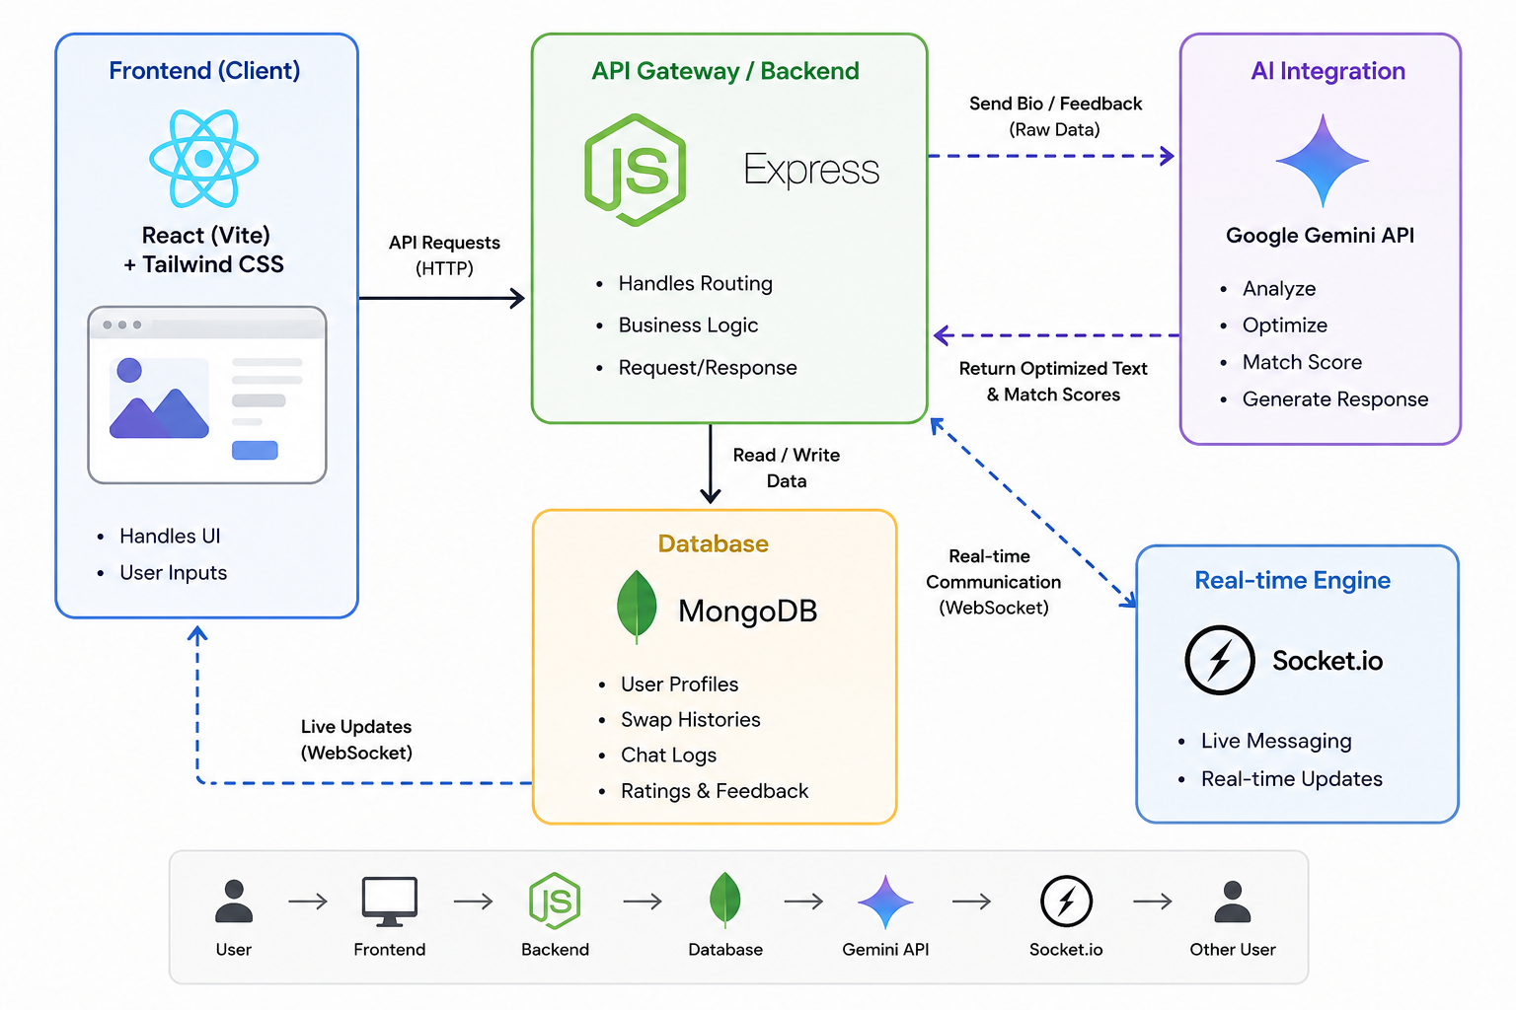
Madhav Institute of Technology & Science, Gwalior (M.P.), INDIA
Deemed University
(Declared under Distinct Category by Ministry of Education, Government of India)
NAAC ACCREDITED WITH A++ GRADE
ARCHITECTURE WORKFLOW DIAGRAM
Frontend (Client): React (Vite) + Tailwind CSS (Handles UI and User Inputs).
API Gateway / Backend: Node.js + Express.js (Handles routing and business logic).
Database: MongoDB (Stores User Profiles, Swap Histories, and Chat Logs).
AI Integration: Google Gemini API (Receives raw bio/feedback -> Returns optimized text and match scores).
Real-time Engine: Socket.io (Handles live messaging between User A and User B).

Slide 6
Madhav Institute of Technology & Science, Gwalior (M.P.), INDIA
Deemed University
(Declared under Distinct Category by Ministry of Education, Government of India)
NAAC ACCREDITED WITH A++ GRADE
CONCLUSION & IMPACT
Conclusion: SkillSphere AI successfully creates a self-sustaining peer-to-peer educational ecosystem by replacing monetary transactions with a "knowledge-exchange" currency. The integration of Generative AI significantly reduces friction in matching and mentoring.
Social Impact (Democratizing Education): We are breaking down financial barriers to high-quality, 1-on-1 mentorship. By allowing anyone to learn premium tech skills for free (in exchange for teaching what they know), we empower underprivileged students and foster a global, collaborative community of continuous learning.

Slide 7
Madhav Institute of Technology & Science, Gwalior (M.P.), INDIA
Deemed University
(Declared under Distinct Category by Ministry of Education, Government of India)
NAAC ACCREDITED WITH A++ GRADE
THANK YOU

