Slide 1


Sarvajanik College of Engineering and Technology
Department of Information Technology
Project-1 (Academic Year 2026-2027)
AtmoGraph
AI-Powered Supply Chain Disruption & Ripple-Effect Prediction Platform
Excel Knowledge Graph • Real-Time News NLP • What-If Shock Simulation • Multi-Tenancy
Presented By:
1. Zeel Makwana (Enrollment No: [ET24BTIT815])
2. Meet Solanki (Enrollment No: [ET24BTIT817])
3. Smit Sapariya (Enrollment No: [ET23BTIT121])
4. Upen Sapariya (Enrollment No: [ET23BTIT122])
Supervised By:
Dr. Ashishkumar Chaudhari
Assistant Professor, Department of Information Technology
Sarvajanik College of Engineering and Technology

Slide 2
AtmoGraph Overview
• Intelligent Supply Chain Mapping: Transforms static, flat spreadsheets into an interconnected knowledge graph linking suppliers, plants, and finished goods.
• Multi-Tier Event Tracking: Ingests live trade news and weather advisories to trace how external shocks propagate across multiple supply tiers.
• Predictive Risk Analytics: Calculates cascading disruption impact, operational delay days, and stockout probabilities before production stalls.
• Interactive Workflow Studio: Enables business owners to explore network topologies, simulate what-if outages, and replay historical incidents.
2

Slide 3
Problem Definition & Project Goal
• Fragmented Information Sources: Disruption bulletins, meteorological warnings, and port strikes occur across disconnected feeds without central aggregation.
• Multi-Tier Visibility Blindspots: Enterprises struggle to manually trace how a Tier-2/3 raw material outage impacts their final product assembly line.
• Automated Decision Support: AtmoGraph instantly resolves news entities, mapping geographical text directly to active supplier IDs and product lines.
• Human-in-the-Loop Architecture: The platform delivers automated predictive analytics and alternative recommendations while keeping final crisis decisions in human hands.
3

Slide 4
System Architecture: End-to-End Pipeline
Step 1
Step 2
Step 3
Step 4
Step 5
Data Ingestion
User uploads Excel / JSON workbooks with Suppliers, Materials, BOM & Routes.
Graph Building
SQLite stores normalized tables; Neo4j links nodes & relationships.
Live News Scan
spaCy NLP extracts locations, disruption types & severities.
Hybrid Simulation
Disruption Engine computes shortage math; PyG GNN scores node risks.
Live Visual UI
ReactFlow renders spider-web graph; WebSocket pushes real-time alerts.
4

Slide 5
News-to-Event Graph Pipeline
• 1. NLP & Entity Extraction: Regex patterns and spaCy (en_core_web_sm) scan news headlines and text to extract event types, severity levels, and geographical locations.
• 2. Database Ingestion & Entity Matching: A structured Event record is committed to SQLite, and supplier names are matched against existing master catalogs using token similarity.
• 3. Knowledge Graph Synchronization: Event → Supplier → Product relationships are synchronized into Neo4j with multi-hop property links for downstream traversal.
• 4. Resilient Fallback Handling: Unmatched entities are preserved as standalone graph nodes, ensuring complete visibility even when master records are incomplete.
5

Slide 6
Data & Knowledge Graph Model
• SQLite Relational Database: Stores core persistent entities including Events, Suppliers, Products, and Supply Chain Links (backend/atmograph.db).
• Business Master Tables: Maintains operational attributes for Manufacturing Plants, Components (BOM), Inventories, Production Capacity, Demand, and Routes.
• Neo4j Graph Database: Stores flexible property graph nodes and directed relationships: (Event)-[:AFFECTS]->(Supplier)-[:SUPPLIES]->(Product).
• Multi-Hop Graph Projections: Subgraphs extracted at depths 1 to 5 are projected directly into feature tensors for the Graph Neural Network (GNN).
6

Slide 7
Risk Prediction & GNN Architecture
• Deterministic Rule Engine: Calculates baseline risk (0-100) using incident severity weights, supplier concentration factors, and resolution status multipliers.
• Graph Neural Network (PyG): Constructs 10 node features (node type, severity, centrality, bias) processed through 2 GCNConv layers (32 hidden units) with ReLU and Sigmoid.
• Hybrid Risk Fusion Formula: Combines deterministic formulas with machine learning predictions: Final Risk = (0.40 × Rule Score) + (0.60 × GNN Score).
• Heuristic Ground Truth: Training targets derive from deterministic lead-time delays and buffer depletion metrics, teaching the model cascading ripple propagation.
7

Slide 8
Technologies, Tools & Libraries Used
Languages
Python 3.12
Core backend, AI & simulation
TypeScript ~6.0
Type-safe frontend code
SQL
Relational data management
Cypher
Neo4j graph query language
HTML5 / CSS3
Obsidian Glass styling
Backend & APIs
FastAPI 0.141
Ultra-fast ASGI framework
Uvicorn 0.52
High-performance async server
SQLAlchemy 2.0
Database ORM & sessions
Pydantic v2
Strict schema validation
WebSockets
Live 2-way real-time push
AI, NLP & Graph
Neo4j 5.x
Property graph DBMS
PyTorch 2.13
Neural network execution
PyTorch Geometric
GCNConv graph convolution
spaCy 3.8
English NER model
OpenPyXL / Pandas
Excel data processing
Frontend & DevOps
React 18 / 19
Modular component UI
Vite 8
Next-gen frontend bundler
ReactFlow 12
@xyflow/react canvas graph
Lucide React
Semantic UI vector icons
pytest (70 tests)
Automated testing suite
8

Slide 9
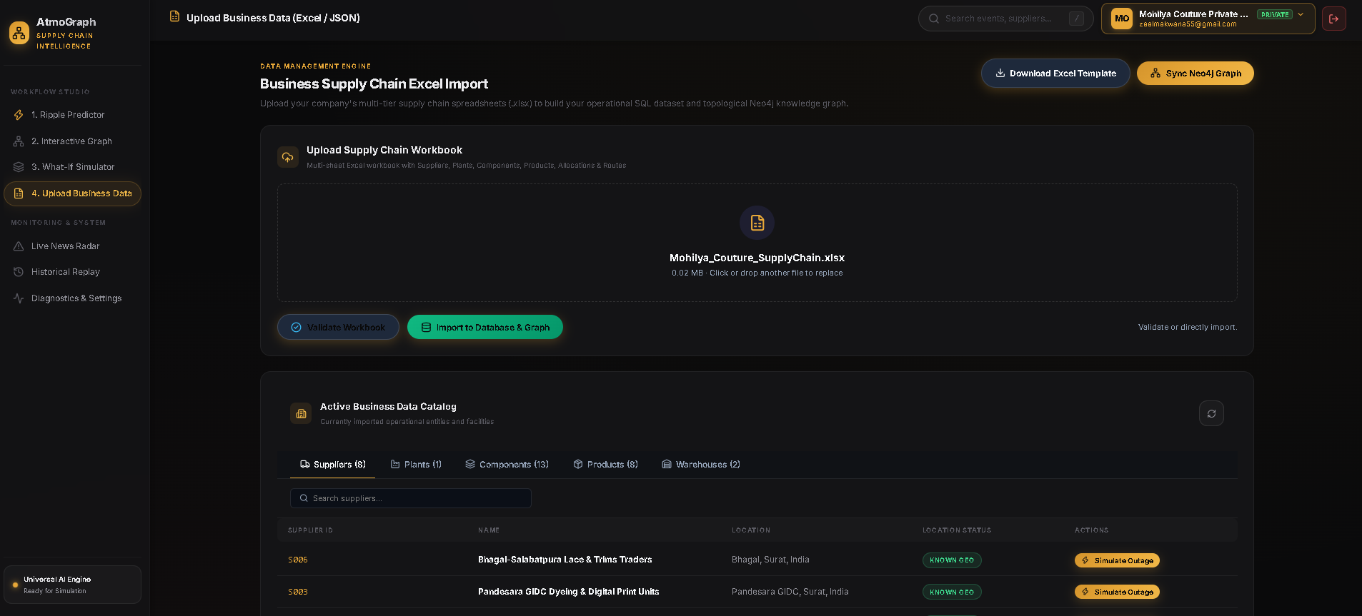
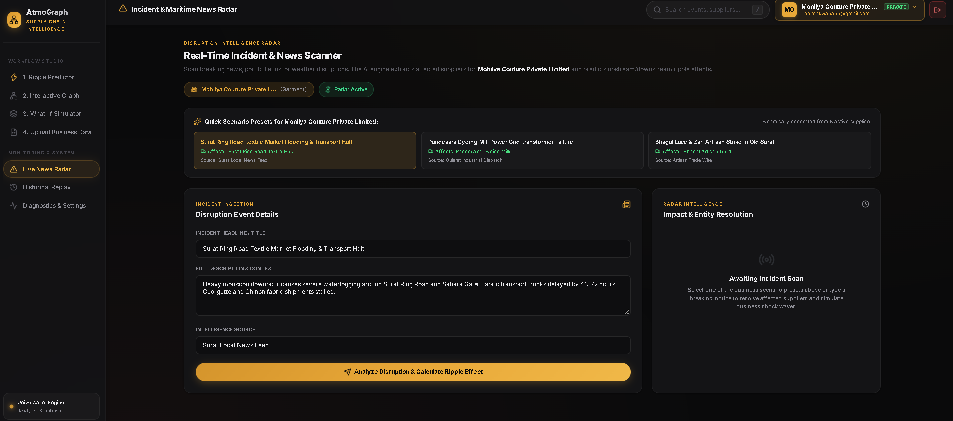
Project Demo: Ingestion & Live Alerts
1. Excel Data Ingestion & Catalog Browser
Upload business spreadsheets (.xlsx) with automated validation, synonym mapping, and zero-configuration graph compilation.
2. Real-Time Disruption Radar & Event Description
Ingest breaking trade news, weather notices, and custom scenario descriptions to instantly calculate cascading supply chain impacts.
9

Slide 10
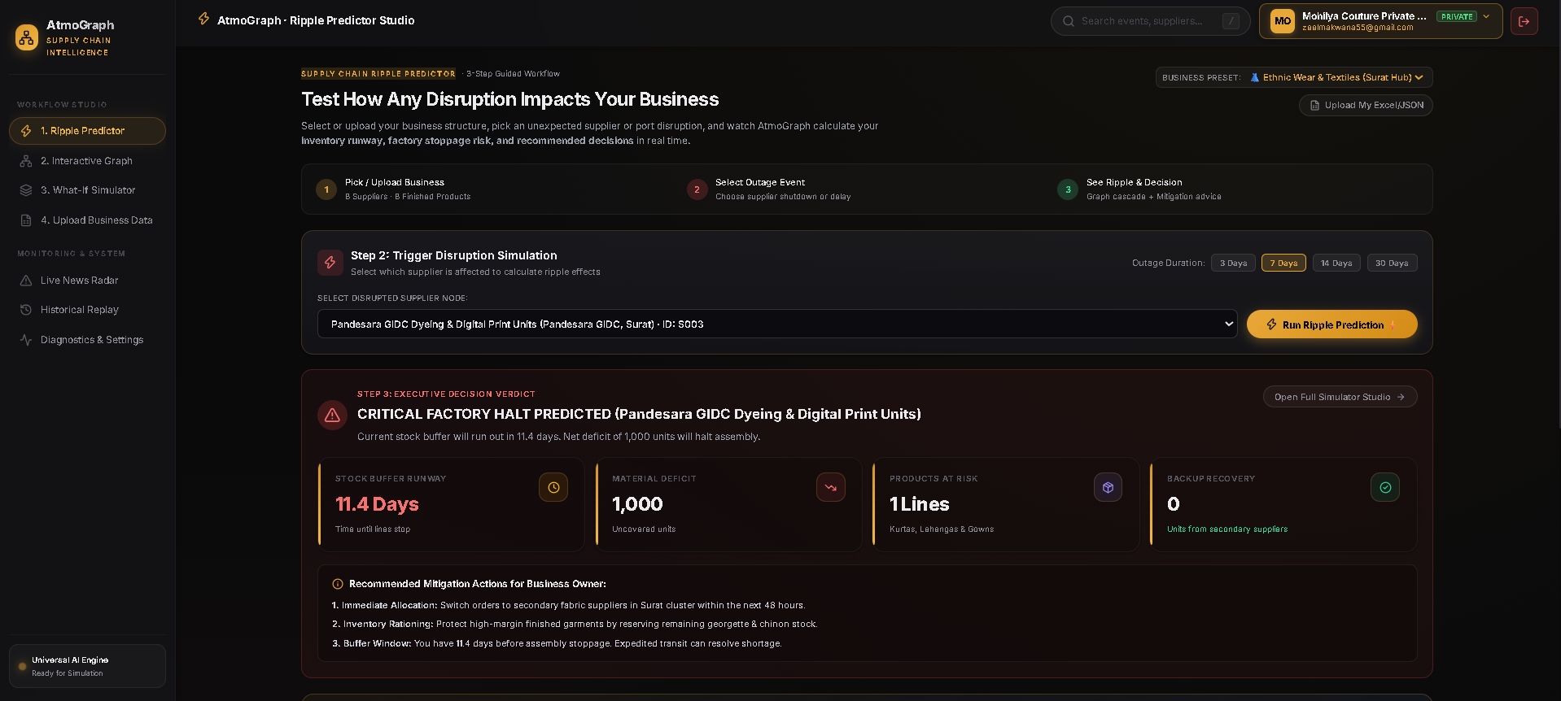
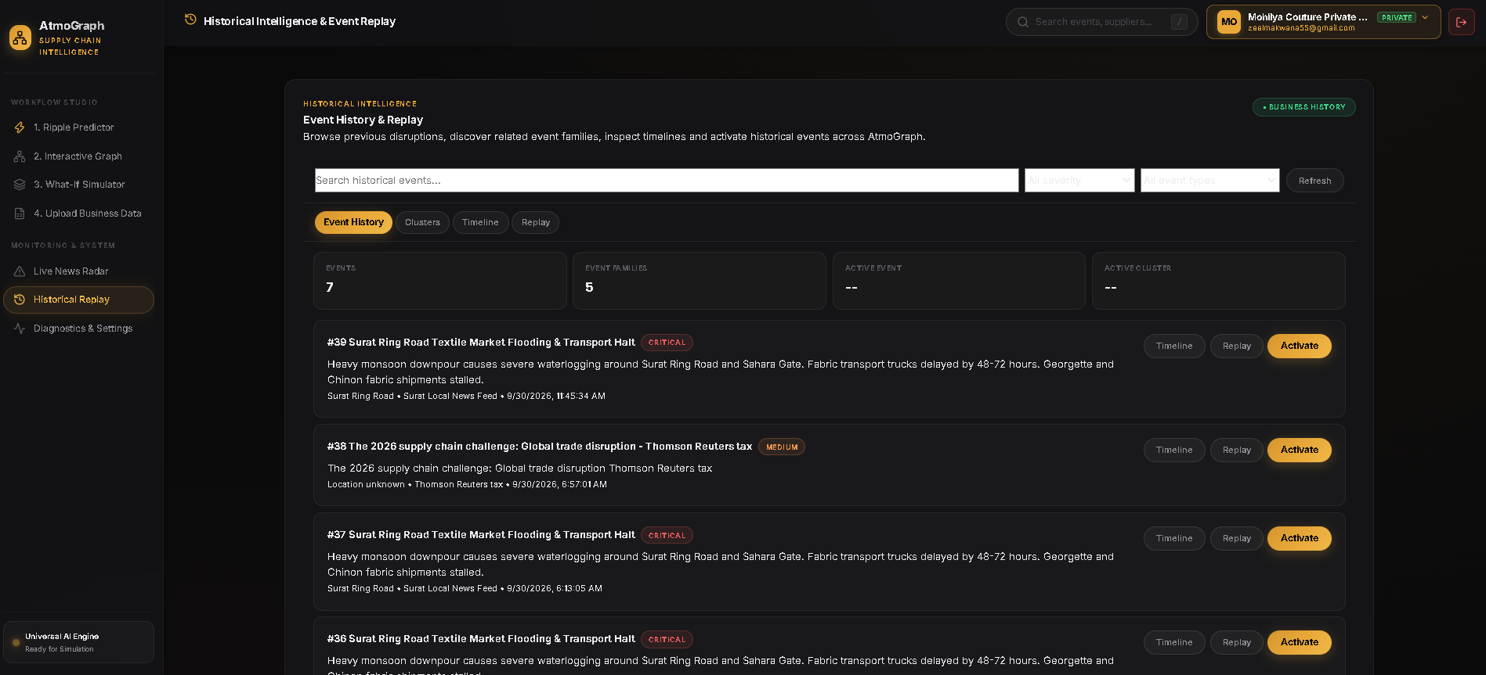
Project Demo: Prediction & Replay
3. Main Prediction Dashboard
Executive cockpit displaying operational health scores, supplier outage status, inventory buffer countdown, and product delay risks.
4. Historical Intelligence Replay
Incident archive enabling operators to review and replay previous disruption events to evaluate recovery workflows.
10

Slide 11
• Neo4j Documentation: Graph Database Management System, Property Graph Ontology & Cypher Query Language.
• FastAPI Documentation: High-Performance Asynchronous Python Web Framework and OpenAPI Specification.
• spaCy Documentation: Industrial-Strength Natural Language Processing & Named Entity Recognition (NER).
• PyTorch Geometric (PyG): Deep Graph Convolutional Networks (GCNConv) for Node-Level Risk Prediction.
• React & TypeScript: Component-Driven Single Page Web Application Architecture and Type-Safe State Management.
• Project Source Code & Datasets: AtmoGraph Repository, Mohilya Couture & AdilQadri Indian Supply Chain Benchmark Datasets.
11

