Slide 1


Sarvajanik College of Engineering and Technology
Department of Computer Engineering
Project-1 (Academic Year 2026-2027)
AtmoGraph
AI-Powered Supply Chain Disruption & Ripple-Effect Prediction Platform
Excel Knowledge Graph • Real-Time News NLP • What-If Shock Simulation • Multi-Tenancy
Presented By:
1. Zeel Makwana (Enrollment No: [ET24BTIT815])
2. Meet Solanki (Enrollment No: [ET24BTIT817])
3. Smit Sapariya(Enrollment No: [ET23BTIT121])
4. Upen sapariya (Enrollment No: [ET23BTIT122])
Supervised By:
Dr. Ashishkumar Chaudhari
Assistant Professor, Department of Information Technology
Sarvajanik College of Engineering and Technology

Slide 2
AtmoGraph Overview
A tool to understand supply-chain disruptions.
News and company data are used to create links between events, suppliers, and products.
The app shows possible impact, delay, and risk scores.
Users can explore the graph, history, and what-if scenarios.
2

Slide 3
Problem and Project Goal
Disruption news is spread across different sources.
It is difficult to manually trace the impact from a supplier to a product.
Goal: Quickly show the suppliers and products connected to an event.
The output provides decision support; the final business decision is made by a human.
3

Slide 4
System Architecture
Step 1
Step 2
Step 3
Step 4
Step 5
Data Ingestion
User uploads Excel / JSON workbooks with Suppliers, Materials, BOM & Routes.
Graph Building
SQLite stores normalized tables; Neo4j links nodes & relationships.
Live News Scan
spaCy NLP extract locations, disruption types & severities.
Hybrid Simulation
Disruption Engine computes shortage math; PyG GNN scores node risks.
Live Visual UI
ReactFlow renders spider-web graph; WebSocket pushes real-time alerts.
4

Slide 5
News to Event Graph
1. Regex + spaCy scan the title and body to find the event, severity, location, and entities.
2. An Event record is created in SQL, and supplier/product names are matched with existing records.
3. Event → Supplier → Product relationships are synchronized between SQL and Neo4j.
4. If a name is not matched, it can still be added as a graph entity, but its connection to the existing catalog may be missing.
5

Slide 6
Core Workflow Studio Modules
SQLite: Stores Events, Suppliers, Products, and Supply Chain Links.
Business tables: Store Plants, Components, Inventory, Capacity, Demand, and Routes.
Neo4j: Stores flexible nodes and relationships. Example: Event → AFFECTS → Supplier.
Supplier → SUPPLIES → Product: The depth of the graph affects the input given to the GNN.
6

Slide 7
Risk Prediction and GNN
Rule Score: Based on event severity, number of affected suppliers/products, and event status.
GNN: Takes 10 node features → passes them through 2 GCN layers with 32 hidden features → produces a 0–100 risk score for each node.
Hybrid Score: Combines 40% rule score + 60% highest GNN node score.
Training Labels: The labels are created using the severity, impact, and delay rules defined in the code. Real-world accuracy has not been proven yet.
7

Slide 8
Technologies, Tools & Libraries Used
Languages
Python 3.12
Core backend, AI & simulation
TypeScript ~6.0
Type-safe frontend code
SQL
Relational data management
Cypher
Neo4j graph query language
HTML5 / CSS3
Obsidian Glass styling
Backend & APIs
FastAPI 0.141
Ultra-fast ASGI framework
Uvicorn 0.52
High-performance async server
SQLAlchemy 2.0
Database ORM & sessions
Pydantic v2
Strict schema validation
WebSockets
Live 2-way real-time push
AI, NLP & Graph
Neo4j 5.x
Property graph DBMS
PyTorch 2.13
Neural network execution
PyTorch Geometric
GCNConv graph convolution
spaCy 3.8
English NER model
OpenPyXL / Pandas
Excel data processing
Frontend & DevOps
React 18 / 19
Modular component UI
Vite 8
Next-gen frontend bundler
ReactFlow 12
@xyflow/react canvas graph
Lucide React
Semantic UI vector icons
pytest (70 tests)
Automated testing suite

Slide 9
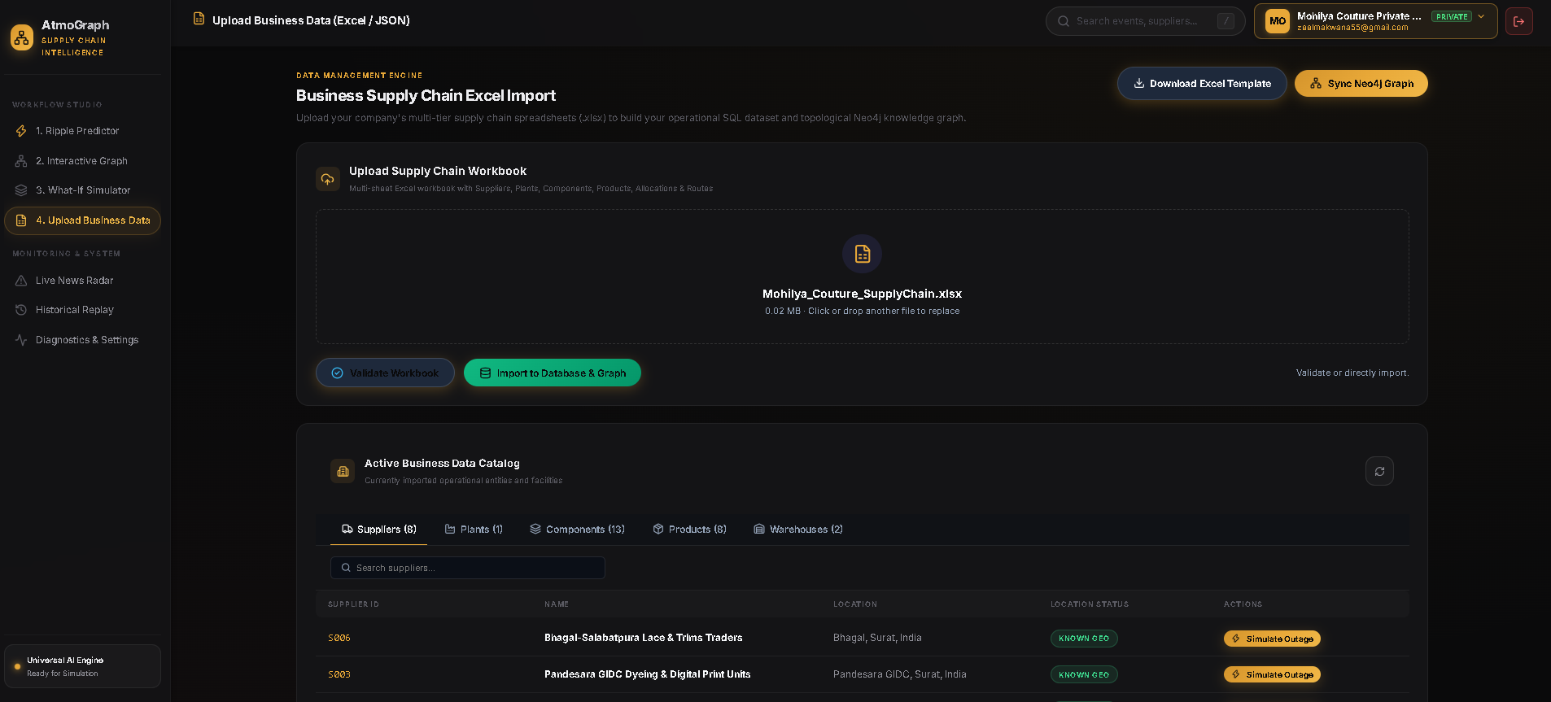
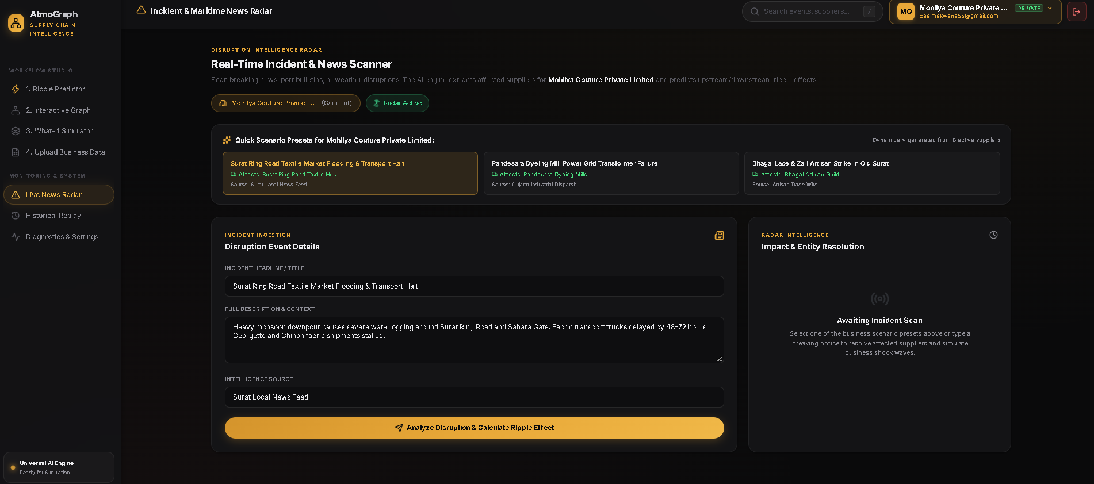
Project Demo and Current Results
Upload business data in form of excel sheet
Add events and its discretion from which it calculates the affects and predictions
9

Slide 10
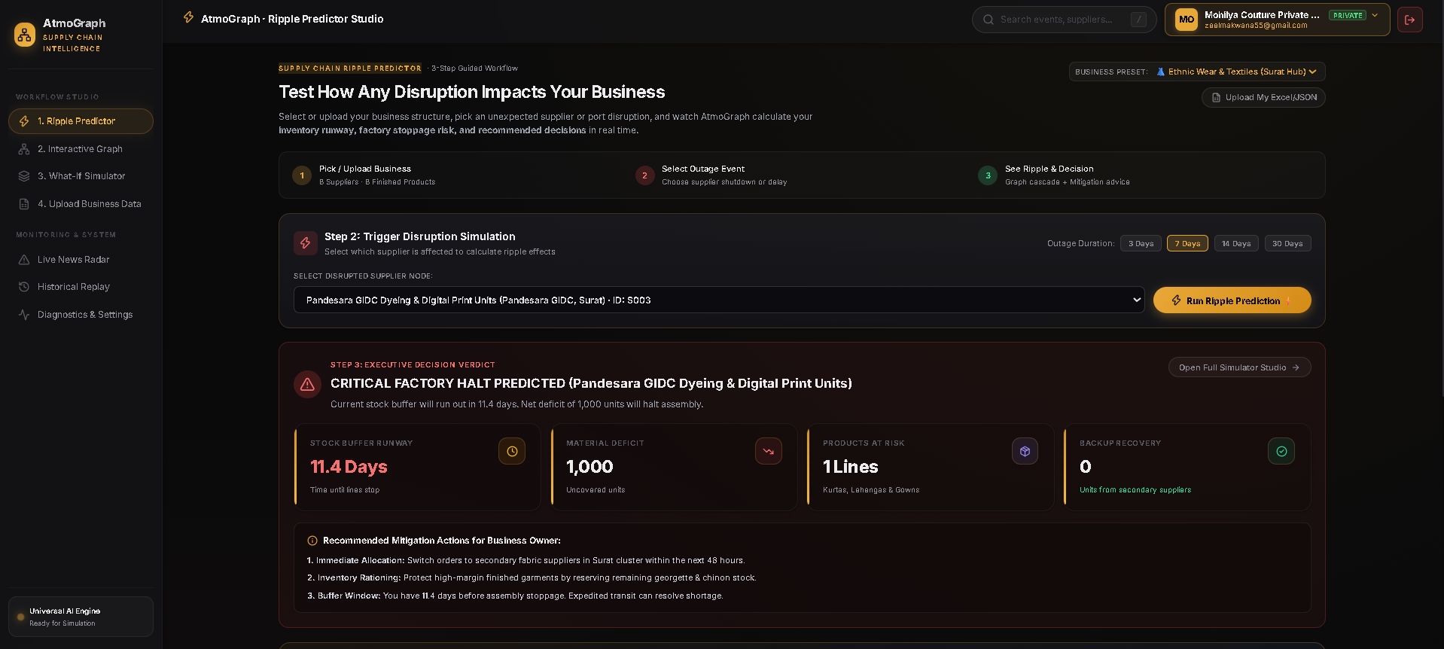
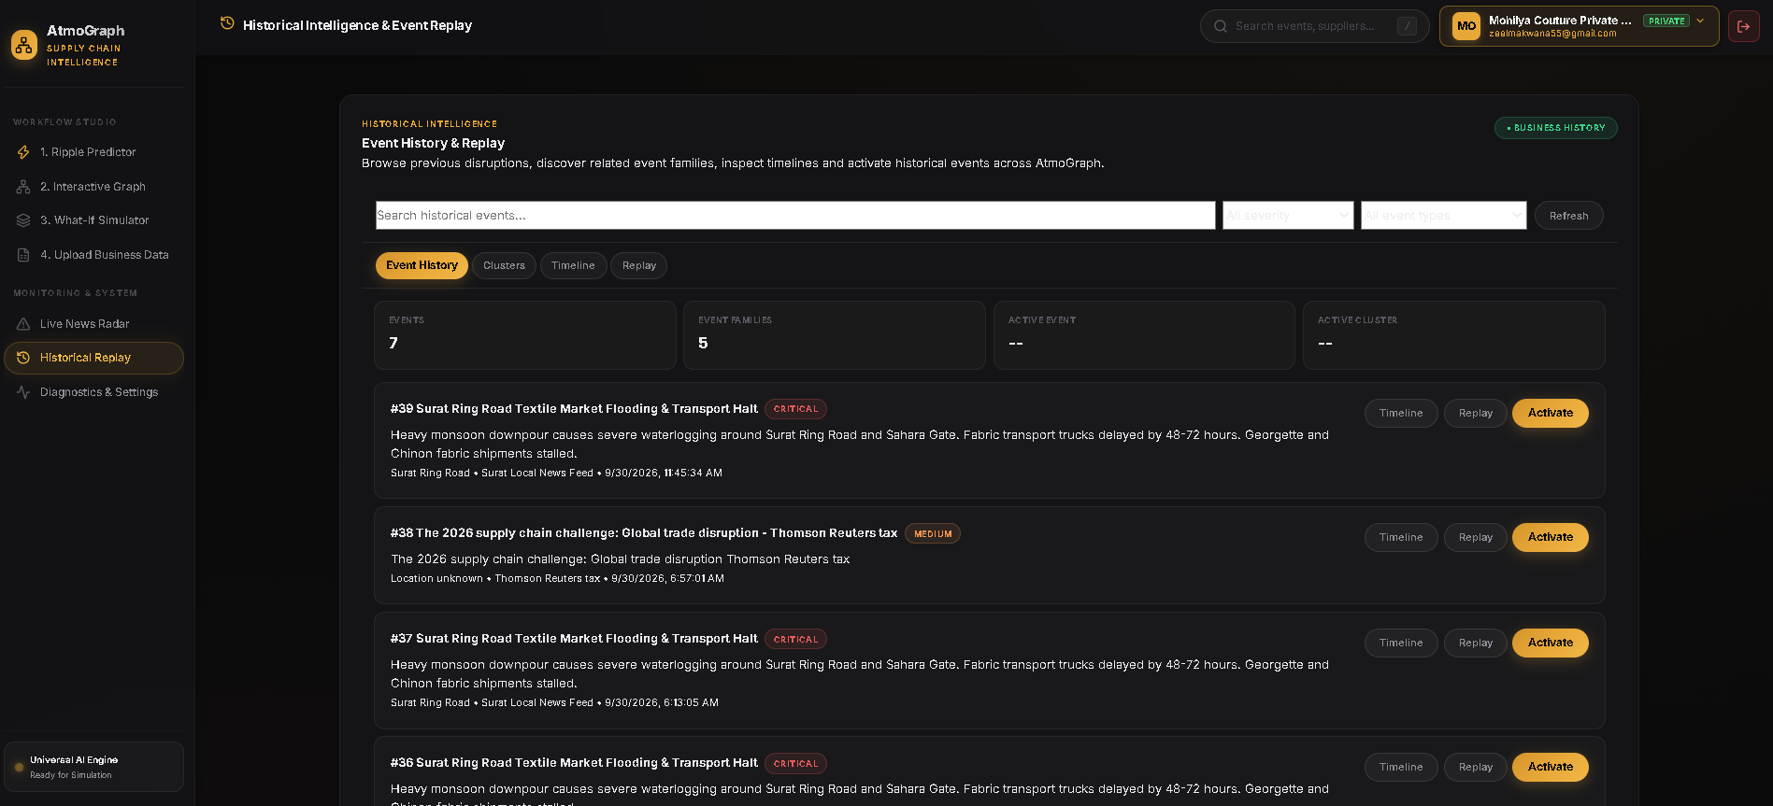
Project Demo and Current Results
Main dash board of prediction user can knoe status of each sup;ly and effects on it
History of privios evenst if it happens again user can activate it
9

Slide 11
References
Neo4j Documentation — Graph Database & Cypher
FastAPI Documentation — Backend APIs
spaCy Documentation — Natural Language Processing
PyTorch Geometric Documentation — Graph Neural Networks
React & TypeScript Documentation — Frontend Development
Project Source Code & Dataset — AtmoGraph Implementation
9

