Slide 1

WISHBOX SHIPMENT SYSTEM
Vyom patel-191200107056
Zeel patel- 191200107057
vishva patel- 201200107602
Internal Guide- Prof. a r kazi

Slide 2
ABSTRACT
Wish-box is a web-based application that is designed to be deployed on internet and provide functionality to every type of user. This application is basically a web Portal designed to get interaction between different clients and Packing and Moving Companies. Wish-box is an online platform for service seekers and service providers. We have listed excellent packing moving service providers of India, household shifting & relocation services providers, car transportation, office relocation, home, shop, industrial or commercial shifting service providers of India. Our wish-box directory is having ultimate objective of providing information to its visitors about best Filler’s movers and relocation companies offering its services in India. The reliable and swift wish-box services providers are the best for any kind of relocation and car transportation services. According to requirement gathered and the technologies used to realize those requirements are best utilized to achieve that functionality.
The wish-box Web Portal gives a platform through which clients and different packing and moving companies can communicate and use the services provided by this portal.

Slide 3
Purpose Of Project
Project is developed by going through the current situation and condition of the transportation facilities provide by the transportation agencies of this generation so the main purpose of the project is to deliver the basic modules of a typical goods transportation application and then going for the advanced and enhanced next generation functionalities.
It will provide services such as product transfer and important personal stuffs with more secure and urgent basis.
Purpose of the project is to enhance the current facilities of the transportation and climbing up to the next level.
In our project we can say it is most important idea which is enhance by us for secure personal transportation include documents.

Slide 4
GOALS & OBJECTIVES
Packing and Moving
Relocation Services
Car Services
Household Shifting

Slide 5
TECHNOLOGY & TOOLS
HARDWARE SPECIFICATION
RAM 4 GB.
Processor Core i3 5th Generation .
Hard Disk Capacity 1 TB.
Monitor 15”.
GPRS API.
SOFTWARE SPECIFICATION
Windows 7,8 and more versions.
HTML
CSS
Python.
SQLITE
PyCharm.
Django

Slide 6
WISHBOX SHIPMENT SYSTEM
The main problem that we face during shifting our goods and households is that either to take all the goods or to leave some of it or to sold them out. To handle such kind of problem the role of Wishbox agencies comes into action. This agency works according to the needs and requirement of the customers and provide them the desirable results. The Wishbox agencies uses best quality packing materials to pack our goods in such a way that all goods remain in safe condition during transit & moving services assure the safe delivery of our goods at our destination. Relocation to new place needs expert packing and moving company to handle all aspects of packing and moving. Moving companies have all latest devices, trucks, containers to provide safe pack and move to the destination. Therefore to handle all the problem of packing the goods and moving them from one place to another the Wishbox agencies are hired.

Slide 7
MODULES OF PROJECT
Admin
Administrative module is provided for the sake of administrators to manage the site and update the content at regular intervals, the major operations included in this module are:
It will see the current user.
It will approved registration.

Slide 8
MODULES OF PROJECT CONT….
Surveyor
It is the verification department of the project where surveyor manually checks for any damage or claim processing of the goods which are being transferred from source to the destination.
User
This would be our end user of the system which would be accessing most of the after login features which would include payment options, category and service selection, store locator and a universal search engine.

Slide 9
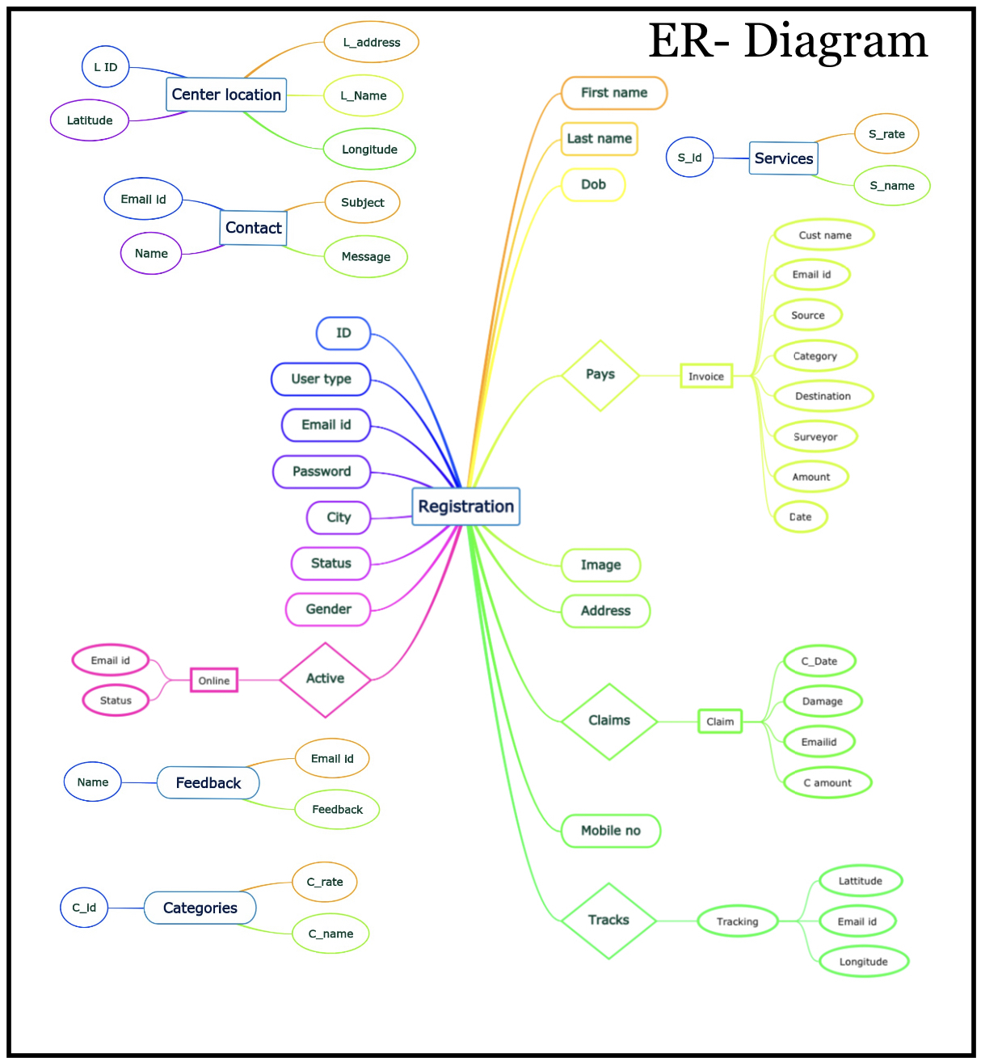
ER-Diagram

Slide 10
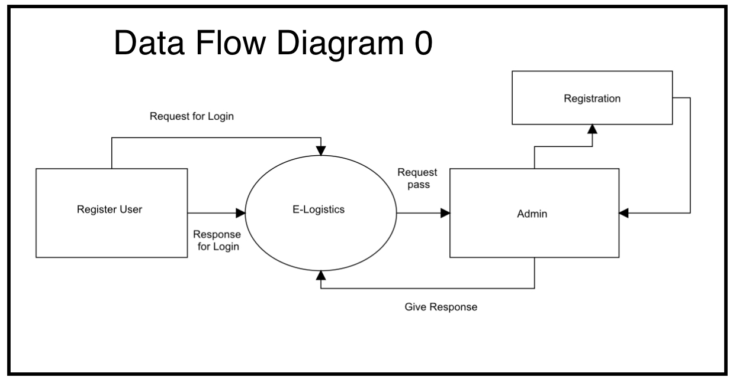
Data Flow diagram 0

Slide 11
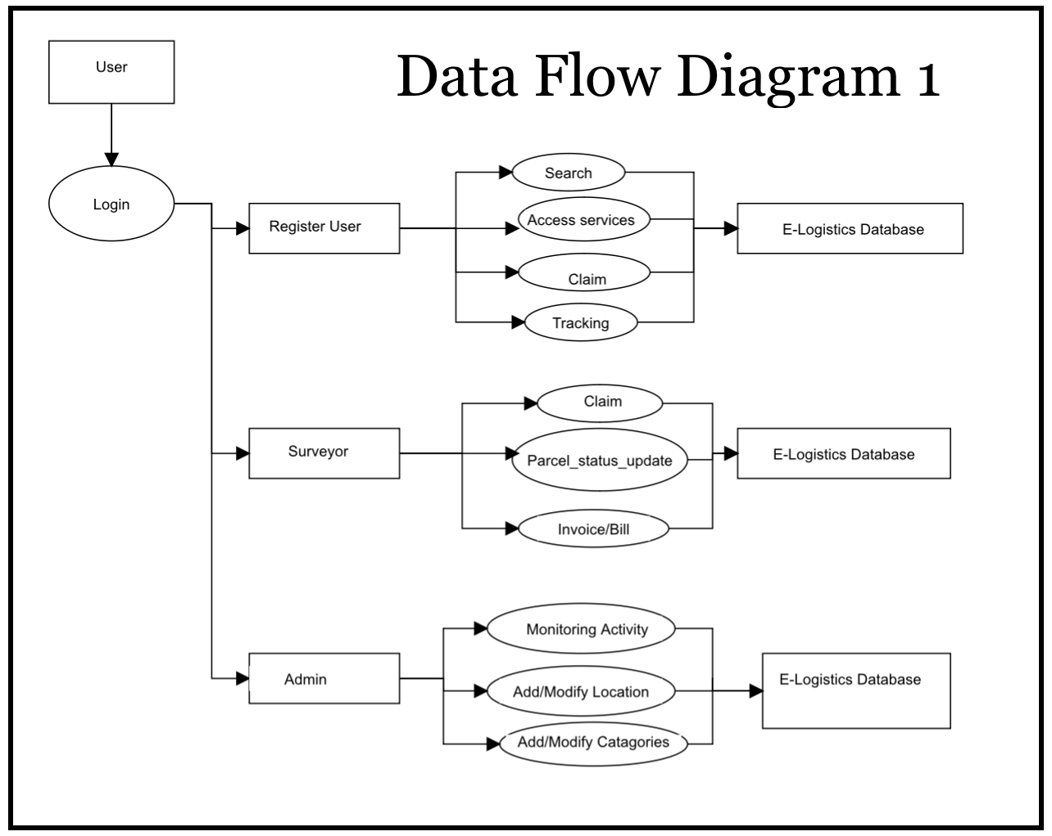
Data Flow diagram 1

Slide 12
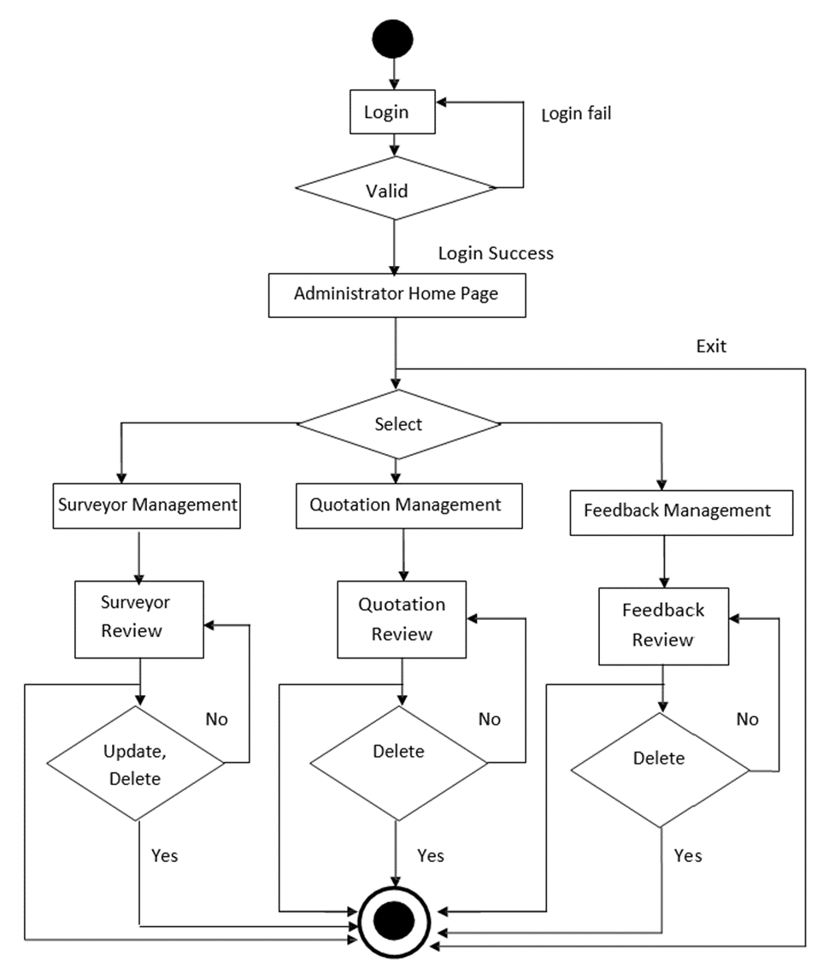
Activity Diagram for Admin

Slide 13
Basic flow for Administrator is as follows:
Administrator enters his correct Login ID and password to enter in his Administrator Home Page.
The condition is checked that weather the Login ID or password is correct or not. if it fails then it shows a message and redirect to login page again for entering the correct Login ID and password.
If the Login is success then Administrator enters into his Home page for various operations to perform.
Then he has to select one of the Modules from list Module.
When surveyor Management is selected, he can view list of surveyors that are registered over this portal.
He selects one from them and does the operations such as addition, deletion, and updating the surveyor and saves it to database.
These changes are permanent and can be viewed by others also.
When Quotation Management is selected, he can view list of Quotations that are placed by user over this portal.
He selects one from them and view and if required delete it from database.
When Feedback Management is selected, he can view list of Feedback that are given by user over this portal.
He selects one from them and view and if required delete it from database.
He also performs required operation according to feedback given from users.
At the end Administrator Logout from his Home page.

Slide 14
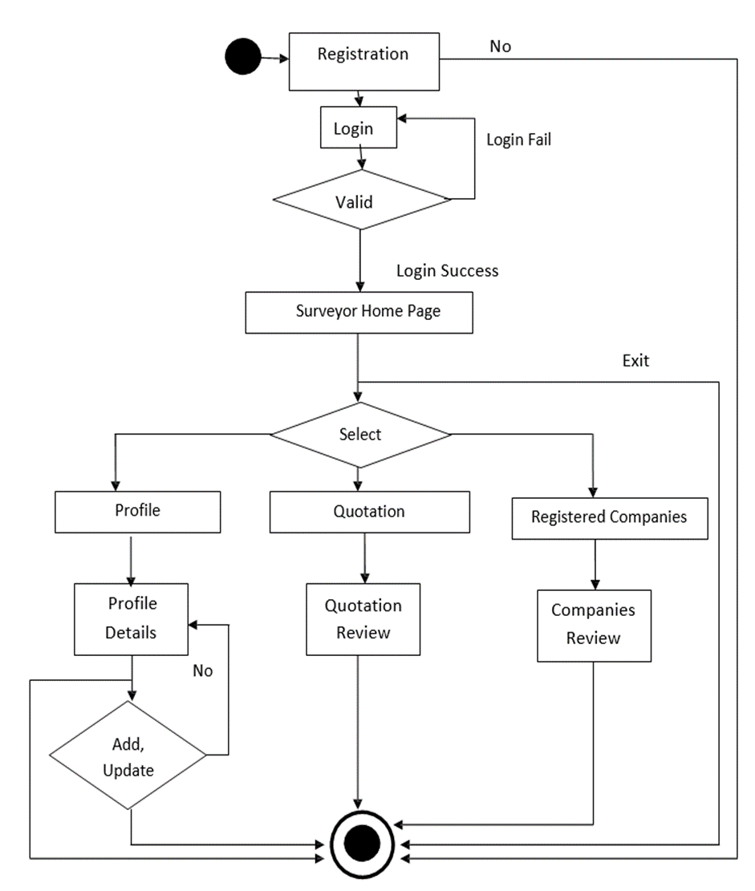
Activity Diagram for Surveyor

Slide 15
Basic flow for Surveyor is as follows:
Firstly, a surveyor has to register their company on this web portal by giving all his basic information such as Company Name, Address, city, state, pin code, contact name, phone number, email ID, password, service type, and mobile number.
When he successfully registers, he has a login ID and password.
surveyor enters his correct Login ID and password to enter in his surveyor Home Page.
The condition is checked that weather the Login ID or password is correct or not if it fails then it shows a message and redirect to login page again for entering the correct Login ID and password.
If the Login is success then surveyor enters into his Home page for various operations to perform.
Then he has to select one of the Modules from list Module.
These changes are permanent and can be viewed by others also.
When Quotation is selected, he can view list of Quotations that are placed by user over this portal.
He selects one from them and views the detailed information about quotation from database.
When Registered Companies is selected, he can view list of all Registered Companies.
He selects one from them and view details of it from database.
He also directly communicates to the users who have placed the quotation to give required services accordingly.
At the end surveyor Logout from his Home page.

Slide 16
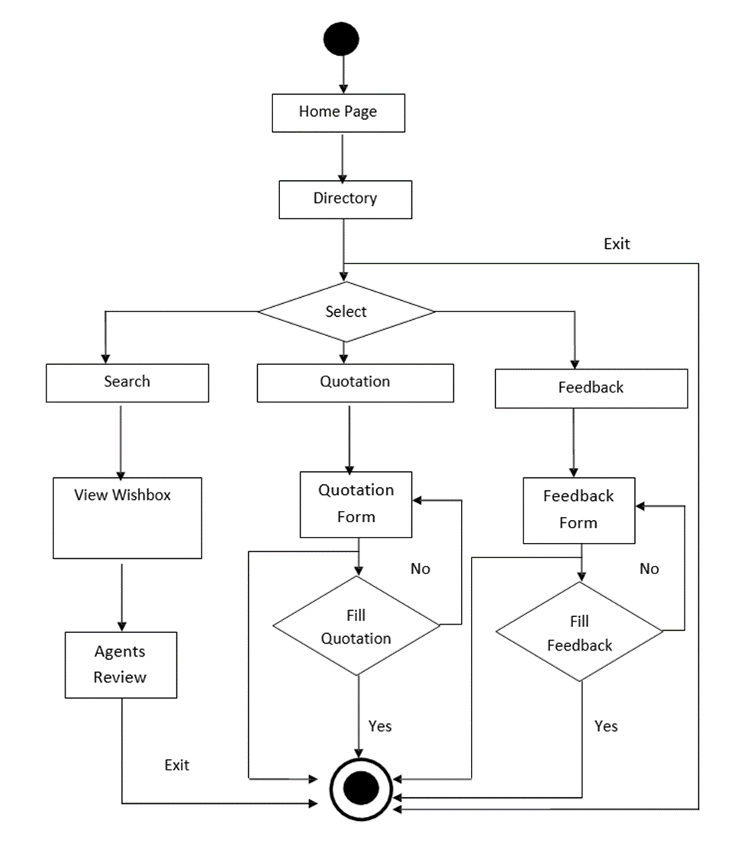
Activity Diagram for User

Slide 17
Basic flow for User is as follows:
Firstly, Clients enters into Home Page of our web portal where he can see all the basic information about the web portal and services that he can access through this website.
For the search of the service providers he has to go to the Directory page where he can search the service providers city vice and also view other useful information that are provided through this website.
After entering to directory he has to select one of the Modules from list Module.
When Search Wish Box are selected, he can view list of all the available Fillers and Moving Companies.
When Quotation is selected, quotations Form is available.
He provides the information such as Name, Email ID, Mobile number, Service type, Shift from, Shift to, service date, contact time, and other details by submitting Quotation.
When Feedback is selected, Feedback Form is available.
He provides the information such as Name, Email ID, Mobile number, Experience, Comments, and other details by submitting Feedback.
At the end Client exits from the site.

Slide 18
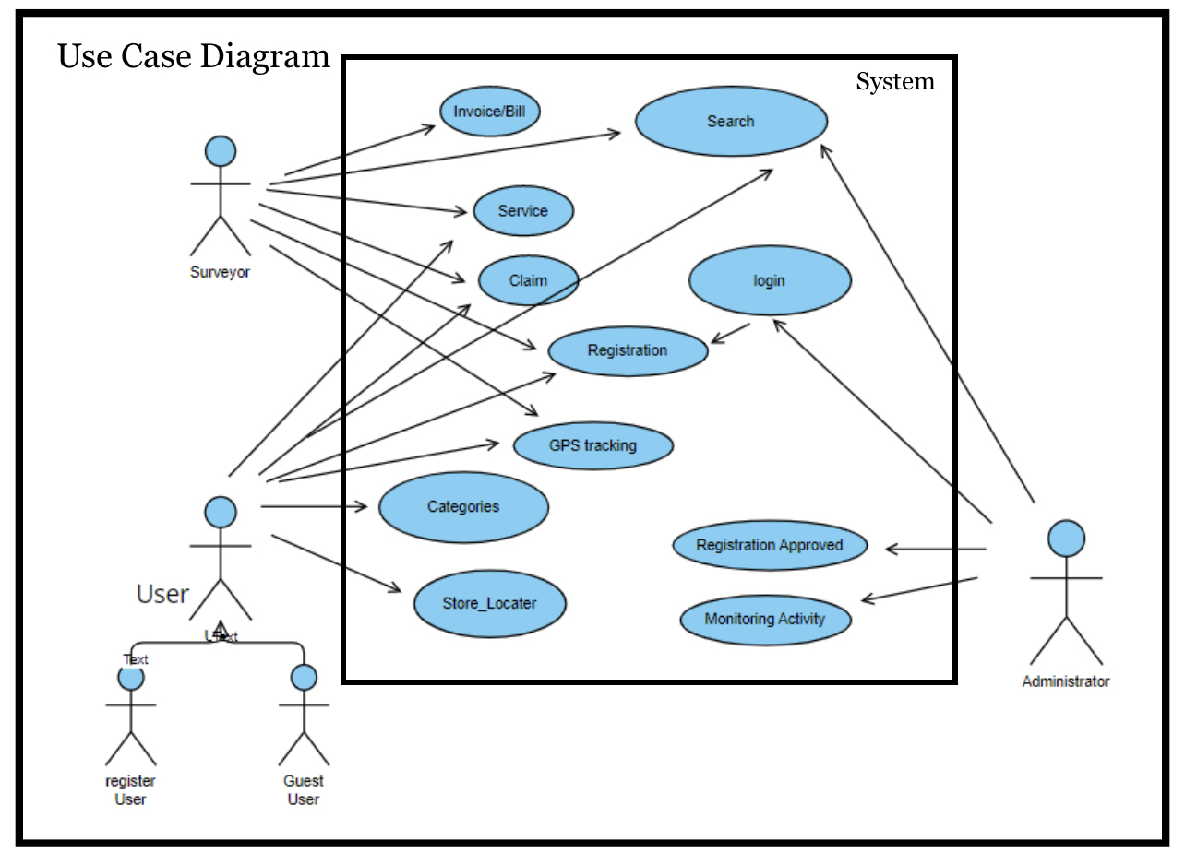
Use Case Diagram

Slide 19
Activity of New System
Actor | Action Performed | System Response
Administrator | Login | After successful login it will show the Admin Home Page. For Various Administrator operations.
 | Surveyor Management | To manages the Surveyor list such as adding, updating and deleting from list.
 | Quotation Management | To view the Quotations and to delete it as it is serviced.
 | Service Management | To manage the system functionality and services, and also the database management.
 | Feedback Management | To view the feedback and delete it if required from database.
Surveyor | Registration | To access the Web portal services first surveyor has to register to this site.
 | Login | After successful login it will show the Surveyor Home Page. For Various Surveyor operations.
 | Quotation View | To review the Quotation placed by clients.
 | Search WishBox | Search WishBox companies registered on this web portal.
 | Profile Updating | To see own profile and to do changes if required and update the changes over database.
Clients | Use Services | To access various services provided on this web portal.
 | Quotation | Place the Quotation with its full details so that reliable surveyor will contact to you directly.
 | Feedback | To give feedback.

Slide 20
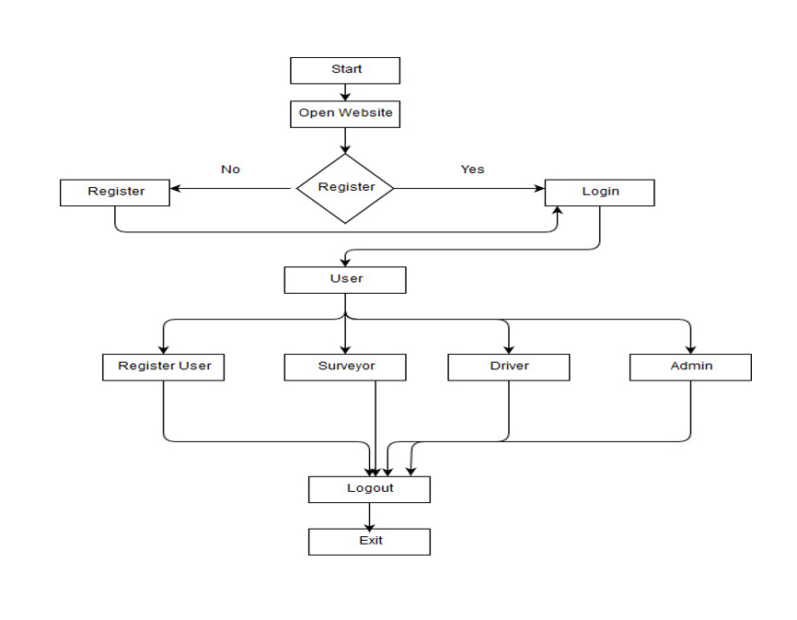
Flowchart
Flowchart

Slide 21
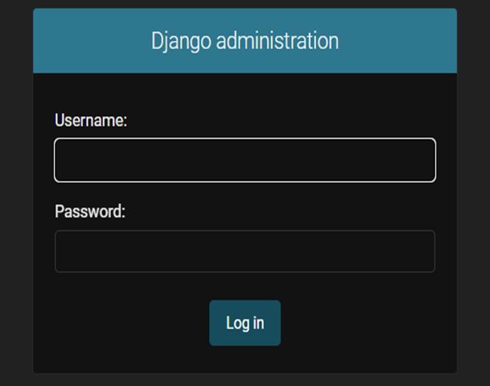
Administration

Slide 22
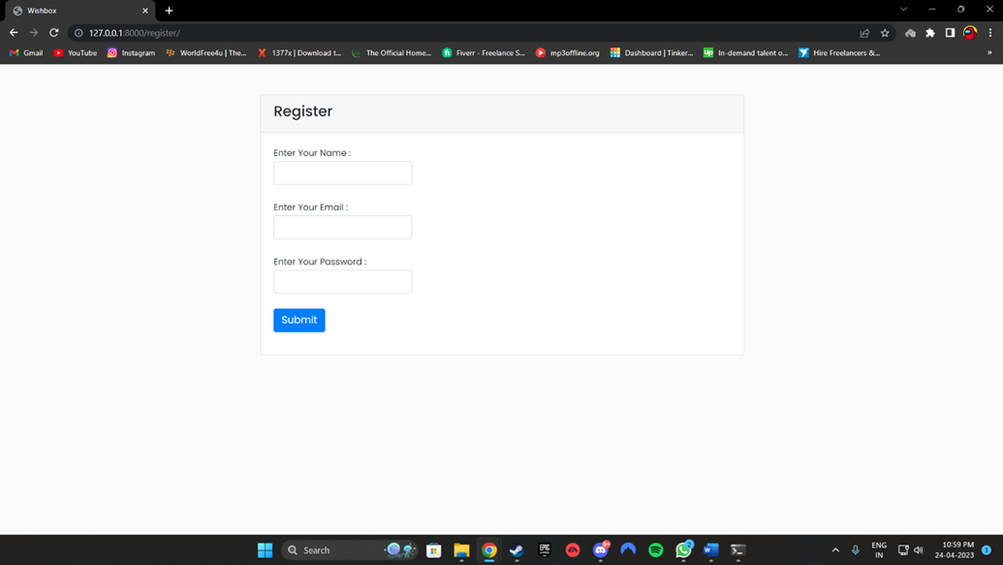
Customer Create Account

Slide 23
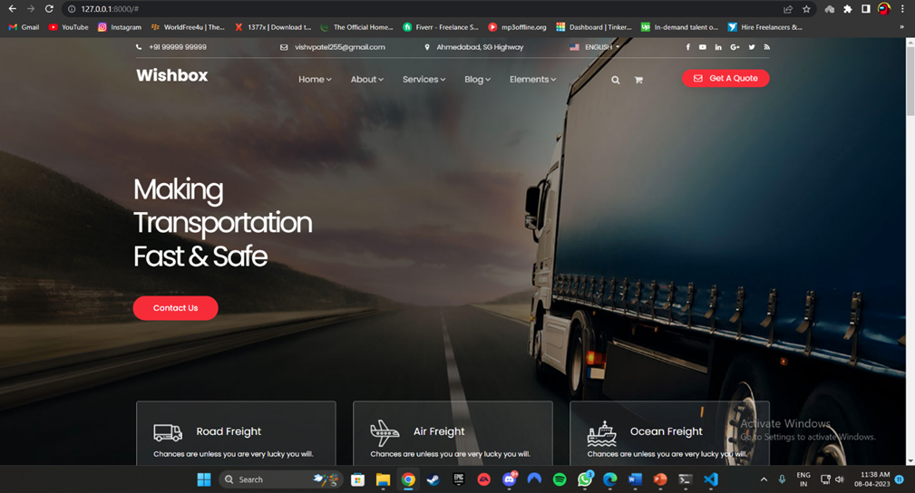
Implementation

Slide 24
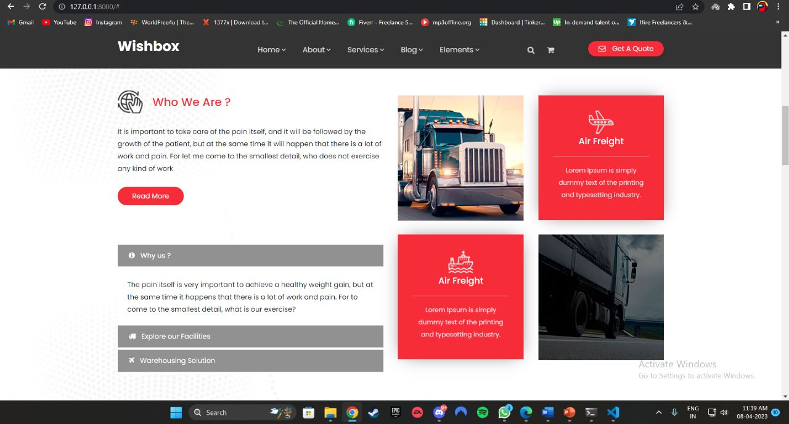
About

Slide 25
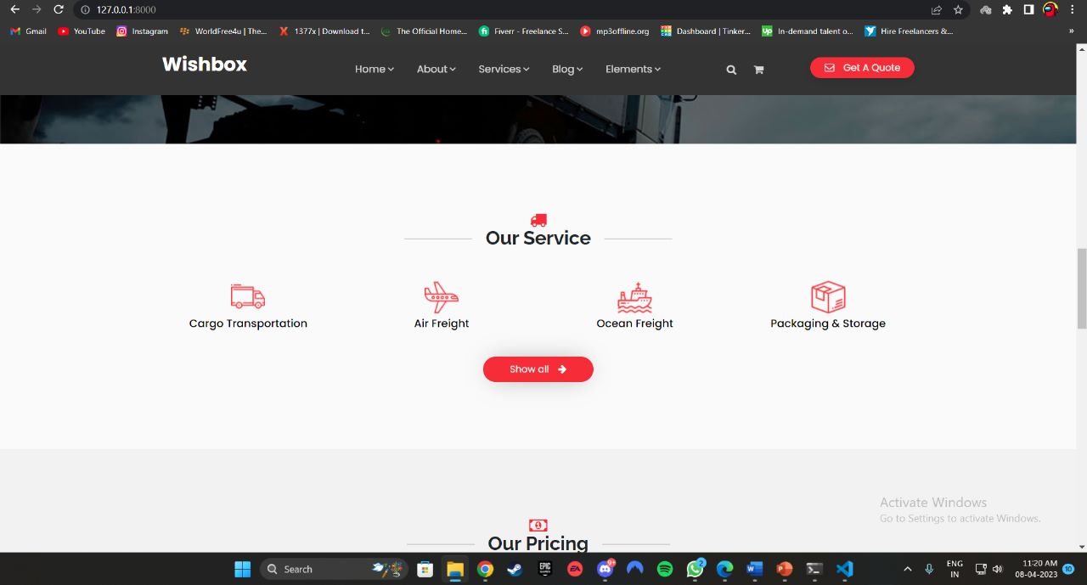
Services

Slide 26
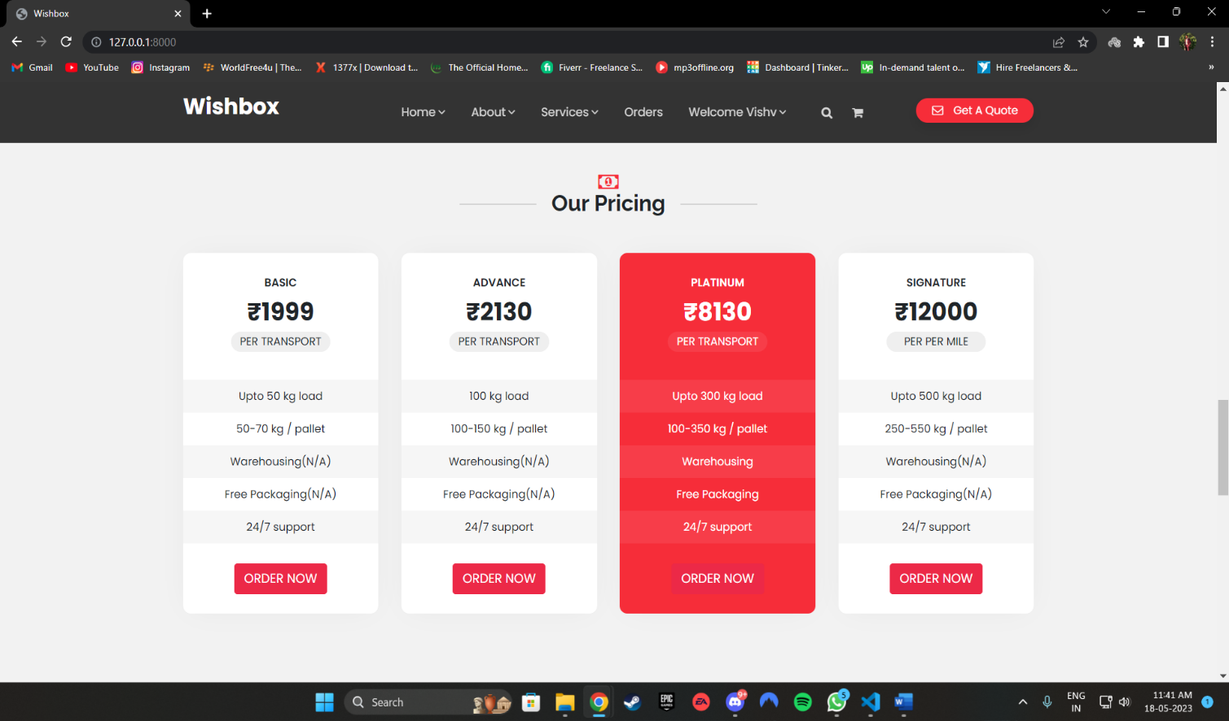
Service-Pricing

Slide 27
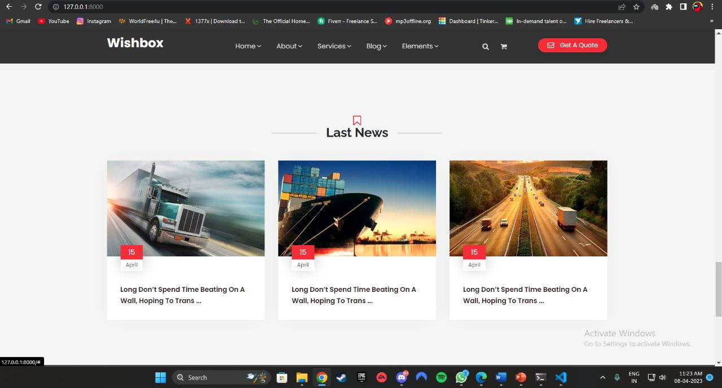
Blogs

Slide 28
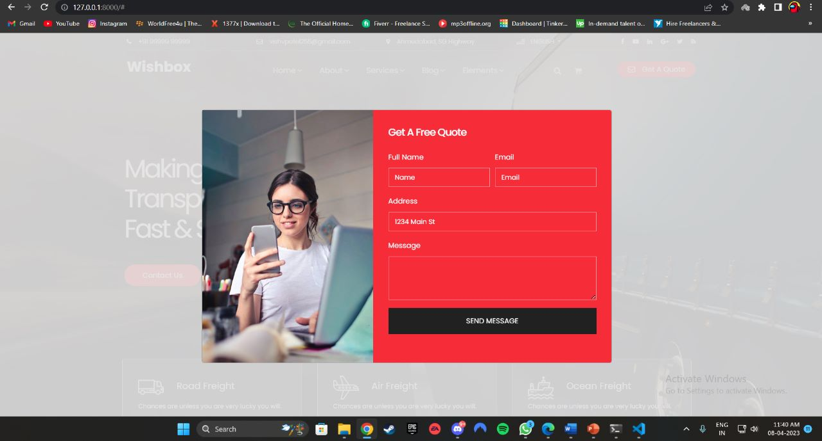
GET A QUOTE

Slide 29
Conclusion
According to requirement gathered and the technologies used to realize those requirements are best utilized to achieve that functionality. The Wishbox(logibox) Web Portal gives a platform through which clients and different packing and moving companies can communicate and use the services provided by this portal.

Slide 30
Thank You

