Slide 1
XGBoost: A Scalable Tree Boosting System
Faculty of Computer Science
Master’s Programme
Master of Data Science
Moscow
2024
By M.M. Melnikov

Slide 2
Introduction
Introduction
Large-scale Machine Learning
XGBoost: A Scalable Tree Boosting System
Machine learning has become very important in many areas in recent years.
Smart spam classifiers, advertising systems, fraud detection systems in banks.
One of the most effective ML methods used in practice is gradient tree boosting, which gives state-of-the-art results on many standard classification tasks.
XGBoost is an open source scalable machine learning system for tree boosting

Slide 3
Introduction
Introduction
Large-scale Machine Learning
XGBoost: A Scalable Tree Boosting System
It’s impact has been widely recognized in different machine learning and data mining challenges, such as competitions hosted by Kaggle: in 2015 17 out of 29 winners used XGBoost.
In KDDCup XGBoost was used by every winning team in the top-10.
So what makes XGBoost so effective?

Slide 4
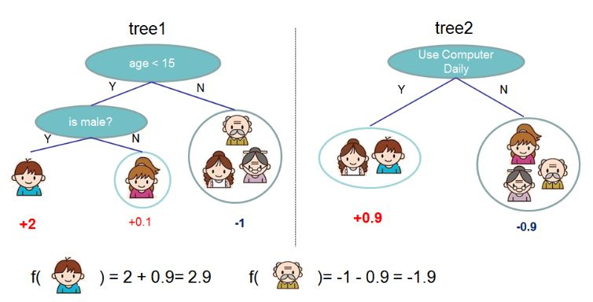
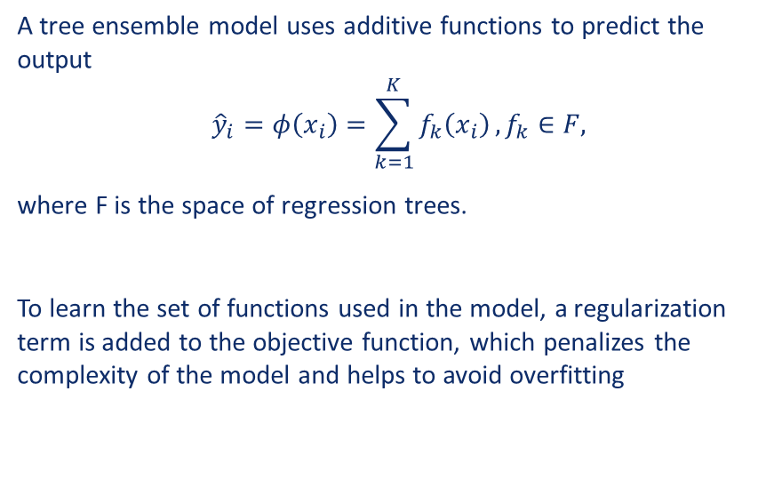
Regularized Learning Objective
Tree boosting
Regularization
XGBoost: A Scalable Tree Boosting System
A tree ensemble model uses additive functions to predict the output
$${\hat{y}}_{i}=φ\left(x_{i}\right)=\sum_{k=1}^{K}{f_{k}\left(x_{i}\right)}, f_{k}∈F,$$
where F is the space of regression trees.
To learn the set of functions used in the model, a regularization term is added to the objective function, which penalizes the complexity of the model and helps to avoid overfitting
Tree Ensemble Model. The final prediction for a given example is the sum of predictions from each tree.

Slide 5
Tree boosting
Regularization
XGBoost: A Scalable Tree Boosting System
The tree ensemble model has functions as hyperparameters and is trained in additive manner.
Taylor series approximation is used to quickly optimize the objective. After that, a scoring function is used to measure the quality of tree structure.
Usually it is impossible to get through all the possible tree structures.
As such, a greedy algorithm is used, which calculates a loss reduction after the split at a given node of a tree, to evaluate split candidates (Alg.1)

Slide 6
Tree boosting
Shrinkage and column subsampling
XGBoost: A Scalable Tree Boosting System
Other than regularization, two other techniques are used to prevent overfitting.
Shrinkage: scales newly added weights by a factor at each step of tree bosting to reduce the influence of each individual tree;
Column (feature) subsampling.

Slide 7
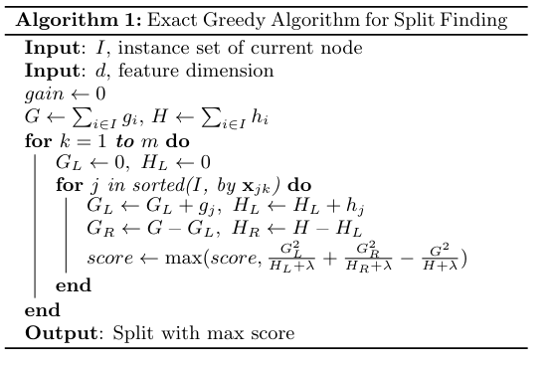
Split finding
Exact greedy algorithm
XGBoost: A Scalable Tree Boosting System
Exact greedy algorithm enumerates over all possibles splits on all features (Alg.1)
It might be very computationally demanding and inefficient in some cases, for example, if data doesn’t fit entirely in the memory or if we work in a distributed setting.
As such an approximate algorithm is required.

Slide 8
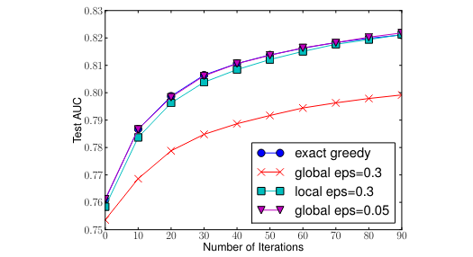
Split finding
Approximate algorithm
XGBoost: A Scalable Tree Boosting System
Approximate algorithm first proposes candidate splitting points, then calculates statistics for suggested splits and finds the best solution among proposals.
There are wo variants of the algorithm:
global variant proposes all the candidates at the initial stage of tree construction and uses them for split finding at all levels;
local variant proposes new candidates after each split.
In general case local proposals requires less candidates. At the same time global variant can be as accurate as the local one, but it usually needs more candidates.
Comparison of test AUC convergence on Higgs 10M dataset.
The eps parameter corresponds to the accuracy of the approximate sketch.

Slide 9
Split finding
Weighted quantile sketch
XGBoost: A Scalable Tree Boosting System

Slide 10
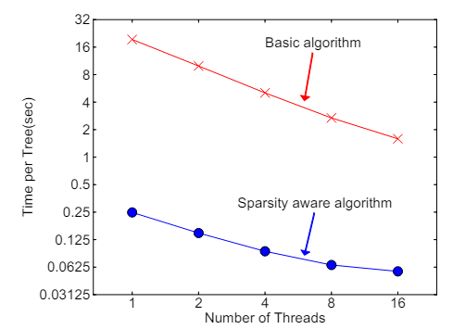
Split finding
Sparsity-aware split finding
XGBoost: A Scalable Tree Boosting System
It is quite common for the data to be sparse. There are many possible reason for this: some values might be missing, there are lots of zeros in the data, for example, because of artifacts of feature engineering.
To make algorithm aware of the sparsity, a default direction is introduced at each tree node.
As such XGBoost exploits sparsity in the data, which allows sparsity-aware version to be more than 50 times fatser, than the naïve version, that doesn’t take sparsity into account
Impact of the sparsity aware algorithm on Allstate-10K. The dataset is sparse mainly due to one-hot encoding.

Slide 11
System Design
Parallel Learning
XGBoost: A Scalable Tree Boosting System
The most time consuming part of tree learning is sorting the data.
To reduce the cost of sorting, the data is stored in blocks by columns, which are sorted by the corresponding feature values.
Such structure helps when using the approximate algorithm. Many blocks can be used for calculations at the same time, which allows the process to be parallelized. At the same time it also simplifies column subsampling, as it is easy to select columns in a block.

Slide 12
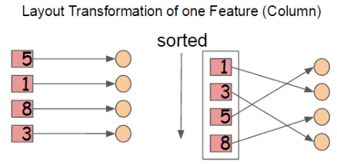

System Design
Cache-aware Access
XGBoost: A Scalable Tree Boosting System
Such block structure helps optimize complexity of split finding, but at the same time, as values are stored in order of feature, it requires some operations to be done by row index.
This slows down split finding when necessary data doesn’t fit into CPU cache.
The problem is solved by adding cache-aware prefetching algorithm.
Using cache-aware prefetching improves the performance by factor of two when the dataset is large.

Slide 13
System Design
Out-of-core computation
XGBoost: A Scalable Tree Boosting System
Another goal of XGBoost is to fully utilize a machine’s resources to achieve scalable learning. For that purposes XGBoost uses two techniques to improve out-of-core computations:
block compression: a block is compressed, and decompressed on the fly by an independent thread when it’s being loaded into the main memory;
Block sharding: block is sharded onto multiple disks, pre-fetcher thread collects the data into an in-memory buffer.

Slide 14
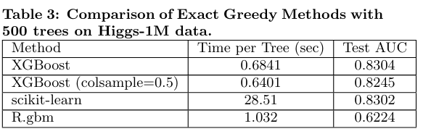
Conclusion
XGBoost: A Scalable Tree Boosting System

Slide 15
Conclusion
XGBoost: A Scalable Tree Boosting System
Thanks for attention!

Slide 19
Название столбца | Кооперация | Минимизация | Актуализация | Верификация | Буферизация
Показатели эффективности | 12 343 567 | 3 287 498 | 34 353 | 456 578 678 | 23 424
Еще показатели, но эффективности ли? | 345 353 | 28 764 | 67 868 | 909 837 459 | 900 077
И еще немного показателей | 67 868 | 1 293 090 | 23 324 213 | 12 334 | 34 567
ИТОГО | 63 836 746 | 35 216 735 | 75 984 375 | 3 984 759 835 | 34 785

Slide 20
Название столбца | Актуализация | Верификация | Буферизация
Показатели эффективности | 34 353 | 456 578 678 | 23 424
Еще показатели, но эффективности ли? | 67 868 | 909 837 459 | 900 077
И еще немного показателей | 23 324 213 | 12 334 | 34 567
ИТОГО | 75 984 375 | 3 984 759 835 | 34 785

