Slide 1
XGBoost: A Scalable Tree Boosting System
Faculty of Computer Science
Master of Data Science
Moscow, 2024
Presentation by
Melnikov Mikhail
Authors: Tianqi Chen, Carlos Guestrin.
Published: 13 August 2016.
Notes:
Hello everyone!
Today we are going to talk about XGBoost: a Scalable Tree Boosting System

Slide 2

Machine Learning
Introduction
Large-scale Machine Learning
XGBoost: A Scalable Tree Boosting System
Notes:
As we all know, machine learning has become very important in many areas.
It allows to create such things as smart spam classifiers, targeted advertising systems and fraud detection systems in banks. It has many applications in other areas as well, as shown on the picture
There are many effective machine learning models out there. One of the most successful ML methods used in practice in recent years is gradient tree boosting, which gives state-of-the-art results on many standard classification tasks.
XGBoost is an open source scalable machine learning system for tree boosting.
It’s impact has been widely recognized in different machine learning and data mining challenges, such as competitions hosted by Kaggle.
For example in 2015 more then half of the winners used XGBoost.
In KDDCup XGBoost was used by every winning team in the top-10.
So what makes XGBoost so effective?

Slide 3
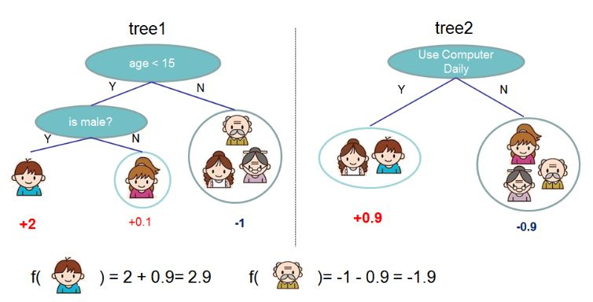
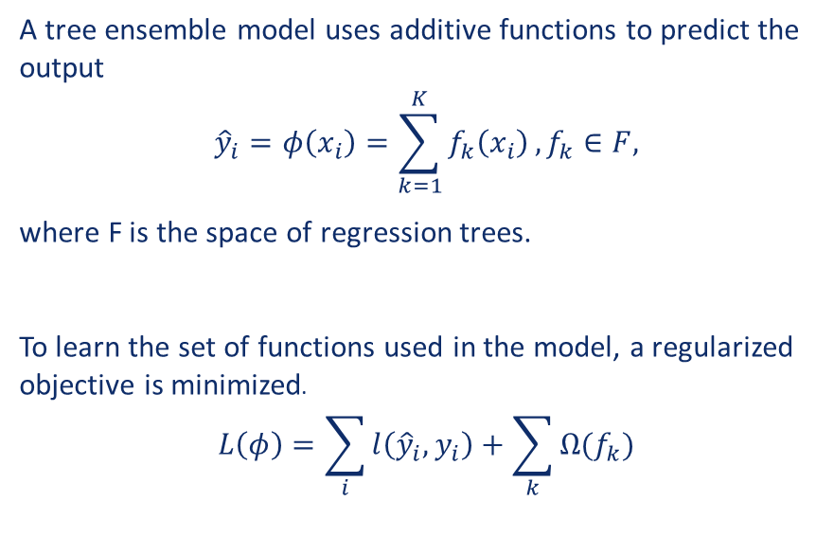
Regularized Learning Objective
Tree boosting
Regularization and gradient tree boosting
XGBoost: A Scalable Tree Boosting System
A tree ensemble model uses additive functions to predict the output
$${\hat{y}}_{i}=φ\left(x_{i}\right)=\sum_{k=1}^{K}{f_{k}\left(x_{i}\right)}, f_{k}∈F,$$
where F is the space of regression trees.
To learn the set of functions used in the model, a regularized objective is minimized.
$$L\left(φ\right)=\sum_{i}{l\left({\hat{y}}_{i},y_{i}\right)}+\sum_{k}{Ω(f_{k})}$$
Tree Ensemble Model
Notes:
A tree ensemble model uses additive functions to predict the output.
We can see an example of such model on the picture.
Here the final prediction for a given example is the sum of predictions from each tree.
To learn the set of functions used in the model, a regularized objective is minimized.
Here l is a differentiable convex loss function that measures the difference between the prediction y_hat and the target y.
The second term is a regularization term. It penalizes the complexity of the model and helps to avoid overfitting.
The tree ensemble model includes functions as parameters and cannot be optimized using traditional optimization methods
Because of that first and second order approximation is used to quickly optimize the objective.

Slide 4
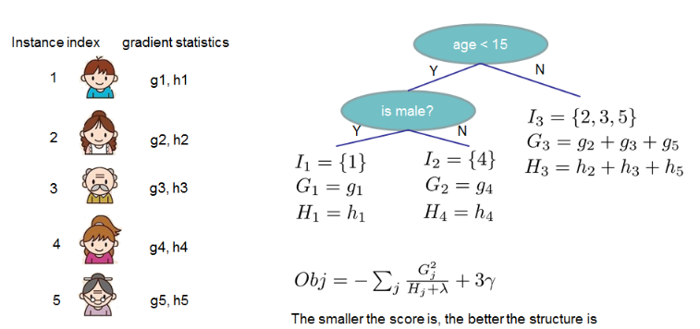
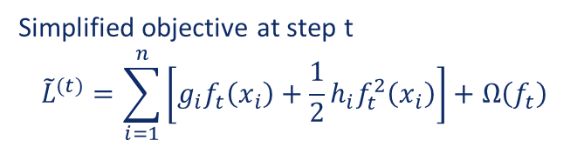
Tree boosting
Regularization and gradient tree boosting
XGBoost: A Scalable Tree Boosting System
Simplified objective at step t
$${\tilde{L}}^{(t)}=\sum_{i=1}^{n}{\left[g_{i}f_{t}\left(x_{i}\right)+\frac{1}{2}h_{i}f_{t}^{2}\left(x_{i}\right)\right]+Ω\left(f_{t}\right)}$$
Notes:
Here we can see a simplified objective
We only need to sum up first and second order gradient statistics (G and H) of loss function on each leaf,
then apply the scoring formula to get the quality score.
The smaller the score is, the better the structure is.
Before going further it’s worth to mention, that other than regularization, two other techniques are used to prevent overfitting.
Shrinkage: scales newly added weights by a factor at each step of tree boosting to reduce the influence of each individual tree;
And the other technique is column (or feature) subsampling, which, according to users feedback, prevents overfitting even more, then traditional row sub-sampling,
Going further. Usually it is impossible to get through all the possible tree structures.
As such, a greedy algorithm is used, which calculates a loss reduction after the split at a given node of a tree, to evaluate split candidates

Slide 5
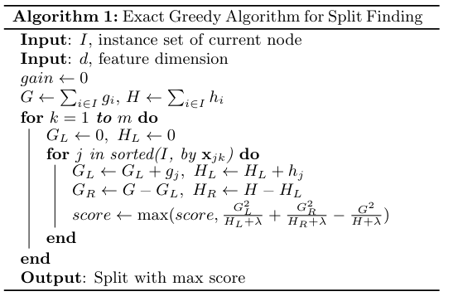
Split finding
Exact greedy algorithm
XGBoost: A Scalable Tree Boosting System
Exact greedy algorithm enumerates over all possibles splits on all features (Alg.1)
Notes:
One of the key problems in tree learning is to find the best split.
In order to do so, a split finding algorithm enumerates over all the possible splits on all the features.
It might be very computationally demanding and inefficient in some cases, for example,
if data doesn’t fit entirely in the memory or if we work in a distributed setting.
As such an approximate algorithm is required.

Slide 6
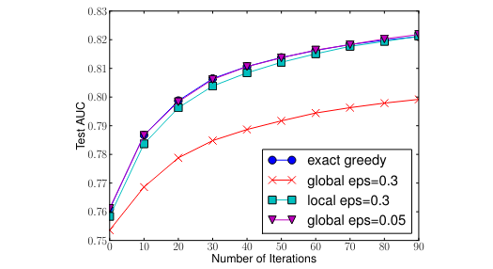
Split finding
Approximate algorithm
XGBoost: A Scalable Tree Boosting System
Approximate algorithm first proposes candidate splitting points, then calculates statistics for suggested splits and finds the best solution among proposals.
Comparison of test AUC convergence on Higgs 10M dataset.
The eps parameter corresponds to the accuracy of the approximate sketch.
Notes:
There are two variants of the algorithm:
global variant proposes all the candidates at the initial stage of tree construction and uses them for split finding at all levels;
local variant proposes new candidates after each split.
In general case local proposals requires less candidates.
At the same time global variant can be as accurate as the local one, but it usually needs more candidates.
On the picture we can see results of testing the algorithm on Higgs dataset.
The epsilon parameter corresponds to the accuracy of the approximate sketch.
This roughly translates to 1 / eps buckets in the proposal,
which shows that local proposals require fewer buckets, because it refine split candidates.
One important step in the approximate algorithm is to propose candidate split points.
Usually percentiles of a feature are used to make candidates distribute evenly on the data.
XGBoost uses a novel distributed weighted quantile sketch algorithm
that can handle weighted data with a provable theoretical guarantee

Slide 7
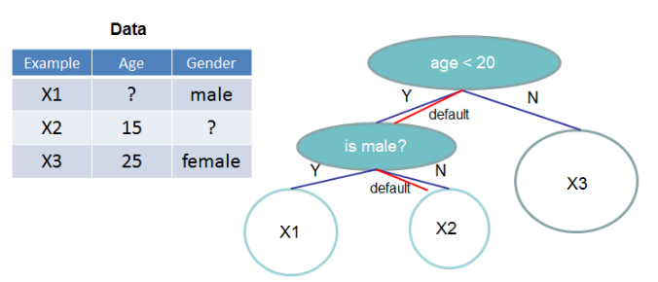
Split finding
Sparsity-aware split finding
XGBoost: A Scalable Tree Boosting System
Tree structure with default directions.
An example will be classified into the default direction when the feature needed for the split is missing.
Notes:
Another issue, that may arise, is data sparsity.
In real-world problems it is quite common for data to be sparse.
There are many possible reasons for this: some values might be missing,
maybe there are lots of zeros in the initial data, or maybe some of them are
caused by feature engineering, such as one-hot encoding.
It is important for the algorithm to be aware of sparsity patterns in the data.
To achieve this, a default direction is introduced at each tree node.
When a value is missing in the sparse matrix x, the instance is classified into the default direction.
The optimal default directions are learnt from the data.
As such XGBoost handles all sparsity patterns in a unified way.
This allows it to exploit sparsity in the data to lower computation complexity of the algorithm,
which in turn leads to sparsity-aware version to be much faster,
than the naïve version, that doesn’t take sparsity into account.

Slide 8
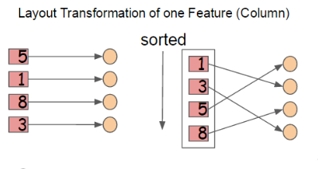

System Design
Parallel Learning
XGBoost: A Scalable Tree Boosting System
Data is stored in blocks by columns, which are sorted by the corresponding feature values.
A pointer from feature value to instance index is stored.
Missing values are not stored.
Notes:
The most time consuming part of tree learning is sorting the data.
To reduce the cost of sorting, the data is stored in blocks by columns,
which are sorted by the corresponding feature values as shown in the picture.
Such structure helps when using the approximate split finding algorithm.
Many blocks can be used for calculations at the same time, which allows the process to be parallelized.
At the same time it also simplifies column sub-sampling, as it is easy to select columns in a block.

Slide 9
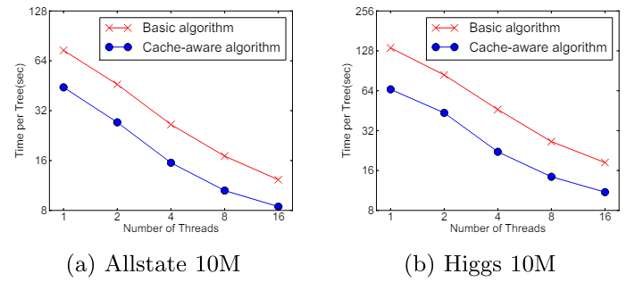
System Design
Cache-aware Access
XGBoost: A Scalable Tree Boosting System
Impact of cache-aware prefetching in exact greedy algorithm
Using cache-aware prefetching improves the performance by factor of two when the dataset is large.
Notes:
On the other hand, such structure requires some operations to be done by row index.
This slows down split finding when necessary data doesn’t fit into CPU cache.
The problem is solved by adding cache-aware prefetching algorithm.
As we can see on the graphs,
using cache-aware prefetching improves the performance by factor of two when the dataset is large.

Slide 10
System Design
Out-of-core computation
XGBoost: A Scalable Tree Boosting System
Block compression: a block is compressed, and decompressed on the fly by an independent thread when it’s being loaded into the main memory
Block sharding: block is sharded onto multiple disks, pre-fetcher thread collects the data into an in-memory buffer.
Notes:
Another goal of XGBoost is to fully utilize a machine’s resources to achieve scalable learning.
For that purpose XGBoost uses two techniques to improve out-of-core computations:
block compression and block sharding

Slide 11
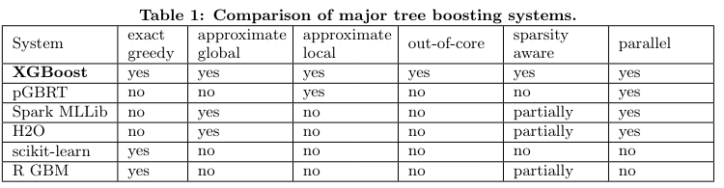
System Design
Out-of-core computation
XGBoost: A Scalable Tree Boosting System
Notes:
There are several classical algorithms used in tree boosting models out there,
that were used as an inspiration for XGBoost model.
XGBoost incorporates main ideas of such algorithms and tries to improve them.
At the same time, it agglomerates many different features and takes advantage of them in such way,
that no other model does.
We can see that by looking at the table,
which compares XGBoost and other major tree boosting systems.

Slide 12
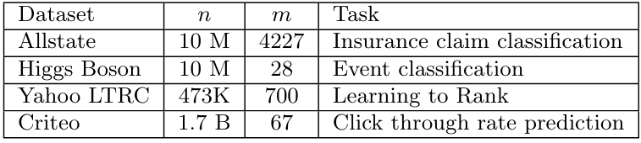
System implementation
Comparison with other tree boosting systems
XGBoost: A Scalable Tree Boosting System
Datasets used in experiments
Notes:
Here we can see which datasets were used in the experiments.
In some cases subsets of these datasets were used
to demonstrate performance of the algorithm on varying dataset sizes.

Slide 13
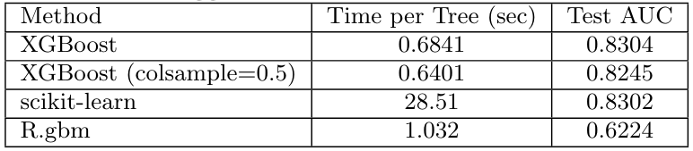
System implementation
Comparison with other tree boosting systems
XGBoost: A Scalable Tree Boosting System
Comparison of Exact Greedy Methods with 500 trees on Higgs-1M data
Notes:
In this experiment we can see results of testing on Higgs dataset with 1m of records.
As you can see, although scikit-learn and XGBoost have nearly same Area under the curve test results,
XGBoost dominates scikit-learn over time per tree.
At the same time it also wins over R.gbm in both time and AUC tests.

Slide 14
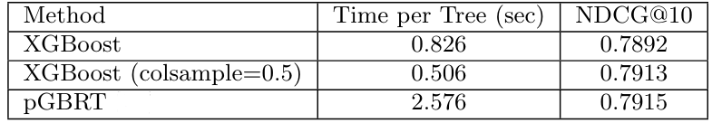
System implementation
Comparison with other tree boosting systems
XGBoost: A Scalable Tree Boosting System
Comparison of Learning to Rank with 500 trees on Yahoo! LTRC Dataset
Notes:
In this experiment we can see results of testing on Yahoo! LTRC dataset with 1m of records.
XGBoost achieves nearly same results as pGBRT, but about 2 or 3 times faster.
Other experiments demonstrate similar results.
For example experiments on out-of-core methods, such as block compression and sharding,
show us, that these methods might give you up to 3 times performance speedup.

Slide 15
Conclusion
XGBoost: A Scalable Tree Boosting System
Thanks for attention!
Notes:
Over all we can say, that XGBoost is really one of the most successful tree boosting system now days,
as it allows to achieve state of the art results, and it does it much faster than many other algorithms.
That’s all I wanted to say about XGBoost today, thanks for your attention! Bye!

