Slide 1
Olist:
Optimizing Inventory Management

Slide 2
Agenda
Background
Objective
Key findings
Recommendations
Appendix:
Data sources
Data methodology
Data model assumptions

Slide 3
Background
Olist has been experiencing a decline in revenue over the past few months.To meet customer demand, the company needs to stock a substantial volume of products in its warehouses.
However, warehousing these products adds significant costs to the company’s operations.Therefore, effective inventory planning is essential for Olist.
The goal is to align inventory levels with customer demand while minimising unnecessary storage costs.This approach allows Olist to strike a balance between customer satisfaction and cost control.

Slide 4
Objective
Utilizing the 80/20 principle to identify the top 20% of products responsible for 80% of our revenue ; Focus resources on optimizing these key products to maximize profitability and overall sales.
Discover patterns of products frequently bought together, enabling strategic bundling and cross-selling opportunities and on the whole, deepen our shared understanding with Market Basket Analysis. This aids in tailoring Marketing Strategies.
Gaining insight into standalone and complementary product preferences to help maximise profitability: Investigate which items are commonly purchased individually and which ones tend to be paired with others.

Slide 5
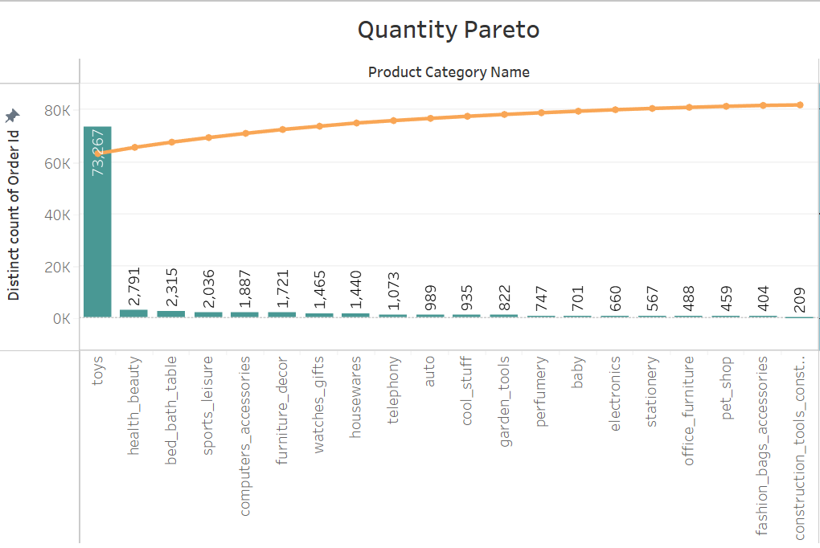
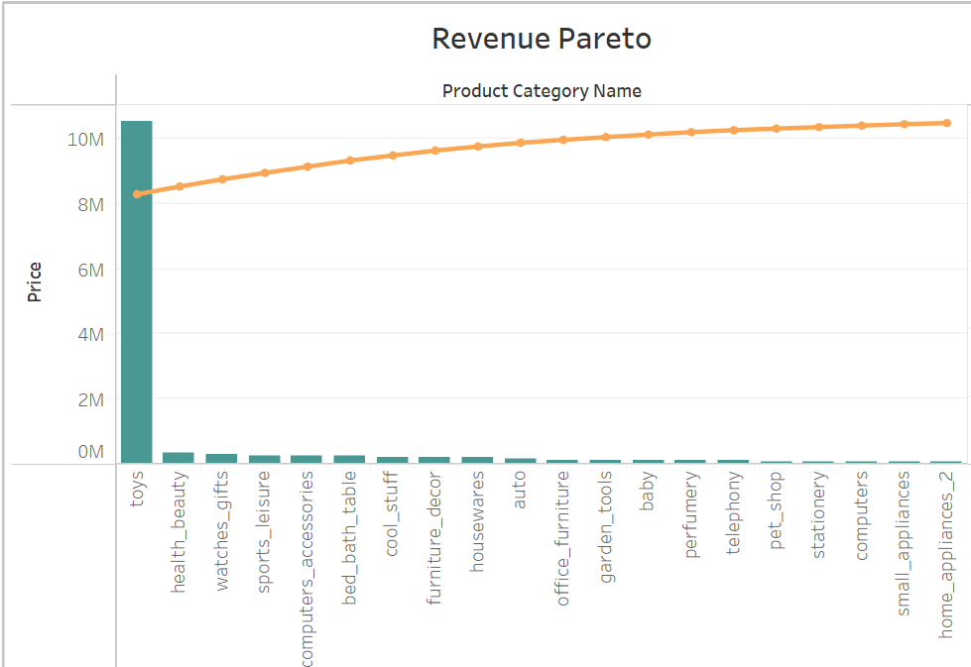
“Toys” Category Leads in Sales and Revenue
Toys stand out as the most ordered product category.
They also contribute the highest revenue among all product categories.
Notably, the revenue generated by Toys surpasses the combined revenue of all other product categories.
Similarly, the number of orders for Toys alone exceeds the total orders across all other categories combined.
Given these compelling statistics, prioritising the stocking and management of the Toys category in inventory emerges as a clear and strategic imperative.

Slide 6
"Three key categories drive over 80% of total orders"
Applying Pareto Analysis reveals that three categories, namely Toys, Health & Beauty, and Bed & Bath Table, collectively account for a significant 80.38% of total orders.
Conversely, the remaining product categories contribute to the remaining 19.62% of orders.
To streamline inventory management effectively, it's prudent to categorize products into priority groups based on their order counts.
This prioritization ensures that the top-selling items, namely Toys, Health & Beauty, and Bed & Bath Table, receive special attention to prevent any shortages and ensure they are managed meticulously.
The product categories of Toys, Health & Beauty, and Watches & Gifts collectively contribute a substantial 80.56% of the total revenues.
In contrast, the remaining 70+ product categories account for the remaining 19.44% of revenues.
In light of these findings, it is imperative to prioritize and plan inventory restocking for these top-performing products.
Ensuring a consistent and adequate supply of these products is essential to meet demand effectively.
Additionally, these high-revenue products should be strategically positioned within the warehouse or facility to facilitate easy access, streamlining the order fulfilment process.

Slide 7
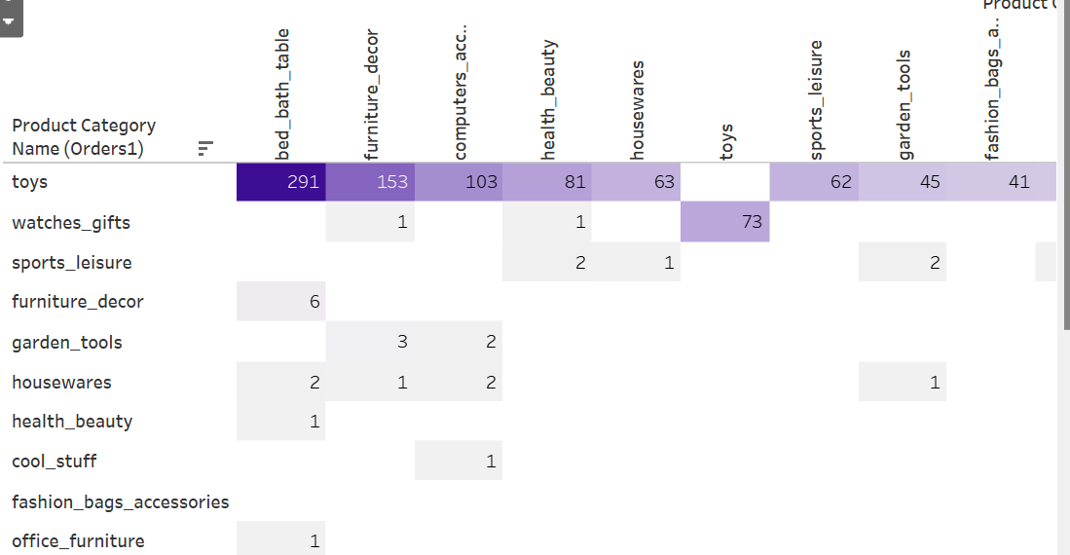
Unlock Sales Potential through Effective Cross-selling with Toys.
The Toys category stands out as the most commonly purchased individual item, with a remarkably high support value of 0.97.
Furthermore, Toys emerge as the most sought-after consequent product, indicating that customers often follow the purchase of other items with Toys.
Leveraging these insights, offering discounts on specific product combinations, such as providing a discount on one of the items, presents an effective strategy.
Implementing such discounts can promote continuous inventory turnover, reducing the risk of products becoming stale and aiding in maintaining a dynamic inventory.

Slide 8
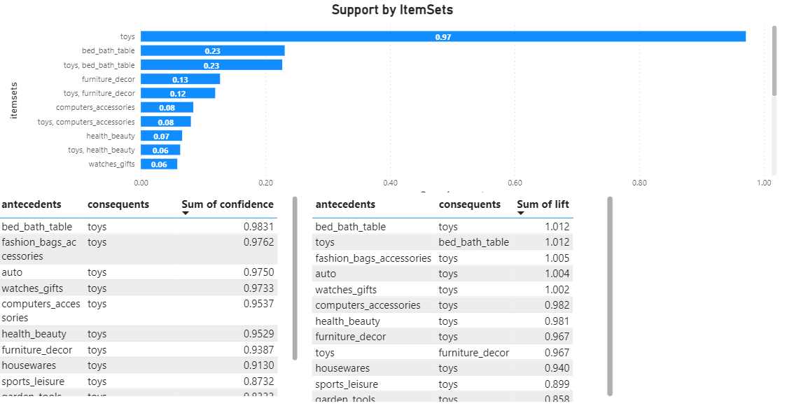

Slide 9
Recommendations
Prioritize the product categories responsible for over 80% of the revenue. Maintain these items consistently in stock and consider proactive restocking to prevent shortages.
Implement discounts on products that are frequently purchased together with Toys, encouraging customers to explore complementary items.
Organise the Toys category alongside related products on the same shelf for efficient access. This facilitates the rapid movement of top product combinations, saving both labor time and expenses.
To maintain a fresh and trend-aligned inventory, offer discounts on older stock within categories. This strategy promotes quicker sales of stagnant items, ensuring the inventory remains current and aligned with market trends.

Slide 10
Appendix - Data Sources
Data Dictionary Overview:
Order details, including order ID, status, price, and shipping charges.
Customer information, such as customer ID, city, and state.
Product attributes like product ID, category name, and dimensions.
Data Sources:
Utilised the OList retail dataset, rich in order-related information.
Data spanned the years 2016 to 2018.

Slide 11

Appendix - Data Methodology
We conducted a thorough analysis of the OList retail data. The process included:
Data Analysis Steps:
Data cleaning and transformation in Jupyter Notebook using Pandas and Numpy.
Exploratory data analysis (EDA) in Jupyter Notebook using Matplotlib and Seaborn.
Key Processes:
Emphasize the importance of data quality through cleaning.
Highlight insights gained from EDA.
Detailed Analysis:
Provided link or reference to the attached Python Jupyter Notebook PDF.

Slide 12
Appendix - Data Assumptions
Revenue Assumption:
Assumed the provided data achieved desired revenue levels.
Expansion Strategy:
Assumed no plans to expand to new warehouses/facilities.
Sales Growth Focus:
Strategies based on constant sales growth expectation.

