Slide 1

Analyzing and Predicting Housing Prices in Bengaluru
Zeenat Tanveer MSDS-123

Slide 2

Introduction
Bengaluru is a rapidly growing city with a booming real estate market.
Accurate price estimation for properties can enhance transparency and aid stakeholders in decision-making.
This project leverages machine learning techniques to predict property prices based on a dataset containing features such as area type, location, size, and other attributes.

Slide 3
Problem Statement
The Bengaluru housing market exhibits complex pricing dynamics influenced by various factors such as location, area type, property size, and amenities. This project aims to develop a predictive model to estimate property prices based on these attributes. The insights derived will assist potential buyers, real estate agents, and policymakers in making informed decisions.

Slide 4
Objectives
Explore and analyze factors affecting housing prices.
1
Clean and preprocess the dataset to ensure quality.
2
Develop a machine learning model for price prediction.
3
Provide actionable insights for stakeholders.
4

Slide 5
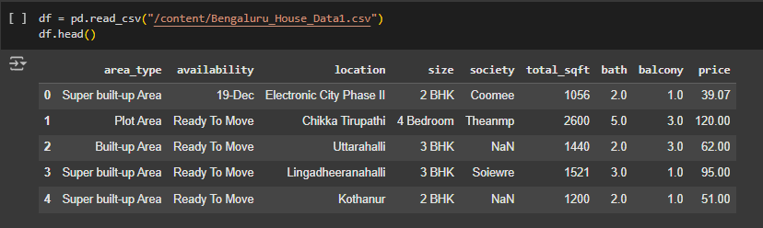
Dataset Overview
Dataset: 13,320 records with 9 features:
Dataset Source: Kaggle
https://www.kaggle.com/datasets/amitabhajoy/bengaluru-house-price-data/data

Slide 6
Tools and Technologies
Python Libraries:
Data manipulation: pandas, numpy
Visualization: seaborn, matplotlib
Machine learning : scikit-learn
Techniques:
Data preprocessing
Regression analysis
Feature engineering

Slide 7
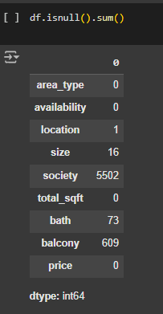
Preliminary Findings
Missing and inconsistent data needs to be addressed before modeling.
Society and Availability
Balcony and bath

Slide 8
Data Preprocessing
Handling Missing Values:
location: Rows with missing values were dropped.
size: Rows with missing values were dropped.
bath and balcony: Missing values were filled using median imputation.
Feature Engineering:
Extracted the number of bedrooms (bhk) from the size column.
Converted total_sqft to a numerical format by handling ranges and invalid entries.
Computed price_per_sqft as a derived feature.

Slide 9
Data Preprocessing
Location Grouping:
Locations with fewer than 10 occurrences were grouped into a category labeled "Other."
Label encoding was applied to the location column.
One-Hot Encoding:
Applied to the area_type column to create binary indicator variables.

Slide 10
Model Training and Evaluation
Several models were trained to predict property prices, including:
Linear Regression:
R^2 Score: 0.94
RMSE: 7.33
Decision Tree:
R^2 Score: 0.998
RMSE: 1.32
Random Forest:
R^2 Score: 0.999
RMSE: 0.73
The Random Forest model demonstrated the best performance and consistency, making it the preferred choice for deployment.

Slide 11
Conclusions
The project successfully predicted property prices with high accuracy, leveraging robust preprocessing and machine learning techniques.
The Random Forest model is recommended for real-world use due to its superior performance and generalization capability.

Slide 12

Thank you

