Slide 1
Name : Zeerak
Surname: Baig
Student Number : 217026768
Computer Science 3A
Mini Project

Slide 2
Drug counterfeiting is one of the major problems in South Africa and Africa as a whole.
Counterfeited drugs can be fatal for one’s life.
Pharmaceutical companies lose millions due to counterfeited drugs.
Problem Statement

Slide 3
Block Chain technology serves as a great solution for improving medical supply chain :
Data in Block chain is nearly impossible to tamper with and is encrypted end-to-end.
Increases transparency as blockchain uses a distributed ledger which stores data identically in multiple locations.
Increases traceability and visibility of drug information which is vital for medical supply chain.
Why Block Chain?

Slide 4
Drug Record
A drug record consist of the following information
Drug ID
Drug Name
Date Manufactured
Expiry Date
Max Temperature
Record Structure

Slide 5
The block verification algorithm takes in a blockchain takes
Blockchain and strength as an argument
It compares the previous hash field of the current block
with the hash of the previous block.
If the hashes match that means that the newly added
block to the blockchain is valid.
Block Verification Algorithm

Slide 6
Command Structure
Connecting to other peers
Sending blocks to other peers
Manufacturer: pharmacy connected to manufacturer
Pharmacy: SENDBLOCK
Manufacturer: received the block
Pharmacy: CONNECT
Delivery: pharmacy connected to Delivery
Data Communication
Data Communication
Pharmacy: received the block
Pharmacy: manufacturer connected to Pharmacy
Manufacturer: SENDBLOCK
Manufacturer: CONNECT
Delivery: received the block
Delivery: manufacturer connected to Delivery
Manufacturer: received the block
Manufacturer: delivery connected to manufacturer
Delivery: SENDBLOCK
Delivery: CONNECT
Pharmacy: received the block
Pharmacy: delivery connected to pharmacy

Slide 7
Command Structure
Block Verification
Get Graph from other clients
Manufacturer: sends a message saying Verified Block Successfully added to blockchain.
Client 2: sends a copy of its graph to client 1.
Pharmacy: VERIFY
Delivery: sends a message saying Verified Block Successfully added to blockchain
Client 1: GET
Client 3: sends a copy of its graph to client 1.
Data Communication
Data Communication
Pharmacy: sends a message saying Verified Block Successfully added to blockchain
Manufacturer: VERIFY
Delivery: sends a message saying Verified Block Successfully added to blockchain
Manufacturer: sends a message saying Verified Block Successfully added to blockchain
Delivery: VERIFY
Pharmacy: sends a message saying Verified Block Successfully added to blockchain

Slide 8
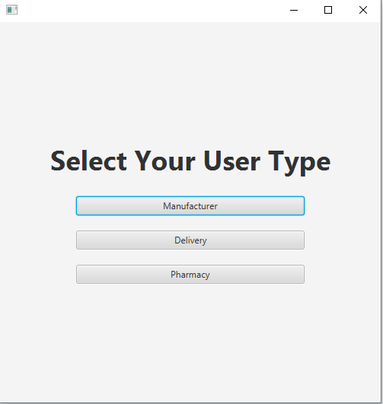
Process Demonstration

Slide 9
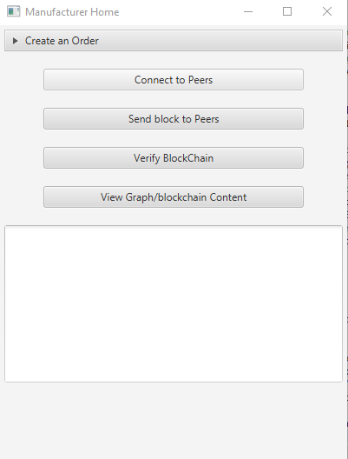
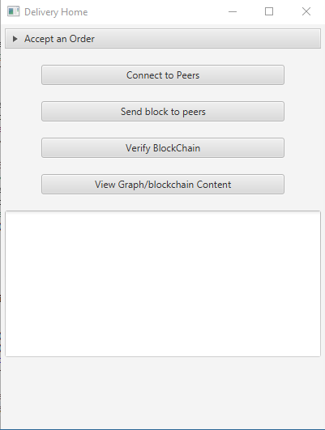
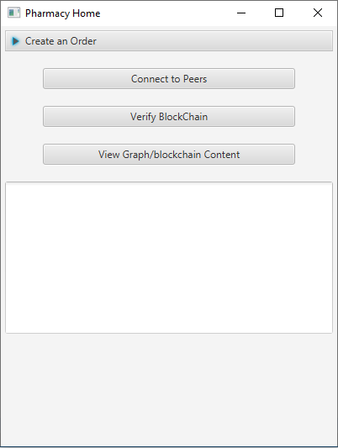
Interfaces specific to user type are presented

Slide 10
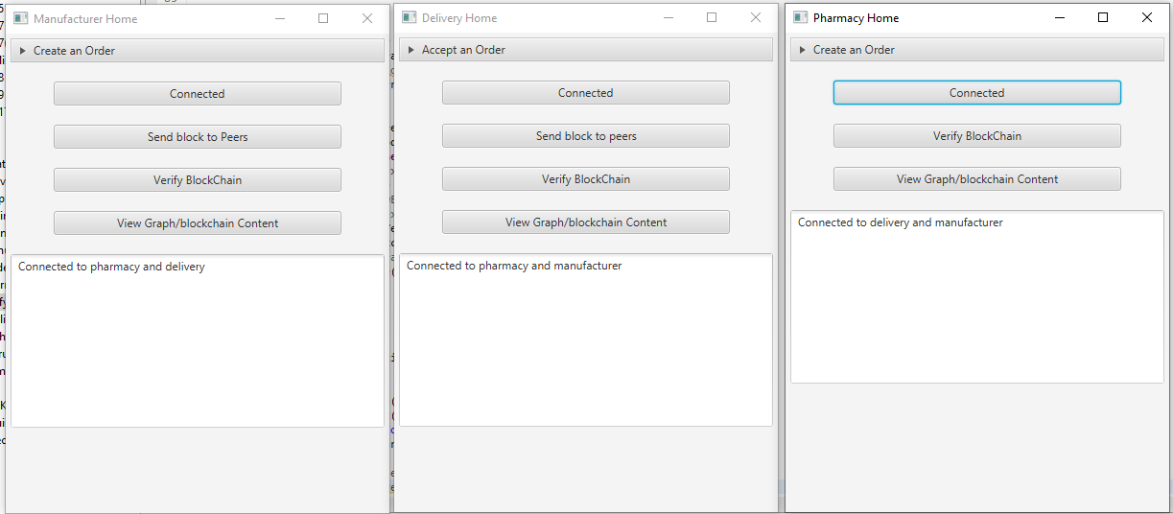
Connecting to all other peers on the network

Slide 11
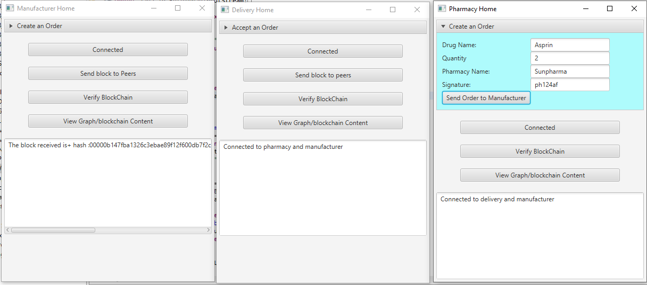
Pharmacy places an order

Slide 12
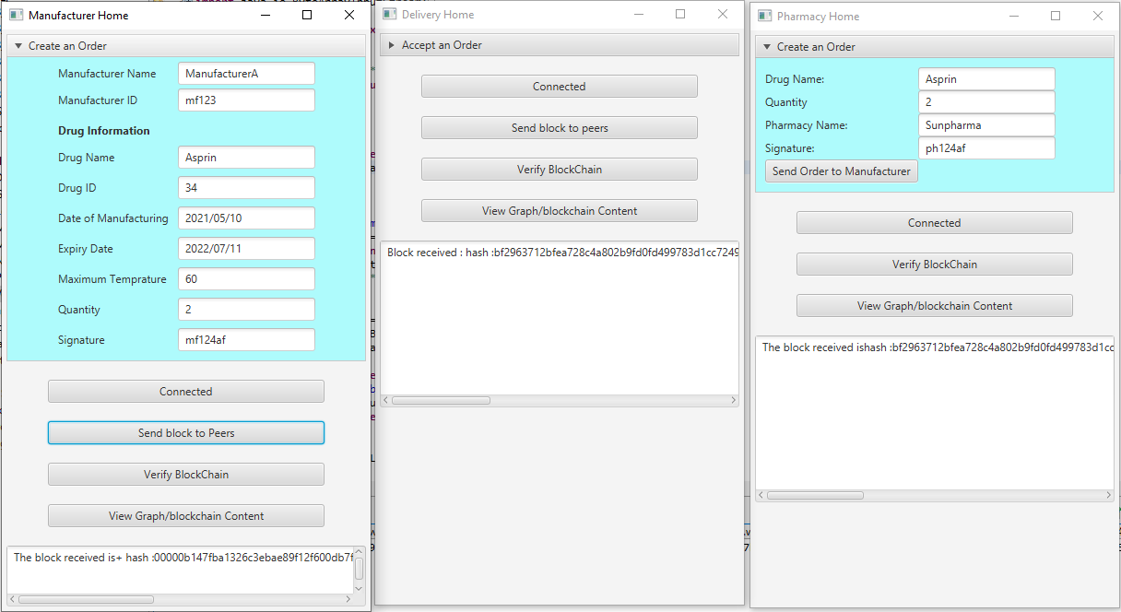
Manufacturer creates an order

Slide 13
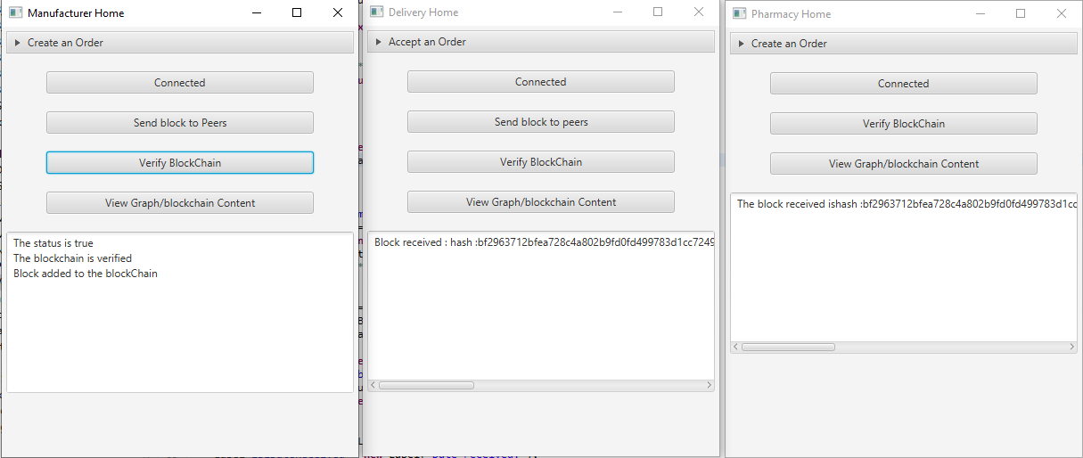
Manufacturer requests for verification

Slide 14
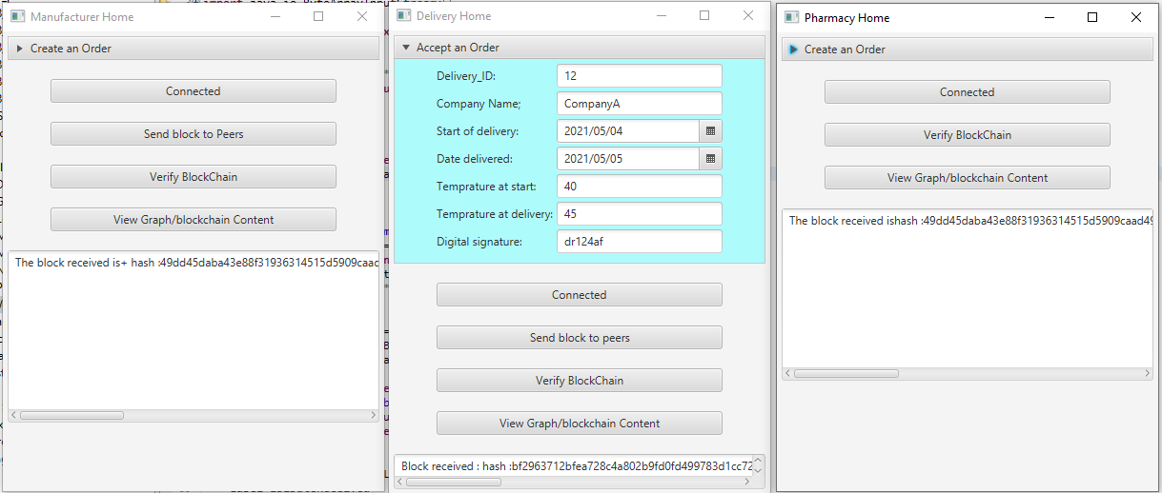
Delivery company accepts the order and delivers to the pharmacy

Slide 15
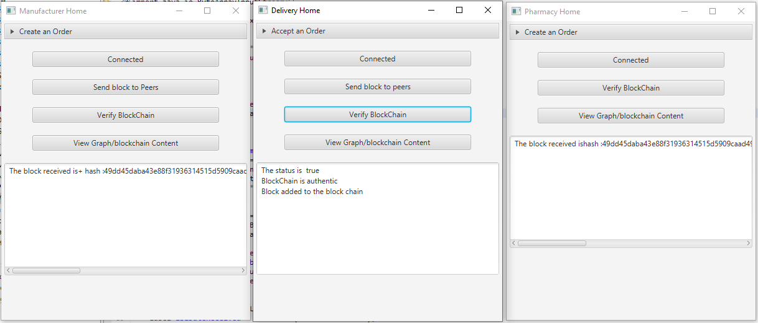
Delivery company requests verification

Slide 16
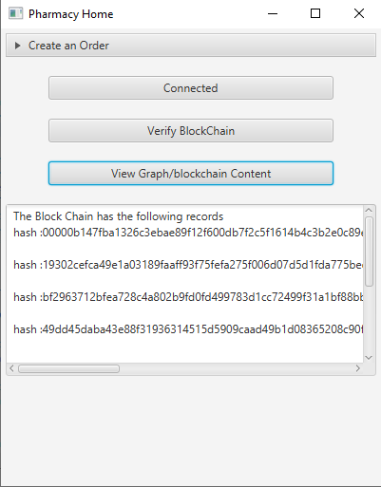
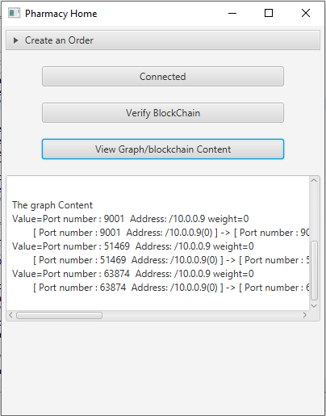
Checking blockchain status and graph information

