Slide 1




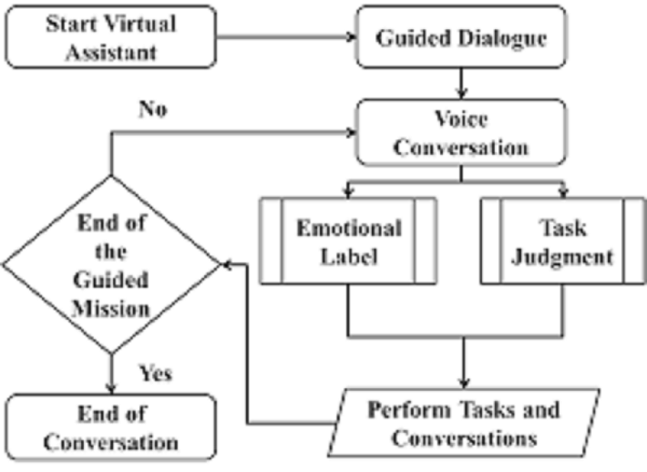
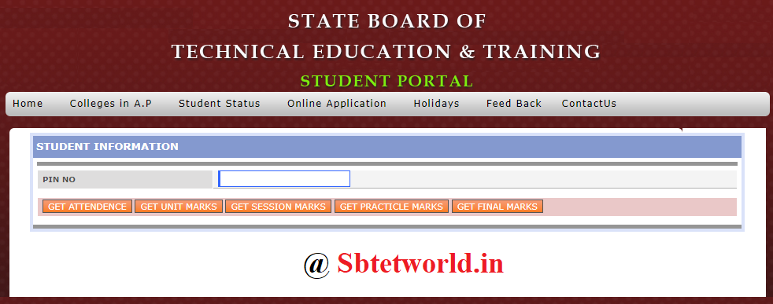


Existing system
HARDWARE
CONCLUSION
Proposed systemS
PROJ
E
C
T
ABSTRACT
SOFTWARE
VOICE ASSISTANT for SBTET
DESIGN AND DEVELOPMENT
ABSTRACT
Personal Computer
Headset
Mic
EX I STING
PROPOSED
The use of Chabot’s evolved rapidly in numerous fields in recent years, including Marketing,
Supporting Systems, Education, Health Care, Cultural Heritage, and Entertainment. In this paper,
we first present a historical overview of the evolution of the international community’s interest in chatbots.
Next, we discuss the motivations that drive the use of chatbots, and we clarify chatbots’ usefulness
in a variety of areas.
Moreover, we highlight the impact of social stereotypes on chatbots design. After clarifying
necessary technological concepts,
we move on to a chatbot classification based on various criteria, such as the area of knowledge
they refer to, the need they serve and others.
Furthermore, we present the general architecture of modern chatbots
while also mentioning the main platforms for their creation.
Our engagement with the subject so far, reassures us of the prospects of chatbots
and encourages us to study them in greater extent and depth.
HARDWARE
The use of Chabot’s evolved rapidly in numerous fields in recent years, including Marketing,
Supporting Systems, Education, Health Care, Cultural Heritage, and Entertainment. In this paper,
we first present a historical overview of the evolution of the international community’s interest in chatbots.
Next, we discuss the motivations that drive the use of chatbots, and we clarify chatbots’ usefulness
in a variety of areas.
Moreover, we highlight the impact of social stereotypes on chatbots design. After clarifying
necessary technological concepts,
we move on to a chatbot classification based on various criteria, such as the area of knowledge
they refer to, the need they serve and others.
Furthermore, we present the general architecture of modern chatbots
while also mentioning the main platforms for their creation.
Our engagement with the subject so far, reassures us of the prospects of chatbots
and encourages us to study them in greater extent and depth.
SOFTWARE
Every Famous sites has its own Voice Assistant or Chatbot
SBTET Portal cannot be accessed Using Voice as it has no Voice Assistant or Chatbot
To Access Every page of the SBTET we cannot use Voice
All the Pages of the Portal should be accessed Manually.
Python IDE
Python Interpreter
Qt Designer
Web Browser
* We can access All pages of SBTET Portal with Voice Commands through our Software.
* Using Our Software, We can access SBTET portal using Voice
DES I G N
TEAM MEMBERS
C.S KOUSHIK 18005-CM-017
SHAIK ZEESHAN 18005-CM-050
M. PREM SUNDER 18005-CM-032
N. AEYBA 18005-CM-042
N. VINAYKUMAR 18005-CM-043
C
O
N
N
C
L
U
S
I
O
N
INTERNAL GUIDE
R.VENKATESH garu (GPT
POLYMA
PRESENTAION
* A PERSONAL ASSISTANT FOR SBTET PORTAL

Slide 2


