Slide 1
AI INITIAL PROJECT PRESENTATION
NetRCA
PROJECT DETAILS
Team members
AI-Powered Network Root Cause Analysis
and Incident Response System
Adil Mehmood — 2024-CE-08
Zeeshan Ahmad — 2024-CE-32
NetRCA connects network telemetry, topology, anomaly detection, and deterministic analysis to help operators investigate failures. The dashboard keeps every conclusion linked to its original evidence.
Supervisor / instructor
Mr. Mehmood
AI + NETWORK OPERATIONS
CONTROLLED LAB
NETRCA
01
Notes:
Timing: 35–40 seconds.
Introduce the team and supervisor, then describe NetRCA in two sentences.
Source: Instruction/NetRCA_AI_Initial_Project_Proposal.docx and README.md.

Slide 2
PROJECT NEED
Problem Statement & Objectives
Network failures produce many symptoms at once, but operators still need one defensible investigation path.
The problem
THREE PROJECT OBJECTIVES
Latency, packet loss, link transitions, and service timeouts can appear together. Manual root-cause analysis becomes slow when symptoms propagate across connected devices.
01
Monitor network evidence
Collect and analyze metrics, logs, events, topology, and interface state.
02
Detect and explain failures
Why it matters
Use anomaly detection, correlation, graph context, and deterministic RCA.
Faster, evidence-based investigation reduces guesswork, preserves the incident timeline, and helps operators explain why a root-cause candidate was selected.
03
Support operator investigation
Present incidents, evidence, root-cause candidates, and impact in a web dashboard.
NETRCA
02
Notes:
Timing: 40–45 seconds.
Explain the simultaneous-symptom problem, then connect each objective to the investigation workflow.
Source: Instruction/NetRCA_AI_Initial_Project_Proposal.docx, sections 1 and 3.

Slide 3
METHODOLOGY
Proposed Solution & Methodology
The system converts controlled network observations into an evidence-linked incident explanation.
1
2
3
4
5
Observe
Detect
Correlate
Analyze
Present
Mininet or stored topology
Metrics, logs, events
Threshold and optional
ML anomaly detection
Shared device, link, service,
and time-window rules
NetworkX context, RCA,
and impact chain
Dashboard plus optional
Gemini explanation
Method rule
Time proximity alone never establishes a relationship. NetRCA keeps stable evidence identifiers, records limitations, and returns an inconclusive result when the stored evidence cannot support a conclusion.
NETRCA
03
Notes:
Timing: 50–55 seconds.
Walk from observation to presentation. Emphasize deterministic correlation and explainability before the optional language model.
Source: Instruction/ARCHITECTURE.md, Instruction/PRD.md, correlation/PHASE9_REPORT.md, and rca/PHASE11_REPORT.md.

Slide 4
IMPLEMENTATION
Technology Stack
Technologies are separated by responsibility so simulation, analysis, persistence, and presentation remain modular.
Programming & backend
Network & intelligence
Python 3.11+
FastAPI and Pydantic
REST API with validated request and response models
Mininet and Open vSwitch
NetworkX topology analysis
Scikit-learn Isolation Forest with deterministic thresholds
Frontend & visualization
Data, APIs & tools
Next.js, React, and TypeScript
Tailwind CSS and responsive custom styling
Interactive topology and investigation views
PostgreSQL and Supabase
Gemini API for optional evidence-grounded explanations
Git/GitHub, pytest, Vitest, WSL2, and VS Code
NETRCA
04
Notes:
Timing: 35–40 seconds.
Describe the stack by responsibility instead of reading every technology name.
Source: Instruction/TECHSTACK.md and the current repository configuration.

Slide 5
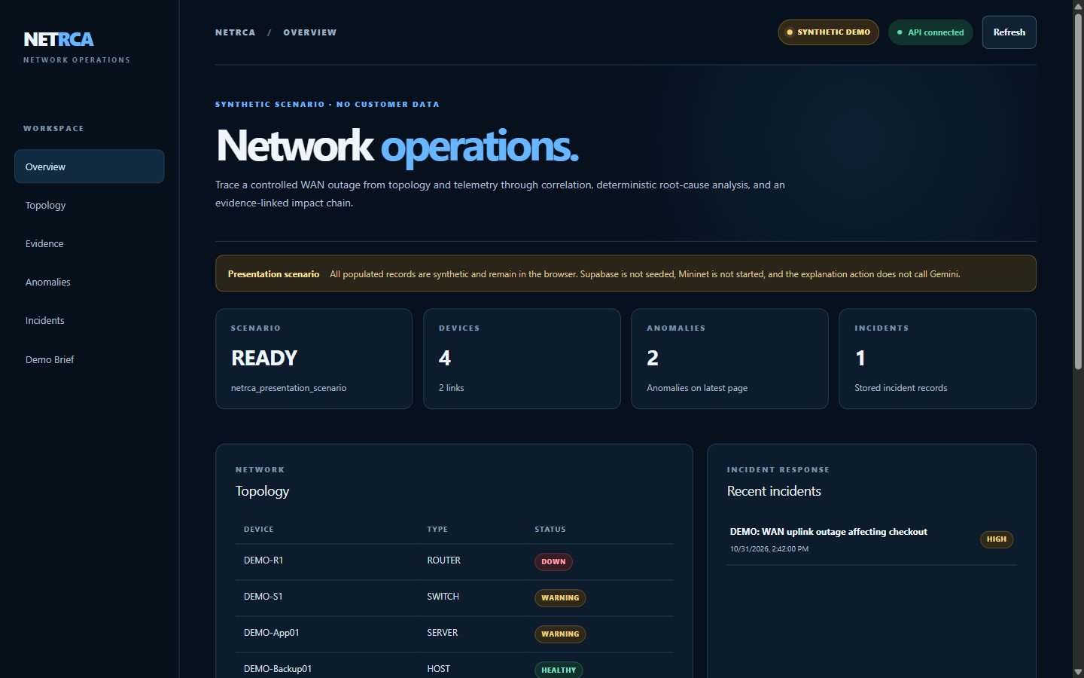
IMPLEMENTATION EVIDENCE
Work Completed So Far
The current build supports a complete synthetic incident investigation and separate real Mininet/PostgreSQL validation paths.
COMPLETED MODULES
FastAPI backend and protected local controls
Topology engine and NetworkX graph analysis
Monitoring plus metrics, logs, and events pipeline
Fault injection and anomaly detection
Incident correlation and transactional grouping
Explainable RCA, impact chain, and Gemini layer
Responsive dashboard and presentation scenario
LATEST LOCAL VERIFICATION
NETRCA
05
Notes:
Timing: 55–60 seconds. This is the main progress slide.
Point to the working dashboard, then summarize the completed modules. Mention that environment-gated database and Mininet tests run separately.
Source: current repository, README.md, audit/PHASE14-18_AUDIT_REPORT.md, and latest local test execution.

Slide 6
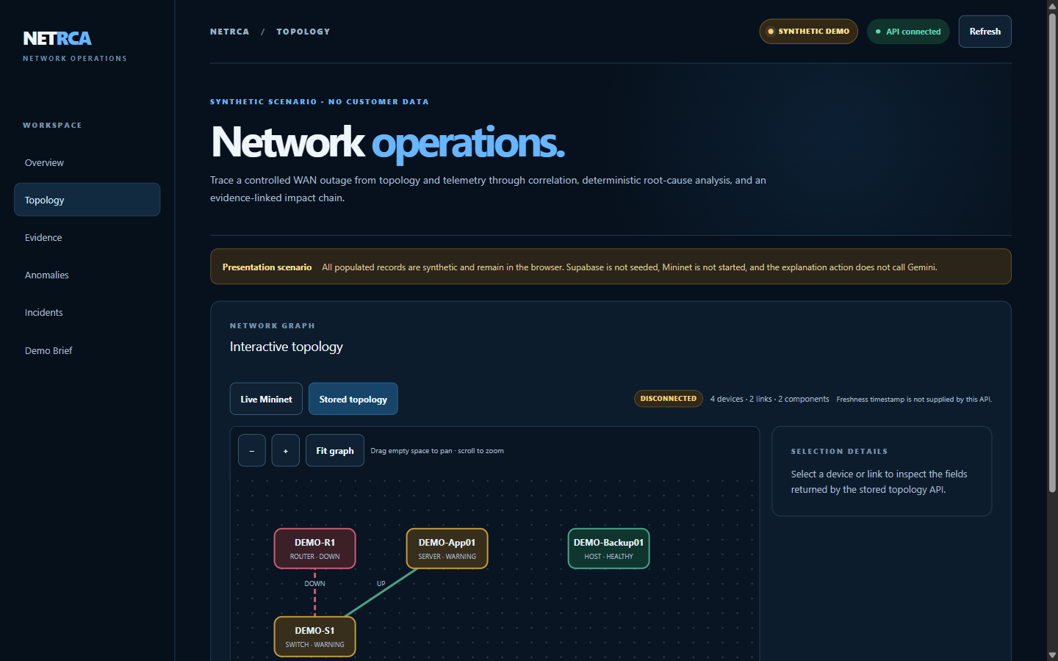
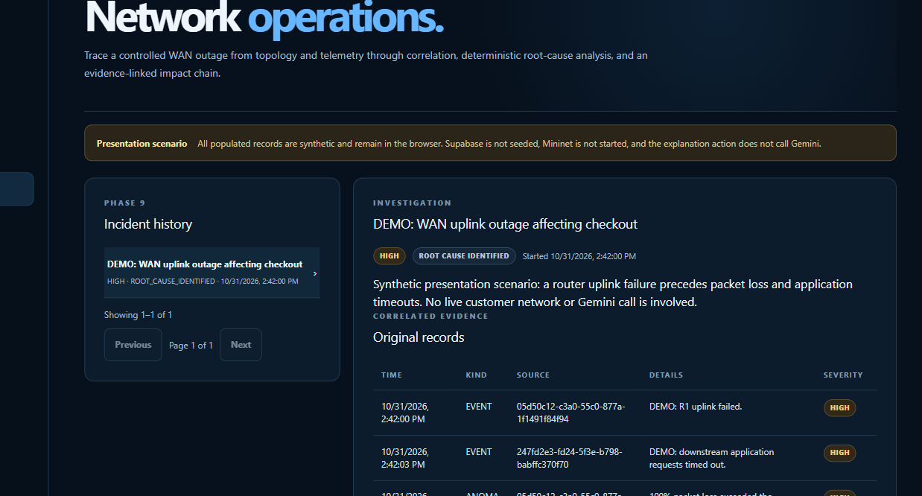
PRACTICAL EVALUATION
Live Demonstration / Current Implementation
Demonstration path: stored topology, evidence, anomaly, incident, RCA candidate, and potential impact.
Interactive topology
Incident investigation
Shows stable devices, links, a failed uplink, and disconnected components.
Shows original evidence, rule-scored RCA, impact, and explicit uncertainty.
WORKING
Synthetic end-to-end workflow, dashboard navigation, evidence views, topology, incident analysis, and safe local startup
NETRCA
06
Notes:
Timing: 60–75 seconds plus the live demonstration.
Run scripts/start-presentation.ps1. Open Topology, Evidence, and Incidents. State clearly that the populated records are synthetic and no Gemini request is made.
Source: PRESENTATION.md, frontend/src/lib/presentation-demo.ts, and current dashboard screenshots.

Slide 7
DELIVERY PLAN
Remaining Work & Future Plan
The core investigation prototype works. Remaining work focuses on production hardening and customer deployment readiness.
Production security
Operational readiness
Customer integration
Tenant authentication, role-based authorization, SSO, managed secrets, and audit actor identity.
Deployment automation, observability, backup and restore, performance testing, and service objectives.
Approved read-only telemetry adapters, pilot feedback, reporting, and support documentation.
EXPECTED COMPLETION PLAN
1
2
3
Weeks 1–2
Weeks 3–4
Weeks 5–6
Security foundation
Deployment verification
Controlled pilot
Authentication, roles, secret handling
CI, monitoring, backup, load tests
Telemetry adapter, user feedback, final report
NETRCA
07
Notes:
Timing: 40–45 seconds.
Explain that the next work converts the controlled prototype into a deployable pilot. Adjust the six-week timeline to the course schedule if required.
Source: README.md commercial-readiness section and audit/PHASE14-18_AUDIT_REPORT.md.

Slide 8
TEAM DELIVERY
Challenges & Team Contributions
Technical challenges shaped the design; final names and responsibilities should match the group’s actual work.
KEY CHALLENGES
TEAM CONTRIBUTIONS
Linux networking on Windows
Use isolated WSL2 Ubuntu for Mininet and Open vSwitch.
01
Zeeshan Ahmad
Evidence integrity
Keep stable IDs, validation, idempotency, and transaction rollback.
Correlation without false causation
02
Adil Mehmood
Require explicit relationships; preserve inconclusive outcomes.
Safe demonstrations
Use a labeled browser-only fixture with no customer or remote database data.
NETRCA
08
Notes:
Timing: 40–45 seconds.
Each member should explain one contribution and one challenge they helped resolve. Replace the placeholders before submission.
Source: project reports and repository history. Contribution placeholders require team confirmation.

