Slide 1
NETRCA
NETRCA
R1
Adil Mehmood 2024-CE-08
Zeeshan Ahmad 2024-CE-32
S1
Supervised by:
Mr. Mehmood
APP
Network evidence, topology, and deterministic reasoning in one operator workspace
DB
Evidence path
NETRCA
01
Notes:
Project sources:
- Instruction/NetRCA_AI_Initial_Project_Proposal.docx
- README.md

Slide 2
OPERATIONAL PROBLEM
Network incidents arrive as disconnected symptoms
High latency
Operators must connect symptoms across devices and services before they can identify the first supported failure.
Packet loss
Telemetry often sits in separate tools.
Topology relationships remain difficult to inspect during an outage.
Manual triage can produce inconsistent conclusions and slow escalation.
Service timeouts
Alarm flood
NETRCA
02
Notes:
Project sources:
- Instruction/NetRCA_AI_Initial_Project_Proposal.docx
- Instruction/PRD.md

Slide 3
PLATFORM WORKFLOW
One evidence trail from observation to action
01
02
03
04
05
06
Collect
Detect
Correlate
Map
Analyze
Explain
Metrics, logs, events
Thresholds and ML
Shared identities
Topology context
RCA and impact
Grounded narrative
Deterministic rules remain authoritative
The explanation layer receives validated incident context. It cannot replace stored evidence, create a root cause, or turn an inconclusive result into a conclusion.
NETRCA
03
Notes:
Project sources:
- Instruction/ARCHITECTURE.md
- Instruction/APIDESIGN.md
- README.md

Slide 4
EVIDENCE MODEL
Incident claims retain their evidence references
METRICS
RCA CANDIDATE
packet loss, latency
rule score and support
LOGS
INCIDENT
interface and service messages
Stable identity
Lifecycle and severity
IMPACT CHAIN
EVENTS
observed vs potential
state changes
ANOMALIES
EXPLANATION
validated findings
Time proximity alone never establishes a relationship. Correlation uses explicit device, link, service, and stored topology identities.
claim references
NETRCA
04
Notes:
Project sources:
- correlation/PHASE9_REPORT.md
- rca/PHASE11_REPORT.md
- impact/PHASE12_REPORT.md

Slide 5
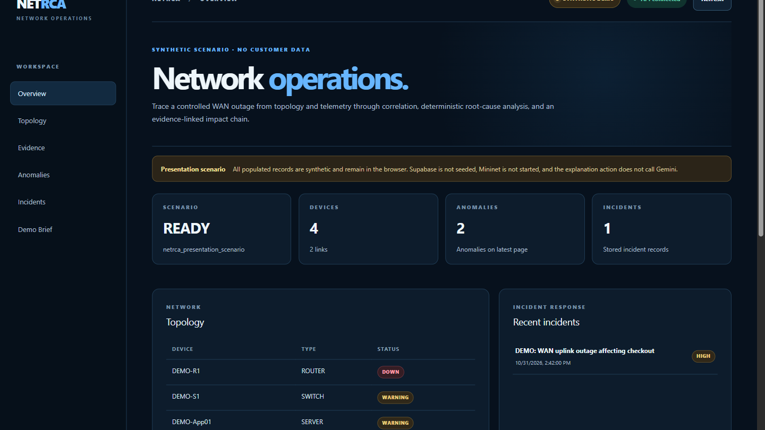
PRODUCT EXPERIENCE
The operator workspace keeps the incident story visible
Operator brief
Degraded devices, the leading signal, and the active incident appear together.
Guided investigation
Topology, evidence, anomalies, and incident analysis remain one click away.
Synthetic scenario shown. No customer data or remote database seed.
NETRCA
05
Notes:
Project sources:
- PRESENTATION.md
- frontend/src/components/dashboard.tsx

Slide 6
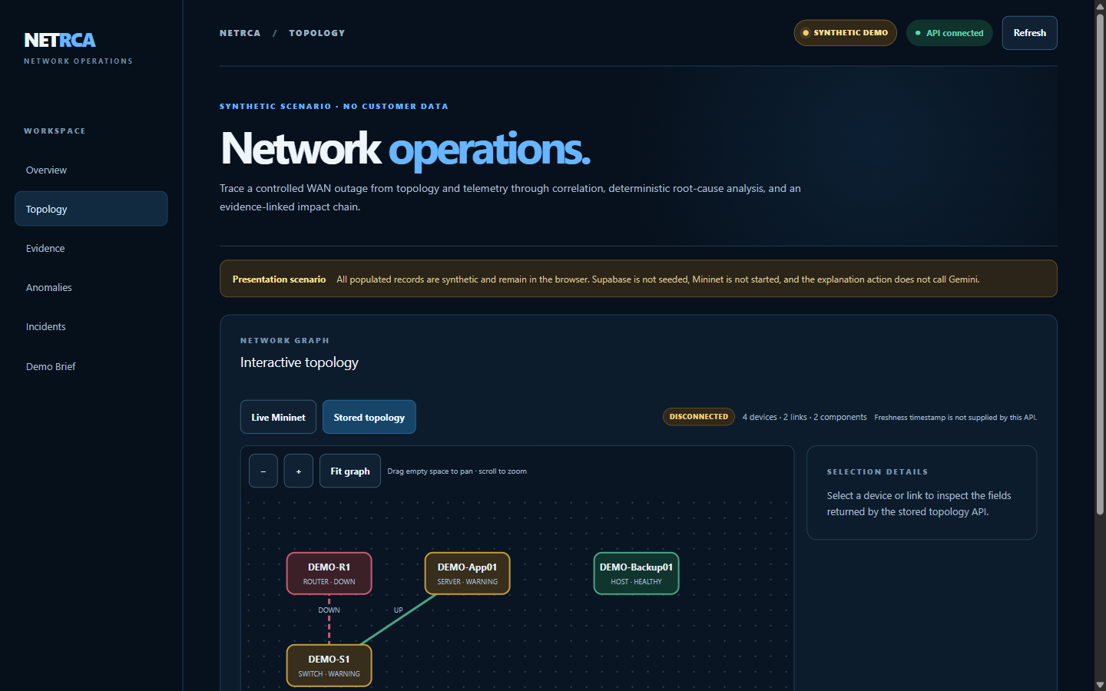
TOPOLOGY CONTEXT
Topology narrows the search without inventing dependencies
Stable device and link identities
Evidence filters use stored identifiers.
Disconnected components stay visible
Partial and unknown graph states remain explicit.
Direct context only
Incident highlighting follows backend validated direct and one hop references.
Live and stored topology sources remain separate.
NETRCA
06
Notes:
Project sources:
- frontend/PHASE17_REPORT.md
- topology/PHASE10_REPORT.md

Slide 7
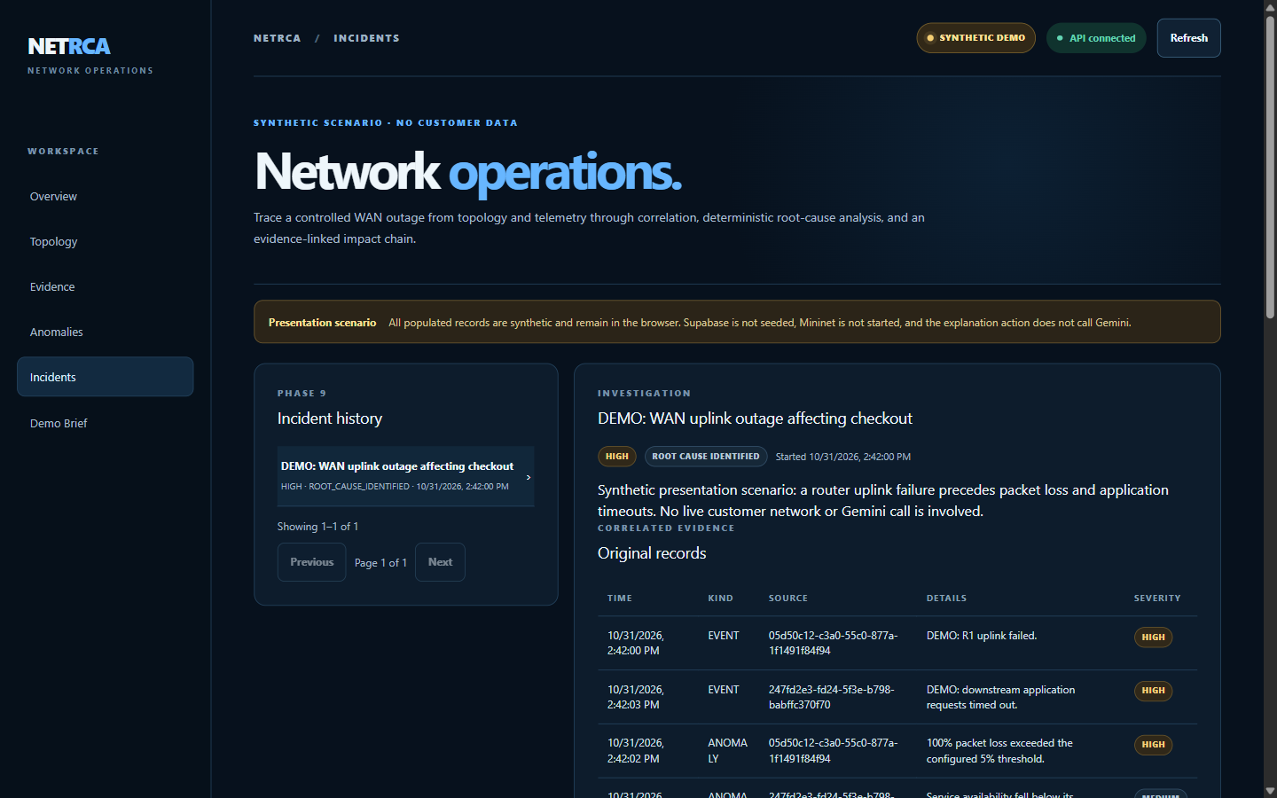
EXPLAINABLE RCA
Analysis separates observed evidence from potential impact
Leading candidate
Failed WAN uplink
Observed
Link down and packet loss
Potential
Application server and checkout service
Uncertainty
Rule score is not a probability. Customer impact remains unconfirmed.
The optional explanation summarizes validated context and keeps claim references.
NETRCA
07
Notes:
Project sources:
- rca/PHASE11_REPORT.md
- impact/PHASE12_REPORT.md
- explanation/PHASE13_REPORT.md

Slide 8
SYSTEM ARCHITECTURE
Modular services keep collection, analysis, and explanation separate
OPERATOR EXPERIENCE
Next.js and TypeScript dashboard
API AND CONTROLS
FastAPI routes, validation, local control gates
ANALYSIS SERVICES
Correlation, NetworkX, deterministic RCA, impact
EVIDENCE SERVICES
Monitoring, metrics, logs, events, anomalies
PERSISTENCE AND LAB
PostgreSQL or Supabase, Mininet and Open vSwitch
Gemini remains an optional explanation provider after deterministic analysis.
NETRCA
08
Notes:
Project sources:
- Instruction/ARCHITECTURE.md
- Instruction/TECHSTACK.md
- backend/app/main.py

Slide 9
SECURITY AND TRUST
Current safeguards support a controlled pilot
Implemented safeguards
Commercial production gates
Loopback only network controls
Tenant authentication with RBAC or SSO
Explicit control header and opt in write flags
Managed secrets and durable actor audit
RLS and restricted client database roles
Dependency upgrade and independent security review
Sanitized API errors and no browser secrets
Backup, SLA operations, and load testing
The current build should remain on loopback until the production gates are complete.
NETRCA
09
Notes:
Project sources:
- Instruction/SECURITY.md
- audit/PHASE14-18_AUDIT_REPORT.md

Slide 10
COMMERCIAL PATH
A controlled pilot validates the customer workflow first
01
02
03
SCOPED PILOT
WORKFLOW VALIDATION
PRODUCTION HARDENING
Connect one approved lab or read only telemetry source.
Review incident evidence, RCA candidates, and operator decisions.
Add tenant identity, deployment controls, operations, and support.
Commercial model to validate
Pilot services for integration and workflow validation
Subscription licensing after the production architecture is agreed
Pricing depends on deployment scope, managed environments, and support requirements.
NETRCA
10
Notes:
Project sources:
- PRESENTATION.md
- README.md

Slide 11
NETRCA
Network investigations
that teams can trace
Next step
Select one approved topology and evidence source for a controlled pilot.
Pilot discussion
Target environment
Available evidence
Success criteria
NETRCA
11
Notes:
Project sources:
- PRESENTATION.md
- Instruction/PRD.md

