Slide 1
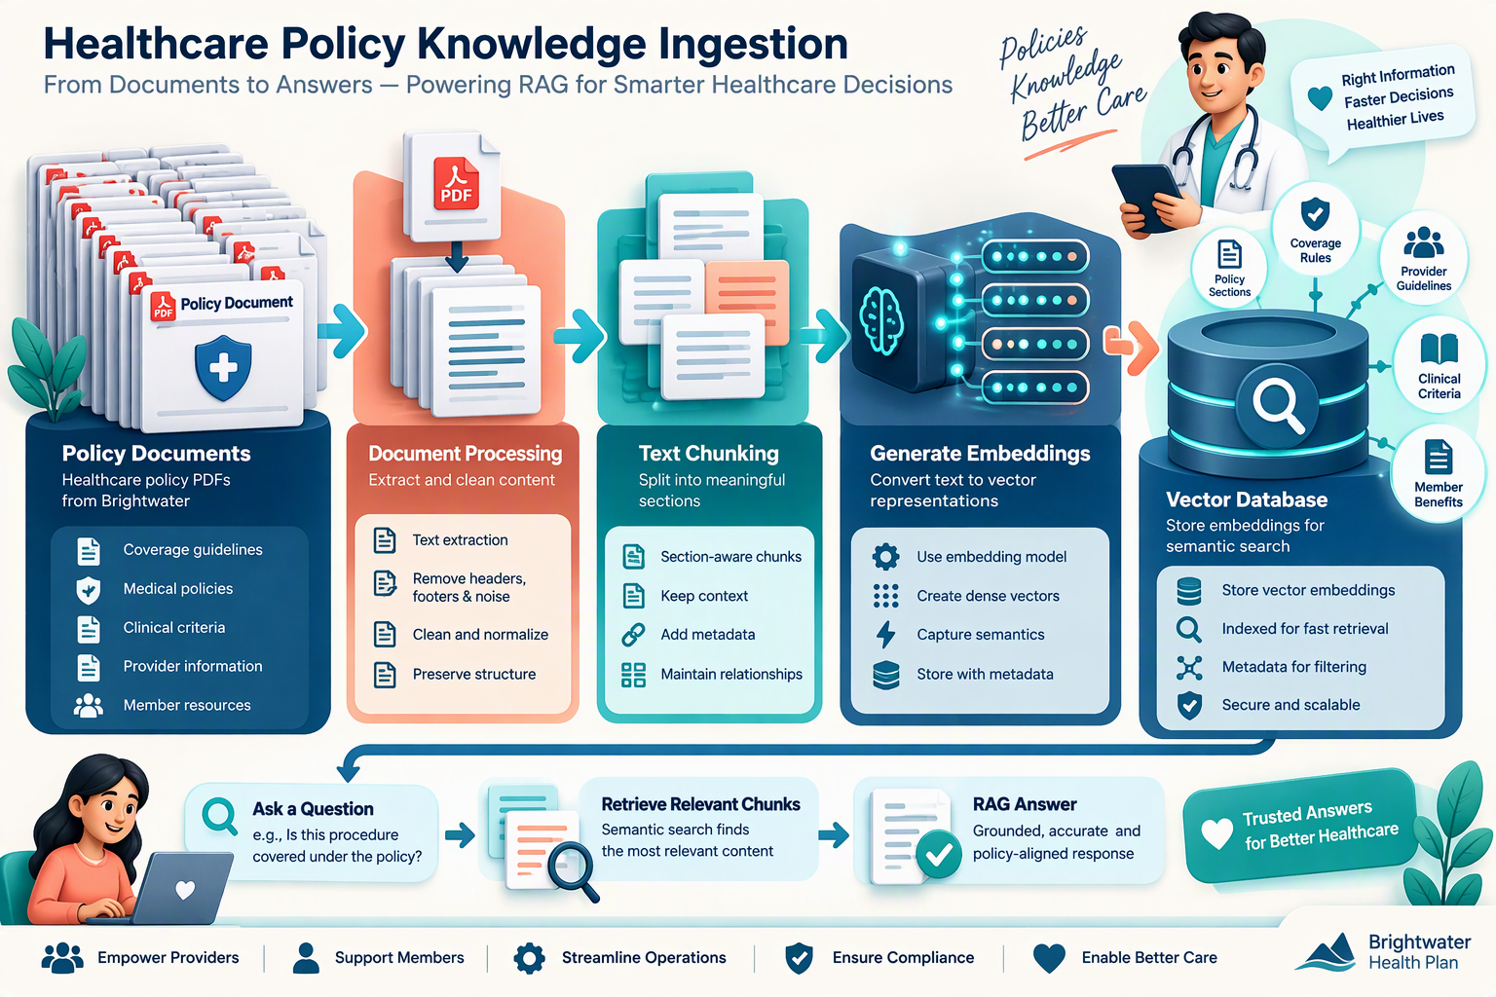
PHASE 1 • ONE-TIME / SCHEDULED SETUP
Build the policy knowledge base
INPUT: 16 policy PDFs
Convert 16 source PDFs into searchable, meaning-based knowledge for the review agent.
1
Extract text
2
Clean + split
3
Add metadata
4
Create embeddings
5
Store in ChromaDB
PyPDF reads each page.
Check for empty pages and preserve the document name.
Remove repeated noise, then create overlapping, section-aware chunks.
Attach source PDF, section, page and chunk ID so evidence can be traced.
all-MiniLM-L6-v2 converts every chunk into a semantic vector.
Save vector + chunk text + metadata in a searchable collection.
Result
A reusable knowledge base that supports semantic search, not only exact keyword matching.
Good practice: keep chunk size/overlap configurable and re-index whenever a PDF changes.
Notes:
Knowledge-base setup happens before live review. Explain that the PDFs are processed once and refreshed when policies change. Metadata is important because the final answer should show where the supporting evidence came from.
[Sources]
- Visual on this slide was generated with Microsoft Copilot.

Slide 2
PHASE 2 • RUNS FOR EACH REVIEW
Doctor submission → RAG answer → UM nurse decision
LIVE REVIEW WORKFLOW
The AI finds supporting policy evidence; the UM nurse remains the final reviewer.
Doctor / provider submits
1
Form review query
2
Embed query
5 LLM generates grounded review support
Clinical files
Combine question + relevant case facts.
Use the same all-MiniLM-L6-v2 model.
• Suggested answer
• Short reasoning
• Evidence snippets
• PDF / section references
• “Insufficient evidence” when needed
Example questionnaire
“Has the patient completed at least 6 weeks of supervised physical therapy?”
Answer: Yes
Evidence: PT progress notes attached
3
Similarity search
4
Retrieve Top-K
Compare vectors in ChromaDB using cosine similarity.
Return the best policy chunks with metadata.
6 UM nurse reviews
Checks the AI answer against the case and evidence, then approves, requests more information, or denies according to policy.
Case data + review question
Top-K is configurable (for example, 4 chunks)
FINAL DECISION = HUMAN
Notes:
Use the questionnaire example to show how the review question is grounded in the submitted clinical evidence. The query is embedded with the same model used for the stored chunks. Cosine similarity ranks the policy chunks, and the LLM receives only the most relevant chunks plus the case context. The UM nurse verifies the response and makes the final decision.
[Sources]
- Visual on this slide was generated with Microsoft Copilot.

